Slide 1


Lesson 10:
Geometric reasoning
Objectives
Understand what it means for lines to be parallel
Calculate missing angles
Use angles to determine whether lines are parallel
Develop fluency and understanding when reasoning with angles

Slide 2
What do you know about angles?
REVIEW
Angles on a straight line
Make a poster.
Use diagrams.
Use colour to show equal angles.
Angles around
a point
Any other angle properties
Angles in a
triangle
Angles on
parallel lines
Notes:
Tell students that they will begin the lesson by reviewing what they know about angles.
Distribute A3 paper and some coloured pens (with tips that are not too thick). Ask students to work in pairs to produce a poster to show what they know about angles. Tell them that they may use the ideas on the slide as a starting point.
Allow students to work on their posters and try not to intervene. The aim of this activity is to provide you with information about what students appear to know already and to get them thinking about geometry.
As students work, identify a couple of students to share their posters with the rest of the class.
Discuss students’ posters. Ask them to add anything that is missing to their poster during the discussion.

Slide 3
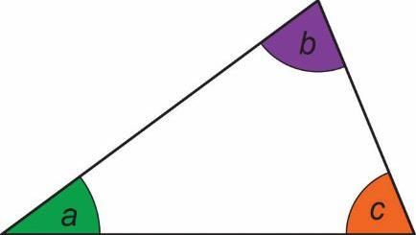
Properties of angles in triangles
When are the three angles equal?
a + b + c = 180°
When are just two of the
angles equal?
Angles in a triangle add up to 180°.
Notes:
When discussing the properties of angles in triangles, ask students when the three angles in a triangle would be equal. Establish that an equilateral triangle has three equal sides and three equal angles that are each 60°, while an isosceles triangle has two sides of equal length and two equal angles.
You may want to ask students what other types of triangles they know (e.g. right angled and scalene triangles) and establish their properties. Emphasise that regardless of the type of triangle, the angles always add up to 180°.

Slide 4
What does parallel mean?
If the lines are parallel, corresponding angles are equal.
If the lines are parallel, what else do we know?
Notes:
Check students’ understanding of what ‘parallel’ means and check that they know that arrows are used to denote parallel lines. Establish that when the lines are parallel, corresponding angles are equal. This slide is designed to emphasise the mathematical structure of parallel lines on a transversal: essentially, the second line can be thought of as a copy of the first. Ask students what else we know about the angles if the lines are parallel. They may mention alternate angles and/or co-interior angles, for example.

Slide 5
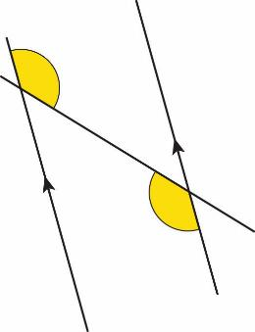
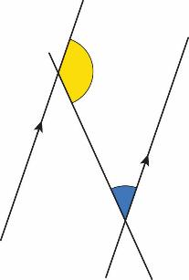
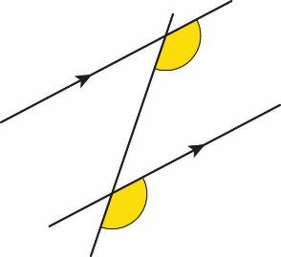
Properties of angles on parallel lines
x
y
x + y = 180°
Corresponding angles are equal only when lines are parallel.
Co-interior angles add up to 180°
only when lines
are parallel.
Alternate angles are equal only when lines are parallel.
Notes:
Emphasise that alternate angles and corresponding angles are equal only when the lines are parallel. If the angles are not equal, we know that the lines are not parallel.
Contrast alternate and corresponding angles with co-interior angles, which add up to 180° only when the lines are parallel.

Slide 6
What does perpendicular mean?
90˚
90˚
These two lines are perpendicular.
Are these two lines perpendicular?
Notes:
Before bringing the discussion to a close, check students’ understanding of what ‘perpendicular’ means. Remind students of the way that a 90° angle is represented and highlight the importance of not assuming that two lines are perpendicular just because the angle looks like a 90° angle.

Slide 7
Adding to posters
REVIEW
Angles on a straight line
Check to see if there’s anything that needs adding to your poster.
Angles around
a point
Any other angle properties
Angles in a
triangle
Angles on
parallel lines
Notes:
Remind students of the angle properties that have been discussed and give them the opportunity to add to their poster, if they haven’t already done so during the discussion. You may like to draw some labelled diagrams of angles on parallel lines on the board for students to copy onto their posters, to refer to later in the lesson.

Slide 8
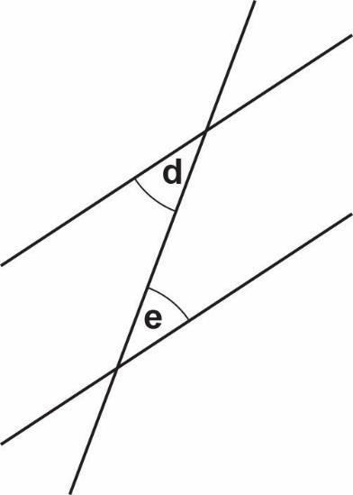

What do we need to know to answer the question?
Are angles d and e equal?
What do we need to know?
Petra
Notes:
Tell students that Petra wants to know whether angles d and e are equal.
Ask students what we need to know to determine whether these angles are equal.
Establish that angles d and e are alternate angles and that if the lines are parallel, alternate angles will be equal. If they know that the lines are parallel, they can conclude that angles d and e are equal. If they know that the lines are not parallel, they can conclude that angles d and e are not equal.

Slide 9
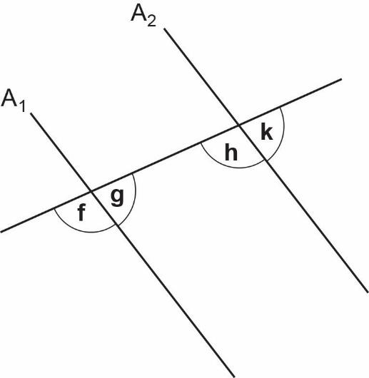

What do we need to know to answer this question?
Are lines A₁ and A₂ parallel?
What do we need to know?
Raheela
Notes:
Tell students that Raheela wants to know whether lines A₁ and A₂ are parallel.
Ask students what we need to know to be able to determine whether or not the lines are parallel. Discuss different possible approaches using either corresponding angles or co-interior angles. Check that students recognise that if we know that corresponding angles f and h are equal, they we can conclude that lines A₁ and A₂ are parallel. Alternatively, if we know that corresponding angles g and k are equal, then we can also conclude that lines A₁ and A₂ are parallel. Highlight that if we know that angle f is equal to angle h then we also know that angle g is equal to angle k .
Another approach is to work with co-interior angles instead. If we know g + h = 180˚, we can conclude that lines A₁ and A₂ are parallel.

Slide 10
Angles and parallel lines
If you want to show that lines are parallel, look for a pair of equal (or supplementary) angles.
If you know lines are parallel you can work out which angles are equal (or supplementary).
Notes:
Before moving on, remind students that:
to show lines are parallel, they need to find a pair of equal alternate angles or corresponding angles, or a pair of supplementary co-interior angles
if they know that two lines are parallel, then they know that the alternate and corresponding pairs of angles are equal and the co-interior angles are supplementary.

Slide 11

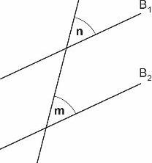
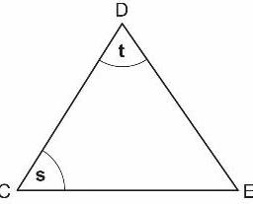
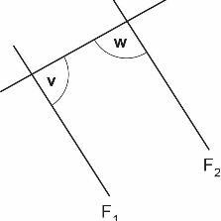
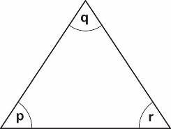
What do we need to know?
YOUR TURN
Handout
available
Q1
Q3
Are lines B₁ and B₂ parallel?
Is angle s equal to angle t?
Q2
Q4
Is this an equilateral triangle?
v + w = 180˚
Is this true?
Notes:
Introduce four different scenarios for students to identify the information needed to be able to answer the question posed. You may want to print out the ‘What do we need to know?’ handout and ask students to work on it in pairs. Alternatively, you could carry out the activity as a whole class.
Questions that students could ask include:
Q1: Is angle m equal to angle n ?
Q2: Are angles p, q and r each 60˚?
Q3: Is CE = DE?
Q4: Is line F₁ parallel to line F₂?

Slide 12
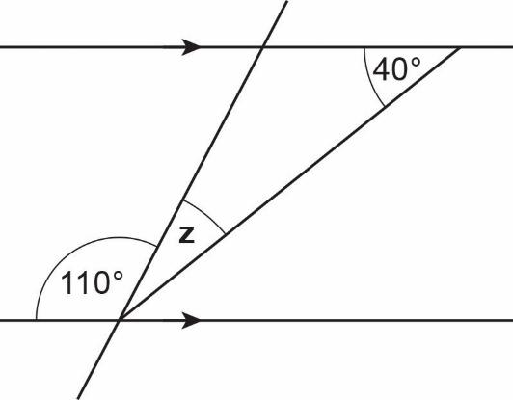
Reasoning
DISCUSS
Is angle z = 30˚?
Yes o
No o
Can’t tell o
How do you know?
Notes:
Introduce a new problem and tell students that we need to determine whether or not angle z is equal to 30°.
Explain that one of the three boxes: ‘Yes’, ‘No’ or ‘Can’t tell’ needs to be ticked/crossed.
Give students a few minutes to discuss in pairs.
This question is provided to model what students will do in the pair work to follow.

Slide 13
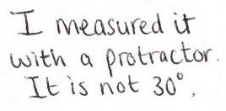
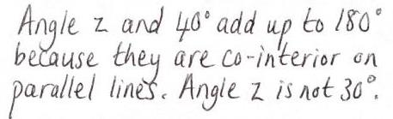

What have they done wrong?
YOUR TURN
Petra
Is angle z = 30˚?
Yes o
No x
Can’t tell o
Raheela
Notes:
Show students Petra’s and Raheela’s responses and ask them to explain what Petra and Raheela have done wrong. Petra assumes the diagram is drawn accurately and concludes from measuring, that angle z does not equal 30˚. Raheela uses the fact that the lines are parallel in her reasoning but has not correctly identified co-interior angles.

Slide 14
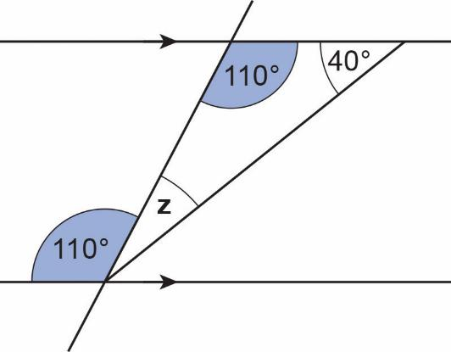
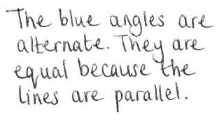
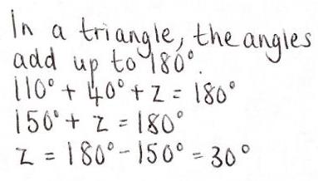
A correct solution
REVIEW
Is angle z = 30˚?
Yes x
No o
Can’t tell o
Notes:
Tell students that Petra produces another response to the question. She shades the angles she wants to talk about. She provides some reasons and concludes that angle z is 30˚ and crosses the ‘Yes’ box.
Confirm that angle z is equal to 30˚ and emphasise that Petra’s approach is just one way of showing this. Check that all approaches used by students have been explored.

Slide 15
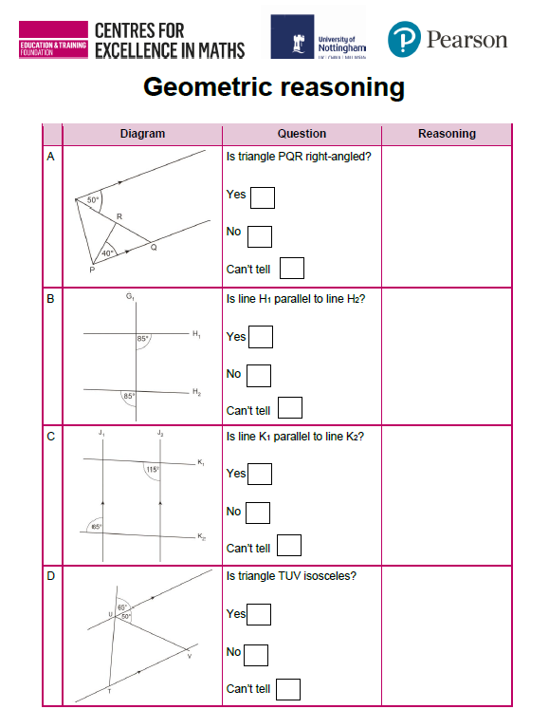
Work in pairs
YOUR TURN
Handout
available
Work together.
Write in all the angles you know.
Colour in equal angles.
Answer the question.
Give reasons.
Notes:
Distribute to each pair of students a copy of the ‘Geometric reasoning’ handout. Tell students that this activity is similar to the one they have just looked at. They should decide whether the answer to each question is ‘Yes’, ‘No’ or ‘Can’t tell’ and tick/cross the appropriate box. They should write their reason(s) in the ‘Reasoning’ column.
When you judge that students have answered enough of the questions, go through possible responses, emphasising alternative valid approaches.

Slide 16
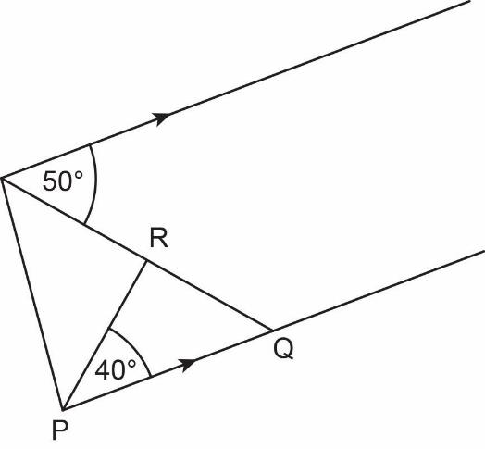
Is triangle PQR right-angled?
REVIEW
Yes o
No o
Can’t tell o
Angles in a triangle add up to 180˚.
90˚
50˚
Alternate angles on parallel lines.
Notes:
When exploring different approaches, emphasise the benefits of being efficient. Rather than alternate angles, co-interior angles could be used to identify the 130° angle and the property of angles on a straight line could then be used to determine the 50° angle shown in triangle PQR. This is an equally valid approach but is less efficient than working with alternate angles as shown.

Slide 17
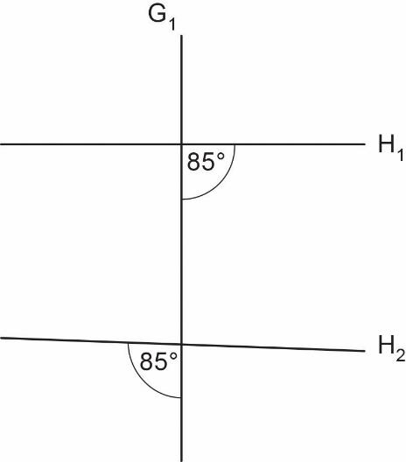
Is line H₁ parallel to line H₂?
REVIEW
Yes o
No o
Can’t tell o
Angles on a straight line add up to 180˚.
Alternate angles are NOT equal.
H₁ is NOT parallel to H₂.
95˚
What is another way to do this?
Notes:
Encourage students to consider a different way of showing that the lines are not parallel. For example, can they identify vertically opposite angles?

Slide 18
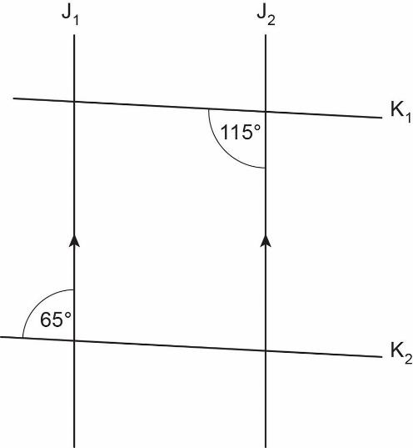
Is line K₁ parallel to line K₂?
REVIEW
Yes o
No o
Can’t tell o
J₁ is parallel to J₂.
Corresponding angles are equal.
65˚
65˚ + 115˚ = 180˚.
Co-interior angles add up to 180˚.
K₁ is parallel to K₂.
Notes:
When thinking about different approaches, check that students understand that they need to show that lines K₁ and K₂ are parallel. Some students may try to show that lines J₁ and J₂ are parallel (which we know to be true) by mistake.

Slide 19
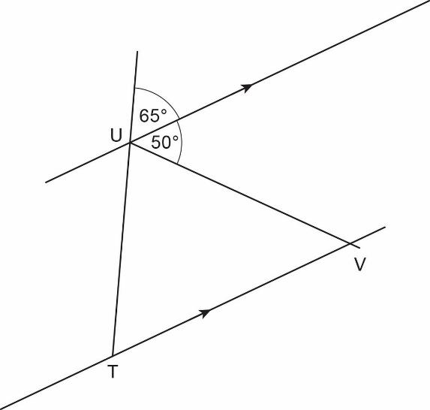
Is triangle TUV isosceles?
REVIEW
Yes o
No o
Can’t tell o
65˚
Angles on a straight line add up to 180˚.
65˚
Triangle TUV has two equal angles.
It is isosceles.
Corresponding angles on parallel lines are equal.
19
Notes:
Isosceles triangles are often drawn with the equal angles at the base and the base of the triangle parallel to the bottom of the page or screen. In this case, the equal angles are at U and T. Check that students know which two sides are equal and perhaps ask them how they would indicate this. Check also that students recognise that the third angle in triangle TUV must be different to the two 65° angles, as the only way that the three angles can be equal is if they are all 60° (i.e. where the triangle is equilateral).

Slide 20
Completing posters
REVIEW
Angles on a straight line
Check to see if there’s anything that you need to add to your poster.
Angles around
a point
Any other angle properties
Angles in a
triangle
Angles on
parallel lines
Notes:
Ask students to return to their posters and add anything else that they feel is missing. Hold a class discussion of the posters, focusing on geometric reasoning.

Slide 21
Geometric reasoning
A diagram is not always accurate.
Don’t assume.
Write down everything you know (use colour).
Explain what you know and how you know it.
Notes:
Bring the discussion to an end by consolidating what students need to remember for geometric reasoning.

Slide 22
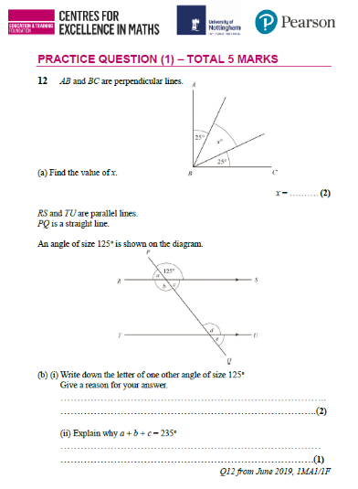
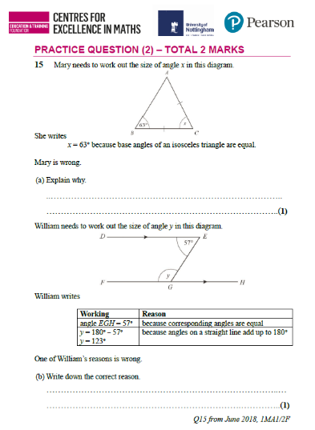
Practice questions
YOUR TURN
Handout
available
Working on your own, answer the practice questions.
Notes:
Distribute to each student a copy of the ‘Practice questions’ handout. There are two questions, each with two parts. You may want to choose just one question or parts of a question for your class.
Give students a couple of minutes to work individually on the questions. Check that students are familiar with the notation used for describing angles.
When students have had sufficient time to complete the questions, discuss their work.

Slide 23
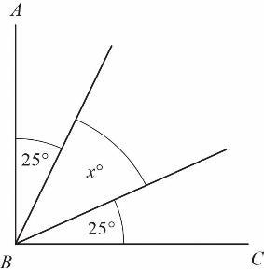
Practice question (1a)
REVIEW
Handout
available
AB and BC are perpendicular lines.
(a) Find the value of x.
x = 40° (2)
Notes:
When discussing part (a), emphasise the importance of not assuming an angle is a right angle because it looks like one. Highlight that the question states that lines AB and BC are perpendicular, so we know that angle ABC is 90°. x is therefore 40°, as 90° – 25° – 25° = 40°.

Slide 24
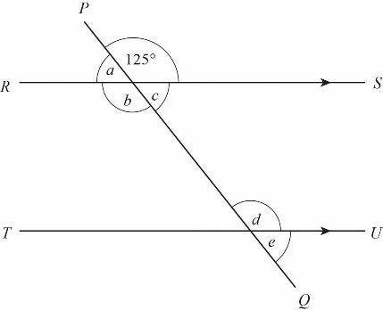
Practice question (1b)
REVIEW
Handout
available
RS and TU are parallel lines.
PQ is a straight line.
An angle of size 125° is shown on the diagram.
(b) (i) Write down the letter of one other angle of size 125°.
Give a reason for your answer.
b or d (2)
(ii) Explain why a + b + c = 235°
Angles around a point add up to 360° (1)
Q12 from June 2019, 1MA1/1F
Notes:
Check that students have identified an angle that is 125° and that their reasoning is correct. They could have selected b or d. You may want to ask them to colour in all the angles that are equal to 125°.
When answering part (ii), students may use the fact that angles around a point add up to 360° (360° – 125° = 235°). Encourage students to identify the values of angles a, b and c using the properties of angles on parallel lines as well, to show that a + b + c = 235°.

Slide 25
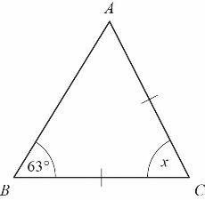
Practice question (2a)
REVIEW
Handout
available
Mary needs to work out the size of angle x in this diagram.
She writes
x = 63° because base angles of an isosceles triangle are equal.
Mary is wrong.
(a) Explain why.
Base angles A and B are equal. x = 180° - 63° - 63° = 54°. (1)
Notes:
Check that students recognise how the two sides of the triangle with equal length relate to the two equal angles. It is important that students explain why Mary is wrong and do not just state the correct size of angle x. (54°).

Slide 26
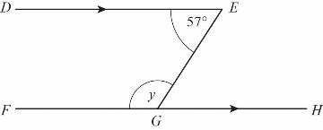
Practice question (2b)
REVIEW
Handout
available
William needs to work out the size of angle y in this diagram.
William writes
One of William’s reasons is wrong.
(b) Write down the correct reason.
The reason for angle EGH = 57° is wrong. Correct reason: ‘because alternate angles are equal’.(1)
Q15 from June 2018, 1MA1/2F
Working | Reason
angle EGH = 57˚ | because corresponding angles are equal
y = 180˚ – 57˚ y = 123˚ | because angles on a straight line add up to 180˚
Notes:
Establish that William’s reason for angle EGH = 57° is wrong, as he has confused corresponding and alternate angles.

Slide 27
Lesson review:
Geometric reasoning
Objectives
Understand what it means for lines to be parallel
Calculate missing angles
Use angles to determine whether lines are parallel
Develop fluency and understanding when reasoning with angles
Suggested further steps/areas to work on
Understand the sum of angles in any polygon

Slide 28
Lesson 10:
Credits
Photo acknowledgements
Shutterstock.com: Vectorfair.com
Text acknowledgements
Pearson Edexcel Level 1 / Level 2 GCSE (9-1) Mathematics Paper 1 (Calculator) Foundation Tier June 2019 1MA1/1F, Pearson Edexcel Level 1 / Level 2 GCSE (9-1) Mathematics Paper 2 (Calculator) Foundation Tier June 2018 1MA1/2F, Pearson Edexcel GCSE (9-1) in Mathematics (1MA1) Foundation (Calculator) Paper 2F, June 2018

