Slide 1


Lesson 4:
Algebraic thinking in problem solving
Objectives
Represent contextual problems mathematically
Use diagrams to represent mathematical structure
Determine the value of an unknown in a problem
Solve problems involving angles

Slide 2



Making walls out of blocks
Em
Twice as long as Em’s wall
Finch
What are possible lengths for the three walls?
Three times as long as Em’s wall
Gill
Notes:
Tell students that Em, Finch and Gill are making walls out of blocks.
Finch builds a wall that is twice as long as Em’s wall and Gill builds a wall that is three times as long as Em’s wall. Ask students to show possible lengths for Em’s, Finch’s and Gill’s walls on their mini whiteboards.
Tell students to hold up their mini whiteboards showing the number of blocks in each wall. If all students have identified the same three walls (for example, the simplest case: 1 (Em), 2 (Finch) and 3 (Gill)), ask a couple of different students to explain their reasoning. If there are different walls identified within the class, ask students to explain their thinking.
If necessary, check your students’ understanding by asking further questions, for example:
A wall is 4 blocks long. Whose wall could this be?
(It could belong to Em or Finch, but not Gill)
Suggest a wall that could be made by Em and Gill, but not Finch.
(e.g. 3, 9, 15, 21, which are the odd multiples of 3)

Slide 3
Em’s, Finch’s and Gill’s walls
Em
Twice as
long as
Em’s wall
Finch
Three times as long as
Em’s wall
Gill
Notes:
Optional slide.
The walls included on this slide can be revealed as appropriate.
First column: 1 (Em), 2 (Finch) and 3 (Gill)
Second column: 2 (Em), 4 (Finch) and 6 (Gill)
Third column: 3 (Em), 6 (Finch) and 9 (Gill)

Slide 4
How many blocks?
Em
Twice as long as Em’s wall
How many blocks will Finch need?
How many blocks will Gill need?
How many blocks will Em, Finch and Gill use altogether?
Finch
Three times as long as Em’s wall
Gill
Notes:
Tell students that Em builds a wall using four blocks. Ask students to answer these questions:
How many blocks Finch will need?
How many blocks will Gill need?
How many blocks will Em, Finch and Gill use altogether?
After a short time, ask one or more students to come to the board and use diagrams to explain their solution(s).

Slide 5
Total number of blocks
Total
24 blocks
Em
4 blocks
Twice as long as Em’s wall
Finch
8 blocks
Three times as long as Em’s wall
Gill
12 blocks
Notes:
Optional slide.
If the class found the questions on the previous slide difficult, use the animations on this slide to help to expose the mathematical structure of the problem.

Slide 6

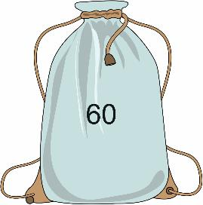
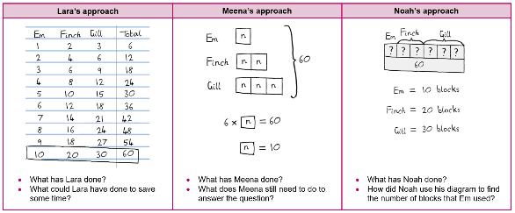
Finding the number of blocks
DISCUSS
Handout
available
Lara, Meena and Noah are answering this question.
Em, Finch and Gill build a wall each.
Altogether they use 60 blocks.
Finch’s wall is twice as long as Em’s wall.
Gill’s wall is three times as long as Em’s wall.
How many blocks are in each of their walls?
Notes:
Show the question given on the slide and allow the students a few minutes to think about it, either individually or in pairs. Then explains that the ‘Approaches’ handout shows three different approaches to working out how many blocks Em, Finch and Gill will each use, given that there are 60 blocks. Tell students to work in pairs and give each pair a copy of the handout. Ask students to look at, and discuss the three different approaches and to answer the questions below each approach.
After a few minutes, bring the class together. Ask students which of the three approaches they found easiest to understand. Would they have used one of the approaches described, or taken a different approach? Encourage students to listen to one another as they share their thinking with the class and consider other viewpoints.

Slide 7
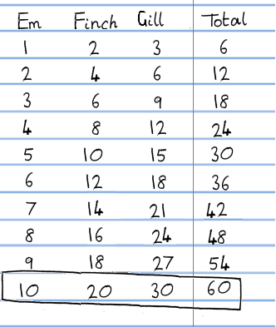
Lara’s approach
REVIEW
What has Lara done?
What could Lara have done to save some time?
Notes:
Use this slide and the next two slides to support a discussion of the three approaches.
Whilst Lara’s listing approach is very methodical, it is also the least efficient. Lara could have saved time by recognising that there was a pattern, and so didn’t need to fill in every cell in the table (the number in Finch’s column is 2 times the number in Em’s column, the number in Gill’s column is 3 times the number in Em’s column, and the total number is 6 times the number in Em’s column).
Deepening understanding
Ask students to describe how the numbers in Gill’s column relate to the numbers in Em’s and Finch’s columns. Exploring this relationship helps to expose how 3x can be thought of both multiplicatively as 3 × x and additively as x + 2x.

Slide 8
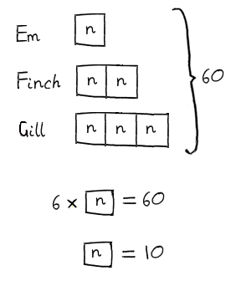
Meena’s approach
REVIEW
What has Meena done?
What does Meena still need to do to answer the question?
Notes:
Meena used a letter n inside a square to represent the number of blocks used by Em. She followed this representation method through to describe the number of blocks in Finch’s and Gill’s walls in relation to the number of blocks in Em’s wall. Using the total number of blocks as 60, Meena identified that the letter n (the ‘base value’) inside a square represented 10 blocks. However, she did not state the number of blocks in Finch’s and Gill’s walls.

Slide 9
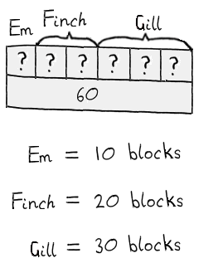
Noah’s approach
REVIEW
What has Noah done?
How did Noah use his diagram to find the number of blocks that Em used?
Notes:
Noah’s method introduces a bar model diagram. When discussing Noah’s approach, spend some time discussing the bar model first, before looking at the answers.
Many students have no experience of creating and using bar models, so you may need to spend some time unpicking exactly how Noah constructed his bar model. Make sure that students understand how Noah knew to draw 6 parts in his diagram, and where the 60 came from. Emphasise that the 6 parts and the 60 end at the same place: the 6 parts make 60 altogether. (He used 1 part to represent the number of blocks in Em’s wall, 2 parts to represent the number of blocks in Finch’s wall and 3 parts to represent the number of blocks in Gill’s wall, resulting in a total of 6 parts. There are 60 blocks in total.)
Ask students how Noah used his bar model to find out the number of blocks that Em, Finch and Gill each used. (Noah divided the total of 60 blocks by the number of parts (6) to get the number of blocks in Em’s walls (10). He then calculated the sizes of 2 and 3 parts to find the corresponding number of blocks in Finch’s and Gill’s walls.)
When all three approaches have been discussed with the class, ask students what is the same and what is different about these methods. Draw out that all three approaches identify the base value (10) and relate the lengths of Em’s and Gill’s walls to this.

Slide 10
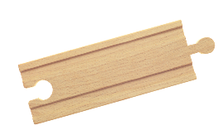
Building train tracks
DISCUSS
Em, Finch and Gill use 25 pieces of track.
Finch’s track is twice as long as Em’s.
Gill’s track is 5 pieces longer than Finch’s.
How long is each of their tracks?
Notes:
Introduce the problem. Tell students that Em, Finch and Gill are building train tracks. They have 25 pieces of track altogether. Finch’s track is twice as long as Em’s. Gill’s track is 5 pieces longer than Finch’s. Ask students to discuss in pairs: ‘What is the longest track they can each make to use all 25 pieces?’ Students do not need to answer the problem at this stage.

Slide 11
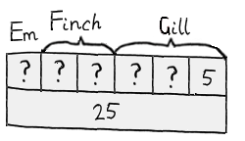
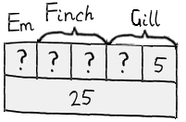
Modelling relationships
DISCUSS
Em, Finch and Gill use 25 pieces of track.
Finch’s track is twice as long as Em’s.
Gill’s track is 5 pieces longer than Finch’s.
Lara’s bar model
Meena’s bar model
Whose bar model
is correct?
Notes:
After a minute or so, tell students that Lara and Meena have tried to draw bar models to represent the relationships between the numbers of pieces in the three tracks. In their pairs, can they decide whose bar model is correct?
After a couple of minutes, ask for a show of hands for those that think Lara is correct and for those who think that Meena is correct. If there is agreement, ask a couple of students to explain their reasoning. If there is disagreement, ask pairs of students with differing views to share their thinking.
Emphasise the importance of considering problems carefully to ensure that the structure of the relationships between values is correctly identified. If students are struggling, encourage them to consider whose model correctly shows that Gill’s track is 5 pieces longer than Finch’s track. Confirm that Meena’s model is correct, and that Lara’s is not.

Slide 12
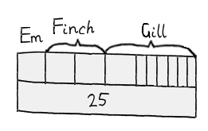
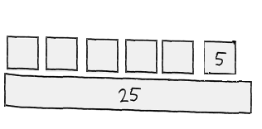
Modelling relationships
DISCUSS
Ollie’s bar model
Pippa’s bar model
What have Ollie and Pippa done wrong?
Notes:
Tell students that Ollie and Pippa have also drawn bar models, but both have some mistakes in their models. Ask them to discuss these bar models in their pairs, identifying what Ollie and Pippa have done wrong.
In Ollie’s bar model, the blocks making up Em’s, Finch’s and Gill’s walls do not come to 25. The 25 bar is too long. This means that it is difficult to use the model to envisage what is left after 5 has been subtracted from 25.
Pippa has confused the base unknown value (Em’s wall) with the numerical value of 5. The way she has drawn it treats each unit of the 5 as the same as Em’s value, which means that Gill’s wall is 7 times as long as Em’s.

Slide 13
Using a bar model
REVIEW
Em, Finch and Gill use 25 pieces of track.
Finch’s track is twice as long as Em’s.
Gill’s track is 5 pieces longer than Finch’s.
Meena’s bar model
How long is each of their tracks?
Notes:
Ask students to work in pairs to use Meena’s bar model to answer the question. After a few minutes, ask a couple of pairs of students to describe their approach.
Check whether students have correctly identified that ? represents 4 pieces, and check whether students have correctly identified the number of pieces in each of the three tracks (Em: 4 pieces long, Finch: 8 pieces long, Gill: 13 pieces long).
Students often lose sight of the original problem during the solution process and it is important to remind them of the need to relate any solution that they obtain back to the question posed. In this case, the length of each of the three tracks needs to be worked out and stated.
It is important that students understand how the bar model is used to solve the problem because they will depend on this understanding later in the lesson.

Slide 14
Working in pairs
YOUR
TURN
Take turns to answer questions.
Explain your reasoning to your partner.
Your partner must agree, disagree or ask for more explanation.
Notes:
Establish guidelines for working in pairs.

Slide 15
Describing diagrams
YOUR TURN
Handout
available
Look at the geometry diagrams in rows
A and B and on cards C1 and C2.
Write down what you know about the angles in each diagram.
Notes:
Distribute a copy of the ‘Solving problems’ handout and ‘Cards’ C1 to C4 to each pair of students. Ask students to write down what they know about the angles in each diagram.
Students do not need to work through the diagrams in order and they may be able to say more about some of the diagrams than others. Students should be encouraged to say whatever they can about the angles in each diagram.
While the expectation at this stage is not necessarily to calculate any missing angles, students may begin to do so, as they record what they can say about each of the geometry diagrams.

Slide 16
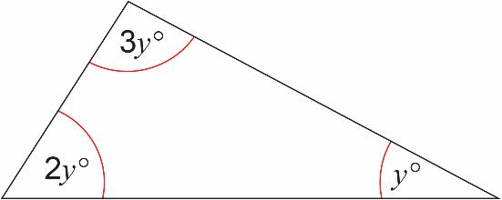
Geometry diagram (row A)
Notes:
After about five minutes, bring the class together. Discuss each of the geometry diagrams in turn, encouraging them to share their thinking about the angles in each one.
For example, a variety of things could be said about the diagram in row A:
The largest angle is 3 times the size of the smallest angle.
One angle is twice the size of another angle.
The angles add up to 180°.
The sum of the two smaller angles is equal to the largest angle.
Establish that the sum of angles in a triangle is 180°.

Slide 17
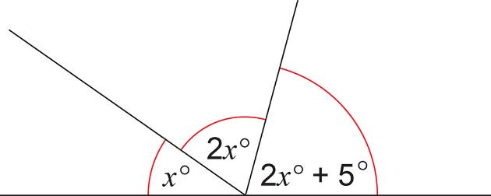
Geometry diagram (row B)
Notes:
Establish that the sum of angles on a straight line is 180°.

Slide 18
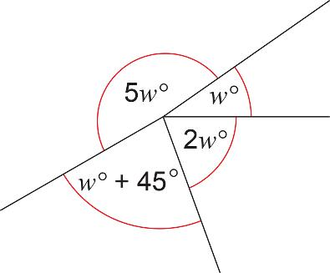
Geometry diagram (card C1)
Notes:
Establish that the sum of angles around a point is 360°. Some students may incorrectly think that the 5w angle is 180°.

Slide 19
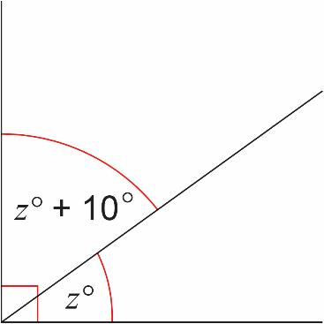
Geometry diagram (card C2)
Notes:
Students need to recognise that the geometry diagram represents a right angle and so identify that 2z° + 10° = 90° .

Slide 20
Placing the cards
YOUR TURN
Handout
available
Place the cards
C1 to C4 in the table.
Draw bar models to represent the maths.
Find the value of the unknowns.
Notes:
Explain that the task also includes four word questions with the same relationships between the unknowns as those in the geometry diagrams. Explain that this means that the same bar model can be used to represent the geometry question and the word question.
Ask students to:
place cards C1 to C4 in the table
draw bar models that could be used to represent the maths.
Some students may prefer to do the card matching first, and others might choose to draw the bar models first. Either way, they should take turns to fill a cell in the table, explaining their reasons to their partner.
Students may not complete all four rows of the table and it is not essential that they do so. If students are struggling, ask them to focus on rows A and B as the relationships between the unknowns in these two rows mirror those explored earlier in the lesson. Also explain that they need to find a ‘base value’ that all the other values relate to (one question mark in Meena’s bar model, for example). It may be helpful to fold the table in half if students are finding working with all four rows overwhelming.
As you circulate around the class, observe what the students are doing, but try not to intervene, other than reminding them that, in each row, the word problem and the geometry diagram are essentially the same. Notice how different pairs approach the task and use your observations to inform the discussion in the next part of the lesson.

Slide 21

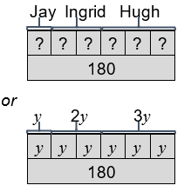
Completing row A
REVIEW
A | Word problem | Geometry problem | Bar model
 | C4 Ingrid is twice as old as Jay. Hugh is 3 times as old as Jay. The sum of Hugh’s, Ingrid’s and Jay’s ages is 180. How old is Jay? Jay is 30 years old. | y = 30
Notes:
The relationships between the unknowns in the problems in row A are the same as between the lengths of Em’s, Finch’s and Gill’s walls introduced at the start of the lesson. It may be helpful to refer back to the bar model used in Noah’s approach (slide 9) and discuss what’s the same and what’s different.
Deepening understanding
Ask students what kind of triangle is in row A. Some of them may notice that it is a right-angled triangle, without needing to calculate the values of 2y° and 3y°.

Slide 22
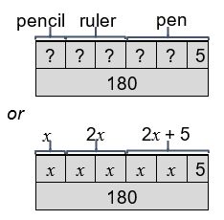
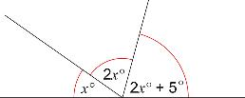
Completing row B
REVIEW
B | Word problem | Geometry problem | Bar model
 | C3 A ruler costs twice as much as a pencil. A pen costs 5p more than a ruler. The total cost of a ruler, pen and pencil is £1.80. Find the cost of a pencil. A pencil costs 35 pence. | x = 35
Notes:
The relationships between the unknowns in the problems in row B are the same as between the lengths of Em’s, Finch’s and Gill’s train tracks introduced in Explore 2. It may be helpful to refer back to the bar model used on slide 11 and discuss what’s the same and what’s different.
If students struggle to find the unknown, use the bar model to support them in understanding why you need to subtract 5 from the total, before dividing by 5.
Deepening understanding
Ask students how the bar model in row B could be modified to demonstrate that you need to subtract 5 from the total before dividing by 5. Some students may suggest that you could remove the 5 part, and shorten the total bar to represent 175 rather than 180.

Slide 23
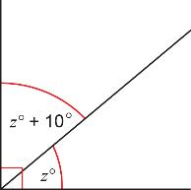

Completing row C
REVIEW
C | Word problem | Geometry problem | Bar model
 | Lee gets 10 more marks than Kia in a science test. Kia and Lee score a total of 90 marks. Calculate Kia’s score. Kia scored 40 marks. | C2 z = 40
Notes:
Students do not need to draw a bar model for row C as one is included in the table. Some students may use this bar model to help them with the matching process, whereas others may use it during the solution process only.

Slide 24
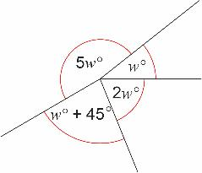
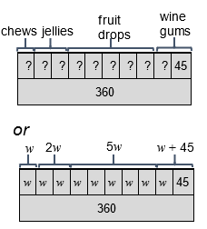
Completing row D
REVIEW
D | Word problem | Geometry problem | Bar model
 | Abdul sells 360 bags of sweets. He sells twice as many jellies as chews, 5 times as many fruit drops as chews and 45 more wine gums than chews. How many bags of chews does he sell? 35 bags of chews | C1 w = 35

Slide 25
Mathematical structure
? | ? | ? | ? | ? | ?
180
Different problems with the same mathematical structure can be represented using the same bar model.
Row A
? | ? | ? | ? | ? | 5
180
Row B
? | ? | 10
90
Row C
? | ? | ? | ? | ? | ? | ? | ? | ? | 45
360
Row D
Notes:
Remind students that for each row the relationships between the unknowns are the same for the word question and the geometry diagram. They have the same mathematical structure and can be represented using the same bar model.

Slide 26
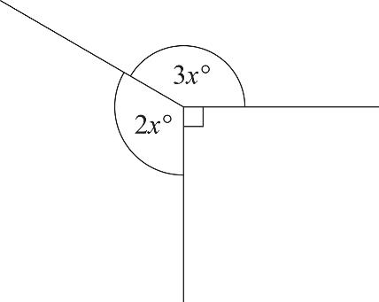
Practice questions
YOUR TURN
Handout
available
Hilary, Imogen and Jeeha are playing a game with cards.
Imogen has 3 cards more than Hilary.
Jeeha has twice as many cards as Imogen.
They have a total of 53 cards.
Work out how many cards Hilary has.
………………. (4)
Find the value of x.
………………. (3)
54
11
Q9 from June 2017, 1MA1/2F
Q10 from June 2015, 5MB3H/01
Notes:
Distribute a copy of the practice questions to each student and give them a couple of minutes to come up with a solution to either one or both of the problems. Make sure that students understand that these are two separate problems, not a pair of problems with the same underlying mathematical structure.
Notice whether students draw a bar model to represent the problems. If they do, do they use 360 as the total for the bars in the first question, or do they simplify the problem straight away by considering the two unknown angles adding up to 270? Once students have found a value for x, encourage them to check that 2x° + 3x° + 90° = 360°.
Notice whether students use ‘Hilary’ as the base value for the second question. It is possible to draw a bar model using ‘Imogen’ as the base value, but students may run into problems representing the fact that Hilary has three fewer cards.
Deepening understanding The first practice question involves a 2x unknown and a 3x unknown, but the mathematical structure of the problem is different to the problems in row A of the task / Em’s, Finch’s and Gill’s walls in the introductory activities (which also involve a 2x and a 3x). Can students explain why this is? Do students recognise that the base value (x) is calculated but does not actually feature in the bar model?

Slide 27

Representing the problem – 1
2x
3x
? | ? | ? | ? | ? | 90
360
Lara
x | x | x | x | x
270
Why are all the diagrams correct?
How can they be used to find x?
Meena
2x | 3x | 90
360
Noah
Notes:
Begin by asking students how they answered the questions. It is important that you spend a bit of time on what they did as well as what the correct answers are. Ask students that drew a bar model to describe their thinking and explain in what ways their bar model helped them to make sense of the problem.
Show students possible bar models to represent the practice questions and discuss as a class the questions related to these possible bar models. For this first question, three different bar models are given, and students should understand that although they are different, they are all correct. Make sure that they know how to use the bar models to find the value of x.
Meena’s simplifies the first problem by subtracting the right angle from the total, so that angle sum is 270° rather than 360°. Both Lara’s and Meena’s bar models make the need to divide by 5 clear and Noah’s bar model makes the unknown value of x explicit.

Slide 28
Representing the problem – 2
Hilary, Imogen and Jeeha are playing a game with cards.
Imogen has 3 cards more than Hilary.
Jeeha has twice as many cards as Imogen.
They have a total of 53 cards.
Work out how many cards Hilary has.
Hilary
Imogen
Jeeha
H | H | 3 | H | 3 | H | 3
53
Noah’s first diagram
Why did Noah re-draw his diagram?
H | H | H | H | 9
53
Noah’s second diagram
Notes:
For this second question, only Noah’s bar model is provided. His first bar model mixes up numbers and the unknown (Hilary’s number of cards), and he then simplifies it by putting all the unknown’s together and adding up all the numbers. This means that to find H, he has to subtract one number (9) from the total.

Slide 29
Lesson review:
Algebraic thinking in problem solving
Objectives
Represent contextual problems mathematically
Use diagrams to represent mathematical structure
Determine the value of an unknown in a problem
Solve problems involving angles
Suggested further steps/areas to work on
Solve linear equations involving negative terms

Slide 30
Lesson 4:
Credits
Text acknowledgements
Pearson Education Ltd: Pearson Edexcel GCSE (9 – 1) In Mathematics (1MA1) Foundation (Calculator) Paper 2F (June 2017)
Pearson Education Ltd: Pearson Edexcel GCSE (9 – 1) In Mathematics (5MB3H/01) Foundation (Calculator) Paper 3 (June 2015)

