Slide 1
Core Skill 4: How to assess and manage risks to your own and others’ safety when planning activities (Part 3)
All images have been sourced through PowerPoint with Creative Commons or from stock images. Where references were available, these have been provided.
ETF/Leeds City College

Slide 2
08
Review and update risk assessments as necessary

Slide 3

Lesson objectives
Recap the five steps to risk assessment and the need to balance and manage risk.
Examine a model of reflection to help you to review the first four steps in risk assessment.
Review a risk assessment using the reflective model.

Slide 4

Starter activity 8.0
Meal time!
Identify:
five hazards
four risks
three control measures
two ways to record findings
one way to ensure inclusion.

Slide 5
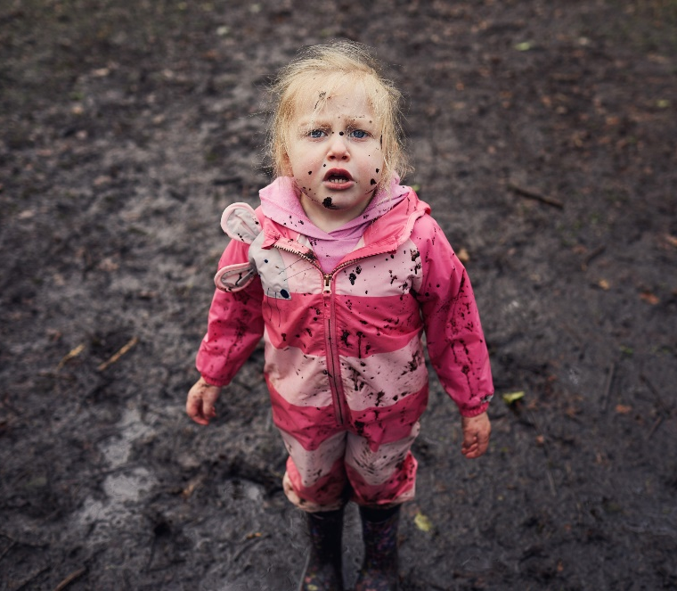
Starter activity 8.0 feedback: How do your ideas compare?
Five hazards: Food, Knife, broken equipment, dirty table, dirty hands
Four risks: Choking, cross-contamination, injury, allergies and intolerances, religious and cultural requirements

Slide 6
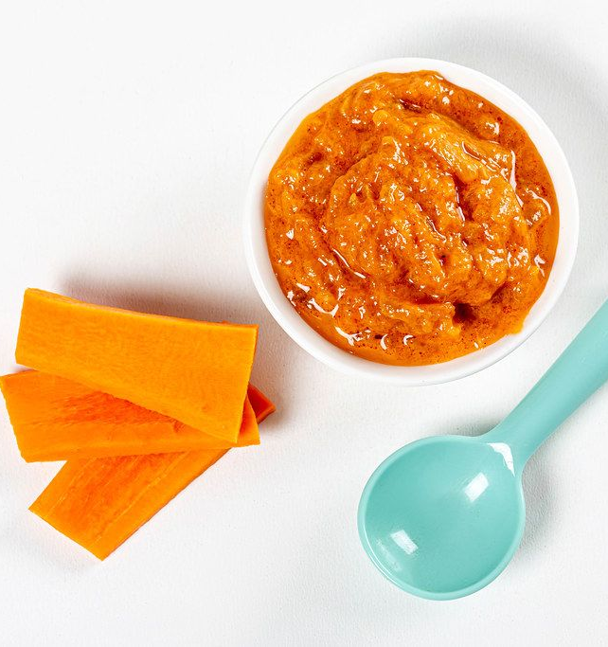
Starter activity 8.0 feedback: How do your ideas compare?
Three control measures: Ensure food is prepared in age-/stage-appropriate ways, an adult is always in sight and hearing when children are eating (EYFS 3.36), all staff are aware of allergies and food preferences
Two ways to record: Written records, dynamic risk assessment

Slide 7
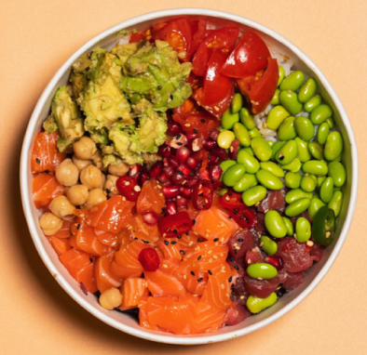
Starter activity 8.0 feedback: How do your ideas compare?
Include a range of nutritious and healthy foods from around the world
One way to ensure Inclusion:
Know all children’s dietary needs and preferences
Have age- and stage-appropriate furniture and equipment

Slide 8
Activity 8.1: Recap the five steps
We have already looked at four of these steps
What were they?
What comes next?
Identify hazards
Assess the risks
Control the risks
Record your findings
Review the controls
https://www.hse.gov.uk/simple-health-safety/risk/steps-needed-to-manage-risk.htm

Slide 9

Activity 8.2: What is a review?
In the context of risk assessments
“an examination of something, with the intention of changing it if necessary”
(Oxford English Dictionary)

Slide 10

Activity 8.2: Discussion, in small groups
Why do we need to review a completed risk assessment?
Write at least three reasons and be prepared to share your ideas.

Slide 11

Reasons, according to the HSE
To make sure controls are working
If controls are no longer effective
New risks potentially arising from changes to:
  staff (e.g. new starter or pregnancy)
  a process, substances or equipment used.
https://www.hse.gov.uk/simple-health-safety/risk/steps-needed-to-manage-risk.htm#_Review

Slide 12
More reasons to ‘review’ and what to do afterwards
Your risk assessment record should also be reviewed if there are any ‘near misses’. Were the control measures effective? Did you consider all hazards and risks?
You should also update the record with any new information after the review.

Slide 13
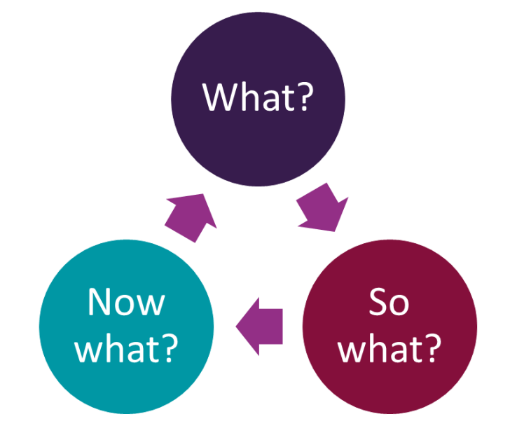
Activity 8.3: Research – What? So what? Now what?
This is a framework for reflection which can help you with a review.
Rolfe et al. (2001)
https://libguides.hull.ac.uk/reflectivewriting/rolfe

Slide 14

Activity 8.3: Research
Use the internet to research the What? So what? Now what? framework.
Note ways this could be useful when reviewing a risk assessment.

Slide 15

Activity 8.3: Feedback
Share and collate your ideas

Slide 16

Activity 8.4: Review own risk assessment
Access the risk assessment from home study 7.0.
Using the What? So what? Now what? Framework, review this risk assessment.
  Are the control measures good enough?
  Have you identified all the hazards and the risks?
  Has anything happened that might require changes?
Extension activity: Swap with a partner and complete a review.

Slide 17

Activity 8.5: Review a case study
Kayla is the manager of a preschool based in a church hall. She has just discovered that she is six weeks pregnant. Complete a review of the risk assessment on the handout which considers this new information.

Slide 18
Plenary: In your notebooks
One key insight you gained from the lesson – What?
Why it is important or impactful to you – So what?
One action you plan to take based on this new understanding – Now what?
https://libguides.hull.ac.uk/reflectivewriting/rolfe

Slide 19

Home study 8.0
Decide on an activity that you can carry out with a small group of children in your setting.
Identify specific children and their individual needs.
Consider the resources needed and location of activity.
Bring this information in note form to the next session.

Slide 20
09
Activity planning, including a risk assessment of the activity, environment and resources

Slide 21
Lesson objectives
Identify requirements for risk assessments within the Core Skills and Occupational Specialisms
Plan an appropriate activity for children
Populate a risk assessment document which identifies the hazards, risks and controls of the activity
Review the risk assessment

Slide 22

Starter activity 9.0: Word tennis
Split into two teams
Each team takes it in turns to say a word related to ‘risk assessment’
Take it in turns to ‘serve’
No words can be repeated – the other team will earn a point
First to three games wins the set, best of three sets wins the match
0 points = Love
1 point = 15
2 points = 30
3 points = 40
Tied score = All
40-40 = Deuce

Slide 23

Core Skill (CS) 4: How to assess and manage risks to your own and others’ safety when planning activities
CS4 and EYE Competency [5.7] – you must be able to populate a risk assessment document and present information clearly, concisely and in an appropriate style.
The level of detail must be appropriate to the audience and purpose to ensure understanding and minimise risks.

Slide 24
CS4: How to assess and manage risks to your own and others’ safety when planning activities
You must be able to make assumptions about risks to your own and others’ safety, identifying the key factors that must be considered.
You must develop appropriate precautions to minimise risk and record the information in an appropriate format.

Slide 25
Activity 9.1: Planning an activity for children
For last session’s home study, you were asked to decide on an activity that you would carry out with a small group of children in your setting. You should have:
identified the specific children you will be leading the activity for and their individual needs
considered which resources were needed and the location of the activity.
Education and Training Foundation

Slide 26

Activity 9.1: Planning an activity for children
Access the handout.
Using Birth to 5 Matters or the National Curriculum, plan your activity – you will be implementing this before the next session.
Populate a risk assessment document which identifies the hazards, risks and controls.
Birth To 5 Matters – Guidance by the sector, for the sector
National curriculum in England: primary curriculum - GOV.UK (www.gov.uk)
Education and Training Foundation

Slide 27
Activity 9.1: Review
Share your planning with a peer
Review the activity, resources and environment that your peer has created
Have they included all appropriate resources?
Have they identified hazards, risks and appropriate precautions?

Slide 28
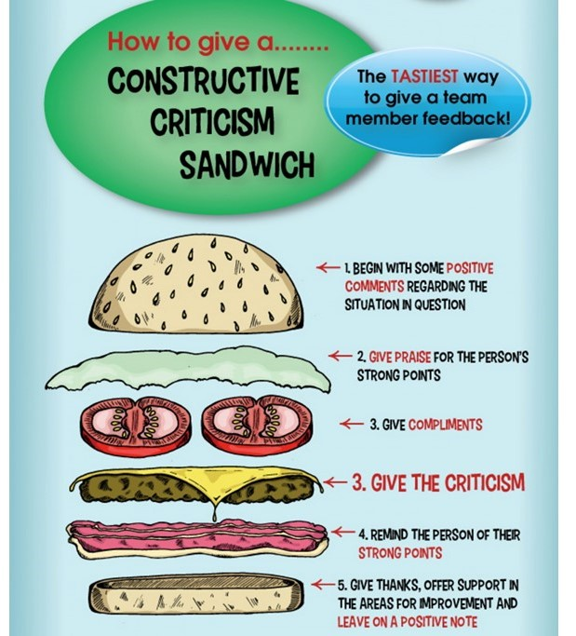
Activity 9.1: Review
Give feedback to peers
This Photo by Unknown author is licensed under CC BY.

Slide 29
Plenary: Nine box squares
The challenge:
Write a short paragraph using all nine key words.
Plan | Legislation | Activity
Hazard | Control | Resources
Differentiation | Risk | Equipment

Slide 30

Home study 9.0: Implement the activity
Implement the activity that you have planned and risk assessed.
Evaluate it using the handout.

Slide 31
10
Peer assessment and review

Slide 32

Lesson objectives
Consolidate learning and skills
Examine and self-assess own plan and evaluation
Peer assess plans and evaluations
Produce a personal development plan (PDP)

Slide 33

Starter activity 10.0
In pairs, create an illustration or factsheet which demonstrates the “feedback sandwich” method

Slide 34
Activity 10.1: Self-assessment using feedback sandwich
When you evaluated your implemented activity, you engaged in self-reflection and self-assessment.
Use the feedback sandwich method to identify your own strengths and points for development.
Review your initial identification of hazards, risks and controls – is there anything you would need to change or adapt if you were to do the activity again?

Slide 35

Activity 10.2: Reading
Please access the reading handout
This discusses the benefits and drawbacks of peer assessment
Consider the implications of this for your own practice
https://www.tes.com/magazine/archive/pedagogy-focus-peer-assessment

Slide 36
Activity 10.3: Success criteria
Develop three success criteria which you will use to review each other’s plans and evaluations.
In small groups, decide:
  what the aims of the activity plan, risk assessment and evaluation were
  exactly what we are looking – be specific
  Whether it can be measured and demonstrated.

Slide 37

Activity 10.3: Success criteria
Now, as a class
Collate a combined set of three appropriate success criteria.

Slide 38
Activity 10.4: Review
Share your planning and evaluation with a peer.
Prepare feedback
Record feedback
Give feedback
Record feedback given by peer – you will use this to create a PDP.
This Photo by Unknown author is licensed under CC BY.

Slide 39
Plenary 10.0
Create a short PDP to address what you can improve
Think about different ways to engage in continuous professional development (CPD), for example:
self-directed reading, research and learning
attend external training
mentor/peer feedback.

Slide 40


ET-FOUNDATION.CO.UK
PRODUCED BY
FUNDED BY
South Gloucestershire and Stroud College (SGS) has produced this resource on behalf of the Education and Training Foundation
This programme is funded by the Department for Education

