Slide 1


Lesson 6:
Frequency charts and averages
Objectives
Construct and interpret frequency charts
Find the averages and range for a set of data
Understand how the mean, median, mode and range summarise data
Use different representations of data to provide insight into mathematical structure

Slide 2


Keeping healthy
Number of days
3
MN
Initials
On how many days
out of the last five days,
were you physically active?
Notes:
Tell students that one of the things that we are advised to do to keep healthy is to exercise/be active. Discuss some different ways that we can be active, such as going for a walk/walking to college, playing sport, dancing, riding a bike, and so on.
Give each student a sticky note and ask them to write down the number of days out of the last five days that they did something physically active for at least 10 minutes (a whole number between 0 and 5), and to put their initials in the bottom right corner.
Ask students to stick their sticky notes at the front of the class and then tell them that we are going to display the results on a class frequency chart.

Slide 3

Frequency chart showing class results
Handout
available
Notes:
Display the axes (using flip chart paper, the ‘Class results’ handout enlarged onto A3 paper, or this slide) and ask students to place their sticky notes in the frequency chart.
Ask students to comment on the chart. Encourage all students to contribute something that they notice to the discussion. You may like to ask students some specific questions about the chart to initiate discussion. For example, ‘How many people in the class were active on all five days?’ or, ‘What did most people do?’
Students may not comment on any statistical measures, and it is not necessary to introduce these at this stage. Being able to identify their own sticky note and as a result recognise where their data value is represented in the chart can play an important part in developing students’ understanding of the relationships between different representations of data.

Slide 4
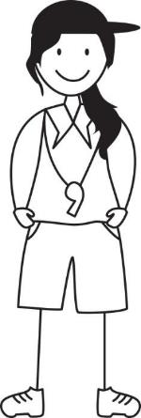
Fitness classes
Current class timetable:
Saturday 10 am
11 am
I could maybe run a fitness class during the week as well?
Yaima
Notes:
Tell students that Yaima runs two fitness classes on a Saturday morning. One class is at 10 am and the other class is at 11 am. She is thinking about running a new class during the week.

Slide 5
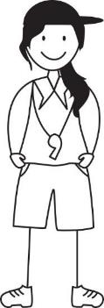
10 am fitness class survey
Write down the number of days
out of the last five days
you have exercised for at least 30 minutes
Yaima
Notes:
Yaima wants to know how much additional exercise the attendees of her class already do. At the end of the 10am class she asks the 11 people who attended to write on a slip of paper, the number of days out of the last 5 days they have exercised for at least 30 minutes. These are the results she gets.

Slide 6



10 am class results
✓
✓
✓
✓
✓
✓
✓
✓
✓
✓
✓
Abi
10 am class results
Baz
Chloe
Yaima
Notes:
Tell students that Yaima puts the results into a chart. You should allow students enough time to see how she does this. She shows it to her colleagues Abi, Baz and Chloe. Ask students for some observations about the data. Then ask them what they think the advantages are of the chart over the list of numbers.

Slide 7

Interpreting the data
10 am class results
What does
the chart
show?
Abi
Baz
Chloe
Notes:
Abi, Baz and Chloe start to discuss how to interpret the data and Abi asks what the chart shows. Ask a couple of students to comment on the chart. They may, for example, say that no one in the class exercised on just one day or that most people exercised every day for the last five days. If students refer to the mean, median or mode, discuss these using the next slide.

Slide 8
Summarising the data
10 am class results
What does
the chart
show?
We could
find the
average.
Abi
Baz
Chloe
Notes:
Tells students that Chloe suggests finding the average. Ask them what Chloe means by this and assess their understanding of how an average value provides a summary of a data set. Students may refer to the mean, median and mode during the discussion. These average values will be explored further as part of the discussion of Abi’s, Baz’s and Chloe’s statements in the slides that follow.

Slide 9
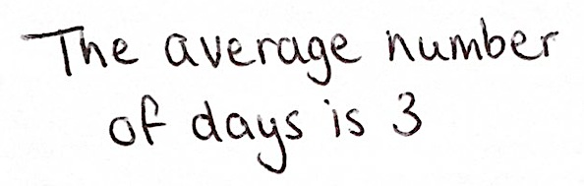

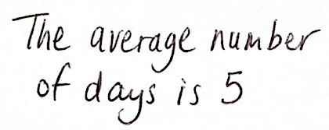
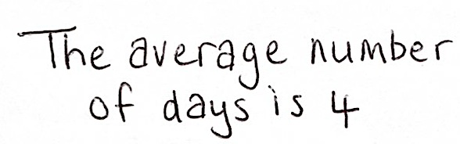
Average statements
DISCUSS
10 am class results
Abi
Baz
How can they
all be correct?
Chloe
Notes:
Abi says, ‘The average number of days is 3.’
Baz says, ‘The average number of days is 5.’
Chloe says, ‘The average number of days is 4.’
Ask the students how all three averages can be correct. Provide calculators and ask students to discuss in pairs what each of Yaima’s colleagues has done. If they struggle, suggest counting the number of items and putting them in order. At this stage, encourage them to work in ways that are familiar to them in order to access the data.

Slide 10
Abi’s statement
REVIEW
10 am class results
Abi
Notes:
Students’ initial thoughts on averages may be to calculate the mean, as this is the most frequently used measure of average. This is what Abi has done.
Discussing with students how many people attended Yaima’s class is important in establishing the total number of values in the data set. Students often understand the calculation of the mean as involving the need to divide by ‘the number of things that there are’, which can sometimes be misinterpreted when the data is represented in frequency tables/charts, rather than in a list. Check that students can identify the 11 attendees from the chart as well as from the list of responses.

Slide 11

Baz’s statement
REVIEW
10 am class results
Baz
Notes:
Ask students to explain to the class what Baz has done. Establish that Baz has identified the mode, which is the most common response. 4 of the 11 people in the fitness class exercised for at least 30 minutes on all 5 days.

Slide 12

Chloe’s statement
REVIEW
10 am class results
Chloe
Did you find
the mode?
Yaima
Notes:
Students can sometimes mistakenly identify the mode as the frequency of the value, rather than the value itself. It is important to check whether students have correctly identified that Chloe has found the median value or whether they are incorrectly interpreting ‘the average number of days is 4’ as the mode, mistaking the highest frequency (4) as the mode rather than the number of days represented (5). Ask students to explain why Yaima may think that Chloe has found the mode and establish that Chloe has identified the median (6th value).

Slide 13
Averages
MEAN
Total of the data values divided by the number of data values
MEDIAN
Middle data value when data values have been ordered
MODE
Data value that occurs the most
Notes:
Summarise the definitions of the three averages and highlight why we consider the different measures of average rather than just one. You might like to discuss how the mean is calculated using all the data values, but may not be a good measure of average if the data contains outliers. The median is not affected by extreme values and can provide a better measure of the average than the mean when the data is skewed. The mode is the least used measure of average, but it is the only measure that can be used for nominal as well as numerical data.
You may like to write the definitions on the board so that students can refer back to them during the lesson.

Slide 14
11 am class results
✓
✓
✓
✓
✓
✓
✓
✓
✓
✓
✓
✓
Abi
Number of days | Frequency
0
1
2
3
4
5
0
1
Baz
4
1
6
Chloe
0
Yaima
Notes:
Tell students that Yaima asks the same question to the 12 people attending her 11 am fitness class. She represents the results in a frequency table for this class and shows it to Abi, Baz and Chloe.
Give students a couple of minutes to engage with the data. They may want to note down on their mini whiteboards what they can identify from the data. It is not necessary for them to work out the correct values for the mode (4), median (3.5) and range (3), but some may want to do so.
Tell students that Abi, Baz and Chloe are discussing the data. The next three slides explore what Abi, Baz and Chloe say.

Slide 15
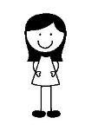
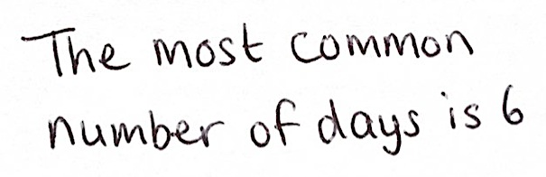
Abi’s statement
DISCUSS
Number of days | Frequency
0 | 0
1 | 1
2 | 4
3 | 1
4 | 6
5 | 0
Abi
Why is Abi wrong?
Notes:
Ask students what mistake Abi has made and what the correct answer is.
She has made the mistake of identifying the frequency of the most common result as the mode, rather than the number of days.

Slide 16

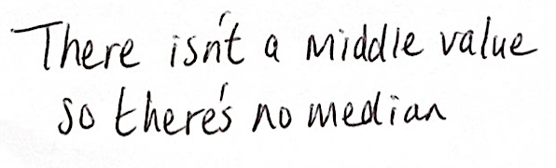
Baz’s statement
DISCUSS
Number of days | Frequency
0 | 0
1 | 1
2 | 4
3 | 1
4 | 6
5 | 0
Baz
Do you agree with Baz?
Notes:
When discussing Baz’s statement it is important to discuss how to determine the median when there is an even number of values in the data set. It is also important for students to recognise that unlike the mode, the median (and mean) can be a value that does not correspond to an actual event. In this case, the median is 3.5 days, even though a person cannot actually have exercised for at least 30 minutes on 3.5 days.
The total frequency (i.e. the number of fitness class attendees that responded to this survey) is an important value that is needed to establish both the median and the mean. You may want to also discuss how to use a frequency table to determine the mean.

Slide 17
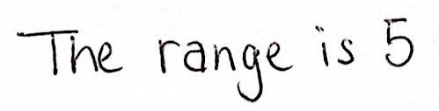
Chloe’s statement
DISCUSS
DISCUSS
Number of days | Frequency
0 | 0
1 | 1
2 | 4
3 | 1
4 | 6
5 | 0
Chloe
Isn’t the range 3?
Yaima
Notes:
Ask students whether they think Chloe is correct or Yaima is correct. Discuss how Chloe may have thought the range is 5 by considering the difference between the greatest possible number of days and the smallest possible number of days (5 – 0 = 5) in the table while failing to take into account that no one exercised for 0 days or 5 days. Establish that Yaima is correct (4 – 1 = 3) and highlight to students the distinction between averages (mean, median and mode) and range, which measures the spread of the data.

Slide 18
Comparing results
DISCUSS
10 am class:
11 am class:
Number of days | Frequency
0 | 0
1 | 1
2 | 4
3 | 1
4 | 6
5 | 0
✓
4
✓
4
✓
2
4
✓
2
4
✓
2
4
1
2
3
4
✓
Mode | 5
Median | 4
Mean | 3
Range | 5
Mode | 4
Median | 3.5
Mean | 3
Range | 3
Notes:
Before moving on to the next activity, spend a couple of minutes comparing the results from the two classes. Displaying the results for the second class on a frequency chart should help students make a direct comparison. Discuss the advantages of the frequency chart over the frequency table and ask students to explain how they identify the range and average values using the chart.
The summary statistics suggest that the attendees of the first class are exercising slightly more often. Ask students to explain how this can be identified from the charts. Highlight that while the attendees of the first class seem to be exercising more often, some of them have not exercised at all in the last 5 days, unlike for the second class where everyone has exercised.

Slide 19
Matching and completing
EXPLORE
Chart A
Table 1
Table 2
Mode | 1
Median | ?
Mean | 2
Range | 5
Mode | 0
Median | 2
Mean | ?
Range | 5
Which table goes with which chart?
Chart B
What is the median value for Chart A?
What is the mean value for Chart B?
Notes:
Tell students that the two tables give a summary of the data represented in the two charts. Ask students which table goes with which chart and how they know. Emphasise that the mode is the easiest average to identify from the chart.
Once the tables/charts have been correctly matched, ask students to complete the missing values in the two tables. Encourage students to use the chart directly when calculating the mean. Emphasise how to identify the median when there is an even number of data values. Remind students of the importance of the total frequency when finding both the median and the mean.

Slide 20
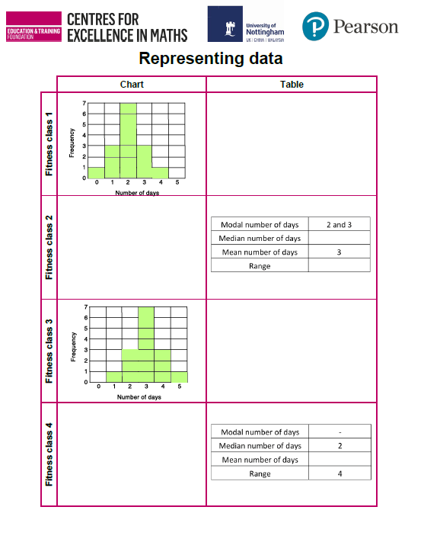
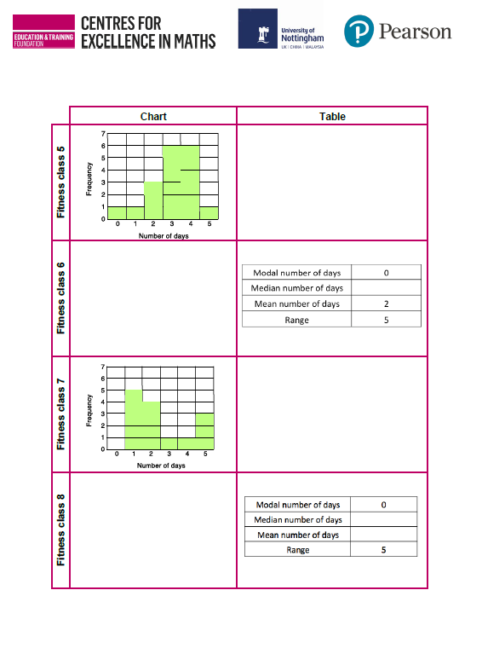
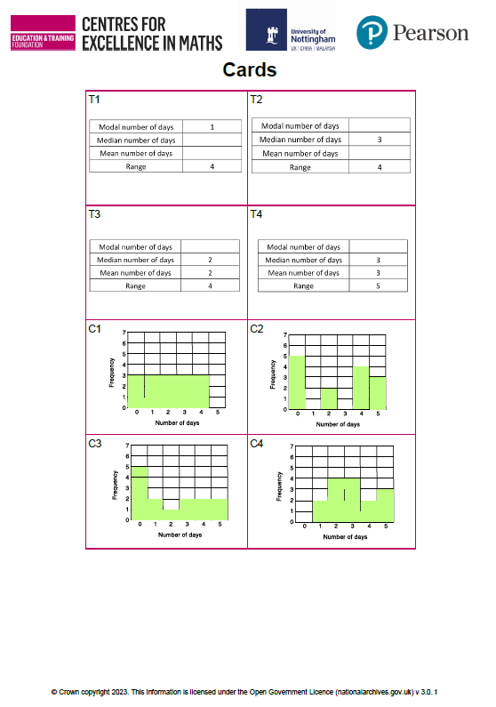
Placing the cards
YOUR TURN
Handout
available
Work in pairs. Take turns and explain to each other.
Match the cards correctly.
Complete the missing values.
Notes:
Tell students that Yaima carried out the same survey during her next eight fitness classes. She recorded the results in charts and made some tables of summary statistics. Distribute to each pair of students a copy of the ‘Representing data’ handout and the ‘Cards’. Ask students to work in pairs to identify which chart goes with each table of summary statistics. Tell students that they need to fill in the missing values in the tables.
Encourage students to take turns when matching the tables and charts. It is important that students work collaboratively (Key Principle 5) and can explain their thinking when placing a card.
If you think students might struggle, you might like to give them the first page of the handout for fitness classes 1–4 only and cards C1, C4, T2 and T3. Alternatively they could be given the full set of cards with just the first page of the handout. To help students to get started, you may want to ask them to count the number of people in each class and think about how this might help them.
As students work, observe whether they group the charts and tables cards in any way. They may, for example, group tables T1, T2 and T3 together as they all have a range of 4, whereas the range in table T4 is 5. If so, ask students if they can group the tables in any other way (no, as some of the values for the other statistical measures are missing from the tables and would need to be completed first) and which statistical measure would be most helpful to use if they could. Use the discussion to check whether students recognise which of the four statistical measures are easiest to identify from the chart and how they might use this to help them match the charts and tables

Slide 21
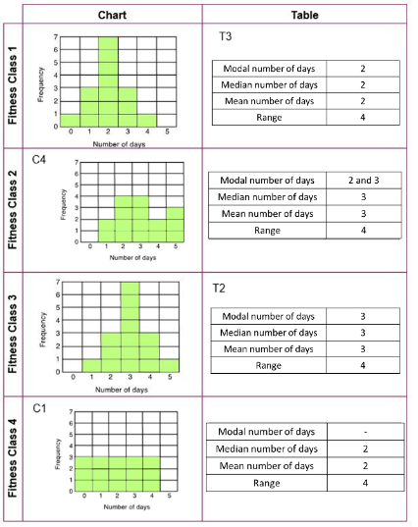
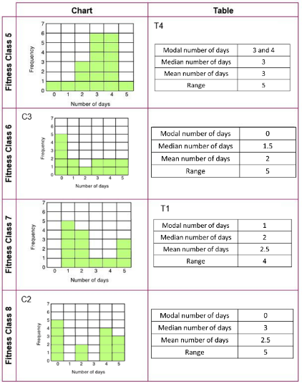
Reviewing matches
REVIEW
Notes:
Once students have had sufficient time to make progress, hold a class discussion. While it is important to establish the correct matches, focus also on bringing the learning together and drawing out comparisons between the different data sets.
Use Slides 22–26 to explore some specific features of the data.
Asking questions such as those suggested below or prompting students using the methods described may be helpful in checking students’ understanding.

Slide 22
Bimodal data
REVIEW
Fitness class 2:
Fitness class 5:
C4
Modal number of days | 2 and 3
Median number of days | 3
Mean number of days | 3
Range | 4
T4
Modal number of days | 3 and 4
Median number of days | 3
Mean number of days | 3
Range | 5
Notes:
The results for fitness classes 2 and 5 contain data that is bimodal.
Ask students to describe the characteristics of the chart they were looking for when matching a chart to the table for fitness class 2.
Students may say that they looked for a chart where the bars representing 2 and 3 days are the same height. Check students’ understanding of modal number of days as most common, so we are interested in charts with two bars of equal height that are taller than all the other bars. Establish that the results for fitness class 5 are also bimodal.

Slide 23
No mode
REVIEW
Fitness class 4:
C1
Modal number of days | -
Median number of days | 2
Mean number of days | 2
Range | 4
Notes:
The frequencies for fitness class 4 are all 3 (for 0 to 4 days inclusive) so all the bars in the frequency chart are the same height.
Ask students to explain why the table for fitness class 4 had no modal value completed and how this helped them to identify the matching chart.

Slide 24
Finding the median
REVIEW
Fitness class 6:
Fitness class 7:
Fitness class 8:
Median number of days | 1.5
Median number of days | 2
Median number of days | 3
C3
C2
Notes:
After matching the charts and tables for fitness classes 6, 7 and 8, the median number of days needed to be identified. There were 14 attendees for all three classes so there is an even number of data values. Check students’ understanding of how to find the median when there is an even number of data values and highlight the differences for each data set.

Slide 25
Making comparisons
DISCUSS
Fitness class 1:
Fitness class 3:
T3
T2
Modal number of days | 2
Median number of days | 2
Mean number of days | 2
Range | 4
Modal number of days | 3
Median number of days | 3
Mean number of days | 3
Range | 4
How are they the same? How are they different?
Notes:
Conclude the discussion by asking students to compare the charts for fitness classes 1 and 3 and comment on what they notice. They should notice that they are the same, but that the chart for fitness class 3 is shifted one to the right.
Discuss the differences between the mean, median, mode and range, noting that the range remains the same but that the averages in T2 are one more than in T3.
Relate the charts to the amount of exercise reported by the participants of fitness classes 1 and 3; the participants of fitness class 3 exercise one more day than those of fitness class 1.

Slide 26
Averages
The mean, median and mode
are all different
measures of average
Data list A: 1, 2, 3, 4, 5
Data list B: 1, 2, 3, 4, 4, 4
Mean = 3, Median = 3, No mode
Is there a ‘best’ average?
Mean = 3, Median = 3.5, Mode = 4
Notes:
Bring students’ thinking together by summarising the three different averages. Ask students to find the mean, median and mode for the two data lists:
Data List A: 1, 2, 3, 4, 5
Data List B: 1, 2, 3, 4, 4, 4
After a couple of minutes, discuss the three values for the mean, median and mode for the two data lists and highlight the different ways in which they measure the average. You might like to discuss how the mean is calculated using all the data values, unlike the median and mode, and how there can sometimes be no mode (as in the case of the first data list) or more than one mode. Check that students are able to identify the median when there is an even number of data values (as in list B) compared with identifying the middle value as in list A.
Once the values for the three averages have been identified for the two lists, ask students which average they think best describes each of the data lists. Contrast data list A, where the mean and median have the same value, with data list B, where the three values are different. Discuss how the mode may be considered as the best average for list B since half of the data values are 4, or how the median could be thought to be the best average as it takes into account the values that are less than 4. Identify that the mean may not be the best measure of average, especially when the data is skewed as it is here, and reinforce how taking each measure of average separately, without the context of the other two, can sometimes give a misleading summary of the data
.

Slide 27
Averages and Range
The range measures
the spread of the data
How are
lists C and D
different?
Data List C: 1, 1, 1, 1, 6, 8
Data List D: 1, 2, 3, 4, 6, 8
Mode = 1, Median = 1, Mean = 3
No mode, Median = 3.5, Mean = 4
Range = 7
Notes:
Discuss the range and establish how it uses the extreme values to describe how spread out the data is. Ask students to find the range for the two data lists and establish that it is the same for data lists C and D. Ask students to describe what is different about the two lists.
Ask students to determine the mode, median and mean for the two data lists and write them on their mini whiteboards. Acknowledge that the range sometimes provides an unreliable measure of how variable the data is, as demonstrated here by two sets of data with the same range but different average values.
It is important that students recognise the distinction between measures of average and range as a measure of spread, and how using the range and average values together can provide a more reliable summary of the data.

Slide 28
Practice question (1)
REVIEW
Handout
available
Here is a list of numbers.
12 15 14 17 22 19 13
Bridgit says,
“To work out the median you find the middle number,
so the median of these numbers is 17”
Bridgit’s answer is not correct.
What is wrong with Bridgit’s method?
She did not order the numbers before working out the median (1)
(b) Work out the range of the numbers in the list.
10 (2)
(c) Work out the mean of the numbers in the list.
16 (2)
Q6 from June 2017, 1MA1/3F
Notes:
Give each student a copy of the ‘Practice questions’ handout. Give students a couple of minutes to work on the questions individually and then discuss their thinking.
When completing the first practice question, it is important that students explain what Bridgit has done wrong and not just state that she is incorrect because the median is actually 15. Observe whether they write out the list in order and if so, how they use this to identify the range as being 10 in part (b).
When discussing the first question, establish the importance of ordering the data and how putting data into a frequency table helps with this. You may want to point out that there is no mode for the list of numbers.

Slide 29
Practice question (2)
REVIEW
Handout
available
The table shows information about the numbers of points scored by 30 students in a quiz.
Find the modal number of points.
2 (1)
(b) Work out the total number of points.
81 (2)
Q18 from June 2019, 1MA1/3F
Number of points | Frequency
0 | 4
1 | 3
2 | 7
3 | 5
4 | 6
5 | 5
Notes:
For the second practice question, students may just find the total of the frequency column to give an answer of 30 (the number of students). If they do, you may wish to ask them the total number of points scored by the five students who each scored 5 points.
Ask students to describe their method when working out the total number of points scored in part (b) and explain why it works. Discuss how adding an additional column to the table may help with finding the total number of points scored. Establish why working out the total number of points scored is a useful thing to do (because we can use it to calculate the mean).

Slide 30
Lesson review:
Frequency charts and averages
Objectives
Construct and interpret frequency charts
Find the averages and range for a set of data
Understand how the mean, median, mode and range summarise data
Use different representations of data to provide insight into mathematical structure
Suggested further steps/areas to work on
Estimate the mean, median, modal group and range for grouped data

Slide 31
Lesson 6:
Credits
Photo acknowledgements
Shutterstock.com: Preto Perola, Vectorfair.com
Text acknowledgements
Pearson Edexcel Level 1 / Level 2 GCSE (9-1) Mathematics Paper 3 (Calculator) Foundation Tier June 2017 1MA1/3F, Pearson Edexcel Level 1 / Level 2 GCSE (9-1) Mathematics Paper 3 (Calculator) Foundation Tier June 2019 1MA1/3F,

