Slide 1
T LEVEL IN DESIGN, SURVEYING AND PLANNING FOR CONSTRUCTION
Supporting holistic delivery of Core Content and Occupational Specialism content

Slide 2
1
Research and case study

Slide 3
Understanding the project scope
Welcome to the project task to propose a sustainable design solutions (to an existing building).
This project focuses on assessing and proposing sustainable design solutions for an allocated case study for a listed building. You will explore the challenges and opportunities of improving energy efficiency, reducing environmental impact and integrating sustainable technologies within the constraints of heritage preservation.

Slide 4
Lesson 1 overview
Understand the importance of sustainable retrofitting in construction.
Define key concepts: sustainability, retrofit,
heritage conservation.
Analyse a listed building case study and identify
key challenges.
Develop a problem statement based on the
case study findings.

Slide 5
What is sustainable retrofitting?
Definition: The process of upgrading existing buildings to improve energy efficiency and sustainability while preserving historical integrity.
Why it matters:
Reduces carbon footprint.
Enhances building longevity.
Preserves cultural heritage.

Slide 6
Key concepts
Sustainability: meeting present needs without compromising future generations.
Retrofit: modifying an existing building with new technology or materials.
Heritage conservation: preserving historical and architectural significance.

Slide 7
Video case study
As a group, watch the Greenleaf Road retrofit case study video.

Slide 8
Introduction to the final project
Final submission expectations:
Research-based report
Analysis of a case study
Sustainable retrofit proposals

Slide 9
Wish Hill case study: Overview
Building history: age, significance, listing status.
Materials used: traditional vs modern materials.
Key challenges: structural, environmental,
historical constraints.

Slide 10
Wish Hill case study and walkthrough
In pairs, revisit the Wish Hill interactive tour and
the Wish Hill case study PDF document.
Underline key facts about the building and note the challenges of retrofitting this building.
Discussion questions:
What are the major sustainability concerns?
What heritage constraints should be considered?

Slide 11
Group task: Retrofit challenge
Group assignments:
Group 1: walls and insulation
Group 2: windows and ventilation
Group 3: heating and energy efficiency
Task:
Identify issues in the assigned category.
Brainstorm sustainable retrofit solutions.
Prepare key findings to share with the class.

Slide 12
What is a problem statement?
A concise summary of the main challenges and proposed solutions.
Example:
The listed building’s outdated heating system leads to excessive energy consumption. A sustainable retrofit solution must consider heritage constraints while improving efficiency.

Slide 13
Writing your problem statement
Framework for your problem statement:
Issue: what is the main problem?
Impact: how does it affect the building/sustainability?
Solution: what can be done while considering heritage constraints?
Task: Write a problem statement based on your group’s analysis (150–200 words).

Slide 14
Peer review and discussion
Swap problem statements with a peer.
Provide feedback based on clarity, relevance and feasibility.
Revise and refine before submission.

Slide 15
Summary and next steps
Recap:
Importance of sustainable retrofitting.
Key challenges and solutions from the case study.
Writing a structured problem statement.
Next lesson: understanding the building fabric.

Slide 16
Questions
Do you have any remaining questions or discussion points?

Slide 17
2
Understanding the building fabric

Slide 18
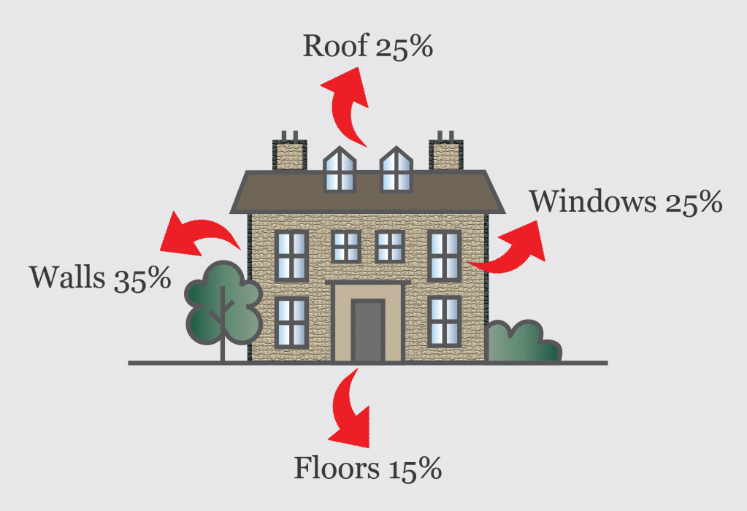
Understanding the building fabric
Lesson 2: Heat loss and insulation in heritage buildings
Ventrolla (n.d.) Heat loss problem areas in your home [online image]. Available at: https://www.ventrolla.co.uk/heat-loss-problem-areas-in-your-home/ (Accessed: 15 June 2025).

Slide 19
Introduction to heat loss
Heat loss occurs through solid walls, roofs and windows.
Affects energy efficiency and increases heating costs.
Insulation helps reduce heat loss and improve
thermal performance.

Slide 20
Heat loss through solid walls
How it happens:
Conduction: heat moves directly through the solid material from the warm interior to the colder exterior.
Radiation: heat is emitted from internal surfaces and absorbed by the wall, then lost to the outside.
Air leakage: small cracks or gaps allow warm air to escape and cold air to enter.

Slide 21

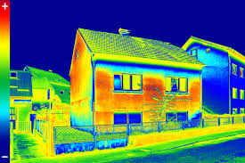
Methods of detecting heat loss areas in a building (1)
1. Thermal imaging cameras: detect temperature differences and highlight heat loss areas.
Department of Energy (n.d.) Thermographic inspection showing heat loss in a home [online image]. Available at: https://www.energy.gov/energysaver/thermographic-inspections (Accessed: 15 June 2025).

Slide 22
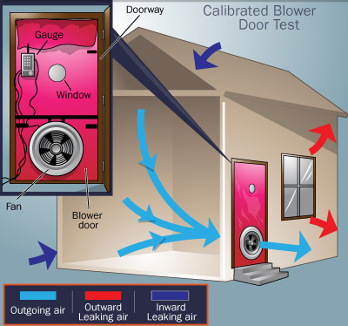
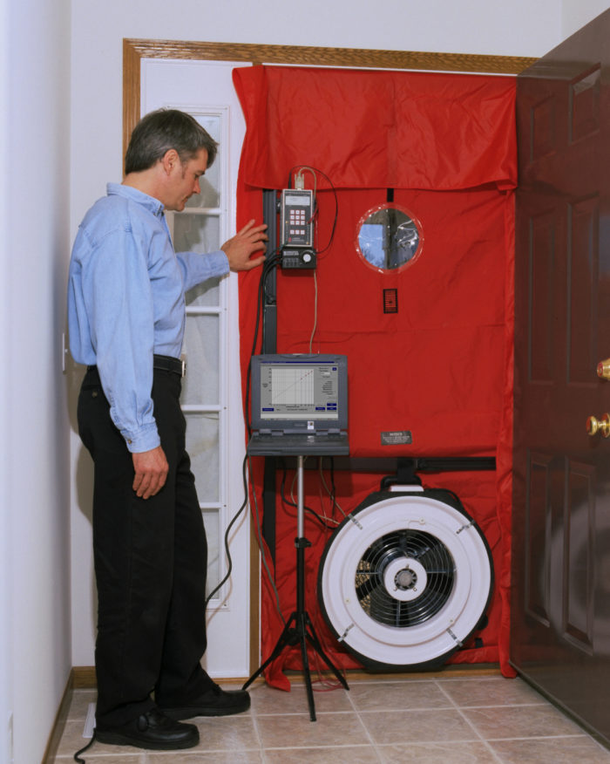
Methods of detecting heat loss areas in a building (2)
2. Airtightness testing (blower door test):
measures air leakage
by creating pressure differences.
Warm Smart (n.d.) Air permeability testing illustration [online image]. Available at: https://warmsmart.co.uk/air-permeability-testing/ (Accessed: 15 June 2025).

Slide 23
Methods of detecting heat loss areas in a building (3)
3. Infrared thermometers: spot-check surface temperatures for cold spots.
4. Smoke pencil or incense test: identifies draughts around windows, doors and gaps.
5. Visual inspection: look for condensation, damp patches or gaps in insulation.
Solution: Identify weak points and apply appropriate insulation or draught-proofing measures.

Slide 24
Effects on building efficiency
Higher heating costs
Reduced thermal comfort
Increased carbon footprint
Solution:
Insulation (internal or external) slows heat transfer and improves energy efficiency.

Slide 25
Challenges in retrofitting historic buildings
Heritage constraints: strict regulations may limit material choices and insulation methods.
Breathability and damp issues: traditional materials need to allow moisture movement to prevent damage.
Structural limitations: older buildings may not support modern insulation methods without alteration.
Aesthetic impact: external insulation can change the historic appearance.

Slide 26
Aesthetic impact of insulating listed heritage buildings
Visual changes: insulating may alter the appearance of historic features, like windows and façades.
Character preservation: efforts should focus on maintaining the building’s original aesthetic while improving energy efficiency.
Discreet solutions: internal insulation and secondary glazing can improve performance without compromising visual appeal.

Slide 27
Aesthetic impact of insulating listed heritage buildings (continued)
Balance: the challenge is to integrate modern insulation while preserving the building’s historic value.
Cost and complexity: specialist materials and skilled labour increase project costs.
Solution: careful balance between energy efficiency and conservation using breathable, reversible and
non-invasive methods.

Slide 28
Group discussion:
Importance of insulation
Why is insulation important?
What challenges exist in retrofitting historic buildings?
How do we balance thermal efficiency and
heritage preservation?

Slide 29
Group task:
Comparing insulation types
Traditional insulation: fibreglass, rigid board
Breathable alternatives: wood-fibre, lime-based plaster
Research in groups and present your findings.

Slide 30
Heritage considerations in insulation
Heritage constraints limit insulation choices.
Adding insulation may affect building breathability and aesthetics.
Careful selection of materials is required.
Discuss the impact of heritage considerations on insulation choices.

Slide 31
Class debate:
Should we insulate everywhere?
What are the benefits of full insulation?
What risks do we face with historic buildings?
Can we find a middle ground?

Slide 32
Lesson summary
Key points about heat loss and insulation.
Challenges in retrofitting heritage buildings.
Next lesson: Energy efficiency challenges: Windows and doors.

Slide 33
3
Energy efficiency challenges: Windows and doors

Slide 34
Proposing sustainable design solutions for Wish Hill
Assess the current condition of Wish Hill’s windows and doors.
Evaluate heat loss, air leakage and energy efficiency issues.
Compare retrofit options: secondary glazing vs slim-profile double glazing.

Slide 35
Importance of energy efficiency in heritage buildings
Why energy efficiency matters in heritage buildings:
Older buildings often have poor insulation, leading to high energy loss.
Single-glazed windows and draughty doors significantly reduce thermal efficiency.
Reducing energy waste improves sustainability and occupant comfort.

Slide 36
Challenges in retrofitting windows and doors
Listed building restrictions: need for like-for-like replacements.
Planning permission required for changes that
affect appearance.
Higher costs compared to modern buildings owing to
specialist materials.
Structural limitations: some buildings cannot support
modern upgrades.

Slide 37
Impacts of poor window and door insulation
Heat loss leads to higher energy bills.
Condensation and damp issues can cause damage over time.
Discomfort for occupants owing to draughts and cold spots.

Slide 38
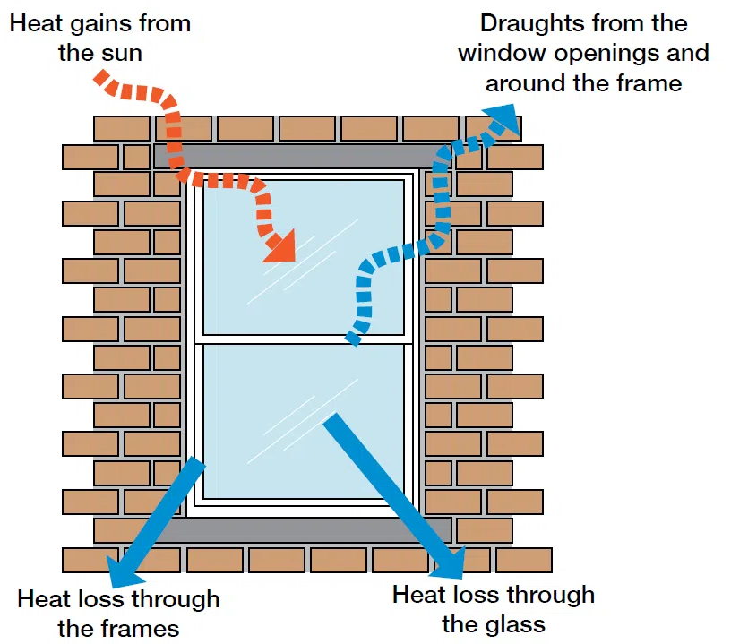
Improving windows in a listed building
Discussion question:
What challenges do you think arise when improving windows in a listed building?
Energysaving Devon (n.d.) [Thermographic/retrofit diagram from Devon retrofit guide] [online image]. Available at: https://www.energysavingdevon.org.uk/document/devon-retrofit-guide/ (Accessed: 15 June 2025).

Slide 39
Understanding air leakage and heat loss
What is air leakage?
Uncontrolled air movement which increases energy use.
What is heat loss?
The loss of internal heat through windows, doors and building fabric.
Impact on energy bills and sustainability:
Higher heating demand leads to greater carbon footprint.

Slide 40
Understanding air leakage and heat loss
What is air leakage?
Uncontrolled airflow through gaps in a building’s fabric.
Causes draughts, increased energy loss and discomfort for occupants.
Particularly problematic in older buildings with
minimal sealing.

Slide 41
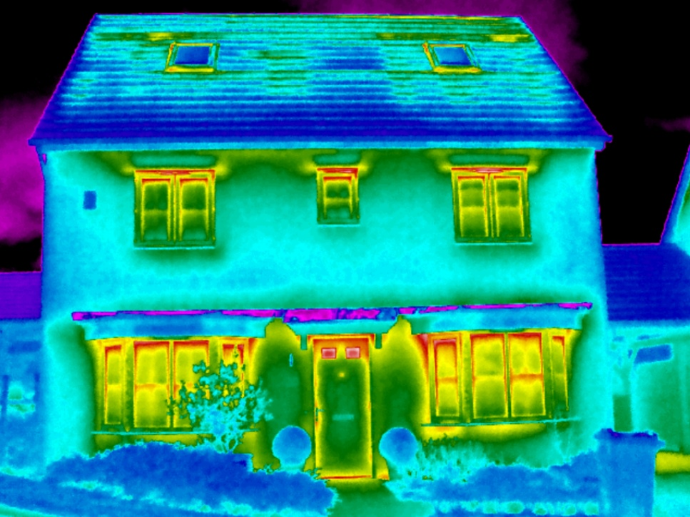
What is heat loss?
The escape of internal heat through walls, roofs, windows, and doors.
Windows are major contributors to heat loss
owing to high U-values.
Affects thermal efficiency and sustainability of a building.
ScanTherm (n.d.) Thermal imaging survey heat‑loss illustration [online image].
Available at: https://www.scantherm.co.uk/thermal-imaging-surveys/heat-loss-home-surveys/ (Accessed: 15 June 2025).

Slide 42
Factors affecting heat loss in windows and doors
Material/glazing type: single-glazed windows lose more heat.
Air gaps and poor sealing: allow warm air to escape,
increasing demand for heating.
Orientation and exposure: windows facing prevailing
winds experience more heat loss.
Building use and occupancy: higher internal temperatures
lead to greater losses.

Slide 43
Impacts of air leakage and heat loss
Higher energy bills owing to increased heating requirements.
Thermal discomfort with cold spots and draughts.
Increased carbon footprint: more energy consumption,
higher emissions.
Condensation issues: moisture build-up owing to warm air escaping and cooling.

Slide 44
Strategies to reduce heat loss
Discussion question:
What strategies can be used to reduce heat loss in heritage buildings without altering their appearance?

Slide 45
U-values and window performance
Definition of U-value: the rate of heat transfer through a material (lower = better insulation).
Comparison of window types:
  Single-glazed: high U-value (~5.0 W/m²K)
  Double-glazed: lower U-value (~1.2 – 3.0 W/m²K)
  Triple-glazed: lowest U-value (~0.6 – 1.0 W/m²K)
  Use this link to compare U-values of building components.

Slide 46
Wish Hill case study:
Window condition
Current windows: single-glazed leaded glass, timber frames.
Condition: significant heat loss, air gaps, cracked panes.
Challenges: listed status limits options for full replacement.

Slide 47
Activity: Wish Hill case study
In pairs, read the case study and highlight key window deterioration issues.
Use a highlighter or different-coloured pen to identify key window issues and make any comments next to photos in the case study.
Discuss your findings with the class.

Slide 48
Task: Heat loss calculations
Aim: to determine heat loss from existing windows and assess potential savings from retrofits.
Formula for heat loss: Q=U×A×ΔT
where:
  Q = heat loss (W)
  U = U-value (W/m²K)
  A = window area (m²)
  ΔT = temperature difference (°C)

Slide 49
Step-by-step calculation activity (1)
Measure window area:
Use given dimensions or estimate from case study data.
Find U-value for current windows:
Use provided U-value comparison chart.
Estimate indoor and outdoor temperature difference (ΔT): Assume typical winter conditions (18–22°C is a
realistic assumption).

Slide 50
Step-by-step calculation activity (2)
Calculate heat loss (Q):
Apply the formula and record results.
Extension task: Compare heat loss for different window types. Repeat calculations for:
secondary glazing
slim-profile double glazing.

Slide 51
Discussion questions
How does the choice of window glazing affect heat loss?
What are the most effective ways to improve window efficiency in listed buildings?
How do the costs compare between retrofitting vs replacing windows?
Activity: work in pairs to answer the above and discuss.

Slide 52
Retrofit options: Secondary glazing vs slim-profile double glazing
Option 1: Secondary glazing
Pros: retains original window; lower cost; improves insulation.
Cons: can be visually intrusive; condensation risk.
Option 2: Slim-profile double glazing
Pros: looks similar to traditional windows; better insulation.
Cons: more expensive; may require planning approval.

Slide 53
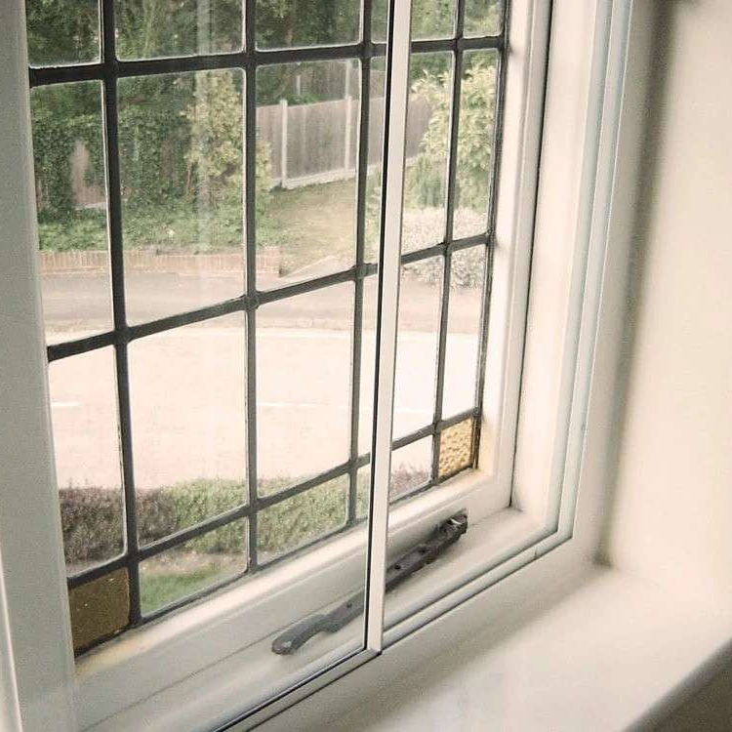
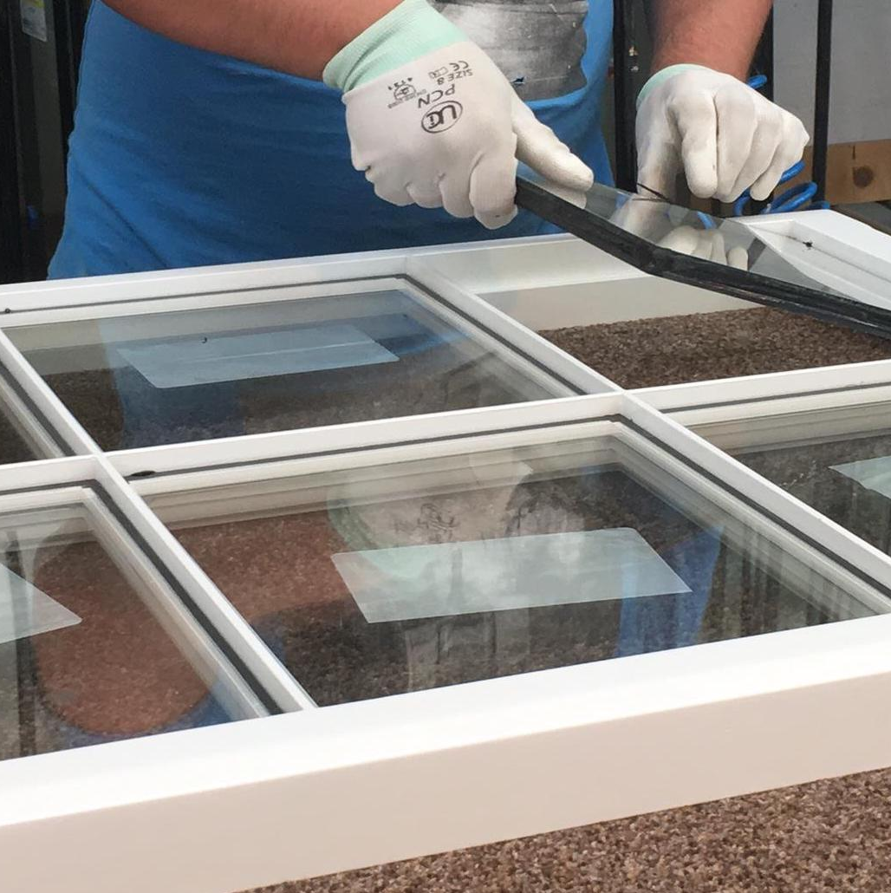
Types of glazing
Secondary glazing
Slim-profile double glazing
Sources: Secondary glazing https://sciwindows.co.uk/windows/secondary-double-glazing/ / Slim profile double glazing Specialists in Slimline Double Glazed Units | Conservation | Timbalite (Accessed: 7 July 2025)
.

Slide 54
Debate: Replace or refurbish windows?
Should we replace or refurbish Wish Hill’s windows?
Consider:
  energy efficiency gains
  aesthetic and historical value
  planning restrictions.
  cost implications.
  Activity: You will take part in a structured debate.
  The class will be split into two teams: one will argue for full window replacement and the other for window refurbishment.

Slide 55
Summary and next steps
Windows and doors significantly affect heat loss in
older buildings.
Calculating U-values helps determine improvement needs.
Retrofit solutions must balance performance and heritage conservation.
Next lesson: Heating and energy efficiency upgrades.
Homework task: Research different heritage-approved
window retrofitting techniques.

Slide 56
4
Heating systems and energy efficiency

Slide 57
Lesson 4 overview
Understand the limitations of the current heating system.
Compare low-carbon heating alternatives.
Discuss the impact of heating upgrades on heritage buildings.

Slide 58
Wish Hill’s current heating system
Existing system: combi boiler with wet radiators
How it works:
  The combi boiler provides hot water on demand and heats water for radiators.
  Wet radiators distribute heat through hot water circulation.

Slide 59
Common inefficiencies
High gas consumption leading to increased carbon emissions.
Heat loss owing to aging radiators and inefficient
heat distribution.
Limited compatibility with renewable energy sources.
Potential maintenance issues and lifespan limitations.

Slide 60
Environmental impact and costs
Gas dependency contributes to higher CO₂ emissions.
Rising energy costs make gas heating less economical in the long term.

Slide 61
Low-carbon heating alternatives
Heat pumps (air source and ground source)
Biomass boilers
Infrared heating panels
Efficiency comparisons (cost, effectiveness, sustainability)

Slide 62
Heat pumps
Air source: extracts heat from the air; works well in
mild climates; requires outdoor space.
Ground source: uses underground pipes to transfer heat;
highly efficient but costly to install.
Pros: low carbon emissions; energy-efficient.
Cons: high upfront costs; may require insulation improvements.

Slide 63
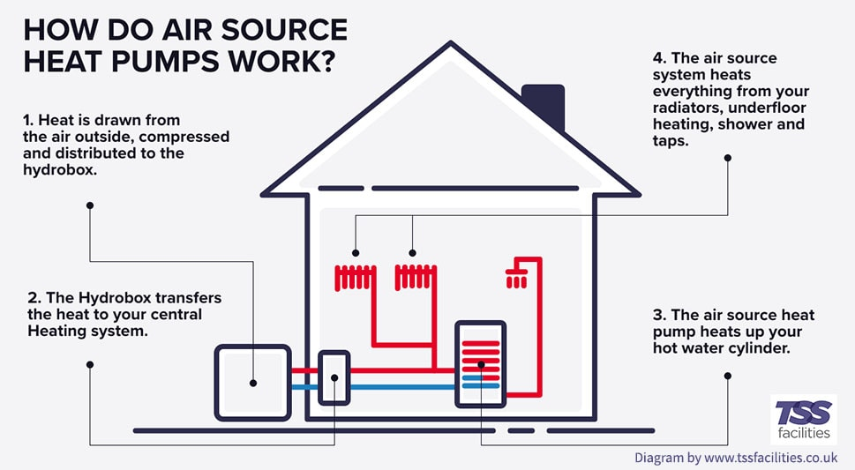
How do air source heat pumps work?
Barefoot Architects (2023) Retrofit & Renewables illustration depicting a home upgraded with fabric‑first measures and renewable heating systems
[online image]. Available at: https://www.barefootarchitects.co.uk/barefootblog/2023/3/16/retrofit-amp-renewables
(Accessed: 15 June 2025).

Slide 64
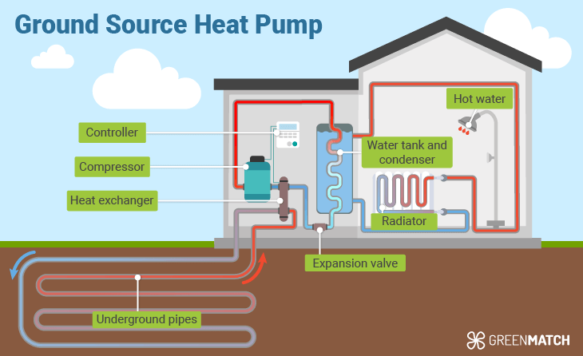
How do ground source heat pumps work?
WhatCost (2025) Diagram illustrating operation of a ground-source (geothermal) heat pump [online image]. Available at: https://whatcost.co.uk/heat-pumps/ground-source
(Accessed: 15 June 2025).

Slide 65
Biomass boilers
Use organic materials like wood pellets or logs.
Sustainable if sourced responsibly.
Pros: can work with existing wet radiator systems;
renewable energy source.
Cons: requires fuel storage; regular maintenance needed.

Slide 66
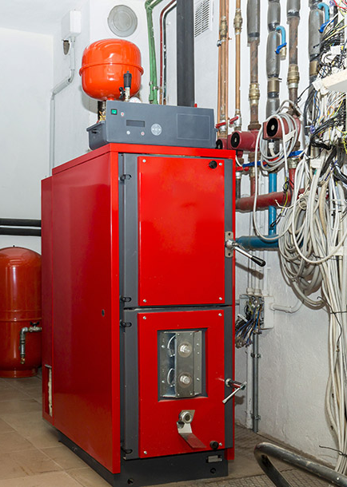
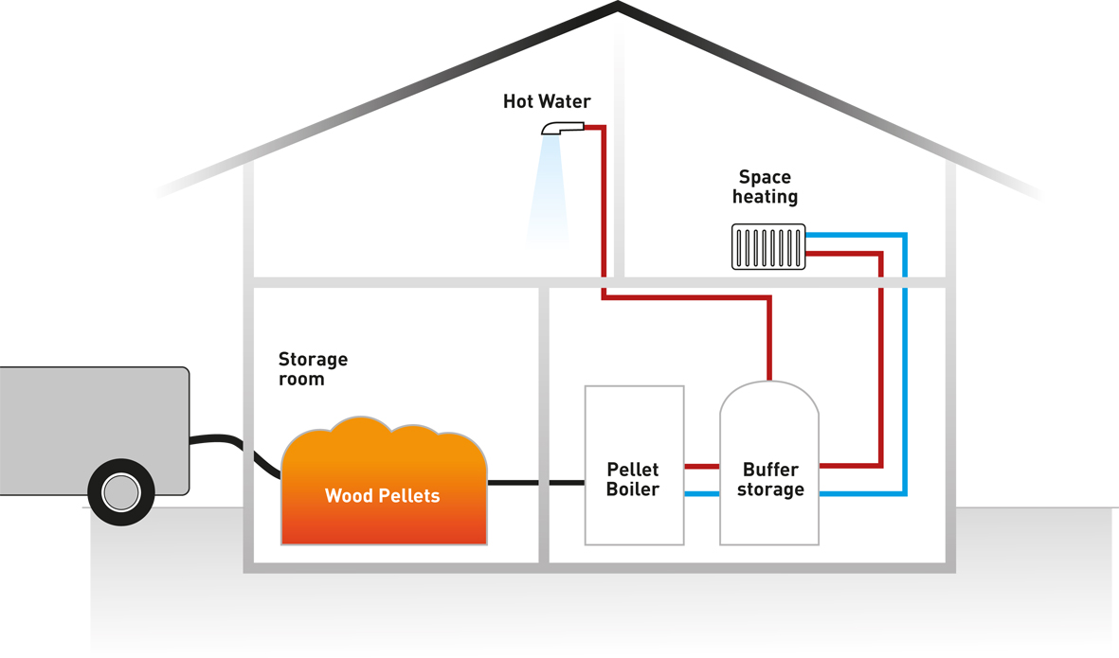
Biomass combustion
Haiqi (Shanghai Haiqi Environmental Protection Technology Co., Ltd.) (n.d.) Diagram illustrating biomass solid fuel combustion process in a boiler [online image]. Available at: https://www.haiqi-energyfromwaste.com/case/solution/technology-status-and-existing-problems-of-biomass-fuel-boiler.html (Accessed: 15 June 2025).

Slide 67
Infrared heating panels
Provides direct radiant heat rather than warming the air.
Highly efficient for well-insulated spaces.
Pros: quick heat-up time; low-maintenance; space-saving.
Cons: limited heat distribution; may require additional heating sources in larger spaces.

Slide 68
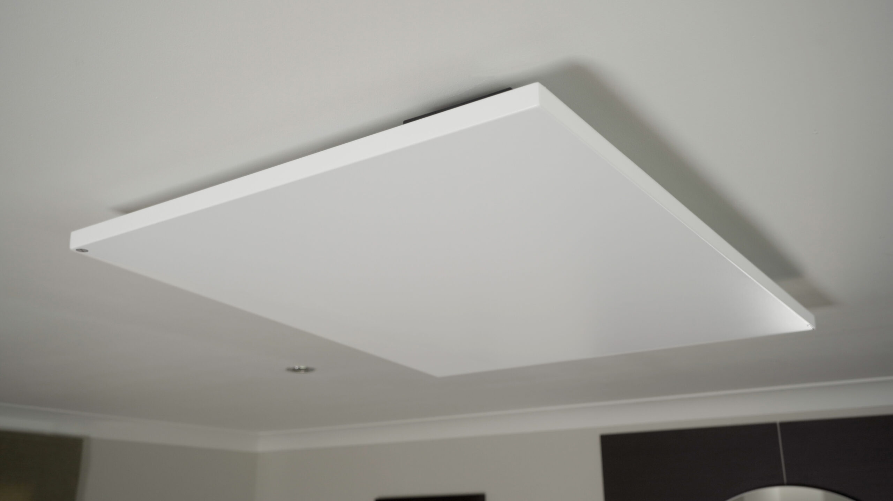
Modern infrared panels
Sundirect (n.d.) Frameless infrared panel heater mounted in a modern flat in Slovenia [online image]. Available at: https://www.sundirect-heater.com/frameless-infrared-panel-heater/ (Accessed: 15 June 2025).

Slide 69
Efficiency comparisons
Cost considerations (installation vs long-term savings)
Suitability for different building types
Environmental impact and carbon footprint
Task:
In pairs, discuss and compare heating technologies and feed back to the class.

Slide 70
Group task: Evaluating heating systems
In small groups, assess the pros and cons of each heating option for Wish Hill.
Consider cost, feasibility, and planning implications.
Use the group worksheet provided.
You will present your findings to the class.

Slide 71
Discussion: Best heating system for Wish Hill
Which system is most suitable?
Consider heritage restrictions.
Justify choice based on sustainability and efficiency.
Task: As a class, discuss which heating system is best for Wish Hill and justify your recommendations.

Slide 72
Summary and next steps
What are the key strengths and weaknesses of each heating system?
How do heritage restrictions affect sustainable heating choices?
What are the long-term benefits of upgrading to a low-carbon system?

Slide 73
Personal reflection questions
Which heating system do you think would work best for Wish Hill and why?
What challenges do you see in transitioning to a low-carbon heating solution?
How would you explain the importance of energy efficiency to someone unfamiliar with it?

Slide 74
Your key takeaways
Share one key takeaway from today’s lesson with the
person next to you.
In small groups, discuss potential solutions for overcoming challenges in heating upgrades.
Quick poll:
Which heating system would you choose for Wish Hill and why?
A. air source heat pump C. infrared heaters
B. ground source heat pump D. biomass boiler

Slide 75
Next steps: Looking ahead to renewable energy
Introduction to solar, wind and hydro power as complementary heating solutions.
Explore how renewable energy sources can be integrated into heating systems.
Consider hybrid solutions: can a mix of technologies provide the best outcome?
We will be looking at this next lesson. Any questions?

Slide 76
5
Integrating renewable energy in heritage buildings

Slide 77
Lesson 5 overview
Assess the feasibility of solar panels and other renewables at Wish Hill.
Compare renewable energy sources:
solar PV, wind, heat pumps, biomass.
Discuss planning constraints for integrating renewables in heritage buildings.

Slide 78
Introduction to renewable energy for buildings
Why use renewable energy?
Reduces carbon footprint.
Lowers long-term energy costs.
Supports sustainability goals.

Slide 79
Common renewable options for buildings
Solar PV: converts sunlight into electricity.
Wind turbines: generate power from wind energy.
Heat pumps: use air, ground or water heat to provide energy.
Biomass: burns organic material for heating.
Key question: Which of these options could work for Wish Hill?

Slide 80
Planning restrictions for listed buildings
Challenges of installing renewables in heritage buildings:
strict conservation laws
visual impact concerns
need for planning permission
compatibility with historic structures

Slide 81
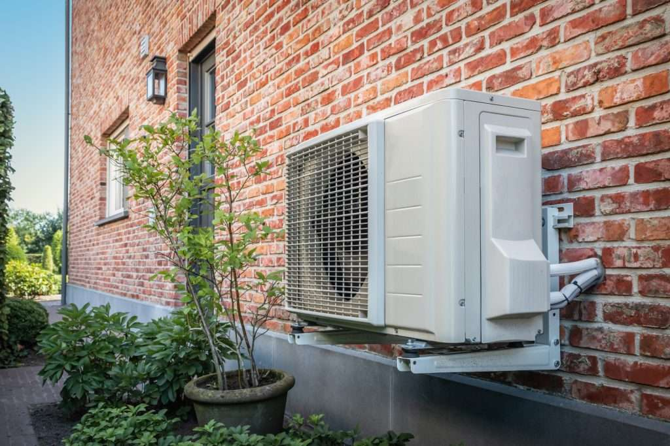
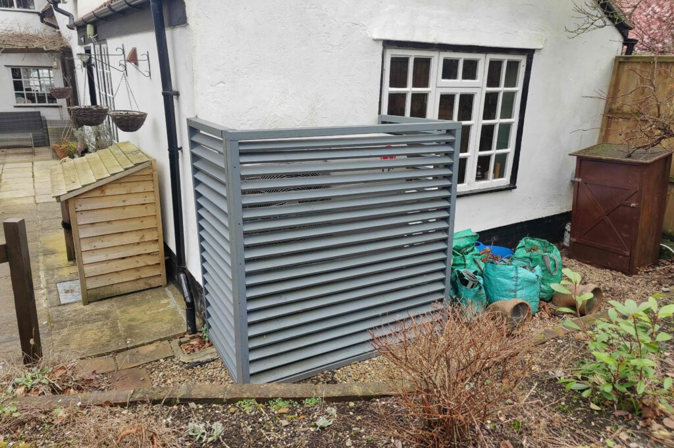
Solutions and workarounds
Discreet panel placement (e.g. rear roofs, non-visible areas)
Using historically appropriate materials
Working with conservation officers
Furbnow (2023) Illustration of various heat pump systems [online image]. Available at: https://furbnow.com/blog/types-of-heat-pumps-explained/ (Accessed: 15 June 2025).

Slide 82
Task: What challenges might Wish Hill face when adopting renewables?
Work in small groups as energy consultants tasked with advising a client (your teacher) on the best renewable energy solutions.
Your team must research and evaluate different technologies, weighing their pros and cons, and then present a compelling proposal recommending the most suitable option for the project.
Use the Historic England website to help you.

Slide 83
Case study review: Renewable energy in historic buildings
Real-world examples:
Successful solar panel installations on listed buildings
Wind and biomass solutions used in heritage sites
Hybrid approaches that balance history with sustainability

Slide 84
Case studies for review
Climate Change Adaptation Case Study:
Installing Solar Panels at Chester Cathedral
Extension to Kenwood House, Maidstone:
For the Kenward Trust
Copper Bottom House, Oxford

Slide 85
Key insights
  What worked well?
  What challenges arose?
  How were obstacles overcome?
  Small group brainstorm:
  How can these lessons be applied to Wish Hill?

Slide 86
Task: Identifying renewable energy solutions for Wish Hill
In small groups, propose a renewable energy solution for Wish Hill.
Consider:
  energy needs
  heritage restrictions
  cost and feasibility.
  Use the group worksheet provided.

Slide 87
Discussion: Selecting the best renewable energy system
  Debate the pros and cons:
  Which system offers the most benefits?
  What challenges must be addressed?
  Which solution best balances sustainability and conservation?

Slide 88
Cost-benefit analysis
  Upfront installation costs vs long-term savings
  Energy output comparison
  Maintenance and efficiency over time
Task:
Use the cost benefit table worksheet provided to review the energy solutions. Use the internet for research. Compare findings with peers.

Slide 89
Summary and next steps
  Key takeaways:
  What are the biggest challenges in integrating renewables in heritage buildings?
  Which energy option seems most viable for Wish Hill?
  Next lesson:
    Managing moisture and damp issues in older buildings
    Why does renewable energy affect building materials and structure?

Slide 90
6
Moisture, damp and ventilation strategies

Slide 91
Lesson 6 overview
  Identify moisture-related risks in Wish Hill.
  Compare breathable vs non-breathable materials for
  damp management.
  Evaluate passive vs mechanical ventilation solutions.
Why does this matter?
  Damp can damage buildings and affect health.
  Choosing the right materials and ventilation can prevent long-term issues.

Slide 92
Understanding moisture risks in historic buildings
Moisture and damp: why does it matter?
Did you know?
  Around 1 in 5 UK homes have some form of damp problem.
  In historic buildings, damp can damage materials, lead to mould growth and cause structural decay.
  Proper damp management is crucial for preserving heritage buildings like Wish Hill.

Slide 93
Common causes of rising damp
What is it?
  Moisture from the ground rises through walls owing to capillary action
  Common in older buildings that lack a damp-proof course (DPC)

Slide 94
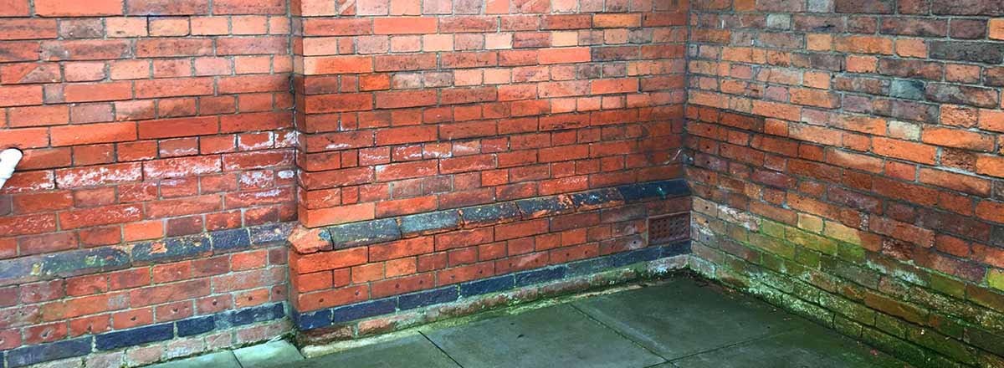
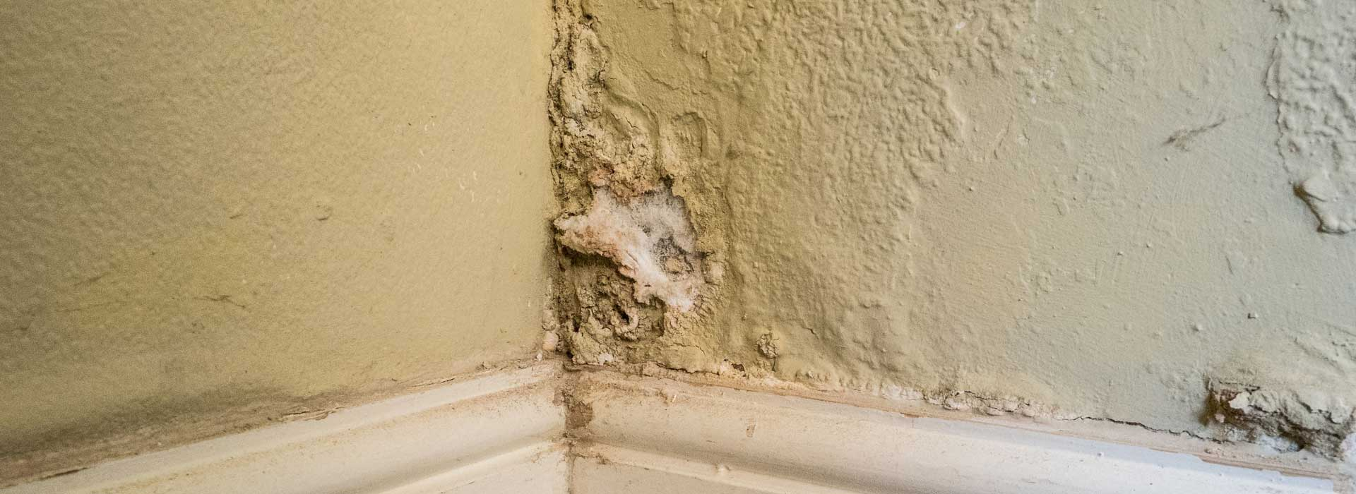
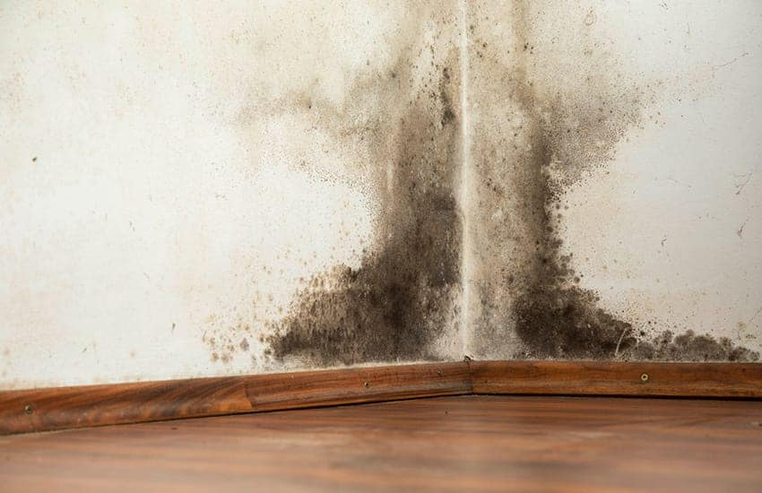
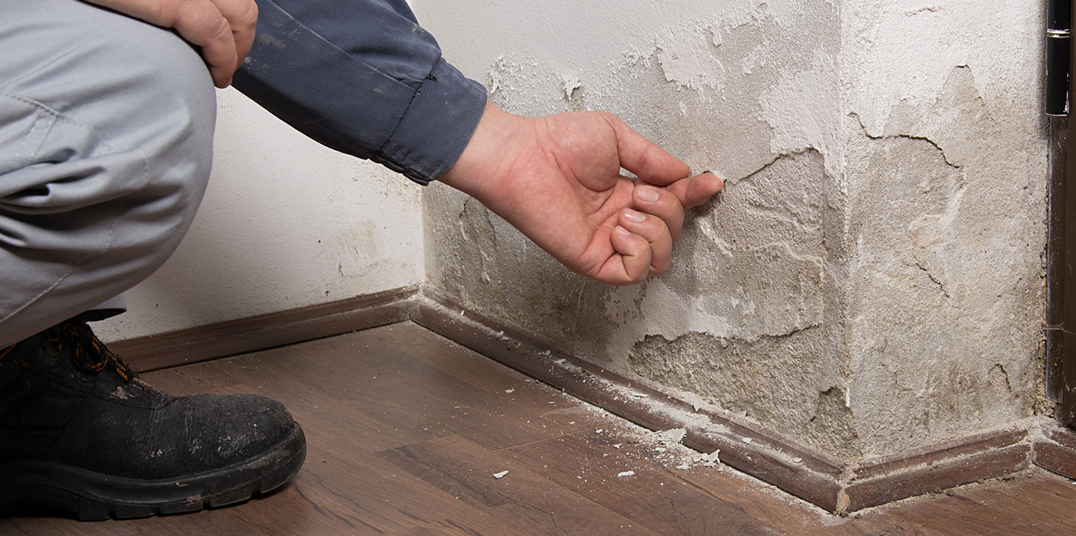
Evidence of damp
Sundirect (n.d.) Frameless infrared panel heater installed in a modern flat in Slovenia [online image]. Available at: https://www.sundirect-heater.com/frameless-infrared-panel-heater/ (Accessed: 15 June 2025).
ProTen Services (n.d.) Damp treatment in a residential property [online image]. Available at: https://protenservices.co.uk/damp/how-to-treat-damp/ (Accessed: 15 June 2025). Corksol (n.d.) A beginner’s guide to black spot mould – causes, problems and solutions A Beginner’s Guide to Black Spot Mould – Causes, Problems and Solutions - CorkSol UK (Accessed: 7 July 2025)

Slide 95
Rising damp: Signs to look for
  Damp patches or tide marks on lower walls
  Peeling paint or wallpaper
  Musty smell
How can it be managed?
  Use breathable materials like lime plaster instead of modern cement render.
  Improve drainage around the building to prevent water build-up.

Slide 96
Task: Identifying damp
In pairs, explore the educational building you are in now and see if you can identify any damp issues.
Take photos for evidence.
Return to the class and report back.

Slide 97
Condensation
  What is it?
  Caused by warm, moist air meeting a cold surface, leading to water droplets forming.
  Common in areas with poor ventilation, like kitchens and bathrooms.

Slide 98
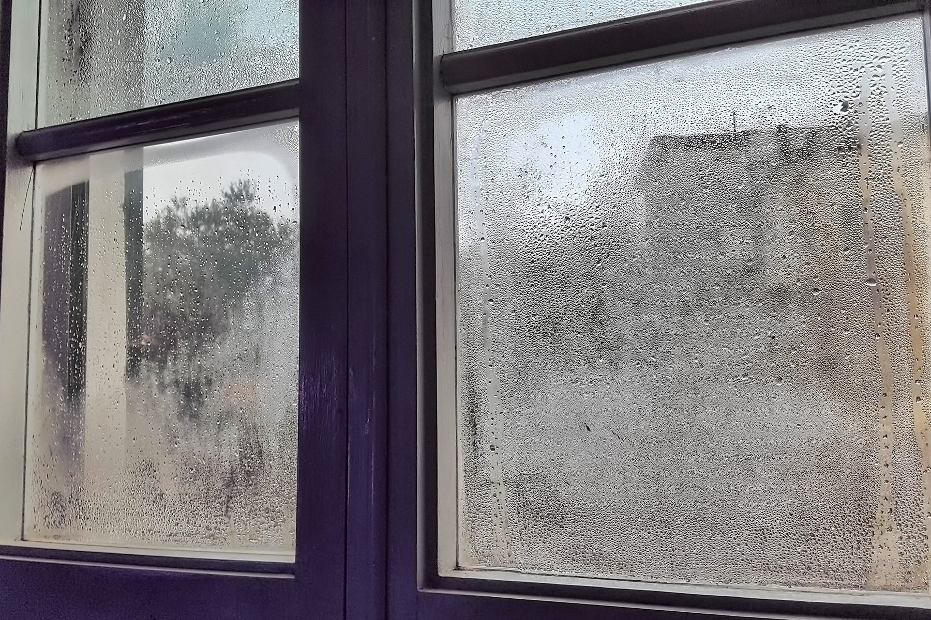
Condensation
Nottingham Post (2025) Expert shares best ways to prevent damp in your home. Available at: https://www.nottinghampost.com/news/uk-world-news/expert-shares-best-ways-prevent-9021843 (Accessed:
15 June 2025).

Slide 99
Condensation: Signs to look for
  Water droplets on windows or walls
  Mould growth (often black spots)
  Musty odours
How can it be managed?
  Improve ventilation: open windows, install trickle vents or use extractor fans.
  Avoid blocking air circulation with heavy curtains or furniture against walls.
  Maintain consistent indoor temperatures to reduce moisture build-up.

Slide 100
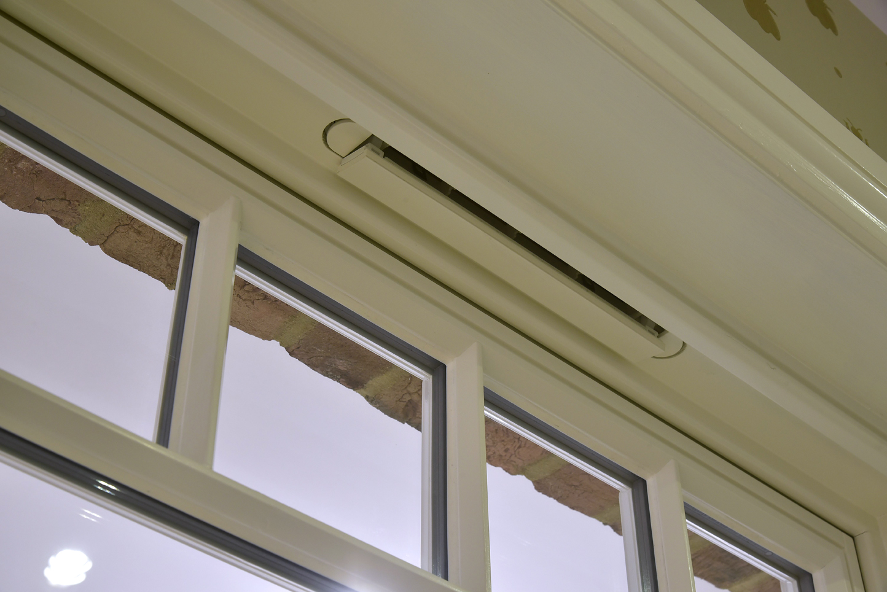
Vents
Dale Joinery (2022) What Is a Trickle Vent & How Do They Work? Available at: https://www.dalejoinery.co.uk/blog/posts/what-is-a-trickle-vent-how-do-they-work/ (Accessed: 15 June 2025).

Slide 101
Penetrating damp
  What is it?
  Water entering the building through cracks, leaks or porous walls.
  Caused by faulty gutters, roof damage or missing mortar.
  Signs to look for:
  Damp patches on walls and ceilings
  Staining or watermarks
  Moss or algae growth on external walls

Slide 102
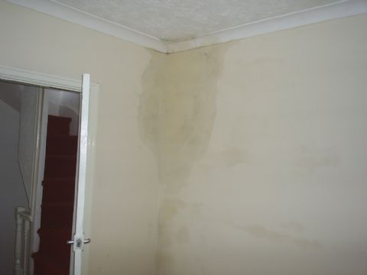
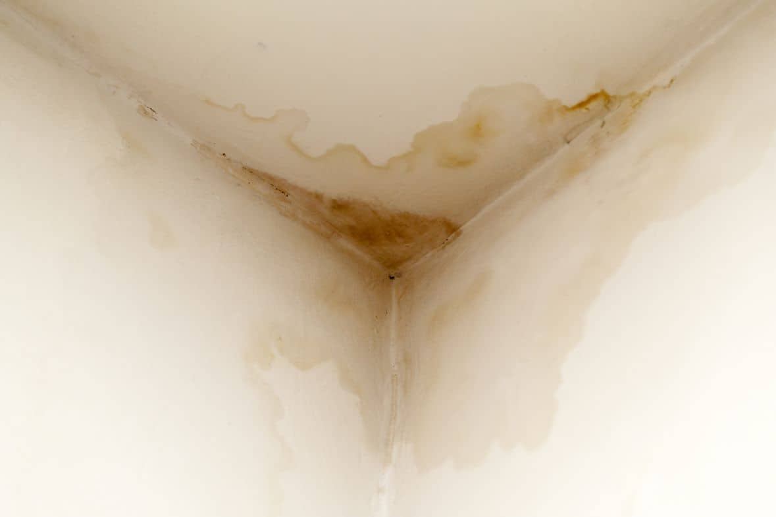
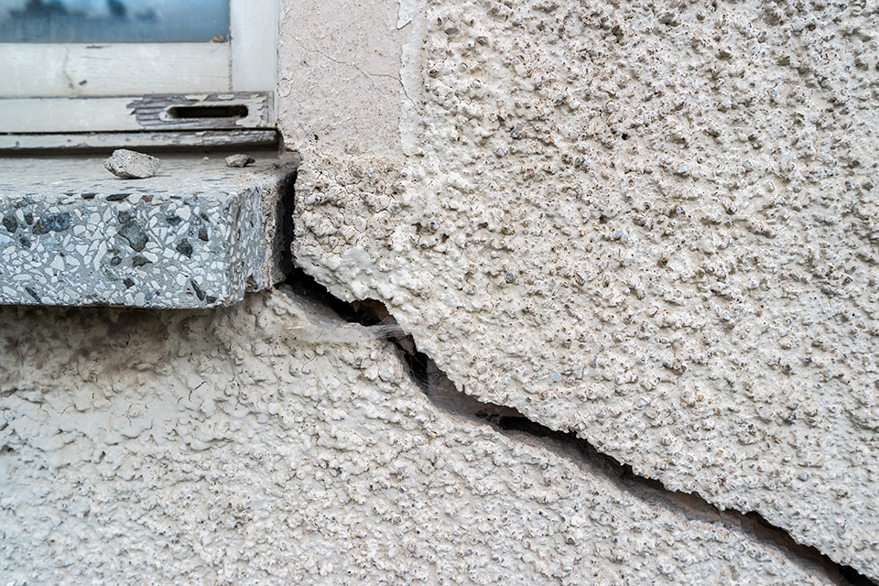
Damp and water ingress
Bramleys Estate Agents (2023) Is the damp in my rental property safe? Available at: https://www.bramleys.com/news/is-the-damp-in-my-rental-property-safe.html (Accessed: 15 June 2025).

Slide 103
How can it be managed?
  Repair damaged roofing, gutters and external walls.
  Use lime-based mortar instead of cement to
  maintain breathability.
  Improve drainage to redirect rainwater away from walls.

Slide 104
Why is damp a bigger issue in historic buildings?
Older buildings were built to ‘breathe’.
  Traditional materials like stone, lime and timber absorb and release moisture naturally.
  Modern materials like cement-based plasters and synthetic paints trap moisture, leading to decay.

Slide 105
Retrofits and damp
  Retrofits can make damp worse.
  Sealing up draughts and replacing old materials without considering ventilation can increase condensation and mould growth.
  Heritage conservation rules limit some damp treatments.
  Some damp-proofing methods (e.g. injected chemical DPCs) may not be allowed in listed buildings like Wish Hill.

Slide 106
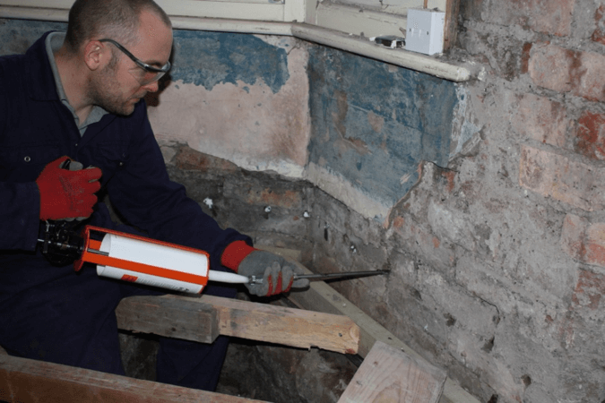
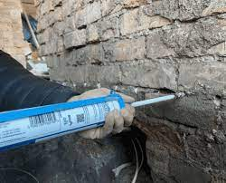
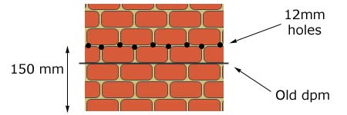
Repair measures
Keep It Cartesian (2024) How To DIY Chemical Injection Damp Proofing. Available at: https://www.keepitcartesian.com/how-to-diy-chemical-injection-damp-proofing/ (Accessed: 15 June 2025).

Slide 107
Task: Damp and Wish Hill
  In pairs, discuss and answer the questions. Revisit the Wish Hill case study and the Wish Hill interactive tour.
  Share your findings with class.

Slide 108
Discussion: Damp and Wish Hill
  What types of damp do you think are affecting Wish Hill? Why?
  Why might modern buildings have fewer damp problems than older buildings?
  How can we balance preserving historic features with effective damp management?

Slide 109
7
Sustainable water and drainage solutions

Slide 110
Lesson 7 overview
  Understand the importance of water efficiency in
  sustainable buildings.
  Identify drainage issues and water inefficiencies in Wish Hill.
  Learn about sustainable drainage systems (SuDS),
  rainwater harvesting and greywater recycling.
  Develop a water saving strategy for Wish Hill.
  Review ‘Greening the grey’ guide for retrofitting SUDS.

Slide 111
Importance of water efficiency (1)
  Why is water efficiency important?
  Reduces water wastage and conserves resources.
  Lowers environmental impact.
  Saves on water bills.
  How does it affect buildings?
  Increases sustainability.
  Ensures compliance with regulations.
  Reduces strain on drainage infrastructure.

Slide 112
Importance of water efficiency (2)
  Environmental benefits:
  Reduces strain on natural water sources.
  Lowers energy consumption from water treatment.
  Helps mitigate climate change.
Economic benefits:
  Lowers utility bills.
  Reduces infrastructure costs.
  Increases property value.

Slide 113
Importance of water efficiency (3)
Social benefits:
  Ensures long-term water supply.
  Promotes healthier living environments.
  Supports urban development.

Slide 114
How water efficiency affects buildings (1)
  Reduces water demand:
  low-flow taps and toilets
  greywater reuse and rainwater harvesting
  Minimises drainage and flood risks:
  SUDS (permeable surfaces, swales, green roofs)
  Prevents waterlogging and soil erosion.

Slide 115
How water efficiency affects buildings (2)
  Ensures compliance with regulations:
  Meets sustainability standards (e.g. BREEAM).
  Aligns with local and national regulations.
  Enhances sustainability:
  Smart water monitoring and leak detection.
  Reduces reliance on potable water.

Slide 116
Wish Hill case study: Key issues
Overview of the Wish Hill case study:
  Follow along with a review of the Wish Hill case study, identifying drainage issues and lack of water efficiency.
  Discuss the issues throughout.
Main challenges:
  poor stormwater management
  high surface run-off
  lack of water efficiency strategies

Slide 117
Further points to consider
Stormwater management issues:
  Existing drainage system overwhelmed during heavy rainfall.
  Blocked or inefficient drainage channels.
Erosion and infrastructure damage:
  Water accumulation weakens surfaces and foundations.
  Increases maintenance costs and safety concerns.

Slide 118
Water efficiency concerns in Wish Hill
  Excessive potable water use:
  No systems in place to reuse rainwater or greywater.
  High water bills and unnecessary consumption.
  Lack of sustainable water management:
  No rainwater harvesting or greywater recycling.
  Increased strain on local water resources.

Slide 119
What is sustainable drainage?
Sustainable drainage systems (SUDS) mimic natural processes to manage water effectively in the built environment.
  Why is sustainable drainage important?
  Reduces flood risk.
  Improves water quality.
  Enhances biodiversity.

Slide 120
Understanding sustainable drainage systems (SUDS)
  Key components of SUDS:
  Permeable surfaces: reduce run-off by allowing water to soak into the ground.
  Swales and detention basins, channels and ponds that slow water movement.

Slide 121
Green roofs and rain gardens:
Natural solutions to absorb rainwater
  How SUDS help:
  Prevent flooding.
  Reduce pressure on drainage systems.
  Support climate resilience.

Slide 122
Rainwater harvesting
  Definition:
The process of collecting and storing rainwater for later use.
  Common uses:
  irrigation
  toilet flushing
  industrial processes

Slide 123
Benefits of rainwater harvesting
  Reduces demand for mains water.
  Lowers water bills.
  Increases sustainability.

Slide 124
Types of rainwater harvesting systems
  Direct storage tanks: collect and store rainwater for outdoor/indoor use.
  Rain barrels: simple, low-cost solution for gardens.
  Underground cisterns: large-scale storage for commercial buildings.
  Key considerations:
  Filtration and purification needed for drinking use.
  System size depends on demand and rainfall levels.

Slide 125
Greywater recycling
  Definition:
Greywater is lightly used water from sinks, showers and washing machines that can be recycled.
  How it works:
  Collected from household appliances.
  Filtered and treated.
  Reused for non-potable purposes
  (e.g. irrigation, toilet flushing).

Slide 126
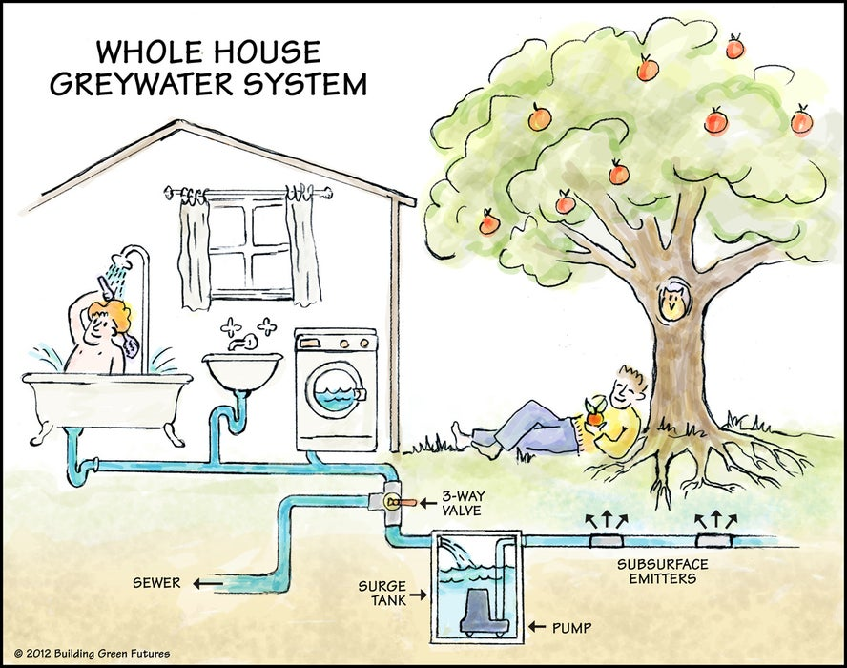
How greywater systems work
Will Anderson (n.d.) Grey Water Guide & Simple System. Available at: https://www.instructables.com/Grey-Water-Guide-Simple-System/ (Accessed: 15 June 2025).

Slide 127
Benefits of greywater recycling
  Environmental benefits:
  Reduces demand for freshwater.
  Lowers wastewater discharge.
  Economic benefits:
  Cuts water bills.
  Reduces strain on public water systems.
  Building benefits:
  Increases efficiency in green buildings.
  Supports sustainability certifications (BREEAM).

Slide 128
Task: SUDS
  In small groups, discuss how SUDS can improve drainage.
  Share ideas about SUDS with the whole class.

Slide 129
Task: Water management
Work in pairs to create a feasible water saving plan.
Use the Water Management plan worksheet
(producing one completed copy per pair).
Hand in completed worksheets.

Slide 130
Review of ‘Greening the grey’
In your pairs, review the ‘Greening the grey’ online document.
Look at the various case studies and note the different
methods for retrofitting SUDs.
Join in a class discussion and debate the pros and cons of different strategies to improve drainage without major structural changes.

Slide 131
Next steps
In the next lesson, we will explore the regulations, policies and legal requirements that influence retrofit in heritage buildings.

Slide 132
8
Planning, policy and legal considerations

Slide 133
Introduction: Planning constraints for listed buildings
  Lesson overview:
  Planning constraints for listed buildings
  Applying for retrofit planning permission
  Government incentives and grants
Starter task: 10-minute recap quiz based on lesson 7. (You will be doing this on a handout).

Slide 134
Key facts about listed buildings
Legal protection: owners must obtain listed building consent before making alterations, extensions or demolitions.
Grading system:
  Grade I: buildings of exceptional national importance
  (e.g. Buckingham Palace).
  Grade II*: buildings of more than special interest
  (e.g. significant churches or manor houses).
  Grade II: buildings of special interest, making up around 92% of all listed buildings.

Slide 135
More key facts about listed buildings
Typical buildings:
Castles, churches, historic houses, bridges,
war memorials and even some modern buildings.
Why are they listed?
To protect heritage, maintain architectural beauty and ensure future generations can appreciate them.

Slide 136
Balancing heritage preservation and sustainability
Balancing heritage preservation with sustainability is crucial to maintaining historical integrity while adapting buildings for modern needs.

Slide 137
Protecting cultural identity and history
  Historic buildings tell the story of a place, community and era.
  Preserving them maintains architectural character and craftsmanship.
  Helps sustain a sense of place and local identity.

Slide 138
Environmental sustainability
  Retrofitting existing buildings reduces demolition waste and carbon footprint.
  Energy-efficient upgrades (e.g. insulation, secondary glazing, renewable heating) improve sustainability without harming the original structure.
  Protecting older buildings prevents the environmental cost of new construction.

Slide 139
Economic and tourism benefits
  Well-maintained heritage sites attract tourists and investment.
  Restoring listed buildings boosts property values and supports local economies.
  Government grants and incentives help fund sustainable retrofits.

Slide 140
Legal and planning compliance
  Listed buildings require Listed Building Consent
  before alterations.
  Conservation officers ensure modern upgrades
  (e.g. solar panels, heat pumps) are installed sensitively.
  Using traditional materials alongside sustainable solutions helps maintain historical aesthetics.

Slide 141
Future-proofing for generations
  Combining heritage protection with green technology ensures buildings remain functional and resilient.
  Encourages innovation in low-carbon retrofitting methods.
  Supports long-term energy efficiency without compromising historical significance.

Slide 142
Conclusion
  Preserving heritage while implementing sustainable improvements allows buildings to remain:
  culturally significant
  environmentally responsible
  economically valuable for future generations.
For further reading, check Historic England’s listed building consent advice.

Slide 143
Task: Listed consent flashcards
  Split into two groups and sort the listed consent flashcards into categories:
  Requires listed consent
  Does not require consent
  When complete, swap tables and review the other group’s cards using the answer sheet.

Slide 144
9
Developing retrofit
solutions and proposals

Slide 145
Lesson 9 overview
  Understand how to write a retrofit report using case studies and structured writing techniques.
  Identify and categorise retrofit measures: low, shallow
  and deep.
  Analyse how sustainability is embedded in design solutions.
  Explore social, economic, environmental and human impacts of retrofit work.
  Understand heritage and conservation principles in
  retrofit projects.

Slide 146
Quick recap quiz (1 of 2)
Which of the following is a shallow retrofit measure?
A. loft insulation
B. full wall rebuild
C. double glazing
D. installing solar PV

Slide 147
Answer 1
A. loft insulation

Slide 148
Quick recap quiz (2 of 2)
What is one benefit of a deep retrofit approach?
A. lower upfront cost
B. less disruption
C. long-term energy savings
D. no need for planning permission

Slide 149
Answer 2
C. long-term energy savings

Slide 150
What makes a good retrofit report?
  Key points:
  Clear structure with subheadings
  Use of technical language
  Relevant costings and benefits
  Visuals: diagrams, graphs and photos
  Reference to sustainability impacts

Slide 151
Example structure for your final report
  Sections to include:
  Introduction to property and context
  Identified issues and goals
  Retrofit measures proposed (with categories)
  Cost comparisons
  Sustainability considerations
  Summary and recommendations

Slide 152
Understanding retrofit measures
Low vs shallow vs deep measures
Measure | Category | Example
Draught-proofing | Low | Door seal strips
Loft insulation | Shallow | 270mm roll
External wall insulation | Deep | Full external cladding
Notes:
Alternative text: a table with three columns labelled "Measure," "Category," and "Example." The rows provide details on different types of insulation measures. The first row lists "Draught-proofing" under Measure, "Low" under Category, and "Door seal strips" under Example. The second row lists "Loft insulation" under Measure, "Shallow" under Category, and "270mm roll" under Example. The third row lists "External wall insulation" under Measure, "Deep" under Category, and "Full external cladding" under Example.

Slide 153
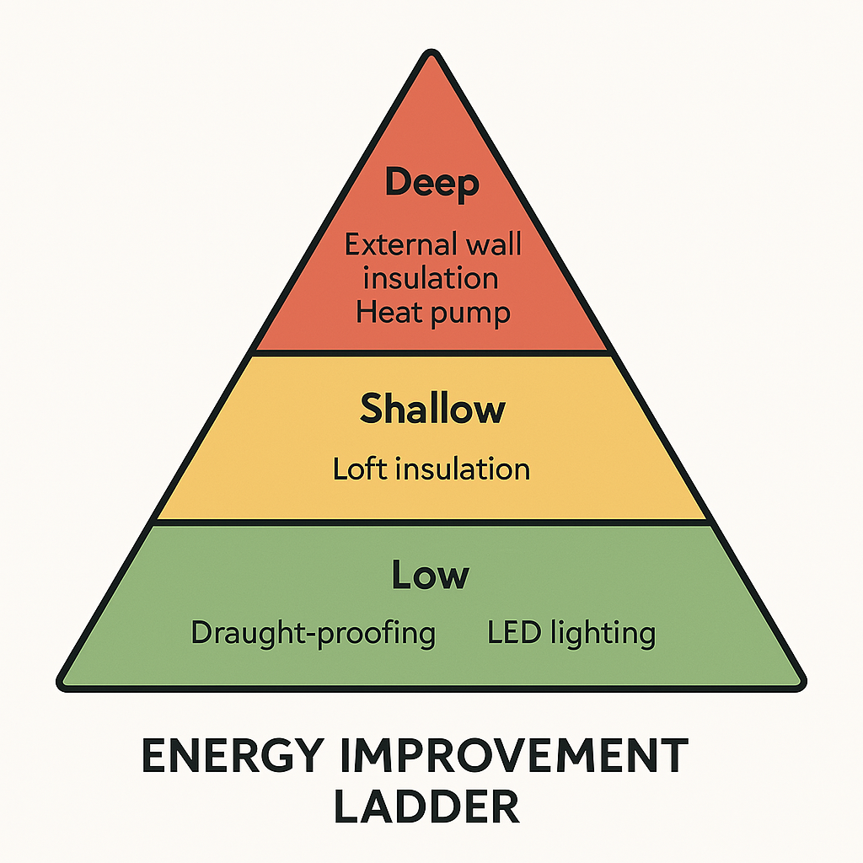
Energy improvement ladder
HCCSP (n.d.) Retrofitting your house guide [PDF]. Available at: https://www.hccsp.org.uk/media/documents/hccsp-retrofitting-your-house-guide.pdf (Accessed: 15 June 2025).

Slide 154
Group task: Introduction
Your task is to analyse the retrofit case studies you looked at for homework and, in groups:
  identify key parts of the report
  use the guiding questions below to explore the content.
      How is sustainability considered?
      Is the report clear and well structured?
      What kind of measures are proposed?

Slide 155
Group task questions
  What sections are used in the report?
  What vocabulary is used to describe sustainability?
  Are costs and benefits clearly explained?
  What measures are proposed and why?

Slide 156
Group feedback discussion
What makes an effective retrofit report?
  Prompted questions:
  Which reports stood out and why?
  What features help the reader understand the proposals?
  What was missing or unclear?

Slide 157
Task: Sorting retrofit measures
  In pairs/small groups, sort the cards into categories:
  Low cost
  Shallow retrofit
  Deep retrofit
Use your knowledge to justify your answers.

Slide 158
Peer review instructions
  Compare and check:
  Join with another pair/group.
  Compare your sorting results.
  Use the answer sheet to check accuracy.
  Discuss any differences.

Slide 159
Summarising the categories
Category | Cost | Impact | Examples
Low | £ | Basic comfort | Draught-proofing
Shallow | ££ | Mid-level upgrades | Loft insulation
Deep | £££ | Whole-home retrofit | ASHP, external wall insulation
Notes:
Alternative text: a table categorising home improvement measures by cost, impact, and examples. The table has four columns: Category, Cost, Impact, and Examples. The rows are divided into three categories: Low, Shallow, and Deep.
Low category: Cost is £, provides basic comfort, example is draught-proofing.
Shallow category: Cost is ££, provides mid-level upgrades, example is loft insulation.
Deep category: Cost is £££, provides whole-home retrofit, examples are ASHP (Air Source Heat Pump) and external wall insulation.

Slide 160
Heritage and conservation in retrofit
  Key points:
  Sensitive design required in listed buildings.
  Use of traditional materials where appropriate.
  Balancing modern sustainability with historic fabric.

Slide 161
Exit questions / reflection
  What is one new thing you have learnt today?
  What is one question you still have?

Slide 162
10
Proposals, recommendations and reflections

Slide 163
Quick recap
  What retrofit measures did we look at last lesson?
  How do these measures link to:
    sustainability?
    building performance?
  What challenges might we face when applying these?

Slide 164
Live document: Retrofit proposal
Let’s view the Retrofit proposal template.
We will focus on one case study together.
  Sections 1 to 4:
  Case study summary
  Key data and context
  Sustainability goals
  Existing building conditions

Slide 165
Group task: Identifying issues
  In your group, discuss:
  environmental concerns
  social factors
  economic impact
  human/user needs
  heritage or conservation challenges.
Use sticky notes to gather your ideas.

Slide 166
Group task (continued)
  Each group gets one section:
  Retrofit measures
  Impact assessment
  Sustainability link
  Risks and limitations
Work together to write your section in the live document.
Use clear report-style language and subject-specific vocabulary.

Slide 167
Group presentations: Peer feedback
  Present your section to the class.
  Give and receive constructive feedback:
  Is it clear?
  Does it meet the brief?
  Could any improvements be made?

Slide 168
Improve your work
  Return to your section and:
  edit it based on the peer feedback you have received.
  check spelling, clarity and use of key terms.

Slide 169
Summary and recommendations
  Think about the following:
  What did we propose?
  Why are these the best solutions?
  How do they address the key issues?
  Final recommendations?
  Work together and help complete the final section.

Slide 170
Self-reflection (sticky notes)
  Use your sticky notes:
  Pink: something new I have learnt.
  Green: something I did well.
  Yellow: something I would like to improve.
Be honest – this helps your progress!
Notes:
Teacher guidance: please update this slide if your sticky notes are different to the colours above

Slide 171
Final thoughts
  Share some of your reflections.
  You have:
  understood sustainability and conservation principles
  interpreted data and applied solutions
  created a full retrofit proposal using teamwork and research.
Well done!

Slide 172


Acknowledgements
PRODUCED BY
FUNDED BY
East Sussex College Group has produced this resource on behalf of the Education and Training Foundation
This programme is funded by the Department for Education
ET-FOUNDATION.CO.UK

