Slide 1
T LEVEL IN CRAFT AND DESIGN
Support holistic delivery of Core Content and Occupational Specialism content

Slide 2
1
Review, refine and reject ideas

Slide 3
Starter task: self-evaluation
Individually, complete self-evaluation.

Slide 4
Questions
What is a client brief?
What needs to be considered when reviewing client requirements in a brief against a proposed solution?

Slide 5
Client brief: printed shirt
  Design a shirt for daily wear
  Unisex style
  Suitable for warm climates
  Include a printed design inspired by the 1980s

Slide 6
Client brief: printed shirt outcome
  Shirt made of polyester
  Zipped closure
  Designed for mass market
  Black colour
  Frill collar detail

Slide 7
Meeting client brief requirements
  Group one: Design a shirt for daily wear
  Group two: Unisex style
  Group three: Suitable for warm climates
  Group four: Include a printed design inspired by the 1980s

Slide 8
Activewear client brief
Individually, read the information provided about the client requirements and propose a solution.
In pairs, evaluate how well the solution meets the requirements of the client brief.

Slide 9
Review, refine and reject
Review
Refine
Reject

Slide 10
Review score
3 = All requirements met
2 = Some requirements met
1 = No requirements met

Slide 11
Exam-style question
A client requests a design for trousers for teenagers. The trouser design needs to be unisex. The solution offered by the designer is a pair of cargo trousers.
Question
Explain how cargo trousers meet the unisex customer requirement.

Slide 12
Sample answer
Cargo trousers meet the unisex customer requirement because they are versatile and fit all body shapes as they are one standard design and suitable for either gender.
They have a functional design and are associated with the army for physical tasks, so people buying cargo trousers associate the design with the army rather than a specific gender.

Slide 13
Next steps: client brief checking criteria
Produce criteria which could be used to check if the requirements of a client brief have been successfully met.

Slide 14
2
Evaluative skills and reviewing concepts

Slide 15
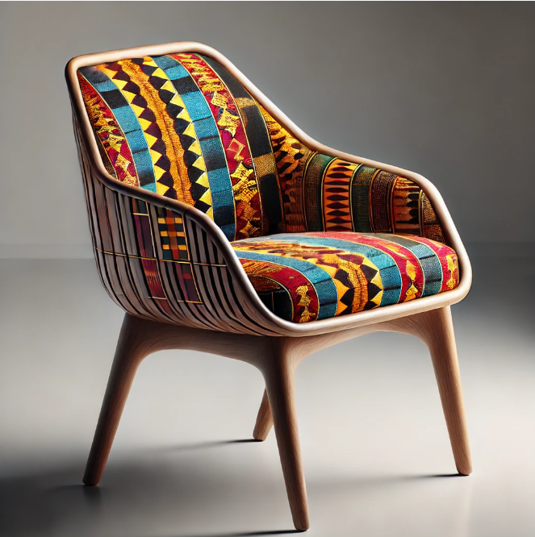
Starter task: chair
Who is the chair designed for?
What features support your answer?
Image: ChatGPT

Slide 16
Who is the chair designed for?
People who appreciate cultural heritage: The use of Kente cloth (Ghanaian textile) suggests a connection to African culture, making it appealing to those who value tradition and storytelling through textiles.
Collectors or art enthusiasts: The chair has a modern design combined with a traditional textile, which may attract individuals who enjoy unique statement furniture pieces.

Slide 17
Who is the chair designed for (continued)?
A high-end or boutique market: The craftsmanship and design suggest it may be a luxury or designer piece, targeting people who invest in exclusive, culturally rich decor.
Educational or museum spaces: The chair could be part of a museum exhibit or cultural institution showcasing African textiles and craftsmanship.

Slide 18
What features support your answer?
Cultural textile (Kente cloth): The vibrant geometric pattern represents African heritage, often linked to royalty, history and storytelling.
Modern, minimalist frame: The sleek, curved wooden frame suggests a contemporary style, making it a fusion of traditional and modern design.

Slide 19
Success criteria list
  Adherence to the client brief
  Functionality and practicality
  Material choice
  Design aesthetics
  Fit and comfort
  Innovation and creativity
  Sustainability and ethical considerations
  Market appropriateness
  Ease of manufacture
  Branding and identity

Slide 20
Alexander McQueen: Plato’s Atlantis
Individually, read the Design brief and concept handout.
In pairs, research on the internet images of Alexander McQueen’s Spring/Summer Plato’s Atlantis designs.
Score the designs.

Slide 21
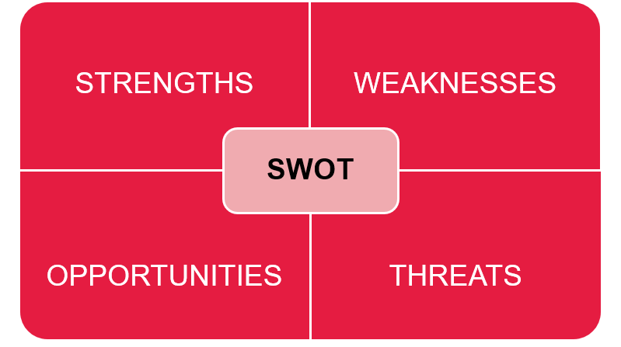
SWOT analysis

Slide 22
SWOT analysis: fashion brands
  Strengths: What makes the fashion brand strong?
  Weaknesses: What limitations could hold it back?
  Opportunities: What market trends or innovations could help?
  Threats: What external challenges does it face?

Slide 23
Plenary design brief
Individually, read the design brief provided – Yves Saint Laurent’s Mondrian dress.
Individually, evaluate the concept against the design brief.
Complete a SWOT analysis.

Slide 24
Next steps: inclusivity
Research the term inclusivity and think about what it means to you?

Slide 25
3
Inclusive designs

Slide 26
Starter task: inclusivity
What does inclusivity mean to you?
Individually, write three words that you think represent inclusivity on the collaborative wall.

Slide 27
What does inclusivity mean in design?
Inclusivity in design means creating products, spaces or experiences that are accessible, respectful and suitable for _______________, regardless of their _______________, _______________ or _______________.
It involves considering different needs, such as _______________, _______________ and _______________, to ensure no one is excluded.

Slide 28
Answer
What does inclusivity mean in design?
Inclusivity in design means creating products, spaces or experiences that are accessible, respectful and suitable for everyone, regardless of their age, gender or background.
It involves considering different needs, such as language, mobility and neurodiversity, to ensure no one is excluded.

Slide 29
What is equality, diversity and inclusion (EDI)?
  Equality: ensuring everyone has equal access and opportunities
  Diversity: representing and respecting a wide range of identities
  Inclusion: creating spaces and products that make all people feel welcome

Slide 30
Why EDI matters in design
  Designs can unintentionally exclude certain groups.
  Inclusive products build trust and belonging.
  Brands that reflect their audience tend to perform better.
  Good design considers race, gender, ability, culture and so much more.

Slide 31
Fashion
Inclusivity considerations when designing fashion:
Fit and comfort example
Works for different body shapes and sizes
Cultural awareness example
Respects different styles, dress codes and traditions
Accessibility example
Easy to put on, take off and move in

Slide 32
Task: college hoodie brief
A college is reviewing a promotional hoodie designed for a college open day. The hoodie should promote the college and appeal to a wide range of learners.
Critically evaluate how inclusive and appropriate the concept is for the college open day.
Complete the inclusivity review worksheet.

Slide 33
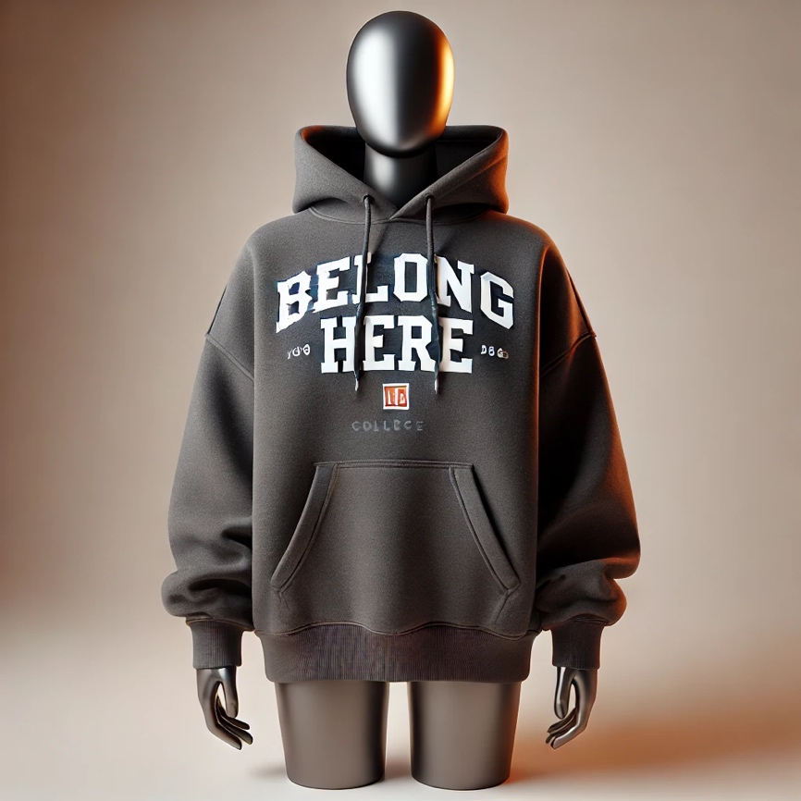
College hoodie one
Image: ChatGPT

Slide 34
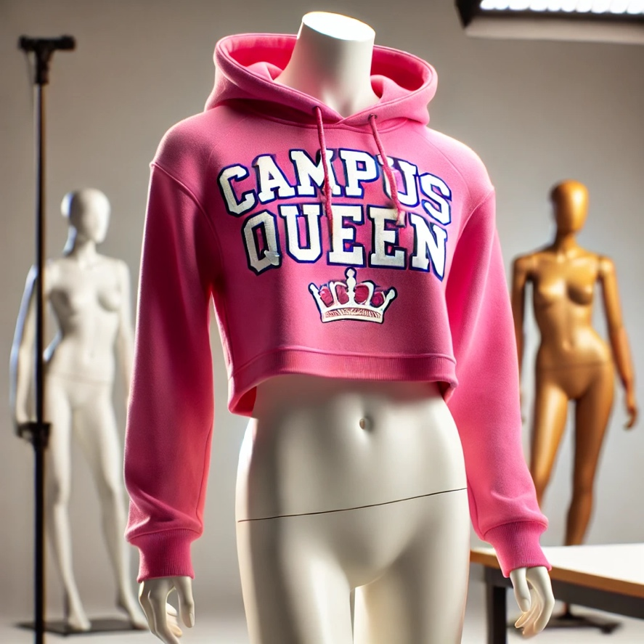
College hoodie two
Image: ChatGPT

Slide 35
Ceramics
Inclusivity considerations when designing ceramics:
Ergonomics example
Easy to hold and use for people with different strengths or mobility
Cultural sensitivity example
Inspired by cultures with respect – not copied
Sensory accessibility example
Comfortable textures, not too shiny or overwhelming

Slide 36
Jewellery
Inclusivity considerations when designing jewellery:
Accessibility example
Easy to fasten, wear and adjust for all abilities
Cultural identity example
Designs that respect and reflect different cultures
Sensory needs example
Soft textures, no irritating or noisy parts

Slide 37
Textiles or print
Inclusivity considerations when designing textiles/print:
Visual clarity example
High contrast, clear patterns, not overstimulating
Cultural relevance example
Inspired by cultures, respectfully
Positive messaging example
Prints that uplift or reflect diverse voices

Slide 38
Furniture
Inclusivity considerations when designing furniture:
Accessibility example
Easy to use, move and sit on for all bodies
Cultural and social use example
Works for different ways people sit, gather or connect
Sensory needs example
Soft edges, calming colours, comfortable textures

Slide 39
Inclusivity task
Complete the inclusivity review handout.
Note key points on the flipchart.
As a group, present the overview of the design, details on how inclusive it is and recommendations for improvement.

Slide 40
Plenary task: learner personas
Complete the questions in the learner personas handout.

Slide 41
Next steps: review of jewellery
Evaluate whether an item of jewellery is inclusive.
Complete the inclusivity checklist. Tick off each question as you reflect on how well it considers different people’s needs, identities and experiences.

Slide 42
4
Consolidating skills

Slide 43
Recap: what makes a strong design brief?
  Clear purpose and goals
  Well-defined target audience
  Inclusive and respectful language
  Clear deliverables and timelines
  Realistic constraints (e.g. budget, time)
  Appropriate tone of voice

Slide 44
Recap: why does a clear and inclusive brief matter?
  Ensures everyone understands the project aims
  Helps creative teams meet expectations
  Reflects and respects diverse audiences
  Encourages ethical and thoughtful design
  Sets up a successful and impactful outcome

Slide 45
What is clarity?
  The quality of being clear, easy to understand and free from confusion or ambiguity.
  Clarity helps ensure a message is communicated effectively and the audience can easily grasp the meaning.

Slide 46
Clarity in design
  Clarity in design briefs is essential for ensuring that creative work meets the intended goals, stays on track and satisfies both clients and creators.
  Clarity:
  saves time and resources
  guides creativity
  aligns teams and stakeholders
  ensures relevance
  helps measure success.

Slide 47
Clarity in user experience and understanding
  What is clarity? It ensures information is easy to understand and navigate.
  Why does clarity matter? It reduces confusion and improves user satisfaction.
  How is clarity achieved? Simplify visuals, maintain consistency and use clear messaging.

Slide 48
Clarity in design principles
  What is clarity? It makes visual content clear and easy to understand.
  Why does clarity matter? It enhances communication and user engagement.
  How is clarity achieved? Use hierarchy, consistency, and whitespace effectively.

Slide 49
Script writing task
Part one
Read through the youth mental health campaign.
Produce a script promoting mental health awareness among young people aged 14–19.
Part two
Peer-review script for clarity and inclusivity.
Provide feedback to peer.

Slide 50
How to record a voiceover presentation
  Identify key information: focus on the main message and eliminate unnecessary details.
  Organise content: structure information logically using headings, bullet points and white space.
  Keep it simple: use straightforward language and avoid jargon to maintain clarity and engagement.

Slide 51
How to record a voiceover presentation (continued)
  Open presentation software (e.g. PowerPoint).
  Navigate to the recording or slideshow tab, and select the “record” or “narrate” option.
  Speak clearly and maintain a steady pace, recording each slide individually if possible.
  Export the presentation as a video file (e.g. MP4) with the voiceover included.

Slide 52
Voiceover task
With a peer, plan a voiceover presentation which demonstrates how to sew a button on material.
Record a voiceover.

Slide 53
Peer-review voiceover
Peer-review voiceover presentation for inclusivity, clarity and effectiveness.

Slide 54
Summary
Define your purpose: know what you want to say and why.
Simplify language: use clear, concise words and avoid jargon.
Organise ideas logically: structure information in a logical flow.
Seek feedback: ask others if your message is clear to them.
Take a step back: review with fresh eyes to spot confusion or overload.

Slide 55
Next steps: updated voiceover presentation
In pairs, produce an updated voiceover presentation which demonstrates how to sew a button on material and takes account of feedback.
Self-review the presentation.

Slide 56
5
Applying evaluative skills

Slide 57
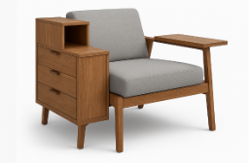
Starter task: product 1
Image: ChatGPT

Slide 58
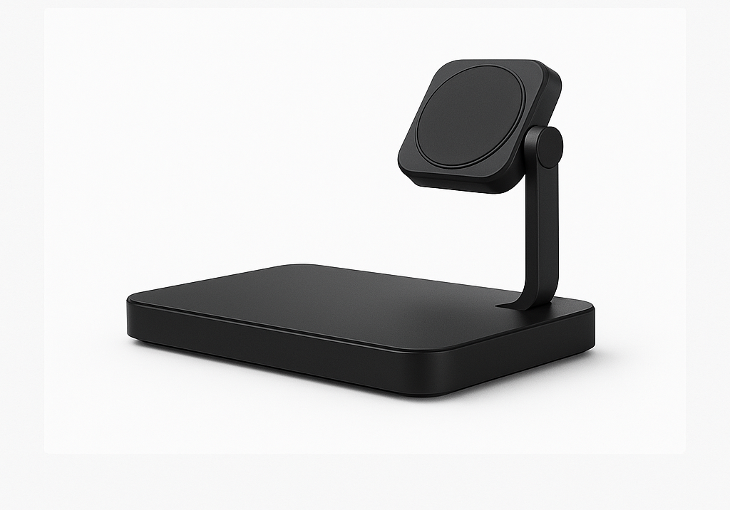
Starter task: product 2
Image: ChatGPT

Slide 59
Interpretation and bias
Interpretation in design means examining a product’s features, like shape, materials, and style, to understand its purpose, function and the audience it was made for.
Bias in design is when personal preferences, assumptions or stereotypes influence how a product is created or judged rather than focusing on the needs of the intended user.

Slide 60
Types of evaluation
Analytical evaluation involves breaking down a product into specific parts, such as function, materials, usability and aesthetics, to judge how well each aspect meets the design requirements.
Comparative evaluation means assessing two or more products side by side to judge which one better meets specific criteria, such as sustainability, usability or appeal to the target audience.

Slide 61
Types of evaluation (continued)
Critical evaluation involves making a well-reasoned judgement about a product by considering its strengths, weaknesses and the trade-offs made, often questioning whether it truly meets the needs of the user or the brief.

Slide 62
Key terms
Sustainability: how environmentally responsible is the product?
Usability: how well does it function for the user?
Audience appropriateness: does it suit the intended user?

Slide 63
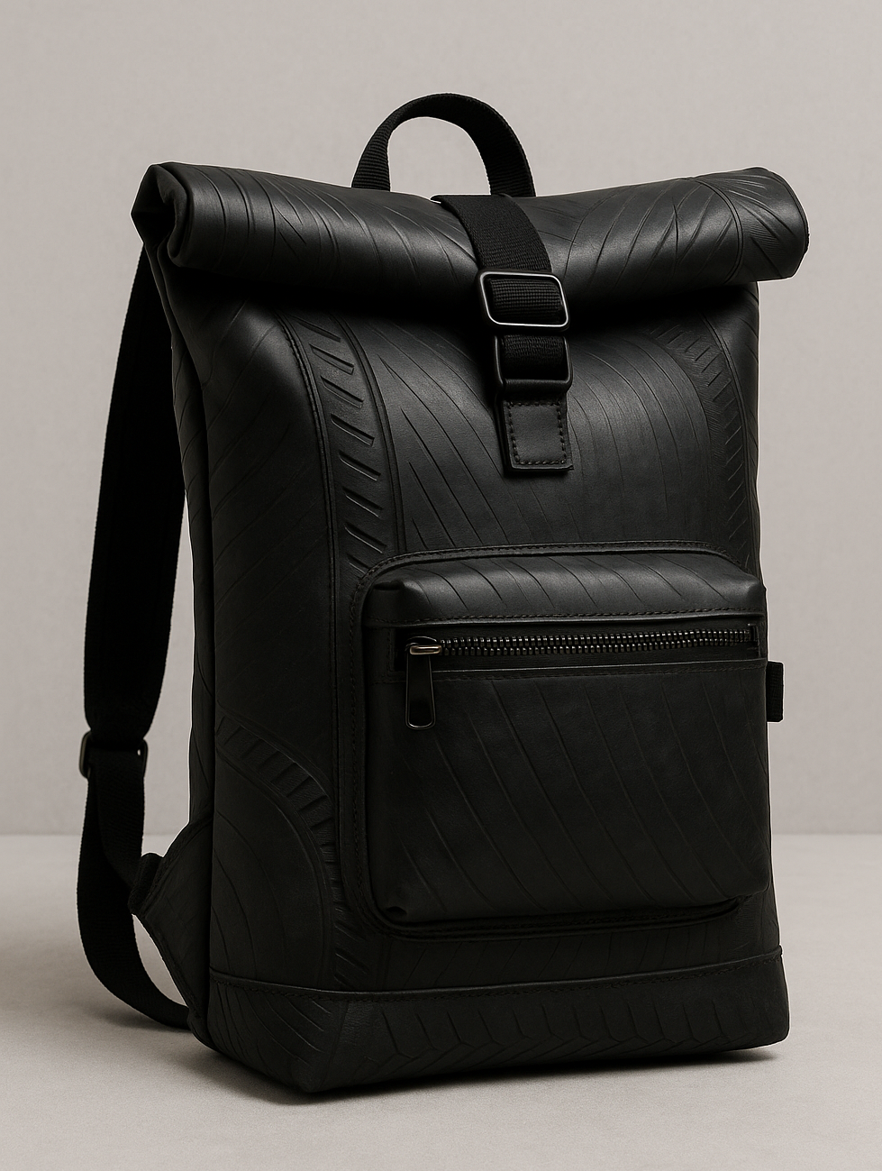
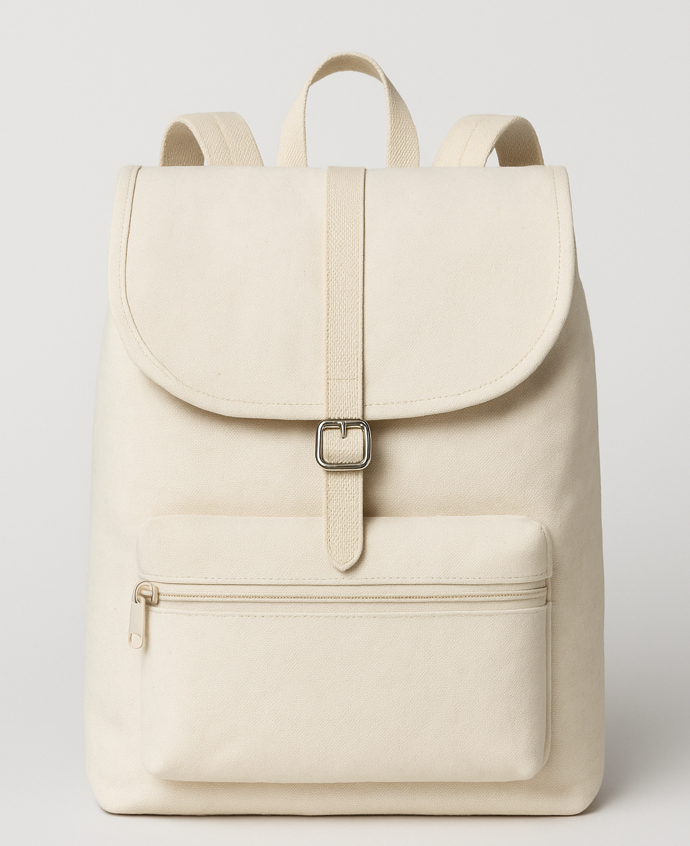
Comparative evaluation task
Recycled tyre backpack
Organic cotton canvas backpack
Images: ChatGPT

Slide 64
Comparisons
  Made from upcycled rubber tyres
  Heavy and less breathable, niche appeal
  Waterproof, durable, edgy urban style
  Emphasises waste reduction and circular economy
Made from certified organic materials
Lightweight, minimal design, biodegradable
Not waterproof, less durable long-term
Emphasises renewable resources and natural feel

Slide 65
Evaluation guidance
  Analytical: break down each product by sustainability, tech integration, comfort, aesthetics and cost.
  Comparative: discuss how well each product matches the requirements of the brief, using direct comparison (e.g. tech vs material sustainability).
  Critical: consider real-world trade-offs.
    Which features are worth prioritising for the audience and brand? What could be improved or combined?

Slide 66
Plenary task
What was the most important judgement your group made and why?
Which evaluation method (analytical, comparative or critical) did you find hardest to apply?
Did your group change its mind about a concept during discussion? What influenced the change?
If you could redesign one part of either product, what would it be and why?

Slide 67
Next steps: design review
Review your design work and choose two key design decisions you made.
Explain how each decision links to the client brief and meets the needs of your target audience.
Share your explanations with a peer.
Get feedback on how clearly your design communicates the intended message and where it could be improved.

Slide 68
6
Using feedback to refine designs

Slide 69
Starter task: constructive feedback
What makes feedback constructive?

Slide 70
Feedback in design
  Feedback plays a critical role in the design process because it helps designers view their work from different perspectives.
  Constructive feedback identifies areas that may not meet the needs of the client or user and offers suggestions for improvement.
  It encourages reflection and refinement and, ultimately, leads to more effective, inclusive and purposeful design outcomes.

Slide 71
Three-part feedback model
Positive comment: highlight one aspect of the work that is effective or well-executed.
Area for improvement: identify a specific element that could be refined or enhanced.
Specific suggestion: provide a clear, actionable recommendation to address the identified area for improvement.

Slide 72
Question
What makes feedback helpful to the designer?

Slide 73
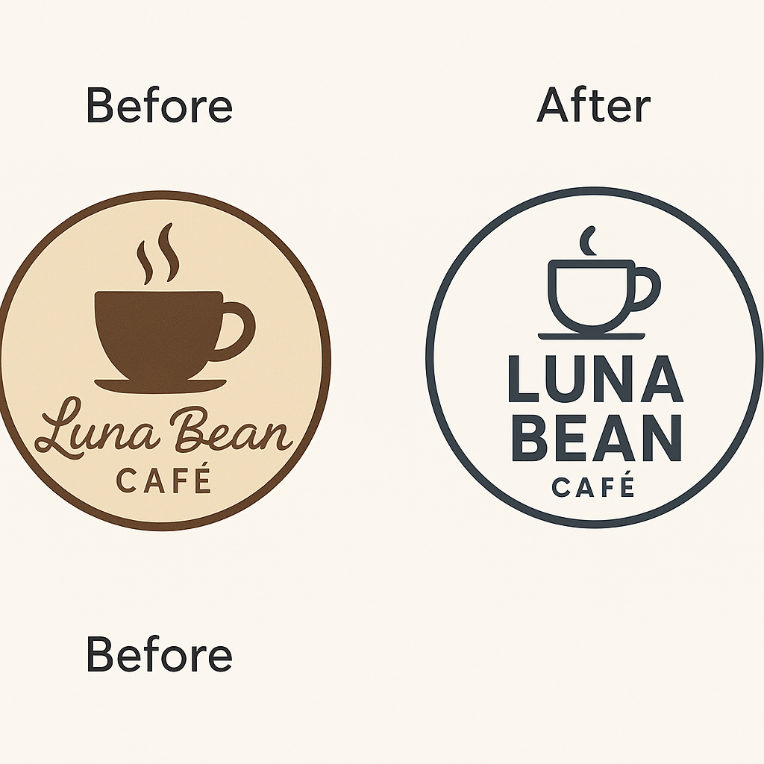
Task: Luna Bean Café
Image: ChatGPT
Before
After

Slide 74

Task: travel magazine
Client brief:
  travel magazine cover
  a vibrant and adventurous cover targeting young adult travellers.
Image: ChatGPT

Slide 75
Task: The Good Earth Skincare brief
Complete the structured feedback form using the three-part feedback model.
Complete the refinement document using the analysis in the structured feedback form.

Slide 76
Peer review
In pairs, swap feedback forms.
Use the three-part feedback model to review the refined The Good Earth Skincare product.
Provide feedback to peer.
Update the refined product based on feedback.

Slide 77
Plenary task: reflective discussion
What was the best feedback you heard today? And why?

Slide 78
Next steps: iterative review
Review: look at an existing design and consider how well it reflects the brand’s message.
Feedback: use the three-part feedback model to give constructive feedback – what works, what needs improving and a clear suggestion.
Refine: choose one design and suggest one change to better align it with the brand.

Slide 79
7
Demographic and geographic considerations in design

Slide 80
Starter task: furniture design
1. Discuss how furniture design might change for different groups. Consider:
    children
    elderly users
    urban commuters
    people in rural or remote areas.
2. Share ideas as a class.

Slide 81
Demographics meaning
What is the meaning of demographics?

Slide 82
Demographics
Age Gender identity Sexual orientation Race Culture Career Religion Education level | Family size Disposable income Interests and leisure time Disability and impairment

Slide 83
Task: user profile
Analyse user profile needs based on demographics.
Write a design rationale to include:
    the design
    reasons for your choice.

Slide 84
Task: design proposal presentation
Present your written design proposal to a peer.
Give feedback to peer using feedback stems:
      “This suits the person because...”
      “Have you considered...?”
      “You could add...”
      “It works well for that environment because...”
Make changes based on feedback.

Slide 85
Constructive feedback
  Focus on improvement.
  Be specific and actionable.
  Be positive, respectful, empathetic and supportive.
  Use observations or facts.
  Be clear and concise.
  Ensure timely feedback.
  Provide a balanced perspective.

Slide 86
Feedback examples
  Constructive criticism
    While your design had some good points, it could be improved. For example, the logo was effective but dominated the design owing to its size.
  Destructive criticism
    Your design was terrible. It did not even seem to take into account any of the client’s brief.

Slide 87
Benefits of constructive feedback
  Helps individuals and organisations improve
  Promotes learning
  Enhances communication
  Builds trust and relationships

Slide 88
Plenary question
Explain how constructive feedback contributes to a more effective design.

Slide 89
Next steps
Write a statement explaining why it is important for designers to think about who they are designing for and where that person lives.

Slide 90
8
Consolidating advanced evaluative skills

Slide 91
Starter task
Match key terms.

Slide 92
What is a critique?
A critique is a detailed evaluation that examines the strengths and weaknesses of a design, product or concept. It involves providing constructive feedback aimed at improving the overall effectiveness and clarity of the design.

Slide 93
Verdant threads
  Using the structured critique form, evaluate how effectively the design aligns with the client’s objectives and target audience.
  Provide specific, actionable feedback, and justify your suggestions.
  Use one method of evaluation from the seven previous lessons in your critique: SWOT; critical types of evaluation; three-part feedback model; review, reflect, reject.

Slide 94
Reverse-engineering definition
Reverse-engineering is the process of analysing a finished product to understand how it was made. This involves breaking down its design, materials, construction methods and functionality to learn from its structure – often to improve, replicate or redesign it.

Slide 95
Reverse-engineering task
Reverse-engineer a completed design to identify the key design decisions, their intended impact and areas for potential improvement.
Consider how each element contributes to the overall effectiveness of the design and how well it aligns with client objectives.
Review the design, noting key visual elements, such as colour, typography, layout and imagery.

Slide 96
Reverse-engineering task questions
Why might the designer have chosen this colour palette?
How does the layout guide the viewer’s eye?
What design choice could better align with the target audience?
What message does this typography convey?
How effectively does the design reflect the client’s values?

Slide 97
Plenary task: mastering a skill
What is one evaluative skill you feel you have mastered, and what is one you would like to work on?

Slide 98
Next steps: Trend Visionary
Create a hand-drawn response to the Trend Visionary brief and prepare notes explaining design choices and intended outcomes.

Slide 99
9
Refining evaluative skills through iterative design

Slide 100
Starter task: iteration
What does iteration mean in design?

Slide 101
Definition of iteration
Iterative design involves creating multiple versions (or iterations) of a product or idea.
After each version, designers gather feedback (from users, clients or team members).
That feedback is used to modify and enhance the design. The cycle repeats until the design meets its goals or requirements.

Slide 102
Professional workplace conduct 1
Why it matters:
  shapes your professional reputation
  creates career opportunities
  builds a positive work environment.
Professionalism is about how you present yourself and interact with others. Make a lasting, positive impression!

Slide 103
Professional workplace conduct 2
  Body language:
  Sit with good posture.
  Use open gestures.
  Avoid crossing arms.
  Nod to show engagement.
  Dress code:
  Wear industry-appropriate attire.
  Keep clothing neat and professional.
  Ensure good hygiene.

Slide 104
Professional workplace conduct 3
Eye contact:
  Make regular, natural eye contact.
  Avoid staring or looking away too much.
Communication skills:
  Speak clearly and professionally.
  Listen actively and respond appropriately.
  Limit phone use and distractions.

Slide 105
Professional workplace conduct 4
Workplace etiquette:
  Arrive on time and be prepared.
  Respect colleagues and supervisors.
  Follow workplace policies.
  Keep your space tidy.

Slide 106
Professional conduct in the workplace
Active listening in discussions:
  Show understanding by summarising points.
  Ask relevant questions.
  Avoid interruptions.
  Use verbal/non-verbal feedback.

Slide 107
Mock discussion task
In pairs, discuss the pros and cons of fast fashion.
Complete the mock discussion review sheet.
Provide oral feedback to your peer and repeat the discussion.

Slide 108
Task: client brief: Trend Visionary
Using the hand-drawn outcome completed for homework, prepare a presentation.
Include notes on explanations for design choices – materials, sustainability and audience fit.
Justify functionality and wearability. Consider how the outcome aligns with Trend Visionary’s ethos.

Slide 109
Task: role-play
As the designer, present to the client.
Complete the client brief review sheet.
Change roles and repeat.

Slide 110
Task: refine hand-drawn outcome
Refine your hand-drawn outcome based on feedback from the client brief review sheet. Complete further iteration, giving explanations for your design choices.
Share your refinements, and receive final oral feedback from the client.

Slide 111
Plenary task: exit ticket
How did each iteration improve your outcome?
What would you do differently in further iterations?

Slide 112
Next steps: iteration checklist
Generate ideas for what could be included in an effective design iteration checklist.

Slide 113
10
Final evaluation and presentation

Slide 114
Starter task: critical evaluation
In pairs, discuss what the term critical evaluation means?

Slide 115
Task: bag doubles up as jacket
Read the client brief.
Evaluate the client brief, highlighting and annotating it.
Provide a written solution that meets the client brief requirements of a bag-to-jacket design.
Produce a mood board.

Slide 116
Task: refinement of bag doubles up as jacket
(a) Individually, present your mood board and written solution to your peer.
Change roles and repeat.
(b) Using success criteria, evaluate your peer’s mood board and written solution. Evaluate how well they meet the requirements of the client brief, and suggest refinements.
(c) Provide oral constructive critical feedback to your peer.

Slide 117
Bag doubles up as jacket refinement task
  Refine the written solution and mood board based on feedback from your peer.

Slide 118
Plenary task: self-evaluation
Individually, complete the self-evaluation.

Slide 119
Next steps: applying learning
Discuss client briefs with your mentor in your placement. For given briefs, analyse client needs, align the brief with project specifications and incorporate sustainability and inclusivity principles.
Ensure the briefs adhere to industry standards by considering factors such as target audience, functional requirements and aesthetic appeal.
Ask your mentor for feedback and apply the iterative process.

Slide 120


ET-FOUNDATION.CO.UK
PRODUCED BY
FUNDED BY
Capital City College has produced this resource on behalf of the Education and Training Foundation
This programme is funded by the Department for Education

