Slide 1
T Level in science: Laboratory sciences Occupational Specialism
Performance Outcome 1
Perform a range of appropriate scientific techniques to collect experimental data in a laboratory setting, complying with regulations and requirements
Quantitative analysis

Slide 2
01
Risk assessment
Identify hazards in a laboratory procedure and create a risk assessment using safety data sheets

Slide 3
Working safely in a laboratory: Identify hazards
Task: Watch the demonstration of a titration.
Identify any hazards
Discuss:
What is a hazard and how does this differ from a risk?
Define Hazards
Define Risk
A Hazard is something that can cause harm.
A Risk is how likely it is that someone can be harmed.
Education and Training Foundation

Slide 4
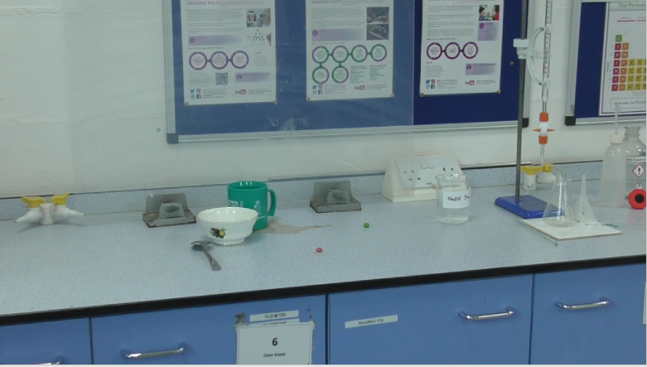
Watch, identify and record hazards and risks found in a laboratory setting
Education and Training Foundation

Slide 5
Examples can include
Chemical hazards: Comply with Control of Chemicals Hazardous to Health (COSHH) regulations
Example: Acid
Physical hazards: Management of Health and Safety at Work Regulations 1999
Example: Water spill
Risk: Caustic, can cause burns
Risk: Can slip and fall

Slide 6









Hazard quiz
Task. Identify the hazards from these symbols
Flammable (Symbol: flame)
Corrosive (Symbol: corrosion)
Acute toxicity (Symbol: skull and crossbones)
Explosive (Symbol: exploding bomb)
Oxidising (Symbol: flame over circle)
Hazardous to the environment (Symbol: environment)
Health hazard / Hazardous to the ozone layer (Symbol: exclamation mark)
Serious health hazard (Symbol: health hazard)
Gas under pressure (Symbol: gas cylinder)
Extension – Can you identify a risk for each?

Slide 7
The Safety Data Sheet (SDS)
REACH (registration, evaluation, authorisation and restriction of chemicals) regulations: Suppliers of dangerous chemicals must provide a safety sheet detailing, hazard, risk and disposal instructions
These come with any shipment and are usually available online.
Task: Using the online SDS database, find hazards and risks for the following:
Ethanol, sulphuric acid (concentrated), heptane

Slide 8
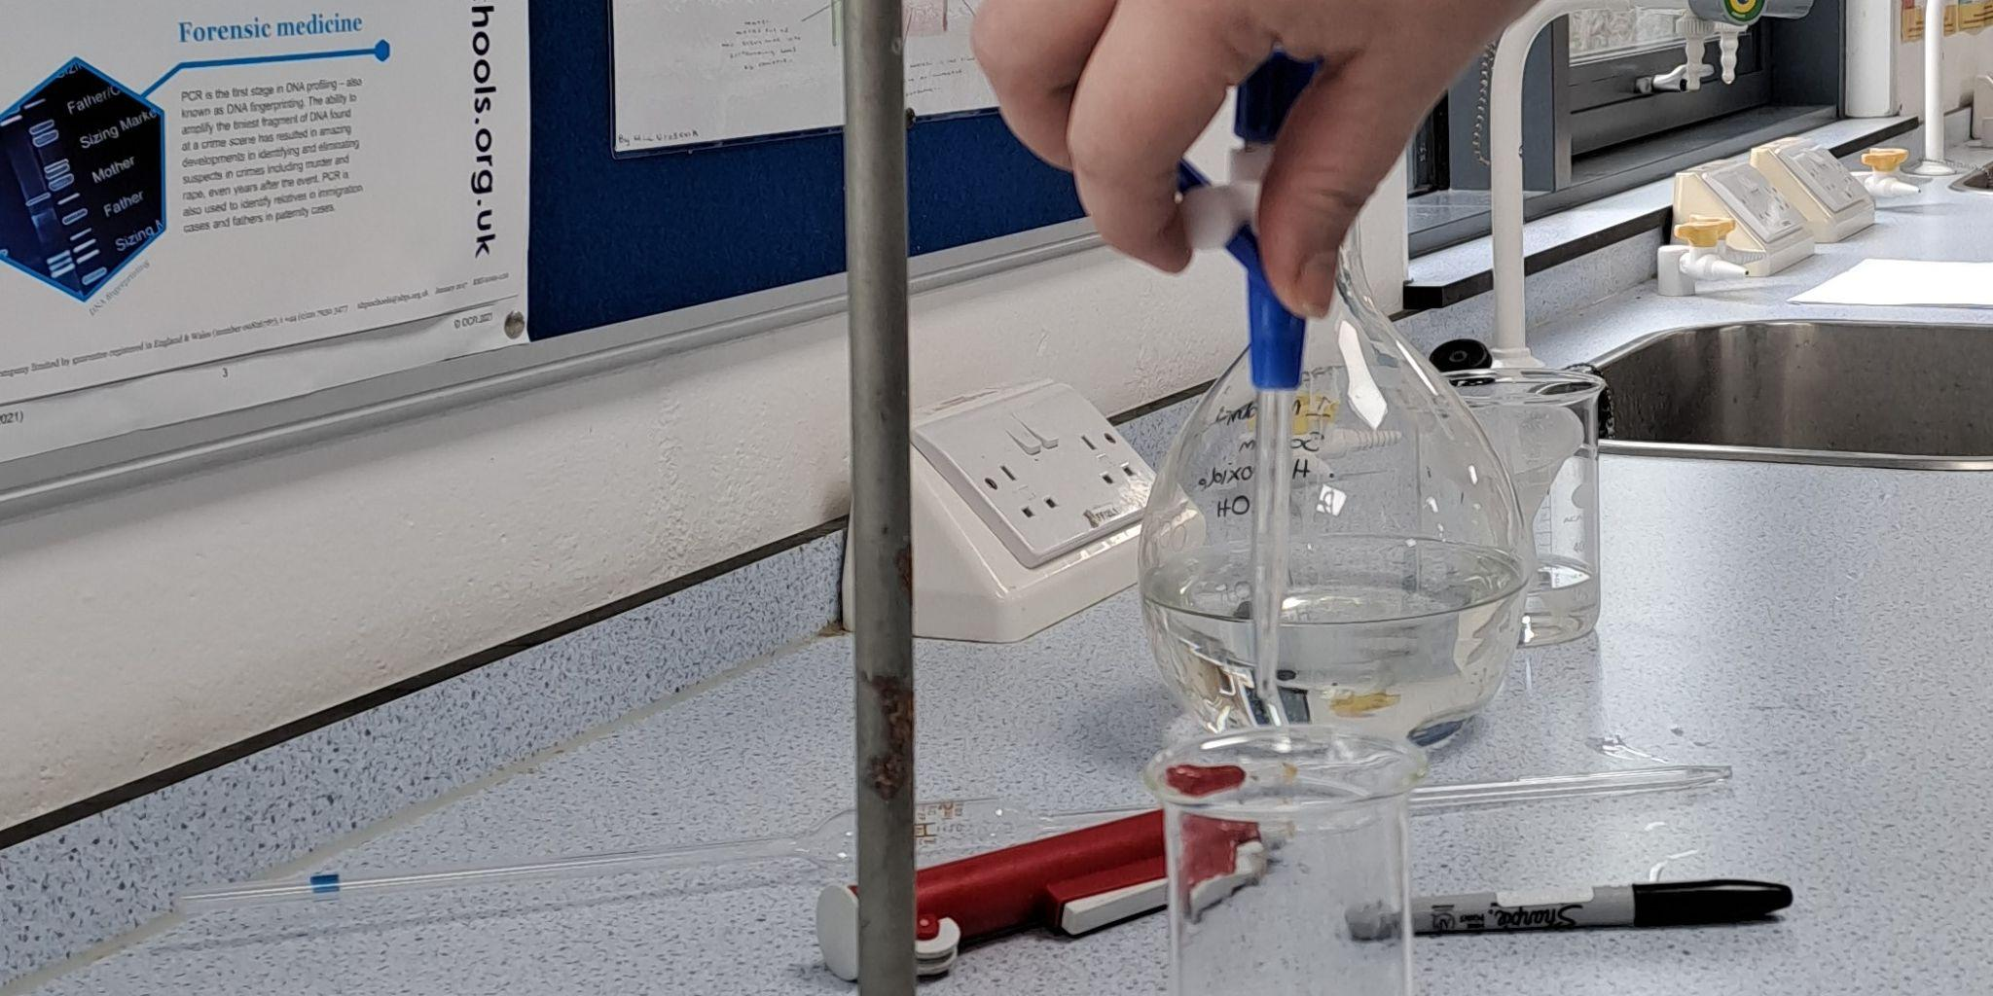
Risk assessment (RA)
The Health and Safety Executive (HSE) considers that any process must be accessed for risk
assessing the risk – Five steps
Identify (what are the hazards?)
Assess (who might be harmed?)
Control (what action is needed?)
  Reduce exposure
  Remove risk (change method)
Record (a risk assessment should be given with the process)
Review (annually or if the process changes)
Risk can be controlled by
lower concentrations, different chemicals, smaller amounts, changing process, isolation (fume cupboard) or personal protective equipment (PPE)

Slide 9
Risk assessment template
We will use this RA template – I have added some hazards
Description of hazard | Risk | Existing controls | Likelihood | Severity | L x S = Risk level | Additional control measures | Completed
Na₂CO₃ | H319 eye irritant | Goggles Wear gloves | 1 | 3 | 3 | Wash hands, eye wash station available | pm 30 Nov 2023
Water bath | Scalding Slip | Set at 50°C limit Spill kit / mop available | 1 | 1 | 1
Glassware – broken | Cuts | Report damage First aid kit | 1 | 2 | 2
Step 3. Mitigate to reduce risk

Slide 10
Risk assessment template
The template should have an author, reviewer and date for review
Name of assessor (date): D. Analyst (30 Nov 23) |  | Authorised (date): A. Supervisor (31 Nov 23)
Review date: 30 Nov 24 |  | Reviewer: A. Supervisor
Title of activity: Preparation of a standard solution of Na₂CO₃
Who this may harm | Analyst | Method/SOP reference: | SOP 1.2A
Usually annually

Slide 11
The risk assessment calculation
It is possible to consider both likelihood and severity to evaluate overall risk:
Likelihood (1 is often, 5 is almost never)
Severity (1 is irritant, 5 is fatal or life altering)
Calculate by multiplying
A low value (<6) is likely to be okay to continue
Above 6, we need to consider changes to lower risk – these are added to the RA
Likelihood | Certain | 5 | 10 | 15 | 20 | 25
 | Very likely | 4 | 8 | 12 | 16 | 20
 | Likely | 3 | 6 | 9 | 12 | 15
 | Unlikely | 2 | 4 | 6 | 8 | 10
 | Very unlikely | 1 | 2 | 3 | 4 | 5
 |  | Minor | First aid | Injury | Long term | Fatality
 | Severity

Slide 12
Task: Risk assessment
Create a RA for this method
SOP Example 1
Weigh about 0.5g of drug into a 150cm³ beaker and dissolve the drug in 25cm³ of ethanol by stirring and heating for 5 minutes at 40°C in a water bath.
Filter the solution using a type 1 ashless filter paper and wash with a further 5cm³ of ethanol. Dry and weigh the retained solids and determine the percentage solids content. Retain the solid residue for further testing.
Transfer the filtrate quantitatively to a 250cm³ volumetric flask and add 100cm³ of standardised 0.1moldm⁻³ NaOH using a burette. Warm the solution with swirling in a water bath a 40°C for 5 minutes.
Dilute to volume with distilled water. Label the flask with full details of the contents, your name and the date.
Using a pipette filler, rinse the pipette with some drug solution and carefully transfer 20cm³ of the solution to a clean 250cm³ conical flask. Add phenolphthalein indicator solution, swirl to mix. The solution will turn pink.
Titrate with 0.1moldm⁻³ sulphamic acid solution until the pink colour is cleared. Record the titre volume to the nearest 0.05cm³. This first flask is just a trial run.
Using the pipette, transfer 25cm³ of the hydrolysed aspirin solution to another clean conical flask.

Slide 13
Completed risk assessment: Example 1
Description of hazard | Risk | Existing controls | Likelihood | Severity | L x S = Risk level | Additional control measures | Completed
Ethanol | Flammable Harmful by ingestion | Avoid naked flames Goggles | 2 | 2 | 4 | Limit of 2L in the laboratory, store in a flammables store cupboard
0.1M sulphamic acid | H315 irritant H319 eye irritant H412 aquatic toxicity | Goggles Low concentration | 1 | 3 | 3 | Wash hands, eye-wash station available Disposal in waste bottle (not to sewer)
0.1M NaOH | H315 Irritant | Low concentration Goggles | 2 | 1 | 2
Water bath | Scalding Slip | Set at 40°C limit Spill kit / mop available | 1 | 1 | 1
Glassware – broken | Cuts | Report damage First aid kit | 1 | 2 | 2
Phenolphthalein indicator | Flammable Irritant Health (Carcinogen) | Less than 100cm³ No naked flames Gloves, goggles | 2 | 2 | 2 | Wash hands Eye-wash station available
Aspirin (200mg) | Harmful | Goggles, avoid dust – ventilation | 1 | 3 | 3 | Possible allergic reaction – staff to be made aware of use

Slide 14
Task: Individual risk assessment
Using the HSE five-point plan, complete an RA for our standardisation practical (standard operating procedure (SOP) 1).
Read the method and identify hazards (chemical and physical). You can use SDS sheets for each chemical
Ensure you mitigate any high-risk activities.
Show the finished RA to your supervisor to sign off before starting the practical work.

Slide 15
02
Titrations
Understand the process of acid-base titrations and calculate the concentration of an unknown sample that has been titrated against a known standard

Slide 16
Starter – Answer these questions
Question 1. Hydrochloric acid reacts with sodium hydroxide.
a) Identify the products.
Sodium chloride and water
b) Write a balanced equation for this reaction.
NaOH_{(aq)} + HCl_{(aq)} NaCl_{(aq)} + H₂O_{(l)}
Question 2. If 1.1g of sodium hydroxide is dissolved in 250cm³ of water,
a) what is the relative formula mass of sodium hydroxide?
23 + 1 + 16 = 40gmol⁻¹
b) what is the concentration of the solution of sodium hydroxide?
n = m/Mr = 1.1/40 = 0.028mol
C = n/V x 1,000 = 0.028/250 x 1,000 = 0.112gmol⁻¹

Slide 17
Starter – Extension
If 0.0123 moles of sodium carbonate (Na₂CO₃) is dissolved in 250cm³ of water,
a) what is the concentration?
C = n/V x 1000 = 0.0123/250 x 1000 = 0.0492gmol⁻¹
b) what mass of sodium carbonate is needed to make this solution?
Mr = (23 x 2) + 12 + (3 x 16) = 106gmol⁻¹
m = n x Mr = 0.0123 x 106 = 1.304g

Slide 18
Acid-base titration demonstration
Collect the relevant required PPE
Watch the demonstration and:
  note the order of each step and why they happen
  ask questions to clarify each stage.

Slide 19
Steps to a titration
Rinse the burette and pipette with water then solution.
Fill the burette with standard (ensure spout under tap filled) and record initial volume.
Rinse conical flask with water and pipette 25cm³ of solution (analyte) and add 2 or 3 drops of indicator.
Run standard into conical flask until colour change.
Rinse conical flask and repeat until concordant (within 0.1cm³).

Slide 20
The titration results
Your titration results should be recorded in a table like this:
The trial is discarded as less accurate
Volume, cm³ | Trial | 1 | 2 | 3
Final | 25.65 | 24.90 | 26.25 | 25.45
Initial | 0.00 | 0.00 | 1.50 | 0.50
Titre | 25.65 | 24.90 | 24.75 | 24.95
The titre is the volume use, final-initial
Select values that agree within 0.1cm³ (concordant)
and use the average of these.

Slide 21
The calculation
The titrated solution has an unknown concentration but known volume (usually 25.00cm³). Since the standard has a known concentration, the titre volume can be used to calculate the unknown concentration.
Use a four-step process:
Calculate n for the standard solution (known).
Write your balanced equation.
Use the stoichiometric ratio to work out the moles of unknown solution required to completely neutralise the standard (equivalence point).
Calculate the concentration of the unknown solution.

Slide 22
Example
Using data from the example table (assume standard C = 0.100moldm⁻³)
The concordant data was 24.90cm³ and 24.95cm³
The average is 24.925cm³
Use the four-step process
1. Calculate n for the standard solution, n = C x V/1000
n = 0.100 x 24.925/1000 = 2.4925 x 10⁻³mol
2. Write a balanced equation
NaCl_{(aq)} + HCl_{(aq)} NaCl_{(aq)} + H₂O_{(l)}
3. Ratio
1:1 so n (unknown) = n (known)
4. Calculate C for the unknown solution using C = n/V x 1000
C = 2.4925x10⁻³ / 25 x 1000 = 0.0997moldm⁻³

Slide 23
Now you try
Practice calculations: When I am happy with your answer, please start the question sheet: Titration calculation worksheet.
If a 25.00cm³ solution of sodium hydroxide required 25.15cm³ of a standard solution of 0.0956mol/dm³ hydrochloric acid to neutralise, what is the concentration of the sodium hydroxide?
n of standard, n = CxV/1000
= 0.0956 x 25.15/1000 = 0.00239mol
2. NaOH_{(aq)} + HCl_{(aq)} NaCl_{(aq)} + H₂O_{(l)} (1:1 ratio)
3. n (standard) = n (NaOH) = 0.00239mol
4. C of NaOH, C = n/V x 1000
= 0.00239/25 x 1000 = 0.096moldm⁻³

Slide 24
Homework: Virtual titration
Use the interactive online titration given (provided free by the Royal Society of Chemistry) to consolidate the steps required and calculate the concentration from your virtual titration.

Slide 25
03
Acid-base titrations
Carry out an acid-base titration and use the data to calculate the concentration of an unknown solution

Slide 26
Starter. Good laboratory practice (GLP) – Recording of data
Task: In groups of four, discuss:
what information do we need to record in a lab book?
2. what layout should we use?
Date, Title
Method – brief, past tense
Safety – hazard/risk
Results – table
Calculations
Observations and recording of mass
Date, title
Method – past/imperfect tense, brief (only what is needed to repeat the work)
Include any safety information
Use diagrams / you can reference a standard procedure
Results: Include any readings needed to prepare, use tables, include observations and calculations.
Note any changes to the method (evaluation).

Slide 27
Example lab book template
Date Title
Method: Past/imperfect tense, brief (only what is needed to repeat the work). There is no need to copy information that is available elsewhere.
- Include any safety information (including COSHH and risk assessment reference).
- Use diagrams to show experimental setup (diagrams must be 2D).
- Include any batch numbers or strength of chemicals used.
- If the work is following an SOP, this can be referenced.
- If work is repeated from an earlier date in this lab book, reference the initial date the method is recorded and include a brief description of any changes made.
Results: Use tables to record data, include observations and calculations.
- Include any readings needed to prepare samples.
- Include any calibration data or a reference to calibration of equipment.
- If data is recorded electronically include a reference to the data location.
- Tables can include processed (calculated) data and should have a title.
Improvement of method: Note any changes to the method (evaluation).

Slide 28
Titration task
Read through the SOP and be prepared to check clarity through questioning.
Collect the relevant required PPE.
Observe setting up of titration equipment and note the process you need to follow in your lab books.
In pairs, individually carry out and observe the titration in turns, critiquing at the end of each complete titration.
Does your data agree with your peer?

Slide 29
Example of recording of your titration results
NB All data is recorded to two decimal places.
The trial is discarded as less accurate
Volume, cm³ | Trial | 1 | 2 | 3
Final | 25.65 | 24.90 | 26.25 | 25.45
Initial | 0.00 | 0.00 | 1.50 | 0.50
Titre | 25.65 | 24.90 | 24.75 | 24.95
The titre is the volume use, final-initial
Select values that agree within 0.1cm³ (concordant)
and use the average of these.

Slide 30
Calculate the concentration of acid
The titrated solution has an unknown concentration but known volume (usually 25.00cm³). Since the standard has a known concentration, the titre volume can be used to calculate the unknown concentration.
Use a four-step process:
Calculate n for the standard solution (known).
Write your balanced equation.
Use the stoichiometric ratio to work out the moles of unknown solution required to completely neutralise the standard (equivalence point).
Calculate the concentration of the unknown solution.

Slide 31
Good laboratory practice – Recording of data
What would you expect to see when reading someone else’s lab book?

Slide 32
04
Standard solutions
Calculate the mass required for a known concentration and prepare a standard solution

Slide 33
Starter
Our scenario
    WFCG is a consumer health company. One of its most popular products is health supplements. WFCG staff carry out quantitative analysis (assay) when developing their health care products. There is an analytical testing department whose role is to determine the content of active ingredients in product development samples. To do this, they need to ensure that all standards are accurate, so they need to make standardised solutions to check that accuracy.
    Over the next three lessons, you will learn the process to be followed to create a standardised solution for checking one of their products.
Why do they need standards?
What properties should a standard have? In pairs, list three reasons.

Slide 34
Standards
Why do they need standards?
Standards have a known and reliable concentration for checking accuracy of stated concentration of solutions in quantitative analysis
What properties should a standard have?
Stable chemical – does not decompose, react with air/water, shelf life
Pure (known purity, e.g. Analar is 99% pure)
Dry (solids) – not hygroscopic = water absorbing
Easy to handle
Safe
Stable in solution

Slide 35
Task 1: In pairs, complete the following mole calculations
Question 1.
a) What is the relative formula mass of sodium hydrogen carbonate?
23 + 1 + 12 + (3x16) = 84gmol⁻¹
b) What is the mass of 0.25moles of sodium hydrogen carbonate?
m = n x Mr = 0.25 x 84 = 21g
c) How many moles in 2.635g of sodium hydrogen carbonate?
n = m/Mr = 2.685/84 = 0.032mol
Question 2.
If 1.1g of sodium hydrogen carbonate is dissolved in 250cm³ of water,
a) how many moles are dissolved?
n = m/Mr = 1.1/84 = 0.013mol
b) what is the concentration of the solution of sodium hydrogen carbonate?
C = n/V x 1000 = 0.013/250 x 1000 = 0.052moldm⁻³

Slide 36
Extension question
Question 3
If a solution of sodium hydrogen carbonate has a concentration of 0.1moldm⁻³,
a) what mass of sodium hydrogen carbonate is required to make 250cm³ of this solution?
n = C x V/1000 = 0.1 x 250/1000 = 0.025mol
m = n x Mr = 0.025 x 84 = 2.1g
b) If the solution is diluted with a further 750cm³ of water, what is the concentration?
C2 = C1 x V1/V2 = 0.1 x 250/750 = 0.033moldm⁻³

Slide 37
Making a standard solution
Read the risk assessment and collect the relevant required PPE
Watch the demonstration and:
note the order of each step and why these happen
ask questions to clarify each stage.

Slide 38
Calibration of balance
Who?
What?
Why?
How?

Slide 39
Task (in pairs): Card sort – Can you remember the order?
Put the given cards in the appropriate order and fill in the blank with the actions needed.
Tare balance, check boat weight and add standard, weigh full boat. Add the standard to the beaker and reweigh the empty boat
Add water to the beaker and stir to dissolve the standard
Add a funnel to the volumetric flask, pour in the standard, rinse the beaker and pour this in and rinse the stirring rod into the volumetric flask and remove the funnel.
Add water to the volumetric flask to under the neck. Add a stopper and mix by inverting.
Add water with a dropping pipette to the meniscus. The bottom of the meniscus will rest on the fill line. Stopper and mix.

Slide 40
Task: Practise filling a volumetric flask
Fill a 250cm³ volumetric flask with water.
Use a four-step process to:
record weight empty
pour water into the flask through a funnel to just below the line – remove the funnel
use a dropping pipette to load more water so the meniscus rests on the line
reweigh the full flask to see if you get 250g.

Slide 41
Task: Making a standard solution
Calculate the mass of sulphamic acid required to make 250cm³ of a 0.1moldm⁻³ solution.
Check your calculation.

Slide 42
Task: Making a standard solution
Collect method sheet.
Record the method reference in your lab books and any safety notes.
Make a 0.1moldm⁻³ solution in a 250cm³ volumetric flask.
Calculate the actual concentration of your sodium carbonate solution.
Label your volumetric flask with name, date, the chemical (sodium carbonate) and the actual concentration – add a hazard label if appropriate.

Slide 43
Task: Making a standard solution review
Note on a sticky note:
one improvement that could be made
one limitation of the method.

Slide 44
05
Standardisation
Titrate a solution of sodium hydroxide using a standard solution of sulphamic acid

Slide 45
Starter
Task: In pairs, calculate the concentration of hydrochloric acid from the following titration.
25.00cm³ of hydrochloric acid with unknown concentration was titrated against a 0.100moldm⁻³ solution of sodium hydroxide. The titre volumes are given in the table below.
Volume, cm³ | Trial | 1 | 2
Final | 24.85 | 25.10 | 25.70
Initial | 0.00 | 0.30 | 1.00
Titre | 24.85 | 24.80 | 24.70
n of sodium hydroxide, n = C x V/1000 = 0.100 x 24.75/1000 = 2.475x10⁻³mol
Ratio 1:1 so n of acid = n of sodium hydroxide
C of acid, C = n/V x 1000 = 2.475x10⁻³/25 x 1000 = 0.099moldm⁻³

Slide 46
Standardisation of NaOH
Check through the RA given and collect and apply appropriate PPE.
Read through the SOP and be prepared to check clarity through questioning.
Observe the equipment and note the process you need to follow. Be prepared to share this
process with the group.

Slide 47
Calibration of glassware
Why does the glassware need calibrating?

Slide 48
SOP 2: Method for standardisation
Procedure
Rinse a clean burette with sodium hydroxide solution and fill it with the same solution. Record the initial burette reading directly into the “trial” column of the results table provided. Readings should be taken to the nearest 0.05cm³, which is equivalent to one drop.
Using a pipette filler, rinse the pipette with some sulphamic acid solution and carefully transfer 25.00cm³ of the solution to a clean 250cm³ conical flask. Add 2 drops of the phenolphthalein indicator solution, swirl to mix.
Run sodium hydroxide solution slowly from the burette into the flask which is placed on a white tile, with swirling, until the solution starts to turn pink around the adding point. Then swirl to clear solution and continue adding 0.5 cm³ at a time until solution stays pink after swirling well. This first flask is just a trial run.
Refill the burette, if necessary, with more sodium hydroxide solution and again record the initial burette reading to the nearest 0.05cm³ (one drop).
Using the pipette, transfer 25.00cm³ of the sulphamic acid solution to another clean conical flask.
Add the burette solution down to the reading 1cm above the trial reading and then swirl well to clear the solution. Continue adding the acid drop by drop, swirling between each drop, until you reach the end point. Record your reading.
Repeat accurate titrations until you have three concordant values.

Slide 49
Calculate the concentration of acid
The titrated solution has an unknown concentration but known volume (usually 25.00cm³). Since the standard has a known concentration, the titre volume can be used to calculate the unknown concentration.
Use a four-step process to:
calculate n for the standard solution (known)
write your balanced equation
use the stoichiometric ratio to work out the moles of unknown solution required to completely neutralise the standard (equivalence point)
calculate the concentration of the unknown solution

Slide 50
Peer review
Review another learner’s lab book against the GLP – Recording good data principles covered in lesson 3.

Slide 51
06
Analysis of citric acid
Titrate a solution of citric acid using a standardardised solution of sodium hydroxide

Slide 52
Starter. Risk assessment
Task: Individually, answer:
An acid-base titration is risk assessed. The RA determines that the calculated level for 4moldm⁻³ sulphuric acid is 9 (likelihood = 3 x severity = 3).
Identify two ways that the analyst can reduce the risk level to an acceptable level.
The concentration of sulphuric acid can be reduced to 1 moldm-3 (reduce severity).
Appropriate PPE can be detailed, e.g. black nitrile gloves.
The titration can be automated to reduce exposure.
Acid can be handled in a controlled environment (fume hood or glove box).
Why must the RA be reviewed every year?
Changes in the SDS of any reagent.
Changes to equipment.
Changes to legislation.

Slide 53
Quantitative analysis of citric acid
Task (individual): To determine the acid concentration using standard sodium hydroxide.
Collect SOP, RA and find SDS online. a. Check the RA and add any additional hazards and control measures. b. Get these authorised by your teacher before starting titration.
Record method, results table and safety information in your book with date.
Follow the SOP to determine concordant data in your titration.
  Dilute your citric acid solution.
  Clean and assemble glassware to determine titre volume.
Use your concordant data to determine the concentration of the acid.

Slide 54
Calculate the concentration of an acid
The titrated solution has an unknown concentration but known volume (usually 25.00cm³). Since the standard has a known concentration, the titre volume can be used to calculate the unknown concentration.
Use a five-step process (based on your four-step calculation from lesson 3) to:
calculate n for the standard solution (known)
write your balanced equation
use the stoichiometric ratio to work out the moles of unknown solution required to completely neutralise the standard (equivalence point)
calculate the concentration of the unknown solution
calculate the concentration of the undiluted unknown solution.

Slide 55
Plenary
Exam-style questions: Complete these individually.
Ammonia solution acts as a weak base. An analyst carries out a titration to determine the concentration of ammonia in cleaning fluid.
1. Outline the steps of the acid-base titration that would determine the concentration of ammonia [4 marks].
i. Clean glassware with distilled water and solution (distilled water only for conical flask).
ii. Pipette 25.00cm³ ammonia into a conical flask and add 3 drops of appropriate indicator (e.g. methyl orange).
iii. Fill a burette with acid and note start volume. Run acid with known concentration (e.g. HCl) from burette until colour change (e.g. yellow to pink) and note end volume.
iv. Repeat steps i to iii using dropwise addition near end point until concordant data achieved.
2. Identify two safety precautions that the analyst should follow [2 marks].
From: Goggles, clean up spills, report breakages, use low concentrations, no naked flams, first aid/eye wash.

Slide 56
07
pH titrations
Understand how pH titrations can be used to quantify weak acids and bases

Slide 57
Starter
Task: In pairs, determine the correct indicator to use:
Titration 1. 0.1moldm⁻³ hydrochloric acid (pH 1) and 0.1moldm⁻³ sodium hydroxide (pH 13).
Equivalence point pH 7 – indicator: bromothymol blue or phenol red.
Titration 2. 0.2moldm⁻³ nitric acid (pH 0.7) and 0.25moldm-3 ammonia solution (pH 9.5).
Equivalence point pH 5.1 – indicator: methyl orange, methyl red, bromocresol blue, alcarin red s or dichlorfluorescein.
Titration 3. 0.1moldm⁻³ ethanoic acid (pH 2.9) and 0.05moldm⁻³ sodium carbonate (pH 11.6).
Equivalence point pH 7.25 – indicator: cresol red, bromothymol red or phenol red.

Slide 58
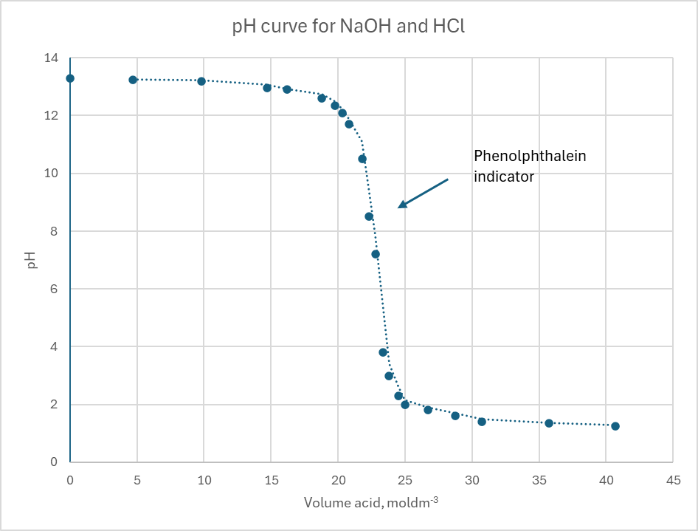
The pH curve
You can measure the pH as you titrate and end up with a plot of pH vs volume added.
Initially, pH does not change as you need 10 x concentration for pH change of -1.
pH changes more rapidly as OH- ions are neutralised.
At the equivalence point, there is a rapid change in pH. A number of indicators will be valid in this very steep range.
Finally, pH does not change as you add more acid.

Slide 59
Task (in pairs): pH curves.
Look at the four pH curves on your handout.
Can you identify and situations where the choice of indicator may not accurately determine the true equivalence point when the colour changes?
1. Strong acid and base (equivalence point pH 7): as the pH changes rapidly with respect to volume then a change of + or – pH 1 will not affect the titre volume.
2. Strong acid and weak base (equivalence point of pH 5): as the pH changes rapidly up to the equivalence point and slowly after pH 5, the actual colour change of (e.g. methyl orange) may lead to an overestimation of volume.
3. Weak acid and strong base (equivalence point of pH 9): as the pH changes slowly up to the equivalence point and rapidly after pH 9, the actual colour change of (e.g. methyl orange) may lead to an underestimation of volume.
4. Weak acid and weak base (equivalence point of pH 7): as the pH changes slowly, the actual colour change of (e.g. methyl orange) may lead to parge error in volume.

Slide 60
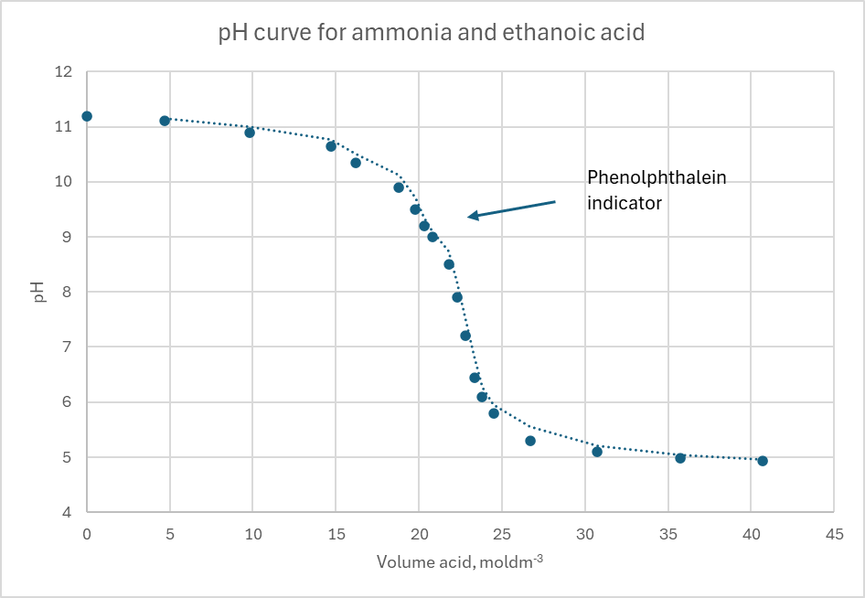
Weak acids and bases
Weak acids and bases do not dissociate fully. Not all OH⁻ or H⁺ ions are released.
pH changes more rapidly than for strong acids and bases as OH⁻ ions are neutralised.
At the equivalence point, there is a more gradual change in pH. Most indicators will not have an end point equal to the equivalence point.
Finally pH does not change as you add more acid.

Slide 61
The pH scale
pH is a measure of the concentration of free hydrogen ions in solution [H⁺].
It is a logarithmic scale: pH = -log [H⁺]:
The pH drops by 1 for each 10x increase in [H+].
You can define log (base 10) as: log [10^{x}] = x e.g. pH of a solution of 0.2moldm⁻³ HNO₃ pH = -log 0.2 = 0.7
For a strong acid, all H⁺ ions are lost in solution (dissociation):
HA_{(s)} + H₂O_{(l)} = H₃O⁺_{(aq)} + A⁻_{(aq)}
A strong base (or alkaline) dissociates fully to form OH⁻:
MOH_{(s)} = M⁺_{(aq)} + OH⁻_{(aq)}

Slide 62
Measuring pH
pH is measured using a pH meter
The meter converts the conductivity of the solution to pH. Higher [H⁺] means higher conductivity.
The potential difference between AgCl and KCl electrodes is measured.
The glass bulb allows the transfer of H⁺ ions between buffer and the measured solution.

Slide 63
The pH titration
Collect the relevant PPE for completion of a titration.
Observe the demonstration of pH titration. Make a note of the stages in the titration and equipment used in the titration.
In groups of three, make a list of what happened in each stage of the titration you have just watched:
- give details of how each step affects the accuracy of the titration
- record your method on the A3 sheet provided.
Send an envoy with the list for review by another group.
Add any amendments and report back.

Slide 64
Write down on a sticky note how each of the following stages helps accuracy and add stick it on the board.
- Cleanliness
- Calibration of pH meter
- Rate of addition of acid as the pH changes
- Stirring and the time taken for each measurement

Slide 65
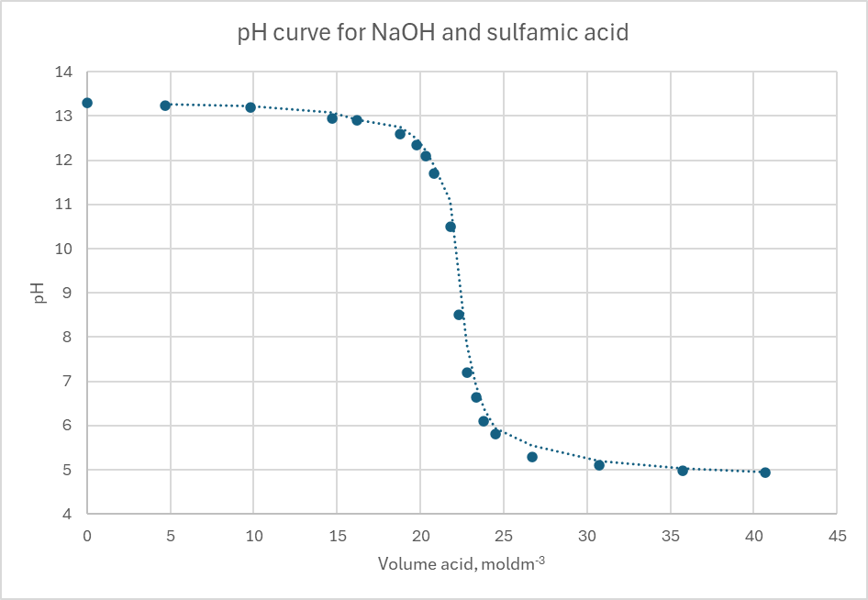
Calculation of concentration
Plot the volume added against the pH at that volume.
Determine the equivalence point = median pH (9.1).
At the equivalence point Find the volume added. Here it is 22.40cm³.
Calculate the unknown concentration using the four point method.
n (known) = c x V/1000 = 0.101x 24.3/1000
= 2.45x10⁻³mol
Balance equation (1:1 ratio)
Use ratio to find n (unknown) = n (known)
C (unknown) = n/V x 1000
= 2.45x10⁻³/25 x 1000
= 0.098moldm⁻³

Slide 66
Now you try
A solution of sodium hydroxide with a concentration of 0.105moldm⁻³ was titrated against 25.00cm³ of a solution of hydrochloric acid with unknown concentration.
1. Using the data given plot a graph of pH against volume of sodium hydroxide added.
Determine the equivalence point = median pH.
At the equivalence point, find the volume added.
2. Determine the volume of sodium hydroxide added at the equivalence point and using this as the titre volume determine the concentration of the hydrochloric acid solution.
Calculate the unknown concentration using the four-step method.
n (known) = c x V/1000
Balance equation (1:1 ratio)
Use ratio to find n (unknown) = n (known)
C (unknown) = n/V x 1000
Volume, cm³ | pH
0.0 | 1.4
5.0 | 1.6
10.0 | 1.7
15.0 | 1.8
17.0 | 2.1
18.0 | 2.2
19.0 | 2.3
20.0 | 2.4
21.0 | 2.6
Volume, cm³ | pH
22.5 | 3.0
23.5 | 3.6
24.0 | 5.7
24.3 | 6.4
24.5 | 7.0
24.7 | 9.3
25.2 | 10.6
26.2 | 11.6
31.2 | 12.5

Slide 67
Exit ticket
Write down on a sticky note:
- one improvement that could be made to the method
- one improvement that could be made to your pH graph.

Slide 68
08
Analysis of Vinegar
Carry out a pH titration of a solution of ethanoic acid (vinegar) using a standardardised solution of sodium hydroxide

Slide 69
Starter
Our scenario
  WFCG is a consumer product company which supplies food and drink products. One of its most popular brands is malt vinegar. WFCG staff carry out quantitative analysis (assay) of each batch of their product before it is dispatched from the factory. There is a quality control laboratory whose role is to determine the content of active ingredients in the finished product. They also carry out testing of the raw ingredients to ensure the accuracy of the process.
As an analytical technician, you will carry out quantitative testing of ethanoic acid using a standard process to determine the concentration of the acid.
Collect the SOP and RA template. Read them.
The RA will need to be completed. Using SDSs, complete the RA to ensure that all chemicals and hazards have been assessed.

Slide 70
Quantitative analysis of ethanoic acid
Task (individual): To determine the acid concentration by following a pH titration using standard sodium hydroxide.
Collect SOP and RA. a. Check the RA and add any additional hazards and control measures. b. Get these authorised by your teacher before starting titration.
Record method, results table and safety information in your book with date.
Follow the SOP to determine concordant data in your titration.
  - Dilute your ethanoic acid solution.
  - Calibrate the pH meter at pH 4.0 and 0.2.
  - Clean and assemble glassware and pH meter to determine change in pH with volume NaOH added.
Use your data to plot a graph of pH against volume and determine the concentration of the acid.

Slide 71
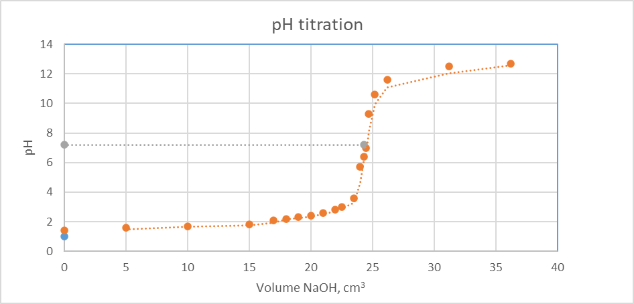
Calculation of acid concentration – Plot recap
Plot the volume added against the pH at that volume.
Determine the equivalence point = median pH.
At the equivalence point, find the volume added.
Calculate the unknown concentration using the volume added.

Slide 72
Plenary
Evaluation: Complete these individually. Answers on a sticky note.
Consider the standard error of your calculation from the graph.
How could you improve the accuracy of the graph?
2. Identify at least one improvement to the method as written on the SOP.

Slide 73
09
RedOx titrations
Understand how changes in oxidation state can be used to quantify chemicals undergoing reduction and oxidation

Slide 74
Starter
Task: Identify species being oxidised and reduced:
1. Copper (II) chloride reacts with zinc to form zinc (II) chloride and copper.
a) Write a balanced symbol equation with state symbols.
CuCl₂ _{(aq)} + Zn _{(s)} Cu _{(s)} + ZnCl₂ _{(aq)}
b) Identify the oxidation state of each of the reacting species.
Cu²⁺ becomes Cu⁰ (reduced)
Zn⁰ becomes Zn²⁺ (oxidised)
c) Write half equations for the oxidation and the reduction process in the reaction.
Reduction: Cu²⁺ _{(aq)} + 2e⁻ Cu _{(s)}
Oxidation: Zn _{(s)} Zn²⁺ _{(aq)} + e⁻
2. Carbon burns in oxygen to form carbon dioxide.
a) Write a balanced symbol equation with state symbols and identify the oxidation state of each of the reacting species.
O₂ _{(g)} + C _{(s)} CO₂ _{(g)}
0 0 4+ 2-
b) Write half equations for the oxidation and the reduction process in the reaction.
Reduction: 2O₂ _{(g)} + 4e⁻ 2O²⁻ _{(g)}
Oxidation: C _{(s)} C⁴⁺ _{(g)} + 4e⁻

Slide 75
Starter
Task: Identify species being oxidised and reduced
Extension question
The first step in the rust formation of iron with oxygen and water is the formation of iron (III) hydroxide with oxygen and water.
Write half equations for the oxidation and the reduction process in the reaction.
Reduction: O₂ _{(g)} + 2H₂O _{(l)} 4e⁻ 4OH⁻ _{(g)}
Oxidation: Fe _{(s)} Fe³⁺ _{(aq)} + 3e⁻
Balance the number of electrons in each half equation to construct a balanced symbol equation for the formation of iron (III) hydroxide.
Balance the electrons in each half equation: 3 x reduction and 4 x oxidation.
4Fe _{(s)} + 3O₂ _{(g)} + 6H₂O _{(l)} 4Fe(OH)₃ _{(aq)}

Slide 76
RedOx
A chemical reaction in which one reactant is reduced and the other is oxidised is called a RedOx reaction.
Oxidation is loss of electrons
Reduction is gain of electrons
For example, in the reaction of copper with sulphur: Cu_{(s)} + S_{(g)} CuS_{(s),} the copper atom loses two electrons, i.e. the copper atom is oxidised:
Cu Cu²⁺ + 2e⁻ (1)
Meanwhile, the sulphur atom gains two electrons, i.e. it is reduced:
S + 2e⁻ S²⁻ (2)
By adding the two ‘half’ reactions (1) and (2), we get the ionic equation as the electrons cancel out:
Cu_{(s)} + S_{(g)} + 2e⁻ Cu²⁺ + S²⁻ + 2e⁻
Cu_{(s)} + S_{(g)} Cu²⁺_{(s)} + S²⁻_{(s)}

Slide 77
Oxidation number
The oxidation number is the oxidation state of an atom in a compound.
It is a positive or negative number in a compound:
The oxidation number of an atom in a free element is always zero.
The oxidation number of a neutral compound is zero.
Oxidation numbers are decided using certain rules (see below), and oxidation is defined as an increase in oxidation number: reduction is a decrease in oxidation number.
The following elements nearly always have the same oxidation number in their compounds:
Group 1 = 1+, group 2 = 2+ and group 3 = 3+
Hydrogen = 1+ and Oxygen = 2-
Group 7* = 1-, Group 6* = 2-
* Note that F, Cl and O will always oxidise less reactive elements
Sulphur has oxidation state +6 in SO₄²⁻

Slide 78
Oxidation number rules
1. The oxidation number of an uncombined element is zero.
2. The oxidation number of an element in a simple ion is the charge on the ion.
3. The oxidation number of any Group I metal in compounds is always +1, and of any Group II metal in compounds it is always +2.
4. The oxidation number of fluorine in compounds is always -1.
5. The oxidation number of oxygen in compounds is usually -2 (except when bonded to fluorine or in peroxides).
6. The sum of the oxidation numbers in any compound equals zero.
7. The oxidation number of hydrogen in compounds is usually +1 (except in metal hydrides when it is -1).
8. The sum of the oxidation numbers in any polyatomic ion equals the charge on the ion.
Now complete the oxidation number exercise sheet.

Slide 79
RedOx exercise:
1. Give the oxidation numbers of nitrogen in the following species:
NO₂, N₂, HNO₃, N₂O, NO²⁻
2. Give the oxidation numbers of phosphorus in the following species:
PH₃ , P₂O₃, P₄, PO₄³⁻
3. Calculate the oxidation numbers and write half equations for the following redox reactions.
(a) I₂ + Sn²⁺ → 2I⁻ + Sn⁴⁺
(b) Cl₂ + 2NaBr → 2NaCl + Br₂
(c) Fe₂O₃ + 3CO → 2Fe + 3CO₂
(extension) S₂O₃²⁻ + 2H⁺→ S + SO₂ + H₂O

Slide 80
The RedOx titration
Collect the relevant PPE for completion of a titration.
Observe the RedOx titration. Make a note of the stages in the titration and equipment used in the titration.
In pairs:
- collect equipment and carry out the titration you have just watched
- critically evaluate the technique of your laboratory partner
- record your method and results in your lab book
- review your laboratory partners lab book (do they have date, titles, methods (or reference to method and any changes, and results in tables with units?).
Using your titre volume, complete and calculate the concentration of the iodine solution.

Slide 81
Write down any significant points from your lab book review.
Order: Can work be found easily?
Detail: Could the work be repeated?
Data: Is this recorded logically and is it easy to understand?
Conclusions: Are calculations, observations and conclusions included?

Slide 82
10
Iron content
Use a standard solution of potassium permanganate to determine a tablet’s iron content

Slide 83
Our scenario
WFCG is a consumer healthcare company which supplies health supplements. One of its most popular brands is iron tablets. WFCG staff carry out quantitative analysis (assay) of each batch of their product before it is dispatched from the factory. There is a quality control laboratory whose role is to determine the content of active ingredients in the finished product. They also carry out testing of the raw ingredients to ensure the accuracy of the process.
As an analytical technician, you will carry out quantitative analysis (assay) of iron in iron sulphate tablets using a standard process to determine the iron content of each tablet.

Slide 84
Starter
Individually, identify the oxidation states and write balanced ionic equations for each of these reactions:
1. Mg_{(s)} + Pb(NO₃)_{2(aq)} → Mg(NO₃)_{2(aq)} + Pb_{(s)}
Mg_{(s)} + Pb²⁺ _{(aq)} → Mg²⁺_{(aq)} + Pb_{(s)}
2. 2HCl_{(aq)} + Mg_{(s)} → MgCl_{2(aq)} + H₂ _{(s)}
2H⁺ _{(aq)} + Mg_{(s)} → Mg²⁺ _{(aq)} + H₂ _{(s)}
3. 3CuO_{(s)} + 2NH_{3(g)} → 3Cu_{(s)} + 3H₂O_{(g)} + N_{2(g)}
3CuO_{(s)} + 2NH_{3(g)} → 3Cu_{(s)} + 3H₂O_{(g)} + N_{2(g)}
3Cu²⁺ + 3O²⁻ + 2N³⁻ + 6H⁺ → 3Cu+ 3H₂O + N₂

Slide 85
Titration of iron tablets with potassium permanganate
Collect the titration method 5 sheet and read it.
An RA and an SOP will need to be written.
Using the method, write an SOP for the RedOx titration of iron in iron sulphate tablets using potassium permanganate.
Using SDSs, please write an RA for your SOP to ensure all chemicals and hazards have been assessed.
Please have your SOP and RA signed off by your supervisor before starting any practical work.
When your SOP and RA have been checked, collect the appropriate PPE, equipment and chemicals and determine the iron content of the iron tablets provided.

Slide 86
Plenary
Exam-style question: Complete in pairs.
Identify factors that could cause data errors in measurements made during the RedOx titration.
Justify which factors are likely to cause the data errors measured.
Use the data recorded, as well as your own knowledge, to help you.
(8 marks)

Slide 87
11
Analysis of vitamin C
Use a standard solution of DCPIP to determine the vitamin C content in a fruit juice solution

Slide 88
Starter
In pairs, read the Occupational Specialism Assessment (OSA) part 2 assignment and mark scheme.
From the table (Task 1(a) learner procedure assessment) identify five pieces of good practice to achieve band 4 or 3.
Band 4: The learner has demonstrated autonomy and judgement in following the multi-step SOP, carrying out all instructions in full and carrying out the task logically and in a time-efficient manner to produce accurate results.
Band 3: The learner has followed the multistep SOP, carrying out most instructions in full, with only occasional minor omissions or errors, such as stoppers not replaced immediately, instructions on air bubbles, mixing or end-point concordance taking longer, followed and carried out the task in the correct order of steps to produce accurate results.

Slide 89
Using a mock Occupational Specialism Assessment
Scenario
A consumer food products company produces fruit juices from concentrate. During the manufacturing process, the juice is pasteurised at 70°C. At high temperature, ascorbic acid (vitamin C) can break down. Each batch of the product is tested to ensure that the content of vitamin C remains above a threshold level.
The vitamin C content in the fruit juice can be titrated directly against a blue dye, 2,6-dichlorophenolindophenol (DCPIP), standardised against ascorbic acid.
Task 1
You have one hour to complete tasks 1(a) and 1 (b).
1(a): Carry out a titration to determine the vitamin C content in samples of fruit juice provided following the SOP and the safety information provided.
1(b): Record your results in a suitable table and carry out any necessary calculations.

Slide 90
Determination of Vitamin C content using PCPIP
All instructions are given on the OSA assignment sheets. An RA and an SOP are given.
You will need to record results and observations accurately in your lab books.
In part A, you will standardise your 0.1 %(w/v) DCPIP solution with ascorbic acid (blue to colourless).
DCPIP is a blue dye that is reduced by ascorbic acid to a colourless compound (DCPIP H₂).
In part B, you will titrate the DCPIP against fruit juice.

Slide 91
Self-assessment
Using the OSA 2, part A mark scheme, mark your laboratory practice against the criteria given in:
Task 1(a) – Assessor observation checklist. (11 marks)
Task 1(a) – Learner procedure assessment. (12 marks)
Use the indicative content to help you determine what band you are in.
Record three actions you need to take to gain a higher grade in the next assignment and post them on the white board using the sticky note provided.

Slide 92
12
Conductometric titrations
Understand how conductometric titrations can be used to quantify reagents with differences in conductivity

Slide 93
Starter
Task: In pairs, determine:
1. in the following electrolysis cell, which species is being oxidised and which is being reduced? Produce half equations.
  Zinc anode and carbon cathode with copper sulphate solution.
  Zinc anode and iron cathode with iron oxide solution.
2. in the electrolysis examples given in 1a and 1b above and the table of conductivity given below, what will happen to the conductivity of the cell as the RedOx reaction proceeds?
Solution | Nominal conductivity, mS/cm
Zinc sulphate | 47.1
Zinc oxide | 68
Copper sulphate | 110.5
Iron oxide | 95

Slide 94
Measuring conductivity
Pure water does not conduct electricity.
Adding electrolytes (soluble, charged species such as salts, acids and bases) increases solubility.
The conductivity increases as the solubility and mobility of the electrolyte in solution increase.
Conductivity also tends to increase as temperature increases.
Conductivity is a fast and stable measurement but is not specific.
The total conductivity of all dissolved electrolytes is measured.

Slide 95
The conductivity meter
Conductivity meters measure the conduction of a small a.c. current through the solution.
Contacting electrode: A pair of specifically sized platinum electrodes 1cm apart are dipped in the sample.
Electrodeless: The sample flows between two isolated inducting coils Torroid A and Torroid B, a small a.c. current in Torroid A induces in Torroid B a current, which is measured. Electrodeless meters tend to be used with flow cells as the meter does not need be in direct contact with the sample.
The conductivity meter will also have a built-in thermocouple to correct for temperature.

Slide 96
The conductivity curve
As the sample conductivity and titrant conductivity are different, a graph shape is observed.
Initially conductivity decreases as H⁺ ions are removed.
Once the acid is neutralised, additional OH⁻ ions increase conductivity
The rate of change in conductivity will be different for each electrolyte due to mobility.
Where the line of best fit for each conductivity series cross is the equivalence point.
The concentration can be calculated conventionally using the four-stage calculation.

Slide 97
Now you try
In pairs, plot the volume added against the conductivity at that volume.
Use the volume added at the equivalence point to determine the concentration of unknown hydrochloric acid using 0.102moldm⁻¹ sodium hydroxide
Volume, cm³ | Conductivity, mS/cm
0 | 1.40
5.00 | 1.20
7.50 | 1.12
10.00 | 0.98
12.20 | 0.89
15.80 | 0.79
18.80 | 0.65
20.30 | 0.60
21.80 | 0.54
Volume, cm³ | Conductivity, mS/cm
22.80 | 0.50
24.30 | 0.40
25.80 | 0.30
26.40 | 0.38
28.80 | 0.38
30.50 | 0.45
34.70 | 0.65
40.75 | 0.80
45.75 | 0.90
At the equivalence point, find the volume added.
Calculate the unknown concentration using the four-stage method.
n (known) = c x V/1000
Balance equation (1:1 ratio)
Use ratio to find n (unknown) = n (known)
C (unknown) = n/V x 1000

Slide 98
The conductivity titration
Collect the relevant PPE for completion of a titration.
Observe the demonstration of the use and calibration of the conductivity meter, and of the titration. Make a note of the stages in the titration and equipment used in the titration.
Individually, plot the data we have just recorded:
- find the titre volume
- calculate the concentration of chloride in the 25.00cm³ of water
- concentration of silver chloride was 0.1moldm⁻³.
Check your value with a peer and critically review each other’s work.

Slide 99
The exit task
Individually, write an SOP instructing another T Level learner in how carry out the titration you have just watched. Include:
- how to calibrate the conductivity meter
- how to set up the equipment
- volumes of reagents required and what equipment to use to measure them.
Exchange your SOP with a peer and critically review each other’s work.
Write at least one improvement point on a sticky note and stick it on the board at the front.

Slide 100
13
Analysis of sulphate ions in water
Use a standard solution of barium chloride to determine the sulphate content in wastewater

Slide 101
Using a mock Occupational Specialism Assessment
Scenario
A water and wastewater services company supplies drinking water to millions of customers. As part of the water treatment process, water quality is checked by an in-house quality control laboratory. One common component of water is sulphates, which occur naturally in ground water but could also represent industrial pollution. The treated water is tested regularly to ensure that the total concentration of sulphates in the water remains below a threshold level.
The total sulphate content in the water can be titrated directly against barium chloride, leading to the precipitation of the sulphate as barium sulphate. The progress of the precipitation reaction can be followed using a conductivity meter. The titration is called conductometric titration.
Task 1
You have one hour and fifteen minutes to complete tasks 1(a) and 1(b).
1(a): Calibrate a conductivity meter and carry out a titration to determine the total sulphate content in samples of water provided following the SOP and the safety information provided.
1(b): Record your results in a suitable table and carry out any necessary calculations.

Slide 102
Determination of sulphate content using standard barium chloride (in pairs)
All instructions are given on the OSA assignment sheets. An RA and an SOP are given.
You will need to record results and observations accurately in your lab books.
In part 1(a), you will calibrate your conductivity meter using the calibrating solution provided. Using the calibrated conductivity meter, titrate the two samples of wastewater against a standard solution of barium chloride.
In part 1(b), you will calculate the total sulphate content for both water samples.

Slide 103
Self-assessment
Using the OSA 2, part A mark scheme, mark your laboratory practice against the criteria given in:
Task 1(a) – Assessor observation checklist. (11 Marks)
Task 1(a) – Learner procedure assessment. (12 Marks)
Task 1(b) – Calculating results. (12 Marks)
Use the indicative content to help you to determine what band you are in.
Record three actions that stopped you from gaining a higher grade and post them on the white board using a sticky note provided.

Slide 104
14
Automation
Describe the automated titration techniques: Karl Fischer, potentiometric, thermometric and pH

Slide 105
Starter
Automation
In the last 13 sessions, you have carried out manual acid-base titrations of citric acid and a titration of ethanoic acid using a pH meter. You have carried out RedOx titrations of iron using permanaganate and vitamin C using DCPIP, and you have carried out an analysis of sulphates using a conductivity meter.
Consider three ways you could have automated any of those titrations:
Are there any advantages to your method of automation?
Are there any disadvantages to your method of automation?

Slide 106
Research task (in groups)
You must investigate one of the following automated titration techniques:
Karl Fischer titration (water content)
Potentiometric or Coulometric
Acid-base using a pH meter
Thermometric
You have 40 minutes to carry out your research and create a presentation.
You will present your findings to the class. You can use an A3 sheet or PowerPoint to support your presentation. Your presentation should last no more than five minutes.
Your presentation must cover how it works, what type of samples it can analyse, how autonomous it is (how many samples it can run before it needs human input) and the advantages and disadvantages of using this type of auto titrator over a comparable manual titration.

Slide 107
Exit task.
Evaluate your work.
Even though auto titrators are available, up to 40% of laboratory titrations are still manual. Compare the manual titrations you have completed with the automated techniques the class has researched and presented:
Name at least one advantage of working manually and of using an automated system.
Record your advantage and disadvantage and post them on the white board using the sticky note provided.

Slide 108



ET-FOUNDATION.CO.UK
PRODUCED BY
FUNDED BY
Strode’s College has produced this resource on behalf of the Education and Training Foundation
This programme is funded by the Department for Education

