Slide 1
Six Early Engagement Activities

Slide 2
Introduction

Slide 3
Introduction.
This resource is part of the broader Apprenticeship Workforce Development initiative and is intended to enhance the effectiveness of Apprenticeship Action Groups (AAGs) by focusing on improving apprenticeship outcomes through 'early engagement activities'. This resource will also align to the AWD live session 'Planning effective curriculum design for apprenticeships’.
Purpose of this Resource
This resource is designed to support providers to develop fundamental principles to engage apprenticeship from day 1 of the apprenticeship. It provides a concise summary of the core elements discussed in live sessions, making it easier for you to revisit and reinforce key concepts.
By using this resource, you can improve the efficiency and quality of your early apprenticeship delivery, which are vital to ensuring the success of apprenticeships within your organisation.
The delivery slides should be adapted and used as required. Extra information can be found in the notes.

Slide 4
How does this resource work?

Slide 5
How to Use This Resource
This document serves as your guide to effectively utilising 6 different engagement activities. By understanding the information provided here, you'll be better equipped to develop your existing materials accurately and make informed decisions that enhance the overall apprenticeship experience.
The following slides contain a selection of tasks designed to engage learners and enhance effective delivery.
    Select from the 6 activities on the next slide. The rationale for each one is provided, backed up by educational theory.
    Use the suggestions to adapt an existing lesson or resource.
    There is also an activity you can adapt or use directly with your learners.

Slide 6
Click on the activity to navigate straight to the explanation slides and sample delivery slides
Timed tasks
Buzz groups: same and different
Not Yet
Square Squad
Nine box squares
Sinking balloon

Slide 7
Task idea 1
Timed tasks

Slide 8

Timed tasks: rationale
Time management is important so that apprentices don’t run out of time in assessed situations
Introducing timed activities can make delivery more dynamic
Familiarity with time pressure can reduce apprentices’ anxiety
Include a regular timed activity in training delivery

Slide 9
Timed Tasks
The next slide contains a timed task activity that can be used for F2F or remote delivery
Educational theory
‘Timers help students learn to self-pace and transition. By using timers, learners develop greater awareness of their ability to pay attention and can use strategies, like breaking up a task, to increase their productivity.
Educational theory sourced from Timers | Learner Variability Project (digitalpromiseglobal.org)
Application in vocational context
Plan/draft a complaint letter based on a vocational scenario explained on the next slide(15m) and then swap with a partner, plan and draft a response (15m)
Wider application/skills
Use of appropriate language
Formal/informal tone
Writing for purpose and audience
Letter formats
Paragraphing
SPaG
Time management
Following instructions
Notes:
Educational theory sourced from Timers | Learner Variability Project (digitalpromiseglobal.org)

Slide 10
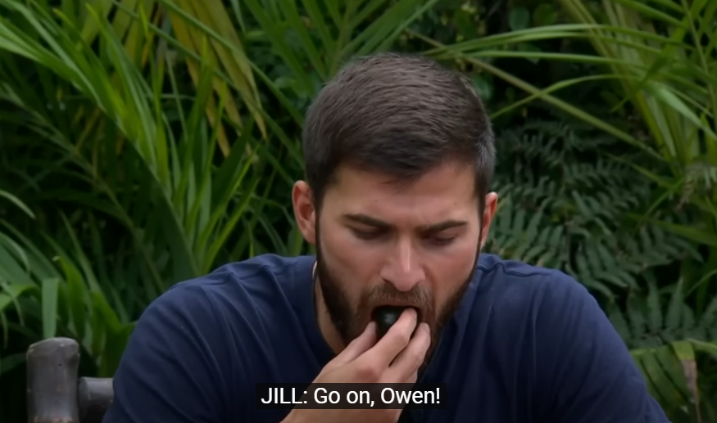
The customer is always right!
https://www.youtube.com/watch?v=7IruO9taW-o
Watch this clip
Using your creative writing skills, write a complaint letter to a restaurant of your choice about the food and service you received, based on one or more of the 6 terrible tasting dishes eaten by Owen.
In the letter consider the audience and purpose, tone and the letter format
This task has a recommended word count between 200-400 words.
00:00:00 (online-stopwatch.com)
Notes:
Collate checklist from group contributions before starting task
Provide a basic letter template if additional scaffolding required (Appendix A)

Slide 11
Task idea 2
Buzz groups – same and different

Slide 12

Buzz groups – same and different rationale
Buzz groups are short discussions, completed in pairs or groups of three people at the most.
As participants start talking, they will generate a 'buzzing noise' in the class with their chat.
Same and different tasks are flexible and facilitate differentiation
Minimal preparation is required
They can be used to compare and evaluate in vocational contexts
These are also useful recap/consolidation activities
Notes:
Definition retrieved from How Do I Use Buzz Groups in Training? (thetrainingworld.com)

Slide 13
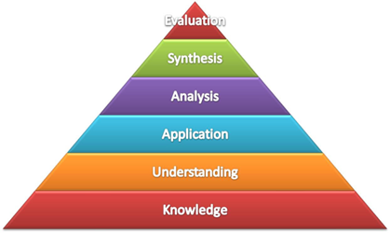
Same and different (buzz groups)
The following slides contain a buzz group activity that can be used for F2F or remote delivery.
Educational theory
‘Comparisons are ubiquitous – whenever we take in information, we make sense of it by comparing that information to what we already know. Such comparison processes are central to all learning processes, especially where learners self-regulate their progress’. Butler & Winne, 1995; Hattie & Timperley, 2007
Application in a Vocational context
Compare qualities/features of different products or processes. Students to research initially using simple grid to facilitate comparison
Wider application/skills
Following instructions
Obtaining information from texts
British Values via consideration of voting models
Useful to compare and distinguish texts written for different purposes
Facilitates higher-order cognitive skills as seen via Bloom’s taxonomy
Notes:
Educational theory sourced from Butler & Winne, 1995; Hattie & Timperley, 2007

Slide 14
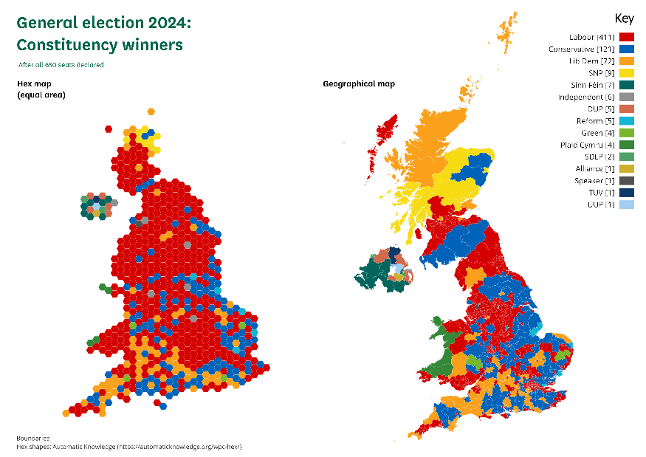
What is your vote worth?
Who are we voting for when we vote in an election? How can a party win without having a majority of seats? What do you think are the most important characteristics of a fair and effective electoral system?
Different voting systems have a variety of different features, ranging from how proportional they are (whether seats in parliament reflect votes cast), the connection between MPs and their communities and the extent to which voters can choose between different candidates.
Notes:
Types of Voting System – Electoral Reform Society – ERS (electoral-reform.org.uk)

Slide 15
What is your vote worth?
TASK: compare the following voting systems in 10 minutes in small groups
First Past the Post (FPTP): Voters select one candidate, and the candidate with the most votes in a constituency wins. It is a simple majority system, used in the UK for general elections.
Single Transferable Vote (STV): Voters rank candidates in order of preference. To win, a candidate needs to reach a quota of votes. Votes are transferred from eliminated candidates or those with excess votes until all seats are filled. This system is more proportional and used in multi-member constituencies.
Additional Member System (AMS): A hybrid system combining FPTP and proportional representation. Voters cast two votes: one for a constituency representative (FPTP) and another for a party list. This ensures a more proportional overall result by adding members from party lists to balance the distribution of seats.
Which system does your group like and why? What was your group rationale?

Slide 16
Task idea 3
‘Not yet’

Slide 17

Not Yet (building learner resilience): rationale
A selection of slides designed to support learners to develop resilience and replace previous potentially negative associations with a more positive attitude.
Created for maths and English delivery, these slides are designed to engage a potentially reluctant cohort and kickstart a positive rapport and growth mindset among learners, from the very first session.

Slide 18
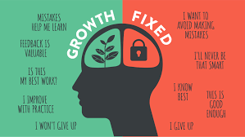
Not Yet (building learner resilience)
The following slides contain resilience activities that can be used for F2F or remote delivery.
Educational theory
The passion for stretching yourself and sticking to it, even (or especially) when it’s not going well, is the hallmark of the growth mindset. This is the mindset that allows people to thrive during some of the most challenging times in their lives.
Source: Carol S Dweck Mindset: The New Psychology of Success
Application in vocational context
The slides can be adapted to any vocational area. Encourage a culture of asking when something is not clear, and using these teachable moments to benefit the group
Wider application/skills
These slides were originally designed to address learner reluctance and build resilience in maths and English, since these are likely to represent areas that have previously proved challenging.
Notes:
Taken from Carol S Dweck Mindset: The New Psychology of Success
https://fs.blog/carol-dweck-mindset/
Teachable moments represent those opportunities in delivery to use a learner interaction as an opportunity to recap, consolidate or revisit learning or introduce new related material

Slide 19
Not Yet…
What does this phrase mean to you?
What is this label suggesting? Is it misleading?
SIX EARLY ENGAGEMENT ACTIVITIES
Notes:
Discussion – not yet implies an expectation that something will happen or be the case.
Why have the food manufacturers chosen to put Not Yet Recycled instead of Not Recycled? Is this misleading?
Let’s think about the power of Not Yet….

Slide 20
Choose a statement that applies to you
These statements relate to your future.
Which of the following responses is most appropriate to use in the present?
I want to be respected in my job
I want to be able to afford the things I would like to buy
I want a rewarding and enjoyable career
I want to be successful
Are you respected in your job?
No/Not yet
Can you afford what you would like to buy?
Yes
Do you have a rewarding and enjoyable career?
Are you successful?
Notes:
Not yet is the best response here – a simple no implies failure, when in fact it would be impossible to have achieved these things yet

Slide 21


Maths/English is part of that journey
I’m RUBBISH at maths
Taken from J Kay, National Education Lead at The Development Wheel via Linkedin
Think again, some of these maths processes you may struggle with, but some you don’t!
Telling the time
Paying for shopping
Dividing things up
Measuring
Deciding on the probability of something happening
Following a recipe
Finding information from eg a bus timetable
Working out the best deal
Which of these are YES and which are NOT YET?

Slide 22
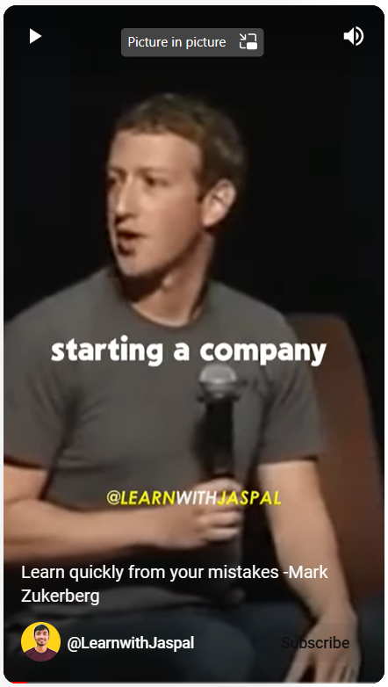
How can you tell whether you are learning?
It’s hard (stuff you can do is in your comfort zone, and you don’t learn anything new here).
You make mistakes (watch this clip)
Learn quickly from your mistakes -Mark Zukerberg – YouTube
So, if you’re making lots of mistakes then you’re learning lots! The important thing is to identify what you need to improve and to accept your mistakes as progress.

Slide 23
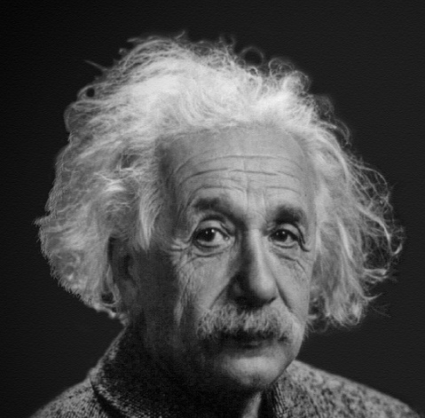

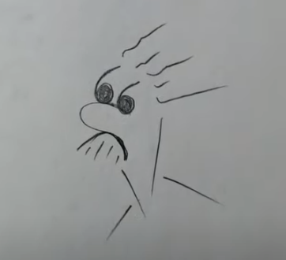
Can you draw me a picture of …?
No
Yes
Not yet
Take a piece of paper and a pen/pencil, and follow the instructions on the clip
How to draw Albert Einstein - Easy - YouTube

Slide 24
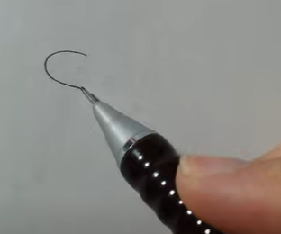
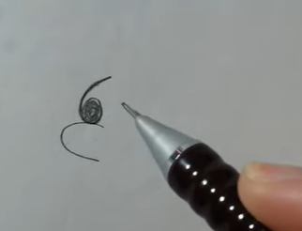
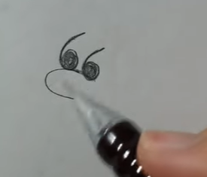
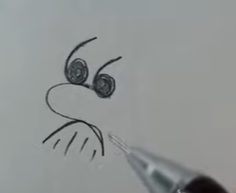
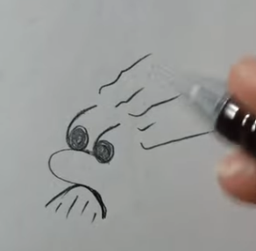
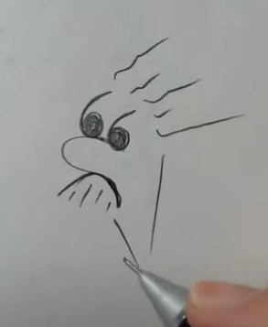
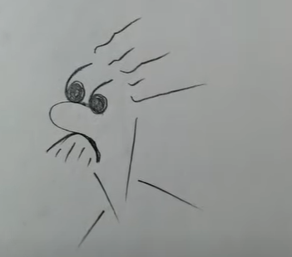
-

Slide 25

Making your personal NOT YET plan
I will make the most of my time at college and enjoy my learning
I will complete a skydive / learn to drive/travel across Europe / get a part-time job / drink more water… (!)
I will pass my maths and enjoy all the mistakes I make on the way!
On a post it note, or in notes on your phone, write three NOT YET statements. One of these should be about your maths or English (or both)
In your maths/ English lessons you will be asked to reflect on what you have learned and what your targets are.
In other words, which skills do you NOT YET have?

Slide 26

Finally, you’re in good company!
This clip is labelled Famous Failures – but it just shows how important the ‘Not Yet’ phase is
Famous Failures - Never Give Up - YouTube

Slide 27
Task idea 4
Square squad

Slide 28
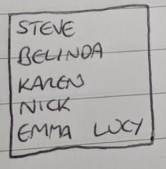
Square Squad: rationale
The Square Squad is all about building resilience and tapping into your support network
Learners need to know who they can rely on for support in different areas of their life
It is a short, reflective task which can also help learners to build connections in their learning cohorts and more widely

Slide 29
Square Squad
The following slide contains a square squad activity that can be used for F2F or remote delivery.
Educational theory
To get clear about who belongs on your square squad, use a one-inch by one-inch piece of paper, write down the names of the people in your life whose opinions really matter. The paper is small because it forces you to narrow the list to only those people who have earned the right to an opinion. (Brene Brown – Dare to Lead)
Application in vocational context
Encourage learners to identify who they feel they can rely on for support in the following areas:
Motivation
Coping with stress/anxiety
Classroom/learning support
Wider application/skills
Personal skills development (identifying support)
Reflective skills
Active learning mindset
Notes:
Dare to Lead Glossary of Key Language Skills, Tools, and Practices - Brené Brown (brenebrown.com)

Slide 30
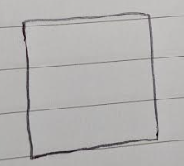
Who is in your square squad?
Whose list would you be on?
It's important to have people you can rely on. (youtube.com)
Who could you call at any time for help?
Use a one-inch squared piece of paper to write down the names of the people in your life who you can rely on
They might be at home, work or at your place of learning
It’s important you know who they are
Now share your answers to these questions:
What did you learn from thinking about who belongs in the square?
Do you devote too much worrying what other people think, rather than spending that time with those that you can rely on?
What’s one thing you can do to strengthen your squad?

Slide 31
Task idea 5
Nine box squares

Slide 32

Nine box squares: rationale
This activity, based on the 9-box grid employee assessment tool, combines retrieval practice and elaboration.
Encouraging students to make connections and form associations, is an effective way of consolidating learning.
It is flexible and simple to use and can even be formulated during lesson time with learners suggesting appropriate content for each box.

Slide 33

Nine box squares
The following slide contains a nine box squares activity that can be used for F2F or remote delivery.
Educational theory
Retrieval practice can be used in selecting the nine key words without access to notes etc. “Recalling information without supporting materials helps us learn it much more effectively. Elaboration asks students to go beyond simple recall of information and start making connections within the content.”
6 Powerful Learning Strategies You MUST Share with Students | Cult of Pedagogy – interview with Megan Smith and Yana Weinstein
Application in vocational context
Write nine key words, used in the previous lesson, in boxes on the board. Challenge students to make a sentence using at least three words, or a short paragraph using them all.
Wider application/skills
Can be used to introduce personal development topics, discuss topical issues or embed maths or English content in delivery, for example by listing nine language techniques or related maths terms
Notes:
6 Powerful Learning Strategies You MUST Share with Students | Cult of Pedagogy – interview with Megan Smith and Yana Weinstein

Slide 34

The following nine words are taken from the Global Goals document that lists 17 priority goals agreed by world leaders to build a greener, fairer, better world by 2030.
Can you combine them in a few sentences to explain their importance?
water | clean | wellbeing
justice | gender | health
sustainable | energies | communities
e.g. Clean water will improve health in poorer countries
Notes:
Goals Archive - The Global Goals

Slide 35
Task idea 6
Sinking balloon

Slide 36

Sinking balloon task: rationale
This is an effective way to engage learners on a topical issue and to encourage the sharing and defending of opinions in a light-hearted way.
It is a twist on the ‘shipwreck activity’ where apprentices discuss and agree on which equipment will best ensure their survival.
The same task structure can be used to evaluate/defend equipment or roles in a vocational context, for example.

Slide 37
Sinking balloon task
The following slide contains a sinking balloon activity that can be used for F2F or remote delivery.
Educational theory
Team building tasks [develop] a sense of belonging, an atmosphere of community, tolerance and team spirit, and improve communication skills.
[They] also create a climate of co-operation and contribute to collaborative problem-solving, develop empathy and trust in the group and in yourself, enhance creativity, and boost self-esteem.
Application in vocational context
Ask students to explain their choices in terms of justifying their weight in the balloon, from a selection of:
Equipment
People/roles
Ingredients, etc
Wider application/skills
Discussion skills
Making an argument
Deliberation and evaluation
Notes:
Importance of Team Building in School > Course for Teachers (teacheracademy.eu)

Slide 38


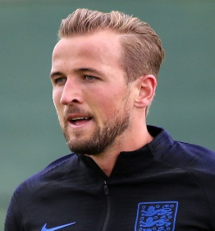







Who’s worth their place?
You are about to share a balloon ride, but you can only take 3 people.
As a group, decide who you will keep and on which grounds.
Best company?
Most deserving?
Most useful?
Actress
Rapper
Footballer
Scientist
Boxer
TV star
Actress
Former president
Influencer
Notes:
You can swap in and out whoever you wish – those pictured are listed below
Nicola Coughlan (actor – Bridgerton, Derry Girls)
Stormzy (rapper)
Harry Kane (England football captain)
Brian Cox (scientist)
Nicola Adams (former professional boxer and first double Olympic female champion)
Joey Essex – TV celeb
Emma Watson (actor, women’s rights activist)
Donald Trump (US former president and presidential candidate)
Molly-Mae (influencer)

Slide 39
Appendix A: letter writing template
Your address (unless on company letterhead)
Date
Addressee name and position
Company name
Address
[Ref]
Dear SALUTATION
Short intro para-state purpose of the letter (I am writing to…)
New para for each new point/ argument
Closing para-state what you want to happen (throw the ball into their court…)
Yours COMPLIMENTARY CLOSE
Your full name
Dear Mr Brown → Yours sincerely
Dear Sir or Madam → Yours faithfully
Since I know your name, I can rely on you.
Don’t put two Ss together (i.e. Sir and sincerely)
SIX EARLY ENGAGEMENT ACTIVITIES

