Slide 1


Lesson 7:
Understanding straight line graphs
Objectives
Understand how linear relationships are represented by straight line graphs
Understand gradient as steepness and rate
Interpret the y-intercept as a constant
Use graphs to identify information about a relationship
Make connections between equations of a straight line and their graphical representations

Slide 2
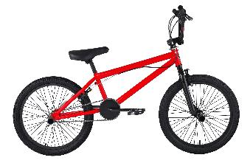
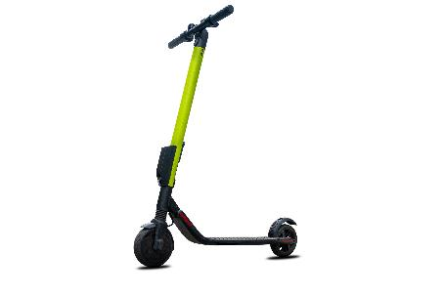



Bike and scooter hire
Pedal bike
E-bike
E-scooter
What are some different ways to charge for a hire?
Debbie
Edwin
Notes:
Tell students that Debbie and Edwin are starting up a bike and scooter hire business in the city where they live. They have pedal bikes, electric bikes (e-bikes) and electric scooters (e-scooters) for hire. They borrowed some money to buy the bikes and scooters. They want to be able to pay off the loan and start making some money as soon as possible.
Debbie and Edwin need to decide on a pricing model. Ask students to suggest some different ways that Debbie and Edwin could charge for a hire. You may like to discuss things such as an hourly rate, or charging to hire for the day. Encourage all students to contribute to the class discussion, providing an opportunity for students to explain their thinking to each other and promoting a collaborative culture (Key Principle 5).

Slide 3
Hire charges
So, the hire cost is 15 times the number of minutes … I’ll write an equation.
Let’s charge 15p per minute.
Pedal bike
h = 15t
Debbie
Edwin
Notes:
Debbie and Edwin decide to charge by the minute, as city hires can often be quite short. They discuss how much to charge per minute for hiring a pedal bike. They want to make sure they are charging a price that attracts customers and isn’t too expensive, but that also means that they will start making a profit as soon as possible.
Debbie suggests they charge 15p per minute.
Edwin writes the equation h = 15t
Ask students what h and t represent in Edwin’s equation and establish that h represents the hire charge amount per minute in pence. Now ask them to write on their mini whiteboards what the charges would be for a 2-minute hire and a 10-minute hire, for example, to check their understanding of substitution. Most students should be able to do this, and the activity provides an opportunity for you to value, and build on, what they already know (Key Principle 2).

Slide 4
Hire charges
Let’s charge 15p per minute.
We need to get at least £3.50 for a 20-minute hire.
Pedal bike
h = 15t
h = 15 × 20
h = 300
Debbie
Edwin
What will the charge be for a 20-minute hire?
Notes:
The average hire length is 20 minutes. Edwin wants to ensure that they receive at least £3.50 from a pedal bike hire of average length. Ask students to work out the hire charge for 20 minutes and to write their answer on their mini whiteboard.
After a minute or so ask students to explain their thinking. When t = 20, h = 300. Check that students recognise that this means the hire charge is 300p, which is £3, so it is less than the required £3.50.

Slide 5
Pedal bike hire
We could charge a fee to unlock the bike and then charge 15p per minute.
Let’s draw
a graph.
h = 15 + (15 × 20) ✗
h = 20 + (15 × 20) ✗
h = 25 + (15 × 20) ✗
Debbie
Edwin
Notes:
Tell students that Edwin suggests they charge a fee to unlock the bike and then charge per minute. He starts to do some calculations to try to work out what to charge as an unlocking fee.
Ask students to explain why Edwin has put a cross after each calculation. Check that students can identify the unlocking fee in each calculation and ask them to work out the value of h in each case.
Tell students that after a while Debbie suggests they draw a graph.

Slide 6
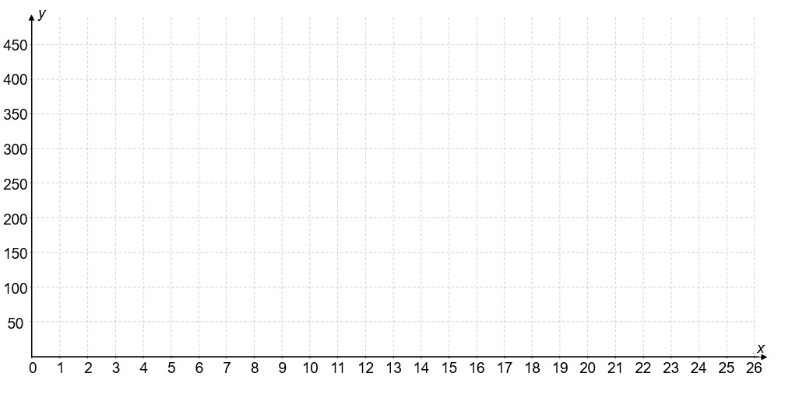
Constructing the graph
DISCUSS
Pedal bike hire
(20,300)
Hire charge in pence (h)
(0,0)
Length of hire in minutes (t)
Notes:
Debbie labels the y-axis the amount to be charged for the hire in pence (h) and the x-axis the length of hire in minutes (t). She knows that she can use any value for t and the corresponding value for h to find a point on the line. For her initial suggestion of charging 15p per minute, there is no unlocking fee, so the charge initially is zero. She plots the point (0, 0). Debbie also knows that a 20-minute hire has a charge of £3 (300p) so she plots the point (20, 300) too. Make sure that students know why only two points are needed, and how the two points are calculated and plotted.

Slide 7
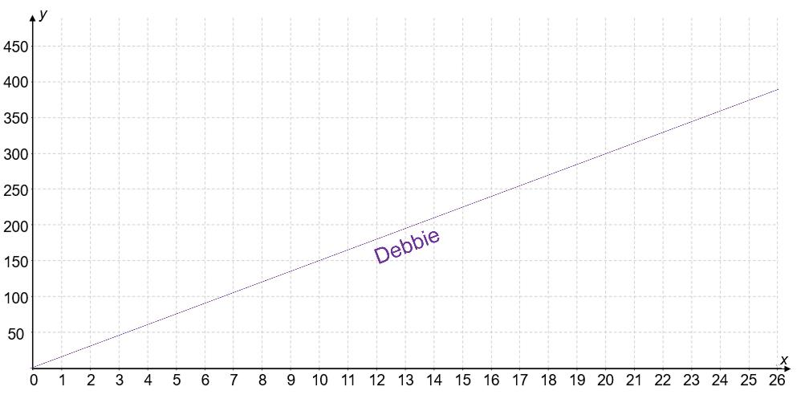
Plotting the line
DISCUSS
Pedal bike hire
Will it be a straight line?
(20,300)
Yes. The charge increases 15p every minute.
Hire charge in pence (h)
Edwin
(0,0)
Debbie
Length of hire in minutes (t)
Notes:
Debbie then draws a straight line passing through the two points she has plotted. Edwin asks if it should be a straight line and Debbie says that the charge increases by 15p every minute so it must be a straight line. Ask students to comment on whether Debbie is correct.
While in reality the graph would be stepped, (as for a 5½ minute hire you pay for 6 minutes), a straight line graph provides an adequate model for reading off values for t and h. Establish that every point on the line satisfies the equation h = 15t.

Slide 8
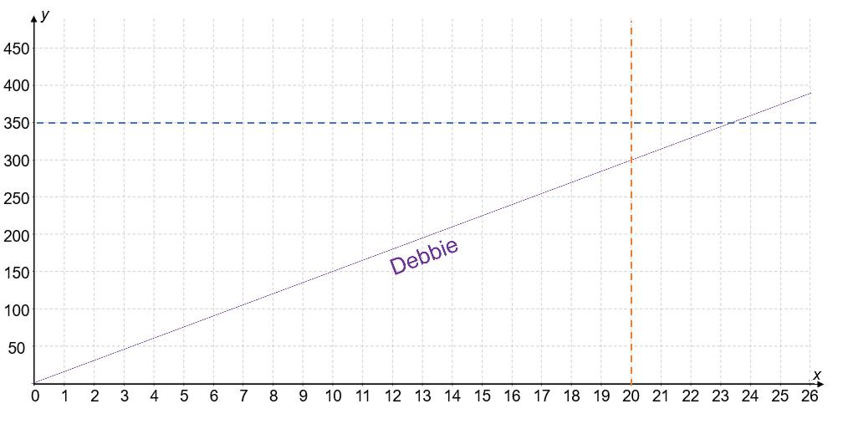
Adding vertical and horizontal lines
DISCUSS
Pedal bike hire
t = 20
h = 350
What are the vertical and horizontal lines for?
(20,300)
Hire charge in pence (h)
(0,0)
Length of hire in minutes (t)
Notes:
Tell students that Debbie adds a vertical and a horizontal line to the graph. Ask students to explain what these lines are for and check whether they can identify the equations for the two lines.
Establish that adding the line t = 20 helps to determine the amount that would be charged for a 20-minute hire (average hire length) and that it is clear from the graph that Debbie’s suggestion of 15p per minute is below the h = 350 line.
For a £3.50 charge, the hire would need to be between 23 and 24 minutes long (350 ÷ 15 = 23⅓, so 24 minutes in reality), which is where Debbie’s line crosses the horizontal line h = 350.

Slide 9
£3.50 for a 20-minute hire
DISCUSS
Pedal bike hire
Target
t = 20
h = 350
How could they reach the target?
(20,300)
Hire charge in pence (h)
(0,0)
Length of hire in minutes (t)
Notes:
Remind the students that Edwin and Debbie have set a target of £3.50 for a 20-minute hire. Establish that this would mean that the graph line would have to go through the target point (or higher). Ask students to suggest what Edwin and Debbie could do.
Debbie and Edwin could increase the per-minute hire charge (which makes the graph steeper) or they could add in an unlocking fee (which would mean the graph is shifted up by the unlocking fee amount), or they could do a combination of both. This should be a short discussion to explore possibilities. Students will look at the way each possibility affects the graph in more detail in the next part of the lesson (next slide).

Slide 10
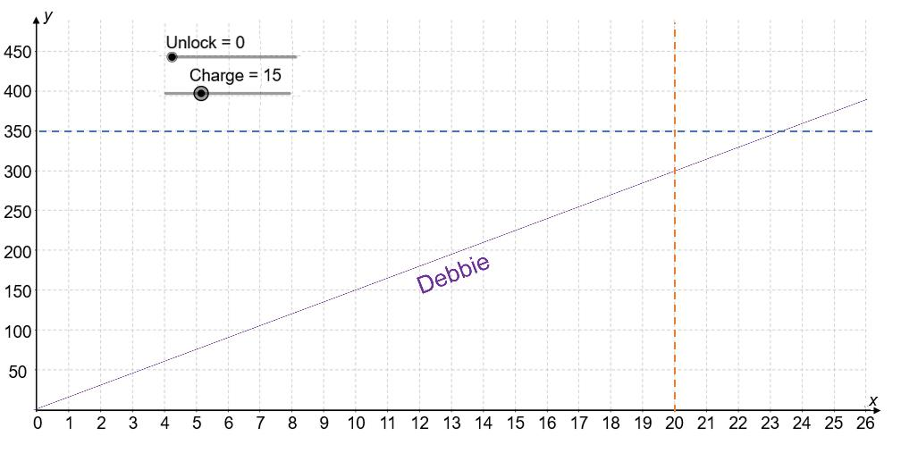
Unlocking charge
DISCUSS
Use the ‘Pedal bike hire’ app: https://www.geogebra.org/m/adyxa7fq
Pedal bike hire
t = 20
h = 350
(20,300)
Hire charge in pence (h)
What should the unlocking charge be?
(0,0)
Length of hire in minutes (t)
Notes:
Use the ‘Pedal bike app’, which can be found at https://www.geogebra.org/m/adyxa7fq to explore changes in the graph.
Ask students to predict what will happen to the graph if a fee is charged to unlock the bike. Keep the ‘Charge’ slider at 15 and increase the ‘Unlock’ slider to a number less than 50. Discuss what happens to the graph. Check that students recognise that the line is parallel to the original line and that it crosses the y-axis at the same value as the unlocking fee amount. Establish that the two straight line graphs have the same steepness/gradient/are parallel because the price per minute (15p) has stayed the same and is identifiable from the change in cost, h, (‘change in y’) divided by the change in length of hire, t, (‘change in x’).
Ask students what the unlock fee needs to be to ensure that Debbie and Edwin are charging £3.50 for a 20-minute hire (50p).
Return the ‘Unlock’ slider to 0. Ask students to predict what Debbie and Edwin would need to increase the per minute charge to if they did not include a fee to unlock the bike. Establish that 17p per minute is just below £3.50 and 18p per minute is just above. Ask students how they could work out the per minute charge exactly (350 ÷ 20 = 17.5). Establish that it is not possible to charge 17.5p per minute so the charge would have to be 18p per minute, resulting in a £3.60 charge for a 20-minute hire.

Slide 11
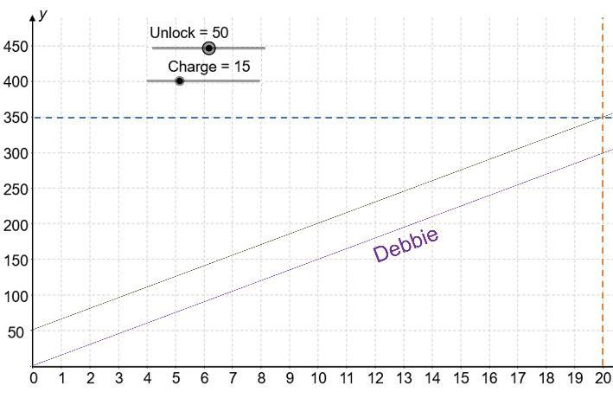

Equation of the line
h = 15t
means 15p per minute.
Pedal bike hire
Hire charge in pence (h)
Edwin
Write an equation for
‘50p to unlock &
15p per minute’
Length of hire in minutes (t)
Notes:
Remind students of the equation that Edwin wrote for Debbie’s suggestion of charging 15p per minute. Ask students what equation Edwin will write if they charge ‘50p to unlock and 15p per minute’. Give students a couple of minutes to write an equation on their mini whiteboards.
Discuss students’ responses and highlight that for any value of t, the new value is 50p more, so the equation will be h = 50 + 15t or h = 15t + 50.

Slide 12
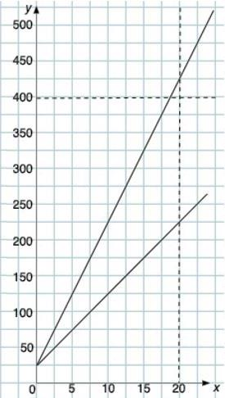
E-scooter hire
DISCUSS
E-scooter hire
We need at least £4
for a 20-minute hire.
Hire charge in pence (h)
Debbie
Edwin
What is the unlocking fee?
How can we find the charge per minute?
Length of hire in mins (t)
Notes:
Explain to students that Debbie and Edwin need to agree on the prices for hiring an e-scooter and an e-bike. They first decide between two different pricing options for hiring an e-scooter. They want to make sure that they are not charging too much, as this could result in them not getting many hires if people think the charges are too expensive. They are aiming to achieve at least £4 for an average length (20 minute) e-scooter hire.
Tell students that the two options have been represented on a graph.
Ask students to look at the scale on the y-axis and check that they can identify the unlocking fee for the two options from the graph (25p).
Now direct their attention to the x-axis and discuss how they could identify the charge per minute (for example, reading off the hire charge for a 5-minute hire or a 10-minute hire). If the charge for a 5- or 10-minute hire and the unlocking fee are known, subtracting the fee and dividing by the length of hire gives the charge per minute.

Slide 13

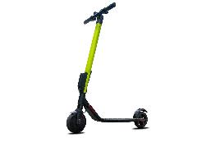
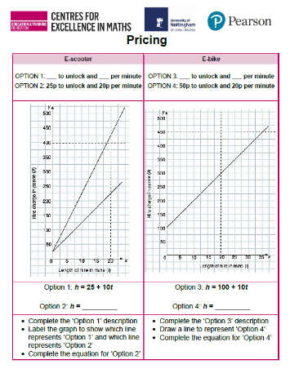

Missing equations/graph
YOUR TURN
Handout
available
We need £4 for
20 minutes.
We need £4.50
for 20 minutes.
Complete the missing descriptions, equations and graph.
Which options are best?
Notes:
Give copies of the ‘Pricing’ handout to each pair of students. You may want to cut and give the two sections out separately or ask students to fold the handout so that they can focus on the e-scooter hire first, before asking them to work on the e-bike hire.
Remind students that Debbie and Edwin need at least £4 for an average length e-scooter hire (20 minutes). Tell students that Debbie and Edwin would like at least £4.50 for an average length e-bike hire (20 minutes).
Ask students to complete the missing descriptions, equations and graph on the handout and identify which option Debbie and Edwin should choose for each type of hire. Tell students that they should use a sharp pencil when completing the graph for the e-bike hire.
Once students have had sufficient time to complete the task, hold a class discussion.

Slide 14
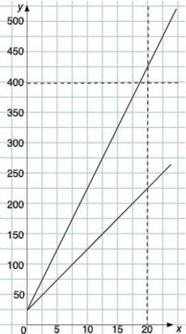
E-scooter hire charges
REVIEW
E-scooter hire
Option 2
We need £4
for 20 minutes.
OPTION 1
25p to unlock &
10p per minute
Option 1
Hire charge in pence (h)
OPTION 2
25p to unlock &
20p per minute
Length of hire in mins (t)
OPTION 1: h = 25 + 10t
OPTION 2: h = 25 + 20t
Notes:
Use Slides 14 – 17 to support a class discussion.
Check that students have correctly identified Option 1 as ‘25p to unlock and 10p per minute’ and have labelled the graphical representations of the two options correctly.
Check what students have written as an equation for Option 2 and ask them to explain how they identified it. If students have written h = 20 + 25t rather than h = 25 + 20t, ask them to use the description for Option 2 to calculate the charge for a 10-minute hire and compare this with substituting t = 10 into equation h = 20 + 25t. Check that students understand and can explain why the missing equation is h = 25 + 20t and check that students understand why this is the case.
Ask students to comment on what‘s the same and what’s different about the two straight line graphs and how this relates to the two equations. Highlight that both graphs start at (0, 25), as the fee to unlock the scooter is 25p for both options. The charge per minute for Option 2 (20p) is more expensive than the charge per minute for Option 1 (10p), so the graphical representation is steeper for Option 2 (gradient = 20) than for Option 1 (gradient = 10). Confirm that charging ‘25p to unlock and 20p per minute’ (Option 2) will ensure that an average e-scooter hire will bring in the desired amount of money. Ask students to use the graph to determine what the charge for a 20-minute hire would be for Option 1 (£2.25).

Slide 15
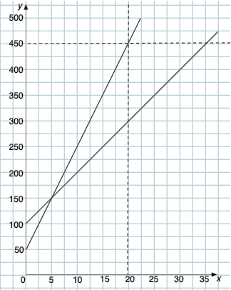
E-bike hire charges
REVIEW
E-bike hire
Option 4
We need £4.50
for 20 minutes.
Option 3
OPTION 3
£1 to unlock &
10p per minute
Hire charge in pence (h)
OPTION 4
50p to unlock &
20p per minute
Length of hire in mins (t)
OPTION 3: h = 100 + 10t
OPTION 4: h = 50 + 20t
Notes:
Check that students have correctly identified that Option 3 has already been represented and have drawn the graph for Option 4 correctly. Students may have struggled when drawing the graph so spend time asking a couple of students to explain how they identified where the graph crosses the y-axis (0, 50) and its gradient (20).
Discuss the features of the two e-bike graphs, focusing on the differences in gradient and y-intercept. Ask students to interpret what the point of intersection of the two graphs means in terms of e-bike hire (the cost of a 5-minute hire would be the same for both of the options).
Check that students can identify the 100p in the equation and on the graph for Option 3 as a £1 unlocking fee (they may have described it as ‘100p to unlock’). Confirm that charging ‘50p to unlock and 20p per minute’ (Option 4) will ensure that an average length e-bike hire will bring in the desired amount of money. Ask students to explain how they could determine what the length of hire would need to be for Option 3 for the charge to be £4.50 (35 minutes). Check whether students can explain how to do this using both the equation (450 = 100 + 10t) and the graph.

Slide 16
Graphical representations
REVIEW
A:
There is no unlocking charge
B:
The unlocking charges
are the same
The charge per minute
is the same
C:
1:
2:
3:
Notes:
Bring students’ thinking together by asking them to identify which of the three graphs match descriptions A–C and write their choice on their mini whiteboard. You may like to use the animations included in the slide and ask students to consider the three descriptions in succession, rather than determining the three matches simultaneously.
Ask students to explain how they know, and focus on the properties of the straight line. Check whether students recognise that both graphs 1 and 3 can be matched to description B.

Slide 17
Features of the straight line graphs
REVIEW
If there is no unlocking charge,
the straight line graph starts at the origin
When the unlocking charges are the same,
the straight line graphs have
the same starting position
When the charge per minute is the same,
the straight line graphs are parallel
Notes:
Once the correct matches have been established (A3, B1 or B3, and C2) and discussed, conclude the discussion with a summary of the key points:
If there is no unlocking charge, the straight line graphs start at the origin.
When the unlocking charges are the same, the straight line graphs have the same starting position.
When the charge per minute is the same, the straight line graphs are parallel.

Slide 18
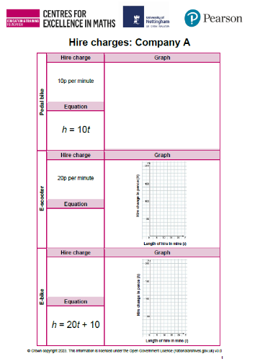
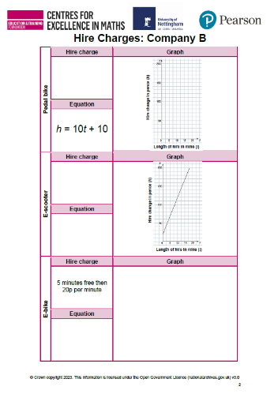
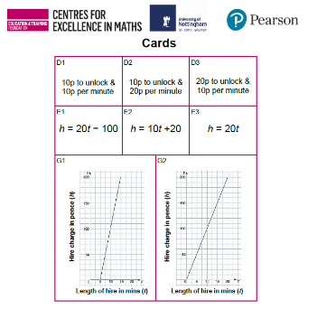
Placing the cards
YOUR TURN
Handout
available
Work in pairs to match the cards to the empty cells.
Take turns giving a reason for your choice.
Complete the blank graphs and any missing ‘hire charges’ and ‘equations’.
Notes:
Give each pair of students a copy of the ‘Hire charges’ handout, the ‘Cards’ and some scissors (if the cards have not already been cut up).
Explain to students that Debbie and Edwin collect information about two other city hire companies (Company A and Company B) so that they can see how competitive their proposed charges are. The charges are described in writing, algebraically and graphically, but some of the information is missing. Ask students to work in pairs to place the cards in the correct empty cells on the handout. They also need to fill in any empty cells and draw three graphs. You might want to work through one of the graphs they need to draw with them, because although they have already drawn a graph in Explore 1, some of them may still need help.
Encourage students to take turns, explaining their thinking to their partner. Explain that they need to complete the three blank graphs on the handout, making sure they use a sharp pencil so that they can draw accurately.

Slide 19
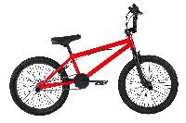
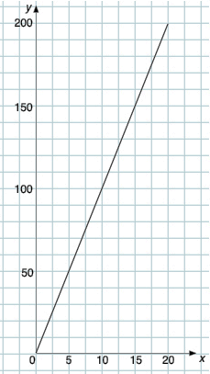
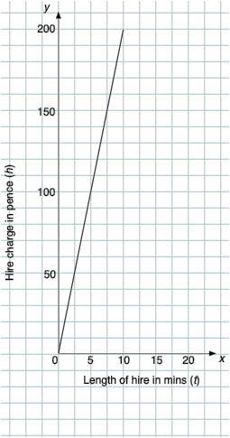
Company A: Pedal bike/E-scooter
REVIEW
10p per minute
G2
Pedal bike hire
E-scooter hire
h = 10t
20p per minute
Hire charge in pence (h)
Hire charge in pence (h)
E3 h = 20t
Why do the graphs start at
the origin?
Length of hire in mins (t)
Length of hire in mins (t)
Notes:
Check that students have matched cards G2 and E3 and have correctly drawn the graph for h = 20t. Students may have plotted some points to complete the graph. If so, ask them which points they plotted and how they determined those points.
Use this slide to emphasise the following:
Both graphs start at the origin (because there is no unlocking charge).
The gradients of the two lines are different. The line representing the scooter hire is steeper than the line representing the pedal bike hire because the price per minute is higher for the scooter.

Slide 20
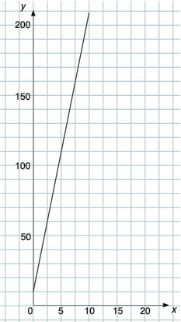
Writing equations
REVIEW
E-bike hire
D2 10p to unlock &
20p per minute
h = 20t +10
Hire charge in pence (h)
OPTION 4
50p to unlock &
20p per minute
How is
h = 20t +10 different to
h = 50 + 20t?
h = 50 + 20t
Length of hire in mins (t)
Notes:
For the e-bike, the correct card is D2. Students need to draw the graph. Check that their straight line graph starts at the point (0, 10) and has a gradient of 20. Ask students to explain how they drew their graphs.
Remind students of the second option (Option 4) that Debbie and Edwin were considering charging for an e-bike hire earlier in the lesson. Ask them what they notice about the equation for this (h = 50 + 20t) compared with h = 20t + 10. In h = 50 + 20t the unlocking fee (the constant term) has been written as the first part of the equation, whereas for h = 20t + 10 the equation has been given in the more conventional ‘y = mx + c’ form and so the variable term comes first.
You may not need to hold this discussion, but it is important that students understand the structure of the equation of a straight line so that they are able to identify the charge per minute (gradient) and unlocking fee (y-intercept) when it is written in different ways.

Slide 21
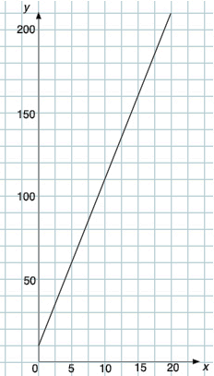
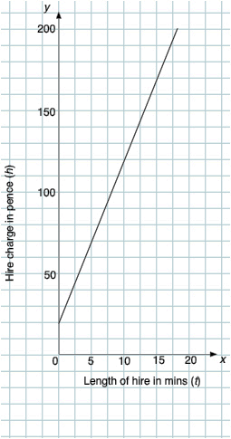
Company B: Pedal bike/E-scooter
REVIEW
Pedal bike hire
E-scooter hire
D1 10p to unlock &
10p per minute
h = 10t + 10
Hire charge in pence (h)
Hire charge in pence (h)
20p to unlock &
10p per minute
E2 h = 10t + 20
Length of hire in mins (t)
Length of hire in mins (t)
Notes:
For Company B, for the pedal bike, students need to draw the graph using the information given in the equation and choose Card D1 for the hire charge.
For the e-scooter, the unlocking fee and rate need to be read off the graph, giving the equation h = 10t + 20 (card E2).
After checking that students understood what to do and could do it, you may want to discuss how these graphs are the same and how they are different, pointing out that the gradients (rate per minute) are the same and the y-intercepts (unlocking fee) are different. Highlight that if two graphs have the same gradient, the change in y will be the same for a given change in x, irrespective of the y-intercepts of the two graphs. The graph for the e-scooter can be described as the straight line graph for the pedal bike hire translated 10 units in the positive y-direction.

Slide 22
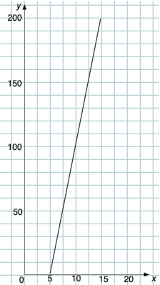
Company B: E-bike
REVIEW
G1
E-bike hire
5 minutes free then
20p per minute
Hire charge in pence (h)
E1 h = 20t – 100
Length of hire in mins (t)
Notes:
If students have placed the cards correctly, they may assume that the remaining cards E1 and G1 match, without considering why this is the case. It is important to explore these hire charges to establish why the equation h = 20t - 100 correctly describes ‘5 minutes free and then 20p per minute’. Ask students if they can describe the relationship between h and t using an equation expressed differently to the one on card E1. It might help to ask students to think about the calculation needed for a specific length of hire, such as 10 minutes. Students may be able to generalise the calculation h = (10 – 5) × 20 to give h = 20(t – 5), for example, and expand the bracket to give h = 20t - 100.

Slide 23

Comparing to Companies A and B
REVIEW
Company A
Company B
Debbie & Edwin
h = 10t
h = 10t + 10
h = 15t + 50
h = 20t
h = 10t + 20
h = 20t + 25
h = 20t + 10
h = 20t – 100
h = 20t + 50
Notes:
Remind students that Debbie and Edwin are interested in how competitive their charges are compared to two other companies (Company A and B). Ask them to comment on whether their proposed charges are cheaper or more expensive than Companies A and B.
If students are struggling, ask them how they could find out (for example, substituting values in, drawing the graphs of the three corresponding charges to make a comparison, thinking about the structure of the equations and what it tells us about the charges).
Establish that Debbie and Edwin are proposing to charge more than both companies for each type of hire and ask them how this might affect their business.

Slide 24
DISCUSS
Constant term and the y-intercept
h = 20t
h = 10t + 20
E-scooter hire
E-scooter hire
No
constant
term (it is 0)
Constant
term = 20
Hire charge in pence (h)
Hire charge in pence (h)
Intersects with the y-axis at
(0,20)
Goes
through
(0,0)
Length of hire in mins (t)
Length of hire in mins (t)
Company A
Company B
Notes:
Draw the discussion to a close by emphasising the relationship between the equations of the straight lines and their graphical representations. Emphasise that the constant term is where the graph intersects with the y-axis, and that when it is zero, the line goes through the origin.

Slide 25
DISCUSS
Variable term and the gradient
h = 20t
h = 10t + 20
E-scooter hire
E-scooter hire
Variable term t,
coefficient 10
Variable term t,
coefficient 20
Hire charge in pence (h)
Hire charge in pence (h)
Gradient = 10
For every 5 across,
it is 50 up
100
Gradient = 20
For every 5 across,
it is 100 up
50
5
5
Length of hire in mins (t)
Length of hire in mins (t)
Company A
Company B
Notes:
Identify the variable term and establish that the coefficient describes the gradient of the line and is a measure of how y increases (or decreases) as x increases (or decreases).
Deepening understanding Discuss how the two lines are not parallel and if drawn on the same graph would intersect at the point (2, 40).

Slide 26
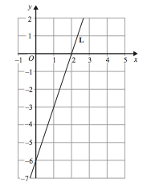
Practice question (1)
REVIEW
Handout
available
The line L is shown on the grid.
Find an equation for L.
y = 3x – 6 (3)
Q22 from June 2018, 1MA1/2F
Notes:
Give each student a copy of the ‘Practice questions’ handout. Give students a couple of minutes to work on the questions individually. Once students have completed both practice questions, discuss their thinking.
Discuss students’ work on the first practice question, and check that they recognise the importance of explaining and documenting their thinking, rather than just completing the equation on the answer line. Ask students to explain whether they used the x- and y-intercepts to determine the gradient or chose alternative co-ordinate points.

Slide 27
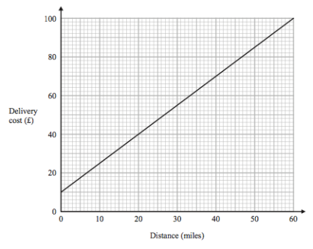
Practice question (2)
REVIEW
Handout
available
Tom uses his lorry to deliver bricks.
You can use this graph to find the delivery cost for different distances.
For each delivery, there is a fixed charge plus a charge for the distance.
How much is the fixed charge?
£10 (1)
Tom makes two deliveries of bricks.
The distance of one delivery is 20 miles more than the distance of the other delivery.
(b) Work out the difference between the two delivery costs.
£30 (2)
Q12 from November 2018, 1MA1/1F
Notes:
Discuss different student approaches when determining the difference between the two delivery costs in the second part of question 2. If students identified the gradient as 1.5, check whether they were then able to use this to identify the difference as £30. If they selected two distances with a difference of 20 miles, check that they are able to explain why any two such distances can be used to determine the difference between the two delivery costs as the gradient is constant.

Slide 28
Lesson review:
Understanding straight line graphs
Objectives
Understand how linear relationships are represented by straight line graphs
Understand gradient as steepness and rate
Interpret the y-intercept as a constant
Use graphs to identify information about a relationship
Make connections between equations of a straight line and their graphical representations
Suggested further steps/areas to work on
Interpret graphs of quadratic functions

Slide 29
Lesson 7:
Credits
Photo acknowledgements
Shutterstock.com: Keport, MVelishchuk, Perla Berant Wilder, Vectorfair.com
Text acknowledgements
2022 GeoGebra
Pearson Education Ltd: Pearson Edexcel GCSE (9-1) In Mathematics (1MA1) Foundation (Calculator) Paper 2F
Pearson Education Ltd: Pearson Edexcel GCSE (9-1) In Mathematics (1MA1) Foundation (Non-Calculator) Paper 1F

