Slide 1
Management and administration
4: Finance (core)
Session 3
Presenter name
Time and date
Location

Slide 2
03
The concept and calculation of breakeven

Slide 3


Spotting financial errors activity (W3.1a, W3.1b, E3.1c)
Using the financial statements provided (balance sheet, profit and loss statement, and cash flow statement), spot the mathematical and business accounting errors they contain.
Businessman Holding Magnifying Glass And Digital Tablet Stock Photo - Download Image Now - iStock (istockphoto.com)

Slide 4
Learning outcomes
Spot errors in financial statements and make adjustments to ensure accuracy.
Understand the different sources of finance available for various types of organisations.
Explain the concept of breakeven.
Identify the breakeven point for a business.

Slide 5
Breakeven chart
Breakeven is the point where total revenue (TR) = total costs (TC).
The formula to calculate this is:
Breakeven point = fixed costs ÷ contribution per unit
Contribution per unit is calculated as:
Selling price – variable cost per unit
Total contribution is calculated as:
Sales revenue – total variable costs
Total variable costs are calculated as:
Variable cost per unit x quantity
Notes:
In the next example, the fixed costs are £7,000 per month, and the variable costs are £12 per unit. The selling price of each unit is £90.
The following chart shows that the breakeven point is 90 units, which is where the total cost line intersects the total revenue line. This means the company needs to sell at least 90 units to cover all its costs and start making a profit.
Below the breakeven point, the total cost line is above the total revenue line, indicating a loss. Above the breakeven point, the total revenue line is above the total cost line, indicating a profit. The steeper the total revenue line, the greater the profit margin for each additional unit sold.
Breakeven charts are useful for businesses to determine the level of production needed to reach profitability, and to understand the impact of changes in fixed or variable costs on their operations.

Slide 6
Breakeven chart: worked example
Mary makes birthday cakes in addition to the standard items she sells. She has fixed costs of £7,000. Her variable cost per cake is £12 and her selling price is £90.
Contribution per unit = selling price – variable cost
Contribution per unit = £90 – £12 = £78
Breakeven point = fixed costs ÷ contribution per unit
Breakeven point = 7,000 ÷ 78 = 90 cakes
Mary needs to sell 90 cakes to break even.
What will happen if she sells fewer cakes?
What will happen if she sells more cakes?

Slide 7


Breakeven chart
Total revenue
Total costs
X = breakeven point
A = profit
A
Variable costs
X
B = loss
Cost/sales (£)
The amount by which sales exceed the breakeven point is the margin of safety.
B
Fixed costs
Output (units)

Slide 8

Breakeven chart activity (W3.2)
Mary is looking to add more lines to her bakery business.
She has decided to start selling fudge made by a local independent seller.
Mary has ordered 100 bags of fudge at a cost of £75.
In addition to the cost of the fudge, Mary has to pay the seller to deliver these at a cost of 20p per bag. Mary’s fixed costs are £500.
She has decided to sell the fudge for £4.95 per bag.
Calculate Mary’s breakeven point: how many bags of fudge does she need to sell in order to break even?
Remember to show each step and write down all your calculations.
Caramel Fudge Candies On A Plate Wooden Background Close Up Stock Photo - Download Image Now - iStock (istockphoto.com)

Slide 9

Breakeven chart activity: answers
Contribution = selling price – variable cost
Mary’s variable cost per bag of fudge is:
(£75 ÷ 100) + 20 pence delivery = 95 pence
Contribution = £4.95 – £0.95 = £4
Breakeven = fixed costs ÷ contribution
Breakeven = 500 ÷ 4 = 125 bags of fudge
Mary must sell 125 bags of fudge to break even.
Fudge Stock Photo - Download Image Now - Fudge, Fudge Sauce, Dessert - Sweet Food - iStock (istockphoto.com)

Slide 10
Breakeven practice
Product X is sold for £30. Each unit has a variable cost of £9.
Fixed costs are £35,000 per month. Complete the following table.
Units sold | Revenue | Variable costs | Fixed costs | Total costs | Profit (loss)
1,000
2,000
3,000
4,000
5,000
What is the breakeven point?

Slide 11
Breakeven practice: answers
Product X is sold for £30. Each unit has a variable cost of £9.
Fixed costs are £35,000 per month. Complete the following table.
Units sold | Revenue | Variable costs | Fixed costs | Total costs | Profit (loss)
1,000 | 30,000 | 9,000 | 35,000 | 44,000 | (14,000)
2,000 | 60,000 | 18,000 | 35,000 | 53,000 | 7,000
3,000 | 90,000 | 27,000 | 35,000 | 62,000 | 28,000
4,000 | 120,000 | 36,000 | 35,000 | 71,000 | 49,000
5,000 | 150,000 | 45,000 | 35,000 | 80,000 | 70,000
What is the breakeven point?
Notes:
Breakeven point (in units) = fixed costs ÷ (selling price per unit – variable cost per unit)
Fixed costs = £35,000 per month
Selling price per unit = £30
Variable cost per unit = £9
Breakeven point (in units) = 35,000 ÷ (30 – 9)
Breakeven point (in units) = 35,000 ÷ 21
Breakeven point (in units) = 1,666.67 (rounded up to the second decimal point)
So the breakeven point is approximately 1,667 units. This means that the company needs to sell at least 1,667 units of product X, in order to cover its fixed costs and start making a profit.

Slide 12
Breakeven practice: answers cont.
Product X is sold for £30. Each unit has a variable cost of £9.
Fixed costs are £35,000 per month. What is the breakeven point?
Fixed costs ÷ contribution per unit = breakeven point
35,000 ÷ 21 = 1,667 (rounded up to the nearest whole number)

Slide 13
Breakeven chart activity: extension (W3.3)
Earlier in the lesson, you calculated that Mary had a breakeven point of 125 bags of fudge.
Now create a breakeven chart for Mary on graph paper.

Slide 14


Case studies
Comet and Woolworths are both UK businesses that closed down.
Access the articles below and discuss whether accurately calculating the breakeven point and being able to forecast sales might have saved these businesses.
Comet: https://www.bbc.co.uk/news/business-20164228 (accessed 30.04.2023)
Woolworths: https://www.theguardian.com/business/2008/nov/26/woolworths-administration-high-street-retailers (accessed 30.04.2023)
Ashford England December 8 2008 Exterior Stock Photo 1859143759 | Shutterstock

Slide 15


PRODUCED BY
FUNDED BY
South Essex College has produced this resource on behalf of the Education and Training Foundation
This programme is funded by the Department for Education
ET-FOUNDATION.CO.UK

Slide 16
Management and administration
4: Finance (core)
Session 4
Presenter name
Time and date
Location

Slide 17
04
Sources of income
Tracking and controlling revenue and expenditure

Slide 18
Learning outcomes
Analyse the advantages and disadvantages of internal and external sources of finance.
Evaluate the suitability of different sources of finance for different types of organisations.
Explain how to track and control revenue and expenditure, including cash and profit.
Explain how financial reports are generated.
Justify the use of double-entry bookkeeping.

Slide 19
Sources of finance activity (W4.1)
In small groups, you will be assigned a legal form of ownership.
Can you remember the different types of legal forms of ownership?
Sole trader
Partnership
Public limited company (PLC)
Private limited company
Charity
Social enterprise

Slide 20
Sources of finance activity (W4.1) cont.
Look at the different internal and external sources of finance.
Discuss and identify which sources of finance would be most suitable for your assigned organisation.
Then share your findings with the other groups.
Internal sources: savings, retained profit, selling assets, owners’ capital.
External sources: bank loans, credit cards, overdrafts, cash advances, private equity,
investor funding (through shareholders, venture capitalists, angel investors), crowdfunding, grant funding, invoice factoring, donations, leasing, hire purchase.

Slide 21
Sources of finance: Epione Bakery case study
In small groups, discuss what sources of finance would
best suit Mary’s bakery if she was looking to expand her
business.
Consider the advantages and disadvantages of these sources of finance in relation to the Epione Bakery’s goals.
Prepare to feed back your suggestions to the other groups.

Slide 22
Sources of finance: matching activity (W4.2)
Match the ownership types with the appropriate source of finance and identify one advantage and one disadvantage for each combination.
Ownership types – blue
Sources of finance – red
Advantages – black
Disadvantages – green

Slide 23

Innocent Drinks: finance example
Innocent Drinks is a smoothie and juice company that was founded in 1999 by three friends who were looking for a healthy alternative to fizzy drinks. In 2009, Coca-Cola acquired an 18% stake in the company for £30 million, providing Innocent with a significant source of finance for its expansion plans.
Innocent used the investment from Coca-Cola to expand into new markets, launch new products, and invest in marketing and advertising. The company also used the funds to increase its production capacity and improve its supply chain. As a result, Innocent was able to grow its revenue and market share, becoming one of the leading smoothie brands in the UK and Europe.
London Uk August 10 2018 Bottles Stock Photo 1154663656 | Shutterstock
Read more at: https://www.theguardian.com/business/2013/feb/22/coca-cola-full-control-innocent (accessed 30.04.2023)

Slide 24

Double-entry bookkeeping
Double-entry bookkeeping is a system of recording financial transactions in which each transaction is recorded in two accounts: one account is debited, and the other account is credited.
This system ensures that the accounts are always balanced and accurate. This method is used to track revenue and expenditure in an organisation.
19,088 Bookkeeping Stock Photos, Pictures & Royalty-Free Images - iStock (istockphoto.com)

Slide 25
How credits and debits affect different accounts
Assets
Debits increase the balance of asset accounts, such as cash, accounts receivable and inventory.
For example, when a company receives cash, it records a debit to the cash account to reflect the increase in cash on hand.
Credits decrease the balance of asset accounts.
For example, when a company makes a payment from its cash account, it records a credit to the cash account to reflect the decrease in cash.

Slide 26
How credits and debits affect different accounts
Liabilities
Debits decrease the balance of liability accounts, such as accounts payable, loans payable and accrued expenses.
For example, when a company pays off a portion of its accounts payable, it records a debit to the accounts payable account to reflect the decrease in the liability.
Credits increase the balance of liability accounts.
For example, when a company borrows money and incurs a new loan, it records a credit to the loans payable account to reflect the increase in the liability.

Slide 27
How credits and debits affect different accounts
Equity
Debits decrease the balance of equity accounts, such as withdrawals or dividends.
For example, when a business owner withdraws funds from the company for personal use, it records a debit to the withdrawals account to reflect the decrease in equity.
Credits increase the balance of equity accounts, such as owners’ capital or retained earnings.
For example, when a company earns profits, it records a credit to the retained earnings account to reflect the increase in equity.

Slide 28
How credits and debits affect different accounts
Revenue
Debits do not typically affect revenue accounts directly.
Revenue accounts are usually credited when the company earns income from providing goods or services to customers.
For example, when a company sells products to a customer, it records a credit to the sales or revenue account to reflect the increase in revenue.

Slide 29
How credits and debits affect different accounts
Expenses
Debits increase the balance of expense accounts, such as expenditure on rent, salaries and utilities.
For example, when a company pays rent for its office space, it records a debit to the rent expense account to reflect the increase in expenses.
Credits decrease the balance of expense accounts.
For example, when a company accrues unpaid salaries for its employees, it records a credit to the salaries expense account to reflect the decrease in expenses.

Slide 30
For example, a company receives £1,000 from a customer, in payment for services provided, as a bank transfer.
The company records the cash received as a debit in the bank account, which is an asset account, since it is receiving cash and increasing its assets.
The company also records the revenue earned from the services provided as a credit in the revenue account, since it represents an increase in the company’s profit.
The journal entry for entering this transaction into the ledger accounts is:
Bank (debit) £1,000
Sales/revenue (credit) £1,000
This journal entry reflects the dual effect of the transaction, with the bank account being debited by £1,000 and the revenue account being credited by £1,000. The total debits and credits in this transaction are equal, which ensures that the accounting system remains balanced.
Use the buttons in the bottom right corner to:
  review a worked through example
  proceed to the next example.
  You will be able to return to this slide by clicking on the return button if you choose to see the worked example.

Slide 31
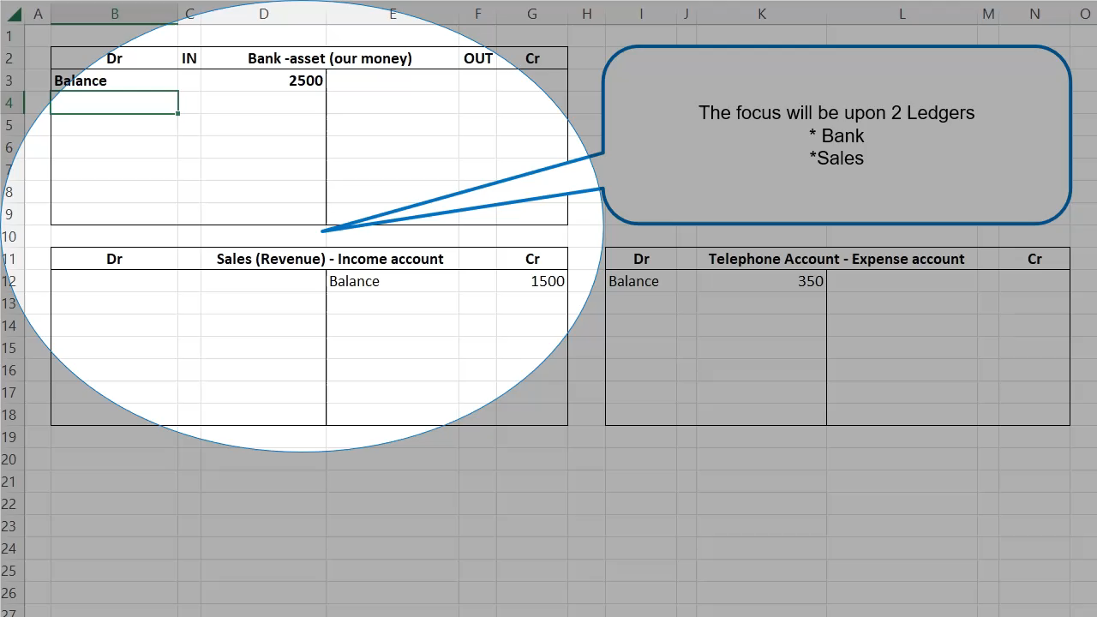
Double entry bookkeeping
The journal entry for entering this transaction into the ledger accounts is:
Bank (debit) £1,000
Sales/revenue (credit) £1,000
Rules
Asset is a debit.
Two entries.
Debit/credit.
Each entry points to the other entry.

Slide 32
Another example of double-entry bookkeeping is when a company pays a bill for £500 through the bank account, ie, the telephone bill.
The company records this payment as a credit in the bank account, since it is decreasing its balance.
The company also records the expense incurred from the bill payment as a debit in the relevant expense account, ie, the telephone expense account, since it represents a decrease in the company’s profit.
The journal entry for entering this transaction into the ledger accounts is:
Bank (credit) £500
Telephone expense (debit) £500
Again, the total debits and credits in this transaction are equal, ensuring that the accounting system remains balanced.
Use the buttons in the bottom right corner to:
  review a worked through example
  proceed to the next example.
  You will be able to return to this slide by clicking on the return button if you choose to see the worked example.

Slide 33
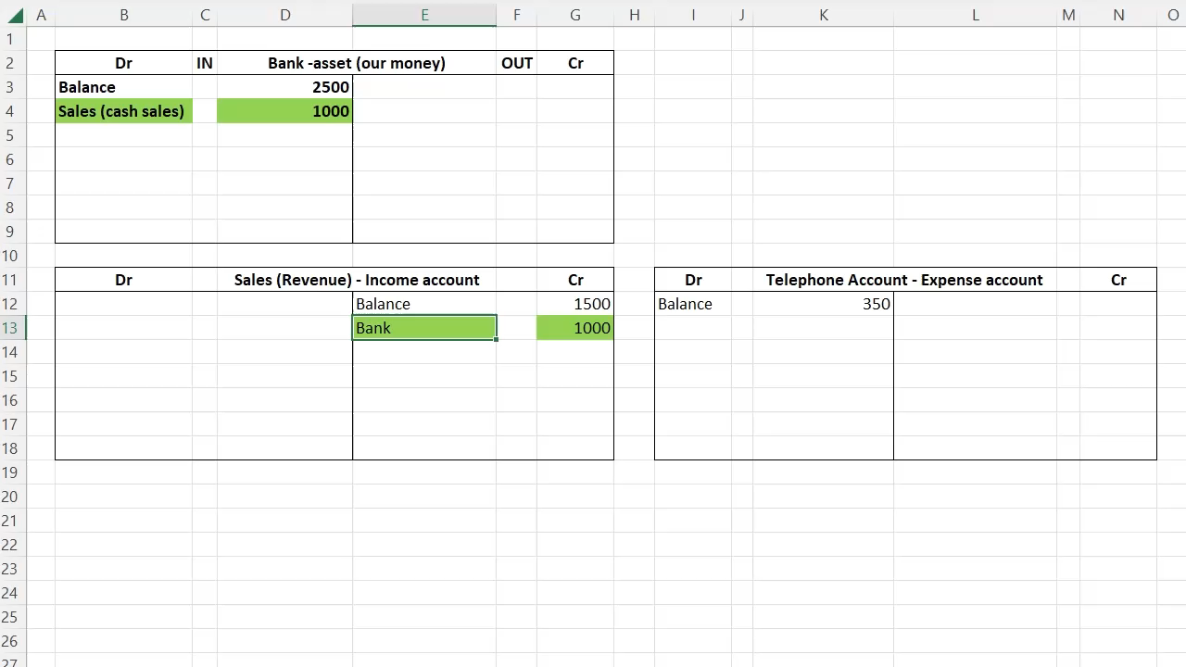
The journal entry for entering this transaction into the ledger accounts is:
Bank (credit) £500
Telephone expense (debit) £500
Rules
Asset is a debit.
Two entries.
Debit/credit.
Each entry points to the other entry.
Double entry bookkeeping

Slide 34

Double-entry bookkeeping activity (W4.3)
Look at the sample transactions provided for Epione Bakery, and use the principles of double-entry bookkeeping to record each transaction using debits and credits in the appropriate accounts.
19,088 Bookkeeping Stock Photos, Pictures & Royalty-Free Images - iStock (istockphoto.com)

Slide 35

Reporting
Reporting is the process of providing financial information to stakeholders, including investors, creditors and management. Reporting includes balance sheets, profit and loss accounts/income statements, and other financial reports. These reports are used to track revenue and expenditure, and to monitor the financial health of the organisation.
Businessman Analyzing Financial Report Data Company Operations Balance Sheet Fintech Stock Photo - Download Image Now - iStock (istockphoto.com)

Slide 36

Reporting cont.
Various tools and methods are used to generate financial reports, including accounting software, spreadsheets and in-house templates.
These tools help businesses to organise and present their financial data in a clear and understandable manner.
Spreadsheet On A Computer Screen Stock Photo - Download Image Now - Spreadsheet, Computer, Business - iStock (istockphoto.com)

Slide 37
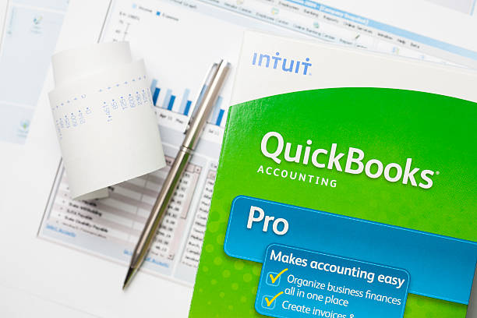
Accounting tools and methods: accounting software
Accounting software, such as QuickBooks, is specifically designed to manage financial transactions and generate financial reports.
It simplifies the process of recording and analysing financial data and offers pre-designed templates for financial statements, such as income statements, balance sheets and cash flow statements. It also provides customisation options to tailor financial reports to the specific needs of a business.
Quickbooks Stock Photo - Download Image Now - Quickbooks, Financial Advisor, 2015 - iStock (istockphoto.com)

Slide 38
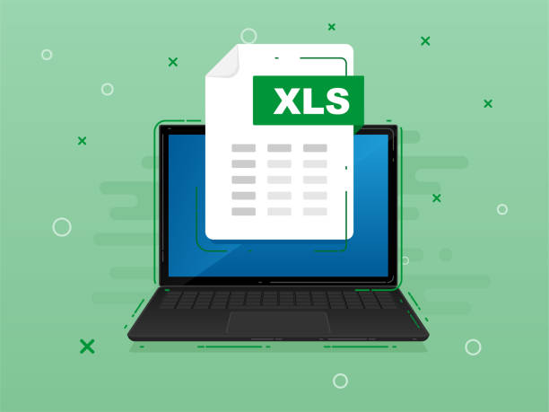
Accounting tools and methods: spreadsheets
Spreadsheet software, such as Microsoft Excel, can also be used to generate financial reports. Users can input financial data, and use formulas and formatting to create customised financial reports. Spreadsheets offer flexibility in designing and formatting financial reports to fit business requirements.
Download Xls File With Label On Laptop Screen Downloading Document Concept Banner For Business Marketing And Advertising Stock Illustration - Download Image Now - iStock (istockphoto.com)

Slide 39
Accounting tools and methods: in-house templates
Some businesses may develop their own templates based on their specific reporting requirements and internal processes. These templates can be created using word-processing or spreadsheet software, and can be customised to suit the unique needs of a business.
It is important to ensure that any in-house templates used for financial reporting are accurate, consistent and aligned with generally accepted accounting principles.

Slide 40
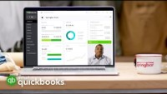
Accounting software
https://quickbooks.intuit.com/uk (accessed 30.04.2023)

Slide 41

PRODUCED BY
FUNDED BY
South Essex College has produced this resource on behalf of the Education and Training Foundation
This programme is funded by the Department for Education
ET-FOUNDATION.CO.UK

