Slide 1
Guidance – How to use during the example month of February 1
5 Steps to help you look at how to embed new topics into your existing curriculum.
Step 1. Curriculum Analysis
Evaluate each month of your curriculum to identify key periods where apprentices require high energy, concentration, or focus. This could include demanding training sessions, hands-on tasks, or moments when apprentices work independently and must sustain focus.
Embed Nutrition 1-2-1s: Once these key periods are identified, use them as natural opportunities to introduce nutrition education. For example: If an apprentice has a concentration-heavy task, use it as an opportunity to discuss how proper nutrition can improve cognitive function and energy levels.
For physically demanding tasks, highlight the importance of hydration and balanced meals for performance.
Contextualised Learning Opportunities: Ensure nutrition discussions are relevant and tied to real-world experiences, making the information practical and meaningful for the apprentices.

Slide 2
Guidance – How to use during the example month of February 2
Step 2. What's the next step after identifying natural opportunities to embed nutrition?
After pinpointing these opportunities, facilitators should closely review the scheme of work (SOW) to fully understand the learning objectives and expectations for the apprentice. This ensures that the nutrition content is seamlessly integrated and aligned with the curriculum.
Step 3. What should we consider for our delivery staff?
Only involve staff who are genuinely interested in and passionate about the topic. Enthusiasm for nutrition is essential for delivering engaging and effective lessons.
Leverage internal expertise: Do you have nutrition specialists or a wellbeing team who can support?
Guest speakers: Could you invite an external expert or record a short video to enhance the session?
Digital resources: If some staff are less confident, platforms like YouTube may offer valuable content to support them.
Consistency: Consider standardising the delivery to ensure the content is taught uniformly across all sessions.
Staff development: Do your staff need additional CPD (Continuing Professional Development) to enhance their knowledge on the subject?

Slide 3
Guidance – How to use during the example month of February 3
Step 4. Our curriculum is set for February, the team is prepared, and the content is ready. What’s the next step?
How will you promote your program? Your editable curriculum overview is an excellent tool for your team to schedule and for employers/apprentices to track the additional topics they’ll be covering.
Communications: Consider sending monthly e-shots or newsletters to keep everyone informed.
Targeted focus: Use the attached interim review to spotlight nutrition during February.
Encourage further learning: Recommend journals, books, or articles to inspire broader reading on nutrition.
Step 5. Our first group of apprentices has completed the programme. Has it made a positive impact?
When implementing curriculum changes, try to consolidate them. Too many changes at once can unsettle stakeholders, especially apprentices.
Gather feedback: Conduct interviews with apprentices, focusing on the relevance of the nutrition content to their apprenticeship, what they’ve learned, and whether they’ve applied the principles.
Evaluate timing: Keep these topics short, focused, and aimed at enhancing Health, Safety, and Wellbeing in a practical way.

Slide 4
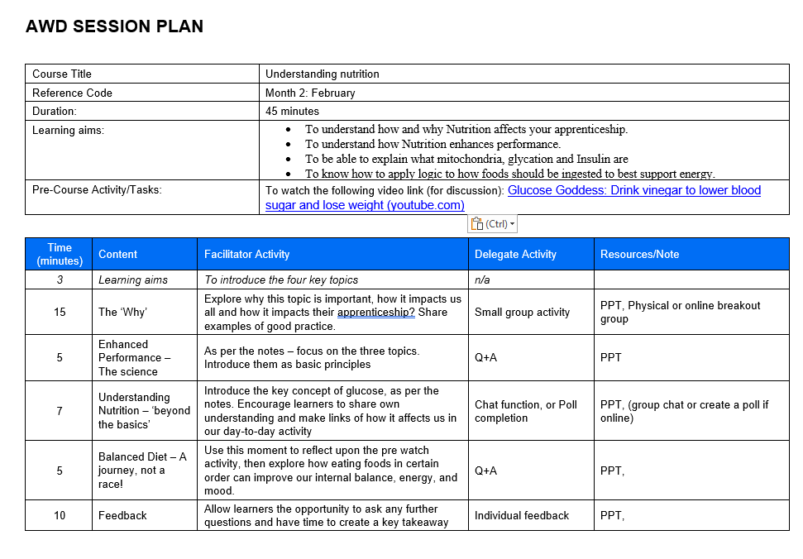
AWD Session Plan example

Slide 5
Nutrition
‘Getting the best out of me starts in the kitchen’

Slide 6
Agenda
01 The ‘Why’
02 Enhanced Performance
03 Understanding Nutrition – Beyond the basics
04 Balanced Diet – A journey, not a race
Notes:
To understand how and why Nutrition affects your apprenticeship.
To understand how Nutrition enhances performance.
To be able to explain what mitochondria, glycation and Insulin is
To know how to apply a logic to how foods should be ingested to best support energy.

Slide 7
Part 1
The ‘Why’

Slide 8
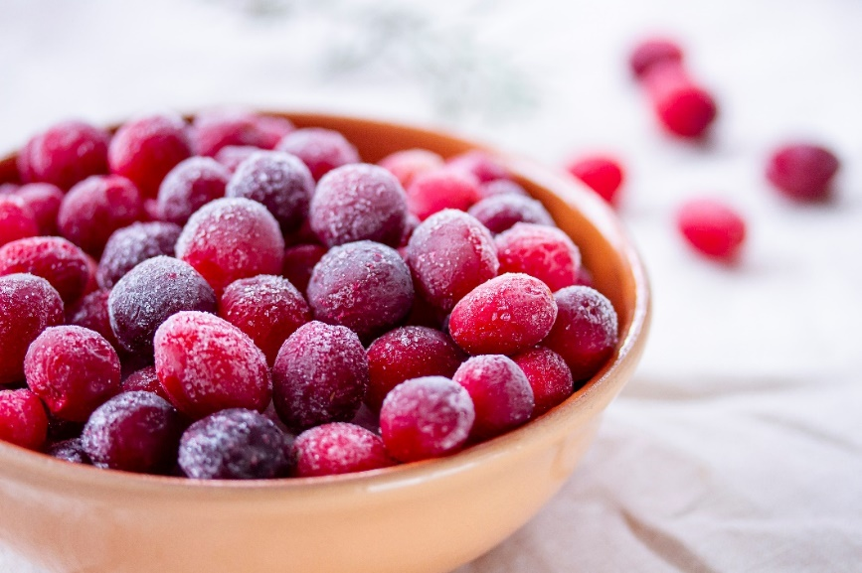
The ‘Why’
Think beyond your KSBs
Think beyond the normal
Maintained energy
Improved consistency at work
Over better mood
More approachable etc…
Small group activity
What is the impact of not being properly ‘fuelled’ in your work or while studying with us?
Extension activity – consider the science involved with the foods that we eat?
Notes:
10-minute break out room sessions – groups of 4-5 – encourage groups to feedback.

Slide 9
Part 2
Enhanced Performance –
The Science

Slide 10

Enhanced Performance – The science
Topics for discussion:
Balanced Macronutrients
Micronutrients for Health
Role of Nutrients
Notes:
– Balanced intake of carbohydrates, proteins and fats support physical endurance and OVERALL energy levels
- Vitamins and minerals are crucial for cognitive functions – memory, thinking, decision making etc
- A few examples of micro/macronutrients
Vitamin B1 (thiamine): Helps convert nutrients into energy
Vitamin B2 (riboflavin): Necessary for energy production, cell function and fat metabolism
Vitamin B3 (niacin): Drives the production of energy from food
Vitamin B5 (pantothenic acid): Necessary for fatty acid synthesis
Vitamin B6 (pyridoxine): Helps your body release sugar from stored carbohydrates for energy and create red blood cell

Slide 11
Part 3
Understanding Nutrition – Beyond the basics

Slide 12
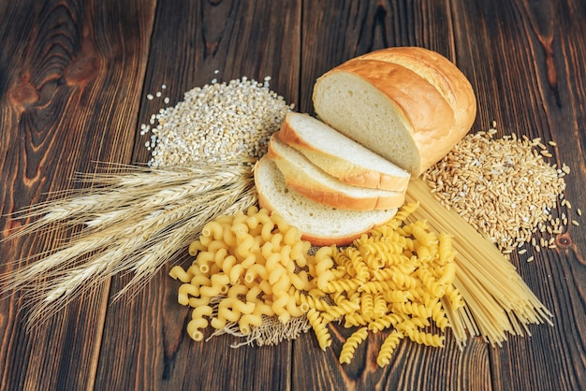
Understanding Nutrition – beyond the basics
First, let us consider what we know here. For example, we know balance is good and ‘5 a day’ is a sensible suggestion
Let's look further – let's talk glucose – What do you know?
      What is glucose? How does glucose affect us?
      Which foods are high in glucose? When should we have glucose in our diet?
Notes:
In the chat ask… or create some ‘polls’ – what is glucose? What foods are high in glucose How does it affect you?
2) Glucose is our body’s preferred source of energy – every cell in our body uses glucose to perform i.e our lung cells to breathe, heart cells to pump blood, brain cells to think etc…
How it can affect us…. Weight gain…chronic fatigue…cravings… constant hunger.. Mental health.. Poor sleep etc

Slide 13
Part 4
Balanced Diet – A journey, not a race!

Slide 14
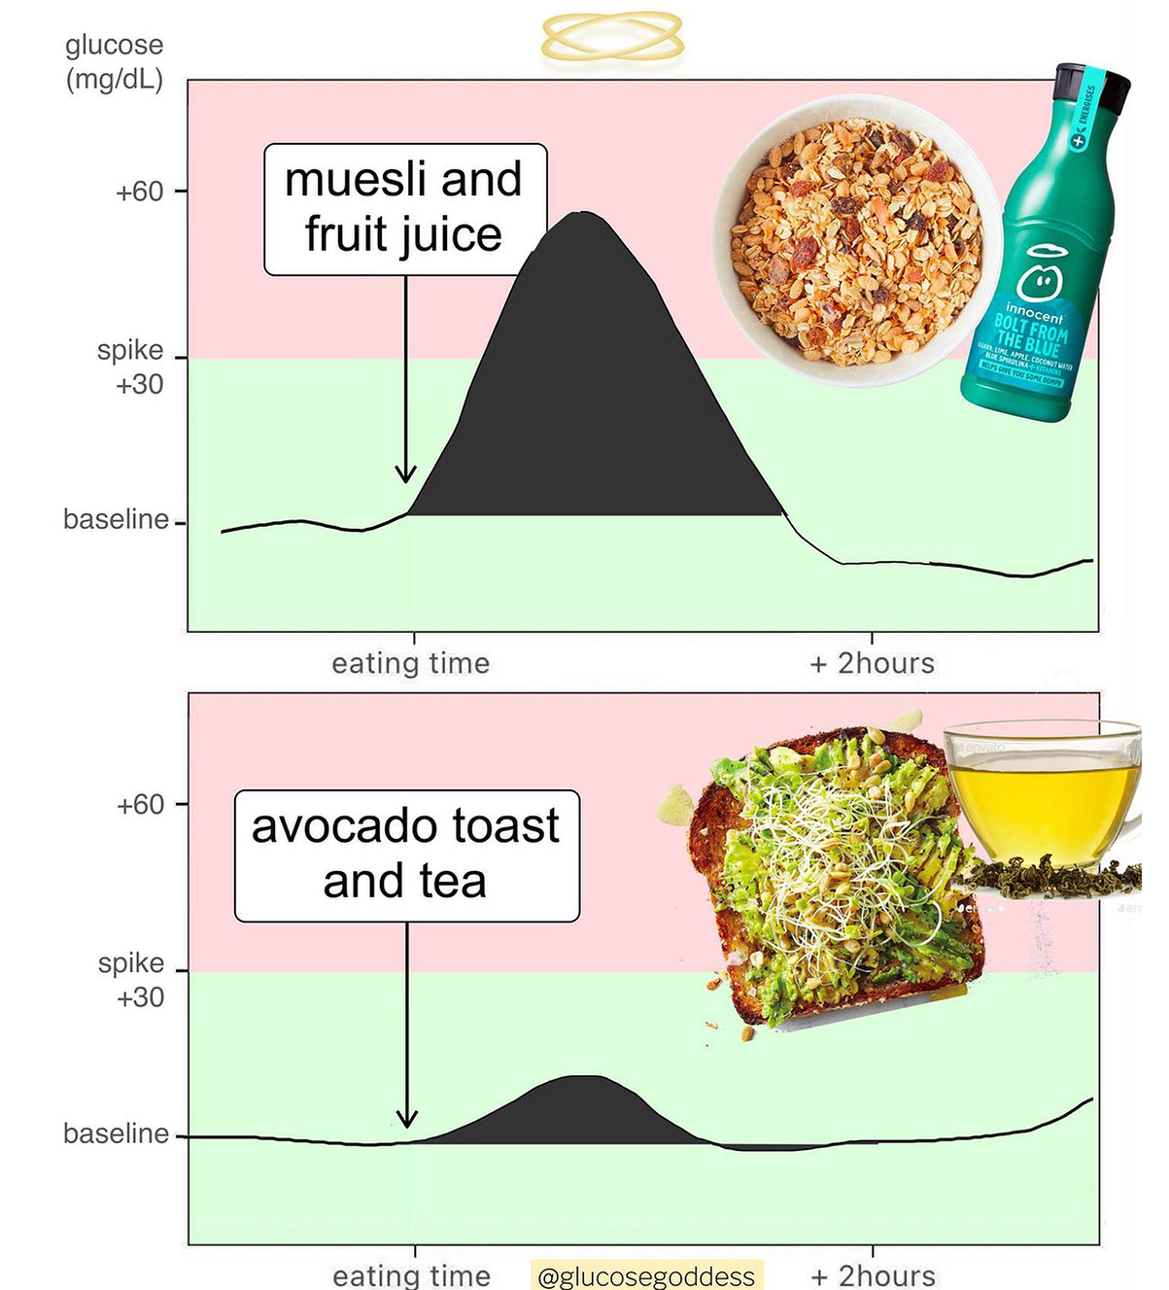
4 Practical eating tips: shaping the ‘order’ in the way we eat
Savoury Breakfast (a standard bowl size)
Vinegar (1 teaspoon in water before meals)
Veggie starter (eg a handful of veg)
Moving after eating (eg a10-minute walk after eating)
Source of image: Glucose revolution: Jessie Inchauspé
Notes:
Help to stop hunger bouts… keep you full for longer and give you steady energy
One tablespoon a day of vinegar (in water) will reduce glucose spikes by up to 30% - 30mins before a heavy meal
Veggie starter – 30% of your normal meal in volume – contains high fibre, this reduces a glucose spike for hours to come (as per the image on the far right) – can also add the vinegar into this (2 in 1 hacks)
10 mins of walking/movement after you eat each meal – help flatten glucose curves and digest food.

Slide 15
What are the doctors saying about managing glucose?
Task: Either individually or in small groups discuss the difference of opinion below, what differences can you spot and what does it mean?
'Jessie Incharpe's research on blood sugar is needed now more than ever. When the majority of the world has a massive metabolic problem and the wellness world squabbles on their trivial tribal soapboxes, Jessie provides accessible, sustainable advice for everyone to have agency over their health, no matter who you are.' A research report by WILL COLE, MD, top 50 functional-medicine and integrative doctors in the United States and bestselling author
'Not all of the research on vinegar supports its benefits for reducing blood sugar after meals. A brief report of research published by van Dijk et al. in 2012 compared the effects of 25 grams of white vinegar administered with a 75 gram oral glucose tolerance test, and found there was no difference in blood sugar after the test with vinegar, versus without'
Question: What could you do next to help you decide what actions help to manage glucose?
Notes:
Note – the van Dijk study is purely about the consumption of vinegar to control glucose – whereas the method shared is about the order that we eat food and the importance of exercise after food to reduce spikes.

Slide 16
Feedback
What I your
‘one key main takeaway’.

Slide 17
Name Surname

