Slide 1
T LEVEL IN DESIGN, SURVEYING AND PLANNING FOR CONSTRUCTION
Supporting holistic delivery of Core Content and
Occupational Specialism content

Slide 2
1
The concept of planning
in construction

Slide 3
Starter task: Superstructure construction methods
In your allocated pairs, discuss the process for your allocated construction method.
Use flipchart paper to record key points.

Slide 4
Task: Construction project scenario
In your allocated group, discuss the given scenario and note any issue(s) affecting the timeline. Analyse potential impacts to the timeline of the project.
Provide feedback to the other groups.

Slide 5
Planning construction projects
Planning is an important consideration in preparation for the on-site construction phase of all projects.
Elements that need to be considered are:
  operatives
  plant and equipment
  materials and storage.

Slide 6
Operative considerations
  The different trades required to undertake activities e.g. plumbers.
  The trade operatives’ levels of skills, experience and speed of undertaking tasks.
  The optimum number of operatives to undertake tasks.

Slide 7
Plant and equipment considerations
  The types and number required to undertake activities,
  e.g. scaffolding, cement mixer.
  How plant and equipment can hinder some other tasks, e.g. scaffolding restricting access or a crane moving on site.
  Onsite space and storage that the plant and equipment require.

Slide 8
Materials storage considerations
  Material types and amounts required to undertake activities, e.g. sand, bricks, timber.
  When materials are required during construction.
  Delivery of materials and storage required on site.
  Security and prevention of damage to materials.
  Health and safety of storage and transport of materials around site.

Slide 9
Task: Project planning preparation
In your allocated group, look at the image showing a residential project.
Discuss what elements of the project will ensure a successful outcome. Take into account operatives,
plant and equipment and material storage considerations.
Write on sticky notes elements discussed.

Slide 10
Setting milestones in construction projects
  Milestones are an effective way of tracking progress.
  Milestones identify the main stages of a project.
  Clients can set milestones to plan a project from conception to building use, i.e. acquiring land, design, approval, procurement, construction, handover through to use.
  Contractors use milestones, i.e. construction phases such as building foundations, drainage, superstructure, roof, internal fit-out, services, decoration, etc.

Slide 11
Setting milestones in construction projects (continued)
  Breaking down a project into manageable phases or stages (milestones):
  promotes effective project planning
  enables each phase or stage to be measured
  supports projects to be delivered on time.

Slide 12
Key Performance Indicators (KPI)
KPIs are ongoing metrics used to measure performance over time, whereas milestones represent specific, significant achievements or events marking progress towards a phase or stage in construction.
Examples of KPIs used to plan projects include:
  input KPIs, e.g. resources
  process KPIs, e.g. efficiency or productivity and production time.
  output KPIs, e.g. meeting timelines.

Slide 13
Using KPIs to support milestones
  Contractors and developers can incorporate the use of KPIs to help track the milestones set for each phase of a project.

Slide 14
Task: Commercial construction
Individually, compose an email suggesting three milestones and two KPIs for the commercial construction project.
Send your email to your allocated peer.
Respond to the email, adding improvements.

Slide 15
Plenary questions
Complete the exam-style questions.
Swap papers and mark the work using the model answers.

Slide 16
Next steps: Project planning research
Homework
Research a construction project where you live.
Produce a written summary about the project which includes:
  project type (residential, commercial or industrial)
  suggested milestones for the project
  a list of the operatives required
  a list of the activities that will be undertaken
  the plant and equipment required
  the materials that will be used in the project.

Slide 17
2
Considerations for programme planning
in construction

Slide 18
Starter task
Present local construction project to peer.
Peer to determine the appropriateness of:
      milestones
      operatives required
      activities undertaken
      plant and equipment required
      materials needed for the project.
3. Provide peer feedback, including improvements.

Slide 19
Substructure techniques
All superstructure techniques will need to be combined with a method of substructure foundation. This enables the building loads to be safely supported.
Examples of foundation types are:
  strip foundation
  pad foundation
  raft foundation
  pile foundation.

Slide 20
Task: Linking superstructure and substructure techniques
In your allocated group:
Complete the card sort, linking possible foundation types that are suitable for use with different superstructure techniques.
Present reasons for your choice to your allocated paired group.
Compare choices.

Slide 21
Task: Reasons for superstructure and substructure foundations
Individually, complete the Reasons for superstructure and substructure foundations handout.

Slide 22
Sequencing of construction activities
  Consider the:
  different construction activities that need to be undertaken, e.g. excavation, roofing, painting
  order that activities are undertaken
  interaction of activities
  interactions of operatives
  storage and space available to undertake the activities.

Slide 23
Order of activities
  Set up site
  Set out building
  Excavation and foundations
  Structural superstructure (depending on method) and roof
  Internal walls
  Services
  Decoration
  External works / landscaping

Slide 24
Task: Construction activity line
Individually, read the Sequencing of activities handout.
In your allocated group:
Discuss the construction project.
Line up the cards to form a sequence of activities for the construction project.
Explain your sequence to the other group.

Slide 25
Other factors that affect sequence
  Labour (if operatives are directly employed or sub-contracted)
  Plant/equipment (if the contractor owns plant and equipment or needs to hire for each contract)
  Materials (if these are ’off the shelf’ or made to order)

Slide 26
Plenary exam-style question
A new large hotel is under construction. The scaffolding has been delayed by several days. The scaffolding is required to complete the cladding on the exterior of the hotel before internal work takes place.
Question:
Explain how the scaffolding delay impacts the schedule of activities.

Slide 27
Model answer
The delay with the scaffolding will mean that the external elements of the building cannot be completed on time. This is because installation of the cladding involves working at height and will require scaffolding.
A delay with the scaffolding could affect the fitting of external windows. These are needed to create a dry envelope to allow internal activities to begin. These windows are often are fitted at the same time as cladding.

Slide 28
Next steps: Planning job advert
Homework:
Produce a job advert that requires an employee to undertake project planning for construction.
Identify the essential and desirable qualities that this person will need to be effective in the role.

Slide 29
3
Programme planning techniques

Slide 30
Programme planning techniques
Previous lessons have covered the concept and considerations for planning construction projects.
The next stage is to look at the techniques that are commonly used in construction projects.
The three most common methods are:
  Gantt charts
  line of balance charts
  critical path analysis.

Slide 31
Gantt chart
  A Gantt chart is a form of a horizontal bar chart that represents a project timeline.
  The horizontal axis identifies the timeline, and the vertical axis lists the individual activities involved in the project.
  Individual activities are shown in bars along the timeline.

Slide 32
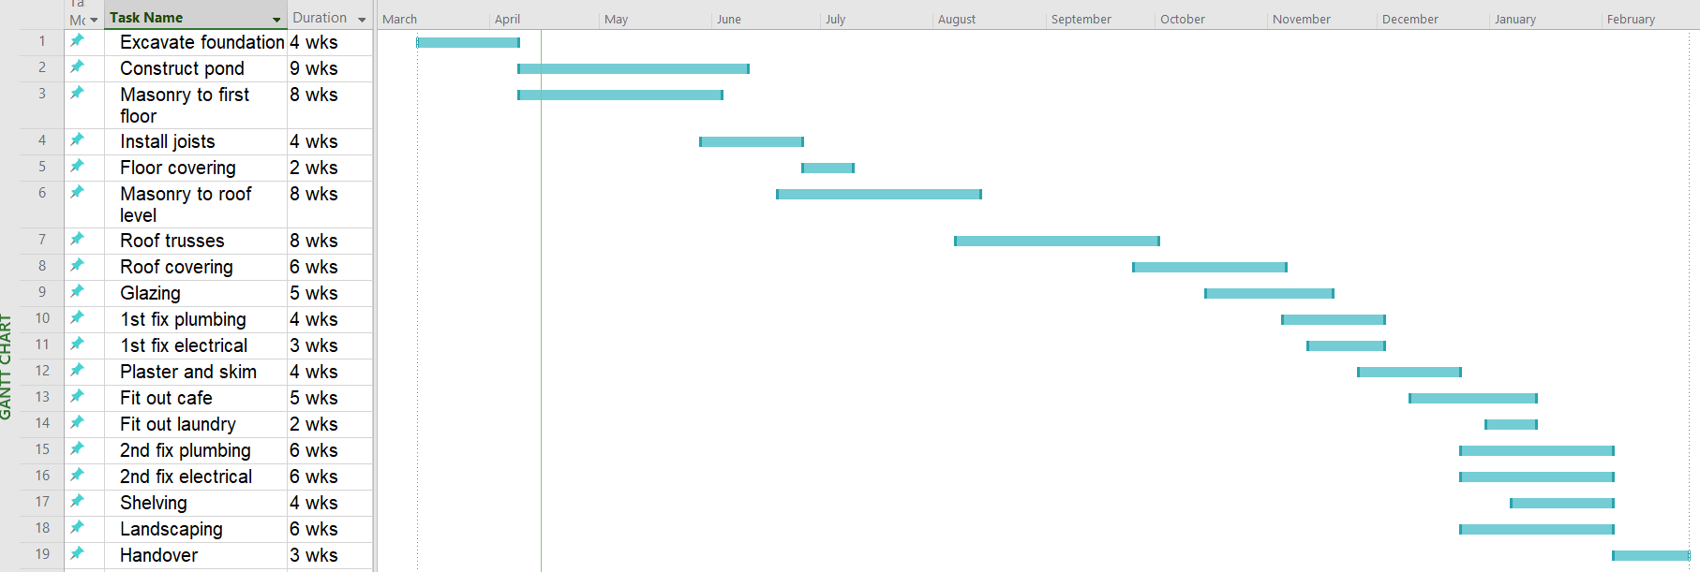
Gantt chart example
Timeline
Planning of each task
Tasks
Notes:
Here is a list of the tasks and their durations as shown in the Gantt chart:
Excavate foundation – 4 weeks
Construct pond – 9 weeks
Masonry to first floor – 8 weeks
Install joists – 4 weeks
Floor covering – 2 weeks
Masonry to roof level – 8 weeks
Roof trusses – 3 weeks
Roof covering – 6 weeks
Glazing – 3 weeks
1st fix plumbing – 4 weeks
1st fix electrical – 4 weeks
Plaster and skim – 6 weeks
Fit out café – 2 weeks
Fit out laundry – 2 weeks
2nd fix plumbing – 3 weeks
2nd fix electrical – 6 weeks
Shelving – 3 weeks
Landscaping – 6 weeks
Handover – 3 weeks

Slide 33
Task: Use a Gantt chart to plan a construction project
Read the case study and answer the questions.

Slide 34
Line of balance chart
  A line of balance chart is like a Gantt as it consists of two axes that plot activities against a timeline.
  However, a line of balance chart will show where activities repeat over a larger project. The vertical axis will now show where the activities are taking place.
  Their appearance can vary depending on the formatting or software used to create them.

Slide 35
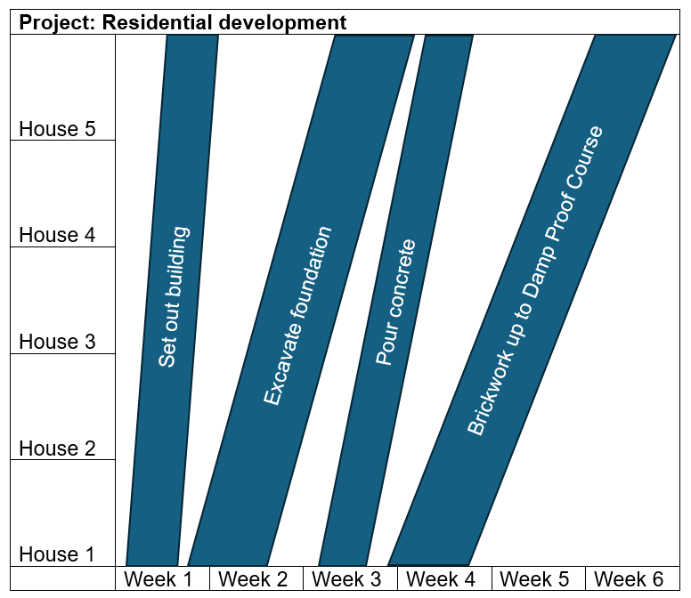
Line of balance chart format 1

Slide 36
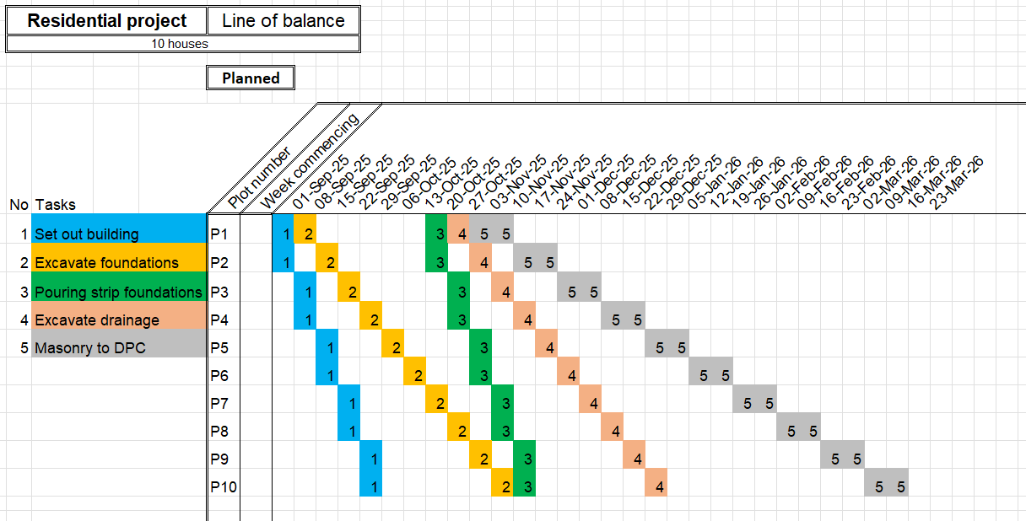
Line of balance chart format 2

Slide 37
Task: Use a balance chart to plan a construction project
Read the case study and answer the questions.

Slide 38
Critical path analysis overview
  A method which shows a linear path for a project.
  Tasks are shown in node points that are interconnected with arrows, showing different paths.
  The start and finish points are often single nodes, but there can be several paths in between that link dependent activities together.
  The method is used to plot which path is critical to the deadline of the project.
  Different formats can be used.

Slide 39
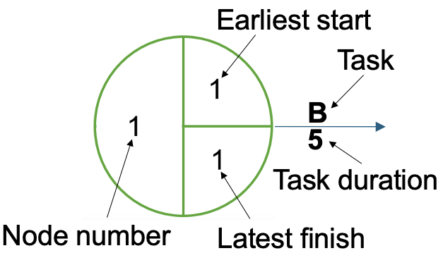
Critical path analysis node point
Critical path analysis uses node points to link tasks and their durations.

Slide 40
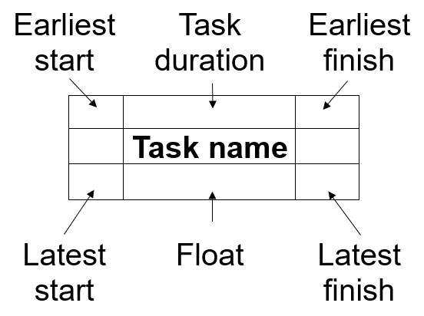
Critical path analysis alternative node point

Slide 41
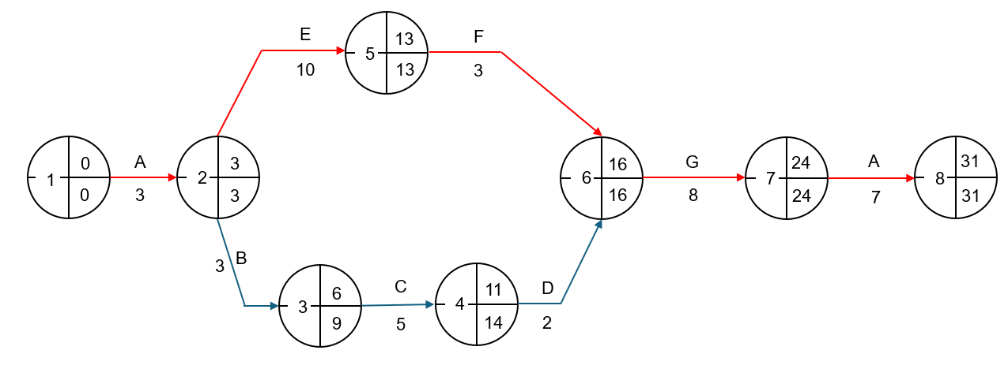
Critical path analysis example
The red arrow shows the critical path

Slide 42
Task: Use a critical path analysis to plan a construction project
Read the case study and answer the questions.

Slide 43
Use of planning tools in construction
  Gantt is best used when the project is:
  bespoke and a ‘one off’ i.e. with one start, middle and end.
  straightforward i.e. in relation to tasks, techniques and methods used.
  Line of balance is best used when the project has:
  repetitive elements, e.g. housing development with
  similar components.
  standardised construction, i.e. in relation to tasks,
  techniques and methods used.

Slide 44
Use of planning tools in construction (continued)
Critical path analysis is best used when the project is complex, e.g. with:
  multiple site locations
  multiple differing tasks taking place simultaneously
  complicated construction techniques used.

Slide 45
Exam-style question
A contractor has won a tender to build a motorway flyover.
Question:
Explain why using critical path analysis would be better than using Gantt or line of balance charts.

Slide 46
Next steps: Research alternative planning techniques
Homework:
Research the planning programme techniques used for construction projects.
Identify alternative techniques to Gantt charts, line of balance charts and critical path analysis.

Slide 47
4
Producing a Gantt chart

Slide 48
Starter task: Sketch of Gantt chart
Sketch an example of a Gantt chart showing the plan for the construction of a simple house with a foundation, superstructure, roof, internal fit-out and external works.
Highlight the following key features on your sketch:
  tasks
  timeline
  when tasks will take place.

Slide 49
What is included in a Gantt chart?
Gantt charts contain the following essential elements:
  tasks in the task column
  full view of the complete timeline for the project
  dedicated blocks of time allocated to each task
  planning of each task within the timeline of the project
  consideration for interaction between activities.

Slide 50
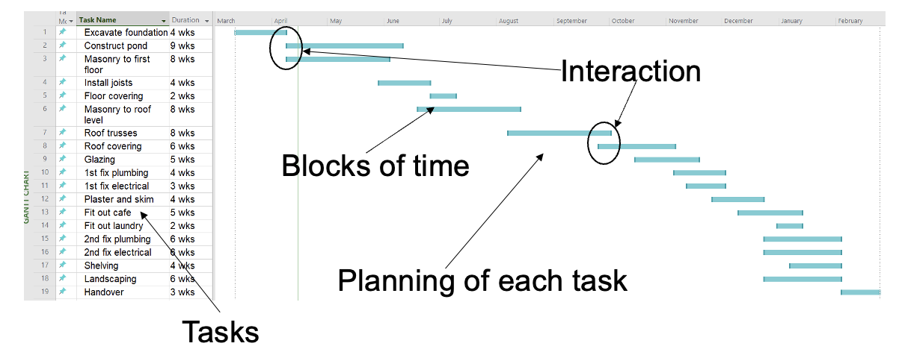
Gantt chart: Timeline for project

Slide 51
Well-designed Gantt charts
Consider:
  keeping the content concise – focus on essential tasks and dependencies
  clear sequencing
  using effective colour coding, e.g. to distinguish different task types or stages
  having clear task descriptions, ensuring that all stakeholders understand what each task entails, including clear milestone markers and dependency types.

Slide 52
Task: Producing a Gantt chart for a construction project
Individually, produce a Gantt chart for the extension to the halls of residence project.

Slide 53
Communication and collaboration
  Share Gantt charts with the stakeholders.
  Regularly update the Gantt chart to reflect changes and progress.
  Share updates with all stakeholders.
  Seek feedback and use it to improve the accuracy and effectiveness of the chart.
  Ensure there are accurate and achievable timelines.
  Show how tasks relate to each other, highlighting dependencies that might cause delays or bottlenecks.

Slide 54
Communication and collaboration (continued)
  Assess work overload – reassignment or rescheduling of tasks.
  Make it easy to track actual progress against the planned schedule and identify potential deviations.
Remember:
Gantt charts are a dynamic tool: they need to be updated throughout the project.

Slide 55
Task: Peer review of Gantt chart
Peer review each other’s Gantt chart.
Consider the effectiveness of the following:
  usability for different stakeholders
  use of colour coding
  interactivity of tasks
  timescales
  ordering of tasks in the task column
  tasks to be completed.

Slide 56
Plenary task: Improving a Gantt chart
Use the construction of a new lecture theatre Gantt chart modelled in class and peer feedback to complete this task.
Update the extension to improve your university Gantt chart.

Slide 57
Next steps: Research software for producing Gantt charts
Homework:
In pairs, research different software products available that can be used to produce Gantt charts for construction projects.

Slide 58
5
Producing a line of balance

Slide 59
Construction term
Define the term ‘plot’ in the context of construction.

Slide 60
Definition
A plot refers to a designated area of land on which a building or structure can be constructed. It is essentially a defined work area earmarked for construction purposes, e.g. a piece of land or building.
Construction plots can be residential (for houses), commercial (for businesses) or industrial (for factories or other industrial buildings).
(Author definition)

Slide 61
What is included in a line of balance?
A line of balance contains the following essential elements:
  sequenced list of tasks
  sequenced list of plots to be worked on
  dedicated blocks of time allocated to each task
  planning of each task within the timeline of the project
  all information for each task
  consideration for interaction between activities.

Slide 62
Advantages of using line of balance
  It allows a clear understanding of the amount of work taking place at a certain time in a specific place.
  Planning of resources can be optimised for several repeated work tasks.
  It allows easier cost and time optimisation analysis.
  It is easy to modify, update and change the schedule.
  It allows problem areas to be identified in advance and at a glance.
  It shows planned timed gaps in the schedule.

Slide 63
Task: Producing a line of balance for a construction project.
Individually, produce a line of balance for the fruit and vegetable producer’s eight new storage units.

Slide 64
Task: Peer review of line of balance
Discuss own line of balances with peers.
Peer review each group member’s line of balance.
Consider the effectiveness of the following:
  usability for different stakeholders
  use of colour coding
  interactivity of tasks
  timescales
  tasks to be completed
  clear sequencing of tasks between plots.

Slide 65
Plenary task: Editing a line of balance
There has been a delay to the delivery of the external wall cladding. The delay is three days.
Individually, update the line of balance for the fruit and vegetable producer’s eight new storage units.

Slide 66
Next steps: Research limitations of using line of balance charts
Homework:
Research the limitations of using line of balance for construction projects.

Slide 67
6
Producing a
critical path analysis

Slide 68
What is critical path analysis?
Watch the video and make notes on the process of creating a critical path analysis.

Slide 69
What is included in a critical path analysis?
A critical path analysis contains the following
essential elements:
  full view of the complete timeline for the project
  dedicated paths of time allocated to linked tasks
  start and finish times for each task
  flexibility of start and finish times, identified as ‘float’
  a clear critical path where there is no float.

Slide 70
Advantages of using critical path analysis
  It allows a clear understanding of the amount of work taking place at a certain time in a specific place.
  Planning of resources can be optimised for several repeated work tasks.
  It allows easier cost and time optimisation analysis.
  It is easy to modify, update and change the schedule.
  It allows problem areas to be identified in advance and at a glance.
  It shows planned timed gaps in the schedule.

Slide 71
Task: Producing critical path analysis for a construction project.
Individually, produce a critical path analysis for the new river crossing road bridge.

Slide 72
Task: Peer review critical path analysis
Discuss own critical path analysis with peers.
Peer review each group member’s critical path analysis.
Consider the effectiveness of the following:
  clear timeline for the project
  appropriate paths of time allocated to linked tasks
  all nodes completed correctly
  a clear critical path where there is no float.

Slide 73
Plenary task: Editing critical path analysis
The subcontractor that has been employed to undertake the river diversion has been delayed by two weeks.
In your allocated groups, discuss the implications of this delay. Individually, update the critical path analysis to reflect this.

Slide 74
Next steps: Develop software skills
Homework (in pairs):
Use different software to produce an alternative critical path analysis for the road bridge construction scenario used in this session.

Slide 75
7
Selecting the appropriate tool for different projects

Slide 76
Selecting planning tools for different projects
When looking to select a planning tool for a construction project, consideration must be given to the factors that make one tool preferable to another for different construction projects.

Slide 77
Gantt charts
  Suitable projects that are
  bespoke with a clear, linear line of activities.
  relatively straightforward in design.
  involving standard construction techniques.
  taking place on a single site layout.

Slide 78
Line of balance
  Suitable projects that
  have tasks that will repeat multiple times over the project timeline.
  may have multiple plots where these repetitive activities will take place.
  have individual tasks performed with a bespoke workforce and resources.

Slide 79
Critical path analysis
  Suitable projects that
  have multiple linked tasks that will run concurrently.
  may contain multiple site locations.
  Enable complex construction techniques may be combined.

Slide 80
Task: Planning tool ranking
  You are going to use the following ranking scores to select the most appropriate planning tool for a construction project.
  One – not suitable for the project.
  Two – has some suitability for the project.
  Three – most suitable for the project.

Slide 81
Summarising texts
  Use skimming and scanning to develop summarising skills.
  Skim the text first to get a general idea of content. Pick out key words. The first sentence is often the most important.
  Scan the text for key words and phrases. Work paragraph by paragraph and list what you feel are the main points.

Slide 82
Next steps: Produce a guide for selecting planning tools
Homework (individual):
Produce a simple guide to highlight the appropriate uses of Gantt charts, line of balance and critical path analysis for differing construction project types.
Identify a minimum of three construction project types per planning tool with a summary justification for each tool.

Slide 83
8
Analysing the effectiveness of planning techniques

Slide 84
Considerations for assessing the effectiveness of planning tools
  Suitability for the project.
    Is it the best tool for the project type?
  Clarity and communication.
    Is there a clear timeline?
  Task dependency.
    Are parallel and interdependent tasks clearly shown?

Slide 85
Considerations for assessing the effectiveness of planning tools (continued)
  Resource allocation.
    Does it clearly show where resources are required during the project?
  Decision-making.
    Does it help identify bottlenecks in the timeline or opportunities to catch up lost time?

Slide 86
Plenary task: Produce flashcards
In your allocated pairs, produce a set of 10 flashcards.
The flashcards should incorporate a range of construction projects, with the most appropriate tool on the reverse of the flashcard.

Slide 87
Next steps: Research potential of using multiple tools
Homework (individual):
Conduct research using AI on the feasibility of using more than one planning tool for a project in construction.
Explain why more than one planning tool may or may not be used.

Slide 88
9
Converting between different planning tools

Slide 89
Converting between planning tools
  Selecting the correct planning tool for each project is very important. However, some projects benefit from having more than one planning tool created.
  The benefits of this are:
  improved accuracy and detail
  improved collaboration between project stakeholders
  the ability to combine the strengths of each method.

Slide 90
Key considerations for converting between planning tools
  A second planning tool can be used and a plan developed, using the first tool as the guide. These plans must accurately match each other.
  When undertaking this process it is important to:
  clearly identify all the tasks involved
  identify the projected timescale for each task
  identify the interdependencies for linking tasks.

Slide 91
Peer review of motor showroom and garage
Peer review the Gantt chart for the motor showroom and garage against the following key considerations:
  clear identification of all the tasks involved
  identified projected timescales for each task
  identified interdependencies for linking tasks.

Slide 92
Plenary task: Exam-style question
Individually, answer the exam-style question.
Hand in your completed answer.

Slide 93
Next steps: Revision in preparation for summative lesson
Homework (individual):
Revise lessons 1–9 in preparation for the summative lesson 10.

Slide 94
10
Planning a health and
wellbeing centre

Slide 95
Task: Health and wellbeing centre
  Read the Case study: Health and wellbeing centre.
  Identify 15 on-site activities for the construction phase
  of the project.
  List the activities in the order in which they will be undertaken.

Slide 96
Task: Peer review
  Conduct a peer review of the completed plan for the construction of a health and wellbeing centre. Complete the Peer review feedback criteria sheet to guide this process.
  In your allocated group,
  compare approaches used.
  select the most effective plan and discuss reasons for choice.
  Participate in a class discussion, justifying the reasons for the choice of most effective plan.

Slide 97
Task: Use the model answer
  Peer assess the answer using the model answer given.

Slide 98
Next steps
  Produce a personal plan to further improve your construction planning skills.

Slide 99


Produced and funded by
PRODUCED BY
FUNDED BY
Shrewsbury Colleges Group has produced this resource on behalf of the Education and Training Foundation
This programme is funded by the Department for Education
ET-FOUNDATION.CO.UK

