Slide 1
T LEVEL FOUNDATION YEAR IN DIGITAL
Supporting delivery of T Level Foundation Year

Slide 2
1
Data detectives

Slide 3
Brightfutures College
You work as a junior data analyst at Brightfutures College. The college recently hosted an open evening, and you have collected feedback from social media platforms.
Your job is to analyse the data to understand its meaning and relevance.

Slide 4
Brightfutures College task
Analyse feedback from the college open day.
  Key terms:
  Unstructured data – information without a predefined format.
  Relevant/irrelevant – data that aligns or does not align with the task goal.
  Sentiment – emotional tone (e.g. positive, neutral, negative).
Notes:
Explain what ‘sentiment’ means with examples.
Explain what is unstructured and structured data.

Slide 5
What is relevant/irrelevant data?
Read the examples below and decide whether each is relevant or irrelevant to Brightfutures College’s open day.
  Examples:
  “The Brightfutures College open day was fantastic! The workshops were engaging and informative.”
  “The weather was great for shopping in town. I didn’t have time to visit the open day.”
Notes:
Relevant:
“The BrightFutures College open day was fantastic! The workshops were engaging and informative.”
Provides positive feedback and highlights key aspects of the event.
“I had trouble finding parking at the college. It made arriving on time difficult.”
Offers constructive feedback directly related to the open day experience.
Irrelevant:
“The weather was great for shopping in town. I didn’t have time to visit the open day.”
Unrelated to the open day or its organisation.

Slide 6
What is sentiment analysis?
Read the examples below. Identify the sentiment as positive, neutral or negative.
  Examples:
  “The staff at the Brightfutures open day were incredibly helpful and welcoming.”
  “The refreshments were fine, but I didn’t have a chance to try everything.”
  “The schedule for the open day was unclear, and I missed a session I wanted to attend.”
Notes:
Teacher answers:
Example 1: Positive – praises for the helpful and welcoming staff.
Example 2: Negative – criticisms of unclear scheduling and its impact on attendance.
Example 3: Neutral – comments on refreshments without strong sentiment or emphasis.

Slide 7
Sorting relevant/irrelevant posts
Identify posts relevant to Brightfutures College’s goals.
  Steps:
  In pairs, classify posts as relevant or irrelevant.
  Participate in a group discussion to resolve differences.
Now that we've identified relevance, let's explore the sentiment of the relevant posts.

Slide 8
Sorting sentiment
Categorise relevant posts by sentiment (positive, neutral, negative).
  Steps:
  Sort posts into sentiment categories.
  Count the number in each category.
  Share results using mini whiteboards.
How could understanding sentiment help Brightfutures College improve its communication?

Slide 9
Recording findings
Use the Classification totals for sorting categories document to total the sentiment data by following the steps:
  Add up post counts for each sentiment category.
  Use the whiteboard to write down your reflection on the most popular and not popular sentiment type.
  Identify any patterns that align with the Brightfutures College’s task.
  Share your reflections to the teacher and class.
Notes:
Discussion point:
What patterns or trends did you notice in the data?

Slide 10
Homework
Watch the video: Structured, semi-structured vs unstructured - what's the difference?
Read the article: Structured vs unstructured data: key differences
Focus areas to note:
  Definitions and examples of both data types.
  How to convert unstructured data into structured formats.
  Applications in spreadsheets.
How will this knowledge prepare you for lesson 2?
Notes:
Video link: https://www.youtube.com/watch?v=_XgwqB7wfXw
Article link: https://www.datamation.com/big-data/structured-vs-unstructured-data/

Slide 11
2
Spreadsheet superstars

Slide 12
Recap
Key objectives from Brightfutures College task.

Slide 13
Wordcloud task
Access the Wordcloud tool using the provided link and class code.
Task instructions:
  Add keywords related to structured and unstructured data from your lesson 1 homework.
  Focus on key terms such as data types, formats and characteristics.
Notes:
Wordcloud link: https://livecloud.online/wordcloud
Discussion questions:
Which words appear most frequently?
How do these terms connect to structured data tasks?

Slide 14
Structured data overview
Structured data is information that is organised in a specific format, such as rows and columns in a table.
Applications that can use structured data:
  Spreadsheets, databases and CSV files.
  Benefits:
  Easy to search, filter and analyse.
  Provides clarity and consistency for decision-making.
  Enables visual representation (e.g. charts, graphs).
Notes:
Discussion points
Demonstrate the basic features of spreadsheets and then ask the learners:
What are the key features using a spreadsheet:
Organised into predefined categories or fields.
Each row represents an entry; each column represents a variable.
Ask for examples of the fields in the teacher demo spreadsheet:
Post date, Platform, Likes, Comments, Sentiment.

Slide 15
Structured data
Structured example:
Post date | Platform | Likes | Comments | Sentiment
01/01/2025 | Instagram | 120 | "BrightFutures open day was amazing! #Excited" | Positive
02/01/2025 | Twitter | 85 | "The Wi-Fi was slow again. Can you fix this?" | Negative
03/01/2025 | Facebook | 200 | "The career fair was really helpful!" | Positive
Notes:
Discussion prompts for learners:
What makes structured data easier to analyse?
How could you convert the unstructured data into a structured format?
What tools might help in this process?
Key difference:
Structured data is predefined and easy to analyse, while unstructured data requires processing to extract useful information.

Slide 16
Unstructured data
Unstructured example:
Compare and identify the differences and similarities.
01/01/2025 Instagram 120 BrightFutures open day was amazing! #Excited Positive
02/01/2025 Twitter 85 The Wi-Fi was slow again. Can you fix this? Negative
03/01/2025 Facebook 200 The career fair was really helpful! Positive
Notes:
Discussion prompts for learners:
What makes structured data easier to analyse?
How could you convert the unstructured data into a structured format?
What tools might help in this process?
Key difference:
Structured data is predefined and easy to analyse, while unstructured data requires processing to extract useful information.

Slide 17
Match the example to the data type
Example
Data type
BrightFutures open day
12/01/2025
Positive
120
Date/time
Text
Number
Notes:
Instructions:
Learners must match each example to the correct spreadsheet data type.
Challenge and probe questions to learners to explain your reasoning.
Answers for teacher reference:
"BrightFutures open day" → Text (Descriptive content about an event).
"12/01/2025" → Date (Formatted as DD/MM/YYYY).
"Positive" →Text (Descriptive content about sentiment).
"120" → Number (Represents a numerical count, such as likes)

Slide 18
Teacher demonstration data
Steps demonstrated:
  Import a .csv file into a spreadsheet.
  Create columns: date, event, attendance, feedback.
  Apply formatting:
    Convert dates to DD/MM/YYYY.
    Align text and numbers.
    Bold headers.
  Sort data by attendance.

Slide 19
Social media data
Your task:
  Import the provided .csv file.
  Create columns: post date, platform, likes, comments.
  Apply formatting:
    Convert dates to DD/MM/YYYY.
    Bold and align headers.
  Sort data by likes or post date.

Slide 20
Self and peer assessment
Complete:
Self-assessment.
Peer assessment.
Write down lessons learnt on the whiteboard.
Notes:
Encourage learners to connect their work to real-world decision-making.

Slide 21
Homework
  Read the article: Tools and tips to help your teen get organised.
Watch the video: The ultimate guide to organise your digital life in 2025.
  Task:
  Take notes on strategies for organising digital files and folders.
  Be ready to discuss how these practices can be applied to Brightfutures College’s data storage needs.
Notes:
Read the article: Tools and Tips to Help Your Teen Get Organized
https://www.understood.org/en/articles/tools-tips-teen-organized
Watch the video: How to Organize Files and Folders on Your Computer
https://www.youtube.com/watch?v=_OWqZUuMv-U
Explain task:
Take notes on strategies for organising digital files and folders.
Be ready to discuss how these practices can be applied to BrightFutures College’s data storage needs.

Slide 22
3
File wizards

Slide 23
Wordcloud task
Access Wordcloud using the provided link and class code.
Task instructions:
  Submit five words that describe key insights from your homework.
Notes:
Discussion questions:
Which words appear most frequently?
How do these terms connect to efficient file organisation?

Slide 24
Why is file organisation important?
  Key benefits:
  Ensures quick access to important files.
  Reduces duplication and confusion.
  Facilitates collaboration.
  Supports security and data management.
Notes:
Teacher to demonstrate a folder structure and then ask the learners to give an example of each of the key benefits.

Slide 25
Sorting disorganised files
Instructions:
  Review 20 disorganised file names provided.
  Work in pairs or groups to categorise them logically.
  Consider:
    naming conventions
    purpose
    relevance.
Notes:
Ask learners to justify their decisions and encourage learners to explain their reasoning and choices.

Slide 26
Reviewing the filing solution
Discussion points:
  Compare your grouping with the proposed solution.
  Did the solution follow a logical structure?
  Could you make any improvements?

Slide 27
Learner task – creating the folder structure
Your task:
  Use a computer to create a logical folder structure for Brightfutures College.
  Organise provided sample files into appropriate folders.
  Apply naming conventions and logical categorisation.
  Be prepared to justify your organisation choices.
Notes:
Teacher instructions:
Step 1: show an unorganised folder system.
Step 2: demonstrate renaming and structuring folders.
Step 3: explain best practices:
Use meaningful folder names.
Apply a clear hierarchical structure.
Follow consistent naming conventions.

Slide 28
Group discussion – challenges and best practices
Discuss:
  What challenges did you face when organising your folders?
  How did you decide on folder names and structures?
  How does file organisation impact teamwork and security?

Slide 29
Checkpoint one – file management assessment
Instructions:
  Complete the Checkpoint one assessment.
  Demonstrate your ability to:
    Rename files using consistent naming conventions.
    Create and organise folders logically.
    Manage files effectively (e.g. editing, moving, deleting).
  Ask for clarification, if needed.

Slide 30
Summary and homework
Lesson recap:
  Key takeaways about file organisation and security.
  The importance of structured digital management.
  Homework:
  Read: How to back up your files.
Notes:
How to back up your file link: https://edu.gcfglobal.org/en/techsavvy/sharing-photos-privately/1/
Inform learners to do the following:
Take notes on different backup methods and their benefits.
Be prepared to discuss how Brightfutures College could implement a backup strategy in lesson 4.

Slide 31
4
Formula fixers

Slide 32
Checkpoint one review
What did we learn from Checkpoint one?
  Strengths?
  Challenges?
  What can be improved?

Slide 33
WellCare Clinic
  WellCare Clinic has identified long wait times for appointments.
  You will use spreadsheet formulas to calculate waiting times.
  Today’s goal:
  Learn how to use formulas to manage and analyse patient data.

Slide 34
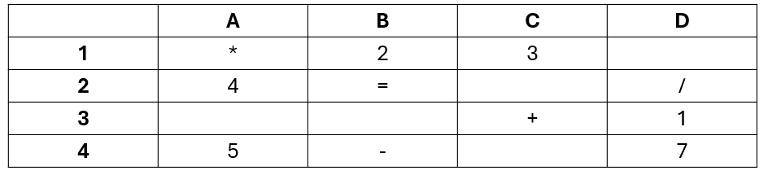
What is the key?
Find the cell reference:
1. What is the cell reference for the value 5?
2. What is the cell reference for the operator '*'?
3. What is the cell reference for the value 3?
4. What is the cell reference for the operator '/'?
5. What is the cell reference for the value 1?

Slide 35
The key = cell references?
Understanding cell references:
  columns = letters (A, B, C, D, etc.)
  rows = numbers (1, 2, 3, 4, etc.)
  example: B3 = column B, row 3.
  Why does this matter?
Notes:
Explain how it matters:
You can use the number in a formula, e.g. 5, however you have to change it every time.
Using a cell reference means the spreadsheet automates changes.

Slide 36
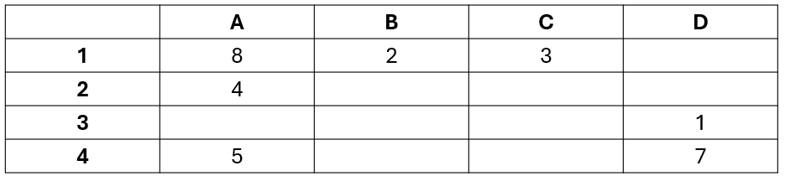
Using formula
  Addition (+): =A1+B1
  Subtraction (-): =A1-B1
  Multiplication (*): =A1*B1
  Division (/): =A1/B1
Notes:
Explain:
Addition (+): =A1+B1 → adds two values.
Subtraction (-): =A1-B1 → subtracts one value from another.
Multiplication (*): =A1*B1 → multiplies two values.
Division (/): =A1/B1 → divides one value by another.

Slide 37
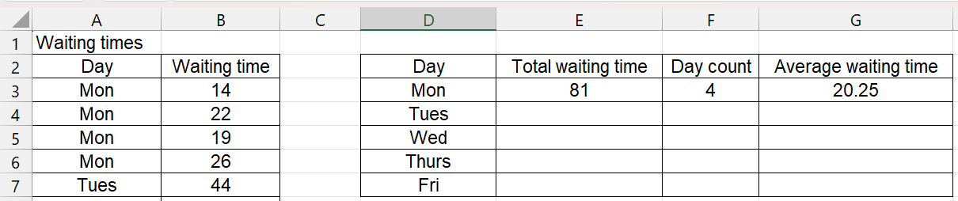
Learner activity spreadsheet
  Complete the Learner spreadsheet task.

Slide 38
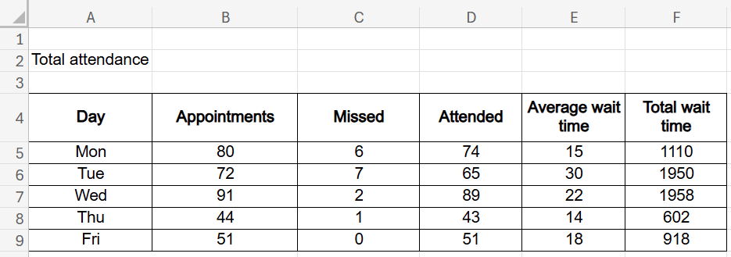
Order the cards
  What is the formula?

Slide 39
Lesson recap
  How did formulas help automate calculations today?
  Why is accuracy important when referencing cells?
  What is the difference between manual and formula-based updates?
  Glossary of terms:
  Identify five new terms from today’s lesson.
  Write them down and update your Glossary.

Slide 40
Homework
  Watch: Excel functions.
  Read: Benefits of using spreadsheets.
  Task:
  Write a short paragraph on how functions can benefit the WellCare Clinic.
  Include an example of a useful formula, e.g. =SUM(A2:A10).
Notes:
Watch – Beginners guide to Excel functions: https://edu.gcfglobal.org/en/excelformulas/functions/1/
Read – Top benefits of using spreadsheets for business: https://www.bbc.co.uk/bitesize/guides/z4wdrj6/revision/2

Slide 41
5
Function masters

Slide 42
Recap
  You are working at WellCare Clinic as a junior data assistant. Your manager needs help with analysing patient waiting times.
  Think of your homework task:
  Write down two functions they could use on whiteboard.
  Write one benefit of using functions at the WellCare Clinic.
  Be ready to share your answer on a whiteboard.

Slide 43
Function and formula differences
Formula:
  uses specific cell references and operators (e.g. =b3+b4)
  created manually by the user.
Function:
  uses a built-in command (e.g. =sum(b3:b4))
  easier to write and faster to use
  works with a range of values
  automatically updates results from changes.

Slide 44
Mix and match activity
In your groups, try to match the function to its description.
There are more descriptions than functions.
Identify a potential function for each description.
Compare results with another group:
What are similar?
What are different?

Slide 45
Cell range activity
What is the result of:
= SUM(B7 : D7)
= MIN (B4: B7)
= MAX(B7 : F7)
= AVERAGE (B4 : F4)
= COUNTIF(B7 : D7, “=2”)
= COUNTIF(B4 : F5, “<10”)

Slide 46
Updating cells
What is the result of:
= SUM(B7 : D7)
= MIN (B4: B7)
= MAX(B7 : F7)
= AVERAGE (B4 : F4)
= COUNTIF(B7 : D7, “=2”)
= COUNTIF(B4 : F5, “<10”)

Slide 47
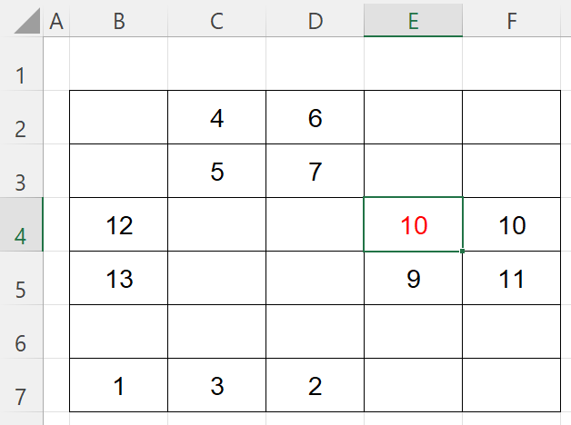
Changing function results
Which functions will change:
= SUM(B7 : D7)
= MIN (B4: B7)
= MAX(B7 : F7)
= AVERAGE (B4 : F4)
= COUNTIF(B7 : D7, “=2”)
= COUNTIF(B4 : F5, “<10”)

Slide 48
Learner WellCare activity spreadsheet
Instructions:
  Use appropriate functions in column F.
  There are errors in the waiting time for some patients.
  What is the impact on the following changes:
  PatientID 102: 15 minutes
  PatientID 122: 37 minutes
  PatientID 133: 19 minutes.

Slide 49
Benefits of automation
How would WellCare Clinic benefit from automating these calculations?

Slide 50
Homework
This week, complete the following activities:
  Read this online guide: Using concatenate to combine names.
  Complete the Excel formulas quiz.
  Note your learning on a Word document or paper.
Notes:
Using concatenate to combine names link: https://edu.gcfglobal.org/en/excelformulas/using-concatenate-to-combine-names/1/
Complete the Excel formulas quiz: https://edu.gcfglobal.org/en/excelformulas/excel-formulas-quiz/1/

Slide 51
6
Data mixologists

Slide 52
Recap
  You are working at WellCare Clinic as a junior data assistant. Your manager needs help with analysing patient waiting times.
  Think of your homework task from lesson 5:
    Give one example of how concatenation may be used in WellCare Clinic?
    Write down an area for improvement from your Excel quiz.

Slide 53
Concatenation examples
  combine first and last names into one column
  e.g. =concatenate(B2, “ ”, C2) → “Aisha Khan”
  join appointment date and patient name for reminders
  e.g. =concatenate(D2, “ – ”, B2, “ ”, C2) → “01/02/2025 - Aisha Khan”
  generate personalised messages
  e.g. =concatenate(“Dear ”, B2, “, your appointment is on “, D2).

Slide 54
Left and right examples
  extract the first letter of a patient's name for an ID
  e.g. =left(B2,1) → “A” from “Aisha”
  extract the last 2 digits of a patientID
  e.g. =right(A2,2) → “01” from “1001”
  create short reference codes
  e.g. =concatenate(left(B2,1), right(A2,2)) → “A01”
  isolate parts of a date or code
  e.g. =right(D2,4) → “2025” from “01/02/2025”.
  create patient IDs with initials and numbers
  e.g. =concatenate(left(B2,1), left(C2,1), A2) → “AK101”.

Slide 55
Formula or function?
Decide whether each task below uses a formula or a function.
Write your answers on your Formula or function document.

Slide 56
Formula or function? both are acceptable
Example task – calculate total revenue from appointments:
  using a formula: =e4 + f4 + g4 + h4
  using a function (many values): =sum(e4:h4).
  What this shows:
  Both are correct – choose what best suits the task.
  Formula = manual and specific.
  Function = faster for longer data sets.

Slide 57
Teacher fee demonstration spreadsheet
Today, we will explore five key functions and how they can be combined with a formula:
  using '+' to add cell values together
  SUM() – total consultation fees
  AVERAGE() – average waiting time
  COUNTIF() – count missed appointments
  CONCATENATE() – combine first and last names
  RIGHT() – retrieving the date of birth year of a patient

Slide 58
Learner fee activity spreadsheet
Now it is your turn:
  Remember what the teacher demonstrated
  Apply spreadsheet functions or formulas on row 4 to automate the calculations.
  Can you remember how to copy the functions or formula to the other blank cells?
  Don’t forget rows 44 and 45.
  Compare your results with another learner.

Slide 59
Peer review task
Check your partner’s spreadsheet for:
  Correct use of functions, e.g.:
    SUM, AVERAGE, COUNTIF, CONCATENATE
  Are your results the same?
    If different, how can you identify who has made the mistake and support?
    Check for errors in formulas or references.
Write down one positive and one improvement that each learner needs to do if they did the task again.

Slide 60
Common misconceptions and fixes
Notes:
Teacher to note misconceptions from learners.

Slide 61
Homework
  Research how the IF function works.
  Give one example how an IF function can be added to the Learner activity spreadsheet.
  Research what a nested IF functions is and how this can be added to the Learner activity spreadsheet.
  Note investigation to bring into the next lesson.

Slide 62
7
Data transformers

Slide 63
Recap
  You explored how to use the IF function in spreadsheets.
  You were asked to research how IF and nested IF functions work.
  Be prepared to share how these functions could be used in the learner activity spreadsheet.
  Try to identify two examples of how they could be added to your Learner activity spreadsheet (lesson 6).
  Could you explain how they are relevant to WellCare Clinic?

Slide 64
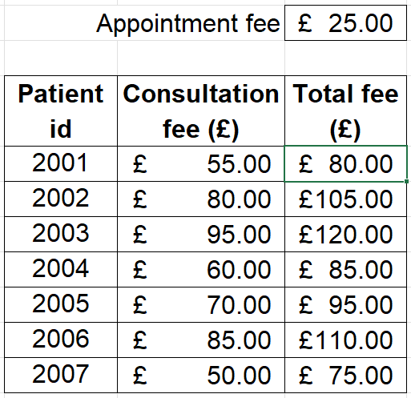
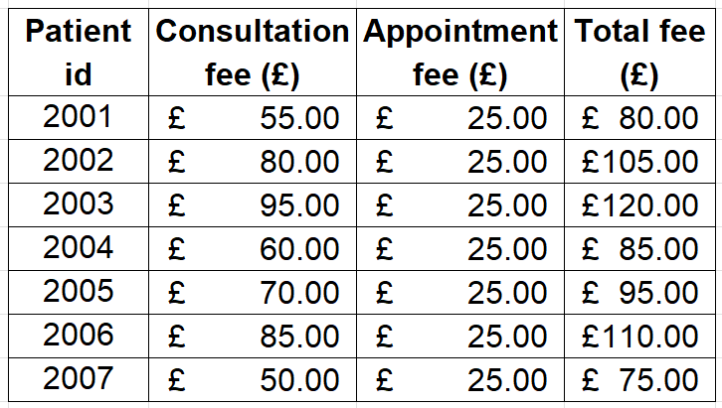
Spot the difference
  What is the same?
  What is different?

Slide 65
How is this possible?
Using relative cell referencing:
  Relative referencing changes when copied to another cell (e.g. A1 becomes A2).
  Using absolute cell referencing:
  Absolute referencing stays fixed using the $ symbol (e.g. $A$1).
  Use a $ on either the letter or the number keeps that part fixed.
Notes:
Get learners to note the process of using absolute cell reference in formulas.

Slide 66
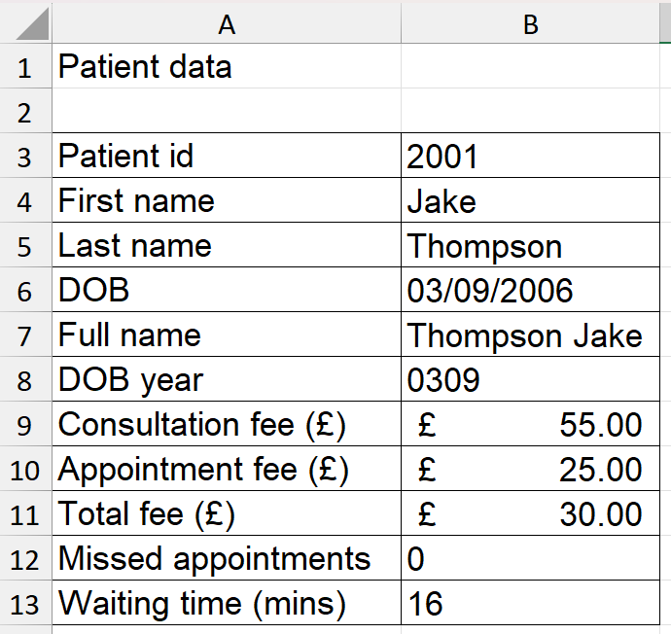
What is the formula or function error?
  Individually use your whiteboard.
  Look at the Patient data spreadsheet.
  Can you see the errors in column B?
  For each error, try to identify:
    the cell reference with the error
    the formula or function used
    the mistake made.

Slide 67
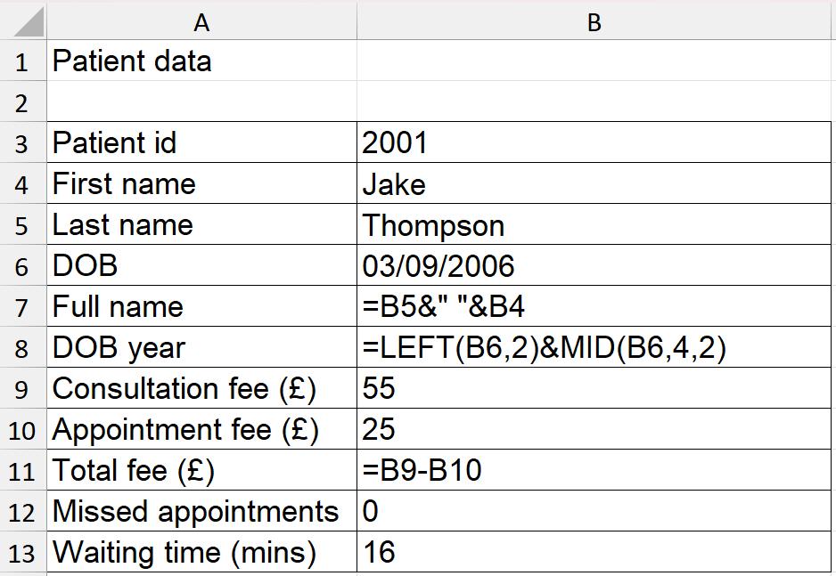
Fixing the error
  Work in your assigned pairs.
  Suggest how each formula or function could be corrected.
  Use your understanding of absolute and relative referencing.
  What steps would you take to fix this?

Slide 68
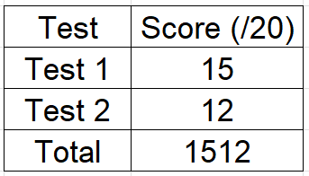
Input and output errors
  Some spreadsheet errors come from incorrect data types or values.
  Input error examples:
    Text in a number field, extra spaces, spelling mistakes.
  Output error examples:
    Incorrect formulas, broken references, missing cells.
  Can you spot the error here?

Slide 69
Cleaning data best practice
  Look for missing or incorrect entries.
  Remove duplicates and extra spaces.
  Check that all columns use consistent formatting and data types.
  Reduce unnecessary columns.
  Add any missing formula or functions.
  Where could absolute referencing help?

Slide 70
Learner sentiment activity spreadsheet
  Open and review the Learner activity spreadsheet.
  On your whiteboard, note down where best practice has not been applied to clean the data.
  Now clean and complete the Learner activity spreadsheet.

Slide 71
Benefits of cleaning the data
Identify the benefits of cleaning data:
  Makes data analysis more accurate.
  Saves time when using formulas and functions.
  Reduces errors in reports and charts.
  Helps with automation and future tasks.

Slide 72
What have you learnt?
On your whiteboard:
  Write one strength you’ve shown today.
  Write one area you want to improve.
  What will you do next time to improve this?

Slide 73
Checkpoint two instructions
  Complete the Checkpoint two task.
  Remember to:
    Read each question carefully.
    Ask for clarification on approach if unsure.
    Check your answers before passing the Checkpoint two back to the teacher.

Slide 74
WellCare Clinic conclusion
Reflect on your learning (lessons 4 to 7).
Use your whiteboard or notebook to answer:
  one spreadsheet skill you now use confidently
  a function or formula that made tasks easier
  how your data analysis improved over time
  a mistake you learnt from
  how spreadsheets help WellCare Clinic.

Slide 75
8
Chart champions

Slide 76
Checkpoint two feedback
Feedback on Checkpoint two:
  What went well for you in this task?
  What did you find difficult? What will you do differently next time?
Feedback on Checkpoint two:
  Check your answers using your class notes.
  Practise writing formulae and using functions.
  Get ready for Checkpoint three – you’ll be creating charts and explaining what the data shows.

Slide 77
Which bar is best?
You have two bar charts showing DriveSuccess feedback from March and April.
Your task (in pairs):
  Study both charts carefully.
  Use labels or arrows to show:
    What makes one chart better?
    What needs to be improved?
    Which chart is best, and why?
Notes:
THINK: What would you change to make the data easier to understand?

Slide 78
Which pie is best?
These pie charts show the same DriveSuccess feedback from two different months.
Your task (in pairs):
  Read both charts carefully.
  Label or highlight:
    What’s clear and easy to read?
    What’s missing or confusing?
    Which chart is best, and why?
Notes:
Ask learners to consider: what would you change to make the data easier to understand?
Tell learners to be prepared to share your reasons with the class.

Slide 79
When to use each chart
Bar chart or pie chart – which is best?
  Bar charts compare categories or changes over time.
  Pie charts show percentages or parts of a whole.
Tips:
  Use a bar chart when comparing numbers.
  Use a pie chart when showing a split or proportion.

Slide 80
DriveSuccess Academy
Your role: junior data assistant.
DriveSuccess Academy has asked you to create charts to help show recent learner feedback.
Your goal:
  Present the data clearly.
  Choose the right chart.
  Help your manager make a decision.

Slide 81
Create a bar chart – paper-based
Use the ‘manual bar chart’ sheet.
Your task:
  Draw a bar chart using feedback data. Include:
  title
  axis labels
  even bar spacing
  clear scale and colour.
  Work in pairs to check and give feedback.

Slide 82
Create a bar chart – review
  Swap your chart with another pair.
  Write one strength and one improvement on a sticky note.
  Place your chart on the wall.
  We’ll vote for the clearest and most accurate bar chart.

Slide 83
How close did you get to this bar chart?

Slide 84
Create a pie chart – in a spreadsheet
Use the ‘pie chart task’ worksheet.
Your task:
  Use spreadsheet software to create two pie charts.
  One for April and one for May.
  Include:
    a title
    a legend or labels
    distinct colours
    percentage values.

Slide 85
Create a pie chart – review
Compare all months on the pie charts:
  What changed most?
  Which chart is easier to understand?
  What would you change to improve your presentation?
Notes:
Extension: add terms like ‘segment’ and ‘proportion’ to your Glossary.

Slide 86
How close did you get to this pie chart?

Slide 87
Which chart would be best?
Walk around the room and read each scenario card.
For each chart:
  Use one sticky note to choose bar or pie.
  Use another sticky note to explain why.
Extension: what kind of decision would this chart help DriveSuccess make?

Slide 88
Homework – prepare for pivot tables
Watch the video: How to create a pivot table.
Read the guide: Using pivot tables.
Make notes on:
  what a pivot table does
  when to use it
  one question you still have.
Notes:
How to create a Pivot table video link: https://youtu.be/MnPVfxOTvvk?feature=shared
Using pivot table article: https://edu.gcfglobal.org/en/excel2010/creating-pivottables/1/0

Slide 89
9
Pivot pros

Slide 90
What can you remember?
Using Wordcloud write three–five words you remember from the homework video on pivot tables.
Tip: think about what a pivot table does and why it's useful.
Notes:
Wordcloud link: https://livecloud.online/en/wordcloud

Slide 91
Recap
Scenario:
Your manager at DriveSuccess Academy needs you to summarise large sets of feedback data quickly and clearly.
Your task:
Use pivot tables to help your manager to make more informed decisions.

Slide 92
Are pivot tables better than functions?
Class discussion:
  Are pivot tables faster than using SUM, AVERAGE and COUNTIF separately?
  Why might DriveSuccess Academy prefer using a pivot table?
Thumbs up / thumbs down to agree or disagree.

Slide 93
Pivot table scenario
Your manager wants to know how many learners attended each session across 10 different weeks. You've already entered the data, but now they want to see it broken down by week and by class type.
Would it be better to use a pivot table or several SUM formulas?
  Thumbs up = use a pivot table.
  Thumbs down = use separate formulae.

Slide 94
Pivot table puzzle
Use the printed worksheet to complete the pivot table puzzle. Fill in missing values, totals, MAX and MIN.

Slide 95
Pivot table puzzle review
Thumbs up / thumbs down: did your answers match?
Month​ | Positive​ | Neutral​ | Negative​ | Total​ | Maximum​ | Minimum​
Jan​ | 40​ | 30​ | 30​ | 100​ | 40​ | 30​
Feb​ | 30​ | 25​ | 15​ | 70​ | 30​ | 15​
Mar​ | 35​ | 30​ | 20​ | 85​ | 35​ | 20​
Apr​ | 20​ | 40​ | 10​ | 70​ | 40​ | 10​
May​ | 50​ | 25​ | 20​ | 95​ | 50​ | 20​
Jun​ | 25​ | 30​ | 15​ | 70​ | 30​ | 15​
Jul​ | 45​ | 35​ | 20​ | 100​ | 45​ | 20​
Aug​ | 35​ | 25​ | 20​ | 80​ | 35​ | 20​
Sep​ | 30​ | 40​ | 10​ | 80​ | 40​ | 10​
Oct​ | 25​ | 30​ | 20​ | 75​ | 30​ | 20​
Nov​ | 30​ | 30​ | 45​ | 105​ | 45​ | 30​
Dec​ | 30​ | 20​ | 10​ | 60​ | 30​ | 10​

Slide 96
Pivot table task
Teacher demo:
  Make notes on how to create a pivot table with SUM.
  (rows = month, columns = sentiment)
Your task:
  Use SUM, AVERAGE, MIN, MAX on your own.
  Add a chart, if you can.
Use your calculator to double-check answers.

Slide 97
Pivot table task review
Thumbs up / thumbs down:
  Have you completed your pivot table?
  Did you add a chart?
Class discussion:
  Which function was easiest to use and understand?
  What does your chart show?

Slide 98
Pick your pivot – what would you use?
Around the classroom activity:
  Read each pivot question.
  Add one post it note for the function you would use.
  Add another post it note with a short reason.
Be ready to explain your answer.

Slide 99
Checkpoint three (30 mins)
Instructions:
  Work silently.
  Use your best skills from the last nine lessons.
  You have 30 minutes.
  You may not use your notes.
Hand your work in at the end.

Slide 100
Glossary reflection
Task:
  Swap glossaries with a partner.
  Check for missing terms or unclear explanations.
  Edit or add any terms you need before next week’s test.

Slide 101
Revision checklist – what to review
Your checklist includes:
  charts and formatting
  functions and formulas
  pivot tables and chart types
  how to explain your choices.
Access your work from lessons 1 to 9 to help review.

Slide 102
Get ready for next week
Final reminders:
  Your formative assessment is next lesson.
  You can email your teacher if you’re stuck.
  Use the checklist to guide your revision.
  Aim to be confident, clear and well-prepared!

Slide 103
10
Data storytellers

Slide 104
Checkpoint three overview
  Identify your strengths and areas to improve from Checkpoint three.
  Note common mistakes made by the class.
  Clarify any misunderstandings by asking questions.
  Update your notes with clear steps to improve your skills.

Slide 105
Welcome to Brew Bliss Coffee
  Brew Bliss Coffee wants to improve customer engagement through data insights.
  Your task: analyse real social media campaign data, identify trends and make recommendations.
  You will use spreadsheets to apply formulae and functions and create data visualisations.

Slide 106
Task overview
  Prepare and clean data – structure and format the dataset.
  Categorise sentiment – classify data using if statements.
  Analyse trends – use functions to calculate engagement.
  Visualise insights – create pivot tables and charts.
  Present findings – make recommendations based on data.

Slide 107
Preparing and structuring the data
  Open the post_data.csv file.
  Rename the worksheet to “Raw Data”.
  Identify and fix any data errors.
  Add columns: Positive sentiment, Neutral sentiment, Negative sentiment.
  Save as BrewBliss_sentiment_analysis.xlsx.
  Think – Pair – Share:
  What happens if data is incorrectly formatted?
  Why is data cleaning important?

Slide 108
Categorising sentiment using formulae
  Use IF statements to categorise posts:
    positive: love, amazing, great, help
    neutral: fair, undecided
    negative: bad, disappointed, poor.
  Copy formula down the column.
  Check if classification is accurate.

Slide 109
Analysing trends and statistical calculations
  Use COUNTIF to count sentiment types per platform.
  Apply SUM to find total engagement.
  Use MAX and MIN to identify engagement trends.
  Discussion:
  How does sentiment data help businesses improve customer engagement?

Slide 110
Data visualisation with pivot tables and charts
  Insert a pivot table to summarise sentiment per platform.
  Create either:
    bar chart – engagement per platform
    pie chart – sentiment distribution.

Slide 111
Presenting insights and recommendations
  Create a short report or slides including:
    trends in engagement
    most common sentiment per platform and recommendations.
  Submit your work as BrewBliss_SentimentAnalysis_YourName.xlsx.

Slide 112
Peer review task
  Swap work with a partner.
  Use the peer review checklist to check:
    formula accuracy
    data structure and clarity
    effectiveness of visualisations.

Slide 113
Final checklist before submission:
  The spreadsheet contains correctly applied formulae and functions.
  Data is structured logically and correctly formatted.
  Visualisations are clear, relevant and well-labelled.
  The final report is structured, insightful and backed by data.
Notes:
Learners should submit work to the teacher for marking.

Slide 114
Final reflection and next steps
  What worked well in your analysis?
  How would you improve next time?
  How can businesses use data to improve their decision-making?

Slide 115


ET-FOUNDATION.CO.UK
PRODUCED BY
FUNDED BY
Shrewsbury College Group has produced this resource on behalf of the Education and Training Foundation
This programme is funded by the Department for Education

