Slide 1


Lesson 5:
Percentage change and best buys
Objectives
Become fluent at working with percentage change
Determine the best deal following a percentage change
Understand different approaches to solving multi-step percentage problems
Use representations to provide insight when solving problems

Slide 2
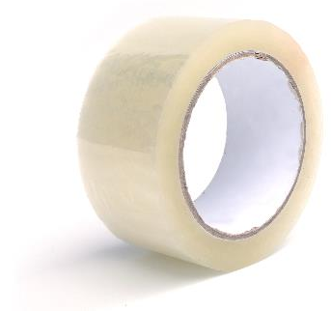
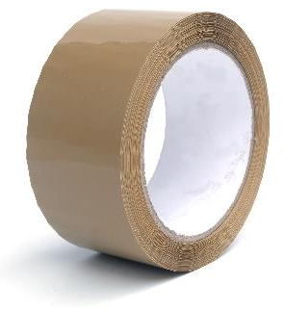
Packing tape
120
metres
50%
longer
How many metres of tape are on the rolls of brown tape?
Notes:
Tell students that a company produces 120-metre rolls of clear tape and rolls of brown tape that contain 50% more tape than the rolls of clear tape. Ask students how long the rolls of brown tape are. Make a note of the different approaches adopted by students.

Slide 3



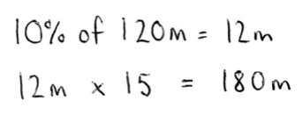

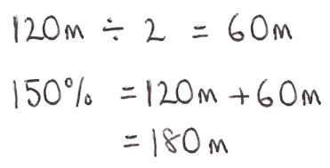
Different approaches
DISCUSS
Nel
Reuben
Saskia
Notes:
After a couple of minutes tell students that Nel, Reuben and Saskia work for the company that manufactures tape. They have each used a different approach to determine the length of brown tape. Ask students to discuss in pairs what each employee has done. Encourage them to draw diagrams to explain how each approach works. The diagrams used by Nel, Reuben and Saskia are discussed later, so do not discuss them at this stage.

Slide 4
Nel’s approach
REVIEW
What has Nel done?
Why has Nel multiplied by 15?
Notes:
Use slides 4-6 to support a discussion of the three approaches. Building up from 10% is a common method that students use when using an additive strategy and Nel may have had this in mind when finding 10% initially. However, Nel has taken a multiplicative approach, scaling up to 150% by multiplying by 15.

Slide 5
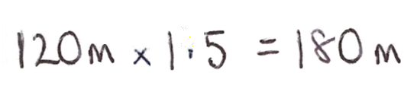
Reuben’s approach
REVIEW
What has Reuben done?
Why has Reuben multiplied by 1.5?
Notes:
Reuben used a one-step multiplier method for finding the length of brown tape. He recognised the multiplicative relationship between 150% and 100% and identified 150% ÷ 100% = 1.5 as a multiplier representing the percentage increase.

Slide 6

Saskia’s approach
REVIEW
What has Saskia done?
Why has Saskia divided by 2?
Notes:
Saskia has used an additive approach, dividing by 2 to find 50% (60 metres) and then adding this to the original 120 metre length. It is important that students develop non-calculator strategies such as this when working with percentage change. However, using an additive approach can often be inefficient and result in mistakes (such as omitting to add to (or subtract from) the original amount). Whilst discussing Saskia’s approach, check whether students can explain why Saskia is interested in working out 150%.

Slide 7
Increasing by 50%
DISCUSS
120
metres
50%
longer
What does an increase of 50% mean?
Notes:
Establish that increasing by 50% means that we add 50% of the original value to itself. The original value is 100%, so we add 50% to 100% to give 150%. Check the students’ understanding by asking them what percent we would be looking for after a 20% increase or decrease.

Slide 8

Diagrams
DISCUSS
Handout
available
Notes:
Tell the students that Nel, Reuben and Saskia each drew a diagram to explain their thinking. The three approaches, and three diagrams are provided on the optional ‘Approaches’ handout. Either use the handout or go straight to slides 9 to 11: either way allow the students some time to think in pairs about which diagram might have been drawn by each of Nel, Reuben and Saskia. Where appropriate, refer to any diagrams your students drew at the start.

Slide 9



Whose diagram? (1)
REVIEW
Nel’s approach
×1.5
0%
100%
150%
Reuben’s approach
0 m
120 m
180 m
×1.5
Saskia’s approach
Notes:
Reuben has used the relationship between 100% and 150% to obtain a multiplier for the percentage change (150% ÷ 100% = 1.5). He has then applied the multiplier to the length of the clear tape, multiplying 120 metres by 1.5 to get 180 metres.

Slide 10
Whose diagram? (2)
REVIEW
Nel’s approach
Clear tape
60 m | 60 m
Reuben’s approach
Brown tape
60 m | 60 m | 60 m
Saskia’s approach
Notes:
Saskia has used two bars to represent the different tapes. The bar representing the clear tape has been divided into 2 equal parts (120 metres ÷ 2 = 60 metres (50%)) and the bar representing the brown tape is 60 metres (50%) longer than the clear tape bar.

Slide 11
Whose diagram? (3)
REVIEW
Nel’s approach
12 m
Clear
tape
10%
120 m
Reuben’s approach
12 m
Brown
tape
10%
12 m × 15 = 180 m
Saskia’s approach
Notes:
Nel has used two bars to represent the different tapes. Both bars have been partitioned to show 10% of the original length (12 metres). The bar representing the brown tape extends beyond the length of the clear tape bar, with the total length labelled as 180 metres = 12 metres × 15.

Slide 12

Brown packing tape offers
DISCUSS
Offer 1:
20% increase in length of tape
180 m
£2.70
Offer 2:
20% decrease in price of tape
Notes:
Tell students that a 180-metre roll of brown tape is currently priced at £2.70. The packing tape company are investigating two possible special offers: increasing the length of tape by 20%, or decreasing the price of the tape by 20%.
Ask students to spend a few minutes working individually to find the new length of tape in Offer 1 and the new price in Offer 2. Encourage them to draw a diagram to help to explain their thinking. Once students have had some time to work alone, ask them to discuss their thinking with their partner. Avoid intervening as they work: it is important that they have enough time to think before you explain. Make a note of the different approaches adopted by students, as you may want to call on students who used different approaches in the next section of the lesson.
Deepening understanding If students have calculated the new length and new price (216-metre roll for £2.70 and 180-metre roll for £2.16), ask them which of the two offers will be best for the manufacturer.

Slide 13

Original length: 180 metres
REVIEW
Additive
approach:
36 m
Click to reveal
Offer 1:
Now 20% longer
20%
180 m
180 m
36 m
216 m
£2.70
 | 20%
216 m
Multiplicative
approach:
×1.2
Click to reveal
0%
100%
120%
0 m
180 m
216 m
Current price: 180 m, £2.70
×1.2
Notes:
Hold a class discussion, asking a couple of different students to share their thinking for the two percentage problems. Many students are likely to use an additive approach for both problems. Use the representations of the additive approaches on these two slides to support a discussion of students’ additive approaches. Use the representations of the multiplicative approaches on these two slides to support students’ understanding that multiplying by 1.2 gives an increase of 20% and multiplying by 0.8 gives a decrease of 20%.
For Offer 1,it is likely that students will have found 20% of 180 m (36 m) and added it on to get 216 m (additive approach). Check whether anyone used a multiplicative approach, using a calculator to multiply 180 by 1.2. Whilst an additive approach is easier to complete numerically without access to a calculator, the double number line representation of a multiplicative approach can be used to support students’ understanding that multiplying by 1.2 gives an increase of 20%, regardless of whether students used a multiplicative approach or not.

Slide 14
Original price: £2.70
REVIEW
Additive
approach:
Click to reveal
Offer 2:
20% OFF
100%
£2.70
80% | 20%
180 m
£2.16
£2.16
54p
Multiplicative
approach:
×0.8
Click to reveal
0%
80%
100%
£0
£2.16
£2.70
Current price: 180 m, £2.70
×0.8
Notes:
For Offer 2, it is likely that students will have found 20% of £2.70 (54 pence) and subtracted it to get £2.16. Ask students to explain how they found 20% (did they find 10% and double it, or did they divide by 5?). Check whether any students used a multiplicative approach.

Slide 15

Price per metre
YOUR TURN
120 m
£2.40
Find the price per metre
If the price per metre is increased, who benefits?
Notes:
Tell students that a 120-metre roll of clear tape is currently priced at £2.40. Ask them to calculate the price per metre.
After a minute or so, ask students to explain their thinking when finding the price (2 pence per metre). Use formative assessment approaches to check that students know which number to divide by, and why; if any students are confused, you may want to spend some time with them to establish what they do, and do not, understand.
Discuss how the price per metre affects the company and the customer. (The greater the price per metre, the more money the company get per metre, but the more expensive it is for the customer to buy, so it is better for the company. The smaller the price per metre, the less money the company get per metre and the cheaper it is for the customer to buy, so it is better for the customer).

Slide 16



Clear packing tape offers
YOUR TURN
Same price per metre
___ m
£2.40
Increase the length, keep the price the same
Nel
120 m
£ ___
Decrease the price, keep the length the same.
Reuben
Notes:
The packing tape company have asked Nel and Reuben to suggest possible special offers for the clear tape. The company wants to find offers where increasing the length of tape and decreasing the price of the roll results in the price per metre of tape being the same for the two offers.
Check that students understand the effects of increasing the length of tape/decreasing the price. You could ask: Will increasing the length of tape you get for £2.40 increase or decrease the price per metre? Will decreasing the price for 120 metres of tape increase or decrease the price per metre?

Slide 17
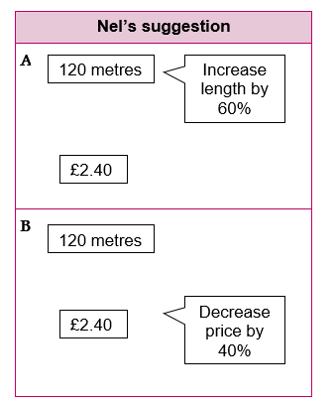
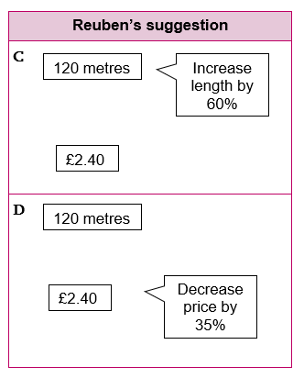
Comparing offers
YOUR TURN
Handout
available
Write down everything you know about the offers.
Do calculations.
Take turns to make a contribution.
Discuss your reasoning with your partner.
Notes:
Give each pair of students a large sheet of paper and scissors and a copy of the ‘Clear tape offers’ handout (or the ‘Clear tape offers landscape’ handout photocopied onto A3 paper).
Explain that Nel and Reuben have come up with some suggestions of offers for the students to explore. Before setting students off on the task, you may like to spend a couple of minutes discussing with students some of the things that might be helpful to consider. These might include things like:
the new length of tape
the new discounted price
similarities and differences between Nel’s and Reuben’s suggestions
a comparison of the price per metre of tape in pence
which offer is best for the company/customer
Ask students to work in pairs to explore Nel’s and Reuben’s suggestions. They should write information about the offers and any calculations next to the relevant suggestion. Emphasise that there is no one correct response; there are many different, valid things they could write down. Students may prefer to use a pencil to record their thinking, so they can make any necessary amendments as they work. They could also use post-it notes.

Slide 18
Offer A
REVIEW
DISCUSS
REVIEW
×1.6
A
0%
100%
160%
120 metres
Increase length by 60%
0 m
120 m
192 m
£2.40
×1.6
Notes:
When discussing each offer, encourage students to identify the percentage they are interested in after the percentage change. For example, for Offer A (and Offer C), an increase of 60% means that we are interested in 160%. Discuss students’ approaches to finding 160%, emphasising how additive and multiplicative approaches relate to each other.

Slide 19
Offer B
REVIEW
DISCUSS
REVIEW
×0.6
B
0%
60%
100%
120 metres
Decrease price by 40%
£0
£1.44
£2.40
£2.40
×0.6
Notes:
Students who used an additive approach may have calculated 40% of £2.40 (96p) and used this as the discounted price, rather than £2.40 – 96p = £1.44. It is important to establish the need to subtract from 100% when calculating a percentage decrease. The double number line representation can be used to support a discussion of the relationship between a percentage decrease of 40% and calculating 60%.

Slide 20
Price per metre
REVIEW
REVIEW
Offer A:
Offer B:
192 m
£2.40
120 m
£1.44
Price per metre
= ……… p
Price per metre
= ……… p
Notes:
Ask students to explain how they checked whether the price per metre of tape is the same for Offers A and B. Students sometimes get confused about which number to use as the divisor in these calculations; check that they understand that price per metre means that the price for one metre needs to be found. Students may have worked in pounds rather than pence. Check that students are able to interpret a price of £0.0125/£0.012 per metre as 1.25 pence/1.2 pence per metre.

Slide 21
Offer C
REVIEW
DISCUSS
REVIEW
×1.6
C
0%
100%
160%
120 metres
Increase length by 60%
0 m
120 m
192 m
£2.40
×1.6
Notes:
Offer C is the same as Offer A.

Slide 22
Offer D
REVIEW
DISCUSS
REVIEW
×0.65
D
0%
65%
100%
120 metres
Decrease price by 35%
£0
£1.56
£2.40
£2.40
×0.65
Notes:
Using an additive approach for a percentage decrease of 35% is a more onerous process than finding 40% and subtracting (as in Offer B). If students have used an additive approach, discuss their methods for finding 35%. Recognising that we are interested in 65% may have prompted students to use non-calculator strategies to find 65%, rather than finding 35% and subtracting. Identifying the multiplier as 0.65 emphasises the need to subtract from 100% when carrying out a percentage decrease.

Slide 23
Price per metre
DISCUSS
REVIEW
Offer C:
Offer D:
192 m
£2.40
120 m
£1.56
Price per metre
= 1.25p
Price per metre
= ……… p
Notes:
The price per metre for Offer C is already known (as it is the same as Offer A). Establish the price per metre for Offer D as 1.3 pence.

Slide 24
Comparing offers
REVIEW
REVIEW
192 m
£2.40
192 m
£2.40
Price per metre: 1.25p
Price per metre: 1.25p
120 m
£1.44
120 m
£1.56
Price per metre: 1.2p
Price per metre: 1.3p
Notes:
Remind students that the packing tape company wanted to find offers where increasing the length of tape and decreasing the price of the roll results in the price per metre of tape being the same for the two offers. Establish that whilst the prices per metre are similar for Offers A and B (1.25p and 1.2p) and Offers C and D (1.25p and 1.3p), they are not the same. Students may notice that there is a difference of 0.5 pence between the prices per metre for both Offers A and B and Offers C and D.

Slide 25
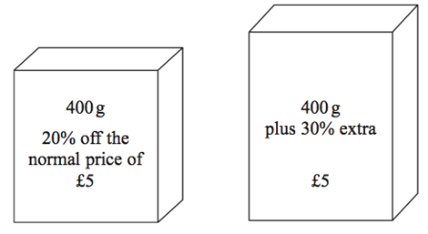
Practice questions
YOUR TURN
Handout
available
Handout
available
Food Mart and Jan’s Store sell boxes of the same type of breakfast cereal.
Each shop has a special offer.
Food Mart Jan’s Store
……………….. (4)
Q18 from November 2018, 1MA1/1F
Tom is going to buy 25 plants to make a hedge.
Here is information about the cost of buying the plants.
Kirsty’s Plants
£2.39 each
Hedge World
Pack of 25
£52.50 plus VAT at 20%
400 g
plus 30% extra
£5
400 g
20% off the normal price of £5
Tom wants to buy the plants as cheaply as possible.
Should Tom buy the plants from Kirsty’s Plants or Hedge World?
You must show all your working.
Which box of cereal is the better value for money?
You must show your working
……………….. (5)
Q15 from Pearson Edexcel Practice Tests: Set 4 Regular (1F)
(From mathsemporium.com)
Notes:
Distribute a copy of the ‘Practice questions’ handout to students and give them a couple of minutes to come up with a solution to the two problems.

Slide 26
Practice question (1)
DISCUSS
Which box of cereal is the better value for money?
Food Mart Jan’s Store
……………….. (4)
Q18 from November 2018, 1MA1/1F
20% off:
×0.8
0%
80%
100%
400 g
plus 30% extra
£5
400 g
20% off the normal price of £5
£0
£4
£5
×0.8
Notes:
Discuss students’ thinking when finding the cost of a box of cereal at Food Mart. Encourage different students to describe their approaches and share any diagrams/representations to explain their thinking. Use the double number line representation to emphasise the relationship between reducing by 20% and multiplying by 0.8.

Slide 27
Practice question (1)
DISCUSS
Which box of cereal is the better value for money?
Food Mart Jan’s Store
……………….. (4)
Q18 from November 2018, 1MA1/1F
30% extra:
×1.3
0%
100%
130%
400 g
plus 30% extra
£5
400 g
20% off the normal price of £5
0 g
400 g
520 g
×1.3
Notes:
Discuss methods for finding the cost of a box of cereal at Jan’s Store in a similar way. The double number line representation can be used to emphasise the relationship between increasing by 30% and multiplying by 1.3.
Discuss how students determined which offer provides the best value for money (Jan’s Store). Did they find the price per gram (1p for Food Mart and 0.96p for Jan’s Store) or did they identify that with Food Mart you get 400g for £4 whereas with Jan’s Store you get 520g for £5 (500g would be comparable with Food Mart).

Slide 28
Practice question (2)
DISCUSS
20% VAT:
Tom wants to buy the plants as cheaply as possible.
Should Tom buy the plants from Kirsty’s Plants or Hedge World?
×1.2
0%
100%
120%
Kirsty’s Plants
£2.39 each
Hedge World
Pack of 25
£52.50 plus VAT at 20%
0 g
£52.50
£63
×1.2
……………….. (5)
Q15 from Pearson Edexcel Practice Tests: Set 4 Regular (1F)
(From mathsemporium.com)
Notes:
Students should be able to find the price of 25 plants at Kirsty’s plants. Discuss what ‘plus VAT at 20%’ means and establish that this means finding 120%. Once students have done this, comparing the total price is straightforward.

Slide 29
Lesson review:
Percentage change and best buys
Objectives
Become fluent at working with percentage change
Determine the best deal following a percentage change
Understand different approaches to solving multi-step percentage problems
Use representations to provide insight when solving problems
Suggested further steps/areas to work on
Calculate percentage change given original and new amounts

Slide 30
Lesson 5:
Credits
Photo acknowledgements
Shutterstock.com: Kitch Bain, Vectorfair.com; joom seeda
Text acknowledgements
Pearson Education Ltd: Pearson Edexcel GCSE (9 – 1) In Mathematics (1MA1) Foundation (Non-Calculator) Paper 1F
Pearson Education Ltd: Pearson Edexcel Practice Tests: Set 4 Regular (1F) (From mathsemporium.com)

