Slide 1
T LEVEL IN ANIMAL CARE AND MANAGEMENT
Supporting the delivery of business and management Core Content

Slide 2
1
Introduction to the business and finance project

Slide 3
Learning overview
In today’s lesson, we will cover:
  the end of project task
  market research and marketing
  business finance
  a review of prior learning with case studies
  peer reviewing.
  Write the above on your learner record of work.

Slide 4
Your project brief
You are part of the practice management team at a veterinary practice that is looking to diversify by selling pet products in the reception area.
You have been asked by the practice manager to create a business proposal. The business proposal will have a maximum of four different products.
Let’s look at the project brief.

Slide 5
Your business and finance project brief
At the end of this project, you will individually:
  use project management skills encompassing all aspects
  create an effective business proposal
  present your proposal to peers and staff members.
  This project will be assessed in week 10.

Slide 6
Case studies
  Identify key features of your case study and answer the questions in your case study sheet.
  Be prepared to feed back to the class.
  Take notes about other case studies and your peers’ feedback.

Slide 7
What is peer reviewing?
Peer review is the evaluation of work by one or more people with similar competencies as the producers of the work.

Slide 8
Sticky note activity
Choose the four best examples of effective peer review from the following list and put one feature on each sticky note:
  'clear and easy to follow’
  'well organised’
  ‘it was good’
  'looks great’
  ‘you could make it better by…..’.

Slide 9
Case study peer review
Working in the same groups, identify the key areas from your case study that link with your end of project task – for example, marketing.
Prepare a three-minute presentation on flipchart paper showing the key areas you have chosen and why.

Slide 10
Peer review presentations
Each group will present to another group and then swap over.
Each group will then discuss the presentation they have just seen and provide effective feedback.
Remember the four points of effective peer reviewing discussed previously.

Slide 11
Plenary – progress check
  Complete your learner record of work.
  Rate your understanding of everything discussed and evaluate your progress using red, amber and green (RAG).
  Homework task – Research an example of the mission statement and values of a veterinary practice and bring to next lesson.

Slide 12
2
Business scenario simulation

Slide 13
Learning overview
In today’s lesson, we will:
  review knowledge of all topics to be covered within the business proposal
  research and discuss real-world business scenarios
  identify what a real-world business focuses on to become successful.

Slide 14
Learning overview reflection task
In your learner record of work, complete the start of your self-assessment of learning.
  In your own words, state what is going to be covered in this lesson.
  RAG rate your understanding of everything discussed in the learning overview.

Slide 15
Recap of previous lesson
In groups, discuss what was achieved in the previous lesson, including your homework task.
  What activities were completed?
  What did you learn?
  How will the previous lesson assist with the overall project?

Slide 16
Review of knowledge
As discussed in the previous lesson, you will be using your prior knowledge of business and finance topics throughout the project. This includes:
  market research and analysis
  business objectives, values and standards
  business costs
  calculating the selling price of goods
  marketing.

Slide 17
Review of knowledge activity
In small groups, identify from your prior knowledge the key points for each of the business and finance topics.
Present the key points on flipchart paper to be presented to the class.

Slide 18
Real-world businesses
We live in a world of both successful and unsuccessful businesses. Can you state any common businesses you use?
  They can be any type of business, not just animal-related.
  Can you identify the reasons behind either the success or demise of the business?

Slide 19
Pets at Home
Investigate Pets at Home as a successful business within the animal industry in more detail. Some points to consider:
  It was founded in 1991 by Anthony Preston.
  The business now has the following facilities:
    457 pet centres
    339 grooming salons
    444 veterinary practices

Slide 20
Research task
Research the techniques used by Pets at Home for your allocated topic. Use the hyperlinks on the next slide.
From the information collected, create a PowerPoint presentation to be delivered to the rest of the class.

Slide 21
Hyperlinks for research task
  Strategy for Pets at Home
  Growing market for Pets at Home
  Business model for Pets at Home
  Sustainability approach for Pets at Home
  Purpose, visions and values for Pets at Home

Slide 22
Pets at Home success
  In your groups, identify the key elements that have enabled the business to be successful.
  Discuss as a whole group and consolidate the main points.

Slide 23
Plenary – progress check
  Complete your learner record of work.
  RAG rate your understanding of everything discussed and evaluate your progress.
  Homework task – Research another animal related business and identify the business’ strengths.

Slide 24
3
Market research and analysis

Slide 25
Learning overview
In today’s lesson, we will:
  recap understanding of the previous lesson
  review the need to complete market research relating to business growth
  identify the techniques used to complete market research
  review the importance of analysing market research
  complete market research and analyse the information relating to your project.

Slide 26
Learning overview reflection task
In your learner record of work, complete the start of your self-assessment of learning.
  In your own words, state what is going to be covered in this lesson.
  RAG rate your understanding of everything discussed in the learning overview.

Slide 27
Recap of previous lesson
In groups, discuss what was achieved in the previous lesson, including your homework task.
  What activities were completed?
  What did you learn?
  How will the previous lesson assist with the overall project?

Slide 28
What is market research?
Market research helps to determine how suitable your product is for your target audience. It also has the following functions.
  It provides information about market variables:
    customers
    competitors
    industries.
  It enables informed decisions to be made.
  It informs potential marketing strategies.

Slide 29
Six steps of market research and analysis
The six steps of market research and analysis include:
  Research the industry
  Investigate competitors
  Identify gaps in the market
  Define the target market
  Identify potential barriers
  Use the intelligence obtained from market research to make business decisions

Slide 30
Importance of market research
Businesses gain valuable information about specific markets, which helps to identify the opportunities and risks of the market.
What techniques are used in market research?

Slide 31
Techniques used in market research
These techniques include:
  research
  focus group meetings
  surveys/questionnaires
  interviews
  customer observations.

Slide 32
Project market research
The first step of your project is to complete market research on behalf of the veterinary practice. This will be accomplished by completing the following steps.
  Investigate the practice’s competitors.
  Design a suitable questionnaire.
  Complete the questionnaire with a range of customers.
  Analyse the results of the questionnaire.

Slide 33
Project market research – competitors
Discuss your answers with a peer from the homework task set. The questions you answered were:
  How many veterinary practices are there in your local area?
  What services/products do these veterinary practices offer?

Slide 34
Questionnaire
  As discussed, a questionnaire is an effective technique for completing market research.
  In small groups, discuss your own previous experiences of completing questionnaires.
  Give examples of the questions you were asked.

Slide 35
Project – questionnaire
Task 1
Individually design a suitable questionnaire to be able to complete market research for the veterinary practice. Remember to consider the following points:
  the purpose of the business project
  the information you have researched on local competitors.

Slide 36
Questionnaire guidance
Consider the following points when creating your questions.
  Use qualitative and quantitative questions. Ratings will help with analysis.
  Use questions to get to know your customers, for example customer age, pet information and animals’ needs.
  Ask specific questions relating to various products to be able to identify any gaps in the market.
  Create 10–15 questions.

Slide 37
Questionnaire results
Now we need customers.
  Ask 5–10 peers to complete your questionnaire based on the customer scenarios.
This will allow you to analyse the data and complete the market research element of the project.

Slide 38
Market research analysis
Task 2
From the results you have obtained from your questionnaires, you should now be able to:
  identify more information on the veterinary practice customers
  identify whether there are any specific product gaps in the market
  have a better understanding of what products would be suitable to sell at the veterinary practice.

Slide 39
Market research summary
From the analysis of your questionnaire results, use Task sheet 3 to compile a 500-word summary of your findings.

Slide 40
Plenary – progress check
  Complete your learner record of work.
  RAG rate your understanding of everything discussed and evaluate your progress.
  Homework task – Based on the information collected, identify two potential products suitable to be sold at the veterinary practice and why.

Slide 41
4
Business objectives, values and standards

Slide 42
Learning overview
In today’s lesson, we will:
  review the need of businesses to have suitable objectives and values
  review the importance of business quality standards
  discuss key performance indicators (KPIs)
  identify the specific products to be sold at the veterinary practice relating to quality standards.

Slide 43
Learning overview reflection task
In your learner record of work, complete the start of your self-assessment of learning.
  In your own words, state what is going to be covered in this lesson.
  RAG rate your understanding of everything discussed in the learning overview.

Slide 44
Recap of previous lesson
In groups, discuss what was achieved in the previous lessons, including your homework task.
  What activities were completed?
  What did you learn?
  How will the previous lessons assist with the overall project?

Slide 45
Values, objectives and standards
In groups, discuss what you feel the values, objectives and standards are for the veterinary practice relating to the business and finance projects. You may want to consider:
  the mission statements and values you found for homework
  prior knowledge and understanding of businesses
  your own personal experiences.

Slide 46
City and Guilds T Level resources
The following slides (47–52) are adapted from City and Guilds T Level resources. Provide an overview of the values, objectives and standards.

Slide 47
Business values
Values are the authentic and deeply ingrained guiding principles of a business organisation’s actions and activities.
  Organisational values may include:
  expectations of how the business should behave
  expectations of how its people should behave
  how things should be done
  how the business differentiates from its competitors.

Slide 48
Business objectives
Objectives are the organisational targets that must be achieved to ensure the required level of business that can be considered a success.
  Specific business objectives include:
  social responsibility objectives
  environmental responsibility objectives
  KPIs.

Slide 49
Social responsibility objectives
Social responsibility means taking a caring and concerned view of society, to ensure the organisation and individuals are prevented from taking destructive actions, to avoid destroying the fabric of well-being for the people and planet alike in the pursuit of profit.

Slide 50
Environmental responsibility objectives
These are crucial for addressing the global social and environmental challenges faced today and can include the following:
  promoting sustainable production techniques
  using renewable natural resources
  using renewable energy sources
  adopting circular economy practices
  repairing, reusing and recycling.

Slide 51
Key performance indicators (KPIs)
KPIs set a quantifiable standard to measure success for business objectives. They can:
  measure values of effectiveness
  focus on setting common goals
  set budgets, allowing objectives to be achieved
  measure the efficiency of time utilisation.

Slide 52
Business quality standards
The primary reason for quality standards is to satisfy customer expectations. Other reasons include:
  to ensure reliability and safety of products/services
  to comply with legal and regulatory rules
  to meet or exceed social and environmental objectives
  to meet business objectives.

Slide 53
Business and finance project
You now have the analysis of the market research completed in the previous lesson, alongside a review of business objectives and standards.
You will now need to decide on the products you are wanting to sell within the veterinary practice.

Slide 54
Product research
Complete research on a range of products and complete the tasks set. Think about:
  social and environmental factors
  customer requirements
  types of products (e.g. toys, supplements, clothing and first-aid equipment).

Slide 55
Plenary – progress check
  Complete your learner record of work.
  RAG rate your understanding of everything discussed and evaluate your progress.
  Homework task – Research and identify a range of suppliers for the products chosen for the business proposal.

Slide 56
5
Business costs

Slide 57
Learning overview
In today’s lesson, we will:
  review the various types of costs incurred by businesses
  review the types of taxation from a business perspective
  identify the various costs involved within your business project.

Slide 58
Learning overview reflection task
In your learner record of work, complete the start of your self-assessment of learning.
  In your own words, state what is going to be covered in this lesson.
  RAG rate your understanding of everything discussed in the learning overview.

Slide 59
Recap of previous lesson
In groups, discuss what was achieved in the previous lesson, including your homework task.
  What activities were completed?
  What did you learn?
  How will the previous lesson assist with the overall project?

Slide 60
Types of costs
Task 1
Individually create a mind map of the types of costs relating to your chosen products for your business proposal.

Slide 61
The types of costs
  Place the identified costs into two or three categories.
  Discuss the possible different categories within your groups.
  Create a table or image of these categories relating to the costs you have identified as part of your business proposal.

Slide 62
Possible categories summary
  Revenue and capital expenditure
  Recurring and non-recurring expenditure
  Pay and non-pay expenditure

Slide 63
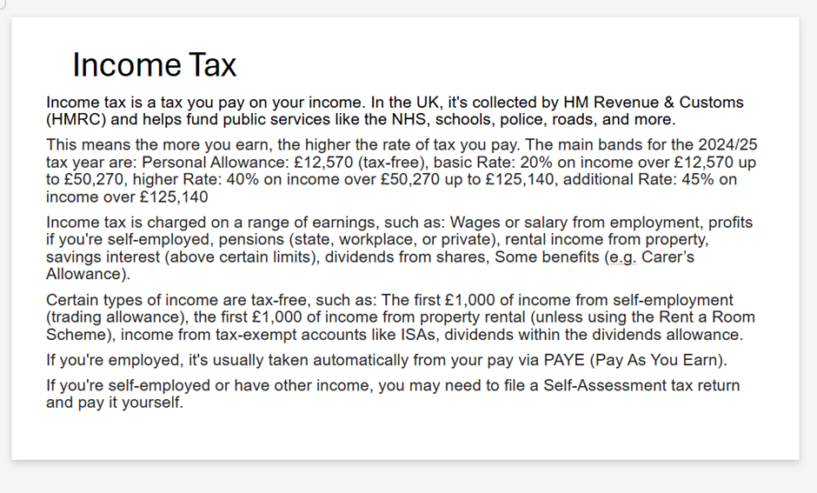
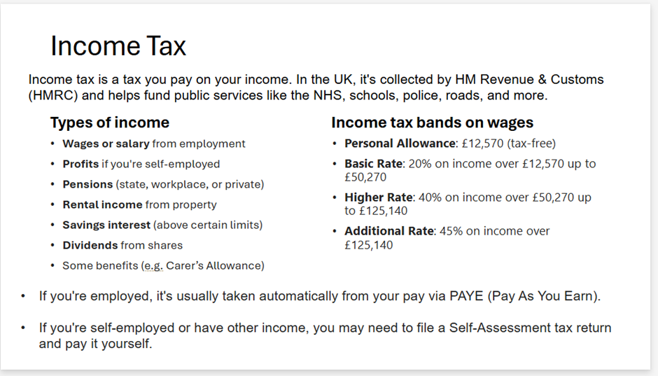
PowerPoint critique
Out of the below slides identify in your groups which slide you feel is more effective.

Slide 64
Taxation and government costs
Task 2
Further costs will need to be reviewed as part of business diversification.
  In groups, design a PowerPoint slide relating to the allocated government cost provided.
  As a group, you will then present this to the rest of the class.

Slide 65
Plenary – progress check
  Complete your learner record of work.
  RAG rate your understanding of everything discussed and evaluate your progress.
  Homework task – Provide an overview of your business proposal with the evidence collated so far. This can be completed in a layout of your choice.

Slide 66
Business and finance project overview
The overview is an opportunity for you to reflect and show evidence of the progress made on your project so far. We’ve covered:
  market research and analysis
  business objectives, values and standards
  business costs.

Slide 67
6
Calculating selling price of goods

Slide 68
Learning overview
In today’s lesson, we will:
  recall knowledge and understanding of the definition of profit within a business context
  review and identify how products are priced to ensure rate of profit margins
  identify and complete the steps involved in calculating the costs of goods for the business proposal
  identify the suitable price of the products for the business proposal.

Slide 69
Learning overview reflection task
In your learner record of work, complete the start of your self-assessment of learning. This includes the following tasks:
  In your own words, state what is going to be covered in this lesson.
  RAG rate your understanding of everything discussed in the learning overview.

Slide 70
Recap of previous lesson
In groups, discuss what was achieved in the previous lesson, including your homework task.
  What activities were completed?
  What did you learn?
  How will the previous lesson assist with the overall project?

Slide 71
Definition of profit
Task 1
  In small groups, complete effective research to identify a suitable definition of profit to present to the rest of the class.
  The definition needs to be succinct and understandable for a non-financial audience.
  We will then discuss as a whole class a suitable definition based on your presentations and feedback.
  Note the website and the date and time it was accessed for any information quoted.

Slide 72
How to price a product
Task 2
Individually read the article guiding start-up businesses on how to price products (Starling Bank handout).
  Identify and note the key points that will be useful for your business proposal.
  Be ready to answer questions and contribute to a class discussion.

Slide 73
Calculate cost of goods
Task 3
Follow these steps for one of your products to gain vital information for your business proposal.
  Step 1 – Research a supplier and choose one product that is part of their business proposal.
  Step 2 – Calculate the total cost of one product, considering all the factors from previous lesson.

Slide 74
Calculate the cost of goods
Task 3 (continued)
  Step 3 – Calculate the mark-up (also known as the margin) that you think will be appropriate, for example 25%.
  Step 4 – Agree on a final selling price, then compare with other practices and shops online.
  Step 5 – Revise the selling price based on your research of competitors.

Slide 75
Ordering products and projected profit
To identify the correct number of products to sell as part of your business proposal, you need to reflect on the various tasks already completed. This will include the market research questionnaire completed on the existing customers at the veterinary practice.
You may also want to consider storage capacity relating to the amount of stock to be ordered.

Slide 76
Ordering products
Before placing an order with your chosen supplier, you will need to consider how much stock you will be holding.
Discuss how:
  Ordering a large amount of stock may result in a bigger discount, but you will need adequate storage, and the products might not sell.
  Ordering a smaller amount of stock will be more expensive and the stock might sell out quickly.

Slide 77
Ordering products and projected profit
Task 4
Provide evidence of all your decisions for the following tasks.
  Complete the steps from task 3 for all your products. You have now identified the supplier to be used.
  Calculate the first order of products. Remember to think about storage.
  Calculate the projected profit on the first order.

Slide 78
Plenary – progress check
  Complete your learner record of work.
  RAG rate your understanding of everything discussed and evaluate your progress.
  Homework task – Based on your peer feedback and self-reflection, identify further considerations and complete the necessary changes.

Slide 79
7
Marketing

Slide 80
Learning overview
In today’s lesson, we will:
  recall knowledge of the importance of marketing for a successful business
  identify examples of marketing strategies used in the animal industry
  evaluate the marketing strategies used within the animal industry
  identify a suitable marketing strategy for your business proposal.

Slide 81
Learning overview reflection task
In your learner record of work, complete the start of your self-assessment of learning.
  In your own words, state what is going to be covered in this lesson.
  RAG rate your understanding of everything discussed in the learning overview.

Slide 82
Recap of previous lesson
In groups, discuss what was achieved in the previous lesson, including your homework task.
  What activities were completed?
  What did you learn?
  How will the previous lesson assist with the overall project?

Slide 83
Does marketing work?
How many of the below slogans can you link to the correct business?
  I’m Lovin’ It
  Just Do It
  Every Little Helps
  The Best A Man Can Get
  Holidays Are Coming

Slide 84
Examples of marketing strategies
On a digital device, individually research examples of marketing from the animal industry that cover two of the situations below:
  a physical event, for example an opening of a new pet store or a zoo event
  an advertisement for a specific product launch
  an online social media post.

Slide 85
Marketing strategies discussion
In small groups, discuss the examples of the marketing strategies from the animal industry that you have found from your research.

Slide 86
Marketing strategies evaluation
  In pairs, choose one example of each marketing strategy found and complete an effective evaluation of the three strategies.
  The evaluation should include identifying what you thought was good and what improvements you thought could have been completed.
  Be ready to feed back to a small group.

Slide 87
Marketing and business success
  After completing both discussions and the evaluation of various examples, identify the marketing strategy you feel has the highest potential for enabling the business to succeed.
  In small groups, choose one example and provide the reasons it has been chosen.
  Select a spokesperson to feed back to the whole class.

Slide 88
Your marketing strategy
With the information and examples discussed throughout this lesson, identify the marketing strategy you feel is the most suitable to be used for your business proposal.

Slide 89
Plenary – progress check
  Complete your learner record of work.
  RAG rate your understanding of everything discussed and evaluate your progress.
  Homework task – Design the marketing strategy you have chosen to use for your business proposal.

Slide 90
8
Project management

Slide 91
Learning overview
In today’s lesson, we will:
  recap knowledge and understanding of project management
  create a purpose statement for your business project
  design a Gantt chart for your business project
  identify the roles and responsibilities of the staff at the veterinary practice in your business project.

Slide 92
Learning overview reflection task
In your learner record of work, complete the start of your self-assessment of learning.
  In your own words, state what is going to be covered in this lesson.
  RAG rate your understanding of everything discussed in the learning overview.

Slide 93
Recap of previous lesson
In groups, discuss what was achieved in the previous lesson, including your homework task.
  What activities were completed?
  What did you learn?
  How will the previous lesson assist with the overall project?

Slide 94
Project management recap
  In small groups, discuss any relevant points you can recall relating to project management.
  Create a mind map of all your points.
  Share and collate information from each group.

Slide 95
Your project management
For your business proposal, you will need to include aspects of project management in your presentation. Please include:
  the purpose of the project
  realistic milestones throughout the project
  the roles and responsibilities of the staff involved.

Slide 96
Business proposal overview
  Task 1
  Individually create a suitable business proposal overview for your business project.
  This will be used for the introductory slide of your presentation in lesson 10.
  It may be useful to review the original project brief from lesson 1.

Slide 97
Realistic project milestones
Breaking projects down into smaller, specific actions to be completed within a set timescale is a vital element of project management. Setting project milestones can:
  provide a full timeline of the project
  outline the required actions needing to be achieved
  identify suitable checkpoints
  assign actions to the relevant individuals.

Slide 98
Gantt charts
Task 2
A Gantt chart is an essential visual tool that provides a simple way to track and manage the progress of project milestones.
Individually design a suitable Gantt chart that could be used in your business project.
Let’s recap the steps needed to design a Gantt chart.

Slide 99
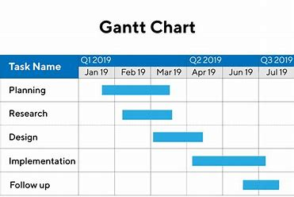
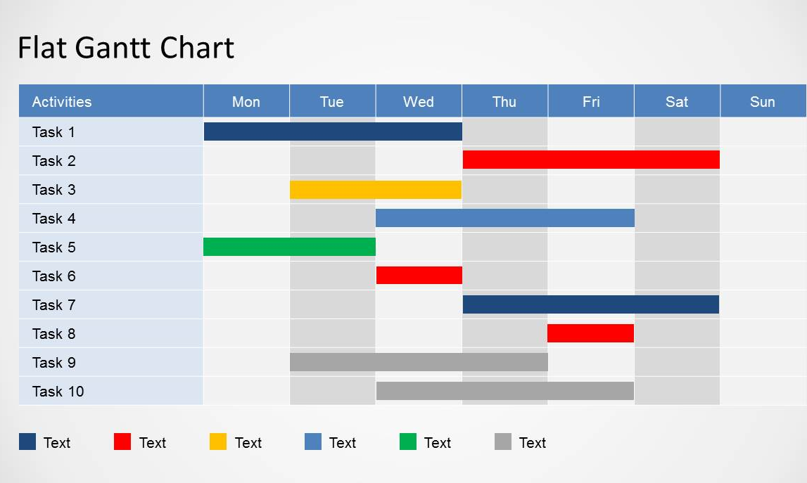
Gantt charts – examples

Slide 100
Gantt charts
You can design your own Gantt chart using Microsoft Excel, a Microsoft Word table or an online sample. Complete the following steps:
  List all the project tasks to be completed down the vertical column.
  Identify the order and timescale required for each task.
  Display the timeline horizontally across the top of the chart.
  Use various colours to highlight the time needed within the chart.

Slide 101
Roles and responsibilities
The various roles and responsibilities within project management will vary depending on the project and the business. In general, these can be defined as:
  the project manager – has overall say
  the project board – makes decisions and ensures effective communication is carried out to all individuals
  the project team – carries out the set tasks involved within the project.

Slide 102
Veterinary practice roles and responsibilities
Task 3
Individually state the roles and responsibilities of the staff at the veterinary practice who will be involved with the business project. Staff that may be included are:
  the veterinary practice manager
  veterinary practice office staff
  veterinary care assistants
  veterinary nurse apprentices.

Slide 103
Informal peer presentation
  Task 4
  Present the information compiled from the three previous tasks with your peer.
  Your peer will be taking notes and asking questions during the presentation.
  Once you have both completed your presentation, provide effective verbal feedback to each other.

Slide 104
Plenary – progress check
  Complete your learner record of work.
  RAG rate your understanding of everything discussed and evaluate your progress.
  Homework task – Organise all the evidence collated over the last eight lessons in preparation for creating your business proposal presentation.

Slide 105
9
Preparation for presentation

Slide 106
Learning overview
In today’s lesson, we will:
  review the topics and activities completed throughout the project
  discuss the possible content for the project proposal presentation
  design and complete your project proposal presentation.

Slide 107
Learning overview reflection task
In your learner record of work, complete the start of your self-assessment of learning.
  In your own words, state what is going to be covered in this lesson.
  RAG rate your understanding of everything discussed in the learning overview.

Slide 108
Recap of previous lesson
In groups, discuss what was achieved in the previous lesson, including your homework task.
  What activities were completed?
  What did you learn?
  How will the previous lesson assist with the overall project?

Slide 109
Overview of topics and activities
To prepare your business proposal presentation, an overview of all the topics and activities completed is essential. For the topics identified below, identify the activities completed:
  market research and analysis
  business objectives, values and standards
  business costs
  calculating the selling price of goods
  marketing
  project management.

Slide 110
Presentation content
The presentation content could include:
  the purpose of the business project
  market research analysis
  business proposal objectives, values and standards – the choice of products and why
  financial plans and projections
  marketing strategies
  an overview of how the business project would be managed.

Slide 111
Plenary – progress check
  Complete your learner record of work.
  RAG rate your understanding of everything discussed and evaluate your progress.
  Homework – finish the business proposal presentation if required. Practise presenting business proposal.

Slide 112
10
Proposal presentations

Slide 113
Learning overview
In today’s lesson, you will:
  recap the peer review and presentation examples completed within the project
  present your business proposal
  complete effective peer review feedback
  complete a self-reflection and evaluation for the project.

Slide 114
Learning overview reflection task
In your learner record of work, complete the start of your self-assessment of learning.
  In your own words, state what is going to be covered in this lesson.
  RAG rate your understanding of everything discussed in the learning overview.

Slide 115
Presentation and peer review
You have completed a wide range of presentations and delivered peer review feedback throughout the business and finance project.
Let’s now discuss these and identify the techniques you have used for them.

Slide 116
Presentation
You will now present your business proposal. You will be following the time allocations below.
  5 minutes to set up
  10 minutes to present
  5-minute stakeholder question-and-answer session
  5-minute feedback session from audience
  5 minutes to complete self-reflection

Slide 117



Acknowledgements
PRODUCED BY
FUNDED BY
PROVIDER LOGO HERE
South Staffordshire College has produced this resource on behalf of the Education and Training Foundation
This programme is funded by the Department for Education
ET-FOUNDATION.CO.UK

