Slide 1
T Level in Design, surveying and planning for construction
Communication skills development
ETF/Shrewsbury Colleges Group

Slide 2
01
Session 1
Target audience in construction
Notes:
2.5 hours

Slide 3
Introduction
Welcome to the programme on adapting communication for different audiences.
This programme is designed to help you develop essential communication skills in the context of the construction industry.
Education & Training Foundation
Notes:
Advise learners that this is a 10-lesson programme of skills development on the theme of communication.

Slide 4
Overview
The lessons are structured around a real town regeneration project.
You will develop and apply communication skills in a realistic scenario relevant to construction.
The skills to be developed include:
analysing the target audience
synthesising relevant information
descriptive and persuasive writing
adapting communication
visual communication methods.
Education & Training Foundation

Slide 5
Lesson sequencing
The lessons focus on three communication skills:
written
visual
oral.
Each lesson builds upon the previous one as you work on different aspects of the project.
You will draw upon and apply knowledge from Core Content as you collaborate in small groups.
Education & Training Foundation
Notes:
Explain to learners:
In this 10-lesson programme of learning, you'll be working on a practical regeneration project that will serve as the foundation for developing your communication and collaboration skills. This project will provide a realistic scenario that mirrors the types of challenges and interactions you'll face in your future careers within the construction industry.
As you progress through the lessons, you'll focus on building discrete skills that are essential for effective communication and collaboration. These skills include analysing your target audience, synthesising relevant information, writing persuasively and descriptively, using visual communication methods, engaging in professional discussions, delivering impactful presentations, employing persuasive speaking techniques, giving and receiving feedback, communicating via video, and reviewing and reflecting on your communications.
Each lesson will build upon the previous one, allowing you to apply your newly acquired skills to different aspects of the regeneration project. By working in small groups, you'll have the opportunity to draw upon and apply knowledge from Core Content areas 8-11, further enhancing your understanding of the subject matter.

Slide 6
Simulating real-world interactions
Throughout the programme, you will have opportunities to practise communicating with various stakeholders.
This simulates the diverse interactions you will encounter while working in the construction industry.
You will gain practical experience communicating professionally in a construction industry context.
Education & Training Foundation
Notes:
Explain to learners that one of the key benefits of this programme is that it provides you with opportunities to practise communicating with various stakeholders, just as you would in a real-world setting. Throughout the programme, you'll engage in simulated interactions with clients, colleagues, supervisors and other professionals in the construction industry.
By participating in these diverse interactions, you'll gain practical experience in communicating professionally within the context of the construction industry. This hands-on approach will help you develop the confidence and competence needed to effectively communicate and collaborate with others in your future careers.

Slide 7
Reinforcement and integration
These lessons introduce key communication skills, but they will need to be reinforced and expanded upon over your course and beyond.
Revisiting the skills in different contexts is essential for deep, lasting competency development.
Education & Training Foundation
Notes:
Explain to learners that it's important to note that while these lessons introduce key communication and collaboration skills, they are just the beginning of their journey. To truly develop lasting competency, these skills will need to be reinforced and expanded upon in subsequent lessons that are based on the Core Content Areas of the T Level in Design, surveying and planning for construction.
By revisiting these skills in different contexts throughout your educational journey, you'll have the opportunity to deepen your understanding and apply your knowledge to a variety of situations. This ongoing reinforcement and integration will help you develop a strong foundation of communication and collaboration abilities that will serve you well throughout your professional life.
By engaging in an authentic project that requires a range of communications, you'll have the opportunity to develop your skills in a meaningful and relevant context.
This practical approach will help you bridge the gap between theory and practice, allowing you to see first-hand how effective communication and collaboration can have an impact on the success of a project in the construction industry.
As you progress through the programme, you'll develop a strong foundation of abilities that you can continue to build upon throughout your educational and professional journeys. By investing in your communication and collaboration skills now, you'll be well-prepared to face the challenges and opportunities that await you in your future careers.

Slide 8
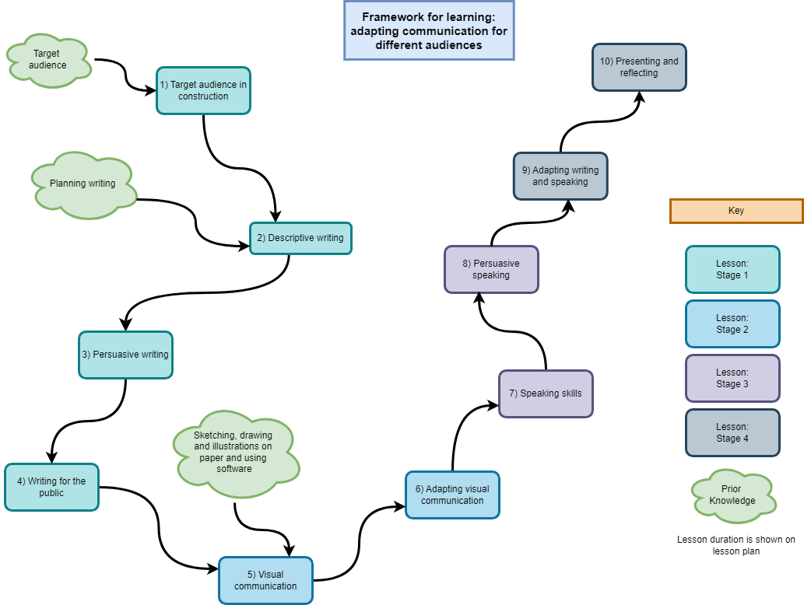
Education & Training Foundation
Notes:
Explain the Framework for learning to the learners. Explain the three stages and that the learning will build on each stage (scaffold) their learning.

Slide 9
Target audience in construction
By the end of this lesson, you will be able to:
explore stakeholder types and target audience in construction
identify information for key stakeholders from a real project
undertake sentiment analysis on selected texts.
Education & Training Foundation
Notes:
Advise learners:
In the context of construction projects, stakeholders are individuals or groups who have an interest in the project's outcomes or are affected by its execution. Exploring stakeholder types involves identifying the various categories of stakeholders involved in construction projects, such as clients, contractors, subcontractors, local authorities, community members, etc.
Sentiment analysis is the process of determining the sentiment expressed in a piece of text, whether it's positive, negative or neutral. Undertaking sentiment analysis on selected texts involves using methods to analyse and interpret the emotions, opinions or attitudes conveyed in the text.

Slide 10
What is a stakeholder?
A stakeholder (in construction) is any individual, group or organisation that has an interest or concern in a construction project.
Stakeholders can be internal or external to the organisation carrying out the construction project.
Stakeholders can have different levels of influence and impact on the project, depending on their role and involvement.
Effective stakeholder management involves identifying, communicating with and engaging stakeholders throughout the project lifecycle to ensure their needs and expectations are met.
Education & Training Foundation

Slide 11
Example of stakeholders
project owners
clients.
Can you think of anymore?
Education & Training Foundation
Notes:
Ask learners to think of various people who might be invested in a construction project.

Slide 12
Group activity
In small groups, identify main stakeholders that would need information about a whole-town development project.
(Think about your location. Who would have an interest in a project in your area?)
Share ideas with class.
Agree on a list of project stakeholders.
Education & Training Foundation
Notes:
Advise learners:
Some ideas of stakeholders can be found here: https://ctb.ku.edu/en/table-of-contents/participation/encouraging-involvement/identify-stakeholders/main
A whole-town development project is one that is organised by the local or national government with a specific purpose, often regeneration of a depressed area. They are designed to have a whole-town impact.
Some stakeholders that might come up are:
Local residents: individuals living within or near the town who will be directly affected by the development project. Their interests may include concerns about changes to their living environment, access to amenities and potential impacts on property values.
Local businesses: businesses operating within the town or in nearby areas that may be affected by the development. Their interests may include opportunities for economic growth, concerns about changes in foot traffic and potential disruptions during construction.
Local government: this includes local authorities, such as the town council or district council responsible for planning and development approvals. Their interests involve ensuring compliance with planning regulations, promoting economic development and addressing community needs.
Developers/investors: entities responsible for funding and executing the development project. Their interests include achieving a return on investment, adhering to project timelines and budgets, and ensuring the project aligns with their strategic objectives.
Environmental groups: organisations advocating for environmental conservation and sustainability. Their interests involve ensuring the project minimises environmental impact, preserves green spaces and promotes sustainable development practices.
Transport authorities: agencies responsible for transportation infrastructure, including roads, public transport and cycling/walking routes. Their interests include assessing the project's impact on transportation networks, improving connectivity and addressing traffic congestion.
Educational institutions: schools, colleges and universities serving the local community. Their interests may involve accommodating potential changes in population demographics, addressing educational infrastructure needs and opportunities for community engagement.
Healthcare providers: hospitals, clinics and healthcare facilities serving the local population. Their interests include assessing the impact of the development on healthcare services, addressing potential changes in demand, and promoting community health and wellbeing.
Utility companies: providers of essential services such as water, electricity, gas and telecommunications. Their interests involve coordinating utility infrastructure upgrades, ensuring service reliability during construction and minimising disruptions to existing services.
Community groups: non-profit organisations, resident associations or grassroots movements representing the interests of specific community segments or advocating for social causes. Their interests include promoting community engagement, addressing social inequalities and preserving cultural heritage.
Heritage organisations: groups dedicated to preserving historical sites, buildings or cultural heritage within the town. Their interests involve protecting heritage assets, ensuring sensitive development practices and promoting heritage tourism.
Emergency services: police, fire and ambulance services responsible for public safety and emergency response. Their interests include assessing the project's impact on emergency response times, ensuring adequate access for emergency vehicles and addressing potential safety risks.

Slide 13
Project stakeholders in construction
project owner/client
architects and designers
engineers
construction managers and contractors
subcontractors and suppliers
local government and regulatory agencies.
If you have missed any of these, please add them to your list.
Education & Training Foundation
Notes:
Explain to learners that the next slides will highlight the importance of, role and communication for each stakeholder group.
Project owner/client:
Importance: the project owner/client initiates and funds the project, making them a pivotal stakeholder. They define the project's objectives, set budgets and determine the desired outcomes.
Role: the owner/client provides direction, approves designs and budgets, and ultimately accepts the completed project. They are responsible for ensuring that the project meets their expectations and fulfils its intended purpose.
Communication: owners communicate with stakeholders to convey project requirements, provide feedback on design proposals, review progress reports and address any concerns with or changes in project scope. Conversely, stakeholders communicate with owners to seek approvals, provide updates on project status and address any issues that may arise.
Architects and designers:
Importance: architects and designers translate the owner's vision into practical, aesthetically pleasing designs that meet functional requirements and regulatory standards.
Role: they conceptualise the project, develop design drawings and specifications, and coordinate with other professionals to ensure design integrity throughout the construction process.
Communication: architects and designers communicate with stakeholders to gather project requirements, present design concepts, solicit feedback and obtain approvals. They also collaborate with engineers and contractors to resolve design challenges and ensure the successful implementation of design solutions.
Engineers:
Importance: engineers provide technical expertise across various disciplines, including structural, civil, mechanical, electrical and environmental engineering, to ensure the project's safety, functionality and sustainability.
Role: they analyse site conditions, develop engineering designs, conduct feasibility studies and oversee the implementation of engineering solutions.
Communication: engineers communicate with stakeholders to assess project requirements, provide engineering recommendations, address technical challenges and ensure compliance with regulatory standards. They also collaborate closely with architects, contractors and subcontractors to coordinate design and construction activities.
Construction managers and contractors:
Importance: construction managers and contractors are responsible for executing the construction phase of the project efficiently, safely, and within budget and schedule constraints.
Role: they plan, organise and coordinate construction activities, manage subcontractors and suppliers, monitor progress, and ensure quality control and safety compliance.
Communication: construction managers and contractors communicate with stakeholders to coordinate construction activities, provide progress updates, address project risks and challenges, and obtain necessary approvals and permits. They also liaise with designers and engineers to resolve construction-related issues and ensure adherence to project specifications.
Subcontractors and suppliers:
Importance: subcontractors and suppliers provide specialised services, materials and equipment necessary for the construction process.
Role: they perform specific tasks such as electrical work, plumbing, carpentry or supplying construction materials, contributing to the successful completion of the project.
Communication: subcontractors and suppliers communicate with project stakeholders to understand project requirements, coordinate delivery schedules, address supply chain issues, and provide updates on work progress and material availability. They also collaborate closely with construction managers and contractors to ensure seamless integration of their services into the project timeline.
Local government and regulatory agencies:
Importance: local government and regulatory agencies enforce building codes, zoning regulations and environmental standards to ensure public safety, environmental protection and compliance with legal requirements.
Role: they review project plans and permit applications, conduct inspections, issue permits, and enforce regulatory compliance throughout the project lifecycle.
Communication: local government and regulatory agencies communicate with project stakeholders to provide guidance on regulatory requirements, review and approve project plans, conduct site inspections, and address compliance issues or violations. Project stakeholders communicate with them to obtain permits, seek regulatory approvals and ensure adherence to applicable laws and regulations.

Slide 14
Affected stakeholders
local businesses
residents
visitors and tourists
end users.
If you have missed any of these, please add them to your list.
Education & Training Foundation
Notes:
Advise learners:
Local businesses:
Importance: local businesses contribute to the economic vitality of the community and play a significant role in supporting the local economy. They provide goods and services essential for project execution and are often directly affected by construction activities.
Role: local businesses may serve as suppliers of construction materials, equipment or services, or they may operate businesses that rely on foot traffic and local patronage. Their role involves adapting to construction-related disruptions, maintaining business continuity and seeking opportunities for collaboration with project developers or contractors.
Communication: local businesses may communicate with project stakeholders to address concerns about construction-related disruptions, seek information about project timelines and impacts, explore opportunities for business partnerships or contracts, and provide feedback on mitigation measures to minimise adverse effects on their operations.
Residents:
Importance: residents are an integral part of the community and have a vested interest in the liveability and sustainability of their neighbourhood. They are directly affected by construction activities and changes to their immediate environment.
Role: residents may serve as advocates for community interests, voicing concerns about potential negative impacts such as noise, dust, traffic congestion or loss of amenities. Their role involves engaging in dialogue with project developers, local authorities and other stakeholders to ensure their voices are heard and their needs are addressed.
Communication: residents may communicate with project stakeholders to express concerns about construction-related disruptions, seek information about project plans and mitigations, participate in community engagement activities, and provide feedback on proposed designs or development plans. Conversely, project stakeholders may communicate with residents to provide updates on project progress, address concerns, solicit input on design alternatives, and collaborate on community initiatives to enhance neighbourhood resilience and wellbeing.
Visitors and tourists:
Importance: visitors and tourists contribute to the local economy through spending on accommodations, dining, entertainment and other leisure activities. They play a vital role in supporting tourism-related businesses and promoting the area as a desirable destination.
Role: visitors and tourists may be attracted to the area by its cultural attractions, natural beauty or recreational opportunities. Their role involves experiencing and enjoying the local amenities, contributing to the local economy and potentially influencing perceptions of the destination.
Communication: visitors and tourists may communicate with project stakeholders to inquire about ongoing construction activities, seek alternative routes or recommendations for navigating the area, express concerns about disruptions to their travel plans or experiences, and provide feedback on the accessibility and attractiveness of tourist destinations during construction. Conversely, project stakeholders may communicate with visitors and tourists to provide information about construction impacts, offer assistance or guidance, and promote alternative attractions or events to mitigate inconvenience and maintain positive visitor experiences.
End users:
Importance: end users are the ultimate beneficiaries of the completed construction project, whether they are individuals, businesses or organisations. Their satisfaction with the project's design, functionality and usability is critical to its long-term success and viability.
Role: end users may directly utilise the facilities, services or infrastructure provided by the construction project, relying on them to meet their needs and expectations. Their role involves providing input during the design phase, adapting to changes during construction and utilising the completed project for its intended purpose.
Communication: end users may communicate with project stakeholders to provide input on design requirements, express preferences or concerns about project features or functionality, seek updates on project progress and timelines, and provide feedback on the usability and performance of the completed project. Conversely, project stakeholders may communicate with end users to gather user requirements, obtain feedback on design proposals, address usability issues or concerns, and promote awareness of project benefits and opportunities for engagement.

Slide 15
Question
What is the difference between target audience and stakeholders?
Education & Training Foundation
Notes:
Stakeholders:
Definition: stakeholders are individuals, groups or organisations that have a vested interest in the project and can influence or be affected by its outcomes.
Scope: stakeholders can be internal or external to the construction project or the organisation undertaking it.
Examples: stakeholders in construction projects may include the project owner, investors, developers, contractors, subcontractors, architects, engineers, local authorities, utility providers, neighbouring communities and end users of the constructed facility.
Role: stakeholders have varying levels of influence and interest in the project. They may be involved in decision-making, providing resources, or may be affected by the project's progress and outcomes.
Target audience:
Definition: the target audience refers to the specific group of people for whom the constructed facility is intended or designed to serve.
Scope: the target audience is typically external to the construction project and the organisation undertaking it.
Examples: the target audience in construction projects may include the end users of the facility, such as residents of a housing development, customers of a retail space, patients of a healthcare facility or employees of an office building.
Role: the target audience's needs, preferences and requirements heavily influence the design, functionality and features of the constructed facility. Understanding the target audience is crucial for delivering a successful project that meets their expectations.
Key differences:
While stakeholders have a vested interest and can influence the project, the target audience is the intended beneficiary of the project's outcomes.
Stakeholders are involved throughout the project lifecycle, whereas the target audience's involvement is primarily focused on the design phase and the post-construction occupancy of the facility.
Stakeholders have varying levels of influence and interest in the project, while the target audience's needs and preferences are a primary driver for the project's design and success criteria.

Slide 16
Pair activity
Read The Big Town Vision handout and discuss the content with your peer.
Highlight the key information that would be most relevant to different target audiences:
business owners
visitors and tourists
residents.
Use a different coloured pen for each audience group.
Share feedback with the class.
Notes:
Advise learners:
For this activity, carefully read through The Big Town vision handout. As you read, use different coloured highlighters to mark the information that would be most relevant to the following groups:
local businesses (use yellow for example)
visitors and tourists
residents.
Some examples to help learners get started:
For local businesses, you might highlight “The Market is going from strength to strength and around it are clusters of new business start-ups, many connected to the growing University.”
For visitors and tourists, consider highlighting “In their place are a vibrant mix of uses including new parts of the University, workspace and apartments. It feels very different walking down to Victoria Quay or to the Quarry with new, high quality pedestrian routes.”
For residents, you may want to highlight “Traffic in the Town centre is very light and slow-moving. Pedestrians and cyclists can walk and move wherever they want, making the streets their own.”

Slide 17
Independent activity
Individually, identify three key benefits and three potential negative impacts of the development for the three construction stakeholders.
Complete Stakeholder impacts worksheet.
Compare answers with a peer and discuss differences.
Share ideas with class.
Education & Training Foundation
Notes:
Advise learners:
Fill in the table with at least three positive and three negative impacts that the Shrewsbury Big Town plan regeneration project will likely have on each of the stakeholder groups: local businesses, visitors and tourists, and residents.
Once you have completed the table, write a short response in the box at the bottom identifying which stakeholder group you think is most likely to be disadvantaged by this development project and explain your reasoning why.
To get you started, here are a couple examples of potential impacts to consider:
Local businesses: positive – increased foot traffic from new apartments and university could bring more customers Negative – rising rents in regenerated areas may force out some local shops
Residents: positive – new riverside promenade and traffic-free town centre spaces to enjoy
Negative – years of disruptive construction noise and access issues near homes
Fill in the rest of the table and answer the final question based on your analysis of the potential impacts on each group. Let me know if you need any clarification or have additional questions!

Slide 18
Sentiment analysis
What is sentiment analysis?
Sentiment analysis is the process of identifying and categorising the emotional tone or opinion expressed in a piece of text.
It helps determine whether a text conveys a positive, negative or neutral sentiment.
Sentiment analysis is useful for understanding public opinion, monitoring brand reputation and analysing customer feedback.
This is particularly important in the construction industry, where goodwill from the local community can be key to the smooth running of a project.
Education & Training Foundation
Notes:
Advise learners:
Sentiment analysis has become increasingly important to the construction industry in recent years. As construction projects can have significant impacts on communities, stakeholders and the public at large, understanding and addressing the sentiments surrounding these projects is crucial for their success.
One key reason sentiment analysis matters in construction is for managing public perception and maintaining good community relations. Construction projects often involve disruptions such as noise, traffic and changes to the local environment. By monitoring public sentiment through social media, news articles and other online forums, construction companies can gauge the public's reactions and concerns. This allows them to proactively address issues, communicate effectively with affected parties and make adjustments to mitigate negative sentiments. Maintaining positive public sentiment can help prevent delays caused by community opposition and ensure a smoother project delivery.
Sentiment analysis is also valuable for understanding and meeting client expectations. By analysing client feedback and communication, construction firms can identify areas of satisfaction or dissatisfaction. This enables them to address any concerns promptly, improve their services and enhance client relationships. Positive client sentiment can lead to repeat business and referrals, while negative sentiment can harm a company's reputation and future prospects.
Sentiment analysis can assist in risk management and decision-making. By monitoring sentiment around suppliers, subcontractors and other project partners, construction companies can identify potential issues or red flags. Negative sentiment may indicate poor performance, financial instability or unethical practices that could jeopardise the project. By detecting these sentiments early, firms can take proactive measures to mitigate risks and make informed decisions about partnerships and project management.
Online reviews and public opinion can have a significant impact on a construction company's brand reputation. Sentiment analysis allows firms to track and manage their online reputation by monitoring mentions, reviews and discussions related to their brand. By promptly addressing negative sentiments and highlighting positive ones, companies can protect and enhance their reputation, attract top talent and secure future projects.
As the construction industry becomes increasingly competitive and customer-centric, sentiment analysis provides a valuable tool for understanding and responding to the emotions, opinions and expectations of stakeholders. By leveraging sentiment analysis, construction firms can improve public relations, client satisfaction, risk management and brand reputation, ultimately leading to more successful projects and long-term business success.

Slide 19
How to do sentiment analysis
While most sentiment analysis is performed using computers, it is easy to perform on a short piece of text using highlighters.
Human annotation:
  Manually read and annotate the text to determine its sentiment.
  Assign labels such as positive, negative or neutral to each piece of text.
  Count the number of each category.
  Assign the sentiment as positive, negative or neutral.
Education & Training Foundation
Notes:
Advise learners:
Importance to the construction industry
Stakeholder perception: by analysing the sentiment of written materials such as news articles, social media posts or customer reviews, construction companies can gain insights into how various stakeholders perceive their projects, services or the industry as a whole. This information can help them identify areas for improvement and make informed decisions to enhance their reputation and relationships with stakeholders.
Risk management: sentiment analysis can help identify potential risks or issues that may have an impact on a construction project. For example, if there is a high volume of negative sentiment regarding a particular aspect of a project, such as safety concerns or environmental impact, the company can take proactive measures to address these issues and mitigate potential risks.
Customer satisfaction: by analysing the sentiment of customer feedback, construction companies can better understand their clients' needs, preferences and pain points. This information can be used to improve their services, communication and overall customer experience, leading to increased satisfaction and loyalty.
Competitive analysis: sentiment analysis can also be applied to the writing related to competitors in the construction industry. By understanding the sentiment surrounding their competitors' projects, services or reputation, companies can identify their own strengths and weaknesses and develop strategies to gain a competitive advantage.
Trend identification: analysing sentiment over time can help construction companies identify emerging trends, changes in public opinion or shifts in market demand. This information can be used to adapt their strategies, offerings or communication to better align with the evolving needs and preferences of their target audience.

Slide 20
Example sentiment analysis
6
Negative
Neutral
Positive
2
Even by the standards of modern London buildings, the Slab is mind-boggling. In bulk, it will be about four times the size of the adjacent National Theatre, which will look like a Tudorbethan cottage in comparison. Unlike the Shard or the Gherkin, it makes no attempt at vertical grace, or indeed at architecture at all. It is just a pile of boxes. Even the Twentieth Century Society, normally tolerant of such buildings, dismissed it as “universally derided”. Designed by the commercial architects Make, it will accommodate 4,000 office workers, whom Gove was persuaded London badly needs. The carbon cost of demolishing and replacing the inoffensive London Studios must be astronomical, and should have been ruled out long ago.
0
If you were the architect, how would this make you feel?
Simon Jenkins, The Guardian, 8 Feb 2024
Education & Training Foundation
Notes:
Source: © Simon Jenkins, The Guardian, 8 Feb 2024 https://www.theguardian.com/commentisfree/2024/feb/08/slab-london-monument-ugly-expensive
Advise learners:
The sentiment analysis of the given text about the Slab building in London reveals a predominantly negative tone. The author's choice of words and phrases conveys a strong sense of disapproval and criticism towards the building's design and its impact on the surrounding area.
The author begins by emphasising the sheer size of the Slab, describing it as “mind-boggling” and stating that it will be “about four times the size of the adjacent National Theatre”. This comparison immediately sets a negative tone, suggesting that the building is excessively large and out of place in its surroundings.
The author then proceeds to criticise the building's lack of architectural merit, stating that it “makes no attempt at vertical grace, or indeed at architecture at all”. This statement implies that the Slab is merely a functional structure devoid of any aesthetic value or consideration for its visual impact on the cityscape. The description of the building as “just a pile of boxes” further reinforces this negative sentiment, suggesting that it is an unimaginative and unappealing design.
The author also mentions the Twentieth Century Society's dismissal of the building as “universally derided”, which adds credibility to the negative sentiment expressed in the text. The use of the word “derided” implies a strong and widespread disapproval of the Slab's design.
The author then questions the decision to demolish the existing London Studios to make way for the Slab, highlighting the “carbon cost” of this action. The use of the word “astronomical” to describe this cost emphasises the author's belief that the environmental impact of the demolition and construction process is unjustifiably high.
Finally, the author suggests that the decision to approve the Slab's construction was influenced by the belief that London “badly needs” office space for 4,000 workers. However, the use of the word “persuaded” implies that this justification may not be entirely convincing or well-founded.
Overall, the sentiment analysis reveals a strongly negative opinion of the Slab building, its design and the decision-making process that led to its approval. The author's language throughout the text conveys a sense of disapproval, criticism and concern about the building's impact on its surroundings and the environment.

Slide 21
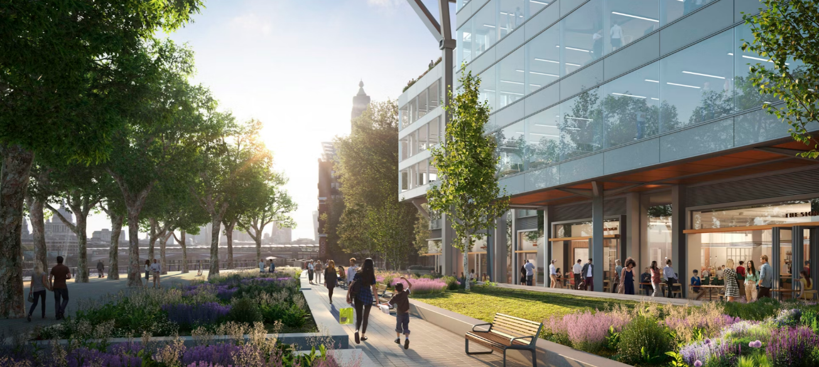
Picture of 72 Upper Ground
© Make Architects
Education & Training Foundation
Notes:
© Make Architects https://www.makearchitects.com/projects/72-upper-ground.
Ask learners how this image makes them feel.
The learners may pick up on lighting, people walking around, colourful flowers, greenery, etc. Ask for feedback then advise the learners that this is the image of the Slab. Discuss how the image is different to the text in the news article (previous slide).
This image supports the next slide.

Slide 22
Make Architects: 72 Upper Ground
0
Negative
Neutral
Positive
1
Our proposals for 72 Upper Ground will bring public use to a closed-off, derelict site on London’s South Bank, combining state-of-the-art workspace with restaurants, gardens, and a new cultural centre for production and performance. With its dynamic mix of uses and extensive, permeable public realm, this new destination will drive much-needed investment pivotal to the post-pandemic recovery of Lambeth and the South Bank.
At the development’s heart is the London Studios, a 40,000ft² centre for grassroots artists and independent cultural producers. This creative hub will nurture local talent in an inclusive space by providing affordable studios and performance venues designed to showcase the next generation of Lambeth’s arts community. The aim is to rebalance the loss of creative employment in the area following the departure of ITV, the site’s former tenant, and increase diversity on the South Bank, giving underrepresented groups a platform to stand shoulder-to-shoulder with the world-renowned established cultural venues and giving them exposure to international audiences.
5
If you were a local resident, how would this make you feel?
© Make Architects 20 April 2024
Education & Training Foundation
Notes:
Source: © Make Architects 20 April 2024 https://www.makearchitects.com/projects/72-upper-ground/
Advise learners:
The sentiment in this text is predominantly positive. The author's choice of words and phrases conveys a sense of excitement, optimism and support for the proposed development at 72 Upper Ground in London.
Positive sentiments:
The proposal will “bring public use to a closed-off, derelict site”, suggesting that the development will revitalise and improve the area.
The development is described as a “new destination” that will “drive much-needed investment” and contribute to the “post-pandemic recovery of Lambeth and the South Bank”, implying that it will have a significant positive economic impact.
The London Studios, a key component of the development, is portrayed as a “creative hub” that will “nurture local talent in an inclusive space”, indicating that it will support and promote the local arts community.
The aim of the London Studios is to “rebalance the loss of creative employment” and “increase diversity on the South Bank”, suggesting that it will address important social and economic issues in the area.
The London Studios is described as giving underrepresented groups a “platform to stand shoulder-to-shoulder with the world-renowned established cultural venues”, implying that it will promote equity and inclusion in the arts.
Neutral sentiments:
The text provides factual information about the size of the London Studios (40,000ft²) and its purpose as a centre for grassroots artists and independent cultural producers.
There are no explicitly negative sentiments expressed in the text.
Overall, the sentiment of the text is strongly positive, highlighting the potential benefits of the proposed development for the local community, economy and arts scene. The author presents the project as a solution to various challenges faced by the area, such as the loss of creative employment and the need for post-pandemic recovery, while emphasising its role in promoting inclusion and diversity.

Slide 23
Individual activity
Complete the Sentiment analysis worksheet.
Share examples of your changed text with the class.
Education & Training Foundation
Notes:
Instructions to complete the activity:
Read through the “10 Goals for Shrewsbury” text.
Highlight all phrases that express a positive sentiment or idea using one colour.
Highlight any phrases that convey a negative sentiment using a different colour.
Highlight any phrases that convey a neutral sentiment using a third colour.
Total the positive, neutral and negative phrases found in the “10 Goals for Shrewsbury” text in the provided spaces.
Read through the second text, “New £77m plans for Shrewsbury Riverside will starve public investment for the rest of county.”
Highlight all phrases that express a positive sentiment or idea using one colour.
Highlight any phrases that convey a negative sentiment using a different colour.
Highlight any phrases that convey a neutral sentiment using a third colour.
Total the positive, neutral and negative phrases found in the second text in the provided spaces.
Answer the question, “Which of these pieces of text was most positive about the Shrewsbury Big Town Plan? Why?”
Answer the question, “What was the most negative phrase you found within the two pieces of text and what impact could that phrase have on other stakeholders?”
Choose three of the 10 goals listed in the “10 Goals for Shrewsbury” text.
Rewrite the chosen goals to express a negative sentiment instead of a positive one by replacing key words with their antonyms.
Write the reworded negative goals in the provided space.
Share examples of the changed text with the class.

Slide 24
Summary
In this lesson, you:
identified key stakeholders in a whole-town development project and their information needs
analysed a vision document to highlight relevant information for different stakeholder audiences
practised sentiment analysis by rewriting positive text in a negative tone, or vice versa
shared and discussed stakeholder impacts and communication strategies with the class.
Education & Training Foundation
Notes:
Summarise the learning and ask for questions.

Slide 25
Final task
Answer the question on a sticky note and put it on the board/wall:
“If this regeneration project was in your town, what would you think about the Big Town regeneration proposal and why?”
Education & Training Foundation

Slide 26
Next steps
Take a positive piece of text from the Big Town Plan pdf and rewrite it to be negative
or
Take a negative piece of text and rewrite it to be positive.
Education & Training Foundation
Notes:
You may wish to review this before the next lesson.

Slide 27
02
Session 2
Descriptive writing

Slide 28
Descriptive writing
By the end of this session, you will be able to:
identify and discuss various applications of descriptive writing within the construction industry
collaborate effectively in small groups to exchange ideas and share knowledge on descriptive writing
explain the differences between uses of descriptive writing in professional and non-technical contexts
utilise appropriate digital and visual tools to enhance communication in construction-related presentations and documents.
Education & Training Foundation

Slide 29
What is descriptive writing?
Descriptive writing is a style of writing that focuses on capturing vivid details and creating sensory experiences through words, allowing readers to imagine the scenes, objects or characters being described as if they were experiencing them first-hand.
Education & Training Foundation

Slide 30
Group activity
Work in small groups to conduct an idea exchange on the uses of descriptive writing in the construction industry.
Discuss the variations between these uses and share your existing knowledge with each other.
Share ideas with class.
Education & Training Foundation

Slide 31
Feedback
Each group to share one idea of where descriptive writing can be found in the construction industry.
Class to share why descriptive writing is an essential skill in this industry.
Education & Training Foundation
Notes:
Ask each group of learners for feedback.
Address any misconceptions or queries raised during activity and feedback.
Suggestions for greater depth questions.
How does descriptive writing help in marketing construction services?
Why is descriptive language important in safety documents?
How does descriptive writing minimise legal disputes in contracts?
What role does descriptive writing play in project progress reports?
How does descriptive writing help architects and designers communicate their vision?

Slide 32
Where is descriptive writing used in the construction industry?
project proposals: convey scope, goals and outcomes
architectural and design documents: explain aesthetics and functionality
construction plans and specifications: detail materials, techniques and processes
marketing and promotional materials: highlight unique selling points and benefits
progress reports and updates: communicate project status and milestones
safety documents and training materials: convey protocols, hazards and best practices
legal contracts and agreements: define terms, conditions and responsibilities.
Education & Training Foundation
Notes:
Advise learners:
Descriptive writing is used in various aspects of the construction industry, including:
Project proposals: descriptive language is used to clearly convey the scope, goals and anticipated outcomes of a construction project to clients, investors or stakeholders.
Architectural and design documents: architects and designers use descriptive writing to explain their vision, detailing the aesthetics, functionality and unique features of a building or space.
Construction plans and specifications: detailed descriptions of materials, techniques and processes are necessary to ensure that all parties involved in the construction process have a clear understanding of the project requirements.
Marketing and promotional materials: descriptive writing is employed to highlight the unique selling points and benefits of a construction company's services, completed projects or properties for sale.
Progress reports and updates: project managers use descriptive language to communicate the current state of a construction project, including completed tasks, challenges faced and upcoming milestones.
Safety documents and training materials: clear, descriptive language is essential in conveying safety protocols, potential hazards and best practices to construction workers and site visitors.
Legal contracts and agreements: descriptive writing is used to clearly define the terms, conditions and responsibilities of all parties involved in a construction project, minimising the risk of misinterpretation or disputes.

Slide 33
What is “vision” in the context of construction?
Vision refers to a comprehensive and clear conceptualisation of what the project aims to achieve in terms of:
design
functionality
impact
aesthetic appeal.
It showcases both the practical and imaginative aspects of what the finished construction will contribute to its users and the surrounding environment.
Education & Training Foundation

Slide 34
Example vision statement
Our vision for the new hospital wing is to create a state-of-the-art healthcare facility that combines advanced medical technology with compassionate care to enhance patient recovery and wellbeing. This wing will be designed as a healing environment that supports both physical recovery and mental wellness, incorporating green spaces and natural light to promote a therapeutic atmosphere. Our aim is to set a new standard in patient care, making our hospital a beacon of hope and health in the community.
Education & Training Foundation
Notes:
Advise learners that this is a fictitious hospital vision.

Slide 35
Components of a vision statement
purpose
aspiration
uniqueness
audience
impact.
Education & Training Foundation
Notes:
Advise learners:
Purpose
The purpose serves as the fundamental reason for the existence of the project or initiative. It explains the core objectives and what the project seeks to achieve. This clarity is crucial as it guides all strategic decisions and actions, ensuring that every step taken is aligned with the ultimate goal.
Aspiration
Aspirations elevate a vision statement from a mere declaration of intent to a source of inspiration. They set high goals that challenge and motivate the team, stakeholders and the community to strive for excellence and innovation. Aspirations help to push boundaries and encourage a culture of ambition and achievement.
Uniqueness
Highlighting what makes the project unique distinguishes it from similar initiatives and competitors. This could be through innovative technology, novel methods, superior design or a special focus on sustainability. Uniqueness not only captures interest but also adds value, making the project stand out and appealing to investors, stakeholders and beneficiaries.
Audience
Specifying the target audience ensures the vision statement is tailored to meet the needs and expectations of those it serves. Understanding the audience helps in designing more effective and focused strategies that resonate with them, enhancing engagement and support for the project.
Impact
Focusing on the impact emphasises the long-term effects and benefits of the project. It outlines what the initiative aims to contribute to the community or field, including social, economic or environmental improvements. Impact-driven visions are compelling as they promise meaningful change and legacy, appealing to a broader range of stakeholders and reinforcing the project’s significance and urgency.

Slide 36
Using images to support your vision
The architect will use images to support their vision statement to visually communicate the underlying concepts and goals of the project.
Images such as architectural renderings, design sketches and environmental simulations illustrate the architect’s ideas for the project.
This makes the vision more accessible and understandable for different stakeholders.
Education & Training Foundation
Notes:
Advise learners:
By presenting a visual depiction of the planned construction, images clarify how the space will be used, the flow of movement within it and the integration with surrounding areas.
Strategic use of imagery can generate an emotional response from viewers, aligning their emotional experience with the aspirations of the vision. This emotional connection is crucial for gaining support and enthusiasm for the project.
Visual content is typically more memorable than text. Images associated with the vision statement help stakeholders remember the project and its goals, keeping them engaged over time.
Consistently used images that align with the vision’s themes – such as sustainability, community or innovation – strengthen the message, ensuring a cohesive understanding of the project’s goals among all stakeholders.
Images can communicate across language and cultural barriers, extending the reach of the vision statement and ensuring that it resonates with a diverse group of stakeholders and the community at large.

Slide 37
Scenario
As the lead architect, you have been asked to create a new vision document for the Smithfield Riverside Development. This will include descriptive text and images.
In pairs, select a suitable image to share the vision of improved pedestrian and disabled access to the area. You should refer to the Big Town Plan pdf.
Your vision statement should demonstrate your commitment to:
improve pedestrian routes to the north side of the town
provide accessible step-free access to the riverbank view
create a vibrant cultural hub.
Education & Training Foundation
Notes:
Learners are to create a vision document for Smithfield Riverside Development, combining text and images to convey the planned enhancements to pedestrian and disabled access.
The vision document should showcase the architectural intent and design philosophy for the development project.
Emphasis should be on the following aspects:
enhancement of pedestrian routes to the north side of the town, considering ease of navigation and aesthetic integration with the surroundings
inclusion of step-free access points to the riverside, ensuring the area is accessible to all, reflecting a commitment to inclusivity
creation of a cultural hub within the development that reflects vibrancy and becomes a nucleus for community activities and engagement.
The document will consist of carefully selected images that:
visually communicate the design intent
illustrate the practical application of the vision in terms of accessibility and cultural enrichment
align with the overall strategic objectives of the Big Town Plan.
Pair work:
Learners are to collaborate, with each pair selecting images that best represent their shared vision.
Discussions should focus on how each image supports the narrative of the vision document.
References:
The Big Town Plan may be used as a reference to ensure consistency with wider urban development strategies.
Images should be chosen for their ability to communicate key aspects of the vision clearly and effectively.

Slide 38
What are key visual assets?
These include photographs, renderings, diagrams and maps that visually communicate the intended design and layout of the development.
They’re essential for illustrating the vision and making it tangible for stakeholders.
Education & Training Foundation

Slide 39
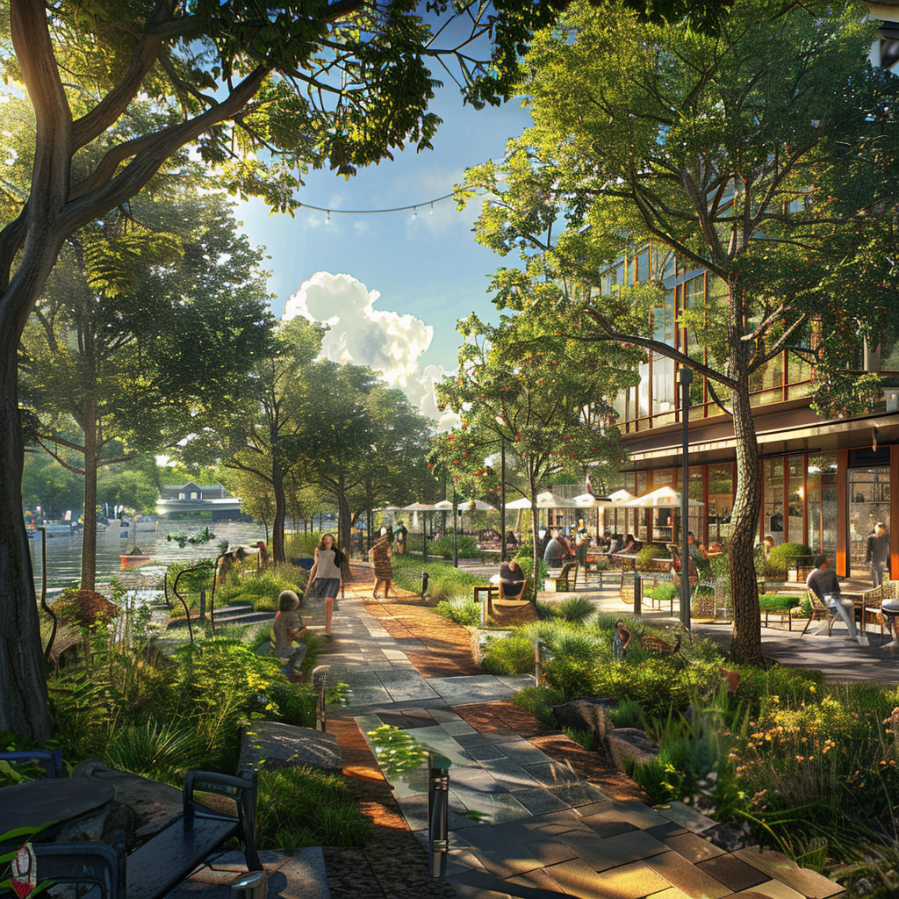
Pair activity: Identify appropriate assets
In pairs, review the Smithfield Riverside Development images in the role of architect.
Identify key image assets to use in a vision document.
Discuss descriptive words and language devices that can be used in the vision document.
Author image
Education & Training Foundation
Notes:
The fifth image has steps so learners should NOT select that image as one of those they want to use.
Once complete, ask for feedback of the descriptive words that the pairs have discussed.

Slide 40
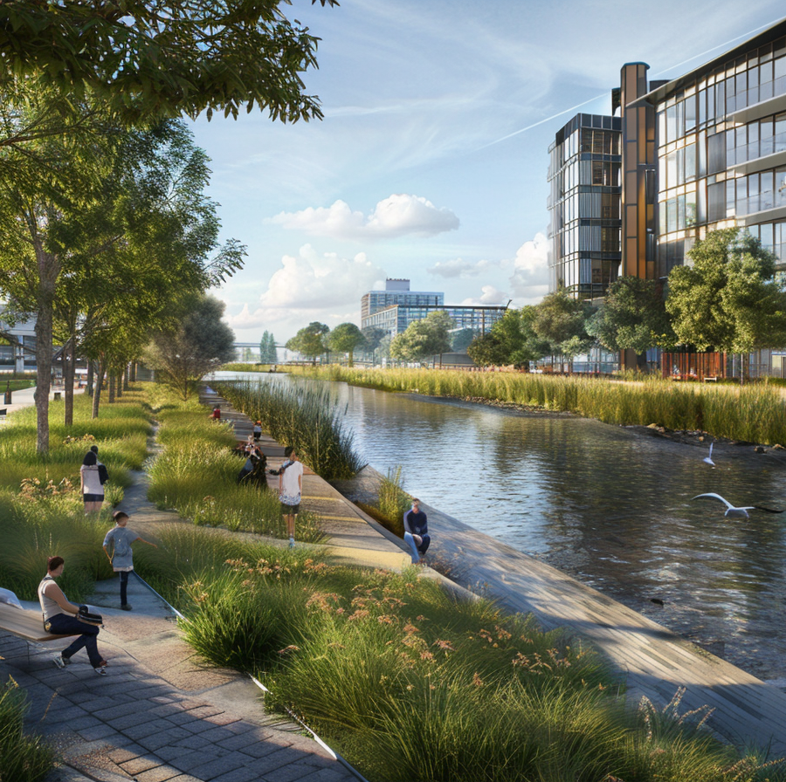
Independent vision drafting activity
Draft a 300-500-word vision document using the Vision document worksheet.
Select an image to use in your vision document.
Author image
Education & Training Foundation

Slide 41
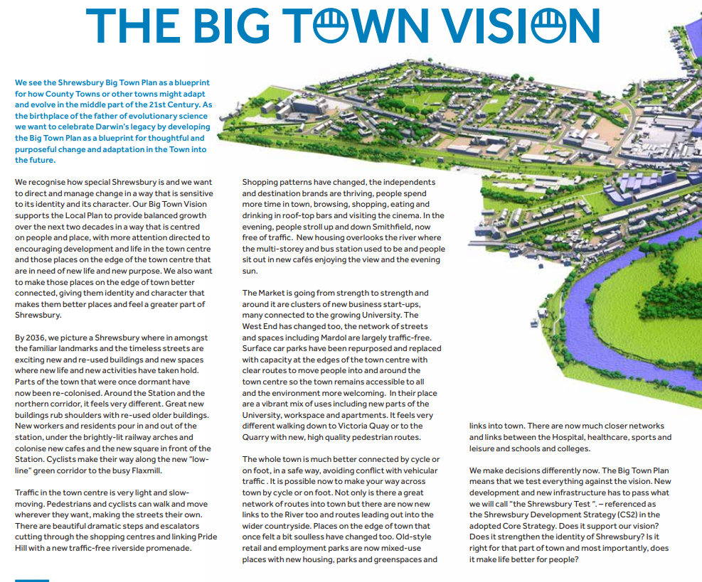
Independent vision document design activity
Create a two-page A4 vision handout for the Smithfield Riverside Development using the text you wrote and the images you selected in the previous activities.
© Shrewsbury Big Town Plan 2021
Education & Training Foundation
Notes:
This is an example of a real vision document taken from the Shrewsbury Big Town Plan.
https://www.shropshire.gov.uk/media/16707/shrewsbury-big-town-plan.pdf

Slide 42
Peer review
Swap vision document with a peer and provide verbal feedback based on these criteria:
at least one relevant image
use of descriptive language or devices
project overview or objectives
key features
design and aesthetics
sustainability
community benefit and social impact.
Education & Training Foundation

Slide 43
Summary
In this lesson you have learnt that:
Descriptive writing plays an important role in the construction industry.
Understanding your target audience and tailoring your writing accordingly is essential for effective communication.
A clear, compelling vision document can help align stakeholders.
Selecting appropriate visuals, such as images or diagrams, can enhance the impact of your descriptive writing.
Developing strong descriptive writing skills is an ongoing process that requires practice, reflection and adaptation to different contexts and audiences.
Education & Training Foundation

Slide 44
Final task
Write your name on the vision document and hand the completed document to the teacher.
Education & Training Foundation
Notes:
You may wish to review this before the next lesson.

Slide 45
Next steps
Create a vision document for a project or development in your local area using descriptive writing. These projects can be found in the local press or on the council website.
Education & Training Foundation
Notes:
You may wish to review this before the next lesson.

Slide 46
03
Session 3
Persuasive writing

Slide 47
Persuasive writing
By the end of this lesson, you will be able to:
understand the importance of effective investor communications in construction projects
identify persuasive writing techniques and positive language devices in investor letters
write a compelling letter to a potential investor, highlighting your project’s community benefits
review persuasive writing, identifying areas for improvement
reflect on your own performance and lessons learnt from the letter-writing process.
Education & Training Foundation

Slide 48
Importance of investor communications
Investors are essential stakeholders in construction projects.
Effective communication builds trust and secures funding.
Persuasive writing can highlight project benefits and address investor concerns.
Tailoring messages to investor interests is key to success.
Education & Training Foundation

Slide 49
Group activity: Community benefits
In groups, skim read the Smithfield Riverside Development framework. Identify some key community elements.
Discuss strategies to emphasise community benefits to potential investors.
Share your ideas with the class.
Reflect on how these ideas can inform your investor letters.
Education & Training Foundation
Notes:
Advise learners that community elements are anything that is related to or will have an impact on the community. For example, a feature of the development that is designed to improve pedestrian links.

Slide 50
Persuasive business writing techniques
Characteristics include:
an engaging introduction that builds rapport
a clear project description and vision
an emphasis on community benefits and social impact
an explanation of the investment opportunity and returns
a call-to-action and next steps
a professional tone and error-free writing.
Education & Training Foundation

Slide 51
Persuasive language 1 / 2
Triplets (rule of three): use a series of three elements to emphasise a point and make it more memorable.
“Our engineering team is dedicated, experienced and passionate about driving results.”
Emotional appeal: tap into the emotions of your investors by using language that evokes feelings of excitement, fear of missing out or a sense of purpose.
“Don’t let this opportunity pass you by…”
Education & Training Foundation

Slide 52
Persuasive language 2 / 2
Rhetorical questions: use thought-provoking questions to engage the reader and encourage them to consider your perspective.
“How often does an opportunity like this come along…”
Social proof: mention reputable individuals, organisations or publications that have endorsed your company to build trust and credibility.
“We are proud to have (well-known investor or expert) as a member of our advisory board.”
Education & Training Foundation

Slide 53
Pair activity: Letter analysis
Work in pairs to analyse an example investor letter.
Identify persuasive techniques and positive language devices.
Record your findings on the Letter analysis worksheet.
Be prepared to share your insights with the class.
Education & Training Foundation

Slide 54
Key language elements to include
Share key language elements to include in investor letters.
Agree key language elements and record onto Letter checklist template.
Education & Training Foundation

Slide 55
Scenario
As the project manager, you have been asked to write a letter to potential investors for the Smithfield Riverside Development.
The letter should persuade investors to provide money to support the project. You may choose any community benefit to highlight to the investor.
Use the provided template to draft your letter.
Focus on highlighting Smithfield Riverside’s community benefits.
Incorporate persuasive techniques and positive language.
Tailor your message to investor interests and concerns.
Aim for a concise, professional and compelling letter.
Education & Training Foundation

Slide 56
Peer review
Exchange your draft letter with a peer.
Use the letter checklist to provide constructive feedback.
Look for strengths and areas for improvement.
Receive and reflect on feedback for your own letter.
Consider how to incorporate suggestions into your final draft.
Education & Training Foundation

Slide 57
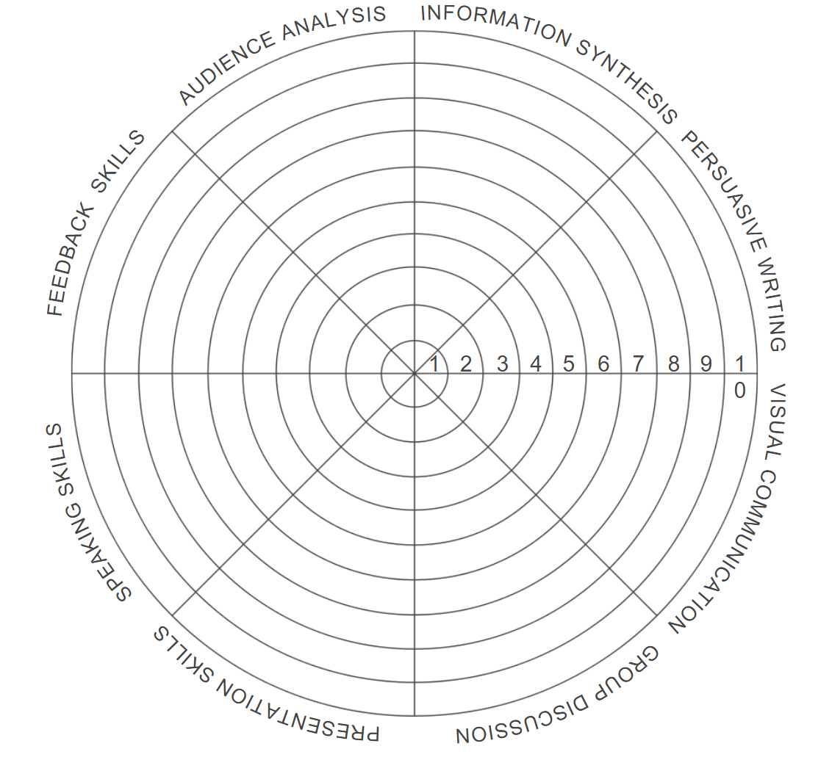
Reflective activity
Complete your communication wheel of life.
Identify three skills you would like to focus on improving.
For each of the three skills you selected that most need improvement, write down three five-minute activities you can undertake to enhance your proficiency in those areas.
Wheel of life
Education & Training Foundation
Notes:
This reflective activity is to draw upon lessons 1, 2 and 3. It is to look at the wider range of communication skills that have been developed.
Speaking skills: Give a 5-minute speech on a given topic.
Feedback methods: Write a constructive feedback paragraph for a peer's work, focusing on specific areas for improvement.

Slide 58
Summary
Persuasive writing is an essential skill for engaging investors.
Tailor your message to investor interests and project benefits.
Use positive language and compelling evidence to make your case.
Seek feedback and refine your writing for maximum impact.
Effective investor communications can help secure funding and support for construction projects.
Education & Training Foundation

Slide 59
Next steps
Write a persuasive letter to a local council member advocating for a new community construction project, such as a park or community centre.
Use the persuasive communication techniques learnt in this lesson.
Education & Training Foundation
Notes:
You may wish to review this before the next lesson.

Slide 60
04
Session 4
Writing for the public

Slide 61
Writing for the public
By the end of this session, you will be able to:
review sources of information
create a summary of information found
draft a press release using skills in descriptive and persuasive language
peer review a press release.
Education & Training Foundation
Notes:
Advise learners:
First, we'll look at how to review sources of information critically, distinguishing between what's relevant and what can be set aside. This skill is paramount in an age where information is abundant but varying in quality.
Next, you'll learn to create summaries from the information gathered. This isn't just about reducing content but about highlighting what's pertinent to our projects and objectives.
Then, we'll dive into drafting a press release. This exercise will not only test your ability to summarise but also how you communicate complex information in an accessible and engaging manner.
Finally, we'll simulate a real-world scenario where you'll communicate your draft press release to your manager (teacher) and respond to feedback, mirroring the iterative process of professional communication.
This session is designed to be interactive, so you are encouraged to engage, ask questions and share insights.

Slide 62
Starter question
What is a floodplain?
Education & Training Foundation
Notes:
Ask learners the question that might seem simple at first glance but is deeply significant in the context of environmental management and construction: what is a floodplain? Tell learners to think about this not just in geographical terms but consider its implications for construction and urban planning.

Slide 63
Floodplains
A floodplain is land adjacent to a watercourse over which water flows or would flow in times of flooding, if defences were not in place.
The flood zone area classification system devised by the Environment Agency refers to:
  Flood zone 1: land outside the floodplain. There is little or no risk of flooding in this zone.
  Flood zone 2: the area of the floodplain where there is a low to medium flood risk.
  Flood zone 3: the area of the floodplain where there is a high risk of flooding.
Adapted from: https://www.designingbuildings.co.uk/wiki/Floodplain
Notes:
Advise learners that a floodplain is the low-lying land adjacent to a river that gets flooded when water levels rise. The Environment Agency classifies floodplains into three zones based on flood risk – little to no risk in zone 1, low to medium risk in zone 2 and high risk in zone 3. Understanding where a construction project lies within these zones is critical for planning.

Slide 64
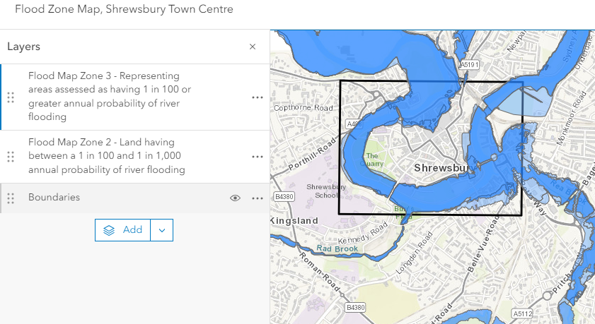
Flood zone maps
© ARCGIS 2024 https://www.arcgis.com/apps/mapviewer/index.html?webmap=0f27e3dd34434cfe8d34748a079401a1
Education & Training Foundation
Notes:
Advise learners:
Flood zone maps serve an important role in the construction industry, acting as vital communication tools for a variety of stakeholders, including developers, planners, engineers, local authorities and the community at large. Their purpose extends beyond mere geographical delineation, embedding into the strategic planning, risk management and community engagement processes integral to successful construction projects. Here's how they function as a key communication tool:
Risk assessment and management
Flood zone maps provide detailed insights into areas prone to flooding, allowing construction professionals to assess the potential risks to new developments. This information is essential for making informed decisions about site selection, design considerations and the implementation of flood defence measures.
Planning and regulation
These maps are instrumental in planning processes, helping to determine where development should be avoided or where special construction techniques and materials are required to mitigate flood risk. They guide regulatory compliance, ensuring that construction projects adhere to local and national policies aimed at managing flood risk and protecting vulnerable areas.
Stakeholder communication
Flood zone maps communicate complex risk information in a visual format that's more easily understood by non-specialists. They are crucial in consultations and discussions with the community, local authorities and other stakeholders, providing a clear basis for discussing the implications of proposed developments and the measures taken to mitigate flood risks.
Insurance and investment decisions
For developers and property owners, flood zone maps influence decisions regarding insurance premiums and coverage options. They also affect investment decisions, as properties within high-risk zones may require additional measures to protect against flooding, affecting overall project costs and viability.

Slide 65
Group activity
Work in small groups to research floodplain best practice using the resource links and find out which areas of the development are at risk from flooding.
Complete Riverside flooding worksheet.
Share findings with the class and update worksheet if necessary.
Education & Training Foundation
Notes:
Advise learners to divide the links between them, research for around 20 minutes and then discuss their findings with their group.
This activity is designed to apply what we've discussed about floodplains and synthesise information through collaborative research. You'll be working in small groups to explore best practices related to floodplains and identify flood risks specific to a development area. This exercise will not only deepen your understanding but also enhance your teamwork and research skills.
Complete the Riverside flooding worksheet to compile your findings. This will help you organise the information you gather and ensure a comprehensive review of flood risks.
Once completed, you'll have the opportunity to share your group's findings with the class. This is a chance to learn from each other and perhaps incorporate new insights into your worksheet.

Slide 66
Communication of sensitive topics
Open, honest and transparent communication helps build trust between construction professionals and the communities they serve. When people feel informed and heard, they are more likely to support the project and have confidence in the construction team.
Question: why do you think people might be worried about flood management of the new project?
Education & Training Foundation
Notes:
Advise learners:
In the construction industry, communication extends beyond simple exchanges of information. It's about building trust, particularly when dealing with sensitive topics like flood management in new projects. This portion of our session looks into the art of conveying sensitive information in a way that fosters understanding and collaboration.
Open, honest and transparent communication forms the basis of trust between construction professionals and the communities they serve. When people are well-informed and feel heard, their support for a project increases, as does their confidence in those leading it.
Consider why individuals might have concerns about flood management in new developments. It's not just the immediate risk of flooding that worries people but also the long-term implications for their homes, communities and natural habitats. Addressing these concerns effectively requires not only technical solutions but also empathetic communication that acknowledges people's fears and provides clear, reassuring information about the measures being taken to mitigate risks.
Keep in mind the power of your words and the importance of framing your messages in a way that respects and addresses the concerns of all stakeholders.

Slide 67
How to communicate sensitively
Be transparent and honest.
Acknowledge concerns.
Highlight benefits.
Use clear and concise language.
Engage in active listening.
Provide regular updates.
Education & Training Foundation
Notes:
Here are some key points to consider when communicating about sensitive topics:
Be transparent and honest: provide accurate and up-to-date information about the project, including its goals, timeline and potential impacts.
Acknowledge concerns: don't ignore or dismiss any worries raised by the community or stakeholders. Instead, address them head on and provide clear explanations on how these concerns will be mitigated or managed.
Highlight benefits: focus on the positive aspects of the project, such as economic growth, job creation, improved infrastructure or enhanced recreational opportunities.
Use clear and concise language: avoid jargon or technical terms that may confuse or alienate your audience. Use simple, easy-to-understand language that effectively conveys your message.
Engage in active listening: encourage open dialogue and actively listen to feedback from the community and stakeholders. Show that their input is valued and considered in the decision-making process.
Provide regular updates: keep the community informed about the project's progress, milestones and any changes or adjustments made along the way.

Slide 68
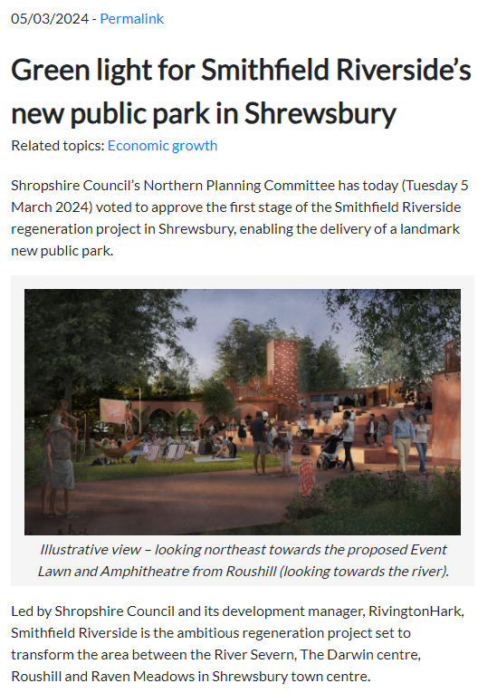
Press releases
A press release is an official statement issued to the media by an organisation to provide information, make an announcement or respond to a particular issue.
In the construction industry, press releases are used to communicate important updates, milestones or developments related to regeneration projects.
© Shropshire Council 2024 https://newsroom.shropshire.gov.uk/2024/03/green-light-for-smithfield-riversides-new-public-park/
Notes:
Highlight to learners how press releases are used in the construction industry for regeneration projects:
Announcing new projects: press releases are issued to announce the launch of new regeneration projects, providing details about the project's scope, goals, timeline and partners involved.
Highlighting project milestones: as the project progresses, press releases are used to showcase significant milestones, such as the completion of key phases, topping-out ceremonies or the opening of new facilities.
Communicating community benefits: press releases can emphasise the positive impact of the regeneration project on the local community, such as job creation, improved infrastructure or enhanced public spaces.
Addressing concerns or issues: if the project faces challenges or concerns from the community, press releases can be used to address these issues head-on, provide clarity and reassure stakeholders about the measures being taken to mitigate them.
Showcasing sustainability and innovation: regeneration projects often incorporate sustainable design features or innovative construction techniques. Press releases can highlight these aspects to demonstrate the project's commitment to environmental responsibility and technological advancement.
Inviting media coverage: press releases are designed to attract media attention and encourage journalists to cover the regeneration project. By providing compelling information and a clear news angle, press releases can help generate positive publicity for the project.
https://newsroom.shropshire.gov.uk/2024/03/green-light-for-smithfield-riversides-new-public-park/

Slide 69
Pair activity
You are part of the project management team for the Smithfield Riverside Development. You need to prepare a press release to reassure stakeholders about the flood defences. You have been given a data handout of information that you might choose to include. You are also able to use other information you found in your research.
Work in pairs to review the Data handout.
Identify key information you could use in a press release about the proposed flood mitigations.
Complete the Press release preparation worksheet.
Education & Training Foundation
Notes:
Advise learners that the activity is in pairs, and it is a practical challenge: drafting a press release about the flood defences for a development project. This exercise is a chance to apply what you've learnt about communicating sensitive information effectively. The activity also builds on your written skills to use descriptive and persuasive writing.
Instructions:
Pair up: find a partner for this task.
Use the worksheet: there's a worksheet to help you organise your thoughts and structure your press release.
Review the data: you've got a handout full of information on proposed flood defences. Dig into it to understand what's planned.
Pick out the key points: decide together which bits of information are most important for the public to know based on the sections in the press release preparation worksheet.

Slide 70
Independent activity
Use your completed Press release preparation worksheet to draft a press release using a word processing application. The press release should be no more than 250 words. Email it to your manager (teacher) and two peers.
Peer review two press releases using the Peer review feedback forms and provide feedback and two suggestions for improvements via email.
Education & Training Foundation
Notes:
You may wish to review this before the next lesson.

Slide 71
Summary
In this lesson, you:
researched floodplains and identified at-risk areas
learnt about communicating sensitive topics to stakeholders through press releases
drafted a press release about proposed flood mitigations and provided feedback
used descriptive and persuasive language in a press release.
Education & Training Foundation
Notes:
Remind learners that the four lessons have developed their writing skills, providing a foundation to practise tailoring their written communication to different readers. The descriptive writing and persuasive writing lessons were designed to help learners consider the needs and perspectives of their target audience. This lesson helped learners put descriptive and persuasive writing into practice through the writing of a construction context press release adapted for a set audience.

Slide 72
Next steps
Adapt the press release for a magazine article that talks about the benefits of the flood defences for the local community.
Education & Training Foundation
Notes:
You may wish to review this before the next lesson.

Slide 73
05
Session 5
Visual communication
Notes:
Explain to learners that this stage of the learning programme focuses on developing visual communication skills. It will build visual literacy skills essential in construction and help them to adapt visual content to different stakeholders.

Slide 74
Visual communication
By the end of this session, you will be able to:
identify appropriate uses of AI images in the construction industry
create a site plan to meet a construction project brief
communicate key information using visual representation.
Education & Training Foundation

Slide 75
Importance of visual communication in the construction industry
Visual communication assists with:
project clarity and understanding
collaboration and planning
decision-making and problem solving
safety and compliance
measurement and costing
accuracy and engineering.
Education & Training Foundation

Slide 76

How AI is being used in concept art
AI is being used to:
create multiple design variations quickly
assist in exploring different styles and aesthetics
generate 3D models and textures based on inputted parameters.
This image prompt: curves and glass design London skyscraper architecture project, drawing board, combine plans section facade perspective, sharp lines, alcohol markers.
Author image
Notes:
Advise learners that while there are legitimate uses of AI-generated art within the construction industry, there are also limitations and problems with using AI.
The image prompt is what the AI takes and processes into an image.
Image prompt: curves and glass design London skyscraper architecture project, drawing board, combine plans section facade perspective, sharp lines, alcohol markers.
Advise how to use Microsoft Copilot to create free AI-generated images using prompts:
Make sure you have access to Microsoft Copilot through an application that supports this feature.
Craft a clear and descriptive prompt that outlines what you want the AI to generate. The more specific your description, the better the AI can understand and generate the image you need.
Enter your prompt into the interface where Microsoft Copilot is integrated.
Submit the prompt and let the AI generate the image based on your description. You may need to adjust the prompt or settings based on the initial results to get the exact image you desire.
“A modern public library in a suburban area, with expansive curved glass windows, solar panels and a landscaped green roof with integrated seating areas. Style the image with high contrast and vibrant colours to highlight eco-friendly features.”
“Artist’s rendering of a sustainable urban high-rise building with a façade, featuring vertical gardens and cascading water elements. Use a watercolour style to softly blend the natural elements with the urban structure.”
“Conceptual design of a pedestrian bridge over a river, featuring innovative lighting and sleek steel structures. Emphasise sharp lines and a monochrome palette in a high-tech architectural style.”
“A futuristic railway station in a busy city centre, showcasing sleek, curved metal structures and transparent ceilings. Render the image in a hyper-realistic style with attention to reflective surfaces and dynamic lighting.”
“Architectural visualisation of a community sports centre, showing both indoor and outdoor facilities with a focus on accessibility and use of eco-friendly materials. Employ a minimalist style with clean lines and a muted colour scheme to emphasise simplicity and functionality.”

Slide 77
Group activity
In small groups, review the AI-generated images in the AI concept art handout.
Identify and assess key elements that make the images effective or ineffective.
Discuss judgements with the rest of the class.
Create a checklist of key elements of effective visual communications using the Checklist template.
Education & Training Foundation
Notes:
Advise learners that they will be using the checklist later in the lesson.
Address potential misconceptions with the Use of AI images in construction handout as a guide.

Slide 78
Site plans
Site plans are a tool in landscape architecture for communicating design proposals.
They allow designers to layer information and show how different elements of the design relate to each other and the existing site conditions.
Site plans typically include:
existing site plan showing current features, e.g. topography and buildings
proposed design elements such as hardscaping, planting and structures
annotations to explain design intent and key features.
Education & Training Foundation

Slide 79
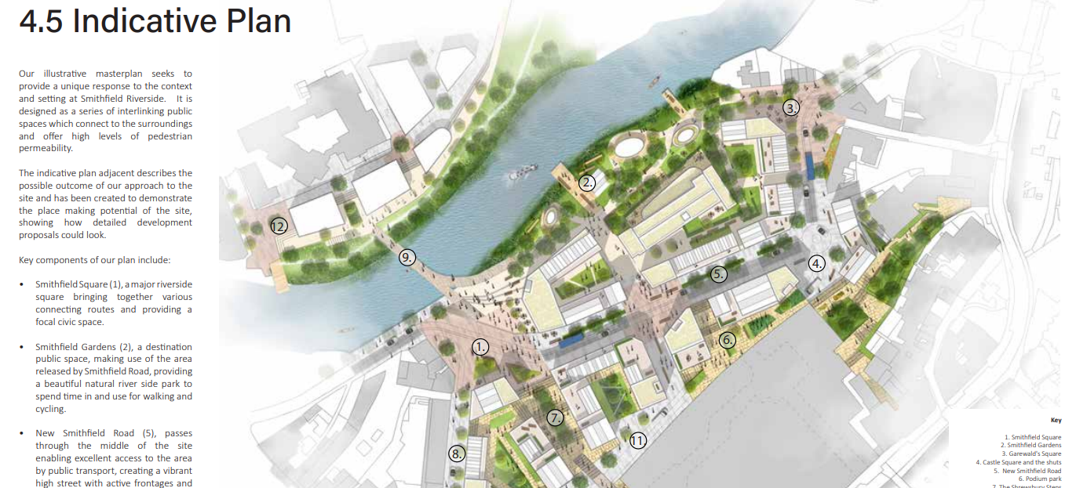
Example of a site plan
© Shropshire Council 2022 https://shropshire.gov.uk/committee-services/documents/s29512/Appendix%20A%20-%20SDF%20final%20document.pdf
Notes:
Source: https://shropshire.gov.uk/committee-services/documents/s29512/Appendix%20A%20-%20SDF%20final%20document.pdf
Page 71

Slide 80
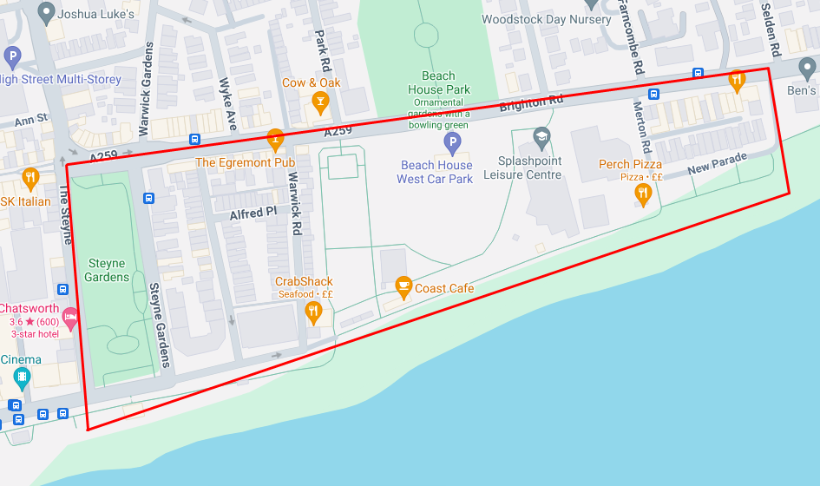
Pair activity
Work in pairs to:
review the Project details handout
sketch ideas for the proposed regeneration development
use the completed Checklist template to review the sketch.
Worthing East Seafront © Google Maps 2024
Education & Training Foundation
Notes:
Learners to use the Project details handout to complete the review.

Slide 81
Independent activity
Use the A3 plan outline in your Project details handout to draw your final landscape design for Worthing East Seafront.
Use rulers and coloured pens to ensure accuracy and bring your designs to life.
Education & Training Foundation

Slide 82
Present designs
Circulate and look at each design.
Assess:
how well each design communicates the artist’s intentions
how well the plan communicates key information using visual representation.
Provide feedback on peers’ designs.
Education & Training Foundation
Notes:
Ask learners to place their designs in a suitable location in the classroom.

Slide 83
Summary
In this lesson, you:
learnt that visual communication is important in landscape architecture
explored how site plans are key for presenting landscape design proposals effectively
explained that good visual communication helps landscape architects successfully share their design vision with clients and stakeholders.
Education & Training Foundation
Notes:
Visual communication skills are important for landscape architects and other construction professionals to effectively share their design vision with clients and stakeholders.
Key skills used include:
creating clear and compelling conceptual sketches, diagrams, renderings and site plans to visually convey design intent
presenting designs persuasively to communicate how the proposal meets project requirements and client needs
integrating text and graphics to tell a cohesive story about the design
organising visual information in a logical way to guide the audience through the design narrative.
Landscape architects apply these visual communication skills when:
pitching conceptual designs to clients to win new projects
sharing master plans with government agencies and the public to get buy-in and approval
communicating detailed construction documents to contractors and installers
presenting as-built results to demonstrate successful delivery on the design vision.

Slide 84
Next steps
Reflect on the site plan design.
Identify three areas of improvement.
Update site plan, taking account of areas of improvement.
Education & Training Foundation

Slide 85
06
Session 6
Adapting visual communication

Slide 86
Adapting visual communication
By the end of this session, you will be able to:
select appropriate conventions for visual communications for different target audiences
adapt visual communications for different target audiences.
Education & Training Foundation

Slide 87
Project stakeholders in construction
project owner or client
architects and designers
engineers
construction managers and contractors
subcontractors and suppliers
local government and regulatory agencies.
Education & Training Foundation
Notes:
Explain to learners that the next slides will highlight the importance of, role and communication for each stakeholder group.
Project owner or client
Importance: the project owner or client initiates and funds the project, making them a pivotal stakeholder. They define the project's objectives, set budgets and determine the desired outcomes.
Role: the owner or client provides direction, approves designs and budgets, and ultimately accepts the completed project. They are responsible for ensuring that the project meets their expectations and fulfils its intended purpose.
Communication: owners communicate with stakeholders to convey project requirements, provide feedback on design proposals, review progress reports and address any concerns or changes in project scope. Conversely, stakeholders communicate with owners to seek approvals, provide updates on project status and address any issues that may arise.
Architects and designers
Importance: architects and designers translate the owner's vision into practical, aesthetically pleasing designs that meet functional requirements and regulatory standards.
Role: they conceptualise the project, develop design drawings and specifications, and coordinate with other professionals to ensure design integrity throughout the construction process.
Communication: architects and designers communicate with stakeholders to gather project requirements, present design concepts, solicit feedback and obtain approvals. They also collaborate with engineers and contractors to resolve design challenges and ensure the successful implementation of design solutions.
Engineers
Importance: engineers provide technical expertise across various disciplines, including structural, civil, mechanical, electrical and environmental engineering, to ensure the project's safety, functionality and sustainability.
Role: they analyse site conditions, develop engineering designs, conduct feasibility studies and oversee the implementation of engineering solutions.
Communication: engineers communicate with stakeholders to assess project requirements, provide engineering recommendations, address technical challenges and ensure compliance with regulatory standards. They also collaborate closely with architects, contractors and subcontractors to coordinate design and construction activities.
Construction managers and contractors
Importance: construction managers and contractors are responsible for executing the construction phase of the project efficiently, safely, and within budget and schedule constraints.
Role: they plan, organise and coordinate construction activities, manage subcontractors and suppliers, monitor progress, and ensure quality control and safety compliance.
Communication: construction managers and contractors communicate with stakeholders to coordinate construction activities, provide progress updates, address project risks and challenges, and obtain necessary approvals and permits. They also liaise with designers and engineers to resolve construction-related issues and ensure adherence to project specifications.
Subcontractors and suppliers
Importance: subcontractors and suppliers provide specialised services, materials and equipment necessary for the construction process.
Role: they perform specific tasks such as electrical work, plumbing, carpentry or supplying construction materials, contributing to the successful completion of the project.
Communication: subcontractors and suppliers communicate with project stakeholders to understand project requirements, coordinate delivery schedules, address supply chain issues, and provide updates on work progress and material availability. They also collaborate closely with construction managers and contractors to ensure seamless integration of their services into the project timeline.
Local government and regulatory agencies
Importance: local government and regulatory agencies enforce building codes, zoning regulations and environmental standards to ensure public safety, environmental protection and compliance with legal requirements.
Role: they review project plans and permit applications, conduct inspections, issue permits, and enforce regulatory compliance throughout the project lifecycle.
Communication: local government and regulatory agencies communicate with project stakeholders to provide guidance on regulatory requirements, review and approve project plans, conduct site inspections, and address compliance issues or violations. Project stakeholders communicate with them to obtain permits, seek regulatory approvals, and ensure adherence to applicable laws and regulations.

Slide 88
Affected stakeholders
local businesses
residents
visitors and tourists
end users.
Education & Training Foundation
Notes:
Advise learners:
Local businesses:
Importance: local businesses contribute to the economic vitality of the community and play a significant role in supporting the local economy. They provide goods and services essential for project execution and are often directly affected by construction activities.
Role: local businesses may serve as suppliers of construction materials, equipment, or services, or they may operate businesses that rely on foot traffic and local patronage. Their role involves adapting to construction-related disruptions, maintaining business continuity and seeking opportunities for collaboration with project developers or contractors.
Communication: local businesses may communicate with project stakeholders to address concerns about construction-related disruptions, seek information about project timelines and impacts, explore opportunities for business partnerships or contracts, and provide feedback on mitigation measures to minimise adverse effects on their operations.
Residents
Importance: residents are an integral part of the community and have a vested interest in the liveability and sustainability of their neighbourhood. They are directly affected by construction activities and changes to their immediate environment.
Role: residents may serve as advocates for community interests, voicing concerns about potential negative impacts such as noise, dust, traffic congestion or loss of amenities. Their role involves engaging in dialogue with project developers, local authorities and other stakeholders to ensure their voices are heard and their needs are addressed.
Communication: residents may communicate with project stakeholders to express concerns about construction-related disruptions, seek information about project plans and mitigations, participate in community engagement activities, and provide feedback on proposed designs or development plans. Conversely, project stakeholders may communicate with residents to provide updates on project progress, address concerns, solicit input on design alternatives, and collaborate on community initiatives to enhance neighbourhood resilience and wellbeing.
Visitors and tourists
Importance: visitors and tourists contribute to the local economy through spending on accommodations, dining, entertainment and other leisure activities. They play a vital role in supporting tourism-related businesses and promoting the area as a desirable destination.
Role: visitors and tourists may be attracted to the area by its cultural attractions, natural beauty or recreational opportunities. Their role involves experiencing and enjoying the local amenities, contributing to the local economy, and potentially influencing perceptions of the destination.
Communication: visitors and tourists may communicate with project stakeholders to inquire about ongoing construction activities, seek alternative routes or recommendations for navigating the area, express concerns about disruptions to their travel plans or experiences, and provide feedback on the accessibility and attractiveness of tourist destinations during construction. Conversely, project stakeholders may communicate with visitors and tourists to provide information about construction impacts, offer assistance or guidance, and promote alternative attractions or events to mitigate inconvenience and maintain positive visitor experiences.
End users
Importance: end users are the ultimate beneficiaries of the completed construction project, whether they are individuals, businesses or organisations. Their satisfaction with the project's design, functionality and usability is critical to its long-term success and viability.
Role: end users may directly utilise the facilities, services or infrastructure provided by the construction project, relying on them to meet their needs and expectations. Their role involves providing input during the design phase, adapting to changes during construction and utilising the completed project for its intended purpose.
Communication: end users may communicate with project stakeholders to provide input on design requirements, express preferences or concerns about project features or functionality, seek updates on project progress and timelines, and provide feedback on the usability and performance of the completed project. Conversely, project stakeholders may communicate with end users to gather user requirements, obtain feedback on design proposals, address usability issues or concerns, and promote awareness of project benefits and opportunities for engagement.

Slide 89
Strategies for communication:
Expert audiences
Provide technical depth, dimensions and materials specs.
Include construction details and phasing plans.
Assume prior knowledge of architecture concepts.
Reference relevant building codes and regulations.
Education & Training Foundation
Notes:
When preparing visual materials for experts, it's important to:
provide technical depth and dimensions – experts will want detailed specifications, measurements and information on materials
include construction details and phasing plans – show how the project will be built, step-by-step, and include relevant construction details
assume prior knowledge of architecture concepts – use industry terminology and don't over-explain basic concepts, as you can assume the audience already understands them
reference relevant building codes and regulations – show how the design complies with all applicable laws, codes and regulatory requirements.
By tailoring the visual communication to an expert audience's knowledge level and information needs, construction professionals can communicate their designs more effectively. The visuals should focus on technical details and assume the audience has an industry background, rather than simplifying concepts for a general audience.

Slide 90
Strategies for communication:
General public and non-technical audiences
Focus on simplified overviews of the design.
Emphasise the experiential aspects and benefits.
Explain any technical elements in accessible terms.
Minimise use of acronyms and industry shorthand.
Provide a glossary for any necessary technical language.
Education & Training Foundation
Notes:
Focus on simplified overviews of the design – provide high-level conceptual drawings and renderings that are easy for a general audience to understand, without getting into technical details.
Emphasise the experiential aspects and benefits – highlight how the design will look, feel and function for end users. Focus on the human benefits rather than construction specifics.
Explain any technical elements in accessible terms – if you need to discuss technical aspects, use plain language and relatable analogies to make the concepts understandable to a lay audience.
Minimise use of acronyms and industry shorthand – avoid using jargon, abbreviations and terminology that may be unfamiliar to the general public. Spell things out clearly.
Provide a glossary for any necessary technical language – if technical terms are unavoidable, include a glossary defining them in everyday language.
When communicating construction projects to non-expert audiences, the visuals and language should be accessible, relatable and focused on the experiential aspects, while minimising technical complexity and industry jargon. The goal is to help the general public understand and appreciate the design.

Slide 91
Strategies for communication:
Formal planning presentations
Use a structured slide deck or boards with agenda.
Do a methodical walk-through process and solutions.
Anticipate and address committee concerns.
Education & Training Foundation
Notes:
Use a structured slide deck or boards with an agenda – organise the presentation in a clear, logical flow using slides or boards. Provide an agenda upfront so the audience knows what to expect.
Do a methodical walkthrough of process and solutions – systematically guide the audience through your design process, explaining how you arrived at the proposed solutions step-by-step. Be thorough and detailed in the walkthrough.
Anticipate and address committee concerns – consider potential questions or objections the planning committee may raise, and proactively address them in the presentation. Show that you've thought through their likely concerns.
For formal planning presentations, use a structured format with an agenda, take the committee step-by-step through your process and design solutions, and aim to anticipate and pre-emptively address any concerns they may have. The goal is to make a thorough, persuasive case for your design.

Slide 92
Strategies for communication:
Client pitches
Use a polished, branded visual style.
Use a compelling narrative showcasing unique value proposition.
Use visuals connecting the design to client goals and priorities.
Education & Training Foundation
Notes:
Use a polished, branded visual style – ensure all visuals have a professionally designed look and feel that aligns with your firm's brand identity. The aesthetics should convey credibility.
Craft a compelling narrative showcasing your unique value proposition – structure the pitch as a persuasive story that highlights what sets your design approach apart and the distinctive value you bring to the project. Make it engaging and memorable.
Connect the visuals to the client's goals and priorities – don't just showcase the design, but explicitly tie it to the client's stated objectives and needs. Demonstrate how your solution will achieve their aims and deliver on what matters most to them.

Slide 93
Strategies for communication:
Community engagement
Use vivid renderings and relatable visual stories.
Highlight community benefits and experiential elements.
Include interactive components to gather public input.
Have a call-to-action.
Education & Training Foundation
Notes:
Use vivid renderings and relatable visual stories – create eye-catching, lifelike visualisations that help the community envision how the project will look and feel. Use storytelling techniques to make the design relatable to their lives.
Highlight community benefits and experiential elements – emphasise how the project will improve quality of life for the community and create enjoyable spaces and experiences for them to use. Focus on the human and social benefits.
Include interactive components to gather public input – provide opportunities for the community to give feedback and share their ideas and concerns, through methods like surveys, workshops or comment boards. Show that their voices are heard.
Have a call-to-action – give the community clear next steps for how to stay engaged with the project, such as signing up for updates, attending future meetings or showing their support to decision-makers. Motivate them to remain involved.

Slide 94
Class activity: Examples of visual communication
Click on the Visual communication resource links.
Review the website content.
Match examples to stakeholders.
Ask clarifying questions.
Education & Training Foundation

Slide 95
Scenario for presentation
UK Construction Project: redevelopment of the former Ironworks industrial site in Middlewich, Cheshire, into a mixed-use development called Middlewich Yards. The project will feature 250 residential units (a mix of apartments and townhouses), 5,000 square meters of commercial space (including offices, retail and restaurants) and a 1,000 square meter community centre with a library, meeting rooms and a public garden.
Education & Training Foundation
Notes:
Explain to learners that they are going to work in allocated groups. Read the scenario and advise learners that the details are also in the handout.

Slide 96
Project details
Developer: Brightstone Properties Ltd
Architects: Innovate Architects & Co
Main contractor: BuildRight Construction Ltd
Project timeline: 2024-2027
Estimated project cost: £75 million
Sustainability features: green roofs, solar panels, rainwater harvesting and electric vehicle charging points
Education & Training Foundation
Notes:
Check learners understand the project details.

Slide 97
Group activity: Presentation planning
In groups, read allocated scenario detailed in the Target audience presentation handout.
Discuss the target audience and establish their needs.
Discuss how to adapt visuals and language to that audience.
Outline a presentation using Presentation planning questionnaire.
List the slides you will need with the content required for each slide.
Education & Training Foundation

Slide 98
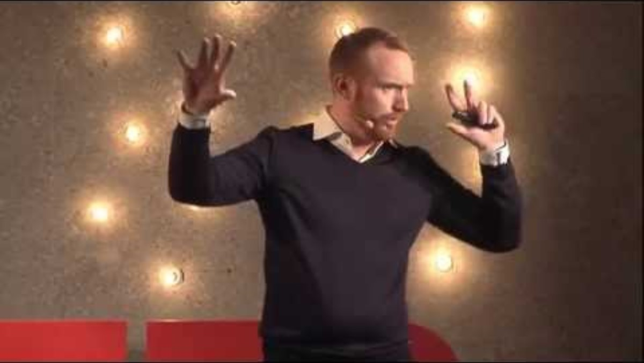
How to avoid death by PowerPoint
https://www.youtube.com/watch?v=Iwpi1Lm6dFo
Education & Training Foundation
Notes:
https://www.youtube.com/watch?v=Iwpi1Lm6dFo
Introduction:
Introduce the objective of the activity, highlighting the importance of visual communication in effective presentations.
Explain how the TEDx Talk will provide valuable insights into adapting visuals to keep the audience engaged.
Watching the TEDx Talk:
Play the TEDx Talk “How to avoid death by PowerPoint”.
Encourage learners to take notes on key ideas that resonate with them, especially those that can enhance visual communication.
Discussion:
Open the floor for learners to share their insights from the talk.
Discuss specific techniques mentioned in the video and how they can be applied to improve visual aspects of a presentation.
Linking to adapting visual communication:
Guide learners to make connections between the TEDx Talk and the broader concept of visual communication adaptation.
Focus on elements like simplicity, use of visuals, data representation and audience engagement.

Slide 99
Group activity: Create presentation
Use the completed Presentation planning questionnaire.
Each group member should prepare the slides they have been allocated.
When the presentation is complete, the whole group should review it and share ideas on how to improve it based on the techniques from “How to avoid death by PowerPoint”.
Review consistency of colours, font size and font type.
Email completed presentation to the teacher.
Education & Training Foundation
Notes:
Suggest to learners that they should review the completed Presentation planning questionnaire before starting the activity. Remind learners they should include the detail from the Presentation planning questionnaire handout. Learners should divide up who will complete each slide, ensuring everyone has the opportunity to contribute.

Slide 100
Summary
In this lesson, you:
reviewed examples of key stakeholder groups you may need to communicate with as construction professionals
studied strategies for adapting level of detail, terminology and presentation style for different audiences
worked in groups to create targeted visual presentations for a specific audience, focusing on adapting visuals and language to that audience’s needs
collaborated in groups to develop presentations, incorporating the techniques from the TEDx Talk.
Education & Training Foundation
Notes:
Begin the summary by recapping the main objectives and outcomes of the lesson.
Highlight the importance of understanding the different stakeholder groups in the construction industry and the tailored communication required for each.
Reflect on the strategies explored for adapting the level of detail, terminology and presentation style to suit various audiences.
Acknowledge the collaborative efforts made by learners in groups to create targeted visual presentations, emphasising the skills applied in adapting visuals and language.
Conclude by discussing the incorporation of techniques from the TEDx Talk “How to Avoid Death by PowerPoint” into their presentations, noting the improvements or changes observed.
Encourage learners to give final thoughts or takeaways from the lesson and how they envision applying these insights in their professional lives.
Collect feedback on the lesson's effectiveness and any suggestions for future improvement.

Slide 101
Next steps
Research how other visual communications tools, such as infographics and videos, can be used and adapted for different purposes and audiences.
Education & Training Foundation
Notes:
Introduce the next steps activity to research how infographics and videos are used and adapted for different purposes and audiences in the construction industry.
Instruct learners to explore examples of infographics and videos created for expert audiences, the general public, clients, planning committees and community engagement. Have them analyse how the visual style, content, language and storytelling approach differs depending on the target audience and communication goal.
Direct learners to consider questions like: what level of technical detail is included or omitted? How is the information structured and presented? What design techniques are used to make it engaging? How is it framed to persuade the audience? What call-to-action, if any, is included?
Explain that the research will deepen their understanding of how to tailor infographics and videos to different construction industry communication scenarios. Set the expectation for learners to be prepared to discuss their findings and insights in the next class.

Slide 102
07
Session 7
Speaking skills

Slide 103
Speaking skills
By the end of this session, you will be able to:
participate in a debate game to practice persuasive speaking and critical thinking
deliver impromptu speeches to develop quick thinking and adaptability
engage in a pair activity to practice delivering prepared content and responding to questions
reflect on personal areas for improvement in speaking skills.
Education & Training Foundation

Slide 104
Importance of speaking skills in construction
Effective communication is essential in the construction industry.
Speaking skills are important for collaborating with team members, clients and stakeholders.
Developing strong speaking skills can help advance your career in construction.
Education & Training Foundation
Notes:
Advise learners:
Engaging your audience
The ability to engage your audience – whether they are clients, colleagues or stakeholders – is essential. Engaging speaking involves not only capturing but also maintaining the audience's attention throughout a presentation or meeting. This can be achieved through clear and lively explanations, using relevant examples and demonstrating enthusiasm for the project at hand. An engaged audience is more likely to support a project and stay committed throughout its duration.
Communicating your message effectively
Effective communication ensures that your ideas, plans and instructions are understood clearly by everyone involved. This is particularly important in construction, where miscommunication can lead to costly mistakes or delays. Articulating your thoughts and intentions clearly helps in avoiding misunderstandings and ensures that all team members are on the same page, which is essential for the smooth execution of a construction project.
Building credibility and trust
Credibility and trust are the foundations of any successful business relationship. In construction, where projects often involve significant financial investment and physical safety, trust becomes even more significant. Effective speaking skills can help build this trust. By speaking confidently and knowledgeably, you demonstrate your competence and reliability, encouraging others to trust your expertise and judgement. This is crucial not only for winning new contracts but also for maintaining long-term relationships with clients and collaborators.
Handling questions and objections
In any construction project, questions and objections are inevitable. Possessing the ability to handle these effectively is a key speaking skill. This involves listening carefully, understanding the concerns being raised, and responding thoughtfully and respectfully. Effective handling of questions and objections not only helps in resolving potential issues but also enhances your reputation as a thoughtful and approachable leader.

Slide 105
Importance of professional discussions
Professional discussions provide a platform for construction professionals to share their expertise, experiences and best practices.
They enable the exchange of valuable insights, tips and tricks that can enhance individual and organisational performance.
Regular discussions support a culture of continuous learning and improvement, helping professionals stay up-to-date with the latest industry trends and innovations.
Education & Training Foundation

Slide 106
Debate game activity
Each team to prepare arguments for the assigned premise.
Select two team members to represent your team in the debate.
Opening statement (three minutes).
Argument (five minutes).
Rebuttal (three minutes).
Questions and answers (five minutes).
Education & Training Foundation
Notes:
Advise learners to read the instructions carefully. Address any questions prior to the debate preparation commencing.
Divide the class into two teams.

Slide 107
Premise
For:
Anyone should be allowed to build a house without restriction if they own the land.
Against:
Nobody should be allowed to build a house without restriction, even if they own the land.
Education & Training Foundation
Notes:
Advise learners that a premise is a fundamental statement or proposition that serves as the foundation for the argument being made. It provides the basis from which a conclusion can be drawn or supported. Premises are crucial in structuring arguments because they lay down the initial assertions that need to be accepted for the conclusion to hold true.
Key aspects of a premise in debate:
Foundation of arguments
A premise is like the building block of an argument. Every argument in a debate is typically constructed from one or more premises that logically lead to a conclusion. For example, in a debate about environmental policy, a premise might be: “Climate change is significantly accelerated by human activities.”
Need for evidence
Premises must often be supported by evidence to be accepted by the audience or the opposition. This could involve statistical data, expert opinions or historical examples. The strength of an argument often hinges on the robustness of the premises and the quality of the evidence supporting them.
Types of premises
There are generally two types of premises in arguments.
Major premise: This is a general statement that is widely accepted as true or is an established fact. For instance, “All humans need water to survive”.
Minor premise: This statement is more specific and usually relates directly to the subject of the debate. For example, “Construction workers are humans”.
An argument might use these two premises to reach a conclusion, such as “Therefore, construction workers need water to survive”.
Role in logical flow
The logical flow from premises to conclusion must be clear and coherent. Debaters use the connection between their premises and their conclusion to persuade the audience that their argument is valid and relevant.

Slide 108
Questions
How did you feel about presenting an argument that you might not personally agree with?
Did this debate change your view on the subject in any way? Why or why not?
Education & Training Foundation
Notes:
How did you feel about presenting an argument that you might not personally agree with? This question allows learners to express any discomfort or challenges they faced during the exercise.
Did this debate change your view on the subject in any way? Why or why not? This encourages learners to reflect on the impact of the exercise on their personal beliefs or understanding of the topic.

Slide 109
Internal conflict
Have you ever faced a situation where your personal beliefs conflicted with a construction project you were working on?
Discuss the challenges of working for an organisation whose values may not align with your own.
Discuss strategies for navigating internal conflict while maintaining professionalism.
Education & Training Foundation
Notes:
Professional development: developing the ability to articulate and support views not held personally can enhance persuasive communication skills, a valuable asset in any career.
Reputation management: successfully arguing for a company’s position can build a reputation for reliability and professionalism, even if the stance differs from personal beliefs.
Ethical considerations: there may be ethical concerns when advocating for something one doesn’t believe in. It’s important to navigate these situations without compromising one’s moral standards, which may sometimes involve seeking common ground or focusing on factual aspects of the argument.
Workplace dynamics: consistently being asked to argue against one’s beliefs might affect relationships with colleagues and management, particularly if the disagreement is known and contentious.
Stress and job satisfaction: it can be stressful and potentially decrease job satisfaction to repeatedly engage in debates that conflict with one’s values, possibly leading to burnout.
Career choices: some may reconsider their career path or employer if there is a fundamental misalignment between personal beliefs and organisational positions.
Professionals might manage these situations by:
seeking clarification: understanding the rationale behind the organisation’s stance can sometimes help reconcile personal differences
focusing on facts: concentrating on the factual components of the argument rather than the emotional or subjective aspects
setting boundaries: knowing when and how to set professional boundaries if a certain stance deeply conflicts with core values
professional support: seeking mentorship or advice on navigating professional dilemmas can be useful.

Slide 110
Impromptu speeches
Impromptu speaking is a valuable skill in the construction industry.
Be prepared to discuss project updates, safety concerns or site issues at a moment’s notice.
Practise delivering concise, informative speeches on various construction-related topics.
Education & Training Foundation
Notes:
Advise learners:
Impromptu is an adjective that means done without being planned or prepared beforehand. It refers to something that is done spontaneously, in the spur of the moment or without prior notice. For example:
An impromptu speech is a speech given without any prior preparation or rehearsal.
An impromptu meeting is a meeting that is called suddenly, without advance notice or planning.
An impromptu party is a celebration organised on short notice, without formal invitations or arrangements.
The word “impromptu” comes from the Latin phrase “im promptu”, which means “in readiness” or “at hand”.
Impromptu speaking is relevant to the construction industry for several reasons:
Problem solving: construction projects often face unexpected challenges or issues that require quick thinking and immediate communication. Being able to articulate problems and propose solutions on the spot is a valuable skill.
Site meetings: impromptu speaking skills are useful during daily or weekly site meetings, where team members provide updates, discuss progress and address concerns without necessarily having time to prepare formal presentations.
Client and stakeholder interactions: construction professionals often need to communicate with clients, investors or other stakeholders on short notice. The ability to explain project details, answer questions, and address concerns confidently and clearly in impromptu situations is essential.
Safety briefings: on construction sites, safety is paramount. Managers and supervisors must be able to deliver impromptu safety briefings or toolbox talks to ensure all workers understand potential hazards and necessary precautions.
Teamwork and collaboration: effective impromptu communication facilitates better collaboration among team members, enabling them to share ideas, provide feedback, and make decisions quickly and efficiently.
Leadership and management: construction managers and leaders often face unexpected situations that require clear, concise communication. Strong impromptu speaking skills can help them guide their teams, delegate tasks and manage crises effectively.

Slide 111
Group activity: Impromptu speeches
Read the list of impromptu speech topics and select one to prepare.
Prepare for one minute.
Take it in turns to give your speech to your group. Take no more than two minutes per speech.
Do not answer any questions on your speech.
Education & Training Foundation

Slide 112
Post-speech prompts
Did you manage to convey your main points clearly and concisely?
Were you able to engage your audience and maintain their interest throughout your speech?
Did you use any techniques to buy yourself time or gather your thoughts, such as pausing or repeating the question?
Did you notice any filler words or phrases that you used repeatedly?
How did it feel only having one minute to prepare?
Education & Training Foundation
Notes:
Did you manage to convey your main points clearly and concisely?
Learners might discuss the challenges of organising their thoughts quickly and effectively or of communicating their ideas within the given time constraint.
Encourage learners to practise identifying key points and structuring their speeches for clarity and impact.
Suggest techniques such as using simple, direct language and providing examples or anecdotes to support their main points.
Were you able to engage your audience and maintain their interest throughout your speech?
Learners may share their experiences with capturing and holding their audience's attention, especially in an impromptu setting.
Discuss the importance of eye contact, facial expressions and vocal variety in engaging the audience.
Encourage learners to practice active listening and to respond to their audience's nonverbal cues.
Did you use any techniques to buy yourself time or gather your thoughts, such as pausing or repeating the question?
Learners might share the techniques they used to gather their thoughts or manage their nerves during the impromptu speech.
Discuss the benefits of pausing, taking a deep breath or rephrasing the question to give themselves time to think.
Remind learners that brief pauses can also help emphasise key points and allow the audience to process information.
Did you notice any filler words or phrases that you used repeatedly?
Learners may identify filler words or phrases they used, such as “um”, “like” or “you know”.
Discuss how filler words can distract from the message and undermine the speaker's credibility.
Encourage learners to practice replacing filler words with pauses or silence, which can help them appear more confident and thoughtful.
How did it feel only having one minute to prepare?
Learners might express feelings of anxiety, pressure or excitement when faced with the challenge of preparing a speech in just one minute.
Acknowledge that impromptu speaking can be daunting but emphasise that it is a skill that can be developed with practice.
Encourage learners to embrace the challenge and focus on the opportunity to improve their ability to think on their feet and communicate effectively under pressure.

Slide 113
Pair activity: Preprepared speeches
The first person in the pair reads out preprepared speech one.
The second person asks and the first person answers questions related to that speech, using the preprepared speech’s questions and answers.
Repeat for the other member of the pair with preprepared speech two.
Education & Training Foundation
Notes:
Advise learners:
There are several reasons why you might be asked to read a speech that someone else has prepared:
Representing an organisation or group: if you are speaking on behalf of a company, organisation or group, you may be asked to deliver a pre-written speech to ensure that the message aligns with the organisation's values, goals and policies.
Consistency in messaging: when multiple speakers are addressing the same topic or event, having them read pre-written speeches ensures that the information and messaging remain consistent across all presentations.
Time constraints: in some situations, there may be limited time for the speaker to prepare their own speech. Reading a pre-written speech allows the speaker to deliver the necessary information without spending time on speech composition.
Expertise of the speechwriter: the person who wrote the speech may have more expertise on the subject matter or be more skilled at crafting effective speeches. By reading their words, you can leverage their knowledge and experience.
Legal or technical accuracy: in cases where the speech contains legal, technical or sensitive information, reading a pre-written speech ensures that the content is accurate and has been vetted by the appropriate parties.
High-stakes situations: in high-pressure or high-stakes situations, such as a crisis response or a major company announcement, reading a pre-written speech can help the speaker stay on message and avoid potential missteps.

Slide 114
Reflection activity
Complete the Reflection activity worksheet.
Education & Training Foundation

Slide 115
Summary
Today you learnt about:
professional speaking, discussion and debate
handling internal conflicts
impromptu speeches
responding to questions
self-reflection and improvement.
Education & Training Foundation
Notes:
Key learnings from this lesson on speaking skills are:
Understanding the importance of speaking skills in the construction industry through a presentation and class discussion.
Practicing professional discussion and debate skills through a structured debate activity in groups, following conventions outlined in handouts.
Reflecting on the challenges of internal conflict when working for an organisation whose ideals may not align with one's own, through an individual whiteboard activity and class discussion.
Developing impromptu speaking abilities by selecting a topic, preparing briefly and delivering a short speech to a small group.
Enhancing skills in responding to questions by working in pairs to deliver preprepared speeches and field questions from each other.
Reflecting on one's own speaking skills development through an individual written reflection activity.

Slide 116
Next steps
Speaking skills:
Prepare a five-minute speech on a construction-related topic of your choice.
Present the speech to a peer.
Reflect on your performance and listen to feedback from peer.
Set personal goals for improvement.
Education & Training Foundation
Notes:
Allocate pairs to work in.

Slide 117
08
Session 8
Persuasive speaking

Slide 118
Persuasive speaking
By the end of this session, you will be able to:
speak to a range of stakeholders about project issues and cost overruns
negotiate with other stakeholders
consider alternative stakeholder viewpoints
create an elevator pitch to concisely state a problem and the proposed solution.
Education & Training Foundation

Slide 119

Project scenario
The Summit Institute is undertaking a major campus expansion project to create a state-of-the-art learning facility that will serve its growing learner community. The project includes the construction of a new building featuring modern classrooms, specialised labs, a learner hub, a multi-purpose auditorium and outdoor learning spaces.
AI-generated image of the college atrium.
Author image
Notes:
This scenario provides the basis for the card game.

Slide 120
Project issues
As the project progresses, several issues have arisen that require additional funding to be addressed. These issues, if not resolved, could lead to project delays, compromised quality or failure to meet the college’s objectives.
As a member of the project team, you must persuasively present one of these issues to various stakeholder groups and convince them of the necessity of allocating extra funds to address the problem effectively.
Each stakeholder group will have a different opinion of whether the funds should be allocated to that issue or another. You will need to adjust your argument based on who you are talking to.
Education & Training Foundation

Slide 121
Group activity
Select game cards as per teacher instructions.
Work in pairs to create a persuasive argument for getting additional funding because of the assigned issue using the game cards or discuss projects that the community stakeholder group would support.
Education & Training Foundation
Notes:
The class will be split into small (two-three people) stakeholder groups, with each group receiving a stakeholder card (either a project stakeholder or an interested party) that outlines their role, interests and concerns regarding the project. There needs to be at least three project stakeholder groups.
Each project stakeholder group will randomly select a project issue card from the pack.
Each “community member” (i.e. the interested party stakeholder groups) will randomly select a character card and will comment as that character.
Groups will have 15 minutes to prepare their arguments for being awarded funding to resolve the issue (project stakeholder groups) or what their position is if they are an interested party (positive, negative, neutral or “it depends”). They will prepare questions to ask based on their community position.
Each group of project stakeholder learners will present their project issue to the “community members” (i.e. the interested party stakeholder groups), explaining why additional funds are needed to address the issue.
The stakeholder groups will ask questions, express concerns and challenge the presenters based on the information provided on their stakeholder cards.
The presenters must respond persuasively to the questions and concerns raised by the stakeholders, adapting their arguments to address the specific interests and priorities of each group.

Slide 122
Class activity: Funding
Present your argument to the stakeholder groups in pairs.
Answer questions and rebut challenges.
Write notes about which arguments you find most effective and why.
Education & Training Foundation

Slide 123
Voting
Complete the voting slips and place votes into the ballot box.
Return the game cards.
Education & Training Foundation

Slide 124
The elevator pitch
The term “elevator pitch” originated in the United States during the early 20th century. The concept is believed to have emerged from the idea that an entrepreneur or salesperson should be able to effectively pitch their business idea, product or service to a potential investor or client during a brief elevator ride.
The scenario imagines a chance encounter with an important decision-maker in an elevator. Given the short duration of an elevator ride, typically 30 seconds to two minutes, the entrepreneur must concisely and persuasively convey the key aspects of their idea, making a memorable impact on the listener.
Education & Training Foundation

Slide 125
Modern elevator pitches
An effective elevator pitch:
is delivered within a short time frame, typically 30 seconds to two minutes
clearly communicates the core idea, problem or value proposition
leaves a lasting impression on the listener
is tailored to the specific audience and situation
encourages the listener to take the next step, such as requesting more information or arranging a follow-up meeting.
Education & Training Foundation
Notes:
Over time, the concept of the elevator pitch has expanded beyond its original business context. It is now widely used to describe any brief, persuasive speech designed to spark interest in an idea, project or even oneself, such as in job interviews or at networking events.

Slide 126

Example elevator pitch
We should invest in accessibility to attract and retain high-quality staff and support local students to attend the college.
Education & Training Foundation

Slide 127
Key elements of this elevator pitch
This elevator pitch:
highlights the importance and benefits of accessibility
appeals to stakeholders’ values around inclusion and equality
appeals to local stakeholders.
Education & Training Foundation

Slide 128
Elevator pitch activity
Choose one of the issues from the issue cards from the previous activity and note its characteristics and cost.
Prepare a concise 30-second elevator pitch to convince a key decision-maker (rest of class) to allocate the extra funds.
Education & Training Foundation

Slide 129
Elevator pitch presentation activity
Deliver your elevator pitch to the whole class.
Listen to other elevator pitches and write notes about which arguments you find most effective and why.
The class votes on the most compelling elevator pitch, placing votes into the ballot box.
Education & Training Foundation
Notes:
Present details of the elevator pitch presentation activity to learners. Time each learner and stop them when they get to 30 seconds. Line up next learners for speed. Aim to get at least 50 per cent of the class to deliver their elevator pitch to the class.
Ask learners to listen to other elevator pitches and write notes on which arguments were most effective.
Leave approximately two minutes for learners to complete and post ballots.

Slide 130
Class activity
Count ballots.
Share which cause got the most votes.
Discuss the differences between community presentations and elevator pitches.
Education & Training Foundation

Slide 131
Summary
In this lesson, you:
learnt about the importance of persuasive speaking in addressing project challenges
worked in pairs to create persuasive arguments
presented arguments to stakeholder groups, answered questions and rebutted challenges
prepared an elevator pitch and delivered it
discussed the differences between presentations to community groups and elevator pitches.
Education & Training Foundation
Notes:
Key takeaways from this lesson
Reinforce the role persuasive speaking plays in addressing and overcoming project challenges.
Acknowledge the cooperative effort in pairs to construct persuasive arguments.
Highlight the experience gained in presenting these arguments to stakeholders, managing queries and skilfully rebutting challenges.
Reflect on the skills developed in crafting and delivering concise elevator pitches.
The lesson concluded with a discussion on the distinct approaches required for different presentation formats, comparing formal stakeholder presentations with the succinctness of elevator pitches.
Reminders
Encourage learners to continue practising these communication strategies in varied contexts.
Suggest that learners review their peers' feedback on both the presentations and elevator pitches to refine their persuasive communication skills.
Inform the class that the next two lessons will be linked together for learners to create and adapt communications before sharing with the class.

Slide 132
Next steps
Record yourself giving a speech, then play it back and identify areas for improvement.
Research and watch effective speakers, such as presenters of TED Talks. Review the techniques used and practise them.
Education & Training Foundation

Slide 133
09
Session 9
Adapting writing and speaking

Slide 134
Adapting writing and speaking
By the end of this session, you will be able to:
write a press release for a project
adapt the message from the press release for a group of investors as a speech and a presentation.
Education & Training Foundation

Slide 135
Importance of adaptation
Different stakeholders have different perspectives, needs and expectations.
Adapt your communication style to connect with your specific audience.
Consider the audience’s level of knowledge and interest in the topic.
Use language, examples and analogies that will resonate with them.
Adjust the level of technical detail and jargon based on the audience.
Focus on the “what’s in it for me” from the audience’s perspective.
Education & Training Foundation
Notes:
Discuss how the same core message may need to be communicated very differently for different audiences, such as the general public, clients, technical experts, executives, etc. Provide some real-world examples of how companies and projects adapt their communication for different stakeholders. Ask students to share their own experiences and examples. Emphasise that being able to tailor communications is a key skill for construction professionals.
Ask learners to provide examples of communications targeted at difference audiences.

Slide 136
Adapting communication content
How would you adapt communication content for:
a safety briefing for workers or management
a project update for a client or subcontractor
a bid proposal for a public or private client
a change order for a client or project team
an end of project (close-down) for a client or project team?
Education & Training Foundation
Notes:
Here are some examples of adapting communication within the construction industry for different audiences:
Safety briefing:
For workers: focus on specific safety procedures, using clear, simple language and demonstrating proper techniques. Emphasise personal responsibility.
For managers: provide statistics on safety incidents, discuss compliance with regulations and highlight the business impact of a strong safety culture.
Project update:
For clients: give a high-level overview of progress, major milestones achieved and any changes in scope or timeline. Use visuals and avoid technical jargon.
For subcontractors: provide detailed information on task coordination, material needs and deadlines. Use industry terms and discuss technical specifications.
Bid proposal:
For a public project: emphasise the company’s experience with similar projects, commitment to the community and ability to meet all regulatory requirements.
For a private client: focus on the unique value proposition, innovative approaches, and ability to deliver high-quality work on time and on budget.
4. Change order:
For the client: explain the reason for the change, the impact on budget and timeline, and provide options for how to proceed. Use persuasive language to get buy-in.
For the project team: provide technical details on the change, discuss logistics of implementation and outline each team member’s responsibilities. Use directive language.
Project close-down:
For the client: summarise the project outcomes, highlight successes and thank them for the opportunity to work together. Offer ongoing support and seek referrals.
For the project team: recognise individual contributions, discuss lessons learnt, and outline next steps for closing out contracts and documentation. Celebrate the team’s hard work.
Ask learners to provide additional examples of communications targeted at different audiences.

Slide 137
Adapting communication skills and styles
How would you adapt communication skills and styles (such as tone of voice) for:
a safety briefing for workers or management
a project update for a client or subcontractor
a change order for a client or project team
an end of project (close-down) for a client or project team?
Education & Training Foundation
Notes:
For workers or management:
Body language: maintain open gestures to promote safety awareness and trust. Stand firm to convey authority.
Tone of voice: use a clear, assertive tone to underscore the importance of safety procedures.
For a client or subcontractor:
Body language: adopt an engaged posture, leaning forwards slightly to show interest and receptiveness.
Tone of voice: employ a friendly, professional tone to build rapport while providing updates.
For a change order:
Body language: display a calm and composed demeanour to help alleviate concerns about changes.
Tone of voice: use a confident, steady tone to convey the necessity and benefits of the change order.
For a project close-down:
Body language: use celebratory gestures to acknowledge team effort; maintain eye contact to show appreciation.
Tone of voice: choose a warm, congratulatory tone to celebrate the completion and acknowledge contributions.
Ask learners to provide additional examples of how you can adapt communications for different audiences.

Slide 138
Individual activity: Press release
Read the Press release instructions handout.
Write a press release aimed at the public for the project issue given.
Ensure you use:
the details provided in the issue card
reassuring language.
Refine your press release based on the feedback from your teacher.
Education & Training Foundation
Notes:
Cut up the project issues within the Project issues handout. Provide each learner with an issue for the activity.

Slide 139
Individual activity: Investor speech
Read the Investor speech instructions handout.
Write a persuasive speech to investors on the issue using persuasive language and the details from the issue card.
Refine your speech based on the feedback from your teacher.
Education & Training Foundation

Slide 140
Individual activity: Investor presentation
Read the Investor presentation instructions handout.
Create a presentation, linked to the project issue, that can be used to present to a group of investors – no more than five slides. The presentation should be used to accompany the investor speech.
Refine the presentation based on the feedback from your teacher.
Education & Training Foundation

Slide 141
Summary
In this lesson, you:
learnt to adapt communication for different audiences
wrote a public press release using a reassuring tone
crafted a persuasive and reassuring investor speech
created an effective investor presentation to support the speech
developed key skills in audience communication and tailored messaging.
Education & Training Foundation
Notes:
In this lesson, you:
learnt the importance of adapting your communication style for different stakeholders and audiences
practised writing a press release about a project issue, using a reassuring tone and language appropriate for the general public
crafted a persuasive speech to investors about the same project issue, acknowledging the seriousness of the situation while providing reassurance on the company's ability to resolve it
created a short slide presentation to accompany the investor speech, applying best practices for effective visual aids that complement the verbal content
developed skills in communicating to an audience, tailoring messages accordingly and communicating through multiple mediums, including writing, speaking and presenting.
By completing these exercises, you have strengthened your ability to communicate complex project information in a clear, persuasive and audience-appropriate manner – a key skill for success in your construction career.

Slide 142
Next steps
Refine your speech and presentation ready for the next lesson.
Education & Training Foundation
Notes:
Advise learners that in the next lesson they will be presenting the information – a speech with a presentation.

Slide 143
10
Session 10
Presenting and reflecting

Slide 144
Presenting and reflecting
By the end of this session, you will have:
used descriptive and persuasive language to present to a group
adapted communication to different audiences and stakeholders
reflected on your performance in the activity and identified further learning opportunities, using a 360° review.
Education & Training Foundation
Notes:
This lesson draws together stages 1, 2 and 3 of the learning programme. It integrates the writing, visual, and oral skills and develops communication skills to help strategically adapt communication approaches to different contexts and audiences. This aims to practise the skills to effectively combine and tailor communication to meet the needs of diverse stakeholders in the construction industry.

Slide 145
Group activity
Present speeches and presentations within allocated groups.
Use the Peer review form to provide feedback and suggestions for improvement to peers.
Discuss the strengths and areas for improvement of each speech and presentation.
Education & Training Foundation
Notes:
Learners are to present the presentations and speeches prepared in lesson 9.
Allocate learners into groups of no more than four. Separate the groups so each group can see a screen for the presentation. Use more than one classroom if possible.
Distribute Peer review forms (there should be enough forms for each learner to receive at least two pieces of feedback).
For each group, ensure their first Investor presentation is loaded and shown on the screen or projector.
Remind learners to listen carefully to each Investor speech and make notes for feedback or questions to ask.
Ask the first person in each group to start when ready.
When each person has finished, ensure there is an opportunity for the audience to ask questions.
Ask the learners to complete a Peer review form for the person who was speaking and presenting.
Repeat speech/presentation/feedback process for the remaining groups.
Return Peer review forms to the learners who were reviewed. Ask the learners to review their feedback.

Slide 146
Class activity: Reflecting on our communication journey
How does the practice of descriptive writing enhance our ability to communicate with the audience?
In what ways does persuasive writing help us to convincingly present our arguments?
How do visual elements support our written or spoken words?
How have we learnt to adapt our communication styles to better connect with our audience?
How has this experience shaped your perception of effective communication?
Education & Training Foundation
Notes:
Instructions:
Introduction (five minutes):
Briefly introduce the activity to the class, explaining the importance of reflection in consolidating learning.
Emphasise that this discussion is about personal growth and that there are no right or wrong answers.
Question breakdown (25-35 minutes):
Address each question on the slide, one at a time.
Invite learners to share their thoughts and experiences related to each question.
Encourage learners to provide examples from their work when possible.
Guide the discussion:
For each question, allow multiple learners to respond, facilitating a diverse range of insights.
Where appropriate, guide the discussion back to key concepts taught during the course.
Use probing questions to deepen the conversation, such as “Can you elaborate on that point?” or “How did that make you feel?”
Encourage reflection:
Ask learners to consider how they will apply the feedback from their peer reviews to improve their communication skills.
Prompt learners to reflect on how these skills might be transferable to other areas of their lives or future careers.
Conclude the activity (five minutes):
Summarise key points from the discussion, highlighting any common themes or particularly insightful comments.
Reiterate the value of the skills the learners have developed and the importance of continued practice and reflection in effective communication.
Thank learners for their participation and encourage them to continue reflecting on their communication skills outside of class.

Slide 147
Individual activity: Self-reflection
Reflect on personal growth and development throughout the communication in construction programme.
Complete the Reflection worksheet, considering personal growth, challenges and future goals.
Education & Training Foundation
Notes:
Introduction:
Explain the purpose of the activity: to reflect on personal growth, identify challenges and set future developmental goals.
Introduce the tools that will be used in the activity: the wheel of life, the reflective questionnaire and the word cloud.
Wheel of life (five minutes):
Distribute the Wheel of life template.
Guide learners to consider aspects of their communication skills as parts of the wheel, such as verbal communication, written communication, active listening and visual communication.
Ask learners to rate their perceived competence in each area on the wheel.
Reflective questionnaire (15 minutes):
Provide the Reflective questionnaire.
Encourage learners to consider their journey through the programme and answer questions honestly.
Questions should prompt reflection on improvements, setbacks and moments of realisation.
Setting developmental activities (five minutes):
Instruct learners to identify areas for improvement based on their wheel of life and questionnaire responses.
Guide them to set specific, measurable, achievable, relevant and time-bound (SMART) goals for these areas.
Word cloud (five minutes):
Hand out or display a word cloud of communication skills.
Instruct learners to circle or highlight the skills they consider most important to their personal and professional development.
Conclusion:
Ask learners to review the outcomes of the activity and consider how they can apply the insights gained.
Encourage them to keep the reflection worksheet as a reminder of their goals.

Slide 148
Summary
In this lesson, you:
engaged in group presentations
participated in group discussions
completed a self-reflection activity
developed key skills in communication.
Education & Training Foundation
Notes:
Engaged in group presentations: collaborated in small groups to present and peer review each other's speeches, enhancing your understanding of effective communication.
Participated in class discussions: shared insights and lessons learnt from the peer review process, discussing the development of your communication skills throughout the series.
Completed a self-reflection activity: reflected on your personal growth and challenges throughout the communication programme and set future goals for improvement.
Developed key skills: practised and enhanced your communication through active participation in discussions, peer reviews and reflective writing.

Slide 149
Communication skills programme summary
(1 / 2)
Over this programme, you:
gained insight into the role of effective communication within the construction industry
learnt how to tailor written communications to different audiences, focusing on both descriptive and persuasive writing
learnt the importance of conveying information effectively through visual means
enhanced speaking skills through various activities, including persuasive techniques and effective handling of question-and-answer sessions
applied these communication skills in realistic scenarios, preparing you for real-world industry demands
Education & Training Foundation

Slide 150
Communication skills programme summary
(2 / 2)
developed the ability to work effectively with others through collaborative exercises
practised adapting your communication style to suit different contexts and stakeholder needs
engaged in self-assessment and peer reviews to critically evaluate and improve communication methods
produced various forms of communication, from reports to presentations and visual aids, reinforcing your learning.
Education & Training Foundation

Slide 151
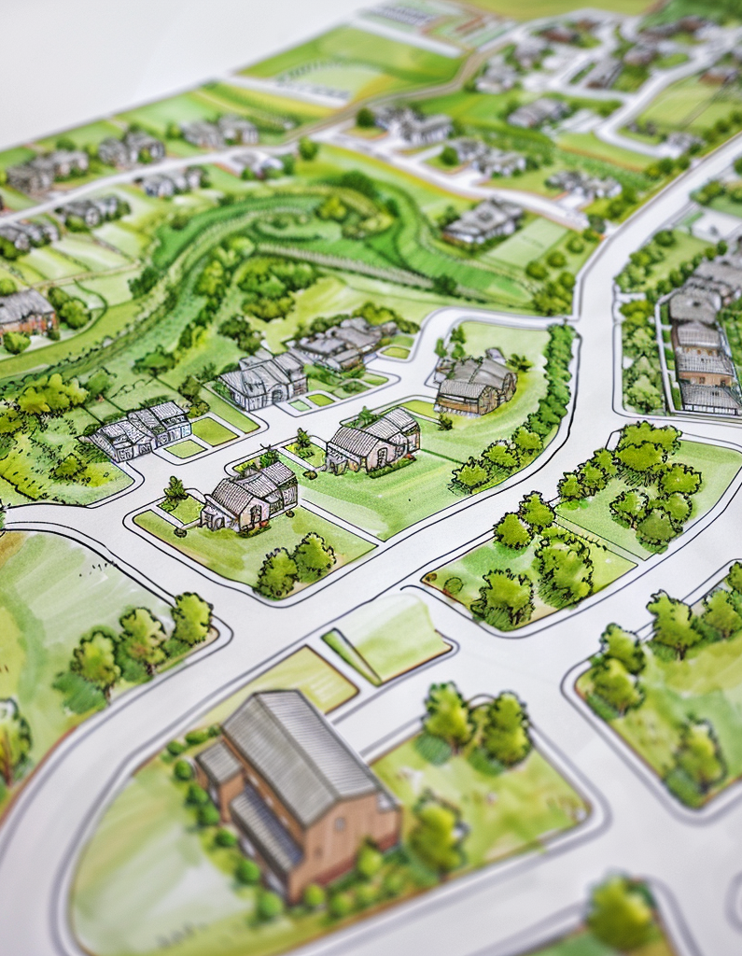
Next steps
Record yourself delivering your persuasive speech and investor presentation. Identify areas for improvement.
Find a mentor at your placement and conduct an interview about how they adapt their communication to different audiences in their job.
Write a reflection on the key communication insights you gained over this course.
Author image
Education & Training Foundation

Slide 152


PRODUCED BY
FUNDED BY
Shrewsbury Colleges Group has produced this resource on behalf of the Education and Training Foundation
This programme is funded by the Department for Education
ET-FOUNDATION.CO.UK
Education & Training Foundation

