Slide 1
T LEVEL IN ANIMAL CARE AND MANAGEMENT
Supporting the development of contextualised core skills –
Critical thinking

Slide 2
1
Industry-relevant legislation

Slide 3
Lesson outline
  Importance of legislation.
  Key legislation: purpose and impact on animal businesses.
  Impacts of legislation on sustainability in animal business.

Slide 4
Why is legislation important?
Take one minute to discuss with the person next to you
the importance of understanding legislation relevant to
animal businesses.
In pairs, read the legislation compliance case studies.
Discuss the consequences of not complying with
specific legislation.

Slide 5
Key legislation and regulations
  Health and Safety at Work Act 1974.
  Animal Welfare Act 2006.
  Environment Act 2021.
  Climate Change Act 2008.
  Control of Waste Regulations (England and Wales) 2012.
  Environmental Protection Act 1990.
  Control of Substances Hazardous to Health (COSHH) 2002.

Slide 6
Key legislation and regulations
  Reporting of Injuries Diseases and Dangerous Occurrences Regulations (RIDDOR) 2013.
  Zoonoses Order 1989 and Zoonoses Order (Amendment) (England) 2021.
  Zoo Licensing Act 1981.
  Animal Health Act 2002.
  Animal By-Products (Enforcement) (England)
  Regulations 2013.

Slide 7
Key legislation/regulations: Purposes
In small groups, complete the Legislation purposes card
match-up activity by matching the legislation with its purpose.
There are two blank purposes.
When you have worked out which two legislations are missing
a purpose, write out your own and add these.
You have 10 minutes.

Slide 8
Key legislation/regulations: Impact
Work in your groups.
Write one way in which the legislation might affect an animal business. Do this for each legislation.
Next, move to another group’s workspace and look at what they have written. Add any other impacts you can think of for any of the legislations.
Return to your own set and see what has been added.

Slide 9
Legislation compliance
Work in pairs.
Your tutor will allocate a specific legislation to each pair.
Create a poster that offers guidance on how to comply with
the legislation.
Your poster is aimed at the animal industry in general and should be informative and eye-catching.
Notes:
There are 12 key legislations/regulations covered in this lesson. Depending on class size, it is not essential that learners create a poster for all 12.
The tutor should display the completed posters on the walls around the room.

Slide 10
Impact of legislation on sustainability
Sustainability involves protecting natural resources and ecosystems, reducing pollution and mitigating climate change.
Legislation can:
  significantly influence a business’s ability to act sustainably
  drive businesses to adopt more sustainable practices
  create obstacles to sustainability that businesses must carefully navigate.

Slide 11
Impact of legislation on sustainability
You have all been given some sticky notes.
Half of you have been tasked with positive impact and half of you with negative impact.
Move around the room and add your positive or negative impacts on sustainability to the legislation posters.
Do not forget to look at what others have added.
Notes:
Tutor distributes sticky notes – enough for each learner to add one sticky note to each poster.

Slide 12
Homework task
Understanding the impact of legislation on working practices is a key part of working in the animal industry.
Analysing the impact of legislation is a popular exam topic.
Homework task: Create a set of revision cards about the key legislations we have covered today.

Slide 13
Summary
On your mini whiteboard, write down two key pieces of legislation that you have learnt about today.
Try to include the dates if you can.
Turn to the person next to you and see which two they
have written.

Slide 14
2
Biosecurity and waste management

Slide 15
Lesson outline
  Legislation recap.
  Legislation relevant to waste management.
  Waste management requirements of animal businesses.
  Biosecurity.
  Designing sustainable waste management plans.

Slide 16
Legislation recap
  Legislation taboo card game!
  Get into groups and then split into two even teams.
  Place the cards face down on the table.
  Use a timer or a stopwatch.
  Your team will score a point for every correct answer they give in one minute.
Notes:
There are more detailed guidelines for playing the game included in the lesson materials.

Slide 17
Legislation relating to waste management
Thinking about the legislation we discussed in the last lesson, which ones have some relevance to waste management?

Slide 18
Legislation relating to waste management
  Environmental Protection Act 1990.
  Control of Waste Regulations (England and Wales) 2012.
  COSHH 2002.
  Animal By-Products (Enforcement) (England)
  Regulations 2013.

Slide 19
Legislation relating to waste management: Task
Research how each of the aforementioned legislations impacts on waste management.
You have 10 minutes.
Notes:
Conduct a whole-class feedback lesson where learners are targeted to share their findings and can add to their own research.

Slide 20
Waste management in animal businesses
Create a mind map of the factors influencing waste management in animal businesses. You have 10 minutes.
Compare your mind map with the person next to you and add any factors that you did not already think of.
Notes:
Some suggestions for what might be considered: size and type of business, organic versus inorganic waste, animal waste, animal by-products and cadavers, environmental impact and sustainability, costs of specific waste management options, biosecurity and disease control.

Slide 21
Biosecurity: Definition
‘Biosecurity is the prevention of disease-causing agents entering or leaving any place where they can pose a risk to farm animals, other animals, humans, or the safety and quality of a food product.’
(Biosecurity | Department of Agriculture, Environment and
Rural Affairs).

Slide 22
Biosecurity and disease transmission
What are the main modes of disease transmission?
1 minute.
What are some examples of biosecurity measures?
2 minutes.
How does biosecurity impact waste management?
Look at your list of biosecurity measures and discuss with your neighbour how these might impact on waste management.

Slide 23
Waste management group task
In your group, complete the Waste management plan template for the animal business you have been assigned.
You have 40 minutes to complete your plan.

Slide 24
Waste management plan: Peer review
Swap your completed Waste management plan with
another group.
Add comments and feedback to the plan before returning it to the group.

Slide 25
Summary questions 1
Which of the following is considered hazardous waste?
A) Manure
B) Bedding
C) Veterinary medicines
Notes:
Learners could be provided with mini whiteboards to write their answers or asked to stand in a designated place for A. B or C or just show of hands.
Answer: C

Slide 26
Summary questions 2
What is the best method for managing organic waste on
a farm?
A) Incineration
B) Composting
C) Landfill
Notes:
Learners could be provided with mini whiteboards to write their answers or asked to stand in a designated place for A, B or C or just show of hands.
Answer: B

Slide 27
Summary questions 3
Which act provides the main framework for waste management in the UK?
A) Environmental Protection Act 1990
B) Health and Safety at Work Act 1974
C) COSHH 2002
Notes:
Learners could be provided with mini whiteboards to write their answers or asked to stand in a designated place for A, B or C or just show of hands.
Answer: A

Slide 28
Summary questions 4
Which act defines and classifies different types of waste?
A) Environmental Protection Act 1990
B) Control of Waste Regulations 2012
C) The Environment Act 2021
Notes:
Learners could be provided with mini whiteboards to write their answers or asked to stand in a designated place for A, B or C or just show of hands.
Answer: B

Slide 29
Summary questions 5
Which of the following statements is true?
A) Biosecurity measures often reduce waste.
B) Biosecurity measures have no impact on waste management.
C) Biosecurity measures usually increase the amount of waste.
Notes:
Learners could be provided with mini whiteboards to write their answers or asked to stand in a designated place for A, B or C or just show of hands.
Answer: C

Slide 30
3
Analysing climate change: Understanding climate change

Slide 31
Lesson outline
  Waste management recap.
  Climate change myth busting.
  The history of climate change.
  Solutions and responsibilities.
  Sustainability.

Slide 32
Waste management recap activity
Assign the following to the most appropriate waste disposal method:
  paper food sack
  otter bedding
  uneaten vegetables
  empty glass medicine bottle
  uneaten raw fish
  goat bedding
  chicken faeces during bird flu restrictions.
Landfill
Compost
Incineration
Recycle

Slide 33
What is climate change?
Take one minute to write down what you understand climate change to mean.
Share your thoughts with your neighbour.

Slide 34
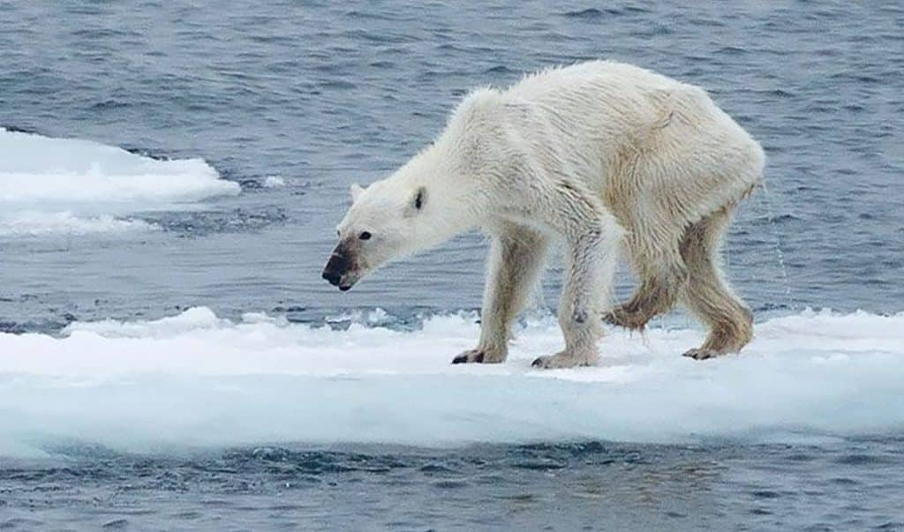
What has happened here?
Image from: Earth.org https://earth.org/polar-bear-struggle-against-climate-change/
Notes:
Lead a class discussion on what the image makes learners think.

Slide 35
What has happened here?
  Starvation is the leading cause of natural death in old animals (Crockford, 2018).
  Hunting is the greatest known cause of polar bear mortality (Sea World, 2025).
  Loss of sea ice owing to climate change is the primary threat to polar bears (Regehr et al., 2016).
  Sea ice that is too thick can inhibit polar bear survival.
  In some areas, thinning sea ice is improving conditions for polar bears (Tandon and Pidcock, 2022).

Slide 36
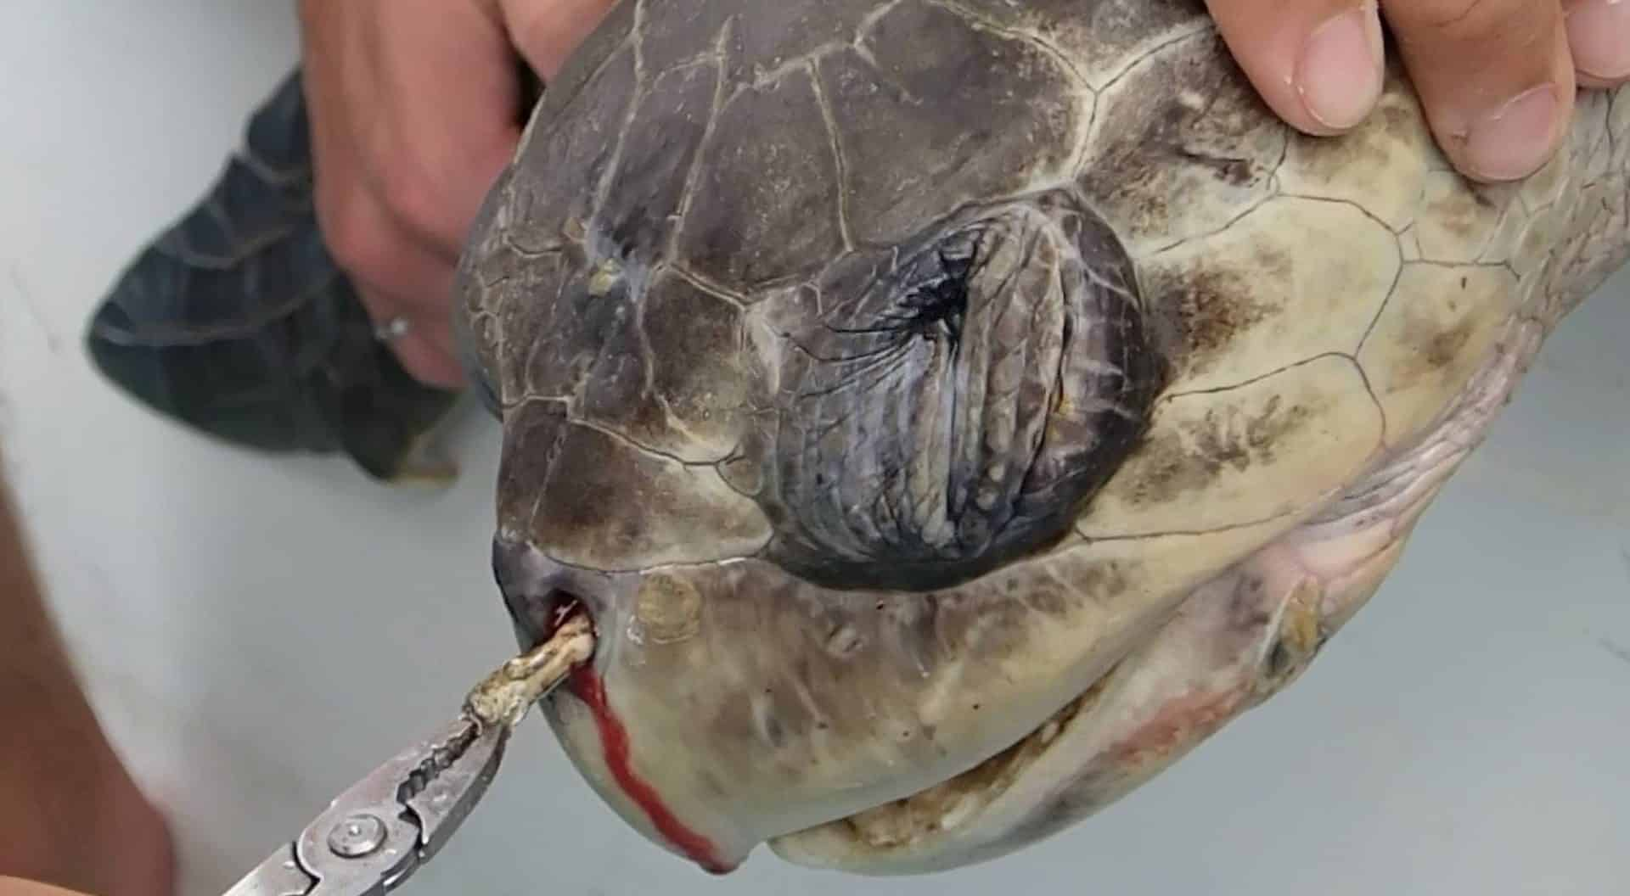
What has happened here?
Image from: Plastic Pollution Coalition plasticpollutioncoalition.org/blog/2015/10/27/the-turtle-that-became-the-anti-plastic-straw-poster-child
Notes:
Lead a class discussion on what the image makes learners think.

Slide 37
What has happened here?
  1,000 turtles die from plastic pollution each year
  (WWF-Australia, 2021). That’s less than 1% of the world's sea turtle population.
  150,000 turtles are killed in shrimp trawls each year
  (Sea Turtle Conservancy, 2025).
  91% of turtles caught in fishing nets die (WWF-Australia, 2021).
  22% of turtles that eat plastic die (CSIRO, 2025).

Slide 38
Climate change: Myth busting
Climate change is real.
But public perception is not always accurate.

Slide 39
Climate change: Myth busting task
Myth busting card activity:
Some of you have been given a myth and some of you a fact.
Work together to match the facts and the corresponding facts.
Once you have found your ‘partner’, sit down together.
Notes:
Once all learners have matched and sat down, get them to read out the myth first and then the corresponding fact.
After everyone has read theirs, ask them to share what they found most surprising or interesting about the myths and facts.

Slide 40
The history of climate change
In 1938, amateur scientist Guy Callendar discovered that global temperatures had risen by 0.3°C over 50 years.
He suggested that CO₂ emissions from industrial activity were to blame.
At the time, he was not taken seriously, but his research turned out to be extremely accurate and he is now considered a pioneer in climate change science.

Slide 41
Climate change timeline activity
Using 1938 as the starting point and the present day as the
end point, create a timeline of all the key elements of
climate change.
As a class, you will work together to add dates and facts to the flipchart paper provided.
Each group will research and add a different element.

Slide 42
Climate change timeline activity
  Group 1: Social factors, e.g. population changes, migration.
  Group 2: Public awareness, e.g. news stories, documentaries, social media.
  Group 3: Technology, e.g. advances in and invention of damaging or problem-solving technologies.
Research significant events, their dates and how they impacted climate change (positively or negatively).

Slide 43
Solutions and responsibilities
Whose responsibility is it to stop climate change?
Let’s vote! Show of hands …
  Global groups?
  Local governments?
  Businesses?
  Individuals?
  Everyone?

Slide 44
Solutions and responsibilities
It is everyone’s responsibility, of course.
But businesses play an important role in tackling climate change because they play a big part in contributing to it.
Businesses have a bigger impact on the environment than individuals and should lead by example and enable customers to make ethical choices. Many believe it should be businesses that lead the way in environmental sustainability.

Slide 45
Environmental sustainability
This involves protecting natural resources and ecosystems, reducing pollution and mitigating climate change.
Look again at the Waste management plan that you created last lesson.
Evaluate the waste management solutions you proposed.
  How environmentally sustainable are they?
  Could they be improved to be more environmentally sustainable?

Slide 46
Homework task: Preparing to debate climate change
Research some key facts to support the following positions:
  Climate change believer: someone who acknowledges that climate change is real and is largely caused by human activities.
  Climate change sceptic: someone who either doubts the extent of human impact on climate change or denies that it is happening at all.

Slide 47
Homework task: Preparing to debate climate change
  You will need this homework for next lesson.
  You should thoroughly research both positions, regardless of your own beliefs.
  Next session you will be debating climate change and may be asked to argue either side.

Slide 48
Summary
Climate change is one of the most defining challenges of
our time. Urgent action is essential to protect the planet and
future generations.
Write down one key takeaway from this lesson.
Write down one thing that you could do differently as an individual to have an impact on climate change.

Slide 49
4
Analysing climate change: The big debate

Slide 50
Lesson outline
  Climate change recap.
  Critical thinking skills.
  Techniques for effective debating.
  Climate change debate.

Slide 51
Climate change recap
Write one key fact about climate change on the whiteboard.
Notes:
Tutor could use a digital application to collate these ideas instead of the whiteboard, e.g. Mentimeter: Interactive presentation software.

Slide 52
Critical thinking skills
Core Skill C (CSC) relates to critical thinking, which includes:
  problem-solving
  decision-making
  researching and planning to include questioning
  evaluating pros and cons
  using logic and reasoned arguments
  synthesising
  concluding.

Slide 53
Critical thinking skills
Complete the Critical thinking skills assessment.
Rate your current aptitude for each skill, where 1 is low
and 6 is high.
Remember to add the date at the top.
You will need this assessment for future lessons so please keep it somewhere safe and accessible.

Slide 54
Critical thinking skills focus
The following task will help with your development of
these skills:
  Ask difficult questions to challenge observations and assumptions.
  View situations from different perspectives.
  Analyse ideas and arguments.

Slide 55
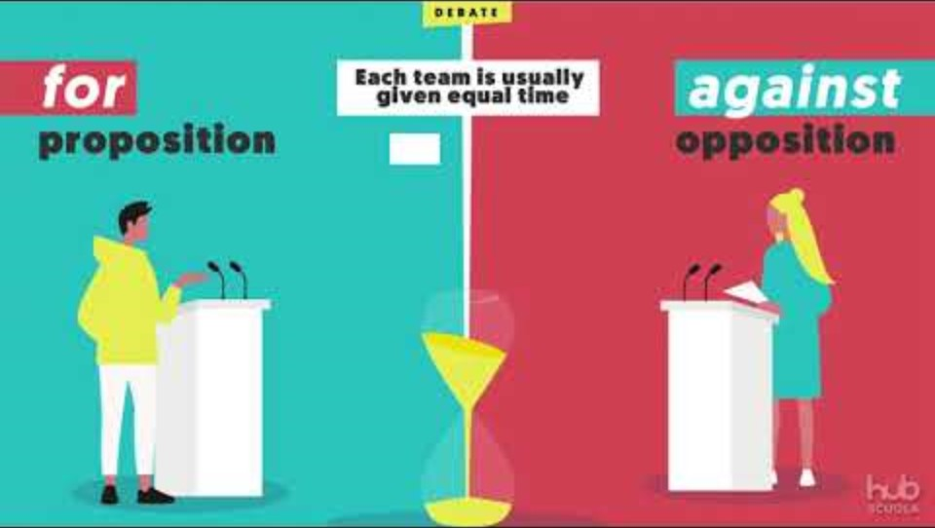
Critical thinking skills and debating
A debate is a structured argument where participants discuss opposing viewpoints on a specific topic.
The aim is to persuade your audience of the validity of your position through logical reasoning and evidence.
Typically, there are two teams:
  the proposition (for)
  the opposition (against).
  Debating skills - Introduction - YouTube

Slide 56
Techniques for effective debating
  Gather credible information and evidence to support
  your arguments.
  Present your points clearly and concisely.
  Use logical reasoning to connect your evidence to
  your arguments.
  Appeal to the audience’s emotions to make your arguments more compelling.

Slide 57
Techniques for effective debating
  Listen carefully to the opposing team and prepare
  counter-arguments.
  Maintain composure and confidence, even under pressure.
  Respect the opposing team and avoid personal attacks.
  Keep track of time to ensure you cover all your points in the allotted time.

Slide 58
Climate change debate: Plan
In your team, prepare your argument using the
following structure:
  opening argument (2 minutes)
  question time (from the other team, 2 minutes)
  closing argument (1 minute).
  Plan how you are going to deliver your arguments and answers to questions. Will you have a single nominated speaker or multiple?
Notes:
Learners should use the research they completed for homework to help them prepare their arguments.

Slide 59
Climate change debate: Deliver
You have been partnered with another team to form a new team.
You have 15 minutes for both teams to present their arguments:
  opening argument (2 minutes)
  question time (from the other team, 2 minutes)
  closing argument (1 minute)
  swap and repeat.

Slide 60
Climate change debate: Reflect
Individually reflect.
Which team delivered the most compelling argument and gave the most valid evidence?
You need to be objective – do not just vote for your own team!
It does not matter which side you agree with – this is about which team debated most effectively.

Slide 61
Climate change debate: Judge
Place a cross in either the ‘proposition’ or the ‘opposition’ box on the Voting paper.
Write your reasoning in the space provided.
Nominate a spokesperson to collect all voting papers and reveal the verdict.
Read the feedback provided on the Voting paper.

Slide 62
Summary
Review your Critical thinking skills assessment from the start of the lesson.
If you feel you have developed that skill, change your score.

Slide 63
Summary
By show of hands, how many of you increased one of
your scores?
How many of you increased two or more of your scores?

Slide 64
Summary
Write one target for yourself to improve one of the critical thinking skills that you did not increase your score for today.
Make sure your target is SMART:
  Specific
  Measurable
  Achievable
  Realistic
  Time-bound.
Notes:
If any learners increased their score for all skills, they should consider how they can further develop these skills.

Slide 65
5
Analysing environmental policies

Slide 66
Lesson outline
  Recap of key environmental legislations.
  The Environment Agency.
  Key environmental policies and initiatives:
    Three pillars of sustainability
    Sustainable Development Goals (SDGs)
    25 Year Environmental Plan (25YEP)
    Ten-point plan for a green industrial revolution.

Slide 67
Environmental legislation recap
Compare and contrast the Environmental Act 2021 and the Climate Change Act 2008.
Which one do you think has the potential to have the greatest impact on climate change?
Notes:
Answer: The Climate Change Act 2008 has a more direct and immediate impact on reducing emissions and mitigating climate change, while the Environment Act 2021 supports these efforts through broader environmental protection and resilience.

Slide 68
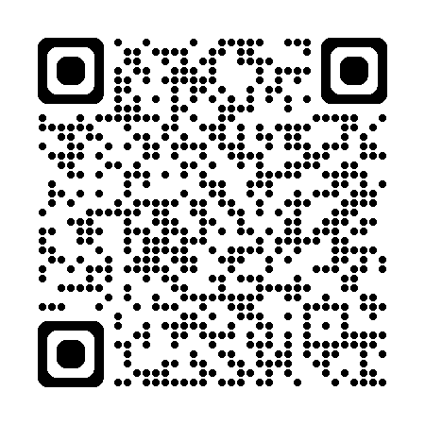
The Environment Agency
Summarise the role, responsibilities and goals of the Environment Agency by reading the following:
About us - Environment Agency - GOV.UK

Slide 69
Key policies and initiatives
  Three pillars of sustainability.
  Sustainable Development Goals (SDGs).
  25 Year Environmental Plan (25YEP),
  including Environmental Improvement Plan (EIP).
  Ten-point plan for a green industrial revolution.

Slide 70
The three pillars of sustainability
  Originated with the 1987 Brundtland Report and was
  further developed at the 2002 World Summit on
  Sustainable Development.
  The three pillars are:
    environmental: protecting nature and reducing pollution.
    social: ensuring fairness and wellbeing for people.
    economic: balancing profit with care for the environment and society.

Slide 71

Sustainable Development Goals (SDGs)
Set of 17 global goals established by the United Nations in 2015 as part of the 2030 Agenda for Sustainable Development.
Image from: UN office for sustainable development

Slide 72
SDGs and climate change
The most directly relevant SDG for climate change is SDG 13: Climate Action.
This goal focuses on taking urgent action to combat climate change.

Slide 73
Reviewing SDGs
The Voluntary National Review (VNR) is a process through which countries assess and present their progress in implementing the 2030 Agenda for Sustainable Development, including the 17 SDGs.

Slide 74
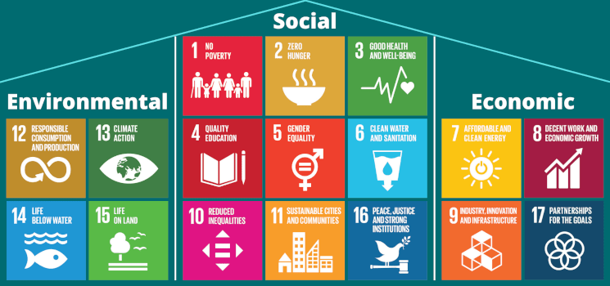
SDGs and the 3 pillars of sustainability

Slide 75
Complying with sustainability initiatives: task
  Read the example sustainability report you have been allocated.
  In your group, discuss how the company is complying with
  the three pillars and SDGs initiatives.
  Make some suggestions for how they could improve further.

Slide 76



Examples of sustainability reports
Report 1,
CVS Group:
Read pages
2, 3 and 6.
Report 2,
Pets at Home:
Read pages
2, 4 and 5.
Report 3,
Mars Veterinary Health: Read pages 2, 4 and 5.

Slide 77
25 Year Environmental Plan (25YEP)
  UK government’s long-term strategy to enhance the natural environment within a generation.
  Environmental Improvement Plan (EIP) 2023 builds on the 25YEP and outlines the government’s strategy to enhance the natural environment.
  The EIP emphasises collaboration with landowners, communities and businesses to achieve these goals and includes interim targets to measure progress.

Slide 78
Ten point plan for a green industrial revolution
  Outlines the government’s strategy to drive the transition to a sustainable, low-carbon economy.
  Aims to invest £12 billion of government funds and potentially three times as much from the private sector, to create and support up to 250,000 green jobs.
  Overall, the plan aims to create a sustainable, low-carbon economy that supports green jobs, drives innovation and enhances the natural environment.

Slide 79
Environmental policy group task
In your group, evaluate the designated policy.
Consider the following:
  clarity and coherence
  effectiveness
  impact.
  Group 1: 25YEP (including the EIP).
  Group 2: Ten point plan for a green industrial revolution.

Slide 80
Summary
Which of the policies and initiatives discussed today stands out the most to you and why?
Write your answer on the sticky note provided.
On your second sticky note, write down one question you still have about climate change and environmental policies.
For homework, try to find the answer to this question and come prepared to share it next lesson.
Notes:
The tutor should collect in all sticky notes and keep them for the following lesson.

Slide 81
6
Sustainability challenges for land-based businesses

Slide 82
Lesson outline
  Recap of climate change and environmental policies.
  Environmental impacts of businesses.
  Sustainable development.
  Sustainability challenges for animal-related businesses.
  Problem-solving skills.

Slide 83
Environmental policies recap activity
You will need your question from last lesson and the answer you found out.
Move around the room and discuss with your peers the question you had and the answer you found out.
Have discussions with at least two peers.

Slide 84
Environmental impacts of businesses
Businesses typically have a greater environmental impact than individuals due to a larger scale of operation.
The decisions and behaviours of individuals are largely led
by suppliers.
Businesses therefore have a responsibility to operate as sustainably as they can.

Slide 85
How do land-based businesses impact the environment?
Discuss with your neighbours some specific ways that
land-based businesses might impact the environment.
Between you, write one of these ways on a sticky note and stick this to the whiteboard.

Slide 86
How do land-based businesses impact the environment?
  Land degradation, e.g. soil erosion, loss of soil fertility, desertification.
  Water availability and quality, e.g. water pollution, volume of water required for daily tasks.
  Climate change, e.g. contribution to greenhouse gases through high energy consumption activities.

Slide 87
How do land-based businesses impact the environment?
  Pollution, e.g. disinfectant and pesticide runoff, air pollutants from manure.
  Waste generation, e.g. high levels of non-recyclable waste contributing to landfill.

Slide 88

Sustainable development
Watch the video and write down:
  a summary of what is meant by ‘sustainable development’
  how sustainable development can boost a business’s value.
BIC: Two minutes to understand sustainable development

Slide 89
Sustainable development
What do you think puts businesses off acting more sustainably?
Discuss this with your partner and write down your thoughts.

Slide 90
Sustainability challenges for animal-related businesses
With so many factors to consider, is it challenging for
animal-related businesses to act sustainably?
What are the key sustainability challenges for animal-related businesses?

Slide 91
Sustainability challenges for animal-related businesses
Sustainability?
Regulatory compliance.
Animal welfare and biosecurity.
Budget constraints.
Environmental policies and initiatives.

Slide 92
Critical thinking skills focus
Effectively solve problems and make informed decisions.
Using the 6-point scale from your Critical thinking skills assessment (1 = low, 6 = high), write a score for your
problem-solving skills on the sticky note and stick it on the wall.

Slide 93
Problem-solving skills
What does the term ‘problem-solving’ mean to you?
Think of a time when you had to solve a problem.
It does not have to be a big problem or related to college or the workplace. It can be any problem you have solved.
Now discuss with your partner:
  Was your solution successful?
  Would you do anything differently next time?

Slide 94
Solving problems effectively
Step 1: Define the problem.
Step 2: Consider possible solutions.
Step 3: Evaluate the solutions.
Step 4: Implement the solution.
Step 5: Monitor and adjust.

Slide 95
Solving sustainability problems in animal-related businesses: Task
Read the scientific journal article you have been allocated.
Top tip: Scientific journal articles can be quite heavy, and not all the information will be relevant. Try skim reading and use a highlighter to identify the key bits of information.
Critical thinking skills focus: Separate what is important and what is irrelevant information.

Slide 96


Sustainability scientific journal articles
Sustainable food procurement.
Environmental impact of companion animal parasiticides.

Slide 97
Solving sustainability problems: Discuss
In your group, discuss ways that animal businesses could overcome the problem detailed in the article.
Use the five-step problem-solving technique to help structure your discussion.

Slide 98
Solving sustainability problems: Compare
Join a group that read the same article and discuss and compare the solutions you produced.
Feed back to the whole class the most viable combined solutions you created.

Slide 99

Solving sustainability problems:
An example
WAZA (World Association of Zoos and Aquariums) campaign for single-use plastics:
How to reduce single-use plastic at your zoo or aquarium

Slide 100
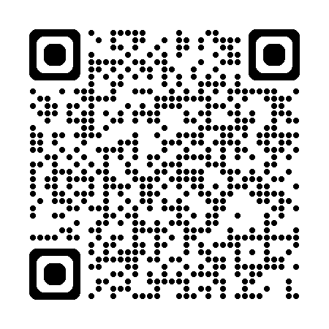
Solving sustainability problems: Additional reading
If you are interested in this campaign and would like to know more, you could read the full WAZA guide at home.
WAZA-short-guide-final-online.pdf

Slide 101
Summary: Reflection
Complete another column in your Critical thinking skills assessment.
Reflect on today’s activities. Have they helped you to develop your problem-solving skills?
If you have increased your score for problem-solving from earlier, retrieve your sticky note from the wall, change your score and move it to the opposite wall.

Slide 102
7
Measuring sustainability

Slide 103
Lesson outline
  Recap of sustainability challenges for animal-related businesses.
  Measuring sustainability performance.
  Carbon offsetting and carbon capture.
  Regulatory compliance.
  Net zero by 2050.
  An introduction to sustainability plans.

Slide 104
Recap: Sustainability challenges
In your group, create a mind map of potential sustainability challenges for your allocated business:
Group 1: Veterinary practice
Group 2: Farm park
Group 3: Boarding cattery
Group 4: Dog grooming salon.

Slide 105
Measuring sustainability performance
  Why is it important for businesses to measure their sustainability performance?
  Accountability.
  Evaluation and improvement.
  Transparency for customers, investors and regulators.
  Regulatory compliance.
  Risk management.
  Competitive advantage and marketing.
  Business long-term viability.
  Global goals, e.g. SDGs.

Slide 106
Key performance indicators (KPIs)
KPIs help businesses understand their performance and identify areas for improvement.
Examples of sustainability KPIs:
  CO₂ emissions in kilotons (kt).
  Energy efficiency in kilowatt-hours (kWh).
  Waste generation in cubic metres (m³).
  Water usage in metric tons (t).
  Financial value of sustainability initiatives in
  pounds sterling (£).

Slide 107

Carbon offsetting
Compensating for CO₂ emissions by participating in schemes designed to make equivalent reductions of carbon dioxide in
the atmosphere.
High greenhouse gas emissions levels.
Funding reforestation project.

Slide 108
Carbon offsetting: Task
In your groups, produce a list of smaller-scale carbon offsetting ideas that you could employ in a small animal business.
Use the businesses you were assigned for the recap activity:
Group 1: veterinary practice
Group 2: farm park
Group 3: boarding cattery
Group 4: dog grooming salon.

Slide 109
Carbon capture
Carbon capture reduces the amount of CO₂ released into
the atmosphere.
CO₂ is captured using chemicals that absorb CO₂ from exhaust gases.
The captured CO₂ is compressed and transported in pipes to a storage site.
It is injected deep underground into geological formations, such as depleted oil and gas reservoirs, where it is stored permanently.

Slide 110
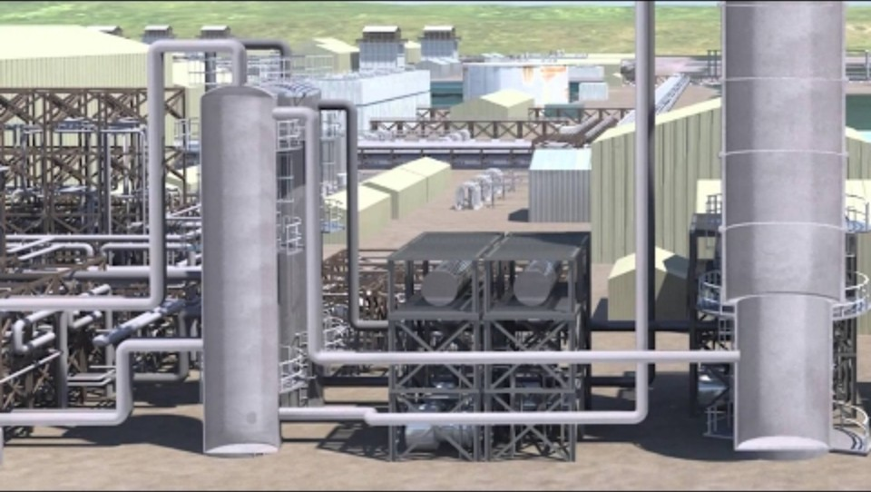
Carbon capture: How it works
Carbon Capture & Storage - How It Works

Slide 111

B Corp: An example of measuring high sustainability standards
B Corp Movement: Transforming the global economy to benefit all people, communities, and the planet

Slide 112
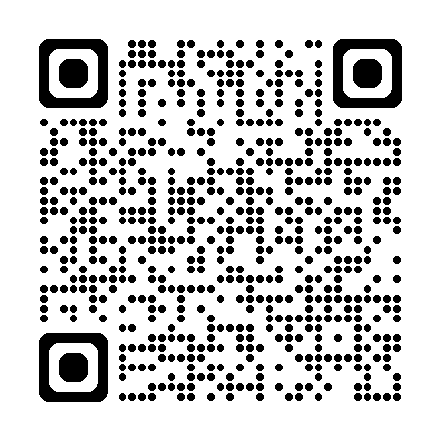
B Corp certification
Scan the QR code and find some examples of
animal-related businesses with B Corp certification.

Slide 113
Mandatory reporting
The UK Sustainability Reporting Standards (UK SRS) are guidelines created by the government to help businesses
report information about their sustainability practices.
They are built on the International Financial Reporting Standards (IFRS) Sustainability Disclosure Standards.
The standards aim to ensure that businesses are transparent about their environmental and social impacts, helping customers and investors make informed decisions.

Slide 114
Corporate social responsibility (CSR)
Refers to how businesses manage their impact on society and the environment, beyond their legal obligations.
It is a comprehensive plan that details a business’s commitment to ethical, sustainable and socially responsible practices.
It is not legally mandated.
It can help improve a business’s reputation and brand image.

Slide 115
Consequences of not complying
Read the article you have been given and answer these questions:
  What is the name of the organisation responsible for prosecuting environmental legal breaches?
  What was the issue?
  What was the consequence?
  Extension task: Carry out some additional research.
  What is the largest amount you can find that a business has been fined by the Environment Agency?

Slide 116
Net zero by 2050
The government has committed the UK to a legally binding
‘net zero’ emissions target by 2050.
Net zero refers to achieving a balance between the greenhouse gases emitted into the atmosphere and those removed from it.
Essentially, any emissions produced are offset by an equivalent amount of emissions being removed, resulting in no net increase in atmospheric greenhouse gases.

Slide 117
Critical thinking skills focus
  Refer to your Critical thinking skills assessment.
  You are going to undertake a task that will help with your development of the following skills:
  View situations from different perspectives.
  Analyse ideas and arguments.

Slide 118
Net zero by 2050: Achievable or not?
In your pairs, one of you will research net zero supporters and the other will research doubters.
For each angle (supporter or doubter), you should find out:
  the names of two organisations that support/doubt
  the reasons they support or doubt the initiative.
  Share your findings with you partner and evaluate the information.

Slide 119
Net zero by 2050: Achievable or not?
Draw a conclusion in your pairs about which ‘side’ you are on – do you support or doubt the initiative? You do not have to agree with your partner, as long as you can each justify your decision.
Feed your conclusions back to the class.

Slide 120
Sustainability challenges for businesses: Knowledge
So far you have learnt about:
  key legislation relating to animal businesses and how they impact on practices
  biosecurity practices and waste disposal
  the history of climate change and what this might mean for the future
  government policies and initiatives that aim to mitigate
  climate change.

Slide 121
Sustainability challenges for businesses: Analysis
  You have also considered:
  the impacts that animal businesses have on the environment
  the challenges that animal businesses face in acting sustainably
  how businesses can measure their environmental impact and sustainability efforts.

Slide 122
Sustainability challenges for businesses: Action
  So what can businesses actually do to improve their sustainability performance and reduce their impacts on
  the environment?
  That is the most important question.

Slide 123
Sustainability plans
A sustainability plan is a strategic document that outlines how a business intends to manage its environmental, social and economic impacts.
It sets goals, actions and measurements to minimise the business’s environmental impact and ensure that practices are sustainable in the long term.

Slide 124
Homework task: Sustainability plans
Find an example of an animal-related business sustainability plan. It might be referred to as a sustainability plan, policy or strategy. If you struggle to find one, you could also look up a sustainability report.
Print or save the document or webpage ready for next lesson.

Slide 125
Summary
  In your pairs, explain the following:
  Partner 1: explain carbon offsetting and give an example.
  Partner 2: explain carbon capturing, including the three steps in the process.
  Challenge one another if you detect any errors.

Slide 126
8
Evaluating sustainability

Slide 127
Lesson outline
  Recap activity.
  Evaluating business sustainability plans.
  Sustainability solutions.
  Creating sustainability plans.

Slide 128
Sustainable food sourcing task
You are responsible for ordering the feed items for several hornbill species at a zoo. Use the provided food table and a digital map application to calculate the approximate distance the food item must travel if you included it in the diet.
Choose the five items that would be most sustainably sourced.
Extension task: What else could you do to reduce the environmental impact of this food order in the longer term?

Slide 129
Critical thinking skills focus
Evaluate information in a logical and systematic way.
How do you effectively evaluate information?
Look for:
  strengths
  weaknesses
  validity
  effectiveness/usefulness.

Slide 130
Critical thinking skills focus
Evaluate information in a logical and systematic way.
Is it CRAAP?!
Current
Relevant
Authority (Was the creator reputable?)
Accurate
Purpose (fit for)

Slide 131
Critical thinking skills focus
Evaluate information in a logical and systematic way.
Important things to remember:
  Evaluation claims have two parts, a conclusion (c) and
  an explanation (e).
  For example: … is effective (c) because… (e).
  You should be able to back up any conclusions you come to with evidence.

Slide 132
Evaluating business sustainability plans
You will need access to the example of the animal business sustainability plan/policy you found for homework.
Find a partner who has focussed on a different business from you.
In your pairs, evaluate the two plans/policies and propose improvements. Complete the Sustainability plan evaluation template.

Slide 133
Sustainability solutions: Task
Get back into the groups you worked in last lesson:
Group 1: veterinary practice
Group 2: farm park
Group 3: boarding cattery
Group 4: dog grooming salon.
Write the business at the top of the flipchart paper.

Slide 134
Sustainability solutions: Ideas
You have three minutes to produce a list of actions and practices the business could employ to improve their sustainability performance.
Move clockwise around the other groups. Read what they already have on their list and add some more ideas.
You have three minutes at each list.

Slide 135
Sustainability solutions: Review
Return to your own list and read what has been added.
Spend five more minutes adding any further ideas you have for your business.

Slide 136
Creating a sustainability plan
Research and benchmark: what are other similar businesses doing?
Assess the business’s current practices and sustainability performance.
Set sustainability goals: what are some short-, mid- and long-term targets you would like the business to achieve?

Slide 137
Creating a sustainability plan
Set actions: what are specific steps that need to be taken to reach these goals?
    Actions should be SMART (Specific, Measurable, Achievable, Realistic, Time-bound).
    Consider these key areas: energy efficiency,
    waste management, suppliers and sourcing, community engagement.
Monitor and review.
Continuous improvement.

Slide 138
Creating a sustainability plan: Task
In your group, create a sustainability plan for your allocated business.
You can make assumptions and create answers when assessing current sustainability performance.
Format your plan however you like, using subheadings as you see fit. Use the steps we have just discussed to help you.

Slide 139
Summary
  Complete another column in your Critical thinking skills assessment.
  How have your skills progressed over the last few lessons? Are you seeing improvements in your scores?
  Do you feel more confident in most or some areas?
  Are there any skills on which you have still scored 3 or lower? Write these on a sticky note and hand it to your tutor.

Slide 140
9
Propose improvements: Appraisal and planning

Slide 141
Lesson outline
Scenario:
You are working in the establishment detailed in your case study and have been asked to appraise their existing sustainability plan.
Produce a proposal and accompanying presentation to make improvements to the plan.
You will work in pairs.

Slide 142
Proposal checklist
  Rationale:
    What is the importance of appraising the current sustainability plan?
  Appraisal:
    What are the positives about the current plan?
  Proposed improvements:
    What should be changed, how and why?
  Basic cost analysis:
    What are the estimated costings of making these changes?

Slide 143
Step 1: Initial read
In your allocated pairs, find a space to work.
You have 10 minutes to read the documents in your case study.

Slide 144
Step 2: Appraisal
20 minutes.
Work together to appraise the documents.
Employ the higher-order thinking skills you have developed in analysing and evaluating.
Highlight and annotate aspects you think could be improved.
Consider how these improvements could be made.

Slide 145
Step 3: Proposal
One hour.
Create a proposal (remember the checklist).
You will need to carry out research where necessary to support and justify your suggestions and ensure your proposal is realistic.
Your proposal should be professionally written and
user-friendly.

Slide 146
Step 4: Presentation
20 minutes.
Create a short presentation (5–10 minutes) to accompany your proposal. This will be delivered, alongside your proposal report, to the relevant ‘manager’ next session.
You can use any format for your presentation: PowerPoint, Canva, poster, infographic, etc.

Slide 147
Summary checklist
You should have completed everything you need to from the proposal checklist.
You should be ready to present your proposal next session.
Your suggestions should be fully justified and include basic
cost analysis.

Slide 148
10
Propose improvements: Delivery and evaluation

Slide 149
Lesson outline
In this session you will present your proposal to another pair, who will act as the relevant managers.
You should provide them with a copy of your formal proposal and present it to them via the presentation you have created.
You will then swap and repeat the same exercise in
reversed roles.

Slide 150
Prepare to present
Get back into your pairs from last session.
Review your proposal and presentation and prepare to deliver it to your assigned managers.
15 minutes.

Slide 151
Present your proposals (one hour)
In your groups, you have 30 minutes each to deliver your proposal to the managers and then swap.
As the manager, you should ask questions where you have them, consider the viability of the improvements being proposed and take notes on where you may want to counter and negotiate the improvements.
You should be prepared to feed back to the whole group.

Slide 152
Feedback
Consider:
  How confident and competent was the proposal presentation?
  What is your decision: decline, accept or conditionally accept?
  What are the conditions of your acceptance?
  What would you like to counter and negotiate?
Once all pairs have presented, you will feed back to the
whole class.

Slide 153
Group feedback session
  In your pairs, feed back to the whole class, making one key comment on the proposal you have just received.
  Individually, on a mini whiteboard, write down the most useful piece of feedback you have been given.
  Write down how you will action this feedback and how it informs your practice in future.

Slide 154
Summary and formative questions
Write down:
  three points that are important to consider when evaluating the sustainability of a business
  two easy and affordable ways for many businesses to improve their sustainability
  what you consider are the main barriers business face in improving their sustainability.
Notes:
The teacher could use a name-generating tool to acquire answers from learners and/or collect these answers in as a formative assessment at the end of the session.

Slide 155
Summary: Final thoughts
Land-based industries should be pioneering sustainable business practice but are often presented with significant barriers to such practices (legislation, biosecurity, animal welfare, budget limitations).
Over these sessions, you have developed skills in critical analysis and evaluation which will enable you to approach this ongoing challenge with confidence and aptitude.

Slide 156


PRODUCED BY
FUNDED BY
South Gloucestershire and Stroud College has produced this resource on behalf of the Education and Training Foundation
This programme is funded by the Department for Education
ET-FOUNDATION.CO.UK

