Slide 1


Lesson 3:
Basic algebra
Objectives
Use correct algebraic notation
Expand brackets
Factorise algebraic expressions
Understand multiplicative algebraic structure using an area representation

Slide 2

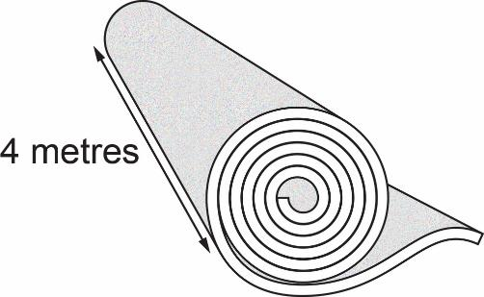
Buying carpet
Sam is buying new carpet for the living room.
n
4
n = length customer wants to buy
Notes:
Help students to understand the context. Tell students that Sam is buying new carpet and has chosen a carpet that comes in a 4-metre width.
The owner of the shop uses the length of carpet a customer needs to find the area of carpet being bought, so he can work out the cost.
Explain that n is used to represent a variable length as the length of carpet being bought varies from customer to customer.

Slide 3
Area of carpet
n
4
4n
Area of carpet =
Length is measured in metres.
Area is measured in square metres.
Notes:
It is important to spend enough time on this slide to emphasise that n is a variable. When working with an unknown quantity, n, students may assume that the value of n needs to be found. After showing the animation, hold a short discussion about what n could be. Emphasise that we don’t know what n is and make sure that students recognise that n can represent different values.
Students might describe the area of the carpet as ‘4 times n’ and write this as 4 × n. It is important to emphasise correct algebraic notation and for students to recognise that the multiplication symbol is not needed when writing algebraic expressions.
Establish that length is measured in metres (m) and area is measured in square metres (m²).

Slide 4

Variables
KEY IDEA
A variable is an unknown value
represented by a letter
(e.g. n).
The value of a variable can change.

Slide 5
Buying extra
The owner recommends buying an extra 2 metres.
n
2
4
4n
8
4(n + 2)
4n + 8
Notes:
Tell students that the owner of the carpet shop recommends that Sam buys an extra 2 metres of carpet (to allow for error when fitting the carpet). Check that students are happy that the diagram shows that the area calculation needed is 4(n + 2).
Tell students that Sam says the calculation should be 4n + 8. Ask students if they can explain Sam’s thinking.
Establish that the owner and Sam are both describing the same thing but in different ways. The owner is describing a calculation that involves multiplying two lengths, whereas Sam is describing a calculation that involves adding two areas. Emphasise where the two expressions are featured in the diagram.
Check that students understand the vocabulary of factorising. Establish that:
4 and (n + 2) are factors
4(n + 2) is the expression in factorised form
4n + 8 is the expression in expanded form.

Slide 6
Factorised and expanded expressions
KEY IDEA
Factorised expression
two or more terms
multiplied together
4(n + 2)
Expanded expression
brackets multiplied out
4n + 8
Notes:
Establish that the owner’s expression is the expression 4n + 8 in factorised form and Sam’s expression is the expression 4(n + 2) in expanded form.

Slide 7

Completing the diagrams
YOUR
TURN
Handout
available
Take turns to fill in the missing information on each diagram.
Notes:
Ask students to work in pairs and give each pair a copy of the ‘Algebraic expressions grid’. Ask them to fill in the missing information on each diagram.
Observe students as they complete this task but do not intervene unless necessary. Notice which areas they find more difficult, to inform the discussion in the next section of the lesson. If a pair of students is struggling to get started, check that they understand that the sides need to multiplied to give the area, and link this task back to the carpet model.
Depending on your class, you may decide to get them started, then discuss the answers (see Slide 8) and then ask them to continue, before going through the rest of the answers. You may also suggest that they leave out the last two diagrams.

Slide 8
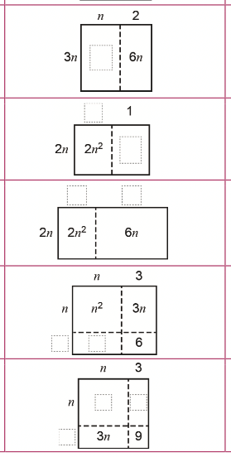
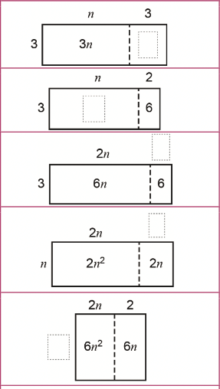
Completing the diagrams
YOUR
TURN
Handout
available
9
3n²
n
3n
2n
2
n
3
2
2
2n
3n
n²
3n
3
Notes:
Use this slide, if you need it, to support a discussion about what should go in the empty boxes on the diagrams.

Slide 9
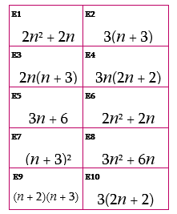
Matching expressions to diagrams
YOUR
TURN
Handout
available
Use the diagrams to identify the factorised and expanded forms of the expression.
In the empty cells, either place a card or write an expression.
Notes:
Give each pair a copy of the ‘Expressions’ cards. (Students will need scissors to cut the expressions cards up if they haven’t already been cut into cards prior to the lesson. Alternatively, they can copy the cards onto sticky notes). Point out that the column on the left of the diagrams has the heading ‘Factorised’ and the one to the right has the heading ‘Expanded’. If needed, remind them that, in the example of Sam buying carpet, 4(n + 2) is the factorised form of the expression and 4n + 8 is the expanded form.
Ask students to use the completed area models to help identify the factorised and expanded forms of each expression, and to use this information to place the cards in the appropriate cells. Tell them that once the cards are placed, they should write the missing expressions in any empty cells.

Slide 10
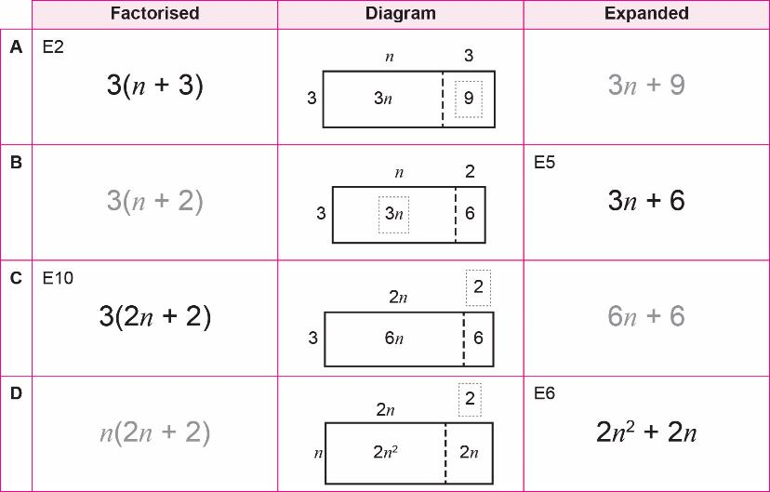
Completing rows A to D
REVIEW
Notes:
Go through the ‘Algebraic expressions’ grid line by line and draw students’ attention to each area model and how the factorised and expanded expressions relate to the model.
Ask students which cards they were able to match first, after completing the missing information on the diagrams. They should have identified E2 as the factorised expression for the diagram in row A and E6 as the expanded expression for the diagram in row D.

Slide 11
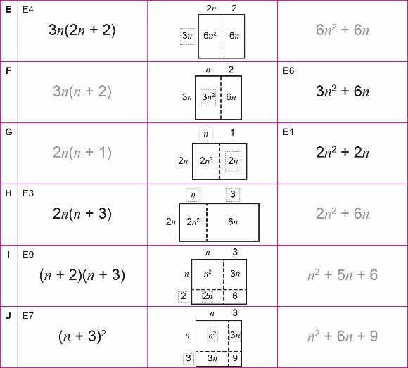
Completing rows E to J
REVIEW
Notes:
Ask students how they completed rows I and J. How did they work with the area model? Did they view the diagram as two rows stacked together? Matching E7 to the diagram in row J relies on understanding that (n + 3)² = (n + 3)(n + 3).

Slide 12
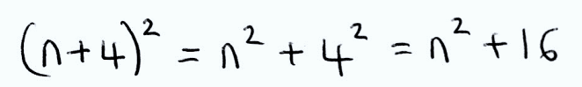
Tony expanding brackets
Tony is expanding the bracket in this expression:
(n + 4)²
He writes:
Explain why Tony’s solution is incorrect.
Notes:
Having identified that (n + 3)² = (n + 3)(n + 3) from the ‘Algebraic expressions grid’, students should be able to explain why Tony’s solution is incorrect. Tell students to draw an area model on their whiteboards to work out the correct expanded expression.

Slide 13
Expanding brackets
Factorised
Diagram
Expanded
n
4
(n + 4)²
n
n²
4n
= (n + 4)(n + 4)
n² + 8n + 16
4
4n
16
Notes:
Check that students recognise how to get the term 8n (i.e. 4n + 4n) and understand how the complete diagram relates to the final (expanded) expression.
Before moving on to slide 14, ask students to look at all the rows on the grid. What is the same? What is different? Allow time for this discussion. If this hasn’t come up as part of the discussion, then ask students to compare the expressions in rows D and G (next slide).

Slide 14
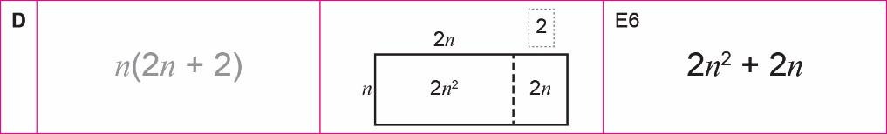
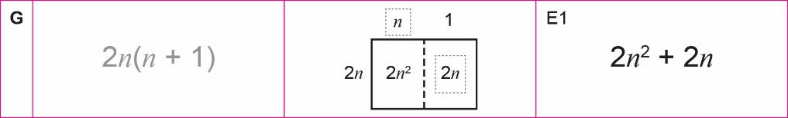
Rows D and G
REVIEW
What do you notice?
Can you factorise 2n² + 2n another way?
2(n² + n)
Notes:
When factorising an expression, students often leave common factors inside the bracket. The factorised expression in row D, n(2n + 2), is an example of this and can be contrasted to the factorised expression in row G, 2n(n + 1), which has been factorised fully. Did students notice that the expanded expressions in rows D and G are the same but the factorised expressions are different? Establish that an expression can be factorised in more than one way if the terms have more than one common factor.
Ask students if 2n² + 2n can be factorised another way: (2(n² + n) where a factor of 2 is taken out).
Explain that our aim when factorising is to factorise fully. This means that there are no common factors for the terms inside the bracket. Establish that factorising fully gives 2n(n + 1).

Slide 15
Common factors and highest common factors
KEY IDEA
An expression is factorised by taking out a common factor of the terms.
To factorise an expression fully,
take out the
highest common factor of the terms.

Slide 16
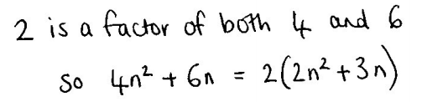
Cameron’s factorising
Cameron is factorising this expression: 4n² + 6n
He writes:
Explain why Cameron hasn’t factorised fully.
Notes:
Ask students to imagine that they are the teacher. Give them a few minutes to discuss in pairs how they could help Cameron to understand why the expression hasn’t been factorised fully. Choose a few of pairs of students to share their explanations with the rest of the class.

Slide 17
Factorising fully
YOUR
TURN
Factorise fully:
12n² + 18n
2n
3
6n
12n²
18n
Notes:
Ask students to work in pairs to complete the diagram on their mini whiteboards.
After a few minutes ask a pair of students to describe their labels for the diagram. Do other students agree? Have they factorised fully? How do they know?
What are all the possible ways of factorising the expression? Can students find all six?
2(6n² + 9n), 2n(6n + 9), 3(4n² + 6n), 3n(4n + 6), 6(2n² + 3n), 6n(2n + 3).
Work with the class to establish that the expression factorised fully is 6n(2n + 3) (shown on next slide).

Slide 18
Practice question
REVIEW
(a) Expand 4e(e + 2)
……………………………
(2)
(a) 4e² + 8e
(b) Factorise fully 9x² + 6x
……………………………
(2)
(b) 3x(3x + 2)
Notes:
In all previous parts of this lesson, n has been used to represent a variable. Ensure that students understand that a variable can be represented by any letter.
Notice whether students draw a diagram to support their thinking. Can they explain their approach when factorising the expression in part (b)? How are they convinced that they have factorised the expression fully?
Notes:
Part a is Q16b from June 2018 1MA1/1F
Part b is Q22b from November 2019 1MA1/3F

Slide 19
Lesson review:
Basic algebra
Objectives
Use correct algebraic notation
Expand brackets
Factorise algebraic expressions
Factorise fully (both number/letters) in the same algebraic expression
Suggested further steps/areas to work on
Factorise quadratics of the form x² + bx + c

Slide 20
Lesson 3:
Credits
Photo acknowledgements
Shutterstock.com: Vincent Giordano Photo
Text acknowledgements
Pearson Education Ltd: Pearson Edexcel
GCSE (9-1) In Mathematics (1MA1) Foundation (Non-Calculator) Paper 1F, June 2018 and Paper 3F, November 2019

