Slide 1


Lesson 8:
Algebraic equations
Objectives
Make connections between real-life situations and algebraic equations
Solve equations and interpret the solutions
Use representations to provide insight into mathematical structure

Slide 2


Selling skincare products
Pack of wipes
Tia
Tia’s dad has ordered
some packs of face wipes
to sell online
Notes:
Tell students that Tia’s dad sells skincare products online and has just ordered a supply of face wipes.

Slide 3

Packs and multipacks
Pack 1
Pack 2
Pack 3
Pack 4
Pack 5
Pack 6
Multipack containing
six packs of wipes
Notes:
The face wipes are delivered to Tia’s dad in multipacks containing six packs of wipes.

Slide 4


Looking at relationships
What is the relationship between the number of multipacks and the number of packs?
Tia
Using
p = the number of packs and
m = the number of multipacks
Write an equation
Vinay
Sade
Notes:
Tia’s dad wants to be able to determine how many packs of wipes he has received, from the number of multipacks that have been delivered. He asks Tia if she can write an equation that describes the relationship between the number of multipacks and the number of packs of wipes. Tia asks her friends Vinay and Sade to help her.
Give each student a mini whiteboard and ask them to write an equation for the relationship between the number of multipacks and the number of packs of wipes, using p to represent the number of packs and m to represent the number of multipacks.
You might like to ask students to think about which is bigger: the number of multipacks or the number of packs. Students may also need reminding about the rules for writing algebra, for example, not including the multiplication sign (i.e. a × b is written as ab).
After a couple of minutes, ask students to show you their mini whiteboards

Slide 5


Equation for the total number of packs
DISCUSS
p = the number of packs
m = the number of multipacks
Tia
Vinay
Notes:
Show students Tia’s equation (m = 6p). Check whether any students have the same equation as Tia. Tell students that Vinay doesn’t think that Tia’s equation is correct and has a different equation (p = 6m).
Survey the class to see if any students have written down the same equations as Tia and Vinay. You might like to ask students with the same equations as Tia and Vinay to explain their thinking.
Use the next three slides to support a discussion of the relationship between the number of multipacks and the number of packs of wipes.

Slide 6
Why is Tia’s equation wrong?
REVIEW
Check:
If Tia’s dad was sent 2 multipacks of wipes, a total of 12 packs of wipes were sent.
Tia
Why doesn’t Tia’s
equation work?
p = the number of packs
m = the number of multipacks
Which number do you have to multiply by 6?
Notes:
Students may wrongly assume that because the number of multipacks is known, m should be the subject of the equation as in Tia’s equation. They may read Tia’s equation as ‘a multipack equals 6 packs of wipes’ and conclude that Tia’s equation is therefore correct. If this is the case, suggest that students substitute some numbers for m and p to check whether Tia’s equation works. For example, If Tia’s dad was sent 2 multipacks of wipes, he has a total of 12 packs of wipes. 2 x 6 = 12, so you need to multiply the number of multipacks by 6 to get the number of packs. Remind the students that the number of packs is always bigger than the number of multipacks.

Slide 7
Vinay’s correct equation
REVIEW
Vinay
p = the number of packs
m = the number of multipacks
Explain why Vinay’s equation works
Notes:
Check that students understand why Vinay’s equation is correct and recognise that multiplying the number of multipacks by six gives the total number of packs of wipes.

Slide 8
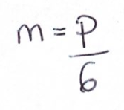
Vinay’s and Sade’s equations
REVIEW
Vinay
Sade
How are the two
equations the same?
p = the number of packs
m = the number of multipacks
Notes:
Introduce Sade’s equation and ask students to think about how it represents the same relationship but in a different way (she has written the number of multipacks as the subject rather than the number of packs of wipes).
Writing Sade’s equation with p as the subject rather than m gives Vinay’s equation, which is the equation that Tia’s dad needs.

Slide 9

Mathematical structure
DISCUSS
REVIEW
Vinay
Sade
m = 1
p = 6
m = 2
p = the number of packs
m = the number of multipacks
p = 12
Notes:
Using a pictorial representation of the relationship between p and m may be helpful when exploring the relationship between Vinay’s and Sade’s equations.

Slide 10
Cost of wipes
We need an equation for the relationship between
the cost of a pack and
the cost of a multipack
Tia
x = the cost of a pack
y = the cost of a multipack
Vinay
Sade
Notes:
Tell students that Tia’s dad decides that he is going to offer the face wipes for sale online, either as a single pack or as a multipack containing 6 packs of wipes (since they arrive already packaged in multipacks of 6 wipes). He knows the unit cost of a pack of wipes and wants to work out the cost of a multipack of 6 packs. He asks Tia if she can write another equation to describe the relationship between the cost of a pack of wipes and the cost of a multipack. Tia asks her friends for help again.
Ask students to suggest an equation and to write it on their mini whiteboard before going on to look at Tia’s, Sade’s and Vinay’s suggestions on the next slide.

Slide 11
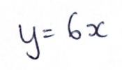
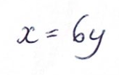
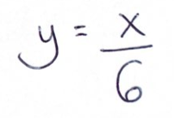
Cost of a multipack of wipes
DISCUSS
x = the cost of a pack
y = the cost of a multipack
Who is right?
Tia
Vinay
Sade
Notes:
Show students Tia’s, Vinay’s and Sade’s equations. Ask students whose equation they think correctly describes the relationship between the cost of a pack of wipes and the cost of a multipack. Remind them to think about which is the bigger number, x or y. Ask them to write the initial of the person they think is right on their mini whiteboard and then show it to you.
If there is agreement about who is right, ask a couple of different students to explain their thinking. If there is disagreement, ask students with different views to explain their thinking.
You can use the next slide to support a discussion of why Tia’s equation is correct
.

Slide 12
Why is Tia’s equation correct?
DISCUSS
REVIEW
Example:
If 1 pack of wipes costs £1.50,
what do 6 packs cost?
X | X | X
X | X | X
£1.50 | £1.50 | £1.50
£1.50 | £1.50 | £1.50
y = 6x
Cost of 6 packs = 6 × cost of 1 pack.
x = the cost of a pack
y = the cost of a multipack
Cost of 6 packs = 6 × £1.50.
Notes:
Check that students understand and can justify why Tia’s equation is correct. Ask them to draw a representation to show the relationship, and, if necessary, show them the representation on the slide, which reveals the mathematical structure of the relationship.
Discuss the example with students and emphasise how this relates to the representation of the mathematical structure.

Slide 13
‘Basic’ and ‘Deluxe’ wipes
DISCUSS
Twice as many ‘deluxe’ multipacks as ‘basic’ multipacks were ordered
d = number of ‘deluxe’ multipacks
ordered
b = number of ‘basic’ multipacks
ordered
w = cost (in £) of a multipack of ‘deluxe’ wipes
z = cost (in £) of a multipack of ‘basic’ wipes
(i)
d = 2b
(ii)
w + z = 15
Together, a ‘deluxe’ multipack and a ‘basic’ multipack cost £15
(iii)
bz = 12
The total cost of the ‘basic’ multipacks ordered is £12
What does the equation tell us?
Notes:
Tell students that Tia’s dad receives some multipacks of face wipes from the supplier. He receives two different types of face wipes; ‘basic’ wipes and ‘deluxe’ wipes.
Ask students to write on their mini whiteboards what equation (i) tells us about the face wipes received and to share their thinking. Check that students have identified the mathematical structure correctly and establish that twice as many ‘deluxe’ multipacks as ‘basic’ multipacks were received.
Show students equation (ii) and ask them what it tells us. In your discussion, emphasise that this equation gives us information about the cost of the wipes rather than the number ordered (as in equation (i)).
Show students the final equation and give them time to think about and write down what it means. Check that students understand that ‘bz’ means b multiplied by z and that the equation tells us that the cost of the ‘basic’ multipacks ordered is £12.
The focus of this discussion is the meaning of the equations, but you might also like to take this opportunity to check that your students can solve simple equations such as these but where there is only one unknown.

Slide 14
Using variables
YOUR TURN
s = the number of small parcels
l = the number of large parcels
r = the cost of sending a small parcel
t = the cost of sending a large parcel
Notes:
Tell students that Tia’s dad has orders from his online shop that are ready to be sent out. Some of them are small parcels and some of them are large parcels. In the next activity they are going to be interpreting and writing equations that describe both the number of parcels and the cost of sending the parcels. Introduce the variables they will be using and emphasise the importance of checking that they are referring to number or cost as appropriate when completing the task.

Slide 15

Working in pairs
YOUR TURN
Handout
available
It costs £3 to send a small parcel
Take turns to complete a missing statement/equation.
Explain your reasoning to your partner.
Find the values of t, s and l.
Work out the cost of sending all the parcels.
Notes:
Give each pair of students a copy of the ‘Completing descriptions’ handout. Explain that it costs £3 to send a small parcel. In their pairs, students need to fill in the missing statements or equations and use this information to work out how much it will cost Tia’s dad to send the parcels. If you think your students will find this task overwhelming, ask them just to work on the first few rows.
As you circulate around the class, observe how the students are working and listen to their explanations to each other. Encourage students to check that they are using the appropriate variable for the number or cost of the parcels as they work. Get them to write down as much information as possible to show how they determine the total cost. Check also that students recognise that the cost of sending a large parcel will be greater than the cost of sending a small parcel (row D).

Slide 16
Statements and equations
REVIEW
I put
t = 9 here
s = the number of small parcels
l = the number of large parcels
r = the cost of sending
a small parcel
t = the cost of sending
a large parcel
Tia
I have
3s = 12
here
Notes:
Discuss each of the rows in the table. There are different valid answers for each row. Take time to explore why different answers are correct. For example, some students may have used the fact that they know that r = 3 when completing the missing equations, as Tia has done. It is important that students recognise that this is also correct and can explain what Tia has done (substituted r = 3 in both rows B and F). Establish that it costs £9 to send a large parcel.

Slide 17
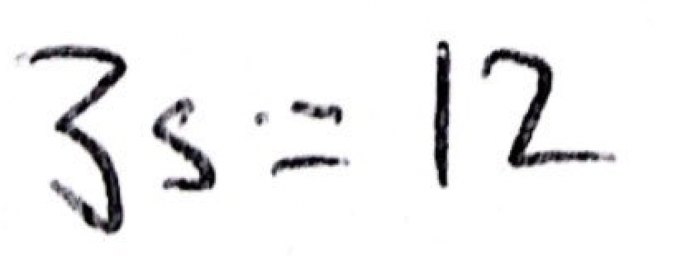
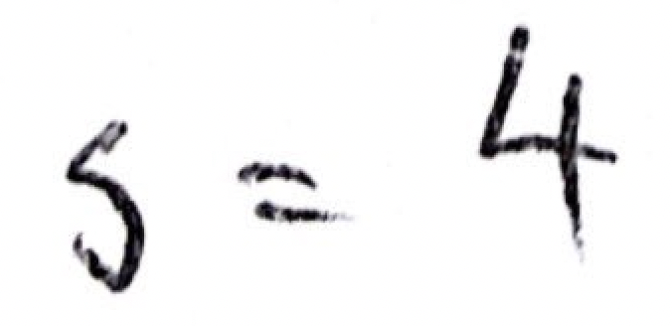
Finding s
DISCUSS
Row F:
It costs £12 to send the small parcels
3s = 12
Tia writes:
How does Tia find s?
There are 4 small parcels to be sent
Notes:
Remind students that to find the cost of sending the parcels we need to know the values of s and l (the number of small and large parcels being sent) as well as the cost for each size of parcel (r and t).
Ask students to consider the equation in Row F. Tell them that Tia uses this equation to find s.
Allow students some time to think about how to find s. You may want to ask them to write the value of s on their mini whiteboards. Then go through how Tia used the equation 3s = 12 to determine that s = 4. Explore different ways of thinking about solving the equation to find s.

Slide 18
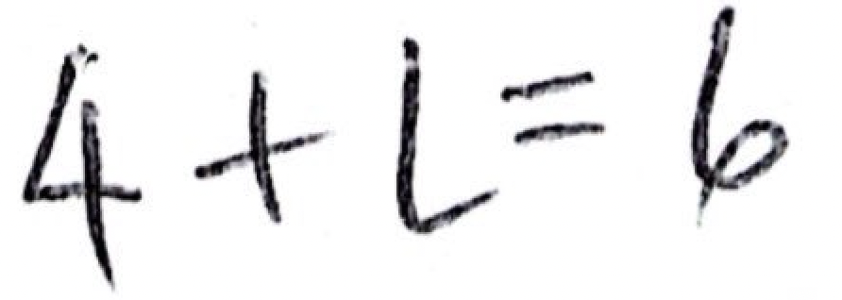

Finding l
DISCUSS
Row A:
There are 6 parcels altogether
s + l = 6
Tia writes:
How does Tia find l?
There are 2 large parcels to be sent
Notes:
Ask students to consider the equation in Row A. Tell them that Tia uses this equation to find l. Allow students some time to think about how to find l. You may want to ask them to write the value of l on their mini whiteboards. Then go through how Tia used the equation 4 + l = 6 to determine that l = 2. Explore different ways of thinking about solving the equation to find l.
Ask students which other row of the table could be used to find l when s is known (row E or row C) and establish that rows C and E provide the same information presented in different ways.

Slide 19
Cost of sending small parcels
DISCUSS
s = the number of small parcels
l = the number of large parcels
r = the cost of sending a small parcel
t = the cost of sending a large parcel
s = 4, l = 2, r = 3, t = 9
Cost of sending small parcels = sr = 4 × £3 = £12
Notes:
Once all four values have been identified, ask students to explain how they used the values to determine the cost of sending the small parcels (£12). Check that students recognise the need to multiply the number of small parcels to be sent (4) by the cost of sending a small parcel (£3).

Slide 20
Cost of sending large parcels
DISCUSS
s = the number of small parcels
l = the number of large parcels
r = the cost of sending a small parcel
t = the cost of sending a large parcel
s = 4, l = 2, r = 3, t = 9
Cost of sending large parcels = lt = 2 × £9 = £18
Total cost of sending parcels = sr + lt = £30
Notes:
Confirm that the cost of sending the large parcels is £18. Check whether students wrote an expression for the total cost. If they did not, ask them to write an expression for the total cost of sending the parcels on their mini whiteboards.

Slide 21
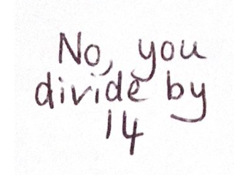
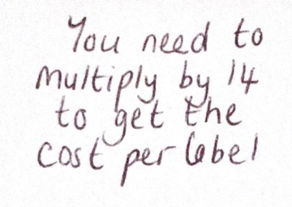
Who is correct?
DISCUSS
Address labels come in sheets of 14 labels
Vinay
Sade
e = the cost of a sheet of address labels
f = the cost per label
Write an equation for the cost per label
Notes:
Bring students’ thinking together by showing them a different scenario to emphasise the importance of understanding mathematical relationships.
Tell students that address labels come in sheets of 14 labels. Tia knows the cost of a sheet of address labels and wants to know how to work out the cost per label. Vinay tells her that she needs to multiply to get the cost per label, whereas Sade tells her to divide.
Ask students for a quick show of hands as to who they think is correct. Ask students to then write an equation on their mini whiteboards for the cost per label (f) given the cost of a sheet of labels (e). If students start to write an equation beginning with ‘e =‘ rather than ‘f =‘, remind them that what Tia wants to know is the cost per label (f).
After a couple of minutes ask students to show you their mini whiteboards. It is likely that students will either write the equation f = 14e or f = $\frac{e}{14}$. If so, ask students to think about which equation makes sense if, for example, the cost of a sheet of address labels is £1.40. Will the cost per label be £1.40 multiplied by 14 or £1.40 divided by 14?
Establish that the cost per label is the cost of a sheet divided by 14, so Sade is correct and the equation needed is f = $\frac{e}{14}$.
Ask students to explain when you would need to multiply. Establish that if you knew the cost per label and wanted to work out the cost per sheet, then the cost per sheet is the cost per label multiplied by 14.

Slide 22
Expressing relationships
REVIEW
We can express a relationship in different ways
f = e
14
e = the cost of a sheet of address labels
f = the cost per label
e = 14f
Notes:
Emphasise that a mathematical relationship can be described in more than one way. If we want to know the cost per label (f) then we divide the cost of a sheet (e) by 14 (f = $\frac{e}{14}$).
We can also describe the relationship between the cost of a label and a sheet of labels in a different way, if we are interested in the cost of a sheet of address labels. Ask students for an equation to express the cost of a sheet of address labels (e) if the cost per label (f) is known and establish that e = 14f also describes the relationship.
Whichever equation we are interested in, establish that in this relationship the cost per label is always the cost of a sheet divided by 14 and the cost of a sheet is the cost per label multiplied by 14.

Slide 23
Why are they all wrong?
DISCUSS
Sade:
Total cost of envelopes ordered is h + k
Cardboard mailing envelopes
cost £h per pack
k = the number of packs ordered
Address labels cost £e per sheet
g = the number of sheets of labels ordered
Vinay:
Total number of envelope packs and label sheets ordered is h + g
Tia:
Total cost of all the envelopes and labels is gh + ke
Notes:
Close the discussion by telling students that Sade, Vinay and Tia have all made incorrect suggestions for expressions relating to this scenario involving envelopes and address labels.
Ask students to look at the three suggested expressions and to explain why each one is incorrect. You may like to ask students to write the correct expressions on their mini whiteboards:
Total cost of envelopes ordered is hk (or kh)
Total number of envelope packs and address label sheets ordered is k + g
Total cost of all the envelopes and labels is kh + ge

Slide 24
Practice question (1)
REVIEW
Handout
available
There are y boats on a lake.
There are 7 people in each boat.
Write an expression, in terms of y, for the total number of people in the boats.
7y (1)
Q7 from June 2019, 1MA1/2F
Notes:
Check whether students tried to introduce an additional variable to represent the total number of boats (question 1) or the total number of cups that Alison buys (question 2). Explain that this isn’t needed when writing an expression. Ask students whether they checked that their expressions worked by substituting some possible numbers in. If they did, ask them which numbers they chose and to explain how they used the result to determine whether or not their expressions were correct.

Slide 25
Practice question (2)
REVIEW
Handout
available
Cups are sold in packs and in boxes.
There are 12 cups in each pack.
There are 18 cups in each box.
Alison buys p packs of cups and b boxes of cups.
Write down an expression, in terms of p and b, for the total number of cups Alison buys.
12p + 18b (2)
Q2 from June 2017, 1MA1/3F

Slide 26
Lesson review:
Algebraic equations
Objectives
Make connections between real-life situations and algebraic equations
Solve equations and interpret the solutions
Use representations to provide insight into mathematical structure
Suggested further steps/areas to work on
Solve simultaneous equations

Slide 27
Lesson 8:
Credits
Photo acknowledgements
Shutterstock.com: Vectorfair.com
Text acknowledgements
Pearson Edexcel Level 1 / Level 2 GCSE (9-1) Mathematics Paper 2 (Calculator) Foundation Tier June 2019 1MA1/2F, Pearson Edexcel Level 1 / Level 2 GCSE (9-1) Mathematics Paper 3 (Calculator) Foundation Tier June 2017 1MA1/3F

