Slide 1
T Level Education and Early Years
Materials to support occupational specialism holistic delivery
OAP Cycle Review

Slide 2
01 – A recap of the observation, assessment and planning (OAP) cycle
OAP Cycle Review

Slide 3
Lesson objectives
By the end of today’s lesson, learners will be able to:
    describe the observation, assessment and planning (OAP) cycle
    explain the OAP cycle’s purpose in supporting young children’s learning, development and progress
    discuss and self-reflect on the skills required to apply the cycle in industry.
Education and Training Foundation

Slide 4
Starter quiz
Let us see what we can remember about the OAP cycle by playing a game of “sit down, stand up”. Stay sat down if the statement is true. Stand up if it is false.
The OAP cycle is a linear process.
The OAP cycle is a formative assessment process.
Part of the observation process is interpreting information and understanding meaning.
Part of the observation process is allowing practitioners to identify children’s likes and interests.
Planning can be done in the moment as well as in the short term, medium term and long term.
Snapshot is a method of observation.
Education and Training Foundation

Slide 5
Initial reflection
Rate yourself out of 10 on your knowledge of the OAP cycle, then rate yourself on using the OAP cycle in practice
10 points: I know how to use the OAP cycle – for example, for taking observations of children
5 points: I have a little experience with using the OAP cycle, but I am not confident
1 point: I know very little / have little confidence in using the OAP cycle – for example, for taking effective observations
Education and Training Foundation

Slide 6
The OAP cycle
3. Planning
What next?
1. Observation
Describe: look, listen and
note
The
child
2. Assessment
Analyse observations
and decide
Education and Training Foundation

Slide 7
The OAP cycle
Part A: Small group task (15 minutes)
In small groups, you will be given one aspect of the cycle. Work together to define your part of the cycle and create a mind map of the key information you can remember from Element 8 such as key terminology and the purpose of each aspect of the cycle.
Your posters will be put up around the room for your peers to make notes on, so make sure they are accessible for your peers to read.
Education and Training Foundation

Slide 8
The OAP cycle
Part B: Small group task (5 minutes)
Create a quiz consisting of three questions based on the information you have provided in your poster. Make sure you know the answers so that you can mark your peers’ ideas.
Part C: Poster workshop (15 minutes)
Put your posters up around the room. You will have five minutes to read and make notes on the information from each poster. Using your study skills, make the notes meaningful to you and legible for you to come back to during revision.
Education and Training Foundation

Slide 9
The OAP cycle
Part D: Quiz
  Observation quiz
  Assessment quiz
  Planning quiz
Count the total number of points you have received and calculate a percentage. How do we calculate a percentage?
Total points scored divided by the maximum points available × 100. For example, if you scored five out of nine, you would do: 5/9 × 100 = 55.555…
Extension: Can you round this to two decimal places?
Education and Training Foundation

Slide 10
The role of the EYP in the process of the OAP cycle
Reflections
Why do we use the OAP cycle as an approach to formative assessment in the early years?
Why is it important to have a process for the OAP cycle?
Can each element of the OAP cycle stand alone?
Should all the elements be used equally?
What might happen if one element is used more than the others?
Next
Why is the OAP cycle an important process in an early years setting?
Education and Training Foundation

Slide 11
The role of the EYP in the process of the OAP cycle
Research and reading task
It is your role as an early years practitioner (EYP) to observe, assess and monitor children’s learning and development.
Using the contents page of the Early Years Foundation Stage (EYFS) Framework (2023), find out your role regarding assessment and discuss with your partner how this underpins the OAP cycle. Please make sure to write your answer in your own words.
Statutory framework for the early years foundation stage for group and school providers (publishing.service.gov.uk) Accessed 1 December 2023.
Education and Training Foundation

Slide 12
How have we seen formative assessment like the OAP cycle used in industry?
In pairs, provide a specific example of where you have seen an element of the OAP cycle being applied in practice, or where you have observed the OAP process.
How was it applied?
What went well?
What could have been improved?
What skills were required?
Education and Training Foundation

Slide 13
What holistic skills are required for the process of the OAP cycle? Consider maths, English and digital skills
Planning
Knowledge of the child’s needs and interests
Knowledge of developmental milestones (for example, Birth to 5 Matters, 2023)
Mathematical thinking
Digital skills
Literacy skills
Creativity
Time management
Observation
Objectivity
Discretion
Concise writing
Listening
Professionalism
Neat writing
Digital skills
Listening and recording
Assessment
Analytical thinking
Literacy skills, like reading and comprehension of Birth to 5 Matters (2023)
Recording of information
Communication skills
Education and Training Foundation

Slide 14
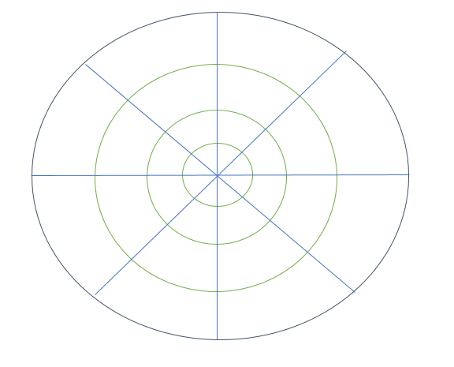
Creating a skills wheel
Draw a circle that has eight sections. Divide each section into four, as in the example below. The inner part of the circle for each section represents 1, and the outer part represents 4.
Label each section with a skill. Mark yourself out of four for each skill by colouring in the appropriate number of segments. This will give you a visual representation of your strengths and the skills you will need to develop to support your application of the OAP cycle process, which we will work on in these sessions.
Education and Training Foundation

Slide 15
Where are we now? How have we improved?
Rate yourself out of 10 on your knowledge of the OAP cycle, then rate yourself on using the OAP cycle in practice
10 points: I know how to use the OAP cycle – for example, for taking observations of children
5 points: I have a little experience with using the OAP cycle, but I am not confident
1 point: I know very little / have little confidence in using the OAP cycle – for example, for taking effective observations
Next steps
Identify whether your knowledge has improved. Write down one thing you have learnt. How has your knowledge improved?
Education and Training Foundation

Slide 16
Takeaway task: Reflection and conclusion
Write a summary of the OAP cycle and how it is used in industry. Then write a paragraph on the skills required to complete the process of the OAP cycle.
Extension: As part of your skills required paragraph, you could outline what you are confident in with regards to the OAP cycle and where you want to improve.
Education and Training Foundation

Slide 17
02 – Observation types – methods and purpose
OAP Cycle Review

Slide 18
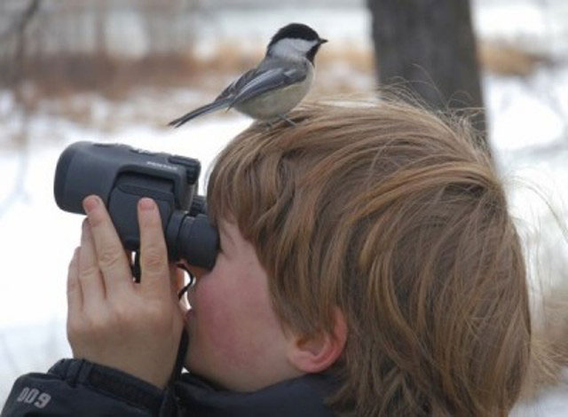
Session objectives
Identify different types of observation methods that are used in education and early years.
Explain the purpose of three different observation methods, and discuss why and when you might use a type of observation.
Evaluate different observation methods from the perspective of the practitioner assessing a child’s learning and development.
This Photo by Unknown author is licensed under CC BY-SA.
Education and Training Foundation

Slide 19
Recap
Paired discussion:
10 minutes
Review:
5 minutes
Share your summary of the OAP cycle and how it is used in industry (take away task) with your partner. What are the similarities and differences in your summaries?
List three reasons why we use the OAP cycle to support children’s learning and development
Reflecting on your skills wheel, what observational skill would you most like to develop and why?
This Photo by Unknown author is licensed under CC BY-SA.
Education and Training Foundation

Slide 20
Initial reflection
Rate yourself out of 10 on your knowledge on types of observation.
10 points: I know a variety of observation methods
1 point: I know very little about observation methods
5 points: I have some knowledge on observation methods
Education and Training Foundation

Slide 21

What are the different methods of observing children?
You will be given two minutes. Can you list the various methods we use to observe children? Remember to consider the different ways you see practitioners observe in your setting. You do not need to use the correct terminology at this stage.
Extension (2 minutes):
Can you identify the purpose of each observation method?
This image is sourced from stock images in PowerPoint online.
Education and Training Foundation

Slide 22
Types of observation
Sociograms
Child tracker
Narrative observation
Snapshot observation
Film clips
Event sample
How many of these observation methods have we seen or used before?
Extension: Why do you think some observation methods are used more than others?
Learning stories / journals
Checklist observation
Education and Training Foundation

Slide 23

Small-group activity: Let us match our observation methods with definitions
Task:
In small groups, you will be given different types of observation and different definitions. You will need to pair them together correctly.
This Photo by Unknown author is licensed under CC BY-SA.
Extension:
Reflect and discuss:
Can you think of examples of why you might use these observation methods? For example, if you want to understand a child’s social interactions and relationships, what method might you use?
Can you refer to your list of observations and do they fall into any of these observation types?
Education and Training Foundation

Slide 24
Group-activity answers:
Type of observation | Definition | When would you use this observation method?
Narrative | This is when you observe a child for a continuous period and write down what you see happening without making any judgement. It is objective. | Gain detailed information about a child.
Snapshot | This a written note, and you write 1-2 sentences about something that a child has done. | When you have observed a significant moment.
Sociogram | This type of observation is usually recorded in a grid system and used to record a child’s friendships by recording who they are playing with and whether it is reciprocal. | To observe a child’s friendships
Event sample | This type of observation is recording specific behaviours or events. It includes recording when the event occurred and the context of the event. | This might be used when there are concerns around a child’s behaviour to assess whether there are any patterns to the behaviour.
Education and Training Foundation

Slide 25
Group-activity answers:
Type of observation | Definition | When would you use this observation method?
Tracker | This type of observation is used to see which activities a child chooses and how long for. | To see how long a child can concentrate on an activity for and which activities the child is interested in.
Film clips | This type of observation is where you film a child taking part in activities. | This can focus on multiple areas of development and does not rely on the practitioner recording the information in written form.
Checklist | This type of observation can also be called tick charts and will contain a list of specific milestones that are related to age. The practitioner will tick if they see the milestone demonstrated. | To see whether a child is making progress in their expected development.
Learning stories/journals | This type of observation is used to record moments in a child’s learning that can be collated together as a scrapbook. They can include images and film clips and be from the perspective of the child. | It could be used as an ongoing observation and assessment method to show a child’s progress in a story/journal form.
Education and Training Foundation

Slide 26

Different examples of observation
You will be given various examples of observations. You will need to read through them and decipher what type of observation it is. Can you write a sentence explaining why you decided it is a certain type of observation?
s Photo by Unknown author is licensed under CC BY-SA.
This Photo by Unknown author is licensed under CC BY-SA.
Education and Training Foundation

Slide 27
What are the strengths and limitations of each observation method?
Poster/Presentation task:
You will be given an observation method. You will need to research the observation method and provide an explanation of it, give examples of when it might be used and consider the strengths and limitations of it from the perspective of the practitioner and the child’s development.
Make sure to reference where you got your information from.
Be prepared to share with the rest of the class.
Can we link this to wider topics such as General Data Protection Regulation (GDPR) Data Protection Act 2018 (legislation.gov.uk) accessed 14/02/23?
Education and Training Foundation

Slide 28
Example:
What are the strengths and limitations of each observation method? Can we link this to wider topics such as GDPR?
Film clips
Strengths:
The clips can be replayed and shared with family members to give more insight into the child’s progress. They can be more accurate than written records as they capture the whole picture.
Limitations:
You must be careful not to include other children unless consent is given by the children’s parents. You must ensure you store the video under GDPR.
Education and Training Foundation

Slide 29
Let us peer review each other’s posters.
What can we learn about the strengths and limitations of each observation method?
Is there an observation method you would like to try?
You will spend three to five minutes reading each poster. You will then need to write down some notes on the strengths and limitations of each observation method.
Education and Training Foundation

Slide 30

Plenary
Let us recap and review
Please stand in a circle. You will have one ball to throw to each other. The first person with the ball will identify an observation method. They will then throw the ball to someone else, who will need to define that observation method. The next person the ball is thrown to will need to explain when you might use that observation. The next person will need to identify a strength of the observation method. The following person will do a limitation. We will then go through this process again. This is to support your thinking on the feet, recalling topics covered today.
Type of observation
Define the observation method
Limitation of observation method.
Purpose of observation
This Photo by Unknown author is licensed under CC BY-NC.
Strength of the observation method.
Education and Training Foundation

Slide 31
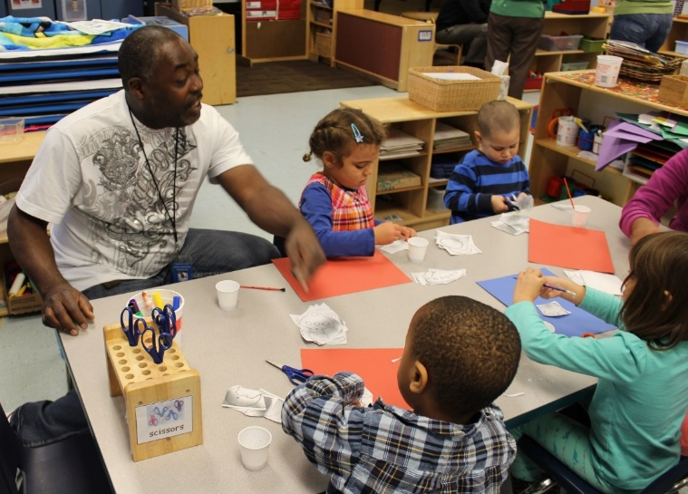
Next steps (Takeaway task)
In placement this week, observe a practitioner completing an observation or look at observation records.
This Photo by Unknown author is licensed under CC BY-NC.
Education and Training Foundation

Slide 32
03 – Observation practice (Practical workshop)
OAP Cycle Review

Slide 33
Lesson objectives
By the end of today’s session, learners will be able to:
discuss information required for completing observations
complete three different observations using three different methods
evaluate the strengths and areas for improvement for their own observation skills.
Education and Training Foundation

Slide 34
Let us recap
Questions to ask from takeaway task:
How do they use observations?
What observation methods have you seen?
What do you know about their purpose and layout?
Can you list the different observation methods?
Education and Training Foundation

Slide 35

What information do we need when recording an observation?
Name of the child
Date and time of the observation
End time of the observation
Age
Who recorded the observation?
This Photo by Unknown author is licensed under CC BY-NC-ND.
Education and Training Foundation

Slide 36
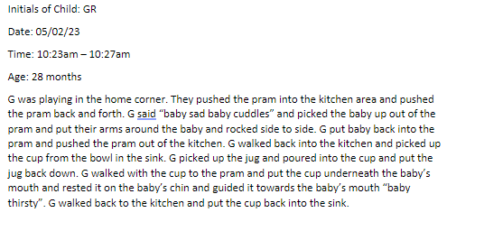
Narrative observation
It is a running record of what is happening and can be written as a story. Keep sentences short.
Remember it is a narration of what is happening.
Make sure to put anything someone says in quotation marks.
At the start of the recording, set the context of what the child is doing and who they are doing it with.
You might use abbreviations like A for adult or C for child.
Be objective. What does this mean?
Example
Education and Training Foundation

Slide 37
What does objective mean?
Not influenced by your own opinion or feelings
Record what you see happening rather than any interpretation
Avoid using adjectives or stating why a child is doing something or reason for doing something
Write down your initial ideas of what it means to be objective, and we will share our ideas.
Education and Training Foundation

Slide 38

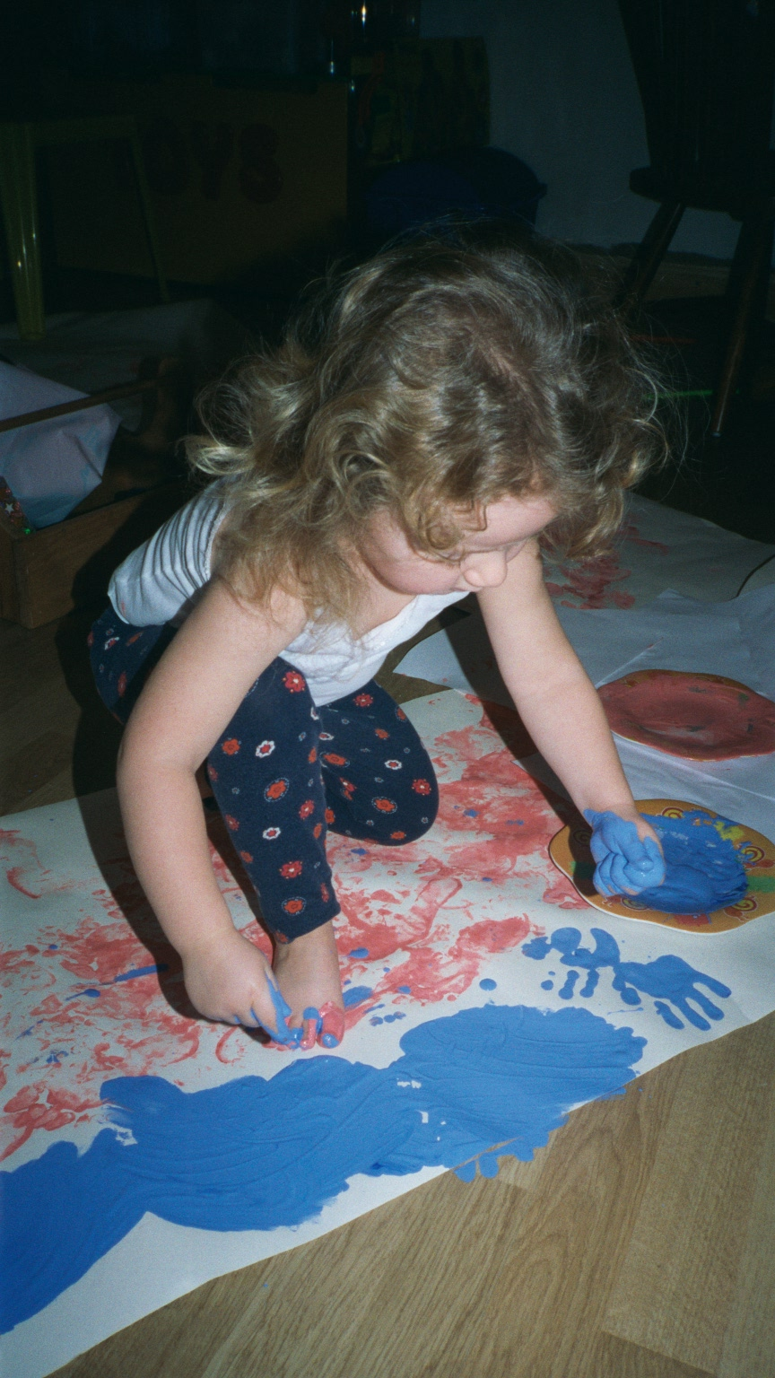
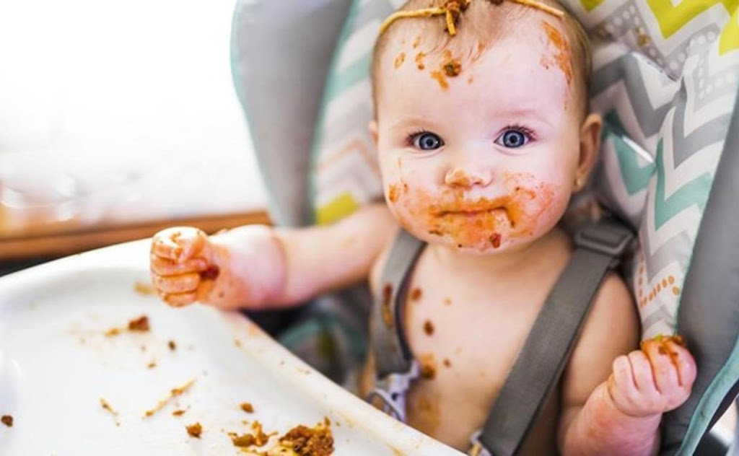
Scenario
Why are we being objective in a narrative observation?
Look at the below images. How do you interpret these? Write down one thing that you see.
Share this with your partner.
This Photo by Unknown author is licensed under CC BY-SA-NC.
This Photo by Unknown author is licensed under CC BY.
This Photo by Unknown author is licensed under CC BY-NC-ND.
Education and Training Foundation

Slide 39
Objective or subjective?
Extension: When you identify it to be subjective or objective, can you identify why?
Child A is at the sand tray holding the spade in her right hand and putting sand into the yellow tray. Child A turns her face and calls Child B’s name three times.
Child A is enjoying playing at the sand tray playing with her friends and trying to make Child B play at the sand tray by calling their name repeatedly.
Education and Training Foundation

Slide 40
Practical observation workshop
You will complete three different observation methods on George.
George is two years and seven months old. Can you identify what range he would be in Birth to Five Matters?
Education and Training Foundation

Slide 41
Narrative Observation:
https://youtu.be/_gKgGIYgEpY

Slide 42
Evaluation of observation
Reflection: How did it go?
What went well when completing the observation? What did you feel confident in?
What did you find difficult?
What are your next steps to help you improve?
Education and Training Foundation

Slide 43
Observation 1: Checklist observation
What skills and knowledge will we need to create a checklist observation?
You need to create a list of statements that are age-related milestones.
You then observe the child to see whether they demonstrate the milestones to see if they are making expected progress.
You will need to have knowledge of the expected milestones to create this, and it might be focused on one specific area of learning in the EYFS.
Education and Training Foundation

Slide 44
Task:
Personal, social and emotional
Physical development
Communication and language
Literacy
Mathematics
Understanding the world
Expressive arts and design
On your hand, can you show me how many of the areas of learning in the EYFS you remember?
What are they?
You will be given an area of learning, and you will need to create a checklist observation for George based on his age and the area of learning.
Education and Training Foundation

Slide 45
Checklist Observation:
https://youtube.com/shorts/L3_fH3gndas?feature=share

Slide 46
Evaluation of observation
Reflection: How did it go?
What went well when completing the observation? What did you feel confident in?
What did you find difficult?
What are your next steps to help you improve?
Education and Training Foundation

Slide 47

Observation 3: Snapshot observation
Write a line or two about a skill you see the child doing that is significant for their development. This might be linked to their developmental milestones
Record the name of the child and the time of the note.
s Photo by Unknown author is licensed under CC BY-SA.
Education and Training Foundation

Slide 48
Snapshot Observation
https://youtube.com/shorts/fypI_a_UIOg?feature=share

Slide 49
Evaluation of observation
Reflection: How did it go?
What went well when completing the observation? What did you feel confident in?
What did you find difficult?
What are your next steps to help you improve?
Education and Training Foundation

Slide 50
Summary of learning
Let us recap and review.
What are our next steps?
Write a short paragraph summarising what you have learnt and areas for improvement in your observation skills. What skills do you need to improve and how will you improve them?
Takeaway task: You will complete at least one observation in your placement. Make sure to bring in as we will use this to practice the OAP cycle.
Education and Training Foundation

Slide 51
04 – Making sense of observation records
OAP Cycle Review

Slide 52
Hangman
_ _ _ _ _ _ _ _ _ _
Education and Training Foundation

Slide 53
Lesson objectives
Identify the purpose of assessment.
Differentiate between summative and formative assessment.
Explain how the OAP cycle forms part of the ‘assessment for learning’.
Identify five key points from your observation on the child's learning and development.
Education and Training Foundation

Slide 54
Glossary of terms
Formative assessment
Write your own definition
Summative
assessment
Write your own definition
What can we remember about assessment?
What do we already know?
Can you come up with a mnemonic to remember the difference between them?
Education and Training Foundation

Slide 55
Assessment of learning (Summative assessment)
It evaluates children's learning and it usually marked against some standard or benchmark. Therefore, it is a summary of learning.
It sums up what a child has achieved at a particular point in time, which is related to learning aims or the curricula. It might be used for tracking progress and cohort data.
There may be an assessment at the end of a topic, at the end of a term or half-term, at the end of a year or, as in the case of the national curriculum tests, at the end of a key stage.
Education and Training Foundation

Slide 56
Assessment for learning (Formative assessment)
Formative assessment takes place on a day-to-day basis during the learning.
It is continuous process, and it is a way of monitoring and evaluating children’s knowledge and understanding as they learn
It can support practitioners to modify their teaching practice where necessary if the children are finding the tasks too easy or difficult. Practitioners can also adapt their practice or use the assessment to plan for next steps to guide and support their learning.
Education and Training Foundation

Slide 57
Tasks:
For two minutes, list as many examples as you can think of, of formative assessment
For two minutes, list as many examples as you can think of, of formative assessment
Is the OAP process an example of formative or summative assessment? Why?
Education and Training Foundation

Slide 58
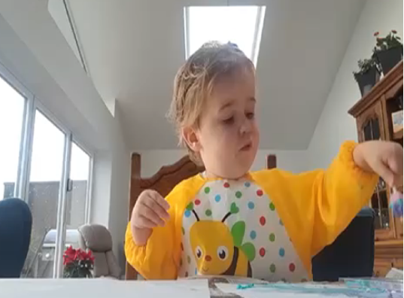
Observation (Formative assessment)
Observation is formative assessment as it informs you about the child’s learning and development during the learning process, and it is continuous. You can use your observations to assess, adapt and plan next steps for the child.
Education and Training Foundation

Slide 59
What does your observation tell you?
Task:
Read your observations.
In section A of your OAP workbook, can you list three to five things your observation tells you about the child’s learning and development? For example, does it tell you what the child can do? What skills are the child showing in your observation? Any needs? Any interests? Any patterns? How do you know this? Does it link to an area of learning in the EYFS?
Education and Training Foundation

Slide 60
05 – Using the Birth to Five Matters Framework
OAP Cycle Review

Slide 61
Lesson objectives
Recall three things you have learnt about your child or George from your observation record.
Identify the correct range in the Birth to Five Matters for your observation child.
Create a mind map outlining expected milestones for your observation child.
Education and Training Foundation

Slide 62

Initial thoughts...
What do we already know about Birth to Five Matters?
You will have five minutes to write down what you know about the early years curriculum and the Birth to Five Matters. What are they, and how do they inform our practice?
Education and Training Foundation

Slide 63
Early Years Foundation Stage (EYFS, 2023)
Four principles | Areas of learning
Enabling environment A unique child Positive relationships Learning and development | Prime: Personal, social and emotional Physical development Communication and language Specific: Literacy Mathematics Understanding the world Expressive arts and design
Education and Training Foundation

Slide 64
Using Birth to Five Matters (2021)
What is it?
The Birth to Five Matters guidance is a resource developed by the Early Years Coalition that helps practitioners to develop an understanding of how children typically develop and learn from birth up to the end of the reception year (aged anywhere up to 71 months). It aims to provide examples of how practitioners and the setting’s environment can support and enhance children's development and learning. The guidance is aimed at preparing children and supporting them in their progress towards all of the statutory EYFS early learning goals.
Education and Training Foundation

Slide 65
Initial reflection
Rate yourself out of 10 on your skills to be able to make sense of an observation with regard to their developmental milestones using Birth to Five Matters
10 points: I feel confident to be able to do this and have done this in my placement
5 points: I have a little experience with using Birth to Five Matters to make sense of an observation record
1 point: I know very little / have little confidence in making sense of an observation record using Birth to Five Matters
Education and Training Foundation

Slide 66
Using Birth to Five Matters (2021) task:
Task:
Using the contents page, read the section on observation, assessment and planning.
Then, find the section on how to use the Birth to Five Matters to support development and learning. You will need to find the age ranges key and convert the Birth to Five Matters ranges into years and months. Identify the range your observation child is in.
Note: Make a note of the ranges somewhere in your notebook you can easily access, e.g. in your glossary.
Education and Training Foundation

Slide 67
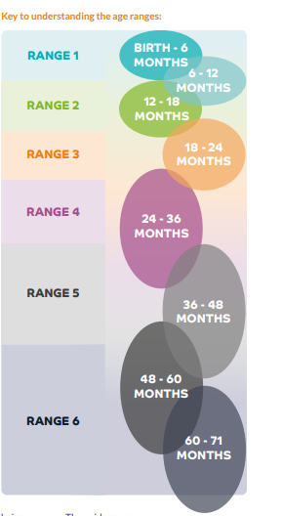
Converting age ranges to years and months
Range | Conversion of the ranges
Range 1 | Birth to 6 months 6 months to 1 year
Range 2 | 1–1½ years
Range 3 | 1½-2 years
Range 4 | 2-3 years
Range 5 | 3-4 years
Range 6 | 4-5 years
 | 5-5 years and 11 months
Reflection... what mathematical skills are we using to understand and convert the age ranges?
Birth to Five Matters (2021) p 51
Education and Training Foundation

Slide 68
Milestones for your child
Physical development – what are the key milestones for a child in this age range?
Task:
In section B of your OAP workbook, create a mind map of the milestones your observation child should be meeting for the various areas of learning. You will need to summarise and write the milestones in your own words.
George
Two years and seven months (Range 4)
Education and Training Foundation

Slide 69
Plenary
In pairs, you will be expected to share three things you have learnt about expected milestones for your observation child's age range. Share with the person next to you.
Home study:
Make sure to bring in your observation and notes as well as your mind map on expected milestones for your child to our next session.
Education and Training Foundation

Slide 70
06 – Analysis of observation record
OAP Cycle Review

Slide 71
Lesson objectives
Identify the milestones your child is meeting and explain how they have met this by referring to your observation.
Identify the milestones the child has not met and explain how by referring to the observation.
Evaluate how effective your observation was regarding understanding the child's learning and development.
Education and Training Foundation

Slide 72
Retrieval quiz
Peer assessment
You will now need to use your skills from last week of using Birth to Five Matters to mark a peer’s quiz. Check their knowledge. Give them a score out of eight. Note what the learner has done well and if there is anything they need to work on regarding their knowledge of Birth to Five Matters.
Write down three things about Birth to Five Matters (3 marks)
What is it and why is it a useful document for a practitioner? (2 marks)
What range would a child that is two years and eleven months be in? (1 mark)
What age range would an 11-month-old child be in? (1 mark)
What age range would a child in reception be in? (1 mark)
Education and Training Foundation

Slide 73
Retrieval quiz (Answers)
Write down three things about Birth to Five Matters (3 marks) This could include the areas of learning, what the characteristics of effective learning are and the role of the practitioner. Do you have other ideas?
What is it and why is it a useful document for a practitioner? (2 marks)This could include how the practitioner can understand how to support the child based on their developmental stages and what they can do to for next steps. Do you have other ideas?
What range would a child that is two years and 11 months be in? (1 mark) Range 4
What age range would a 11-month-old child be in? (1 mark) Between Range 1 and Range 2
What age range would a child in reception be in? (1 mark) Range 6
Education and Training Foundation

Slide 74
Analysis of observation (30 minutes)
Read your mind map on expected milestones for your age range.
Read your observation(s).
Can you identify any milestones the child is meeting? What areas of learning does your observation show?
How do they show you they are meeting them?
Are there any milestones your child is expected to meet but, in the observation, you can see the child is not meeting or they have not mastered the skill yet. How do you know this?
From your observation, what does your child need to work on? What area of learning will you focus on? What are their next steps?
Note: Remember, you are not assessing all developmental milestones in all areas of learning. Allow your observation to lead your judgements. Observations are just a small snippet of a child’s holistic development.
Education and Training Foundation

Slide 75
Reflection:
Have we developed in confidence? What continuous professional development (CPD) can you do on placement to
continue to grow in confidence?
Rate yourself out of 10 on your skills to be able to make sense of an observation with regard to their developmental milestones using Birth to Five Matters
10 points: I feel confident to be able to do this and have done this in my placement
5 points: I have a little experience with using Birth to Five Matters to make sense of an observation record
1 point: I know very little / have little confidence in making sense of an observation record using Birth to Five Matters
Education and Training Foundation

Slide 76
Takeaway Task:
Make sure to bring in your observations and OAP workbooks with Section A, B and C completed for 07 lesson
Education and Training Foundation

Slide 77
07 – Peer assessment and feedback on observation and assessment
OAP Cycle Review

Slide 78
Lesson objectives
Discuss the benefits of peer assessment and factors to consider when giving feedback.
Read through a peer’s OAP workbook and peer assess their observation and assessing skills.
Give peer feedback.
Education and Training Foundation

Slide 79
Retrieval: Sentence starter
Ten-minute writing task:
In fewer than 100 but more than 60 words, write a paragraph explaining how can we use Birth to Five Matters to make sense of an observation and plan for next steps of a child's development. What do we need to consider when using developmental milestones?
We can use Birth to Five Matters to make sense of what milestones the child is meeting for their age range and area of learning. We can also use it to see milestones the child might need extra support on and how we can support them. Remember every child is unique and will develop at different rates. We need to sequence and scaffold children’s development and plan for their next steps rather than expected age milestones.
Education and Training Foundation

Slide 80
Peer assessment task
In pairs, you will share your OAP workbook and read over your partner’s interpretations and next steps for the child’s learning and development.
Why do we peer assess? Is this a type of summative or formative assessment? Benefits of peer assessment and feedback
What do we need to remember when giving feedback?
Education and Training Foundation

Slide 81
What do we need to consider when giving feedback?
Is feedback just about saying “well done”? What learning can be gained from this?
Saying “well done” does not always help children to know what they need to do to improve. We need to encourage children to reflect on their feedback and identify what they do well while supporting them in making progress in their learning.
Education and Training Foundation

Slide 82
What do we need to consider when giving feedback?
Timely: It works better when it is soon after the completed learning/activity because the child or young person is likely to retain the information and be motivated to embed the feedback.
Action orientated: It is supportive when there are goals for children or the young person to work towards, as it helps them plan next steps for their long-term development.
Clear and detailed: It helps if the child or young person knows what they have done well and what they need to do to improve.
Supportive: To make sure that a child or young person is motivated by the feedback, they need to feel supported and know the areas for improvement are achievable.
Education and Training Foundation

Slide 83
Peer assessment
You will be given a peer’s OAP workbook to complete peer feedback.
Read their observation. What do they do well in the observation? What could they improve? How could they improve this? Consider CPD.
Read their interpretations of their observation regarding Birth to Five Matters. Is there interpretations relevant to the observation? Are they age appropriate? Do you agree on the next steps based on the Birth to Five Matters analysis?
What has the learner done well? Can you provide any notes on steps for improvement? Could you think of any other ideas for the child’s next steps?
Education and Training Foundation

Slide 84
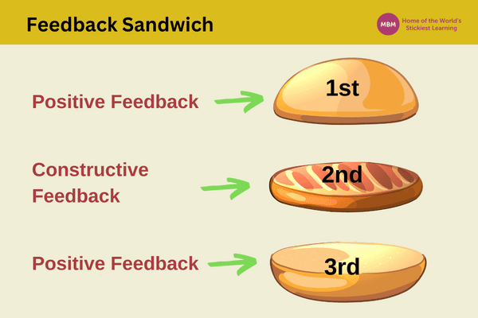
Peer feedback
Using the feedback section in the OAP workbook, make sure to provide supportive feedback for your peer that they can act on and feel supported by. Consider the feedback sandwich.
Feedback Sandwich for Effective Communication | MBM (makingbusinessmatter.co.uk)
Education and Training Foundation

Slide 85
Summary of observation and assessment
Task: Complete section E of your OAP workbook. ​
What has gone well as part of the observation and assessment cycle so far? ​
Using your own reflections and peer assessment feedback, what are your strengths in observing children and making sense of your observations as part of the assessment process using Birth to Five Matters? ​
What areas do you need to improve on? ​
How are you going to do this?
Education and Training Foundation

Slide 86
Takeaway task
When you are next at your placement, speak to your mentor and team to find out how they use planning to support children’s learning and development.
What planning approaches do they use?
Be prepared to share in lesson 8.
Education and Training Foundation

Slide 87
08 – Different types of planning
OAP Cycle Review

Slide 88

Application of knowledge
Do you think understanding milestones is important? If yes, go to the right side of the room. If no, go to the left side of the room.
Now you have two sides of a debate, in your groups, discuss why you believe it. What are the advantages? Consider the OAP cycle. How does it help to inform your planning and next steps for a child. What are the limitations?
Education and Training Foundation
This image is sourced from stock images in PowerPoint online.

Slide 89
Lesson objectives
Identify the next steps for your observation child using your observation and assessment interpretations.
Explain different approaches to planning.
Outline the planning approach you will be using when planning an activity for your observation child.
Education and Training Foundation

Slide 90
Let us review observation and assessment so far… What comes next?
Areas to focus on for child’s development based on observation and expected milestones
Child’s strengths and milestones met for their age range
Child’s next steps
Education and Training Foundation

Slide 91
Different approaches to planning
Can you list different approaches to planning?
Plan, do review cycle
Short-term planning
Medium-term planning
Long-term planning
In-the-moment planning
In your groups, you will be given an approach to planning. You will need to create a poster to summarise the planning approach and why this type of planning is important.
Education and Training Foundation

Slide 92
Different approaches to planning
Short term | Medium term
These are detailed activity plans that will include objectives and timings for the day or week. You might include information about how to meet individual needs for specific children in the group. | These are often done on a term basis as well as weekly. They will have finer details of specific activities and include notes on for amendments or formative assessment methods. You might discuss medium-term plans in team meetings, and some professionals will be responsible for short-term planning of different topics/themes in the medium term.
Education and Training Foundation

Slide 93
Different approaches to planning
Long term | In the moment
These are often planned yearly and can often be reused with few adaptations. They are stored on a computer. They are planned to ensure the curriculum is met and a variety of activities and assessment methods are used. You might create topics/themes for each term. This is in place to ensure the equipment required is available, as sometimes it is shared with other teams. | Guided by children’s interests and learning. For example, a child might show an interest in a specific topic, and you might respond to this by building their learning around their interest. It is important to let children lead their own learning.
Education and Training Foundation

Slide 94
Summary of learning
Application of knowledge:
How do the different approaches to planning support each other?
Plenary:
What approach to planning will you be using if you plan an activity for your observation child?
Short-term planning
Home study:
Ask your placement to view some of their approaches to planning. How do they feed into each other? How do they plan?
Education and Training Foundation

Slide 95
09 – What makes a good plan?
OAP Cycle Review

Slide 96
Lesson objectives
Outline 10 factors that make a good activity plan
Discuss how your observation and assessment of your child can be used to support your planning process.
Education and Training Foundation

Slide 97
Recap and review
Home study task:
Ask your placement to view some of their approaches to planning. How do they feed into each other? How do they plan?
Paired discussion:
What planning methods have you used in your placement to support children’s learning and development? Give examples such as using themes/topics.
How do the different approaches interconnect?
What planning methods have been successful?
Education and Training Foundation

Slide 98
Todays focus: Short-term planning
Ten minutes (five minutes each)
In pairs, discuss when you have been impressed by a short-term activity.
What was the activity?
Why did you like it?
Was it successful? How did you measure the success?
Could you run the activity yourself?
What learning have you taken from seeing this activity?
Education and Training Foundation

Slide 99
Today's focus: Short-term planning
What makes a good activity plan? What do you need to include?
Identify 10 factors that contribute to an effective activity plan.
Education and Training Foundation

Slide 100
What makes a good activity plan?
Inclusive
Engaging
Purposeful
Age/stage appropriate
Structured (clear objectives)
Supportive
Differentiated
Education and Training Foundation

Slide 101
Today’s focus: Short-term planning
Reading task: Engage Education (2020) Engage Education (2020) A Beginner’s Guide To Lesson Planning - Engage Education (engage-education.com) accessed 27/03/24
Let us see if your ideas are considered in this reading.
Extension:
What else could you add to your 10 factors?
Education and Training Foundation

Slide 102
Short-term planning
What makes a good activity plan?
How will you use your observation assessments to inform the planning process, and why is this important? ​
Refer to your observations. What can you include? Make a list of ideas.
Education and Training Foundation

Slide 103
Home study
Using your observation and assessments of your observation child, research activities that you could do to support the child’s development and ignite their interests.
Education and Training Foundation

Slide 104
10 – Activity planning from the observation and assessment
OAP Cycle Review

Slide 105
Lesson objectives
Plan an activity for your observation child that focuses on next steps from your observation and assessment.
Include children’s interests in the activity plan.
Education and Training Foundation

Slide 106
Retrieval
Spend two minutes writing down as many factors as you can think of that contribute to writing a good activity plan.
Review home study (Paired discussion)
How can you use your observation and assessment to plan for next steps and embed in your planning, for example, the child's interests and child’s strengths/areas to work on?
Education and Training Foundation

Slide 107
Writing the activity plan
You will need to use your observation and assessment to plan an activity for your child that is appropriate for your setting. For example, consider the environment and availability of resources. This can be a 1:1 activity or a small-group activity.
You will then present your activity to a small group, explaining your activity and how you have used observation and assessment to inform your activity planning.
You will all have an opportunity to share your activities and give feedback to your peers on their activities.
Let us look at an activity plan template.
Education and Training Foundation

Slide 108
Peer feedback and discussion
You will now be put into groups of three or four people. You will take it in turns to explain what your activity is and why you have chosen to do this activity, linking to your observation and assessment. When you are listening to your peers’ presentations, make sure to really listen and give supportive feedback outlining what you like about their activity and any areas they could consider to improve their activity.
Extension: How could you use the feedback to improve your activity plan?
Education and Training Foundation

Slide 109
Takeaway task:
Takeaway task:
You will now need to lead your activity for achild or small group of children in your setting by lesson 12. Make sure when you complete it to make notes of any observations from the activity. That might include notes on the child’s/children’s engagement/learning/development. You can do this during or after the activity. Make a note on how the activity went. Make sure to bring your notes in for lesson 12.
Education and Training Foundation

Slide 110
11 – Reflection. What is it? Why is it important?
Models of reflection
OAP Cycle Review

Slide 111
Lesson objectives
Define reflective practice.
Discuss the process of reflection and its importance.
Summarise one reflective model.
Education and Training Foundation

Slide 112
Retrieval:
Reflection
What is it? Define it in 15 words.
Should we reflect during the OAP cycle and why?
Before we start the OAP process again, we need to reflect on what has worked well and why. We also need to understand our own behaviours, consider what did not work well for the practitioner and the child, and assess ways to improve. We will break this into two sections: reflect on the activity plan from the teacher’s perspective; reflect on the observation of the child’s learning and development. There might be some overlap.
Education and Training Foundation

Slide 113
Starter discussion:
What is the process of reflection? Can you put these in order and discuss/debate why you chose that order.
Analyse
Evaluate
What feelings did you have?
Describe what happened
Conclusion
Action plan
Education and Training Foundation
Gibbs (1998)

Slide 114
Gibbs’ (1998) reflective cycle
Describe what happened
Action plan
What feelings did you have?
Conclusion
Evaluate
Analyse
Education and Training Foundation
Gibbs (1998)

Slide 115
Reflective models:
Task:
You will be put into groups and given a handout to read on a reflective model. Read the handout, create a poster summarising the model and give examples of how you can apply this reflective model.
Extension: What are the strengths and limitations of the model?
Schön (1991)
Brookfield (1995)
Kolb (1984)
Gibbs (1998)
Education and Training Foundation

Slide 116

Reflective models posters
This image is sourced from stock images in PowerPoint online.
Put your posters around the room. You will spend time going around the room reading the posters and identifying what models of reflection you like and why.
Education and Training Foundation

Slide 117
Why is reflection important?
Summarise in fewer than 100 words why reflection is important and the benefits of using reflection when applying the OAP cycle.
Education and Training Foundation

Slide 118
Takeaway task
Reflect on an experience in your setting. Write about it using one of the models of reflection.
Bring your notes to lesson 12.
Education and Training Foundation

Slide 119
12 – Application of reflective model on planned activity
OAP Cycle Review

Slide 120
Lesson objectives
Use a model of reflection to reflect on an experience in your setting.
Provide peer feedback on a piece of reflective writing.
Evaluate how effective your reflection was.
Education and Training Foundation

Slide 121
Retrieval:
In pairs, you will share the reflective writing you completed as home study. Once you have read your peer’s reflective writing, you will need to identify what model it is and explain how you know this?
Extra support: If unsure, look at your notes from last session.
This image is sourced from stock images in PowerPoint online.
Education and Training Foundation

Slide 122
Activity reflection
Task 1a: Small-group discussion: Reflection on action
How did your activity go?
Were the children engaged and did it support their learning and development?
What went well?
What could be improved? Why?
Task 1b:
Now, use a model of reflection to complete a written reflection. For example, you can use Gibbs or Brookfield’s lenses.
Education and Training Foundation

Slide 123
Task 2: Peer feedback
In pairs, swap your written reflections. Using your feedback sheet in the OAP workbook, section G, make sure to provide supportive feedback for your peer so that they can act from and feel supported by. Consider the feedback sandwich.
Feedback Sandwich for Effective Communication | MBM (makingbusinessmatter.co.uk)
Education and Training Foundation

Slide 124
Task 3:
Once you have received peer feedback on your writing, evaluate your own reflective writing skills, outlining your strengths and areas for improvement. Use your peer feedback as a prompt.
Useful joining words to use in evaluating:
However
On the other hand
To conclude
Overall
Education and Training Foundation

Slide 125
13 – What would you do next? Consider the continuum of the OAP cycle
OAP Cycle Review

Slide 126
Retrieval quiz
In small groups:
recall two models of reflection
identify three benefits of reflective practice
explain three different ways you can reflect in education.
Education and Training Foundation

Slide 127
Lesson objectives
Review the OAP cycle process and consider how you can apply what you have learnt to the next cycle.
Gather your notes from the informal observation during the activity you led and consider how they can be used to support the child’s next steps.
Identify three things you could include in continuous provision to meet your child’s individual needs.
Education and Training Foundation

Slide 128
The OAP cycle
What next?
How do we use what we have learnt in our first OAP cycle to inform the next cycle?
3. Planning
What next?
1. Observation
Describe: look, listen and
note
The
child
2. Assessment
Analyse observations
and decide
Education and Training Foundation

Slide 129

Can you unscramble the letters to make two words?
I | T | S | O | U | N | U | O | C | N
R | S | I | V | P | O | O | I | N
This image is sourced from stock images in PowerPoint online.
Education and Training Foundation

Slide 130
Continuous provision
Continuous provision provides children the resources to learn independently. It should promote children’s learning and development without direction from an adult. There should be resources and learning areas in the setting that are designed to meet the individual needs of the child and support all seven areas of learning in the EYFS.
Education and Training Foundation

Slide 131
Reading task
What is continuous provision? What Is Early Years Continuous Provision? - Early Years Careers
A guide to creating continuous provision – A Guide To Creating Continuous Provision - Early Years Careers
Education and Training Foundation

Slide 132


Informal observation notes from the activity plan
What observation notes have you made during the activity?
What main points have you identified from the activity plan/observation?
What are the child’s next steps? What would you do next for the child?
Are there any other activities that could support the child’s development?
Identify three ways you can provide continuous provision to support the child’s learning and development?
Education and Training Foundation
These mages is sourced from stock images in PowerPoint online.

Slide 133
14 – Consider how your observation of your activity can be used to plan for larger groups
OAP Cycle Review

Slide 134
Lesson objectives
Summarise the next steps for your child based on your formal observation, assessment, observations and reflections from your activity plan.
Create a tree of interest and development for a small group of children.
Education and Training Foundation

Slide 135
Summary of your OAP and next steps
What age range is your child?
Based on the formal observation and notes from your informal observations during the activity, what are the child’s next steps in their learning and development?
Based on your reflection of the activity, are there any reflections you need to consider when planning next steps? For example, a child’s interest or focus? Or what they engaged with or what they did not engage with?
Recall three ways you can embed these next steps into continuous provision.
Education and Training Foundation
These images are sourced from stock images in PowerPoint online.

Slide 136
Planning for small groups and large groups
Reading task:
Identify three key points you can take from the reading that can support your planning for larger groups. What do you need to consider?
EYFS planning – How to do early years planning effectively | Enabling Environments | Teach Early Years
Education and Training Foundation

Slide 137
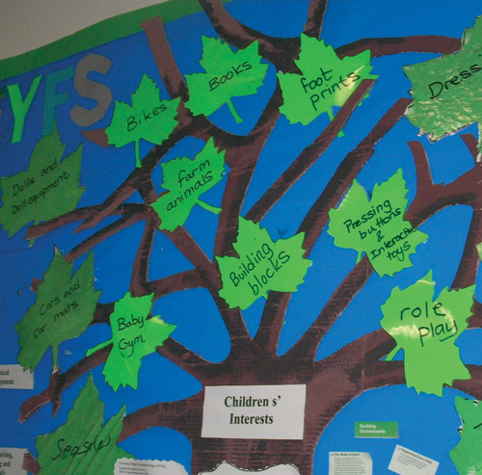
Planning for small groups
You will be put into small groups. The peers in your group will have completed observations on children that are similar ages. You need to work together to create a children’s interest and development tree. This should be based on what the children’s next steps are for areas of learning in the EYFS. You will need to have a combination of areas for all the children in your group. We will plan from this in session 15.
EYFS planning – How to do early years planning effectively | Enabling Environments | Teach Early Years
Education and Training Foundation

Slide 138
Plenary
Explain in 15 words why working together to create the tree of interests and developmental areas might be a good place to start for planning for small groups?
Education and Training Foundation

Slide 139
15 – Plan for a small group
OAP Cycle Review

Slide 140
Lesson objectives
Plan an activity or experience for the children you have observed in your small groups to meet their individual needs and interests.
Provide a rationale for your chosen activity/experience and explain how it supports all the children in your group.
Education and Training Foundation

Slide 141
Retrieval
Refer to your tree of children’s interests and developmental areas.
Are there any themes/overlap?
Can you create an area of continuous provision, child-led or adult-led activity that can support the children in your group’s learning and development?
EYFS planning – How to do early years planning effectively | Enabling Environments | Teach Early Years
Education and Training Foundation

Slide 142
Planning for a small cohort
Continuous provision | Child-led activity | Adult-led activity
Create an area in the room that you could set up that would support the children in your group’s learning and development. | Create an activity/play experience that you could set up that would support the children in your group’s learning and development. | Plan an activity to support all the children in your group’s learning and development.
Education and Training Foundation

Slide 143
Planning for a small cohort
You will need to plan an activity/design your provision area. You will then present to the group a summary of each child’s next steps and interests, along with a rationale for your chosen provision/activity/experience. This rationale will explain your choice and how you anticipate it supporting the children’s learning and development.
Continuous provision | Child-led activity | Adult-led activity
Education and Training Foundation

Slide 144
16 – Plan for a whole cohort
OAP Cycle Review

Slide 145
Lesson objectives
Create an educational space for a large cohort using the child’s interests, developmental stages, next steps.
Summarise what they have learnt from applying the OAP cycle in practice.
Education and Training Foundation

Slide 146
Planning for a larger cohort
You will now be put into a larger group. You need to review your trees of development and interests. How can you meet the needs of all the children in your group?
Task:
You will now design an educational space for the children in your large cohort. Highlight the areas in the room where various activities will take place. Make a note of why you have chosen this approach and how it supports the children in your group’s learning and development. How does it support their individual needs, interests and areas of learning in the EYFS? You will need to present one area to the rest of the group and share why you have included this based on the children’s development, interests and EYFS.
Education and Training Foundation

Slide 147
Summary of learning
What have you enjoyed about the OAP process?
What have you found challenging?
List three things you now confident in.
List three things you feel you need support in.
Are there any CPD activities you can complete to continue your development in observation, assessment and planning?
How are you going to do this? Can you create action by speaking to your tutor or placement?
Education and Training Foundation

Slide 148

PRODUCED BY
FUNDED BY
South Gloucestershire and Stroud College has produced this resource on behalf of the Education and Training Foundation
This programme is funded by the Department for Education
ET-FOUNDATION.CO.UK

