Slide 1
APPRENTICESHIP WORKFORCE DEVELOPMENT
CPD to Support Academic Colleagues with Apprenticeship Requirements
SESSION 2 - Knowledge, Skills and Behaviours
By University of Portsmouth

Slide 2
Delivery guidance
Three sessions have been created grouping together three key themes to underpin degree apprenticeship delivery.
Introduction to apprenticeships
Knowledge, Skills and behaviours
End Point assessment
Colleagues are welcome to attend any session but it is strongly advised that Session 1 is attended first as an introduction, after which the remaining sessions can be completed in any order.
The slide package has been designed as a base for providers to adapt to their own institution and apprentice population. We recognise the slides may be text heavy, but again this is to allow full dissemination of the content from our aligned CPD Site. This will allow provider colleagues to create their own online CPD or develop alternative face to face delivery. Text will be written in blue where it prompts for personalised content to be added.

Slide 3
Welcome
All colleagues (number dependent) introduce themselves and their involvement, interest and understanding level of apprenticeships.
Colleagues should also share their expectation of the session.
How can I support apprentices
What are the rules and regs?
Practical takeaways
How apprentices may differ from standard students
Introduction session - we do recommended you have attended or completed the introduction session

Slide 4
Knowledge, Skills and Behaviours. KSBs
An apprenticeship standard sets out the knowledge, skills and behaviours (KSBs) required of apprentices. They also show what an apprentice will be doing in their day-to-day job role.
This session includes
- Breaking down KSBs into learning outcomes - What
- Including them in delivery - How
- Why is this important - Why

Slide 5
Introduction to Knowledge, Skills and Behaviours
Apprenticeship standards are designed by Trailblazer Groups (employers/industry regulators) and are designed to deliver full competence in specific job roles.
Links to all current degree apprenticeship programmes can be found by directly accessing the Institute for Apprenticeships and Technical Education (IfATE) You can access the requirements of the apprenticeship standards. The End Point Assessment plans are also located here.
You can find out more on Ifate here https://www.instituteforapprenticeships.org/apprenticeship-standards/
We provide links to all the standards on our internal moodle support site. These can be built into the slide and the presentation shared at the end with attendees allowing for direct links to the standard but also an overview of other standards delivered across the institution to encourage cross collaboration.

Slide 6
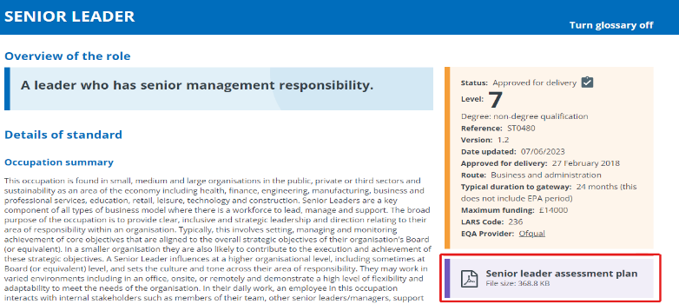
Understanding the standard
How to find the assessment plan. What information can be found on IFATE and how to navigate to the assessment plan.

Slide 7
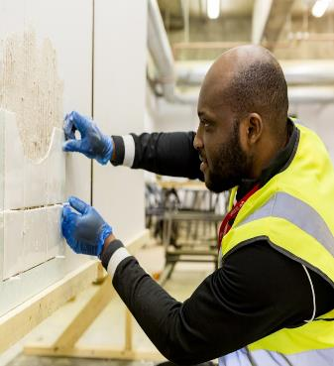
What does each criteria look like?
Can you provide any examples from standards you work on?
What does a knowledge criteria look like?
What does a skill criteria look like?
What does a behaviour criteria look like?

Slide 8
What does each criteria look like?
What does a knowledge criteria look like?
‘Understand financial strategies, including budgets’
Apprentices are expected to know about these subjects, and where they have come from.
What does a skill criteria look like?
‘Manage budgets’
Apprentices are expected to be able to demonstrate they are able to do this task
What does a behaviour criteria look like?
‘Sets an example, and is ethical, fair, consistent and impartial’
Apprentices are expected to be able to behave professionally and in line with their organisation's values and ethics. This could be demonstrated or explained throughout their programme.
You could amend this example to a particular standard relevant to your audience.

Slide 9

Learning Outcomes - What
Identify module’s KSBs
Develop the learning objectives for your module
  Break these KSBs down into more detail
  Think: What are we really supposed to be doing?
  Review the complete list of KSBs from the standard
  Note the KSBs that are addressed in your module
  How does this guide your module?
  What should your module be achieving?
Expand your KSBs

Slide 10
Putting KSBs into Learning Outcomes
KSB Detail
Expansion
Learning Objective
  Understand different forms of communication (written, verbal, non-verbal, digital) and how to apply them.
  Awareness of the interpersonal skills of effective listening, influencing techniques, negotiating and persuasion
  Understand different forms of communication: written, verbal, non-verbal and digital
  Understand how to apply written forms of communication
  Understand how to apply verbal forms of communication
  Be aware of the interpersonal skills of effective listening, influencing, negotiating and persuasion
  To show an understanding of the different forms of communication.
  To demonstrate an understanding of how to apply different forms of communication
  To demonstrate an awareness of how to use influencing techniques to lead people and develop collaborative relationships

Slide 11
Don’t forget the skills and behaviours
We tend to focus on the delivery of knowledge within our teaching, but we need to ensure all 3 elements are incorporated into our curriculum and delivery.
?
How might we do this?
Share your best practice and suggestions

Slide 12
Putting this into delivery - How
Be fully aware of the skills and behaviours required for the standard and ensure you clearly reference these within your sessions.
What situations might an apprentice demonstrate the required skills and behaviours in the workplace? Ask the apprentices to share their ideas in discussions or break out groups to support peer-to-peer learning and add work based context.
Encourage apprentices to save evidence of any examples they share that demonstrate the required skills and behaviours within their workplace. This will support their portfolio/competency logs.
Use a variety of activities to encourage group work and shared projects to enhance professional behaviours whilst learning.
Consider if assessments will help to generate evidence of skills and behaviours as well as knowledge. It’s also good to consider if the mode of assessment is best suited to the apprenticeship and if the content is contextualised to the workplace to support better relevance and learning transfer.
The KSBs to be covered in each session should be added to the first slide of each taught session to highlight this. It is also helpful to reference how this session/module builds on KSBs learnt in previous learning and will support future modules/EPA
This helps apprentices to accurately record what they are learning in their off the job record or when selecting evidence for their end point assessment. They can look back at slides on Moodle or their notes and clearly identify how what they have learnt relates to the KSBs
We have included a podcast recording from one of our senior teaching fellows describing how they introduce the relevant KSBs at the start of each session. You can incorporate other colleagues sharing examples of good practice.

Slide 13
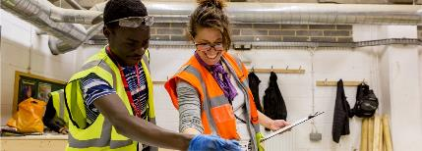
And the why?
Why do we need our curriculum and learning to be based on the KSBs?
Why is this important?
Having learning objectives directly linked to the KSBs of the apprenticeship standard, apprentices will be able to:
Fully understand the requirements of their apprenticeship and how this relates to their job role.
Fully understand how their learning is preparing them for end point assessment.
Be able to link their off the job training and professional development to their job roles.
Be able to incorporate their learning into the workplace, providing evidence of competence for their portfolios and/or competency logs.
Be able to reflect on their learning outcomes as stepping stones to becoming a professional in their industry.
Be able to identify gaps in their knowledge and competence, allowing them to set appropriate goals to enhance their practice.
Be able to be assessed throughout their apprenticeship
in line with the expectations of the standard and ensure
they are occupationally competent on successful
completion.

Slide 14
Final thoughts
Some IfATE links include typical job roles. This may be useful to review when you are delivering a standard that contains a more diverse range of roles and can support with ensuring teaching materials are relevant to the cohort.
Getting information on where your apprentices work and their past experience can also help this to ensure you are contextualising the learning – for example making sure you have a range of suitable case studies/examples integrated into teaching.
Remember the KSBs are what you are teaching to when delivering on an apprenticeship.
We signpost our internal teaching and learning site as well as the programme to support module redesign. You may wish to include this here.

Slide 15


Case studies
Reflect on the two experience of the apprentices shown.
What corrective actions could be taken?
We have shared two inhouse examples created. You could create your own or discuss scenarios that have occurred.

Slide 16
Knowledge check
1. Which of the following best defines the purpose of KSBs?
KSBs are part of the EPA
KSBs are a set of criteria linked to specific industries that demonstrate competency in the job role.
KSBs are linked to job role.
2. Learning outcomes should come from the KSBs? Yes/No
Ask the group to share examples of knowledge, skills and behaviours from standards relevant to them? Support navigating to IfATE if needed.
3. The theory delivered in modules is important and supports the knowledge aspect of the KSBs. However, the EPA is all about ensuring an apprentice is competent in their work role and can apply this knowledge. How could skills and behaviours be incorporated within module delivery?

Slide 17
Knowledge check - answers
Which of the following best defines the purpose of KSBs?
KSBs are part of the EPA
KSBs are a set of criteria linked to specific industries that demonstrate competency in the job role.
KSBs are linked to job role.
2. Learning outcomes should come from the KSBs? Yes/No
Ask the group to share examples of knowledge, skills and behaviours from standards relevant to them? Support navigating to IfATE in needed.
3. The theory delivered in modules is important and supports the knowledge aspect of the KSBs. However, the EPA is all about ensuring an apprentice is competent in their work role and can apply this knowledge. How could skills and behaviours be incorporated within module delivery?
Examples include
Provide activities for apprentices to practice skills and behaviours, for example deliver presentations, completion of shared projects.
Give apprentices time to make links from theory to practice and identify potential work based evidence relevant to the topic.
A good awareness of which Skills and Behaviours related to the module and refer to these during delivery.
Create assessments that relate to the workplace.
Facilitate discussions for apprentices to share good practice and experiences from their workplace.

Slide 18
Who can support
List the the contacts and departments it may be necessary to liaise with in your organisation. You may also wish to discuss when you may need to contact each of the different contact types
Course leaders
Course administrators
Quality manager
Head of school
Work based tutor
Degree apprenticeship team
Attend session 1 and 3 if you haven't already done so
?

Slide 19
CPD for you - Further Support
Engage in continuous professional development to stay up-to-date with the latest industry practices, teaching methodologies, and assessment techniques. Actively seek opportunities for training, networking, and collaboration to enhance your own expertise and contribute to the continuous improvement of the degree apprenticeship program. You can take advantage of our UVAC membership as UVAC regularly delivers apprenticeship CPD.
Colleagues can access UVAC. You will need to register under your institution, and this will allow access to all the member content. You can do this here - https://uvac.ac.uk/registration/ and just select your institution from the dropdown menu.
Once your membership is approved, you can access previously recorded webinars, resources and guides and can register for upcoming live webinars and sessions.
You can also access The AWD training and resources via the UVAC site, or you can go direct to ETF to book. There are 8 open access online courses available delivered via the FutureLearn Platform.
You can also access our own learning and teaching gateway here to browse a range of CPD options.
You can remind colleagues that the Powerpoint will be shared or provide a link at the end to all the resources. You may wish to ask if colleagues have undertaken any other training.

Slide 20
AWD Project: CPD to Support Academic Colleagues with Apprenticeship Requirements
Session 2 – Knowledge, Skills and Behaviours

