Slide 1
Education for sustainable development: ESOL resources
Local issues – a five session course for entry level ESOL learners
Introduction and teacher’s notes

Slide 2
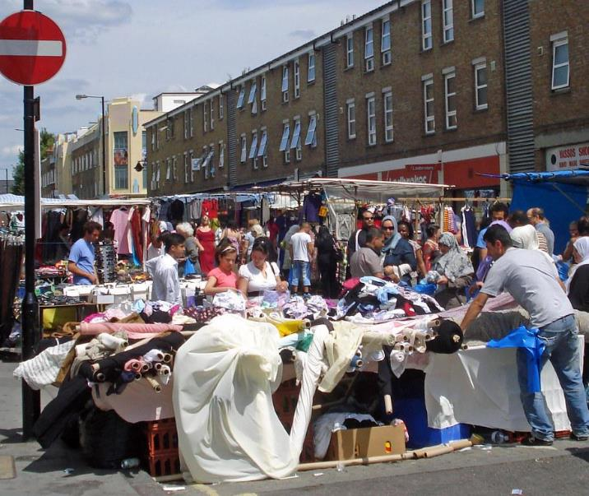
Why local issues?
Increased community-based engagement is seen as critical to build climate action and achieve the Sustainable Development Goals.
UN High-Level Political Forum on Sustainable Development, 19 July 2019
Education & Training Foundation
Notes:
"Church Street Market" by diamond geezer is licensed under CC BY-NC-ND 2.0

Slide 3
Introduction
Learners are more likely to engage in sustainability if topics are framed in a local context rather than attempting at the outset to use generic materials related to issues such as the Amazonian rain forest. In particular, by focusing on local issues such as air pollution, litter, crime, housing, etc., all of which link with inequality, the aim is to provide learners with the means to achieve social justice by engaging in community representation.
To that end these resources provide a readily adaptable template for all levels and all regions of the UK using these themes. The aim is to provide learners with the vocabulary and language structures to enable them to take action to address their concerns by using their local authority residents’ website. Many current resources (and exam boards) are still reliant on the traditional letter of complaint. By encouraging learners to engage in social justice through twenty-first century means, the hope is that it will provide them with the confidence to do so on an ongoing basis thereby fostering community cohesion.
Education & Training Foundation

Slide 4
Sustainable development – local Issues
How to use this resource
This is a five-session resource, aimed at entry level ESOL learners. Over the five sessions, learners will:
talk about their local area
discuss issues and problems
write about concerns and issues
look at local information on council websites
practise writing online messages to report problems
present their priorities for their local area
explore sustainable development through the lens of local issues
Education & Training Foundation

Slide 5
How it works
Each session is designed to last approximately 2 hours. There is a Powerpoint file for each session which can be edited and adapted for local use with images and relevant details (e.g. addresses in session 1, screenshots of local council websites in session 3, photos of local neighbourhood in session 5).
Education & Training Foundation

Slide 6
Sustainable development links
The focus of this resource is local community engagement. Examples of local issues used in the resources relate to the United Nations Sustainable Development Goals (see session 1 and 2).
Education & Training Foundation

Slide 7
Teacher’s notes
In each Powerpoint file, there are notes to accompany each slide. Select “view” – “notes page” to see notes alongside each slide.
Learners are encouraged to make their own notes and write their own examples during the sessions, with vocabulary and structure prompts provided as needed.
Education & Training Foundation

