Slide 1


Lesson 12:
Area and volume
Objectives
Understand how the area and volume of shapes are affected by scaling the sides
Understand and apply conservation of area and volume
Use relationships between similar figures to determine areas and volumes

Slide 2
What do these words mean?
Area
Volume
Similar
Surface Area
Explain the words to the person next to you,
or write their meanings in your notebook.
Notes:
Begin the lesson by spending a few minutes checking students’ understanding of the terms ‘area’, ‘surface area’, volume’ and ‘similar’.

Slide 3
Area
20 cm
10 cm
Write down everything you can about the surface area of this block.
18 cm
Notes:
Ask students to think about the 20 cm by 10 cm by 18 cm block in terms of area and write, on their mini whiteboards, everything that they know about the surface area for this block. Give students a couple of minutes to think individually and then share their thinking with a partner.
As students work, circulate and observe what they are writing on their whiteboards. If it is clear that many of them are struggling to get started, spend some time revising and reviewing areas of surfaces of 3-dimensional shapes. Students should be able to identify that the six faces of the block consist of three pairs of different-sized rectangles.

Slide 4
Areas
DISCUSS
Top/Base
Side
Side
Area = 200 cm²
10 cm
Area =
180 cm²
Area = 360 cm²
18 cm
18 cm
20 cm
20 cm
10 cm
Notes:
Ask a couple of students to share their thinking. You may want to call on students that you identified while they were working.
If students are able to work out the areas as 200 cm², 360 cm² and 180 cm², check whether they can explain why you multiply 20 cm by 10 cm, 20 cm by 18 cm and 10 cm by 18 cm. Use the animations on the slide to help to develop an understanding of why the sides are multiplied to give the area.

Slide 5
Soft play blocks
Block dimensions:
Minimum = 10 cm.
Maximum = 60 cm.
Notes:
Tell students that a manufacturer of soft play equipment makes blocks of different sizes. The smallest side a block can have is 10 cm and the biggest side is 60 cm.

Slide 6
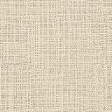
Non-slip fabric
Non-slip fabric goes on the base of each block.
Side
Side
Top
Side
Side
Non-slip fabric on base
Notes:
Explain to students that a piece of non-slip fabric with a logo on goes on the base of each block.

Slide 7
Smallest block
10 cm
10 cm by 10 cm by 18 cm
10 cm
10 cm
18 cm
10 cm
Base
Notes:
Introduce the smallest block that the manufacturer currently produces. The block measures 10 cm by 10 cm by 18 cm and requires a 10 cm by 10 cm piece of non slip-fabric for the base. Check that students recognise that the area of the fabric on the base is 100 cm².

Slide 8
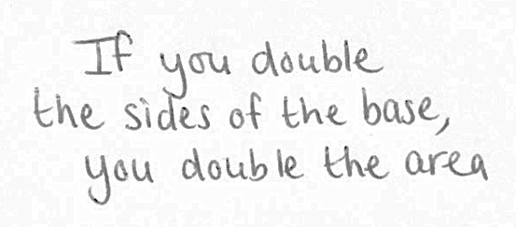
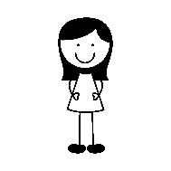
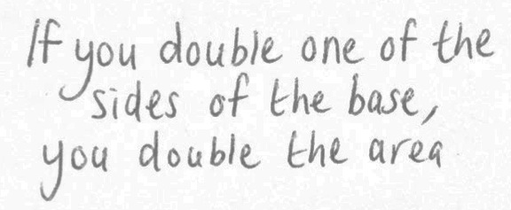
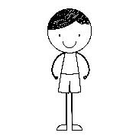
Base area
10 cm
10 cm
Charlie
Area = 100 cm²
Who is correct?
Dee
Notes:
Explain to students that two employees, Charlie and Dee, are discussing the area of non-slip fabric needed for different sized blocks and suggesting what will happen to the area when you double one or both of the sides. Ask students to discuss in pairs which employee, Charlie or Dee, is correct. Avoid telling students who is correct, as this will be discussed on the next slide.

Slide 9
Comparing areas
10 cm
20 cm
10 cm
Area = 100 cm²
Area = 400 cm²
20 cm
20 cm
10 cm
Area = 200 cm²
Notes:
After a couple of minutes, display the three base sizes in question. Ask for a show of hands from students who think that the 20 cm by 20 cm base has double the area of the 10 cm by 10 cm base, and then from those that think the 20 cm by 10 cm base has double the area. If there is disagreement, ask a couple of pairs of students with opposing views to explain their thinking. If there is agreement, ask a couple of different pairs of students to share their reasoning.
Once it has been established that the area of the 20 cm by 10 cm base is twice the area of the 10 cm by 10 cm base, establish how many times bigger the area of the 20 cm by 20 cm base is than the 10 cm by 10 cm base.

Slide 10
Comparing bases
10 cm
20 cm
10 cm
SIMILAR
20 cm
20 cm
10 cm
SIMILAR
Notes:
Develop the discussion further to look at the features of the three different sized bases.
Ask students what is the same and what is different about the three bases. Students may comment that two of the bases are squares and one is a rectangle. They may also recognise that the 20 cm by 20 cm base is mathematically similar to the 10 cm by 10 cm base, demonstrating that they understand that similar shapes are in proportion to each other.
Ask students what they notice about the logos on the three bases. Students may comment that the logo on the 20 cm by 10 cm base has been stretched and so is no longer in proportion, whereas the logo on the 20 cm by 20 cm base is still in proportion. Using the term ‘proportion’ in their description suggests that they have made the connection between similarity and proportionality.
Emphasising similarity will be important as the lesson goes forward.

Slide 11
Volume of smallest block
10 cm by 10 cm by 18 cm
10 cm
10 cm
Volume of top layer = 10 cm × 10 cm.
Height of block = 18 cm.
18 cm
Volume of block
= 10 cm × 10 cm × 18 cm
= 1800 cm³.
Notes:
Use the animation on this slide to check that students can explain why multiplying the three dimensions of the block together gives the volume.

Slide 12
Doubling one length
DISCUSS
10 cm
20 cm
10 cm
10 cm
Doubling one length
doubles the volume
18 cm
18 cm
What happens to the volume if you double one of the 10 cm sides?
Notes:
Display the 10 cm by 10 cm by 18 cm block and explain that the soft play equipment manufacturers are now considering a block that has one 10 cm length doubled to 20 cm while the other dimensions (10 cm and 18 cm) remain the same. Ask students to discuss in pairs what will happen to the volume of the block.
After a few minutes, ask a couple of different pairs to explain their thinking. Observe what they refer to when they explain the relationship between the two blocks and make sure to acknowledge and value their prior learning. Use the animation to show that two of the 10 cm by 10 cm by 18 cm blocks make up the 20 cm by 10 cm by 18 cm block, so the volume is two times bigger.

Slide 13
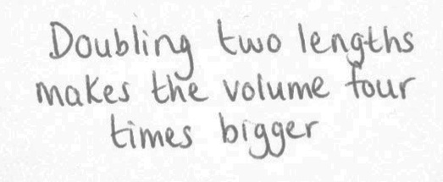

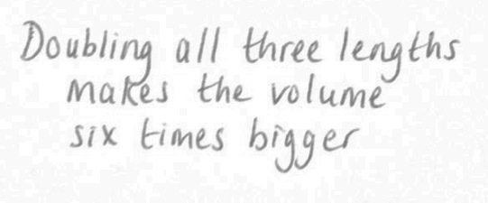
Doubling two / all lengths
YOUR TURN
10 cm
10 cm
Charlie
Volume
= 1800 cm³
18 cm
Dee
Are Charlie and Dee both correct?
Notes:
Remind students that the volume of the 10 cm by 10 cm by 18 cm block is 1800 cm³. Present the two statements and ask students to work in pairs to check whether Charlie and Dee are correct. Avoid telling students who is correct, as this will be discussed on the next slide.

Slide 14
Comparing volumes
REVIEW
20 cm
10 cm
20 cm
10 cm
20 cm
20 cm
18 cm
Doubling two
lengths makes
the volume
four times bigger
Doubling all
three lengths
makes
the volume
eight times bigger
SIMILAR
18 cm
36 cm
SIMILAR
Notes:
After a couple of minutes, display three blocks that fit Charlie’s and Dee’s criteria. (Another possible block that fits Charlie’s criteria would be a 20 cm by 10 cm by 36 cm block, whereas there is only one possible block for Dee’s criteria). Ask for a show of hands for whether Charlie is correct, whether Dee is correct, or whether both are correct. Discuss Dee’s misconception, emphasising that doubling all three lengths will make the volume 2 × 2 × 2 = 8 times bigger.

Slide 15

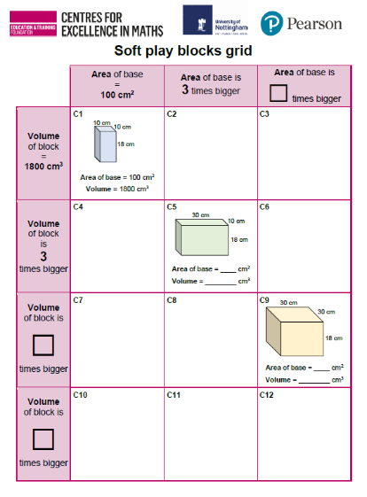
Working in pairs
YOUR TURN
Handout
available
Take turns to fill in the missing areas and volumes of C5 and C9.
Explain your reasoning to your partner.
Agree on the answer before writing it down.
Notes:
Distribute the ‘Soft play blocks grid’ handout and a calculator to each pair of students and explain that they are going to be working in pairs with a grid containing rows and columns. Tell students that the smallest block they have been discussing is in the top row; first column of the table (C1) because the area of the base is 100 cm² and the volume of the block is 1800 cm³. Ask students to work in pairs, taking turns, to calculate the area of the base and the volume of the two other blocks in the table (C5 and C9).

Slide 16
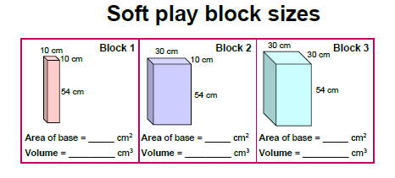
Placing the cards
YOUR TURN
YOUR TURN
Handout
available
Work in pairs.
Place the three blocks.
Make sure you can both explain the reasons for your choice.
Notes:
As students are working, distribute a copy of the ‘Soft play block sizes’ cards to each pair. Students will need a pair of scissors if the cards have not already been cut out.
Check that students have understood how the table works. For example, any block in the column ‘Area of base is 3 times bigger’ will have a base with an area that is three times the area of the base of the 10 cm by 10 cm by 18 cm (smallest) block (C1).
Explain to students that they need to decide where to place the three blocks. They should complete the area of the base and volume of the block on each card. Encourage students to explain their reasoning to each other.
Ask students to complete the numbers in the row and column headers as they work. It might be helpful to prompt students to compare C5 and C9 initially to help them recognise that the base of C9 has an area that is three times bigger than the area of the base of C5 (and so is nine times bigger than the 100 cm² base).

Slide 17
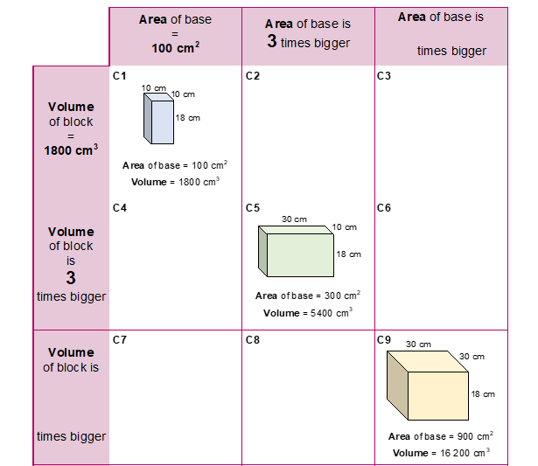
Completing C5 and C9
REVIEW
Are any blocks similar?
Are any bases similar?
What is the volume of a 10 cm by 10 cm by 54 cm block?
Notes:
First, check that students have correctly completed the missing base areas (C5 = 300 cm², C9 = 900 cm²) and block volumes (C5 = 5400 cm³, C9 = 16 200 cm³). Ask different pairs of students to talk about how they completed the missing information.
Use the three questions on the slide to prompt further discussion and explore the relationships between the blocks. None of the blocks are similar but the bases of C1 and C9 are similar.
Explore the conservation of volume by asking students to compare the volumes of a 10 cm by 10 cm by 54 cm block (C4) with C1, C5 and C9. For example, ask them to explain why the volume of a 10 cm by 10 cm by 54 cm block (C4) is the same as the 30 cm by 10 cm by 18 cm block (C5).

Slide 18
Placing Blocks 1, 2 and 3
REVIEW
Why are the volumes of C8 and C9 the same when the areas of the bases are different?
Notes:
Check that students have correctly positioned the three blocks (C4 – Block 1, C8 – Block 2 and C12 – Block 3). Ask different pairs of students to talk about the block positions and headers, and explain their thinking to the rest of the class. Some may have used C8 and C9 / C9 and C12 to help them in completing the missing values in the row and column headers. Some may have noticed that Block 1 (C4) is three times taller than C1, Block 2 (C8) is three times taller than C5 and Block 3 (C12) is three times taller than C9. Discuss what effect this has on the volume. The conservation of volume can be discussed further by comparing the dimensions of C8 and C9, both of which have a volume of 16 200 cm³.

Slide 19
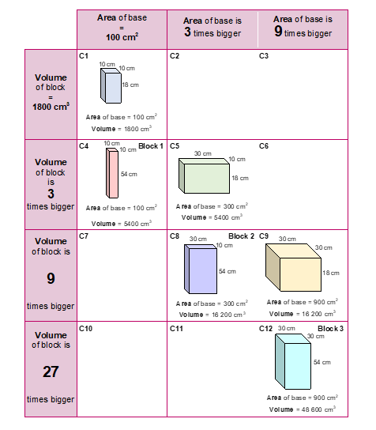
Adding more blocks
YOUR TURN
Handout
available
Choose two empty cells.
Work out how big the blocks in these cells are.
Draw the blocks and label the sides.
Notes:
Ask students to draw in two other blocks in any of the empty cells (C2, C3, C6, C7, C10 and C11) and work out their dimensions. You may want to choose two empty cells for students to work on rather than asking them to choose. It might also be helpful to work through the dimensions of a block together, as a class, before asking students to work in pairs on this.

Slide 20
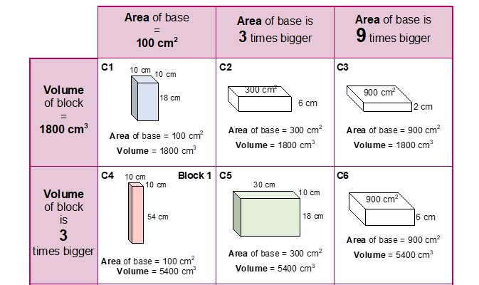
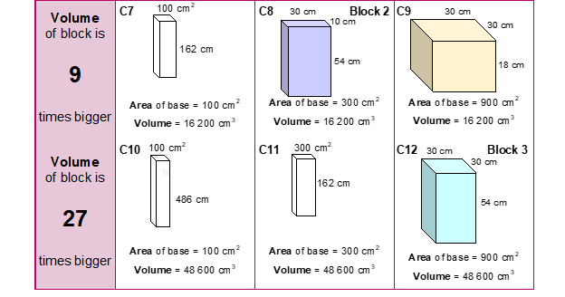
The completed grid
REVIEW
REVIEW
When the area of the base is three times bigger, what happens to the height?
Which blocks have similar bases?
Notes:
All of the cells in the table do not need to have been completed in order to review students’ work and draw together their collective thinking. Rather than revealing all the blocks and then discussing the questions posed on the slide, pose the questions at appropriate points in the discussion based on students’ responses.
Discuss the dimensions for possible blocks for a couple of the spaces, focusing on the relationships between the rows and columns. For example, C2 needs to have the same volume as the 10 cm by 10 cm by 18 cm block (1800 cm³) and a base with three times the area (300 cm²). This means that the height needs to be divided by 3, giving 6 cm. However, if we compare C11 with C7, the height remains the same, as the volume of C11 is three times the volume of the C7.
Help students to make some generalisations about what they notice. For example, in each row, the heights of the blocks in the second column are one-third of the height of the blocks in the first column. Similarly, the heights of the blocks in the third column are one-third of the height of the blocks in the second column (and a ninth of the height of the blocks in the first column).
Check whether students recognise that C1 and C12 are the only two blocks that are similar. However, the bases of the blocks in the first and last columns are similar (10 cm by 10 cm and 30 cm by 30 cm) as they are an enlargement scale factor 3.

Slide 21
Scaling one or both lengths
DISCUSS
Rectangle
If one length is multiplied by 3, the area is multiplied by 3.
If both lengths are multiplied by 3, the area is multiplied by 9.
One length is multiplied by 5.
What happens to the area?
Both lengths are multiplied by 5. What happens to the area?
Notes:
Using examples from the table, remind students that:
if one length of a rectangle is multiplied by 3, the area is multiplied by 3; the resulting shape is not similar, and
if two lengths of a rectangle are multiplied by 3, the area is multiplied by 9; the resulting shape is similar.
Ask students what would happen to the area if the lengths were multiplied by 5, rather than 3.

Slide 22

Scaling lengths: Effect on area
KEY IDEA
Rectangle
If one length is multiplied by k,
the area is multiplied by k.
If both lengths are multiplied by k,
the area is multiplied by k²
and the resulting shape is similar to the original.
Notes:
Ask students to describe what happens to the area when both lengths are multiplied by k. You may need to remind them about the cases explored:
when both lengths are multiplied by 2, the area is multiplied by 4 (slide 9),
when both lengths are multiplied by 3, the area is multiplied by 9 (slide 18),
when both lengths are multiplied by 5, the area is multiplied by 25 (slide 21).
Check that students recognise that 4, 9 and 25 are square numbers

Slide 23
Doubling lengths
REVIEW
10 cm
20 cm
20 cm
20 cm
10 cm
10 cm
20 cm
20 cm
Doubling one
length makes
the volume
two times bigger
Doubling two
lengths makes
the volume
four times bigger
18 cm
18 cm
SIMILAR
18 cm
Doubling all three lengths makes
the volume
eight times bigger
36 cm
SIMILAR
Notes:
Remind students about the relationship between the volumes of the blocks when one length, two lengths and all three lengths are doubled.

Slide 24
Scaling lengths: Effect on volume
KEY IDEA
Cuboid
If one length is multiplied by k, the volume is also multiplied by k.
If two lengths are multiplied by k, the volume is multiplied by k².
If all three lengths are multiplied by k, the volume is multiplied by k³
and the resulting shape is similar to the original.
Notes:
Establish the effect on the volume of a cuboid when one, two and all three lengths are multiplied by k.

Slide 25
2-dimensional similar shapes
These two shapes are similar.
If you know the area of one, you can work out the area of the other.
Area = ?
Area
= 43 cm²
5 cm
10 cm
Notes:
Ask students to work out the area of the regular pentagon with side 10 cm, using what they know about the area of the similar regular pentagon with side 5 cm. (Area = 43 × 2² = 43 × 4 = 172 cm²).

Slide 26
3-dimensional similar shapes
These two shapes are similar.
If you know the volume of one, you can work out the volume of the other.
15 cm
Volume
= ?
Volume
= 120 cm³
5 cm
30 cm
10 cm
6 cm
18 cm
Notes:
Ask students to work out the volume of the second triangular prism using what they know about the first one. (Volume = 120 × 3³ = 120 × 27 = 3240 cm³).

Slide 27


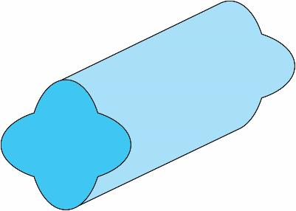

Working with similar shapes
Area
= 9 cm²
3.5 cm
Area
= ?
7 cm
3.5 cm
7 cm
Volume
= 108 cm³
2 cm
6 cm
Volume = ?
Notes:
Check that students recognise that the two leaves are similar and ask them to identify the scale factor of enlargement. Once it is established that the first leaf has been enlarged by a scale factor of 2, ask students to determine the area of the second leaf. (Area = 9 × 2² = 9 × 4 = 36 cm²).
Now use the volume example to highlight that you can look at the relationship in both directions, i.e. where the shape has been made smaller rather than bigger. Discuss different ways of working out the volume. For example, do students consider a scale factor of one third and multiply by 1/27, or do they prefer to think of it as dividing by 27 to get a volume of 4 cm³?

Slide 28
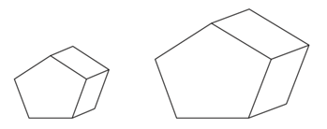
Practice question
REVIEW
Handout
available
The diagram shows two similar solids, A and B.
B
Diagram NOT accurately drawn
A
4 cm
8 cm
Solid A has a volume of 80 cm³.
(a) Work out the volume of solid B.
………………. (cm³) (2)
Solid B has a total surface area of 160 cm².
(b) Work out the total surface area of solid A.
………………. (cm²) (2)
Question 25 from Nov 2012, 1MA0/1H
640
40
Notes:
Check that students have correctly identified the length scale factor of 2. They should be able to use the volume scale factor (2³ = 8) to determine the volume of solid B.
When finding the surface area of solid A, they should recognise that the surface area is the sum of the areas of the sides and so the area scale factor (2² = 4) applies. They should realise that A is smaller than B and so they need to divide by 4 or multiply by $\frac{1}{4}.$

Slide 29
Lesson review:
Area and volume
Objectives
Understand how the area and volume of shapes are affected by scaling the sides
Understand and apply conservation of area and volume
Use relationships between similar figures to determine areas and volumes
Suggested further steps/areas to work on
Construct similar figures

Slide 30
Lesson 12:
Credits
Photo acknowledgements
Shutterstock.com: Vectorfair.com
Text acknowledgements
Pearson Education Ltd: Pearson Edexcel GCSE Mathematics (Linear) 1MA0 Higher (Non-Calculator) Paper 1H November 2012

