Slide 1
Employer-set project
Lesson plans for coding and project-management ability,
and example project work
ETF/Leeds City College

Slide 2
01 Python dictionary
02 Testing
03 AI/deep-learning chatbot
04 Offensive security
05 Port scanner/IP sweeper

Slide 3
01
Python dictionary

Slide 4
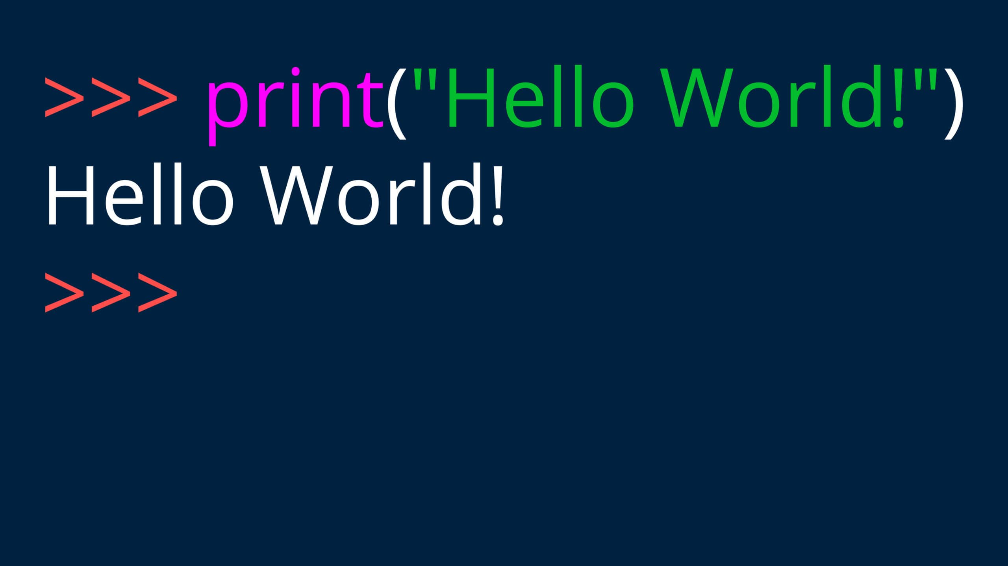

Slide 5
#Print string
print("Strings and things")
print("Hello world!")
print("""Hello, this is
a multi-line string!""")
print("This is"+" a string")
print('\n') #new line
#Maths
print("Math time:")
print(50 + 50) #add
print(50 - 50) #subtract
print(50 * 50) #multiply
print(50 / 50) #divide
print(50 + 50 - 50 * 50 / 50) #PEMDAS
print(50 ** 2) #exponent
print(50 % 6) #modulo
print(50 // 6) #number without leftovers
print('\n') #new line
#Variables & Methods
print("Fun with variables and methods:")
quote = "All is fair in love and war"
print(len(quote)) #length
print(quote.upper()) #uppercase
print(quote.lower()) #lowercase
print(quote.title()) #title
name = "Heath"
age = 29 #int / integer int(29)
gpa = 3.7 #float float(3.7)
print(int(age))
print(int(29.9)) #does not round
print("My name is " + name + " and I am " + str(age) + " years old.") # str(age) coverts the integer for 'age' (29) into a string as we cannot mix types (eg string and integer, string and float)
print('\n') #new line
age += 1
print(age)
birthday = 1
age += birthday
print(age)
print('\n') #new line
Notes:
Lesson one

Slide 6
#Functions
print("Now, some functions!")
def who_am_i():
name = "Heath"
age = 29
print("My name is " + name + " and I am " + str(age) + " years old.")
# str(age) coverts the integer for 'age' (29) into a string as we cannot mix types (eg string and integer, string and float)
who_am_i() #if a variable is defined in the function, it only exists in the function. if you want to use a variable from inside a function outside a function too, make sure to define it outside the function. It may be the case that all variables need be defined outside the function.
#Adding in Parameters to a function e.g. def my_function(parameter)
def add_one_hundred(num):
print(num + 100)
add_one_hundred(100)
#add in multiple parameters
def add(x,y):
print(x + y)
add(7,7)
add(305,207) print(age)
print('\n') #new line
Notes:
Lesson two

Slide 7
#Using return
def multiply(x,y):
return x * y
print(multiply(7,7))
def square_root(x):
return x ** .5
print(square_root(64))
#Boolean expressions (True or False)
print("Boolean expressions!")
bool1 = True
bool2 = 3*3==9 #code can be 'squashed up' like this - no spaces needed as expression is clear.
bool3 = False
bool4 = 3 * 3 != 9 # note that to make the 'does not equal' sign the following must be typed (without spaces): ! =
print(bool1,bool2,bool3,bool4)
print(type(bool1))
bool5 = "True"
print(type(bool5))
Notes:
Lesson three

Slide 8
#Relational and Boolean operators
greater_than = 7 > 5
less_than = 5 < 7
greater_than_equal_to = 7 >= 7
#note that to perform 'greater than/equal to' symbol following must be typed (without spaces): > =
less_than_equal_to = 7 <= 7 #same for the less than/equal to
print(greater_than,less_than,greater_than_equal_to,less_than_equal_to)
test_and = (5 < 7) and (7 > 5)
test_or = (5 < 7) or (7 > 5)
test_not = not True
print(test_and,test_or,test_not) #any trouble understanding operators then consult truth tables e.g as found on stack overflow (understanding logic in python)
print('\n') #new line
Notes:
Lesson three

Slide 9
#Conditional Statements
print("Conditional Statements")
def soda(money): #define a variable 'soda' with parameter 'money'
if money >= 2:
#tab if statement #make sure to put ':'
return "You've got yourself a soda!" #tab * 2 return
else:
#tab else statement
return "No soda for you!" #tab * 2 return
print(soda(3))
print(soda(1))
def alcohol(age,money):
if (age >= 21) and (money >= 5):
return "We're gettin' tipsy!"
elif (age >= 21) and (money < 5): #elif denotes else/if function
return "Come back with more money."
elif (age < 21) and (money >= 5): #tab things after a :!
return "Nice try, kid..."
else:
return "You don’t have enough money and are too young."
print(alcohol(22,5))
print(alcohol(21,4))
print(alcohol(18,7))
print(alcohol(20,3))
Notes:
Lesson four

Slide 10
#Lists
print("Lists have brackets:")
movies = ["When Harry Met Sally", "The Hangover", "The Perks of Being a Wallflower", "The Exorcist"]
print(movies[0]) #will print 'When Harry...' as all lists start from 0
print(movies[0:3]) #will print 'When Harry...', 'Hangover' and 'Wallflower' - when requesting sections of list always add n+1 to the number as the second term (eg movies[0:3] is NOT included. - "up to but not including"
print(movies[1:])
print(movies[:1])
print(movies[-1]) #pulls the last item from the list ('Exorcist')
print(len(movies))
movies.append("JAWS")
print(movies)
movies.pop() #pop removes a datum - a blank parameter defaults to removing last item on list (-1)
print(movies)
movies.pop(1)
print(movies)
movies = ["When Harry Met Sally", "The Hangover", "The Perks of Being a Wallflower", "The Exorcist"]
person = ["Zach", "Abi", "George", "Jacob"]
combined = zip(movies, person) #zip storesin memory and can 'zip' variables together...(movies, person) will list n1 movie and n1 person, n2 movie and n2 person....(movies + person) will return n movies and n person
print(list(combined))
Notes:
Lesson five

Slide 11
#Tuples
print("Tuples have parentheses and cannot change") #cannot be modified, appended etc.
grades = ("A", "B", "C", "D", "F")
print(grades[1])
#Looping
print("For loops – start to finish of iterative:")
vegetables = ["Pepper", "Onion", "Carrot"]
for x in vegetables:
print(x)
#While Loops
print("While loops – execute as long as true")
i = 1
while i < 10:
print(i)
i += 1
Notes:
Lesson six

Slide 12
with open('readme.txt', 'w') as f:
f.write('Create a new text file!')
#create new file and write to it
with open('readme.txt', 'a') as f:
# append to file
f.write('appendices')
f = open("readme.txt", "r")
# read file
print(f.read())
f = open("D:\\cartest.rtf", "r")
# open file from elsewhere
print(f.read())
with open('cartest.txt', 'w') as f: #create new file and write to it
f.write(' car \n car \n car \n car')
Notes:
Lesson seven

Slide 13
02
Testing

Slide 14


Slide 15
Software testing
Software testing is the process of verifying a system, with the purpose of identifying any errors, gaps or missing requirements when compared with the actual requirement.
Software testing is broadly categorised into two types:
functional testing*
non-functional testing*
Notes:
Lesson eight – Software testing is defined as an activity to check whether the actual results match the expected results, and to ensure that the software system is defect-free. It involves the execution of a software component or system component to evaluate one or more properties of interest. Software testing also helps to identify errors, gaps, or missing requirements when compared with the actual requirements.
Useful article: https://www.softwaretestingmaterial.com/software-testing/
Black, grey, white box

Slide 16
Interface testing
Interface testing is performed to evaluate whether systems or components pass data and control correctly to one another.
Interface testing is used to verify whether all the interactions between these modules are working properly, and whether errors are handled properly.
Notes:
Lesson eight – Interface testing is performed to evaluate whether systems or components pass data and control correctly to one another. It is to verify whether all the interactions between these modules are working properly, and whether errors are handled properly.

Slide 17
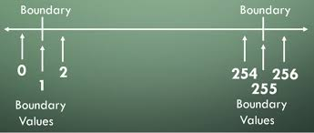
Boundary testing
Notes:
Lesson eight – Boundary testing is the process of testing between extreme ends or boundaries between partitions of the input values. So these extreme ends – like start-end, lower-upper, maximum-minimum, just inside-just outside values – are called boundary values, and the testing is called "boundary testing“
Article on BVA: http://tryqa.com/what-is-boundary-value-analysis-in-software-testing/

Slide 18
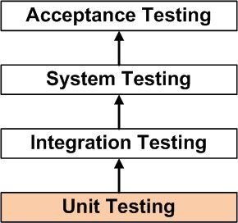
Unit testing
Notes:
Lesson eight – Unit testing is a level of software testing where individual units or components of a software are tested. The purpose is to ensure that each unit of the software performs as designed. A unit is the smallest testable part of any software. It usually has one or several inputs and a single output. In procedural programming, a unit may be an individual program, function, procedure, etc.
Useful article: https://www.guru99.com/unit-testing-guide.html

Slide 19
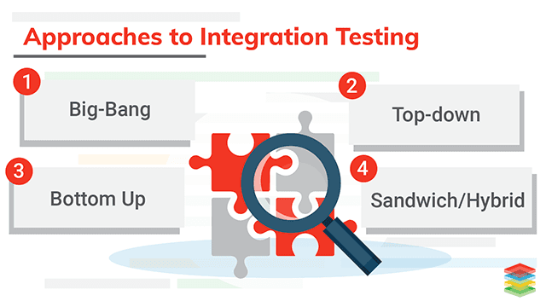
Integration testing
Notes:
Lesson eight – A type of testing where software modules are integrated logically and tested as a group. A typical software project consists of multiple software modules, coded by different programmers. The purpose of this level of testing is to expose defects in the interaction between these software modules when they are integrated.
Integration testing focuses on checking data communication among these modules. It is also referred to as I&T (integration and testing) or as string testing.
Article: https://www.guru99.com/integration-testing.html
Integration testing: https://www.xenonstack.com/insights/what-is-integration-testing/

Slide 20
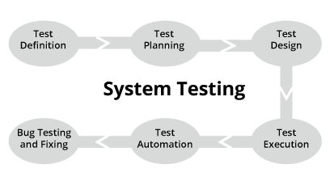
System testing
Notes:
Lesson eight – System testing is a type of software testing that is performed on a complete integrated system, to evaluate the compliance of the system with the corresponding requirements.
In system testing, components that have passed integration testing are taken as input. The goal of integration testing is to detect any irregularity between the units that are integrated together. System testing detects defects within both the integrated units and the whole system. The result of system testing is the observed behaviour of a component or a system when it is tested.
System testing is carried out on the whole system, in the context of either system requirement specifications or functional requirement specifications, or in the context of both. System testing tests the design and behaviour of the system and also the expectations of the customer. It is performed to test the system beyond the bounds mentioned in the software requirements specification (SRS).
System testing is performed by a testing team that is independent of the development team, so as to test the quality of the system impartially. It has both functional and non-functional testing.
Article: http://softwaretestingfundamentals.com/system-testing/
Article: https://www.geeksforgeeks.org/system-testing/

Slide 21
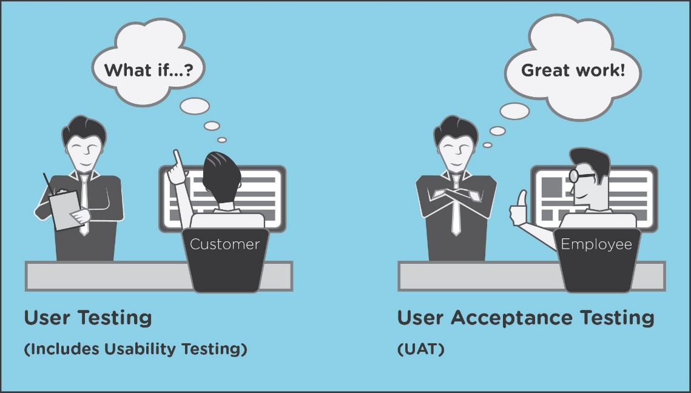
Acceptance and usability testing
Notes:
Lesson eight – Usability testing is performed to ensure that users can use the product with ease and to test whether it's ready to deliver.
Article: https://www.h2kinfosys.com/blog/what-is-the-difference-between-usability-test-and-user-acceptance-test/

Slide 22
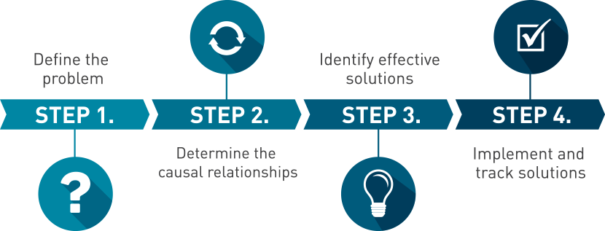
Root-cause analysis (RCA)
Notes:
Lesson eight – Root-cause analysis is part of a more general problem-solving process. Because of this, root-cause analysis is one of the core building blocks in an organisation’s continuous improvement efforts. It's important to note that root-cause analysis in itself will not produce any results; it must be made part of a larger problem-solving effort for quality improvement.
APPROACHES TO ROOT-CAUSE ANALYSIS
There are many methodologies, approaches and techniques for conducting root-cause analysis, including:
Events and causal-factor analysis: Widely used for major, single-event problems, such as a refinery explosion, this process uses evidence gathered quickly and methodically to establish a timeline for the activities leading up to the accident. Once the timeline has been established, the causal and contributing factors can be identified.
Change analysis: This approach is applicable to situations where a system’s performance has shifted significantly. It explores changes made in personnel, equipment, information and more, which that may have contributed to the change in performance.
Barrier analysis: This technique focuses on what controls are in place in the process either to prevent or to detect a problem, and which might have failed.
Management oversight and risk-tree analysis: One aspect of this approach is the use of a tree diagram to look at what occurred and why it might have occurred.
Kepner-Tregoe problem-solving and decision-making: This model provides four distinct phases for resolving problems:
Situation analysis
Problem analysis
Solution analysis
Potential problem analysis
Article: https://asq.org/quality-resources/root-cause-analysis

Slide 23
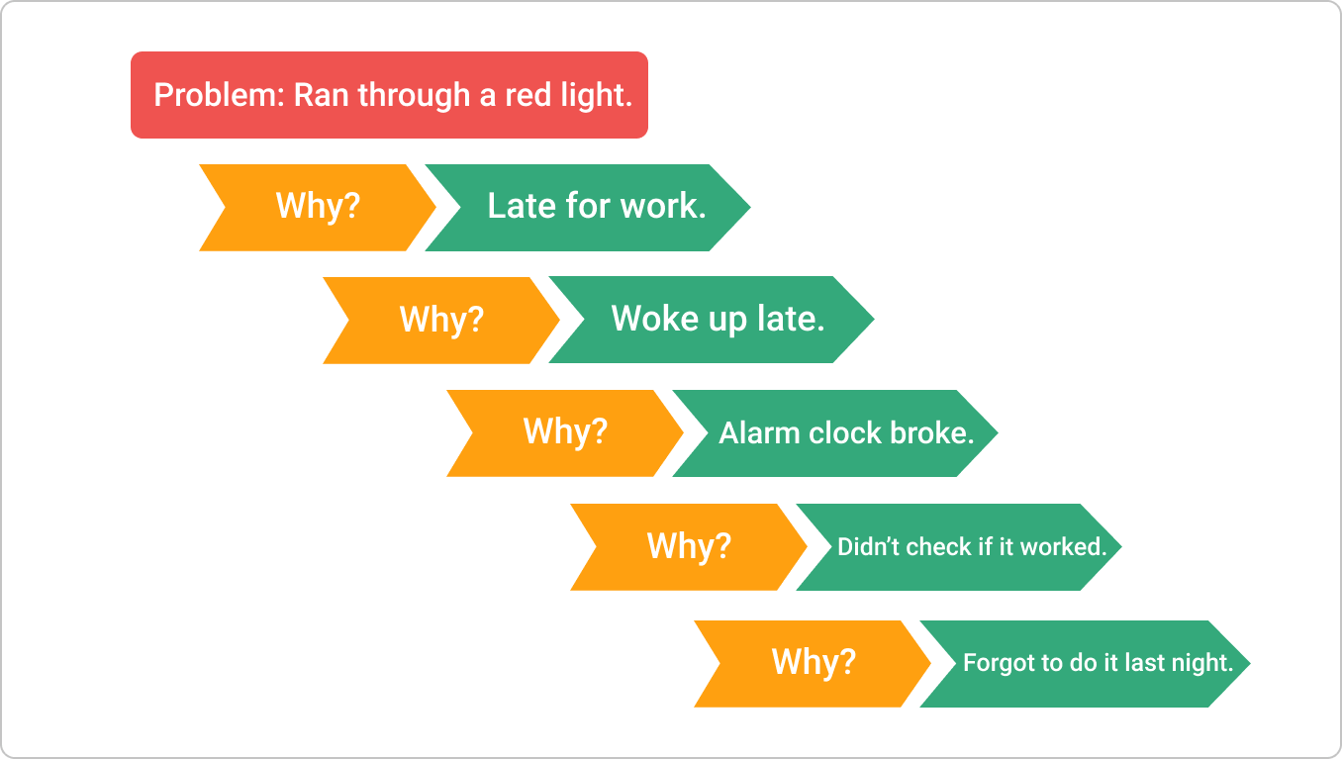
Five whys of RCA
Notes:
Lesson eight – One of the key factors for successful implementation of RCA is taking an informed decision. This means that the decision-making process should be based on an insightful understanding of what is actually happening on the work floor.
Article: https://kanbanize.com/lean-management/improvement/5-whys-analysis-tool

Slide 24

How to create test plans
Notes:
Lesson nine
Article: https://www.guru99.com/what-everybody-ought-to-know-about-test-planing.html

Slide 25

How to report test results
Notes:
Lesson nine

Slide 26
03
ESP 1 – Deep learning

Slide 27
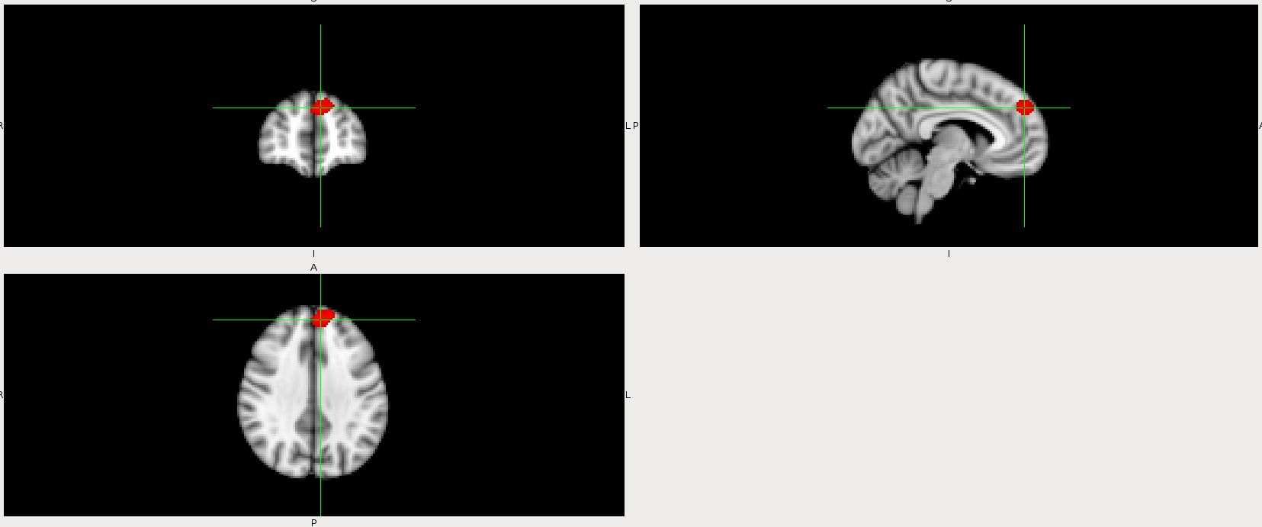
Notes:
Lesson 10

Slide 28
How deep learning/machine learning works
The early stages of machine learning (ML) saw experiments involving computers recognising patterns in data and learning from them. Today, after building on those foundational experiments, machine learning is more complex.
While machine-learning algorithms have been around for a long time, the ability to apply complex algorithms to big data applications rapidly and effectively is a more recent development. Being able to do these things with some degree of sophistication can set a company ahead of its competitors.
Notes:
Lesson 10

Slide 29
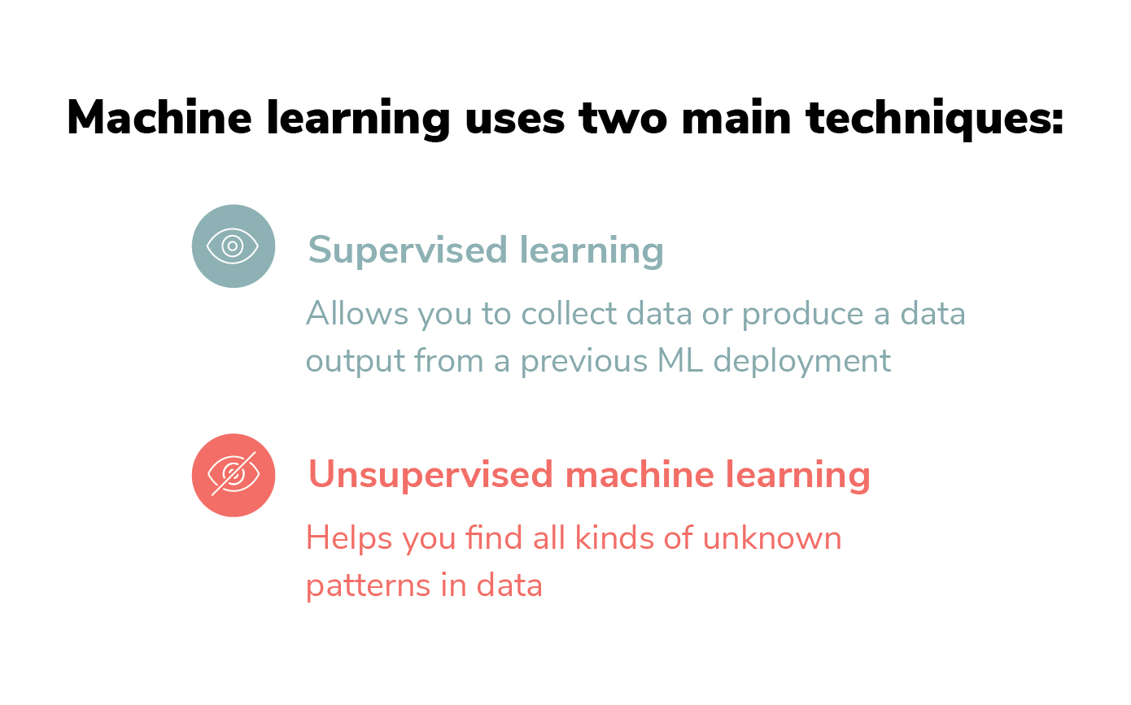
How does machine learning work?
Machine learning is a form of artificial intelligence (AI) that teaches computers to think in a similar way to humans: by learning from and improving on past experiences. It works by exploring data and identifying patterns, and involves minimal human intervention.
Almost any task that can be completed with a data-defined pattern or a set of rules can be automated using machine learning. This allows companies to transform processes that it was previously only possible for humans to perform –responding to customer service calls, bookkeeping or reviewing CVs.
Notes:
Lesson 10

Slide 30
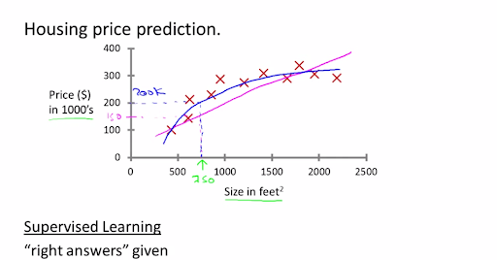

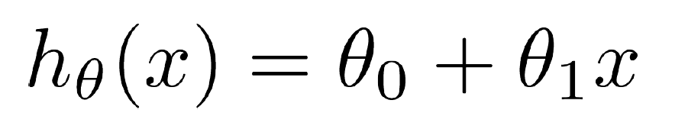
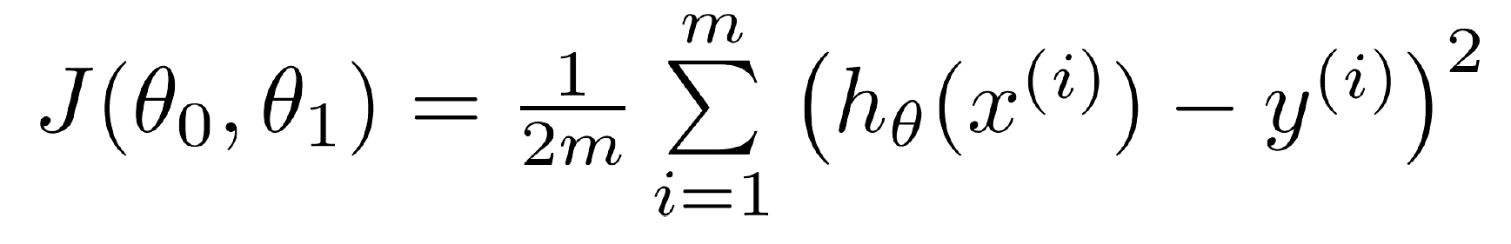
Supervised-learning example: House prices
One practical example of supervised learning problems is the prediction of house prices. How is this achieved?
First, we need data about the houses: square footage, number of rooms, features, whether or not it has a garden and so on. We then need to know the usual price of these houses, ie, the corresponding labels. By leveraging data coming from thousands of houses, their features and prices, we can now train a supervised machine-learning model to predict a new house’s price, based on the examples observed by the model.
Linear regression
Hypothesis
Cost function
(What our fitted line looks like)
(What we think the line should look like)
(How well our line fits the data)
The goal of any machine-learning model is to minimise the cost function.
Notes:
Lesson 10

Slide 31
Supervised-learning example: House prices
One practical example of supervised learning problems is the prediction of house prices. How is this achieved?
First, we need data about the houses: square footage, number of rooms, features, whether or not it has a garden and so on. We then need to know the usual price of these houses, ie, the corresponding labels. By leveraging data coming from thousands of houses, their features and prices, we can now train a supervised machine-learning model to predict a new house’s price, based on the examples observed by the model.
Linear regression
Hypothesis
Cost function
(What our fitted line looks like)
(What we think the line should look like)
(How well our line fits the data)
The goal of any machine-learning model is to minimise the cost function.
Notes:
Lesson 10
This equation simply plots a line of best fit on a graph, based on some data input.

Slide 32
Supervised-learning example: House prices
One practical example of supervised learning problems is the prediction of house prices. How is this achieved?
First, we need data about the houses: square footage, number of rooms, features, whether or not it has a garden and so on. We then need to know the usual price of these houses, ie, the corresponding labels. By leveraging data coming from thousands of houses, their features and prices, we can now train a supervised machine-learning model to predict a new house’s price, based on the examples observed by the model.
Linear regression
Hypothesis
Cost function
(What our fitted line looks like)
(What we think the line should look like)
(How well our line fits the data)
The goal of any machine-learning model is to minimise the cost function.
Notes:
Lesson 10
This equation simply says that our hypothesis (h-theta (x)) will be tested by small adjustments in the parameters theta-0 and theta-1x. This will make the AI model ‘guess’ where any new data might fit on to the previously predicted slope.

Slide 33
Supervised-learning example: House prices
One practical example of supervised learning problems is the prediction of house prices. How is this achieved?
First, we need data about the houses: square footage, number of rooms, features, whether or not it has a garden and so on. We then need to know the usual price of these houses, ie, the corresponding labels. By leveraging data coming from thousands of houses, their features and prices, we can now train a supervised machine-learning model to predict a new house’s price, based on the examples observed by the model.
Linear regression
Hypothesis
Cost function
(What our fitted line looks like)
(What we think the line should look like)
(How well our line fits the data)
The goal of any machine-learning model is to minimise the cost function.
Notes:
Lesson 10
The cost function simply tries to minimise the difference between the guesses of the AI and the actual regression slope, in essence making the AI learn how to make better predictions.

Slide 34
Supervised-learning example: House prices
One practical example of supervised learning problems is the prediction of house prices. How is this achieved?
First, we need data about the houses: square footage, number of rooms, features, whether or not it has a garden and so on. We then need to know the usual price of these houses, ie, the corresponding labels. By leveraging data coming from thousands of houses, their features and prices, we can now train a supervised machine-learning model to predict a new house’s price, based on the examples observed by the model.
Linear regression
Hypothesis
Cost function
(What our fitted line looks like)
(What we think the line should look like)
(How well our line fits the data)
The goal of any machine-learning model is to minimise the cost function.
Notes:
Lesson 10
This section simplifies the data output with a 1/2m function, making it more readable for humans. m/Sigma i=1 simply repeats the cost function on a loop for every data point we ask the AI to make a guess for.

Slide 35
Supervised-learning example: House prices
One practical example of supervised learning problems is the prediction of house prices. How is this achieved?
First, we need data about the houses: square footage, number of rooms, features, whether or not it has a garden and so on. We then need to know the usual price of these houses, ie, the corresponding labels. By leveraging data coming from thousands of houses, their features and prices, we can now train a supervised machine-learning model to predict a new house’s price, based on the examples observed by the model.
Linear regression
Hypothesis
Cost function
(What our fitted line looks like)
(What we think the line should look like)
(How well our line fits the data)
The goal of any machine-learning model is to minimise the cost function.
Notes:
Lesson 10
This section is just telling us that our earlier hypothesis (h-theta (x)) and the actual regression slope (y) will be compared with the goal of minimising the difference between the action regression trend and the guesses the AI makes.

Slide 36
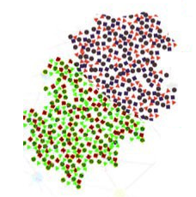
Unsupervised learning example: Finding customer segments
Clustering is an unsupervised technique, where the goal is to find natural groups or clusters in a feature space and interpret the input data. There are many different clustering algorithms. One common approach is to divide the data points so that each data point falls into a group that is similar to other data points in the same group, based on a predefined similarity or distance metric in the feature space.
Clustering is commonly used to determine customer segments in marketing data. Being able to determine different segments of customers helps marketing teams to approach each customer segment in a unique way. (Think of features like gender, location, age, education, income bracket, and so on.)
Notes:
Lesson 11

Slide 37
Speech/text recognition
Tokenisation is an initial stage of abstraction that assists in recognising patterns in the data.
It involves breaking down an utterance or sentence into component parts, called ‘tokens’.
“I’d really like to go to the park if the weather is nice.”
[I’d] [really] [lik] [to] [go] [to] [the] [park] [if] [the] [weather] [is] [nic] [.]
Removing punctuation and caps helps to prepare the data for machine learning.
[id] [really] [lik] [to] [go] [to] [the] [park] [if] [the] [weather] [is] [nic]
Notes:
Lesson 11

Slide 38
Speech/text recognition
Tokenisation is an initial stage of abstraction that assists in recognising patterns in the data.
It involves breaking down an utterance or sentence into component parts, called ‘tokens’.
“I’d really like to go to the park if the weather is nice.”
[I’d] [really] [lik] [to] [go] [to] [the] [park] [if] [the] [weather] [is] [nic] [.]
Removing punctuation and caps would be a final feature to prepare the data for machine learning.
[id] [really] [lik] [to] [go] [to] [the] [park] [if] [the] [weather] [is] [nic]
Notes:
Lesson 11

Slide 39
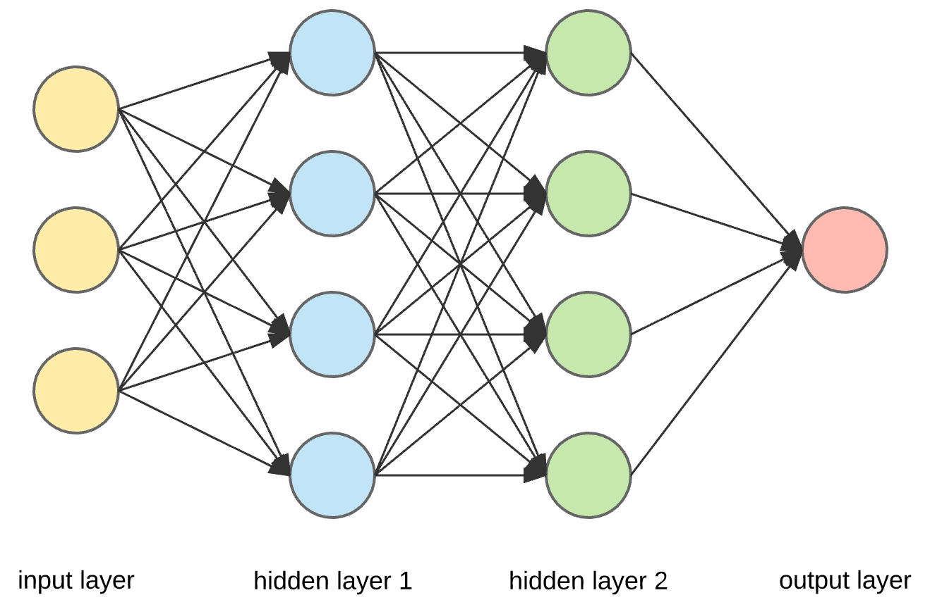
[i] [like] [wanna] [go] [get] [the] [park]
“Yes, a walk in the park would be nice.”
“I’d like to go to the park.”
“I wanna get to the park.”
“Looking forward to going to the park.”
Notes:
Lesson 11

Slide 40




Learning let loose
‘Big data’ is a term that describes the large volumes of data – both structured and unstructured – that inundate a business on a day-to-day basis. But it’s not the amount of data that’s important – it’s what organisations do with the data that matters. Big data can be analysed for insights that lead to better decisions and strategic business moves.
Nowadays, companies commonly use big data in order to outperform their peers. In most industries, existing competitors and new entrants alike will use the strategies resulting from analysed data to compete, innovate and capture value.
Big data helps organisations to create new growth opportunities and entirely new categories of companies, which can combine and analyse industry data. These companies have ample information about the products and services, buyers and suppliers, and consumer preferences, which can then be captured and analysed.
Notes:
Lesson 11

Slide 41
Scenario brief
You have been asked to develop a new chatbot to assist staff and students at your college campus. This bot should use supervised machine-learning methods to allow it to tokenise inputs given by users. It should then compare them against a list of possible responses, in order to answer timetabling queries from students in specific years and groups. The bot should also be able to understand basic greetings and pleasantries, in order to appear more human-like.
Scope
The project will include:
Working chatbot.py file with deep-learning model encoding three neural layers
A JSON file containing a list of possible responses
A model training file, which will allow the bot to learn from updates to the JSON file
Responses to student timetabling questions, tailored to specific years and groups
The ability to respond to common greetings, such as “Hello”, and pleasantries, such as “How are you?
Constraints
The project will not include:
A non-CMD GUI for the bot
Voice or speech recognition (text-based input will be used)
Connection of the bot to internet services, such as Wikipedia.
Notes:
Lesson 12

Slide 42
from nltk.stem.porter import PorterStemmer
stemmer = PorterStemmer()
def tokenize(sentence):
return nltk.word_tokenize(sentence)
def stem(word):
return stemmer.stem(word.lower())
def bag_of_words(tokenized_sentence, words):
# stem each word
sentence_words = [stem(word) for word in tokenized_sentence]
# initialize bag with 0 for each word
bag = np.zeros(len(words), dtype=np.float32)
for idx, w in enumerate(words):
if w in sentence_words:
bag[idx] = 1
return bag
Notes:
Lesson 12
Setting up natural language and text recognition
First, we split the sentence into array of words or tokens. A token can be a word, a punctuation mark or a number.
Examples:
words = ["organise", "organises", "organising"]
words = [stem(w) for w in words]
-> ["organ", "organ", "organ"]
Next, we return a bag of words in an array: one for each known word that exists in the sentence; zero otherwise.
Example:
sentence = ["hello", "how", "are", "you"]
words = ["hi", "hello", "I", "you", "bye", "thank", "cool"]
bog = [ 0 , 1 , 0 , 1 , 0 , 0 , 0]

Slide 43
import numpy as np
import random
import json
import torch
import torch.nn as nn
from torch.utils.data import Dataset, DataLoader
from nltk_utils import bag_of_words, tokenize, stem
from model import NeuralNet
with open('intents.json', 'r') as f:
intents = json.load(f)
#Loop through JSON
all_words = []
tags = []
xy = []
for intent in intents['intents']:
tag = intent['tag']
# add to tag list
tags.append(tag)
for pattern in intent['patterns']:
# tokenize each word in the sentence
w = tokenize(pattern)
# add to our words list
all_words.extend(w)
# add to xy pair
xy.append((w, tag))
# stem each word
ignore_words = ['?', '.', '!']
all_words = [stem(w) for w in all_words if w not in ignore_words]
# remove duplicates and sort
all_words = sorted(set(all_words))
tags = sorted(set(tags))
print(len(xy), "patterns")
print(len(tags), "tags:", tags)
print(len(all_words), "unique stemmed words:", all_words)
# create training data
X_train = []
y_train = []
for (pattern_sentence, tag) in xy:
Notes:
Lesson 12
Designing an AI training model
We now loop through each sentence in our JSON intents patterns.
Next, we tokenise each word in each JSON intents sentence.
Them we stem and trim each word, remove punctuation and make lowercase.
We remove any duplicate entries, and we sort the tokenised words into a set.
We then output the tokenised words and create two empty sets for them: X and Y.

Slide 44
# X: bag of words for each pattern_sentence
bag = bag_of_words(pattern_sentence, all_words)
X_train.append(bag)
# y: PyTorch CrossEntropyLoss needs only class labels, not one-hot
label = tags.index(tag)
y_train.append(label)
X_train = np.array(X_train)
y_train = np.array(y_train)
# Hyper-parameters
num_epochs = 1000
batch_size = 8
learning_rate = 0.001
input_size = len(X_train[0])
hidden_size = 8
output_size = len(tags)
print(input_size, output_size)
class ChatDataset(Dataset):
def __init__(self):
self.n_samples = len(X_train)
self.x_data = X_train
self.y_data = y_train
# support indexing such that dataset[i] can be used to get i-th sample
def __getitem__(self, index):
return self.x_data[index], self.y_data[index]
# we can call len(dataset) to return the size
def __len__(self):
return self.n_samples
dataset = ChatDataset()
train_loader = DataLoader(dataset=dataset,
batch_size=batch_size,
shuffle=True,
num_workers=0)
device = torch.device('cuda' if torch.cuda.is_available() else 'cpu')
model = NeuralNet(input_size, hidden_size, output_size).to(device)
# Loss and optimizer
criterion = nn.CrossEntropyLoss()
optimizer = torch.optim.Adam(model.parameters(), lr=learning_rate)
Notes:
Lesson 12
Designing an AI training model
Our X training set becomes a bag of words.
Our Y training set becomes the tags and labels our chatbot will use to select an appropriate response from the bag of words.
We then add the hyper-parameters for our model, including the number of training epochs and learning rate (we can customise these hyper-parameters to see their effects).
We then index the sorted set, so that our bot can search and find words in the dataset.
Finally, we code loss and optimisation features, allowing the bot to select responses from the bag of words and to measure how accurate the selection was when comparing this information against the JSON intents data.

Slide 45
# Train the model
for epoch in range(num_epochs):
for (words, labels) in train_loader:
words = words.to(device)
labels = labels.to(dtype=torch.long).to(device)
# Forward pass
outputs = model(words)
# if y would be one-hot, we must apply
# labels = torch.max(labels, 1)[1]
loss = criterion(outputs, labels)
# Backward and optimize
optimizer.zero_grad()
loss.backward()
optimizer.step()
if (epoch+1) % 100 == 0:
print (f'Epoch [{epoch+1}/{num_epochs}], Loss: {loss.item():.4f}')
print(f'final loss: {loss.item():.4f}')
data = {
"model_state": model.state_dict(),
"input_size": input_size,
"hidden_size": hidden_size,
"output_size": output_size,
"all_words": all_words,
"tags": tags
}
FILE = "data.pth"
torch.save(data, FILE)
print(f'training complete. file saved to {FILE}')
Notes:
Lesson 12
Designing an AI training model.
We then add the code to train our chatbot model.
We add a forward-pass, which sorts our Y dataset (tags and labels) and allows out bot to apply these values to the X dataset (bag of words).
We load an optimiser, which allows our model to find a cost function during training, and to
minimise errors in responses.
Finally, we save our completed training data and output a notice informing the user that training has finished.

Slide 46
{
"intents": [
{
"tag": "greetings",
"patterns": [
"Hi",
"Hey",
"How are you",
"Is anyone there?",
"Hello",
"Good day",
"Howdy",
"Move and appear",
"How are you?",
"how are you",
"how are you?"
Hey wuu2?
],
"responses": [
"Hey, thanks for stopping by",
"Hello, thanks for visiting",
"Hi there, what can I do for you?",
"Hi there, how can I help?",
"Hello there! How can I help",
"Hello! Welcome to LCC!"
]
},
Notes:
Lesson 12
Coding responses to learn
Next we encode a list of responses as a JSON file for our bot to access.
The responses consist of tags, which the bot will tokenise and then look for any input matching those tokens.
Tags are organised into categories (eg, greetings, questions).
The responses (randomised for each tag category) are listed for each tag.
Any number of new tags and responses can be added in this manner, and the JSON file can be tweaked to make the bot appear more human-like.

Slide 47
{
"tag": "goodbyes",
"patterns": [ "Bye", "See you later", "Goodbye", "Farewell", "Toodles", "Seeya", "That is all" ],
"responses": [
"See you later",
"Have a nice day",
"Bye! Come back soon.",
"Goodbye"
]
},
{
"tag": "thanks",
"patterns": [ "Thanks", "Thank you", "That's helpful", "Thanks a lot!", "Thankyou" ],
"responses": [ "Happy to help! Anything else you need?", "Any time! Can I help with anything else?", "My pleasure! Do you need anything else?" ]
},
{
"tag": "courtesies",
"patterns": [
"How are you?",
"How's it going?",
"What is it like?",
"How are you feeling?"
],
"responses": [
"I wouldn't know, I only have three layers of neurons",
"I don't quite understand – please address me as if you were addressing a small child",
"My internal algorithms suggest a significant probability that I am well, thank you",
"Optimal",
"I haven't got much depth to me – more importantly, how are you?",
"Optimal, thanks – and you?"
]
},
Notes:
Lesson 12
Coding responses to learn
Next we encode a list of responses as a JSON file for our bot to access.
The responses consist of tags, which the bot will tokenise and then look for any input matching these tokens.
Tags are organised into categories (eg, greetings, questions).
The responses (randomised for each tag category) are listed for each tag.
Any number of new tags and responses can be added in this manner, and the JSON file can be tweaked to make the bot appear more human-like.

Slide 48
{
"tag": "help lessons",
"patterns": [
"What lessons do I have today?",
"What's my timetable?",
"What's today's schedule?",
"What are my lessons?"
],
"responses": [
"Sure, I can help with that – what group are you in?",
"No problem, just let me know which year and group you are in",
"I'll get that info to you – I just need to know which group you are in"
]
},
{
"tag": "group a",
"patterns": [
"group A",
"I'm in group A",
"I'm group A"
],
"responses": [
"Ah, yes! Today you have principles in computing (10.30), encryption (13.00) and software design (15.00) – is there anything else I can help with?"
]
},
Notes:
Lesson 12
Coding responses to learn
Next we encode a list of responses as a JSON file for our bot to access.
The responses consist of tags, which the bot will tokenise and then look for any input matching these tokens.
Tags are organised into categories (eg, greetings, questions).
The responses (randomised for each tag category) are listed for each tag.
Any number of new tags and responses can be added in this manner, and the JSON file can be tweaked to make the bot appear more human-like.

Slide 49
{
"tag": "group b",
"patterns": [
"group B",
"I'm part of group B",
"I'm in group B",
"I'm with group B"
],
"responses": [
"Looks like today you have impact of computing – is there anything else I can help with?"
]
},
{
"tag": "group c",
"patterns": [
"group C",
"I'm in group C",
"I'm part of group C"
],
"responses": [
"Okay – it looks like you have mobile apps (12.00) and social media (14.30) today – anything else you need?"
]
},
{
"tag": "happyuserinput",
"patterns": [
"I'm good",
"I'm well",
"I'm great",
"I feel fantastic",
"good",
"ok",
"okay"
],
"responses": [
"I'm very glad to hear that!"
]
},
Notes:
Lesson 12
Coding responses to learn
Next we encode a list of responses as a JSON file for our bot to access.
The responses consist of tags, which the bot will tokenise and then look for any input matching these tokens.
Tags are organised into categories (eg, greetings, questions).
The responses (randomised for each tag category) are listed for each tag.
Any number of new tags and responses can be added in this manner, and the JSON file can be tweaked to make the bot appear more human-like.

Slide 50
{
"tag": "saduserinput",
"patterns": [
"I'm bad",
"Not so good",
"Not great",
"Sad",
"terrible",
"I feel awful",
"None of your business"
],
"responses": [
"I'm very sorry to hear that"
]
},
{
"tag": "identity",
"patterns": [
"What are you?",
"Who are you?",
"What is this?",
"Are you alive?",
"Can you understand me?",
"Are you real?"
],
"responses": [
"I'm LCCbot, your helpful AI guide to your studies!",
"I'm programmed to help LCC students",
"As far as I can tell, I'm a basic learning system – about as smart as a simple cellular organism – but don't judge me"
]
},
Notes:
Lesson 12
Coding responses to learn
Next we encode a list of responses as a JSON file for our bot to access.
The responses consist of tags, which the bot will tokenise and then look for any input matching these tokens.
Tags are organised into categories (eg, greetings, questions).
The responses (randomised for each tag category) are listed for each tag.
Any number of new tags and responses can be added in this manner and the JSON file can be tweaked to make the bot appear more human-like.

Slide 51
{
"tag": "negative",
"patterns": [
"No",
"No thanks",
"No thank you",
"Not today",
"Not now"
],
"responses": [
"No problem, glad to help!",
"Okay, great – hope I helped!"
]
},
{
"tag": "funny",
"patterns": [
"Tell me a joke!",
"Tell me something funny!",
"Do you know a joke?",
"Tell me a joke",
"Be funny"
],
"responses": [
"Did you hear about the mathematician who’s afraid of negative numbers? He'll stop at nothing to avoid them!",
"Why do we tell actors to break a leg? Because every play has a cast",
"Yesterday I saw a guy spill all his Scrabble letters on the road – I asked him: What's the word on the street?"
]
}
]
}
Notes:
Lesson 12
Coding responses to learn
Next we encode a list of responses as a JSON file for our bot to access.
The responses consist of tags, which the bot will tokenise and then look for any input matching these tokens.
Tags are organised into categories (eg, greetings, questions).
The responses (randomised for each tag category) are listed for each tag.
Any number of new tags and responses can be added in this manner, and the JSON file can be tweaked to make the bot appear more human-like.

Slide 52
import torch
import torch.nn as nn
class NeuralNet(nn.Module):
def __init__(self, input_size, hidden_size, num_classes):
super(NeuralNet, self).__init__()
self.l1 = nn.Linear(input_size, hidden_size)
self.l2 = nn.Linear(hidden_size, hidden_size)
self.l3 = nn.Linear(hidden_size, num_classes)
self.relu = nn.ReLU()
def forward(self, x):
out = self.l1(x)
out = self.relu(out)
out = self.l2(out)
out = self.relu(out)
out = self.l3(out)
return out
Notes:
Lesson 12
Coding our neural network
Now we specify how many neural layers we would like in our model. Here, we are using three layers.
We use PyTorch to specify which layers receive input and give output, and where.
Here, layer one is our input layer for our X dataset (bag of words), layer two receives this data and tokenises it, and layer three applies tags and labels, before a selected output/response is given.

Slide 53
import random
import json
import torch
from model import NeuralNet
from nltk_utils import bag_of_words, tokenize
device = torch.device('cuda' if torch.cuda.is_available() else 'cpu')
with open('intents.json', 'r') as json_data:
intents = json.load(json_data)
FILE = "data.pth"
data = torch.load(FILE)
input_size = data["input_size"]
hidden_size = data["hidden_size"]
output_size = data["output_size"]
all_words = data['all_words']
tags = data['tags']
model_state = data["model_state"]
model = NeuralNet(input_size, hidden_size, output_size).to(device)
model.load_state_dict(model_state)
model.eval()
bot_name = "LCCbot"
print("I'm LCCbot – here to help with your schedule! Let's see if I can help with your query, or type 'quit' to exit")
while True:
sentence = input("You: ")
if sentence == "quit":
break
sentence = tokenize(sentence)
X = bag_of_words(sentence, all_words)
X = X.reshape(1, X.shape[0])
X = torch.from_numpy(X).to(device)
output = model(X)
_, predicted = torch.max(output, dim=1)
tag = tags[predicted.item()]
probs = torch.softmax(output, dim=1)
prob = probs[0][predicted.item()]
if prob.item() > 0.75:
for intent in intents['intents']:
if tag == intent["tag"]:
print(f"{bot_name}: {random.choice(intent['responses'])}")
else:
print(f"{bot_name}: Apologies, I haven't been taught how to answer that yet – I’m not too bright at the moment!")
Notes:
Lesson 12
Creating and running our chatbot application
We import the neural network we have coded, the JSON intents and the natural language-processing features.
We then add display names for UI purposes, with our bot’s responses highlighted with our bot’s name, and our inputs marked as “You:”.
We specify that if previous training has given a likelihood of more than 75 per cent that a certain correct response (X dataset) will be given to a specific tag (Y dataset), then the bot will choose a response from that category and display it on screen. If no response has been guessed to be correct with 75 per cent certainty or more, then the bot will give an error message.
To run our bot, we simply navigate to the folder in which all these files are saved in CMD, then use Python 3 to run the training application. After training is finished, we can use Python 3 to run the bot and chat with it.

Slide 54
04
Offensive security project

Slide 55

Notes:
Lesson 13

Slide 56
Scenario brief
You have been asked by your line manager to test a newly designed and potentially vulnerable webserver. In order to do this safely and without exposing the company network to threat, you have been asked to create a local network and DHCP server as a test lab for this task.
After establishing the network and assigning IP addresses accordingly, you should test for vulnerabilities using a professional suite of tools to access the webserver, obtain admin privileges and identify and obtain three crucial pieces of information consisting of passwords given as flag files.
Scope
The project will include:
Working DHCP server, providing a range of IP addresses on an internal network
An offensive machine/laboratory running Kali Linux OS
A victim machine running Mr. Robot vulnerable webserver
Evidence of the use of network/hacking tools to retrieve three flags.
Constraints
The project will not include:
Internet access for the offensive machine or the victim machine
Retrieval of any confidential data.
Notes:
Lesson 13

Slide 57
Setting up Kali on VirtualBox
Notes:
Lesson 13

Slide 58

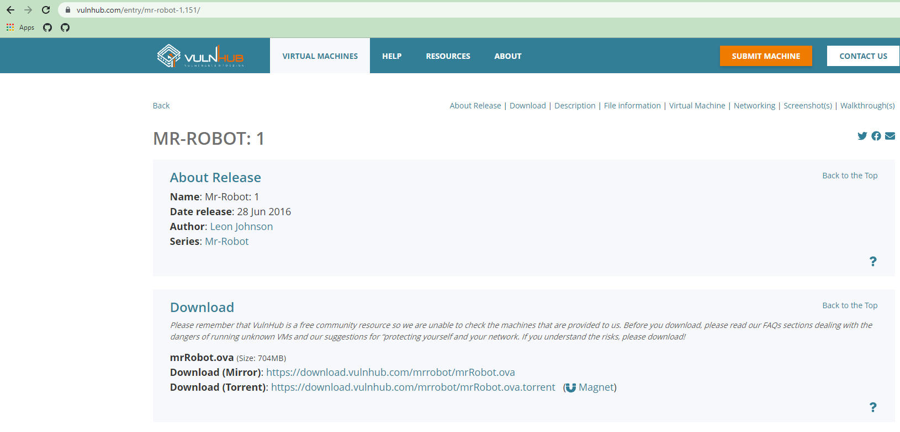
Notes:
Lesson 13

Slide 59
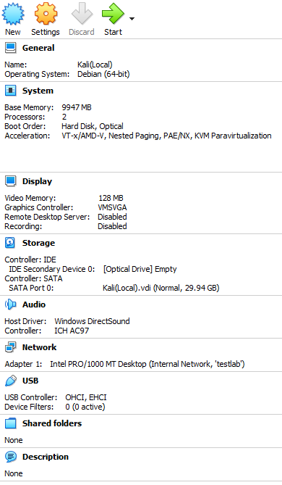
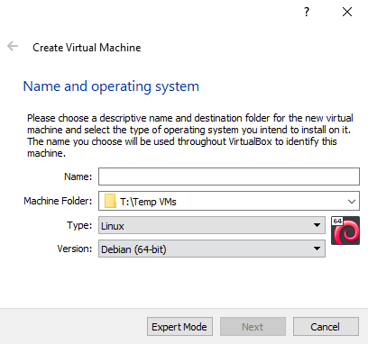
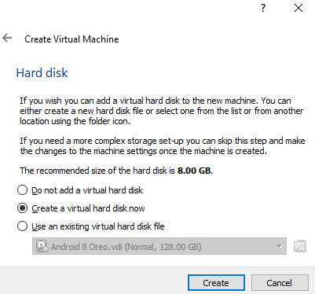
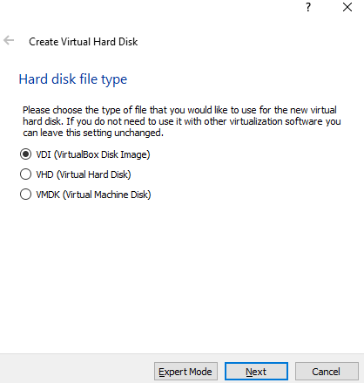
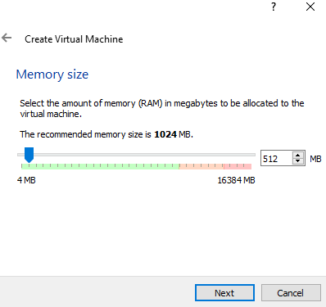
Notes:
Lesson 13

Slide 60
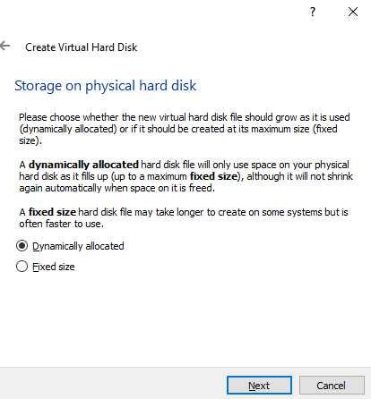
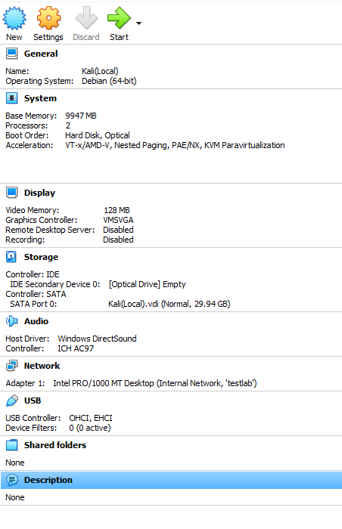
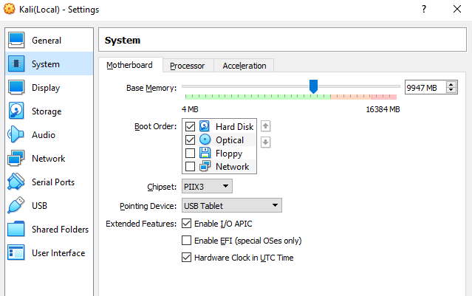
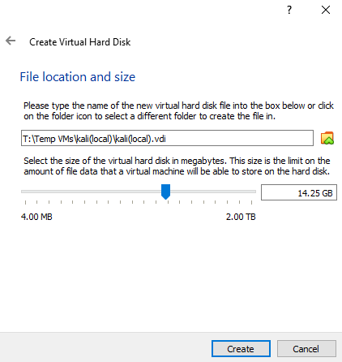
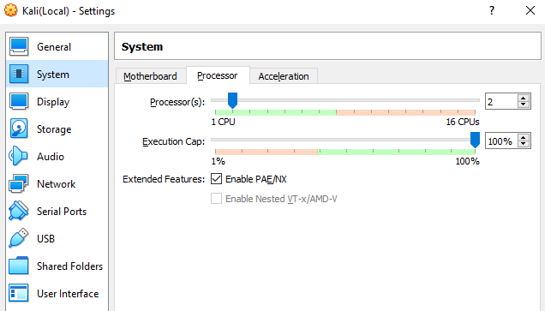
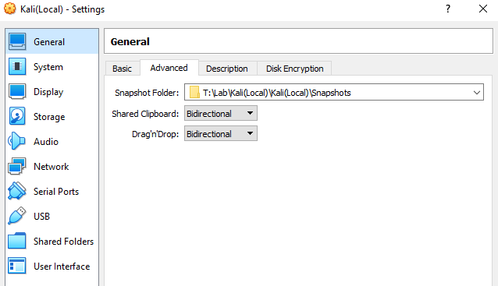
Notes:
Lesson 13

Slide 61
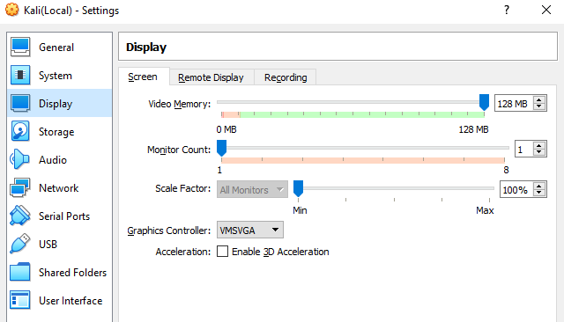
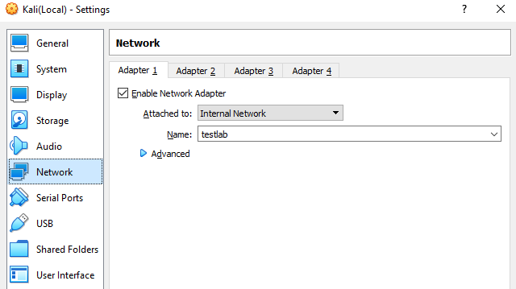
Notes:
Lesson 13

Slide 62
Setting up Mr. Robot on VirtualBox
Notes:
Lesson 13

Slide 63
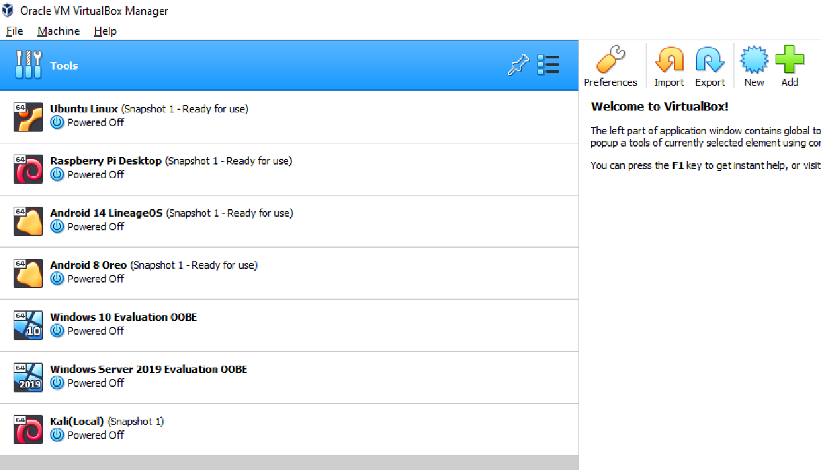
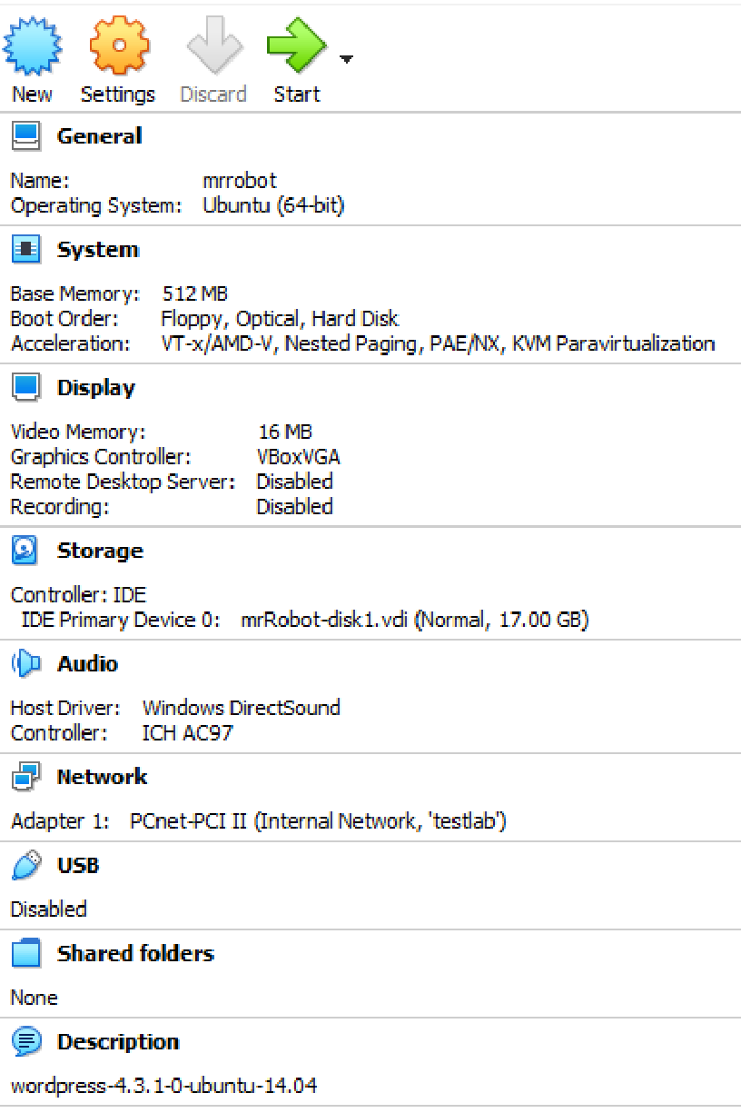
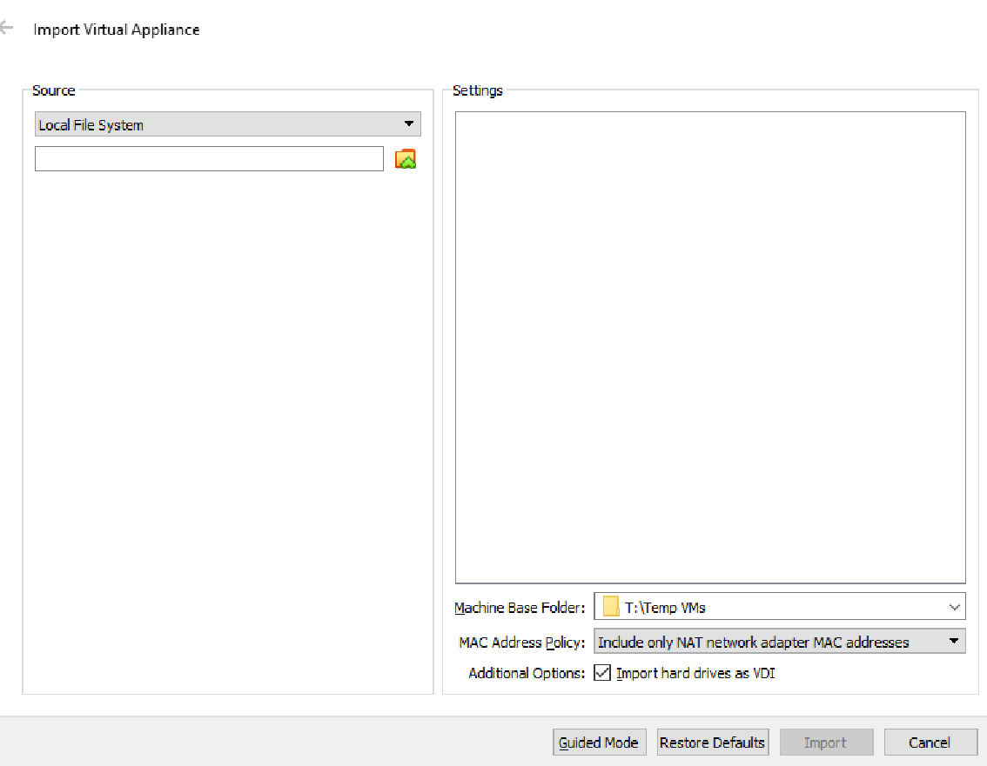
Notes:
Lesson 13

Slide 64
Setting up our DHCP server
Notes:
Lesson 13

Slide 65
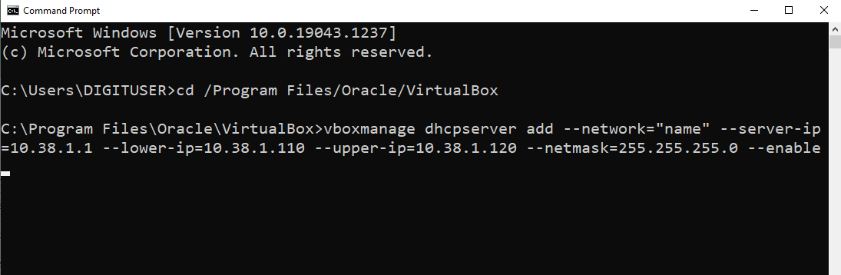
vboxmanage (Tool to manage our VMs)
dhcpserver add (Create a DHCP server.)
--network=“name” (We give our network a name.)
--server-ip=10.38.1.1 (Grant an IP address to our server.)
-- lower-ip=10.38.1.110 --upper-ip=10.38.1.120 (Range of IPs to allocate to connected devices is between 110-120.)
--netmask=255.255.255.0 (Assign a network mask to our server.)
-- enable (Initiate server.)
Notes:
Lesson 13

Slide 66
dhcp server - A DHCP server is a network server that automatically provides and assigns IP addresses, default gateways and other network parameters to client devices. It relies on the standard protocol known as Dynamic Host Configuration Protocol – or DHCP – to respond to broadcast queries from clients.
A DHCP server automatically sends the required network parameters for clients to properly communicate on the network. Without it, the network administrator has to manually set up every client that joins the network, which can be cumbersome, especially in large networks. DHCP servers usually assign to each client a unique dynamic IP address, which changes when the client’s lease for that IP address has expired. By default, your home router will serve as a DHCP server.
ip - The Internet Protocol (IP) is a protocol, or set of rules, for routing and addressing packets of data so that they can travel across networks and arrive at the correct destination. Data traversing the internet is divided into smaller pieces, called packets. IP information is attached to each packet, and this information helps routers to send packets to the right place. Every device or domain that connects to the internet is assigned an IP address, and as packets are directed to the IP address attached to them, data arrives where it is needed.
Once the packets arrive at their destination, they are handled differently depending on which transport protocol is used in combination with IP. The most common transport protocols are TCP and UDP.
Notes:
Lesson 13

Slide 67

ip - The IP address is a 32-bit number that uniquely identifies a network interface on a machine. An IP address is typically written in decimal digits, formatted as four eight-bit fields, separated by full stops. Each eight-bit field represents a byte of the IP address. This form of representing the bytes of an IP address is often referred to as the dotted-decimal format.
The bytes of the IP address are further classified into two parts: the network part and the host part.
10000001.10010000. 00110010.00111000
Network part
This part specifies the unique number assigned to your network. It also identifies the class of network assigned. In the example above, the network part takes up two bytes of the IP address.
Host part
This is the part of the IP address that you assign to each host. It uniquely identifies each machine on your network. Note that for each host on your network, the network part of the address will be the same, but the host part must be different.
Notes:
Lesson 13

Slide 68
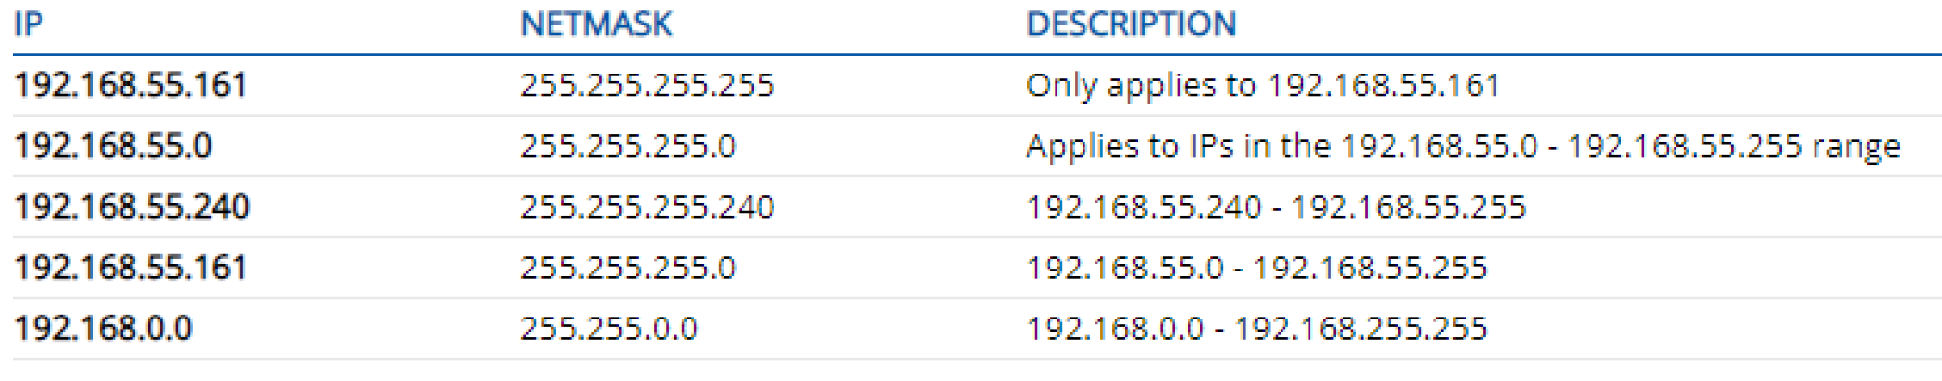
netmask - In TCP/IP, the parts of the IP address that are used as the network and host addresses aren't fixed.
Unless you have more information, the network and host addresses above can't be determined. This information is supplied in another 32-bit number called a subnet mask.
The subnet mask is 255.255.255.0 in this example. It isn't obvious what this number means, unless you know that 255 in binary notation equals 11111111. So, the subnet mask is 11111111.11111111.11111111.00000000.
A netmask is a 32-bit "mask“, used to divide an IP address into subnets and to specify the network's available hosts. In a netmask, two bits are always automatically assigned. For example, in 255.255.225.0, "0" is the assigned network address. In 255.255.255.255, "255" is the assigned broadcast address. The 0 and 255 are always assigned and cannot be used.
Notes:
Lesson 13

Slide 69
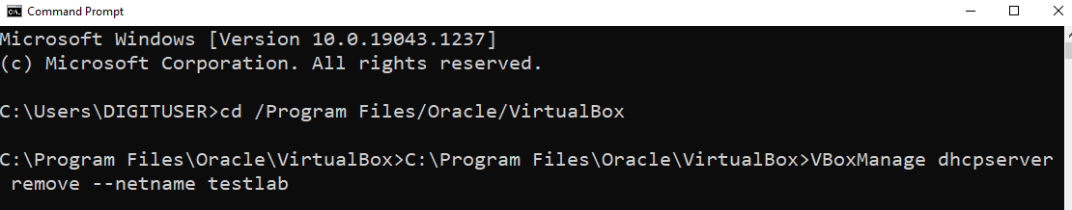
If we make a mistake or get an error message, we can run the command above to remove the server and start over. Just replace “testlab” with whatever you called your network.
Notes:
Lesson 13

Slide 70
Firing up our devices on the network we have made
Notes:
Lesson 13

Slide 71
START KaliLinux on VirtualBox.
Follow through install instructions, clicking yes whenever we are asked if we want to continue with the install.
Make sure we install GRUB (this will allow us to boot and load our OS in future).
Keep default settings when asked (unless you want to test things out – it’s ok to break things on a VM!).
If you are asked for a server IP, enter the one you made when setting up the DHCP server (in this case 10.38.1.1).
We can set our hostname, domain name, username and password.
START Mr. Robot.
Notes:
Lesson 13

Slide 72
Checking that our network is isolated
Notes:
Lesson 13

Slide 73
In our physical device’s CMD:
ping “our kali ip” –n 2
(Ping our machine’s IP to see if we get a response: ‘-n 2’ means we count two packets to send. You can add any number of packets). We can check our kali IP in the kali terminal with the ifconfig command (inet is our address).
We want no response (100 per cent packet loss – this tells us that we have no connection).
In our Kali terminal:
ping 8.8.8.8 –c 2
(Ping Google server to see if we get a response: ‘-c 2-’ means we count two packets to send. You can add any number of packets. Note: the command is ‘-n’ in Windows and ‘-c’ in Linux.)
ping “our device’s ip” –c 2
(Ping our machine’s IP to see if we get a response: ‘-c 2’ means we count two packets to send. You can add any number of packets.) We can check our physical device’s IP in the CMD terminal with the ipconfig command (IPv4 is our address).
We want no response (100 per cent packet loss).
Notes:
Lesson 13

Slide 74
Our first nmap scan
Notes:
Lesson 14

Slide 75
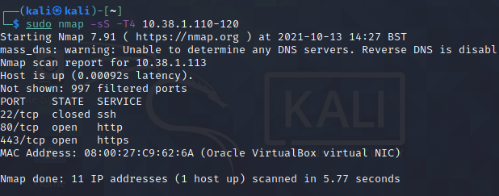
sudo stands for either "substitute user do" or "super user do“, and it allows you to elevate your current user account to have root privileges temporarily.
nmap is the tool we will use.
-sS is a SynScan, which does not perform a full TCP handshake (does not make a full connection), so is less intrusive.
-T4 will set the scan speed to maximum.
10.38.1.110-120 (specifying the range of IP addresses to scan).
Notes:
Lesson 14

Slide 76
Tools to use for next stages:
nmap
sudo nmap –sS –T4 10.38.1.113
hydra
hydra -vV -L /home/kali/Downloads/fsocity.dic -p ddddd 10.38.1.113 http-post-form '/wp-login.php:log=^USER^&pwd=^PASS^&wp-submit=Log+In:F=Invalid username' –F
wpScan
wpscan –url http://example.com –passwords rockyou.txt –usernames andy –max-threads 50
nikto
nikto -h 10.38.1.113
Notes:
Lesson 14

Slide 77
05
ESP 3 – Building a
port scanner/IP sweeper

Slide 78
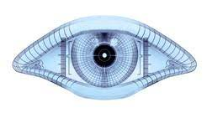
Notes:
Lesson 15

Slide 79
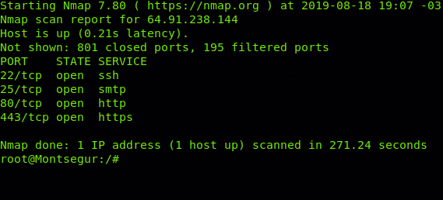
What is port scanning?
Port scanning is a method of determining which ports on a network are open, and so whether data can be sent and received by them. Data packets can also be sent to specific ports via this method, and the responses of different ports can be observed.
An initial network scan will identify hosts in a network and map them to an IP address. From here, ports can be scanned to determine whether they might be open or vulnerable. So the security layout of a network can be tested. For example, port scanning can reveal the presence of a firewall blocking incoming packets.
Port scanning is a valuable tool, which can be used by network administrators to check the robustness of security measures in a network. However, like all tools, port scanning can also be misused by cyber-criminals looking for a vulnerable entry point to a network.
Notes:
Lesson 15

Slide 80


Think of two tools and how we used them during our CTF hack of Mr. Robot…
How could these tools be considered threats to a system?
How could they be used to help protect a system?
Notes:
Lesson 15

Slide 81
https://www.youtube.com/watch?v=N5sKVaQLYjY&ab_channel=Sourcefire
What port did we scan for with Mr. Robot that shows a webserver service?
How might we use a network scan for defensive/protective reasons?
Notes:
Lesson 15

Slide 82
CVEs: Common vulnerabilities and exposures
The mission of the CVE programme is to identify, define, and catalogue publicly disclosed cybersecurity vulnerabilities. There is one CVE record for each vulnerability in the catalogue. The vulnerabilities are discovered, then assigned and published by organisations from around the world that have partnered with the CVE programme. Partners publish CVE records to communicate consistent descriptions of vulnerabilities. Information-technology and cybersecurity professionals use CVE records to ensure that they are discussing the same issue, and to coordinate their efforts to prioritise and address the vulnerabilities.
https://www.cve.org/About/Process
What is the process of logging CVEs?
Notes:
Lesson 15

Slide 83
Nmap Vulnscanning
https://www.youtube.com/watch?v=HukLd-6C4Ew&ab_channel=ProfessorMesser
https://securitytrails.com/blog/nmap-vulnerability-scan
Choose one of the outputs and research one of the vulnerabilities shown. What is the nature of this vulnerability?
What is the CVE ID? And what does the CVE programme say about it?
Notes:
Lesson 15

Slide 84
Socket module
What is AF_INET, and how does it relate to Socket?
What features does it allow?
Notes:
Lesson 15
Solution 1

Slide 85
Scenario brief
You work in network security for a company processing confidential details across a number of departments. For security reasons, the company has asked for the tools used to be in-house.
You have been asked to develop a Python-based port scanner to assess the network and to provide a basic layout of open and potentially vulnerable ports. You must:
Build the port scanner
Test the network (IP address will be given)
Record open ports and research them. What are they?
Fill out testing form and report results.
Scope
The project will include:
A working port scanner application with a scan range of at least 50-499
Output showing total scan time
Ability to input a target hostname.
Constraints
The project will not include:
Scanning of all ports
A comprehensive or complete vulnerability scan.
Notes:
Lesson 15

Slide 86


Legal notice
When we run our script, it should prompt for a target hostname. You can provide any hostname – like the name of any website – but be careful because port scanning can be seen as, or construed as, a crime.
We should never execute a port scanner against any website or IP address without explicit, written permission from the owner of the server or the computer that you are targeting.
Port scanning is akin to going to someone’s house and checking their doors and windows. That is why it is advisable only to use our port scanner on a local host, your own website or property, or something you have express permission to scan.
Notes:
Lesson 15

Slide 87
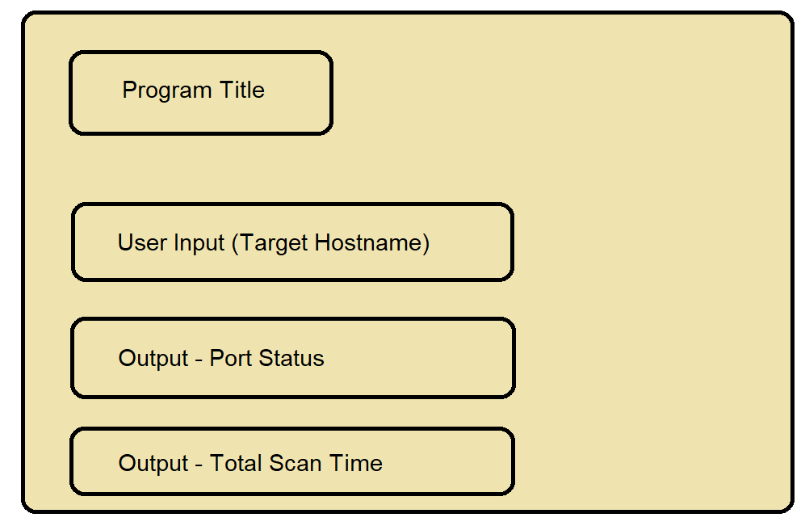
UI design
A working port-scanner application with a scan range of at least 50-499
Output showing total scan time
Ability to input a target hostname
Notes:
Lesson 15

Slide 88
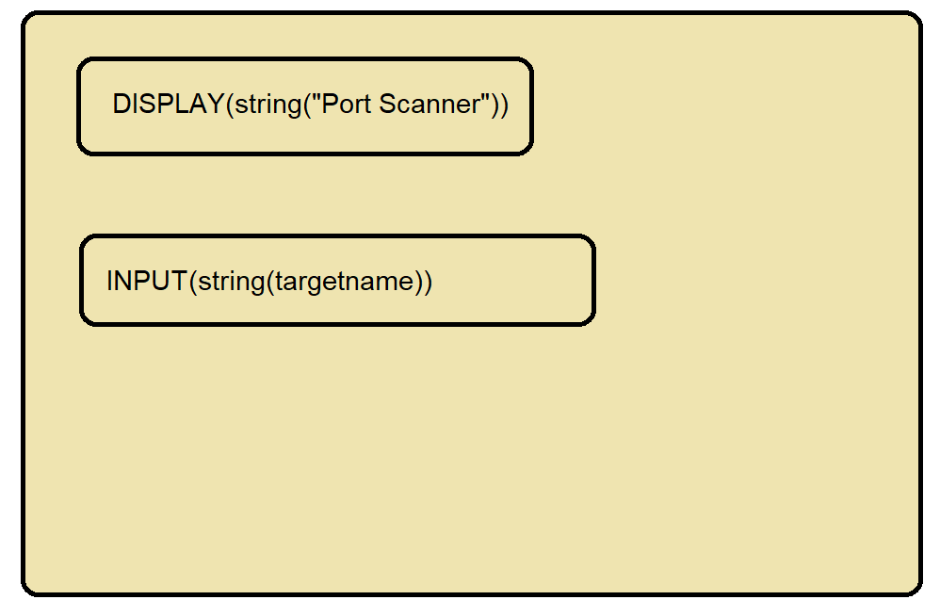
UI storyboard one – initial display
Casting input data as string, to avoid type-errors and to allow hostname to be read
Notes:
Lesson 15

Slide 89
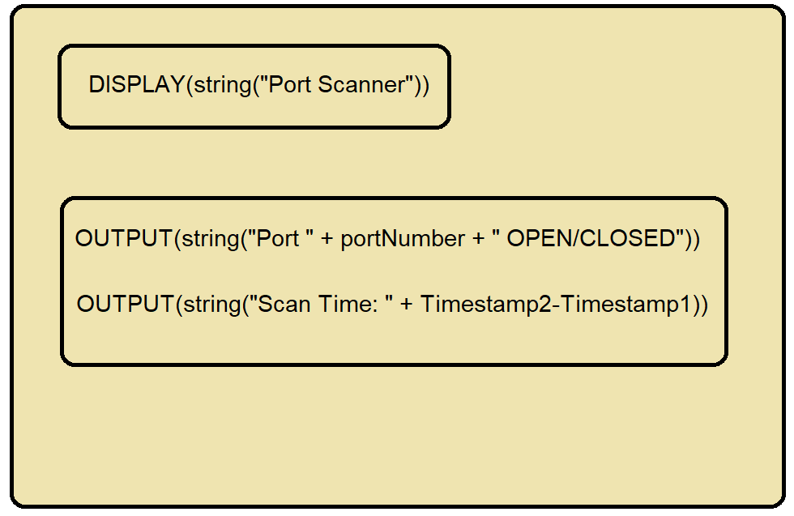
UI storyboard two – output display
Notes:
Lesson 15

Slide 90
Program design
Scan ports 50-499
OUTPUT
(timestamp 2 – timestamp 1)
Start
OUTPUT (port scanner)
Port open?
End
INPUT (enter target hostname)
No
Yes
OUTPUT (port # closed)
OUTPUT (port # open)
Search target IPv4 with socket + take timestamp 1
Is last port?
No
Can connect?
No
Yes
OUTPUT/
(no connection)
Take timestamp 2
Notes:
Lesson 15

Slide 91
Program design
(Validity checks)
Is integer?
OUTPUT (Please enter a valid port number)
Start
No
OUTPUT (port scanner)
Yes
INPUT (final port to scan)
INPUT (enter target hostname: )
Is integer?
OUTPUT
(Please enter a valid port number)
No
OUTPUT
(Please enter a valid hostname)
Is valid hostname?
No
Yes
Yes
Perform scan
End
INPUT (initial port to scan)
Notes:
Lesson 15

Slide 92
from socket import *
#importing necessary module
if __name__ == '__main__':
target = input('Enter target IP or hostname: ')
tip = gethostbyname(target)
#socket function allowing for IP input as a string and subsequent targeting
print('Scanning target: ', tip)
for i in range(50, 500):
s = socket(AF_INET, SOCK_STREAM) #scans through ports 50-499
conn = s.connect_ex((tip, i))
if (conn == 0):
print('Port %d: OPEN' % (i,)) #outputs 'OPEN/CLOSED status for ports in loop
s.close()
Notes:
Lesson 15

Slide 93
Scenario update
The company has asked to put a timestamp in the program, so we can see how much time a scan has taken. They would also like to change the script to scan from ports 50-599.
Research the module needed.
Import it into our script.
Take an initial timestamp.
Print total time taken for the scan.
Update the port scan to include 599 ports.
Notes:
Lesson 15

Slide 94
from socket import *
import time
#importing neccesary modules
startTime = time.time()
#take initial timestamp
if __name__ == '__main__':
target = input('Enter target IP or hostname: ')
tip = gethostbyname(target)
#socket function allowing for IP input as a string and subsequent targeting
print('Scanning target: ', tip)
for i in range(50, 500):
s = socket(AF_INET, SOCK_STREAM) #scans through ports 50-499
conn = s.connect_ex((tip, i))
if (conn == 0):
print('Port %d: OPEN' % (i,)) #outputs 'OPEN/CLOSED status for ports in loop
s.close()
print('Time taken:', time.time() - startTime) #print overall time taken for scan
Notes:
Lesson 15
Solution 1

Slide 95
Project analysis for solution one
Scope
The project will include:
A working port-scanner application with a scan range of at least 50-499.
for i in range(50, 500):
s = socket(AF_INET, SOCK_STREAM)
Shows scans through ports 50-499.
Output showing total scan time
print('Time taken:', time.time() - startTime)
Prints overall time taken for scan.
Ability to input a target hostname
target = input('Enter target IP or hostname: ')
tip = gethostbyname(target)
Allows specification of a target via IP / hostname.
Notes:
Lesson 15

Slide 96
Project analysis for solution one
Constraints
The project will not include:
Scanning of all ports
for i in range(50, 500):
s = socket(AF_INET, SOCK_STREAM)
Program allows for specification of a range of ports.
A comprehensive/complete vulnerability scan
if (conn == 0):
print('Port %d: OPEN' % (i,))
Outputs 'OPEN/CLOSED’ status for ports in loop and does not access common vulnscan databases.
Notes:
Lesson 15

Slide 97
import sys import socket import pyfiglet from datetime import datetime banner = pyfiglet.figlet_format(“Network Scanner") print(banner) # Gives us a target if len(sys.argv) == 2: # Allows us to input targer via IPv4 or url target = socket.gethostbyname(sys.argv[1]) else: print("Invalid amount of Argument") t1 = datetime.now() # customising our banner with scan data print("-" * 50) print("Scanning: " + target)
Notes:
Lesson 16
Solution two

Slide 98
try: # will scan ports between 1 to 500 for port in range(1,500): sport = socket.socket(socket.AF_INET, socket.SOCK_STREAM) socket.setdefaulttimeout(1) # code below tells us whether port is open or if error is encountered result = sport.connect_ex((target,port)) if result ==0: print("Port {} is open".format(port)) t2 = datetime.now() print(“Scan begun at + str(datetime.now()) + “ total time = “ + t1-t2) sport.close() except KeyInterrupt: print(“Closing Program”) sys.exit() except socket.gaierror: print(“Invalid Hostname, Please Try Again") sys.exit() except socket.error: print(“No Response from Server”) sys.exit()
Notes:
Lesson 16
Solution two

Slide 99
Project analysis for solution two
Scope
The project will include:
A working port-scanner application with a scan range of at least 50-499
for port in range(1,500):
sport = socket.socket(socket.AF_INET, socket.SOCK_STREAM)
socket.setdefaulttimeout(1)
Shows scans through ports 1-499.
Output showing total scan time
print(“Scan begun at + str(datetime.now()) + “ total time = “ + t1-t2)
Shows scan time.
Ability to input a target hostname
if len(sys.argv) == 2:
target = socket.gethostbyname(sys.argv[1])
Allows specification of a target via IP/hostname.
Notes:
Lesson 16

Slide 100
Project analysis for solution two
Constraints
The project will not include:
Scanning of all ports
for port in range(1,500):
Program allows for specification of a range of ports.
A comprehensive/complete vulnerability scan
if result ==0:
print("Port {} is open".format(port))
Outputs 'OPEN/CLOSED’ status for ports in loop and does not access common vulnscan databases.
Notes:
Lesson 16

Slide 101
#!/usr/bin/env python import sys import socket import subprocess from datetime import datetime # Clear screen subprocess.call('clear', shell=True) # Get user input Server = raw_input("Enter a target to scan: ") ServerIP = socket.gethostbyname(Server) # Output scan data Print("-" * 60) Print(“Scanning Target", ServerIP) print("-" * 60) # Get scan start timestamp t1 = datetime.now()
Notes:
Lesson 16
Solution three

Slide 102
# Specifying ports and handling errors try: for port in range(1,500): sock = socket.socket(socket.AF_INET, socket.SOCK_STREAM) result = sock.connect_ex((ServerIP, port)) if result == 0: print("Port {}: Open".format(port)) sock.close() except KeyInterrupt: print(“Closing Program“) sys.exit() except socket.gaierror: print(“Host Not Found”) sys.exit() except socket.error: print("Couldn't connect“) sys.exit()
Notes:
Lesson 16
Solution three

Slide 103
# Getting second scan timestamp t2 = datetime.now() # Calculating difference of timestamps time = t2 - t1 # Output total print(“Scan took”, time)
Notes:
Lesson 16
Solution three

Slide 104
Project analysis for solution three
Scope
The project will include:
A working port scanner application with a scan range of at least 50-499
try:
for port in range(1,500):
sock = socket.socket(socket.AF_INET, socket.SOCK_STREAM)
result = sock.connect_ex((ServerIP, port))
Shows scans through ports 1-499.
Output showing total scan time
t1 = datetime.now()
t2 = datetime.now()
time = t2 - t1
print(“Scan took”, time)
Shows scan time.
Ability to input a target hostname
Server = raw_input("Enter a target to scan: ")
ServerIP = socket.gethostbyname(Server)
Allows specification of a target via IP/hostname.
Notes:
Lesson 16

Slide 105
Project analysis for solution three
Constraints
The project will not include:
Scanning of all ports
for port in range(1,500):
Program allows for specification of a range of ports.
A comprehensive or complete vulnerability scan
if result ==0:
print("Port {} is open".format(port))
Outputs 'OPEN/CLOSED’ status for ports in loop and does not access common vulnscan databases.
Notes:
Lesson 16

Slide 106
from datetime import datetime import errno import sys # Enter a target by hostname server = input("Enter target hostname: ") server_ip = socket.gethostbyname(server) #Enter the range of ports and start scan timer print("Enter the range of target ports:") initPort = input("Enter port to begin with: ") finalPort = input("Enter port to end with: ") print(“Scanning Target", server_ip) time_1 = datetime.now()
Notes:
Lesson 16
Solution four

Slide 107
# Create a socket to connect to host, decide whether the port is open or closed. # Give exception error message if needed try: for port in range(int(initPort), int(finalPort)): print("Checking port {} ...".format(port)) server_sock = socket.socket(socket.AF_INET, socket.SOCK_STREAM) server_sock.settimeout(5) result = server_sock.connect_ex((server_ip, port)) if result == 0: print("Port {}: Open".format(port)) else: print("Port {}: Closed".format(port)) print("Reason:", errno.errorcode[result]) server_sock.close() except socket.error: print("Couldn't connect") sys.exit()
Notes:
Lesson 16
Solution four

Slide 108
# Calculate total time taken for scan time_2 = datetime.now() time = time_2 - time_1 print(“Scan took”, time)
Notes:
Lesson 16
Solution four

Slide 109
Project analysis for solution four
Scope
The project will include:
A working port scanner application with a scan range of at least 50-499
try:
print("Enter the range of target ports:")
initPort = input("Enter port to begin with: ")
finalPort = input("Enter port to end with: ")
Allows scans through ports 1-499.
Output showing total scan time
time_1 = datetime.now()
time_2 = datetime.now()
time = time_2 - time_1
print(“Scan took”, time)
Shows scan time.
Ability to input a target hostname
server = input("Enter target hostname: ")
server_ip = socket.gethostbyname(server)
Allows specification of a target via IP/hostname.
Notes:
Lesson 16

Slide 110
Project analysis for solution four
Constraints
The project will not include:
Scanning of all ports.
for port in range(int(initPort), int(finalPort)):
print("Checking port {} ...".format(port))Program allows for specification of a range of ports.
A comprehensive / complete vulnerability scan
if result == 0:
print("Port {}: Open".format(port))
else:
print("Port {}: Closed".format(port))
print("Reason:", errno.errorcode[result])
Notes:
Lesson 16

Slide 111
import socket import argparse from colorama import init, Fore from threading import Thread, Lock from queue import Queue from datetime import datetime # adding colour init() GREEN = Fore.GREEN RESET = Fore.RESET GRAY = Fore.LIGHTBLACK_EX # specifying number threads to utilise for scan threads = 200 q = Queue() print_lock = Lock()
Notes:
Lesson 16
Solution five

Slide 112
def pscan(port):
time_1 = datetime.now()
#Scan a target port and print result
try:
s = socket.socket()
s.connect((host, port))
except:
with print_lock:
print(f"{GRAY}{host:15}:{port:5} closed {RESET}", end='\r')
else:
with print_lock:
print(f"{GREEN}{host:15}:{port:5} open {RESET}")
finally:
s.close()
def sthread():
global q
while True:
# get port number from the queue
worker = q.get()
# scan port number
pscan(worker)
q.task_done()
Notes:
Lesson 16
Solution five

Slide 113
def main(host, ports): global q for t in range(threads): # form a queue of ports and scan through queue t = thread(target=sthread) # work through ports t.daemon = True t.start() for worker in ports: q.put(worker) q.join() time_2 = datetime.now() time = time_2 - time_1 print(“Scan took”, time)
Notes:
Lesson 16
Solution five

Slide 114
Project analysis for solution five
Scope
The project will include:
A working port scanner application with a scan range of at least 50-499
def sthread():
global q
while True:
worker = q.get()
pscan(worker)
q.task_done()
Allows scans through ports 1-499.
Output showing total scan time
time = time_2 - time_1
print(“Scan took”, time)
Shows scan time.
Notes:
Lesson 16

Slide 115
Project analysis for solution five
Scope
The project will include:
Ability to input a target hostname
try:
s = socket.socket()
s.connect((host, port))
except:
with print_lock:
print(f"{GRAY}{host:15}:{port:5} closed {RESET}", end='\r')
else:
with print_lock:
print(f"{GREEN}{host:15}:{port:5} open {RESET}")
finally:
s.close()
Allows specification of a target via IP/hostname.
Notes:
Lesson 16

Slide 116
Project analysis for solution five
Constraints
The project will not include:
Scanning of all ports
global q
while True:
# get port number from the queue
worker = q.get()
# scan port number
pscan(worker)
q.task_done()
Program allows for specification of a range of ports.
A comprehensive or complete vulnerability scan
s = socket.socket()
s.connect((host, port))
except:
with print_lock:
print(f"{GRAY}{host:15}:{port:5} closed {RESET}", end='\r')
else:
with print_lock:
print(f"{GREEN}{host:15}:{port:5} open {RESET}")
finally:
s.close()
Notes:
Lesson 16

Slide 117
Scenario brief
You work in network security for a company processing confidential details across a number of departments. For security reasons, the company has asked for the tools used to be in-house.
You have been asked to develop a Python-based port scanner to assess the network and to provide a basic layout of open and potentially vulnerable ports. You must:
Build the port scanner
Test the network (IP address will be given)
Record open ports and research them. What are they?
Fill out testing form and report results.
Scope
The project will include:
A working port scanner application with a scan range of at least 50-499
Output showing total scan time
Ability to input a target hostname.
Constraints
The project will not include:
Scanning of all ports
A comprehensive or complete vulnerability scan.
Notes:
Lesson 16

Slide 118
Run your program and record results. Research the ports identified and list them.
Run nmap as a comparison.
Nmap –sS T4 [ipaddress]
Record your results in the test document.
Notes:
Lesson 16

Slide 119


PRODUCED BY
FUNDED BY
Leeds City College has produced this resource on behalf of the Education and Training Foundation
This programme is funded by the Department for Education
ET-FOUNDATION.CO.UK

