Slide 1
Core Skill 4: How to assess and manage risks to your own and others’ safety when planning activities (Part 1)
All images have been sourced through PowerPoint with Creative Commons or from stock images. Where references were available, these have been provided.
ETF/Leeds City College

Slide 2
01
Introduction to risk assessment: Duty of care and underpinning legislation

Slide 3
Lesson objectives
By the end of this activity, learners should be able to:
explain the legal framework for risk assessment and risk management
describe the implications of legislation on risk assessment and risk management
analyse how risk assessment and risk management can be improved by following the relevant legislation.

Slide 4

Starter activity 1.0: Part 1
In the context of education and early years, annotate the matchstick person with your understanding of what is meant by
“duty of care”.

Slide 5
Starter activity 1.0: Part 2
Compare your work with a partner:
Are there any similarities?
Are there any differences?
Agree on a definition for the term “duty of care”.
Share with another pair and agree on a new definition.
Copy this onto flipchart paper and display it in the room.

Slide 6

Duty of care
The legal obligation to ensure the safety and wellbeing of
everyone in your care; to keep them safe from physical, personal or emotional harm.
This includes not only children but also staff, volunteers and any visitors either on the premises or working offsite, for example on a trip or external training.

Slide 7
Activity 1.1: Legislation, frameworks and guidance
In small groups, brainstorm which legislation and guidance may underpin duty of care.
Think about the legislation, guidance and frameworks that ensure:
fire safety
health and safety
food safety
personal safety
child protection
any other relevant factors.

Slide 8

Legislation (non-exhaustive list)
Health and Safety at Work Act 1974
Reporting of Injuries, Diseases and Dangerous Occurrences (RIDDOR) 2013
Control of Substances Hazardous to Health (COSHH)
Food Hygiene (England) Regulations 2006
Equality Act 2010
Children Act 1989/2004
Childcare Act 2006
Early Years Foundation Stage
Working Together to Safeguard Children
Keeping Children Safe in Education
Please refer to the latest versions.

Slide 9
Activity 1.2: Researching legislation, frameworks and guidance
In pairs, research the legislation or guidance assigned to you and create an information leaflet.
Present your findings to the class.
Produce an information leaflet that explains the
key points of the legislation, guidance or framework in relation to duty of care.
Example
Food Hygiene (England) Regulations 2006: Safe storage of food to avoid cross-contamination.
Take meaningful notes from others’ presentations so that you can collate the key points for all the legislation.

Slide 10

Definitions
Compliance: Obeying rules or meeting requirements.
Breach: Breaking rules or regulations, not meeting requirements.

Slide 11

Activity 1.3: Compliance and breach
In pairs, complete the case study assigned to you.

Slide 12
Progress check (1/2)
Duty of care requires employers to take reasonable steps to protect their employees from harm. True/False
The Health and Safety at Work Act 1974 requires employers to provide a safe and healthy working environment. True/False
Duty of care does not require individuals to take action to protect the wellbeing of others. True/False

Slide 13
Progress check (1/2): Answers
Duty of care requires employers to take reasonable steps to protect their employees from harm. True/False
The Health and Safety at Work Act 1974 requires employers to provide a safe and healthy working environment. True/False
Duty of care does not require individuals to take action to protect the wellbeing of others. True/False

Slide 14
Progress check (2/2)
Duty of care obliges individuals to use reasonable skill and judgement when dealing with those in their care. True/False
Duty of care requires employers to eliminate all risks in the workplace. True/False
It is safe to eat food that is past its expiration date. True/False

Slide 15
Progress check (2/2): Answers
Duty of care obliges individuals to use reasonable skill and judgement when dealing with those in their care. True/False
Duty of care requires employers to eliminate all risks in the workplace. True/False
It is safe to eat food that is past its expiration date. True/False

Slide 16
Home study 1.0
Research the policies and procedures of your industry placement, and create a document that provides an outline of the following:
health and safety policy, including fire safety
food hygiene policy
safeguarding policy
visitor policy
confidentiality policy.
Extension: Talk to your placement mentor or supervisor and determine your setting’s approach to risk.

Slide 17
02
Introduction to risk assessment and management: The difference between risk aversion and risk management

Slide 18
Lesson objectives
By the end of this activity, learners should be able to:
define “aversion” and “management” in relation to risk
define the difference between risk aversion and risk management
explain the importance of risky play for developing children’s resilience
support and manage risk.

Slide 19

Starter activity 2.0
In small groups, share your home study overview of your setting’s policies and procedures:
  What do you think these documents tell you about the setting’s approach to risk?
  Are there any similarities and differences between individual settings?

Slide 20
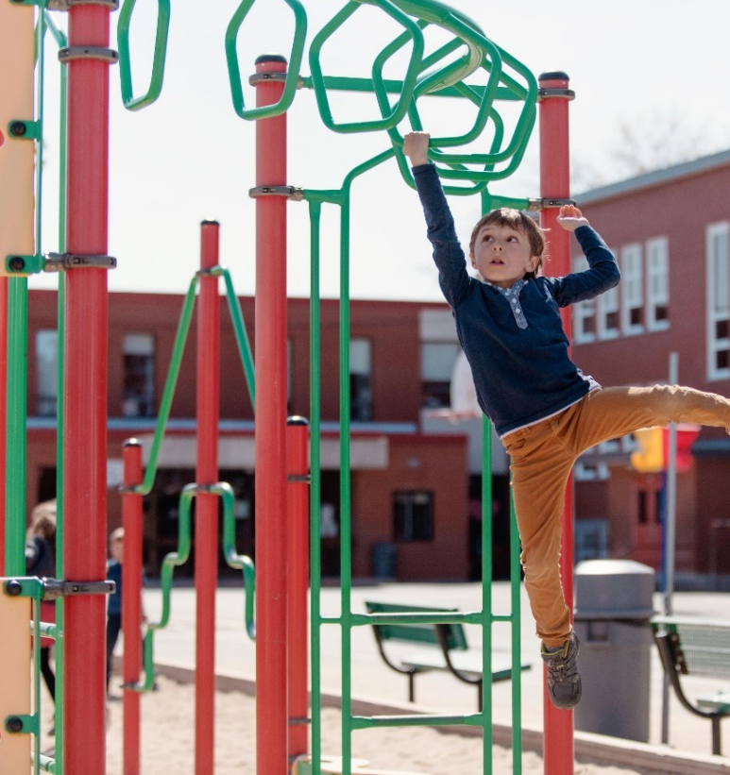
Activity 2.1
Look at the image on the right:
  Identify any risks.
  Describe any benefits to this type of play.
  Do the benefits outweigh the risks?

Slide 21

Introduction and background
    In the 1970s, most seven to eight year olds went to and from school on their own.
    By the 1990s, this was around 1 in 10, and this figure remains around the same today.
    What factors do you think may have caused this shift?
In the UK, the way we think about keeping children safe changed in a generation.

Slide 22

Statistics
In a National Travel Survey, parents gave some of the following reasons for accompanying their 5-10-year-old children to school:
  traffic danger (47 per cent)
  fear of assault (29 per cent).
  How does this compare to your own thoughts?

Slide 23

Definitions
What do you think the following terms mean?
  Aversion
  Management
  Can you put your definitions in the context of early childhood education?

Slide 24
Our idea
Risk aversion
Overshielding; constraining children’s innate desire to discover, challenge themselves and actively experiment.
Risk management
  Providing a nurturing age- and stage-appropriate environment where the risks and benefits are effectively weighed up and children can develop “risk literacy”.

Slide 25
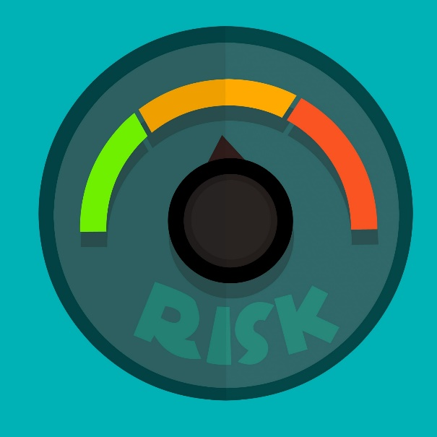
Risk literacy
The ability to deal with uncertainties in an informed way.
Gigerenzer, G. (2008). Rationality for Mortals: How People Cope with Uncertainty. Oxford: Oxford University Press.
Further information: Gerd Gigerenzer, “Risk Literacy”, TedX Zurich.

Slide 26

Activity 2.2: Common risks in education and early years settings
Working in two groups, consider either the indoors or the outdoors and identify risks that children take daily in these environments.
Extension: Do the risks change with the age/stage of the children? Give reasons for your answers.
This Photo by Unknown author is licensed under CC BY.

Slide 27

Risk aversion
Why do you think some individuals in education and early years tend to discourage children from taking risks?
What factors do you think contribute to this thinking?

Slide 28
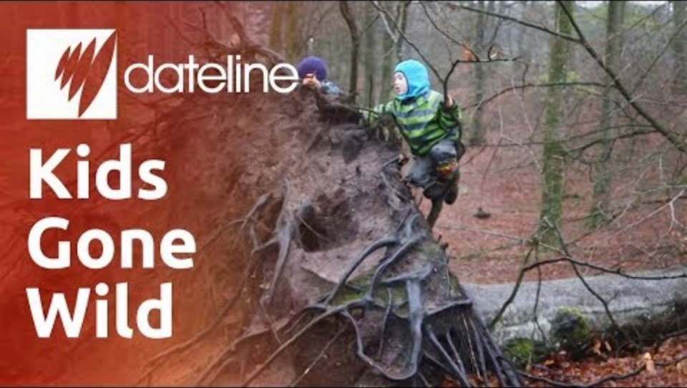
Kids Gone Wild: Denmark’s Forest Kindergarten
https://youtu.be/Jkiij9dJfcw?si=bKt4j0Vt_Xn4cphG&t=174
(2:54 to 6:13)

Slide 29
Class discussion
Think about this approach:
Why do you think the attitude in this
Denmark kindergarten differs from that in
most early years settings in the UK?
From the video, what benefits did you identify for children using this approach?

Slide 30

Activity 2.3: Reading handout
Play England has welcomed a shift in attitudes
following the introduction of a new standard in 2023.
Read the Play England blog post and summarise in no more than 20 words what this standard means for early years settings.
https://www.playengland.org.uk/newsblog/child-safety-experts-welcome-game-changing-new-international-benchmark-that-gives-a-green-light-to-more-adventurous-play?rq=risk%20management

Slide 31
Effective strategies for managing risks in the early years
The standard says, crucially, that we should consider the benefits of allowing a degree of risk and challenge.
How do we weigh up the level of risk involved and the benefits to children?

Slide 32

Our idea
  Start with the idea that risk is essential for children’s holistic development.
  What will they miss out on if they do not take part in the activity?
  Ensure the environment, resources and equipment are age and stage appropriate.

Slide 33

Activity 2.4: Case studies – Risk benefit analysis
Children cooking
  Children cook using real ingredients, real utensils and a real hob.
Fire at Forest School
  Under adult supervision, young children tend to a fire while at Forest School.

Slide 34

Progress check: Identify the true statements
  Risky play enables children to learn how to face danger.
  Health and safety legislation and guidance make it clear that all risk should be removed.
  The adult’s role is to ensure children can take risks without placing them in actual danger.
  A risk benefit analysis is difficult to carry out.
  By developing a culture of managed risk, you are helping children to develop resilience.

Slide 35
Progress check: Answers
  Risky play enables children to learn how to face danger.
  Health and safety legislation and guidance make it clear that all risk should be removed.
  The adult’s role is to ensure children can take risks without placing them in actual danger.
  A risk benefit analysis is difficult to carry out.
  By developing a culture of managed risk, you are helping children to develop resilience.

Slide 36

Home study 2.0
Next week, we will be investigating the difference between a hazard and a risk. Briefly research a definition for each term, paraphrase them in your own words and provide a reference to your sources.
Extension: Reflect on your own attitude and approach to risk and consider how your values and previous experiences have impacted this.

Slide 37
03
Introduction to risk assessment and management: Types of hazards

Slide 38

Lesson objectives
Explain the difference between hazard and risk.
Describe the five types of hazard:
        physical
        security
        fire
        food safety
        personal safety.
Link hazard and risk to policies and procedures examined in lesson 1.

Slide 39

Starter activity 3.0: Early Years Foundation Stage (EYFS) Statutory Framework 2024
3.76 Providers must ensure that they take all
reasonable steps to ensure staff and children in
their care are not exposed to risks.
How is this statutory requirement associated with the concept of risk benefit?
Explain your thoughts in your notebooks and compare with a partner.

Slide 40
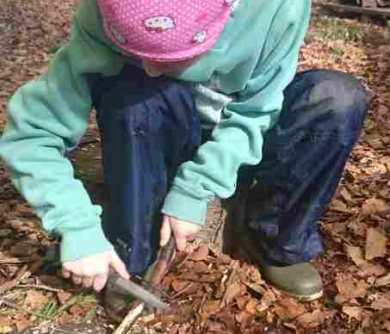
Activity 3.1
Recall the definitions you completed for the home study. Examine the picture and note the hazards and risks involved in this activity.
Do the benefits outweigh the risks? Explain your answer.

Slide 41


Difference between hazard and risk
A hazard is a potential source of harm.
Hazards are not risks themselves, but they create risks.
A hazard can generate various risks, as it may have the potential to cause harm in several ways.
Risk is the likelihood that harm will occur.

Slide 42
Our idea
Hazards
The knife is a potential source of harm, in several ways, to:
    the child themselves
    other children.
Risks
The chance that injury or harm might occur.
How likely is it that the child could harm themselves with the knife?

Slide 43

Different types of hazard
There are five main types of hazard:
  physical
  security
  fire
  food safety
  personal safety.

Slide 44

Physical hazards: Discuss the risks associated with these hazards
These are things in the immediate environment with the
potential to cause harm:
building and grounds
electricity and gas
water
play resources
activities
standard of equipment.
Link to placement experience: Provide an example of a hazard have you identified in your setting.

Slide 45

Activity 3.2: Link to legislation and policies and procedures from lesson 1
What can you remember from lesson 1?
Name one piece of legislation or guidance that links to the physical environment.
Link this to a setting policy and procedure.

Slide 46
Links to legislation, guidance, policy and procedure: Our idea
Health and Safety at Work Act 1974
RIDDOR 2013
COSHH
EYFS 3.64 Safety of premises
Health and safety policy
Equipment and resources policy

Slide 47

Activity 3.3: Security hazards
How many security hazards can you and your group name in just 60 seconds?
For example, entry and exit systems.

Slide 48

Security hazards: Our ideas
Unauthorised people on the premises
Unaccompanied visitors
Security breaches to the perimeter
Children leaving the premises unaccompanied
Ensuring children only go home with an authorised person

Slide 49
Activity 3.4: Link to legislation and policies and procedures from lesson 1
What can you remember from lesson 1?
Name one piece of legislation or guidance that links to security hazards.
Link this to a setting policy and
procedure.

Slide 50
Links to legislation, guidance, policy and procedure: Our idea
Childcare Act 2006
Children Act 1989/2004
EYFS 3.72 Organising premises
Working Together to Safeguard Children
Keeping Children Safe in Education
Visitor policy
Premises policy
Child collection policy and procedures

Slide 51

Activity 3.5: Fire hazards
In pairs, use the internet to research the term “fire hazard”.
Explain what this might be in the context of education settings.
Be prepared to feed back to the class and compare notes.
Extension: Can you find a statistic relating to fire hazards?

Slide 52

Activity 3.5: Fire hazards cont..
These hazards can be caused by environmental factors or human action/error. For example:
failure to turn off heating and cooking equipment
covering heat sources
overloaded sockets / faulty electrics
arson
natural disasters like an earthquake or lightning strike
smoking.

Slide 53

Activity 3.6: Link to legislation and policies and procedures from lesson 1
What can you remember from lesson 1?
Name one piece of legislation or guidance that links to fire safety.
Link this to a setting policy and procedure.

Slide 54
Links to legislation, guidance, policy and procedure: Our idea
HASAWA 1974
EYFS 3.65 Safety of premises
EYFS 3.22 Smoking/vaping
Health and safety policy
Premises policy
Fire safety check procedures
Fire drill procedures

Slide 55

Food safety hazards: Discuss the risks associated with these hazards
Cross-contamination
Use-by dates
Food not reheated correctly
Allergies
Dietary requirements
Poor hygiene practices
Poor food storage
Pests

Slide 56
Activity 3.7: Link to legislation and policies and procedures from lesson 1
What can you remember from lesson 1?
Name one piece of legislation or guidance that links to food safety.
Link this to a setting policy and procedure.

Slide 57
Links to legislation, guidance, policy and procedure: Our idea
Health and Safety at Work Act 1974
COSHH
Food Hygiene (England) Regulations 2006
Childcare Act 2006
EYFS 3.56 Food and drink
Food safety policy
Healthy eating policy

Slide 58

Personal safety hazards: Discuss the associated risks
Contagious diseases
Poor hygiene practices
Poor adult-to-child ratios
Choking
Slips, trips and falls
Poisoning
Suffocating
Drowning
Burns and scalds
Inappropriate play
resources
Crushing

Slide 59
Activity 3.8: Link to legislation and policies and procedures from lesson 1
What can you remember from lesson 1?​
Name one piece of legislation or guidance that links to the physical environment​.
Link this to a setting policy and procedure.

Slide 60
Links to legislation, guidance, policy and procedure: Our idea
Health and Safety at Work Act 1974
COSHH
RIDDOR
Childcare Act 2006
EYFS 3.71 Toilets and intimate hygiene
Food safety policy
Managing sick children policy
Cleaning procedures

Slide 61
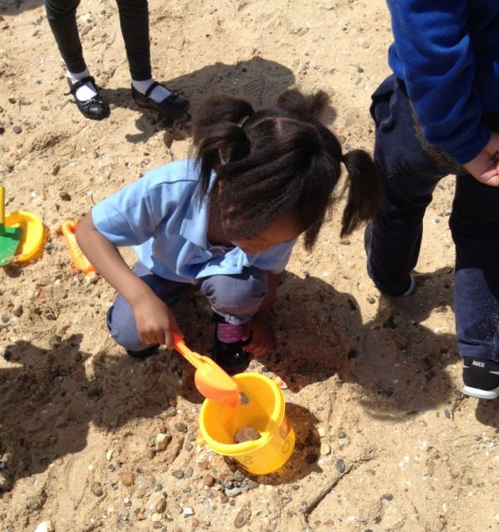
Safety on outings: EYFS Statutory Framework 2024
3.74 Children must be kept safe while on outings:
Providers must assess potential risks or hazards.
This must include consideration of adult-to-child ratios.
Statutory framework for the early years foundation stage for group and school providers (publishing.service.gov.uk)

Slide 62
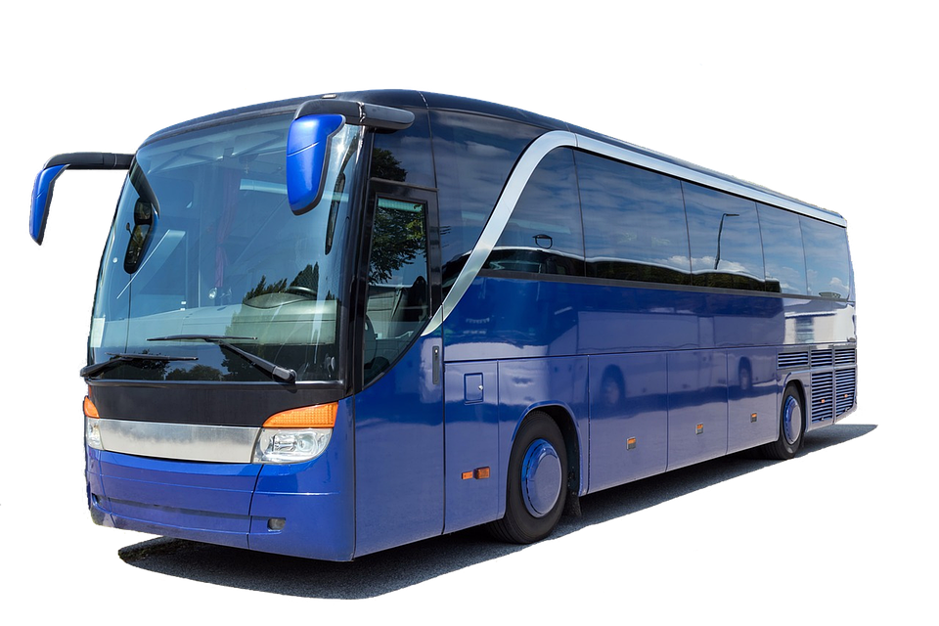
Safety on outings: EYFS Statutory Framework 2024
3.75 Vehicles transporting children, and the drivers of those vehicles, must be adequately insured.

Slide 63

Activity 3.9
Your school setting is planning a reception class trip to the beach in March. They will travel the short distance using the school minibus.
In small groups, identify the hazards and risks involved in this trip.
Categorise the hazards using the five types:
  physical
  security
  fire
  food safety
  personal safety.

Slide 64

Progress check: Case study
The nursery manager is driving home in a
storm. They see a parent and child walking
home from the setting, so they stop and
offer them a lift.
What potential hazards can you identify in this scenario?
What is the risk of each hazard happening?
What advice would you give to the manager?

Slide 65
Progress check: Case study – Our idea
What potential hazards can you identify in this scenario?
Uninsured driver, driving conditions, road traffic accident.
What is the risk of each hazard happening?
Small risk of harm, high risk of breaking statutory guidance and the law if uninsured for business use.
What advice would you give to the manager?
Do not offer a lift if uninsured for business use.

Slide 66

Home study 3.0
Find an example of a risk assessment that has been carried out in your setting. Bring in a blank or anonymised copy of the template or the completed risk assessment.
Extension: Design a risk assessment template. What do you think should be included?

Slide 67
04
Five steps to risk assessment

Slide 68

Lesson objectives
Recap the difference between hazard and risk
Describe the five steps to risk assessment as identified by the Health and Safety Executive (HSE).

Slide 69
Starter activity: Put these steps in the order you think they happen when carrying out a risk assessment
Assess the risks
Identify hazards
Review the controls
Record your findings
Control the risks
Extension activity
Justify your decision in your notebooks.

Slide 70

Starter: Answers
Identify hazards
Assess the risks
Control the risks
Record your findings
Review the controls
https://www.hse.gov.uk/simple-health-safety/risk/steps-needed-to-manage-risk.htm

Slide 71

Reflective questions
Was there anything in the order that surprised you? Why?
Share your original thoughts with a partner and explain your thinking.

Slide 72

Progress check: Risk or hazard?
What can you remember about the difference between hazards and risks?
The chance that someone may be harmed is a …?
A potential source of harm is a …?

Slide 73
Progress check: Risk or hazard? Answers
The chance that someone may be harmed is a RISK.
A potential source of harm is a HAZARD.

Slide 74

Activity 4.1: Compare and contrast risk assessments
Access the blank template or anonymised and completed risk assessment that you sourced for home study.
Swap with a partner, compare similarities and differences, then do this again with another learner until you have seen at least three risk assessment templates.

Slide 75

Activity 4.2: The five steps to risk assessment
How do the risk assessment examples seen compare with the five steps from the HSE?
Summarise your findings in your notebooks.
Identify hazards
Assess the risks
Control the risks
Record your findings
Review the controls

Slide 76

Activity 4.3: Case studies
In small groups, complete the case study allocated to you.
Trigger warning: All cases are genuine incidents involving real children. Some of these cases have resulted in serious injury or death.
Extension activity: Explain the wider implications of the case.

Slide 77

Activity 4.3: Case studies – Present your case and findings
Each group should now take it in turns to share their case study overview and findings with the rest of the class.
While listening, you should record any pertinent information in your notebooks.

Slide 78
Activity 4.4
Thinking about each of the four cases examined, contribute to a class discussion to identify the legislation, guidance and policy and procedures that were not followed or were breached in each of the cases.

Slide 79

Progress check: True or false?
You should identify who might be harmed before you identify the hazard.
A risk assessment should be reviewed at least weekly.
It is a statutory requirement of the EYFS that risk assessments be carried out.
All risk assessments should be written.
You should remove all risk to keep children safe.

Slide 80
Progress check: True or False? Answers
You should identify who might be harmed before you identify the hazard. False, you first need to know what the hazard is before you can assess the likelihood of harm and who might be harmed.
A risk assessment should be reviewed at least weekly. False, risk assessments should be reviewed as often as necessary. This may be more or less often than weekly. For example, you may not need to review a trip risk assessment as this is a one-off activity.

Slide 81
Progress check – True or False?
It is a statutory requirement of the EYFS that risk assessments should be carried out. True, EYFS 3.76.
All risk assessments should be written. False, but it is important to consider how these risk assessments will be shared effectively if they are not recorded.
You should remove all risk to keep children safe. False, we need to consider the risk benefit and manage the risk accordingly.

Slide 82

Home study 4.0
Prepare a poster for display in the classroom
The poster should clearly explain to parents how and why settings carry out risk assessments
You could include the five steps to risk assessment to help you explain

Slide 83
05
Identifying hazards

Slide 84
Lesson objectives
Explain the difference between hazard and risk.
Explain different types of risk assessment:
          generic
          specific
          dynamic.

Slide 85

Starter activity 5.0
Imagine you are explaining risk assessment to a level 2 apprentice.
Use an example from a setting’s outdoor area to explain the difference between a hazard and a risk.

Slide 86
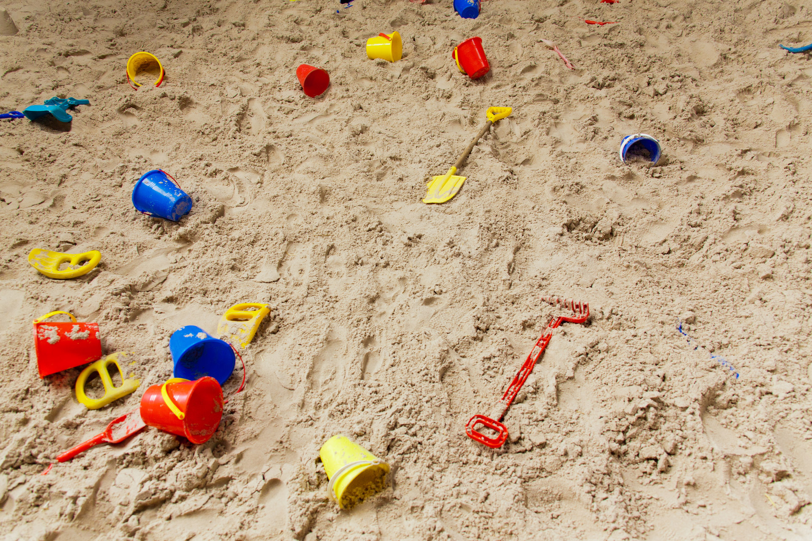
Starter activity example: Our idea
The sand tray could be a hazard because of:
animal faeces – if left uncovered
mouldy sand – if left too wet.
The risk is that the children and adults in the setting could become ill.
The likelihood of this happening is low to medium.

Slide 87
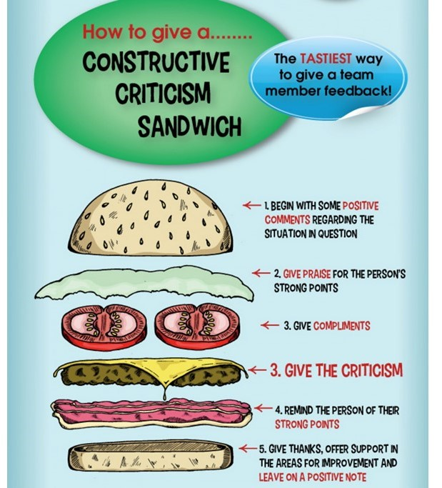
Activity 5.1: Home study – Peer evaluation
Share the poster you created with a peer.
Take it in turns to appraise the posters created and provide feedback using the “feedback sandwich” method.
This Photo by Unknown author is licensed under CC BY.

Slide 88
Reflection
How did you feel being the one who gave feedback?
And how did you feel receiving feedback?

Slide 89
Can you remember the correct order of the five steps to risk assessment?
Assess the risks
Record your findings
Control the risks
Identify hazards
Review the controls
Identify hazards
Assess the risks
Control the risks
Record your findings
Review the controls

Slide 90
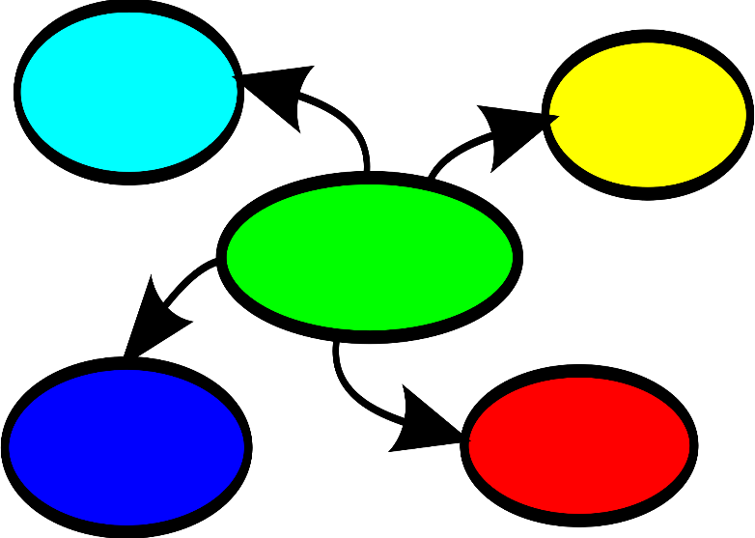
Activity 5.2: Identifying hazards
This is the first task in the five steps to risk assessment.
In small groups, discuss and record in a mind map ways to identify hazards in a setting
What needs to be considered?
Are there other records that could help us to identify hazards?

Slide 91
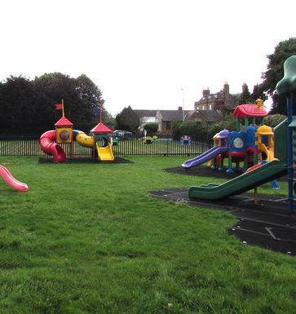
Checklist: Actions
First, look around the environment and think about what may cause harm.
What is the condition of the premises, building, equipment, security measures, etc.?
Risk assessment: Steps needed to manage risk - HSE
This Photo by Unknown Author is licensed under CC BY-SA

Slide 92
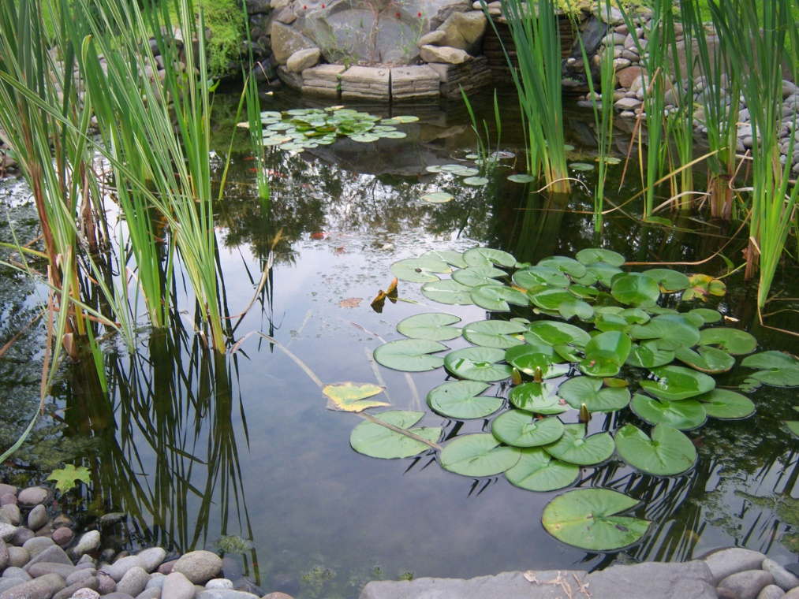
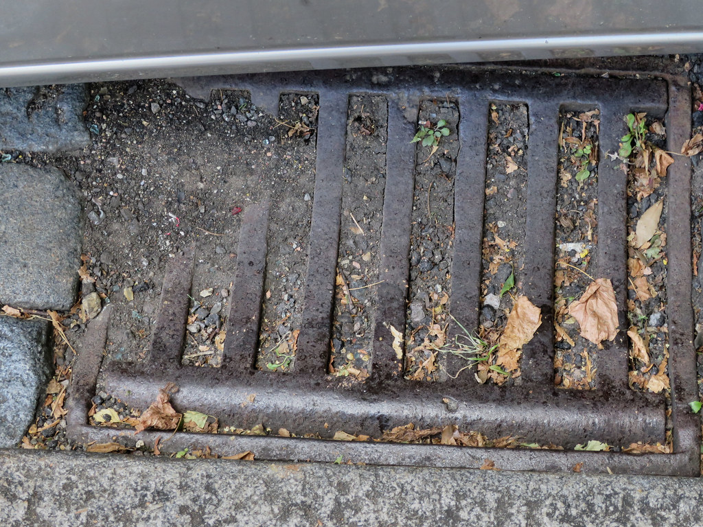
Identify the hazards in these images

Slide 93

Checklist: Actions
How do people work in this area and how is equipment used?
Consider routine maintenance and cleaning schedules.
Are there any chemicals or other hazardous substances?
Risk assessment: Steps needed to manage risk - HSE

Slide 94


Identify the hazards in these images

Slide 95
Checklist: Actions
Are there any safe or unsafe work practices already happening?
Consider previous accident records to help identify less obvious hazards.
Risk assessment: Steps needed to manage risk - HSE

Slide 96
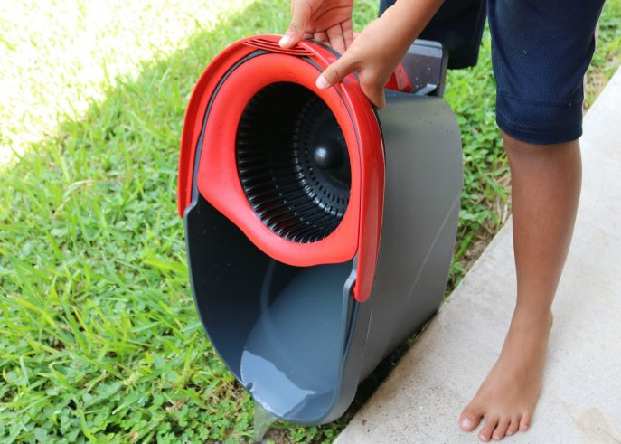
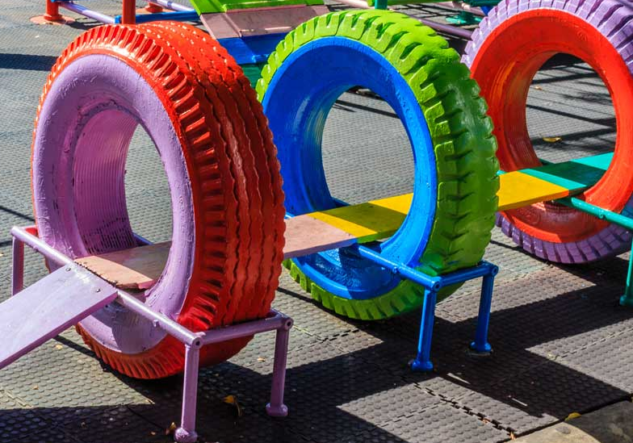
Identify the hazards in these images

Slide 97
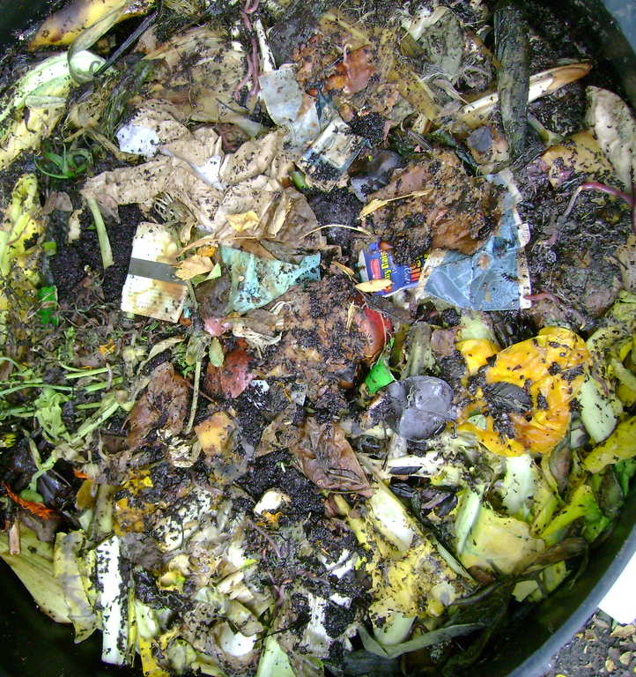
Checklist: Actions
Think about hazards to health, such as manual handling, waste disposal and use of chemicals, and causes of work-related stress.
Risk assessment: Steps needed to manage risk - HSE

Slide 98

Checklist: Actions
For each hazard, you should think about what might harm the children, employees, visitors or members of the public.
Risk assessment: Steps needed to manage risk - HSE

Slide 99
Checklist: Actions
Pregnancy and maternity
Young, inexperienced staff
People with a disability
People with English as an Additional Language
You also need to consider any vulnerable employees.
Can you think of three examples?

Slide 100
Types of risk assessment
We have just examined ways to carry out a generic risk assessment
These are completed for general, everyday activities and are site-specific
Risk assessments should be unique to a setting

Slide 101

Specific risk assessment
Although happening in the setting, this activity would not be considered in a generic risk assessment.
We need to identify the hazards for this specific activity.

Slide 102

Activity 5.3: Specific risk assessments
Contribute to a whole-class list which shows the different events and occurrences for which a specific risk assessment would need to be carried out.

Slide 103

Activity 5.4: Reading
Complete the reading to recap everything covered so far.
Produce a definition for and an example of a ‘Dynamic’ risk assessment.

Slide 104
Plenary: Match the definition
Is this definition:
generic
specific or
dynamic?
specific
This type is written for a certain site or activity. It takes into account where you are going, ​and it considers the specific group, its needs and abilities.

Slide 105
Plenary: Match the definition
Is this definition:
generic
specific or
dynamic?
dynamic
An assessment taken by staff in response to hazards, carried out throughout the day, and can be ever changing.

Slide 106
Plenary: Match the definition
Is this a description of a:
generic
specific or
dynamic risk assessment?
It defines a generic risk assessment
This type highlights commonly identified hazards and is associated with general locations, events or activities​.

Slide 107

Home study 5.0
Create a document which identifies possible hazards involved in a specific activity:
A Year 1 school trip to the local zoo.

Slide 108


ET-FOUNDATION.CO.UK
PRODUCED BY
FUNDED BY
South Gloucestershire and Stroud College (SGS) has produced this resource on behalf of the Education and Training Foundation
This programme is funded by the Department for Education

