Slide 1
Core Skill 4: How to assess and manage risks to your own and others’ safety when planning activities (Part 2)
All images have been sourced through PowerPoint with Creative Commons or from stock images. Where references were available, these have been provided.
ETF/Leeds City College

Slide 2
06
Evaluating risks and deciding on precautions

Slide 3

Lesson objectives
Recap the importance of risk management and benefit analysis
Examine methods of evaluation
Define what is meant by control measures
Select appropriate control measures to mitigate the risk and support children’s safety and security

Slide 4

Starter activity 6.0: Identify the hazards
Education and Training Foundation

Slide 5
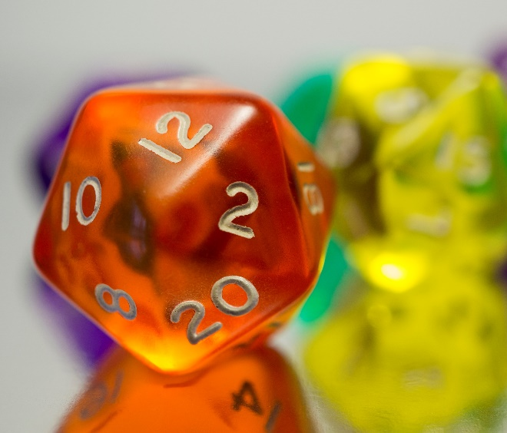
Starter activity 6.0:
Step 2 is “Assess the risks”
Once you have identified the hazards, the next step is to evaluate the risks
  Who might be harmed?
  How might they be harmed?
  How serious might the harm be?
  What is the likelihood of harm occurring?
  Can it be controlled?

Slide 6
Starter activity 6.0: Our idea
Hazards
The water itself
Risks
Drowning, child drinking it, contamination, stagnant water, child becoming cold and wet, etc.
Likelihood
This depends on the age and stage of the child, the adult supervision

Slide 7

Evaluation
Definition of ‘Evaluation’
“the act of forming an opinion of the amount, value or quality of something after thinking about it carefully”
Oxford Learner’s Dictionary
evaluation noun - Definition, pictures, pronunciation and usage notes | Oxford Advanced Learner's Dictionary at OxfordLearnersDictionaries.com

Slide 8

How and why does ‘evaluation’ relate to risk assessment?
We need to develop an informed opinion on the hazards and risks.
We use our knowledge and previous experiences to help us to evaluate advantages and disadvantages.

Slide 9

Recap: EYFS Statutory Framework 3.90
Providers are collectively responsible in their duty of care to staff, children and families who receive a service
Individuals and service users also have a responsibility for their own health and safety as well as that of others.

Slide 10

Activity 6.1
For home study, you produced a document which identified possible hazards involved in a Year 1 school trip to the local zoo.
Task: Evaluate the risks associated with the hazards you identified.

Slide 11

Recap of risk benefit: Reading
“Risk Benefit Assessment (RBA), starts with the principle that risk is an essential element in the development of children’s physical, emotional and intellectual development.”
Play Learning Life (2024)
https://www.plloutdoors.org.uk/_files/ugd/ac7854_7355434d0edb485c9a69736f74a85970.pdf

Slide 12

Activity 6.2: Look at the image again
In pairs, discuss:
Are there any benefits to this risk?
What will the child gain from this?

Slide 13
Activity 6.3: Look at the image again
Is there anything we can do to fully remove the risk? Should we?
Anything to make it safer?
Make a judgement!

Slide 14
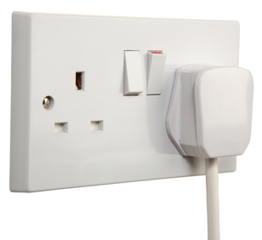
Activity 6.4: Control measures
These are necessary steps we take to ensure hazards and risks do not cause harm.
Can you think of measures already in place from your work experience?
In pairs, list as many of these as you can and compare your findings with another pair.
Education and Training Foundation

Slide 15

Activity 6.5
Access the reading from Play Learning Life which outlines RBA.
The next activity will be to complete the template with the examples given, plus two more from your own work placement experiences.
https://www.plloutdoors.org.uk/_files/ugd/ac7854_7355434d0edb485c9a69736f74a85970.pdf

Slide 16
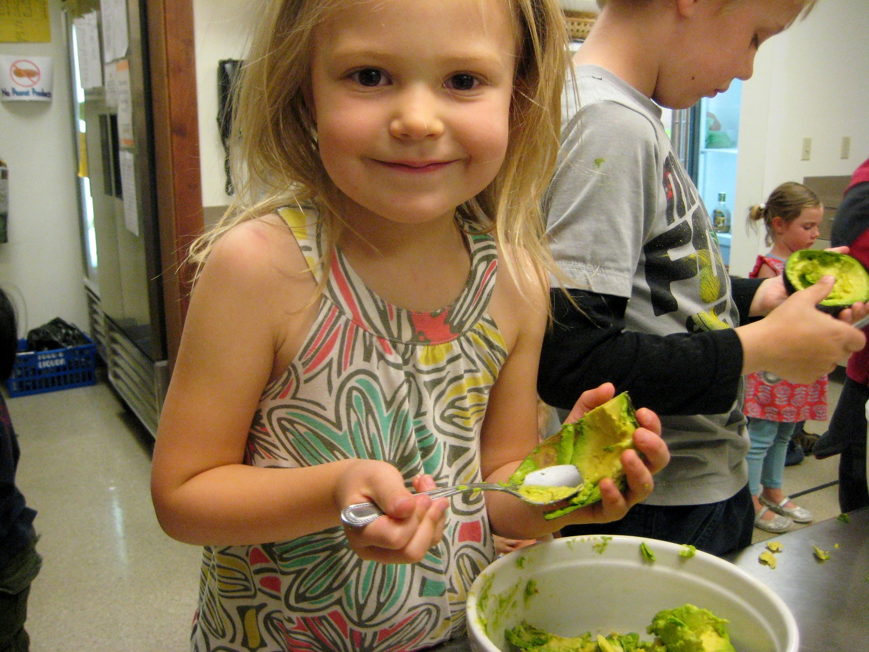
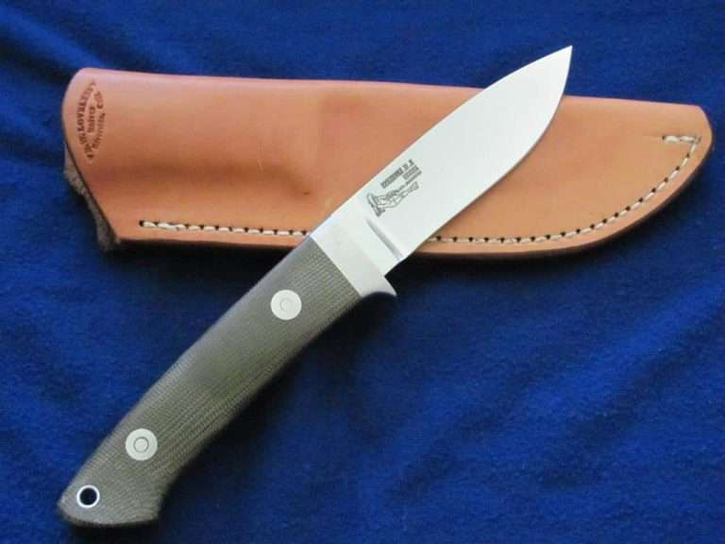
Activity 6.6: In pairs, complete a risk benefit analysis and add control measures – include two examples from placement
A six-year-old child using a knife to whittle wood during a Forest School session
A cooking activity with a group of eight children in Year 1

Slide 17

Plenary
Share your findings and explain your decisions with another pair
Note any differences and similarities
Explain why some risks are beneficial for children

Slide 18

Home study 6.0: RBA of an outdoor activity
Use the template from Activity 6.6 to carry out a Risk Benefit Assessment/Analysis on an activity or resource that takes place outdoors in your setting.
Bring this to the next session as you will be using this in the Starter Activity

Slide 19
07
Recording findings and implementing them

Slide 20
Lesson objectives
Recall types of hazard
Examine hazards, risks and control measures in specific contexts
Explain reasons why risk assessments should be recorded
Record a risk assessment using a template

Slide 21
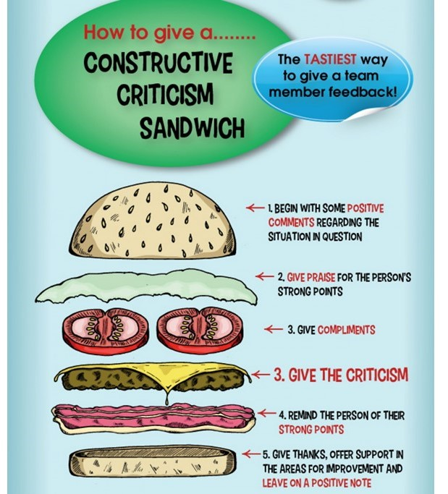
Starter activity 7.0
Share and compare, with at least two other learners, your home study from last session: RBA on an outdoor activity.
What similarities are there?
What differences?
Give constructive feedback.
This Photo by Unknown author is licensed under CC BY.

Slide 22
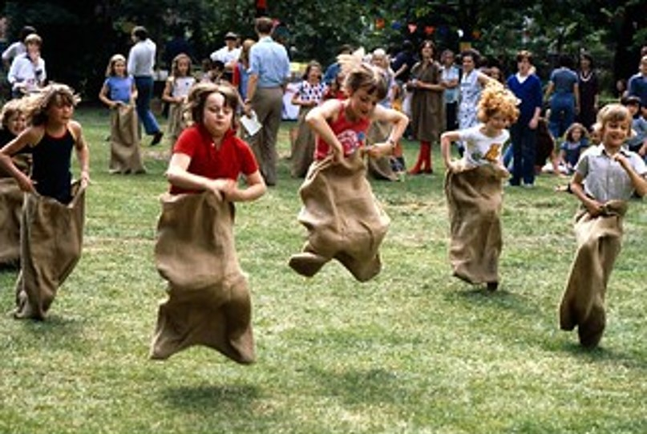
Activity 7.1
You are planning the annual Reception and Key Stage 1 sports day. What hazards, risks, and control measures do you need to consider?
In groups, you will be assigned one of these types of hazard:
  physical, security, fire, food safety, or personal safety.

Slide 23
Activity 7.1: Feedback
Each group should nominate a spokesperson to present findings to the class.
Take notes from other presenters to ensure you have a holistic view.
Prepare a question for each group.

Slide 24
Activity 7.2: 3.3 EYFS Statutory Framework
Providers should have contingency plans for dealing with emergencies
“providers must take all necessary steps to keep children safe and well”

Slide 25
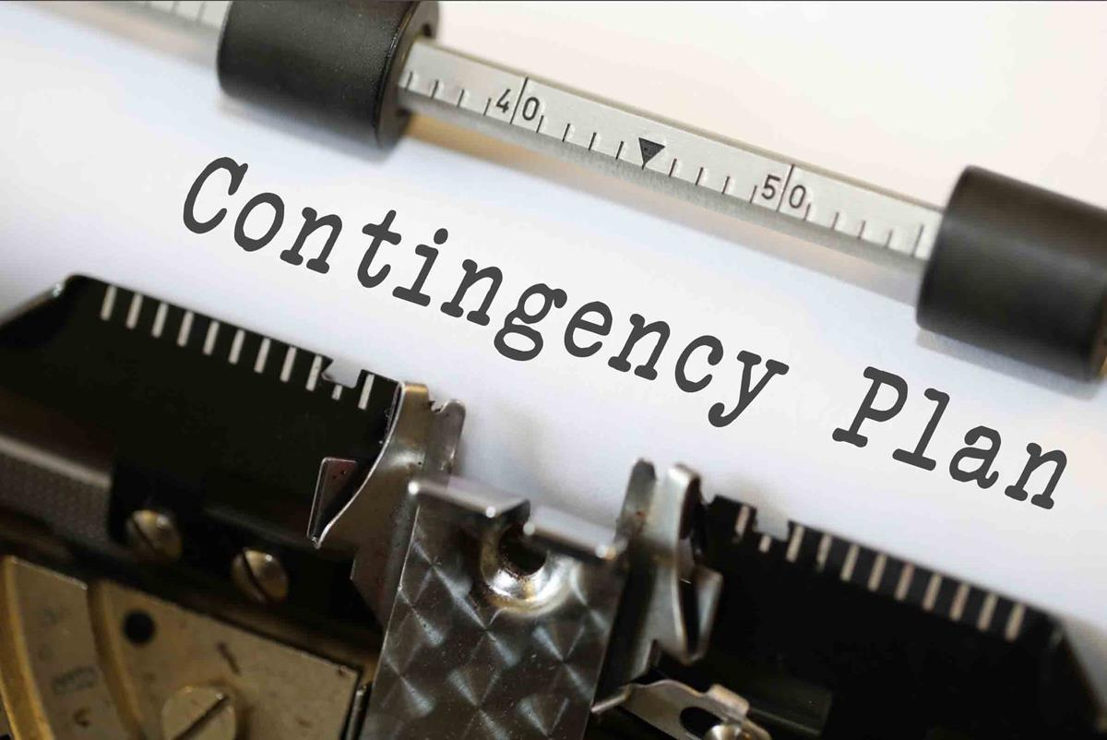
Activity 7.2: Definition – contingency plan
Sometimes known as a backup plan or Plan B, a contingency plan is the record of actions that will be taken to help a setting respond effectively to an incident, event or situation that may or may not happen in the future.

Slide 26

Activity 7.2: Small group discussion and mindmap
What types of events might need a contingency plan in an educational setting?
How should these be recorded?

Slide 27
Take note! What the HSE tells us about recording
If five or more people are employed, significant findings must be recorded. These include:
The hazards – things that may cause harm
The risks – who might be harmed and how
Control measures – what you are doing to control the hazard and risk
https://www.hse.gov.uk/simple-health-safety/risk/steps-needed-to-manage-risk.htm#_Control_the_risks

Slide 28
Note! What the EYFS 3.76 tells us about recording
Providers should be able to demonstrate to stakeholders how they are managing risk
Statutory framework for the early years foundation stage for group and school providers (publishing.service.gov.uk)
“determine where it is helpful to make some written risk assessments in relation to specific issues”
Identify what needs to be checked on a regular basis, and by whom
Assess how the risk will be removed or minimised

Slide 29
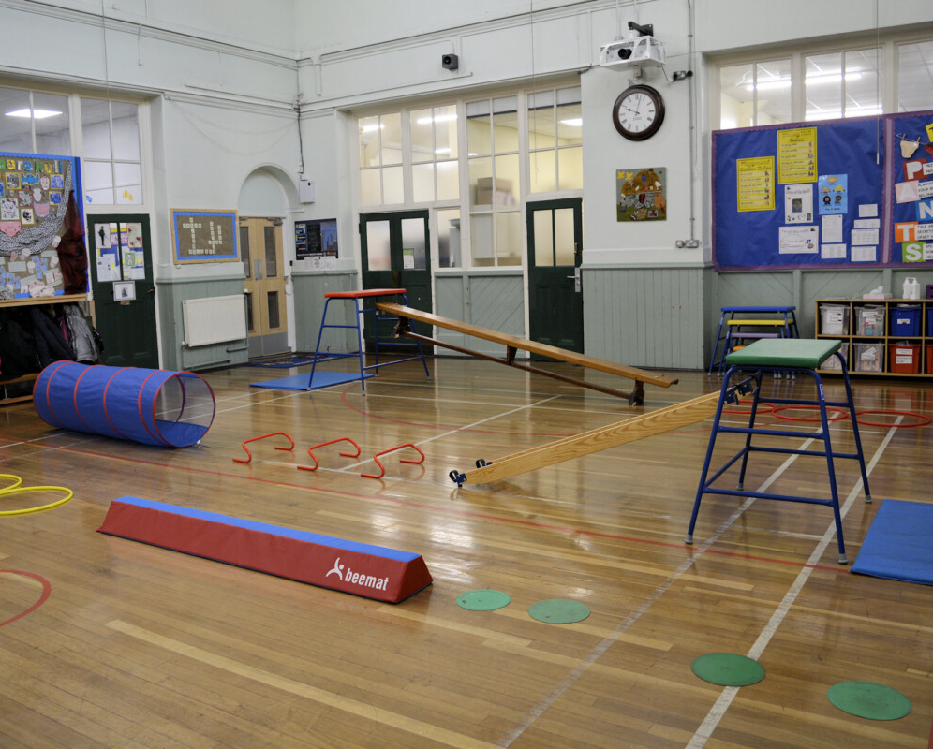
Activity 7.3: Work in pairs using the template
You are setting up an obstacle course in the school hall for a Year 2 physical education class. You need to:
assess the hazards and risks
record the control measures.

Slide 30
Plenary
Explain three reasons to record a risk assessment
List three events that may need to have a contingency plan in both a school setting and a childminder setting

Slide 31

Home study 7.0: Record a risk assessment in the work experience setting
Use the handout to:
record a risk assessment in an area of your real work environment indoor space
record any hazards
evaluate the risks to include who might be harmed, how they might be harmed and the severity of harm.
record control measures.
Bring this to the next session for review.

Slide 32


ET-FOUNDATION.CO.UK
PRODUCED BY
FUNDED BY
South Gloucestershire and Stroud College (SGS) has produced this resource on behalf of the Education and Training Foundation
This programme is funded by the Department for Education

