Slide 1

T level technical qualification in management and administration

Slide 2
Management and administration
4: Finance (core)
Session 1
Presenter name
Time and date
Location

Slide 3
01
Financial reporting

Slide 4
Learning outcomes
Outline common terms used in financial reporting.
Explain the importance of understanding the meaning of terms used in financial reporting.
Be able to estimate, calculate and communicate financial information accurately.
Use formulas and rules to calculate financial data.

Slide 5
Financial reporting terms
Sales turnover: the amount of revenue a company generates from its sales.
Revenue: the total amount of money a company earns from sales, services or any other sources of income.
Profit and loss: a profit and loss statement that shows a company’s revenue, costs and expenses over a specific period, resulting in a net profit or loss.
Accounting period: the duration of time for which financial statements are prepared and reported, usually a year or quarter.
Capital: the difference between a company’s assets and liabilities.
Gross profit: the difference between the cost of goods sold and the revenue from sales.
Net profit: the total amount of revenue after deducting all expenses.

Slide 6
Financial reporting terms cont.
Breakeven point: the point at which a company’s revenue covers all its costs, resulting in neither profit nor loss.
Income statement: a financial statement that shows a company’s revenue, costs and expenses over a specific period, resulting in a net profit or loss.
Balance sheet: a financial statement that shows a company’s assets, liabilities and equity at a specific point in time.
Adjustment: changes made to financial statements to ensure accuracy and completeness.
Stakeholders: individuals or groups with an interest in a company, including shareholders, employees, customers, suppliers and creditors.
Costs: expenses incurred by a company in producing goods or services.

Slide 7
Financial reporting terms cont.
Assets: items owned by a company that have value, including cash, equipment and property.
Liabilities: a company’s debts and obligations, including loans, mortgages and outstanding bills.
Cash flow: the movement of cash in and out of a company.
Corporation tax: a tax paid by companies on their profits.
Income tax: a tax paid on an individual’s income.
VAT: value-added tax, a tax on goods and services.
Profit margin: the percentage of revenue that is profit.
Retained profit: the amount of profit kept by a company after paying out taxes and dividends.
Accounts receivable: invoices that are owed to the business.
Accounts payable: invoices that are owed by the business.

Slide 8


Blank-filling activity (W1.1)
Complete the activity based on the financial reporting terms you have just covered.
Financial Literacy Is Shown On The Business Photo Using The Text Stock Photo - Download Image Now - iStock (istockphoto.com)
Notes:
Discuss with learners why it is important to understand and use the correct financial terms. What could happen if the incorrect terms are used?

Slide 9
The role and importance of financial reporting
Financial reporting is a critical function for any organisation.
Financial reporting provides information about the financial health and performance of an organisation.
It helps stakeholders (investors, lenders, employees, etc.) make informed decisions about the organisation.
Financial reporting also ensures that the organisation complies with legal and regulatory requirements.
Financial reporting includes two main areas: income/sales and spend/costs.
The income/sales area includes information about revenue, sales and other income streams.
The spend/costs area includes information about expenses, such as salaries, rent, utilities and other costs.

Slide 10

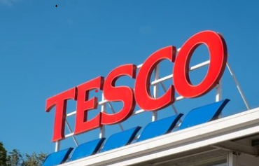
Tesco scandal
In September 2014, Tesco announced that it had overstated its profits by £250 million owing to the incorrect booking of payments from suppliers. The company’s share price dropped by 11% in response to the news, and the UK Financial Conduct Authority (FCA) launched an investigation into the matter.
In 2017, Tesco reached a deferred prosecution agreement with the FCA, where the company agreed to pay a fine of
£129 million to settle the investigation into the accounting irregularities. In addition, several senior Tesco executives were charged with fraud and false accounting in connection with the scandal, and some were sentenced to prison.
(The Guardian, 2017)
Evesham Uk October 2017 Tesco Supermarket Stock Photo 729900883 | Shutterstock
https://www.theguardian.com/business/2017/mar/28/tesco-agrees-fine-serious-fraud-office-accounting-scandal (accessed 30.04.2023)

Slide 11
Financial reports
Financial reports come in various formats, including the following.
Balance sheet: shows a snapshot of the organisation’s assets, liabilities and equity at a specific point in time.
Profit and loss accounts: show the organisation’s revenue, expenses and profit or loss for a specific period.
Management accounts: provide detailed financial information to help management make informed decisions.
Year-end reporting: summarises the organisation’s financial performance for the entire year.
Cash flow: shows the organisation’s inflows and outflows of cash during a specific period.

Slide 12
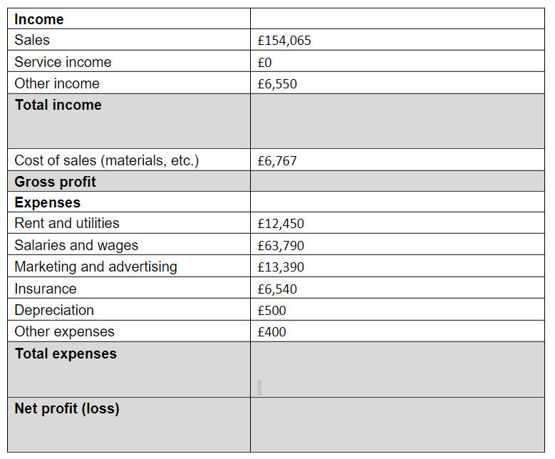
Profit and loss statement
W1.2 Activity
Notes:
A profit and loss account shows the organisation’s revenue, expenses and profit or loss for a specific period. It helps stakeholders understand how the organisation is performing financially.

Slide 13
Gross profit
Gross profit is the amount of revenue (total income) that remains after deducting the cost of goods sold (COGS). In other words, it is the difference between the revenue generated by a company’s sales and the direct costs of producing or purchasing the goods sold.
The formula for calculating gross profit is:
Gross profit = revenue – cost of goods sold
For example, if a company generates £100,000 in revenue from the sale of goods and incurs £60,000 in direct costs, its gross profit would be £40,000.

Slide 14
Gross profit: question
A company has an annual turnover of £650,000.
The annual cost of goods is £180,000.
Calculate the gross profit.
£650,000 – £180,000 = £470,000
Gross profit = £470,000

Slide 15
Net profit
Net profit is the amount of revenue that remains after deducting all the expenses, including COGS, operating expenses, interest, taxes and other non-operating expenses. It represents the total profit or loss earned by the company during a specific period.
The formula for calculating net profit is:
Net profit = revenue – cost of goods sold – operating expenses – interest – taxes – other non-operating expenses
For example, if a company generates £100,000 in revenue from the sale of goods, incurs £60,000 in direct costs, £20,000 in operating expenses and £5,000 in interest and taxes, its net profit would be £15,000.

Slide 16
Net profit: question
A company generates £250,000 in revenue from the sale of goods.
There are £80,000 in direct costs.
There are £25,000 in operating expenses.
There are £7,500 in interest and taxes.
What is the net profit?
£250,000 – (£80,000 + £25,000 + £7,500) = £137,500

Slide 17

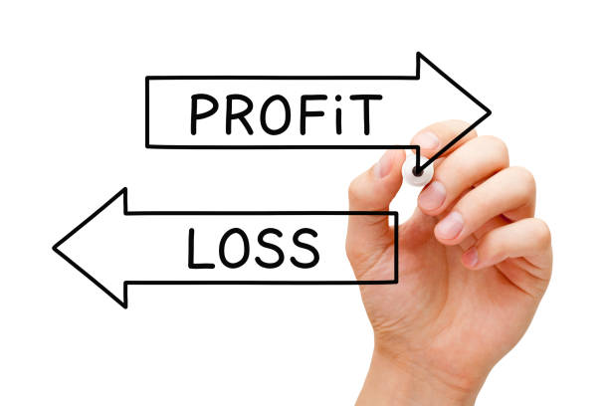
Profit and loss statement activities (W1.2 and W1.2a)
For each profit and loss statement provided, calculate:
total income
total expenses
gross and net profit.
If you want an extra challenge, there is a further activity with more complex mathematics.
Profit Or Loss Arrows Business Concept Stock Photo - Download Image Now - Loss, Making Money, Bank Statement - iStock (istockphoto.com)

Slide 18
Rearranging formulas
When working in finance, there will be times when you have only parts of the information you need. For example, you may know the gross profit and cost of goods sold, but not the revenue figure. In these situations, you can rearrange this formula to help you find the missing value:
Gross profit = revenue – cost of goods sold (COGS)
Rearrange the formula to make the revenue the subject.
Rearrange the formula to make the cost of goods sold the subject.

Slide 19
Rearranging formulas: answers
Hint:
When moving items from one side of the equation to the other + to – and vice versa
Rearrange the formula to make the revenue the subject.
Gross profit = revenue – cost of goods sold (COGS)
Add “+ COGS” to both sides of the equation:
Gross profit + COGS = revenue – COGS + COGS
On the right, “– COGS + COGS” cancel each other out to leave:
Gross profit + COGS = revenue
2. Rearrange the formula to make the cost of goods sold the subject.
Gross profit = revenue – cost of goods sold (COGS)
Do the steps in 1 above. Then add “– gross profit” to both sides of the equation:
Gross profit – gross profit + COGS = revenue – gross profit
On the left, “gross profit – gross profit” cancel each other out to leave:
COGS = revenue – gross profit

Slide 20
Rearranging formulas: practice questions
Calculate the revenue when the cost of goods sold is £12,750 and the gross profit is £34,555.
Gross profit = revenue – cost of goods sold
Revenue = gross profit + cost of goods sold
Revenue = £12,750 + £34,555
Revenue = £47,305
2. Calculate the cost of goods sold when the revenue is £132,850 and the gross profit is £82,125.
Gross profit = revenue – cost of goods sold
Cost of goods sold = revenue – gross profit
Cost of goods sold = £132,850 – £82,125
Cost of goods sold = £50,725

Slide 21


Gross and net profit activity (W1.3)
Find the missing monetary values for each of the two scenarios provided, using the formulas just demonstrated.
Stack Of Silver Coins With Trading Chart In Financial Concepts And Financial Investment Business Stock Growth Stock Photo - Download Image Now - iStock (istockphoto.com)
Notes:
Discuss with learners why it is important to understand and use the correct financial terms. What could happen if the incorrect terms are used?

Slide 22
Balance sheet
A balance sheet is a financial statement that provides a snapshot of a company’s financial position at a specific point in time. It shows what the company owns (assets), what it owes (liabilities), and the difference between them (equity).​
​The balance sheet is divided into two main sections: assets and liabilities and equity.
Assets are resources owned by the company that have future economic value. Assets can be divided into two categories: current assets and non-current assets. ​
​Current assets are assets that can be converted into cash within a year, such as cash, accounts receivable and inventory. ​
Non-current assets are assets that have a longer useful life, such as property, plant and equipment.

Slide 23
Balance sheet cont.
Liabilities are the obligations owed by the company to external parties, such as suppliers, lenders and employees. Like assets, liabilities can be divided into current and non-current liabilities.
Current liabilities are obligations that must be paid within a year, such as accounts payable, short-term loans and taxes owed.
Non-current liabilities are obligations that have a longer-term maturity, such as long-term debt.
Equity represents the residual interest in the assets after deducting liabilities. It includes the owner’s investment in the company and any accumulated profits or losses.
The balance sheet equation is:
Assets = liabilities + equity.

Slide 24


PRODUCED BY
FUNDED BY
South Essex College is working in partnership with the Education and Training Foundation to deliver this programme
This programme is funded by the Department for Education
ET-FOUNDATION.CO.UK

Slide 25
Management and administration
4: Finance (core)
Session 2
Presenter name
Time and date
Location

Slide 26
02
Financial statements, formulas and expenditure

Slide 27
Profit and loss statement activity (W2.1)
Epione Bakery
Mary runs a small business called “Epione Bakery”. She started the business three years ago and has since been baking and selling cakes, pastries and bread. Mary employs two bakers and a sales assistant. Her business is located in London, and she has a steady customer base. Mary keeps all the financial records of the business in a ledger book.
Create a profit and loss statement for Mary.
You can make up the figures, but make sure they are realistic for the size of the business and use the formulas already covered to accurately calculate the key financial terms.

Slide 28
Learning outcomes
Communicate financial information accurately using mathematical language and terminology.
Understand different forms of expenditure.
Use financial formulas and rules to calculate revenue, costs and profit.
Discuss the importance of accuracy.
Use the net profit margin formula (net profit ÷ revenue x 100) to calculate the profit margin as a percentage.

Slide 29

Stakeholders activity
In groups, discuss the issues that apply for the stakeholder assigned to you, including:
the interests and expectations of your stakeholder
how financial decisions may impact them.
Then present your findings to the other groups.
Profit Through Cooperation Stock Photo - Download Image Now - Stakeholder, Adult, Business - iStock (istockphoto.com)
Notes:
Stakeholders are individuals or groups who have an interest in a company and its operations. They can have a significant impact on a company’s finances in several ways.
Shareholders/investors: they are the primary source of capital for a company, and their investments provide the company with the financial resources it needs to operate and grow. Shareholders expect a return on their investment in the form of dividends or capital appreciation. They can influence the company’s financial decisions by exercising their voting rights and by pressuring management to increase profits and share prices.
Customers: they make up a critical stakeholder group that can have a significant impact on a company’s finances. They provide the company with revenue through the purchase of goods and services. Satisfied customers can help a company to increase its sales and profits, while dissatisfied customers can damage the company’s reputation and revenue.
Employees: they form another critical stakeholder group that can affect a company’s finances. They contribute to the company’s operations and productivity, and can influence the company’s financial performance through their work output, motivation and retention. Satisfied employees can lead to higher productivity, lower turnover and improved financial performance.
Suppliers: they provide the company with the raw materials and supplies it needs to produce goods and services. They can influence the company’s finances by setting prices and terms of payment, and by providing high-quality goods and services that meet the company’s needs.
Regulators/government bodies: they can impact a company’s finances through various regulations and policies. These can include tax laws, environmental regulations, labour laws and safety regulations. Failure to comply with these regulations can result in fines, penalties and other financial costs.
In summary, stakeholders can have a significant impact on a company's finances through their investment, purchasing decisions, work output, pricing, regulations and policies. It is essential for companies to manage their relationships with stakeholders effectively, in order to ensure long-term financial success.

Slide 30

Thomas Cook bankruptcy
In September 2019, Thomas Cook declared bankruptcy after failing to secure a rescue deal with its creditors, leaving around 150,000 British holidaymakers stranded abroad and many more with cancelled bookings. The company’s collapse also affected its employees, suppliers and shareholders, with thousands of jobs lost and suppliers left unpaid.
The UK government was forced to launch the largest repatriation effort in peacetime history, in order to bring stranded British holidaymakers back to the UK, at a cost of £100 million to taxpayers. In addition, Thomas Cook’s shareholders saw the value of their investments wiped out, with the company’s stock falling to zero. (BBC, 2019)
Amsterdam Netherlands July 21st 2016 Otcx Stock Photo 600031202 | Shutterstock
https://www.bbc.co.uk/news/world-europe-49824427 (accessed 30.04.2023)

Slide 31

Business case study: expenses activities (W2.2 and W2.2a)
Create budgets
for Mary’s “Epione Bakery” based on the lists of expenditures provided.
What impact does a budget have on the business and why is it important?
Retail Clerk Serving A Customer Stock Photo - Download Image Now - Bakery, Baker - Occupation, Saleswoman - iStock (istockphoto.com)

Slide 32
Cost of goods sold
Cost of goods sold (COGS) is an accounting term that represents the direct costs incurred by a business in producing and delivering the goods or services it sells to customers.
It includes the cost of raw materials, labour and overhead expenses that are directly related to the production of the goods or services.
COGS is typically calculated by subtracting the cost of the ending inventory from the sum of the cost of the beginning inventory plus the cost of goods purchased or produced during a given period. COGS is an important metric for businesses to track, as it has a direct impact on the company’s gross profit margin and overall profitability.

Slide 33

Cost of goods sold: example
Epione Bakery produces and sells cupcakes. For the month of January, the bakery listed the following transactions.
Beginning inventory: raw materials to make 100 cupcakes at a cost of £0.50 each.
Purchases: raw materials to make a further 500 cupcakes at a cost of £0.60 each.
Ending inventory: raw materials to make 150 cupcakes at a cost of £0.60 each.
To calculate the cost of goods sold for January, we use the following formula:
COGS = beginning inventory + purchases – ending inventory
COGS = (100 x £0.50) + (500 x £0.60) – (150 x £0.60)
COGS = £50 + £300 – £90
COGS = £260
So the cost of goods sold for January was £260. This means the bakery incurred £260 in direct costs to produce and sell the cupcakes during the month. This figure will be subtracted from the bakery’s revenue to calculate its gross profit.
Vanilla Cupcake With Cherry Stock Photo - Download Image Now - Cupcake, Cherry, White Background - iStock (istockphoto.com)

Slide 34
Cost of goods sold activity (W2.3)
During the month of January, the bakery purchased £1,000 worth of flour, £500 worth of yeast, and it incurred £500 in direct labour costs.
In addition, the bakery had £200 worth of flour and £100 worth of yeast left over from the previous month, and it produced and sold 1,000 loaves of bread during January.
The bakery had £175 worth of flour and £80 worth of yeast left over at the end of January.
The revenue for the bakery from bread was £3,450 for the month of January.
Calculate the cost of goods sold for January.
Calculate the gross profit for January.

Slide 35
Cost of goods sold activity: answers
Calculate the cost of goods sold for January.
COGS = beginning inventory + purchases – ending inventory
COGS = £300 + £2,000 – £255
COGS = £2,300 – £255
COGS = £2,045
2. Calculate the gross profit for January.
Gross profit = revenue – cost of goods sold
Gross profit = £3,450 – £2,045
Gross profit = £1,405

Slide 36
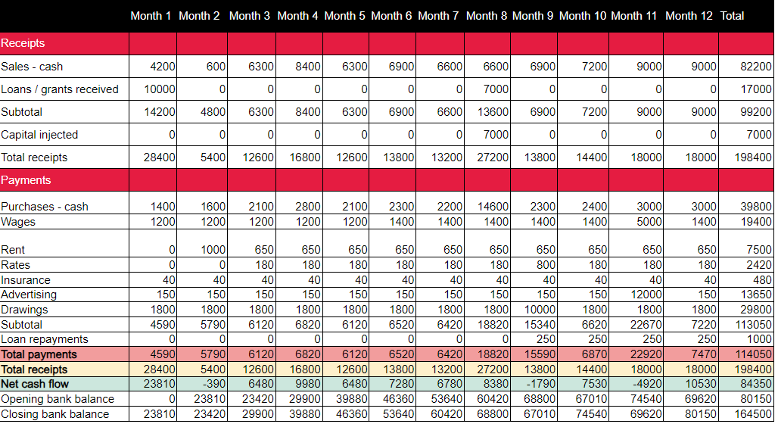
Cash flow statement

Slide 37

Cash flow statement: negative cash flow
During a month where total payments exceed total receipts, this causes a negative cash flow which will decrease the bank balance.

Slide 38
Increasing and decreasing percentages
In month 1, the bank balance was £23,810. In month 2, the bank balance was £23,420. What is the percentage decrease in the bank balance?
In month 3, the bank balance was £29,900. In month 4, the bank
balance was £39,880. What is the percentage increase in the bank
balance?

Slide 39
Increasing and decreasing percentages: answers
In month 1, the bank balance was £23,810. In month 2, the bank balance was £23,420. What is the percentage decrease in the bank balance?
£23,810 – £23,420 = £390
390 ÷ 23,810 x 100 = 1.64%
In month 3, the bank balance was £29,900. In month 4, the bank balance was
£39,880. What is the percentage increase in the bank balance?
£39,880 – £29,900 = £9,980
9,980 ÷ 29,900 x 100 = 33.38%

Slide 40
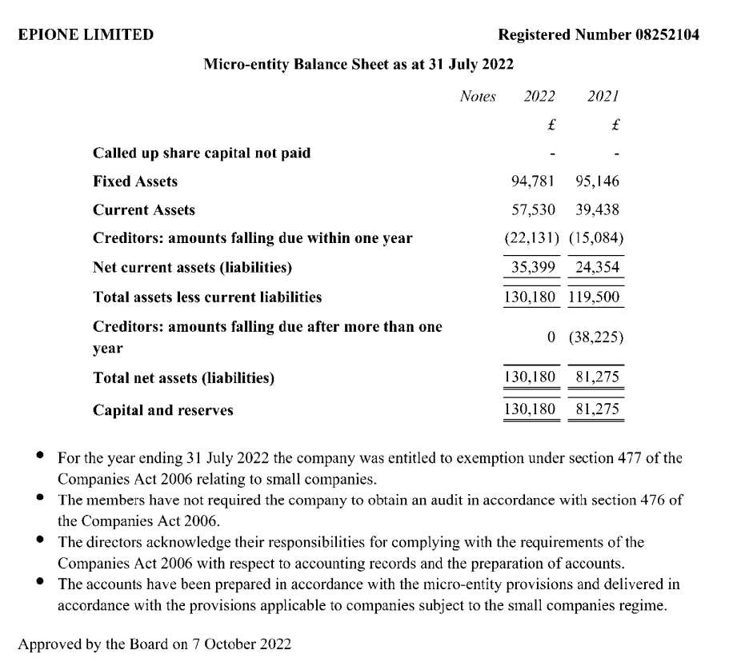
Balance sheet
A balance sheet is an accounting report that shows a company’s assets, liabilities and shareholders’ equity. It provides a snapshot of the business on a given date.
(Companies House, 2023)

Slide 41
Balance sheet activity (W2.4)
Create a balance sheet for Mary using the template provided.
You can make up the figures, but make sure the amounts are realistic for the size of the business, and that you use the formulas covered to accurately calculate the key financial entries.

Slide 42
Fixed costs versus variable costs
Fixed costs
Rent or lease payments for a building or office space.
Salaries and wages of permanent employees.
Insurance premiums.
Property taxes.
Depreciation of fixed assets.
Annual maintenance fees for equipment and machinery.
Interest payments on loans.
Legal and accounting fees.
Advertising expenses for long-term campaigns.
Annual software licensing fees.
Variable costs
Direct material costs, such as raw materials used in manufacturing a product.
Direct labour costs, such as wages paid to production workers.
Commission paid to salespeople on the basis of sales volume.
Packaging costs for each unit produced.
Cost of electricity or fuel used to run machinery.
Shipping and handling costs that vary based on the volume of products shipped.
Sales commissions that are based on the number of sales made.
Cost of consumables, such as office supplies, cleaning materials and fuel for company vehicles.
Notes:
Fixed costs: these costs do not vary with changes in production or sales volumes, and they are generally incurred regardless of the level of business activity. Fixed costs are important to consider when calculating breakeven points and determining profitability levels.
Variable costs: these costs are important to consider, because they can influence the profit margin of a company. As sales or production increases, variable costs will increase, and the profit margin may decrease. Conversely, when sales or production decreases, variable costs will decrease, and the profit margin may increase. By understanding variable costs, a company can make informed decisions about pricing, production levels and cost management.

Slide 43
PRODUCED BY
FUNDED BY
South Essex College has produced this resource on behalf of the Education and Training Foundation
This programme is funded by the Department for Education
ET-FOUNDATION.CO.UK

