Slide 1
T LEVEL IN ANIMAL CARE AND MANAGEMENT
Support holistic delivery of core content and occupational specialism content

Slide 2
1
Why do we study animal behaviour?​

Slide 3
Starter: Confidence rating​
Reflect on your skills and knowledge using the
Animal behaviour confidence rating worksheet.

Slide 4
Task
Define animal behaviour.

Slide 5
Natural vs atypical behaviour​
  Natural behaviour​:
    Behaviour that has developed during evolutionary processes​.
    Serves a function e.g. promoting health, survival and reproduction.​
  Atypical behaviour:
    Any action that an animal performs which is not natural and does not serve a purpose.

Slide 6
Examples of natural and atypical behaviours​
Locomotion Play​ Aggression Territorial Feeding​ Socio-sexual Reproduction​ Displacement behaviour. | Crib-biting​ Grooming Excessive grooming Foraging​ Hyperactivity Excessive inactivity Pacing​ Self-mutilation​

Slide 7
Task​​: Species-specific behaviours
Write natural and atypical behaviours specific for allocated animal on each piece of the flipchart paper.
Rotate to the next animal and add behaviours.

Slide 8
Monitoring animal behaviour​
  To establish an animal’s normal routine using less invasive methods​.
  To detect any changes in animal behaviour.
  To improve welfare of animals in captive environments.​
  To support conservation and preservation of species.

Slide 9
Causes of atypical behaviour
  Underlying cause: chronic stress, pain, frustration, ill health.
  The following can be due to poor management, care
  and welfare:
    confinement
    unsuitable environment and or diet
    inappropriate social grouping.
  Consider the five welfare needs.

Slide 10
Confinement​
Lack of adequate space (challenges accommodating larger species), overcrowding e.g. battery/factory farms​.

Slide 11
Examples of unsuitable environment​
Inappropriate housing: excessive noise, extremes of temperature, dirty and unhygienic, no enrichment provided, hazards, not suitable for species​.
Inappropriate diet or insufficient food or water​.

Slide 12
Examples of inappropriate social grouping​
  Housing social animal on its own​.
  Solitary animals housed together​.
  Forcing social groups​.
  Incorrect social structures​.

Slide 13
Natural behaviour​​​ examples
Two specific animal species examples with regards to natural behaviour:
  meerkat
  elephant.

Slide 14
Natural behaviours
Behaviour | Meerkat | Elephant
sleep/wake cycle | diurnal animals | nocturnal/diurnal animals
feeding | insectivores | herbivores
communication | scent marking/ alarm cries | wide frequency range

Slide 15
Natural behaviours: Activity levels
Behaviour | Meerkat | Elephant
activity levels | awake and foraging during the day, will spend time sunbathing, sleep in burrows at night | always on the move, searching for food and water

Slide 16
Natural behaviours: Grooming
Behaviour | Meerkat | Elephant
grooming | mixture of allo- and autogrooming | scratch with sticks and dust bathe

Slide 17
Natural behaviours: Sexual behaviour
Behaviour | Meerkat | Elephant
sexual behaviour | dominant female and male are the only ones allowed to reproduce | males will fight when in musth to reproduce

Slide 18
Natural behaviours: Aggression
Behaviour | Meerkat | Elephant
aggression | territorial so will fight for land with rival gangs | females will protect their young and males will assert dominance

Slide 19
Natural behaviours: Play
Behaviour | Meerkat | Elephant
play | seen in both young and adults and helps determine the hierarchy | seen in young

Slide 20
Natural behaviours: Social interaction
Behaviour | Meerkat | Elephant
social interaction | groups of 5–30, very social creatures that rely on scent rather than sight | matriarchal family groups of females and lone males or bachelor herds

Slide 21
Task: Natural behaviour
Complete the Natural behaviours worksheet for your allocated animal.​
Feed back to peers regarding each animal species.

Slide 22
Plenary: Snap
Play behaviour snap in pairs.

Slide 23
​Question
Why do we study animal behaviour?

Slide 24
Answer
To deepen our understanding of why animals behave the way they do, so that we can learn how to respond to the challenges that animals face when living in captive and wild environments.

Slide 25
Next steps: Ethologists
Research one of the following ethologists:
  Nikolaas Tinbergen
  Konrad Lorenz
  Jane Goodall
  Charles Darwin.

Slide 26
2
Understanding ethologists and observation techniques in animal behaviour

Slide 27
Starter: Who are ethologists?
  Nikolaas Tinbergen: The four questions of behaviour.
  Konrad Lorenz: Imprinting in birds.
  Jane Goodall: Primate behaviour studies.
  Charles Darwin: Natural selection.

Slide 28
Nikolaas Tinbergen
  Research:​ Known for his work on the fixed action patterns and behaviour of animals, particularly birds and fish​.
  Conclusion:​ He identified and described various innate behaviours and how they contribute to an animal’s survival and reproduction​.
  Contribution:​ Tinbergen’s research laid the foundation for understanding the genetic and evolutionary basis of animal behaviour.

Slide 29
Konrad Lorenz
  Research:​ Known for his pioneering work on imprinting in birds and the concept of ethology as a discipline.
  Conclusion:​ He discovered that certain animals, like ducks and geese, form strong bonds with the first moving object they see, often their parent, which is crucial for their survival.
  Contribution:​ Lorenz’s work helped establish the field of ethology and contributed to our understanding of instinctual behaviour and the critical period for social attachment in animals.

Slide 30
Jane Goodall
  Research:​ Renowned for her long-term study of wild chimpanzees in Gombe Stream National Park, Tanzania.​
  Conclusion:​ Her work revealed complex social structures, tool use and the emotional lives of chimpanzees, challenging previous notions of human uniqueness​.
  Contribution:​ Goodall’s research significantly advanced our understanding of primates, leading to insights into the evolution and behaviour of our closest relatives​.

Slide 31
Charles Darwin
  Research:​ Contributions to ethology were foundational as he developed the theory of evolution by natural selection.
  Conclusion:​ His theory explained how species evolve and adapt to their environments over time.
  Contribution:​ Darwin’s work laid the groundwork for understanding the diversity and adaptation of species, including their behaviour, in the context of evolution.

Slide 32
Observation techniques
  Animal observation is the systematic study of animal behaviour in natural or controlled environments.
  The purposes of animal observation include:
  monitoring health and welfare
  understanding natural behaviours
  assessing environmental or husbandry changes
  supporting conservation efforts
  improving training and enrichment programmes.

Slide 33
Types of animal observation: Ethograms
  A comprehensive list of all observed behaviours in a species or individual.
  Can be general (covering all behaviours) or specific (focusing on certain behaviours, such as feeding or aggression).
  Used to track behaviour patterns over time.

Slide 34
Types of animal observation:
Time sampling
  Observations are recorded at specific time intervals (e.g. every five minutes).
  Provides a snapshot of behaviour trends over time.
  Useful when continuous observation is not possible.

Slide 35
Types of animal observation:
Event sampling
  Records specific behaviours whenever they occur, rather than at set intervals.
  Ideal for capturing rare or significant behaviours (e.g. mating displays, aggressive interactions).
  Helps in understanding triggers and consequences of certain actions.

Slide 36
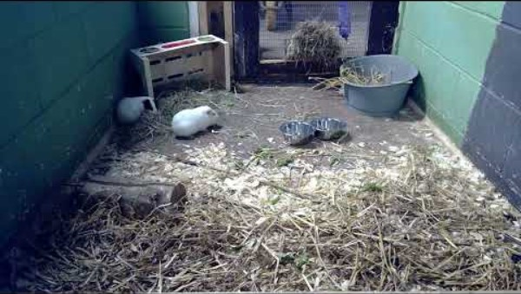
Task: Observing guinea pig behaviour
Watch a short clip of animal behaviour.
Identify key behaviours of one guinea pig.

Slide 37
Task: Noting guinea pig behaviour
Complete the Ethogram template.
Watch a short clip of animal behaviour.

Slide 38
Active listening
In teamwork, active listening means fully concentrating on a speaker, understanding their message, responding thoughtfully and remembering the information, fostering a more cohesive and productive team dynamic.

Slide 39
Active listening continued
  Listening: paying attention to the speaker’s words, tone and body language.
  Reflecting: paraphrasing or summarising what the speaker has said to ensure understanding.
  Clarifying: asking clarifying questions to address any uncertainties.
  Summarising: recapping the main points of the conversation to ensure everyone is on the same page.

Slide 40
Task: Animal behaviour observations
Discuss observations with peers.
Compare any inconsistences in the observations.

Slide 41
Plenary question: Guinea pig behaviour
During a training programme for a guinea pig, learners are asked to observe the animal’s behaviour and responses.
Explain how continuous observation and recording of the guinea pig’s behaviour can contribute to ensuring the welfare needs of the animal are met.

Slide 42
Next steps: Safe working practices
Read the distributed Safe working practices document(s) for working with animals.
Note the steps required to observe animals in an enclosure at your institution.

Slide 43
3
Health and safety in animal behaviour observations

Slide 44
Starter: Plan
In groups, produce a plan that follows the Safe working practices document(s) for an allocated animal.
Include considerations before, during and after the observation.

Slide 45
Key health and safety considerations
  Risk assessments and control measures.
  Proper use of PPE and equipment.
  Safe handling and restraint techniques.
  Clear documentation and reporting procedures.

Slide 46
Monitoring foxes case study
Key risks: staff without personal protective equipment, electric fencing, injured animals.
Identify hazards and control measures to ensure safety and mitigate risk to the person working with the animals.
Note key points on the flipchart paper.

Slide 47
Animal risk assessment definition
A risk assessment is a process of identifying hazards, evaluating the risk of harm and implementing measures to reduce or eliminate the risk.

Slide 48
Animal risk assessment: Severity
Determine severity of harm:
  Minor: bruises, small cuts, temporary discomfort.
  Moderate: fractures, burns, prolonged illness.
  Severe: permanent disability, life-threatening injury, fatality.

Slide 49
Animal risk assessment considerations
Consideration when evaluating the likelihood of harm occurring:
  Rare: highly unlikely to happen.
  Unlikely: could happen but not often.
  Likely: expected to happen occasionally.
  Very likely: almost certain to occur.

Slide 50
Incident reporting
Definition: recordable incidents are specific events or behaviours that are documented owing to their significance in monitoring animal welfare and safety.
Purpose: to ensure accurate tracking of animal behaviour and health, enabling timely interventions and the maintenance of a safe environment for both animals and visitors.

Slide 51
Why report incidents?
  Link to welfare: recording incidents helps in identifying stressors and health issues early, ensuring animals receive appropriate care and interventions.
  Safety: protects both animals and visitors by monitoring and addressing potentially dangerous behaviours.
  Compliance: adheres to zoo policies and legal requirements for animal welfare and safety.

Slide 52
What should be recorded?
  Details of the incident: date, time and location of incident.
  Behavioural observations: specific behaviours observed.
  Affected animals: identification of animals involved.
  Impact on others: effects on other animals and visitors.
  Immediate actions taken: any interventions or changes made in response to the incident.
  Follow-up: recommendations for further monitoring or actions needed.

Slide 53
Observing male goat case study
Individually, read the case study.
In pairs, discuss the behaviours in the case study and complete the Incident report form template.

Slide 54
Animal sanctuary case study
Individually, read the case study and complete the Incident report form template.

Slide 55
Effective communication in animal observations
  Who needs the information? (staff, vets, inspectors)
  Formal vs informal reporting methods.
  Adapting communication for different stakeholders.
  The importance of accurate, unbiased reporting.

Slide 56
Plenary: Zoo incident
Write a formal email to the zoo manager based on one of the Incident report form templates.
Include detail about the incident, your concerns and recommendations.

Slide 57
Next steps: Animal incident
Research an incident where an animal’s behaviour has caused significant harm to an individual
Complete Incident report form template.

Slide 58
4
Developing and using ethograms

Slide 59
Starter: Glossary worksheet
Review the terms in the Glossary worksheet.
Write a definition for those behaviours most associated with degus.

Slide 60
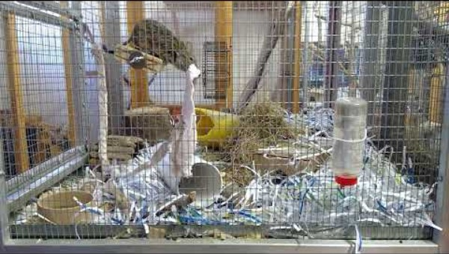
Task: Observing degu behaviour
Watch the clip of the degu and complete an Ethogram template for one degu.

Slide 61
Task: Noting degu behaviour
Discuss observations with peers.
Compare any inconsistencies in the observations.

Slide 62
Task: Observing animal behaviour
Watch the video clip of your allocated animal and complete an Ethogram template.
Notes:
Allocate learners one of the videos to watch:
Chinchilla video.
Mouse behaviour video.
Rabbit behaviour video.

Slide 63
Comparison of ethograms
  Compare ethograms in small groups.
  Identify differences in recorded behaviour.
  Discuss how accuracy can be improved.

Slide 64
Plenary question: Rehomed rabbit
You are working in an animal care setting. One of your responsibilities is to observe animal behaviour and report on any unusual signs. You are asked to observe a rabbit that has recently been rehomed.
a) Identify three types of behaviour you would expect to observe in a healthy, settled rabbit.
b) Describe each identified behaviour.
Notes:
Examples could include:
a) Locomotive behaviour, social behaviour, feeding behaviour, resting behaviour.
b)
Locomotive behaviour (e.g. hopping, exploring the enclosure) indicates confidence and good health.
Social behaviour (e.g. grooming another rabbit if housed with others) builds social bonds, shows comfort.
Feeding behaviour (e.g. eating hay, drinking water) suggests healthy appetite and normal function.
Resting behaviour (e.g. lying stretched out, eyes half-closed) indicates relaxation and trust in the environment.

Slide 65
Next steps: Research jobs
Research job posts for working in an animal collection.
Bring notes and advertisements to the next lesson.

Slide 66
5
Working with animals over their life stages: Roles and responsibilities

Slide 67
Starter: Working at a zoo
Refer to your notes from the next steps activity from the previous lesson.
Open and review the provider Safe working practice document.
In pairs, create a list of all the tasks and responsibilities required of staff working at a zoo.
Add your list to the collaborative space.

Slide 68
Task: Zookeeper
In your group, review either the person specification or the job description.
Write a short summary of your group’s section.
Add your group’s summary to the collaborative space.

Slide 69
Features of a job advert
  Job title which clearly states the role (e.g. zookeeper).
  Summary of the role providing a short overview of the job and what it involves.
  Key responsibilities: main duties the person will carry out.
  Required qualifications or experience: skills, experience or training needed to apply.

Slide 70
Task
Individually, use the summaries on the collaborative space to write a job advertisement for the role of the zookeeper.
In pairs, compare advertisements and make any improvements based on discussion with peer.

Slide 71
Key life stages in animals
  Juvenile (growth and learning).
  Adult (maturity and reproduction).
  Senior (ageing and health decline).

Slide 72
Interview preparation
The zoo needs to move a mob of five juvenile meerkats into a shared enclosure with a senior porcupine.
Individually, research what animal behaviours you would monitor to determine whether the move is successful.
Make appropriate notes to take to the interview.
Note: notes will be presented to peers.

Slide 73
Interview task
In groups, discuss the animal behaviours findings.
Work together to compile a list of behaviours on the flipchart.

Slide 74
Task: Mammal life stages
Choose a named mammal species.
Describe the main physical and behavioural changes that occur during each of the key life stages.
For each stage, explain how these changes affect the care needs of the animal.

Slide 75
Next steps: Nutritional needs
Research how the nutritional needs of the animal change over the key life stages.

Slide 76
6
Preparation for behavioural observation

Slide 77
Starter: Word cloud
Think about the key terms related to nutrition and life stages that you researched for homework.
Write three terms which are relevant to the infant life stage. Add these to the word cloud software.
Repeat for juvenile, adult and senior life stages.

Slide 78
Macronutrients
  Macronutrients provide energy and support growth, maintenance and health.
  The three main types are carbohydrates, proteins and fats.
  Different species have varying requirements based on their diet and metabolism.

Slide 79
Cats
  Protein: 30–50% of diet (high need for essential `
  amino acids).
  Fat: 15–30% (important for energy and skin health).
  Carbohydrates: Less than 10% (minimal requirement).

Slide 80
Dogs
  Protein: 18–25% of diet.
  Fat: 10–15% (important for energy and skin health).
  Carbohydrates: 30–50% (can digest starches
  and fibres).

Slide 81
Horses
  Protein: 8–14% (higher for foals or working horses).
  Fat: 2–5% (low natural intake, but it can be supplemented).
  Carbohydrates: 60–70% (mostly fibre from grasses
  and hay).

Slide 82
Rabbits
  Protein: 2–16% (essential for growth and health).
  Fat: 2–4%.
  Carbohydrates: 60–70% (high fibre from hay and plants).

Slide 83
Calculating percentages: Stage 1
  What is the whole amount (total)?
  What is the percentage you need to find?
Example: What is 20% of 50?
Total = 50
Percentage = 20%

Slide 84
Calculating percentages: Stage 2
  Divide the percentage by 100.
  Multiply the decimal by the total.
Example:
20 ÷ 100 = 0.2
0.2 × 50 = 10

Slide 85
Calculating percentages: Stage 3
  Double-check your working.
  Make sure the answer makes sense.
  Use this in context if needed (e.g. 10% of feed, discount, attendance).
Answer to example:
20% of 50 = 10

Slide 86
Task: Calculation
What is 10% of 70?
What is 25% of 80?
What is 5% of 200?
What is 50% of 90?
What is 20% of 120?
What is 15% of 60?
What is 30% of 150?
What is 40% of 250?
What is 75% of 100?
What is 60% of 300?
Notes:
Answers
10% of 70 = 7
25% of 80 = 20
5% of 200 = 10
50% of 90 = 45
20% of 120 = 24
15% of 60 = 9
30% of 150 = 45
40% of 250 = 100
75% of 100 = 75
60% of 300 = 180

Slide 87
Calculating percentage of occurrence: Stage 1
  What is the total number of occurrences?
  What is the total number of a specific occurrence?
Example:
A mouse showed locomotion 6 times out of total of 20 recorded behaviours.
Total occurrences = 20
Locomotion = 6

Slide 88
Calculating percentage of occurrence:
Stage 2
  Divide specific occurrence by total number of occurrences.
  Multiply by 100.
Example:
6 ÷ 20 = 0.3
0.3 x 100 = 30
Answer to the example:
30% of the behaviours observed were locomotion.

Slide 89
Task: Behaviour percentages
Using one of the Ethogram templates you completed in lesson 4, calculate the percentages of the behaviours.

Slide 90
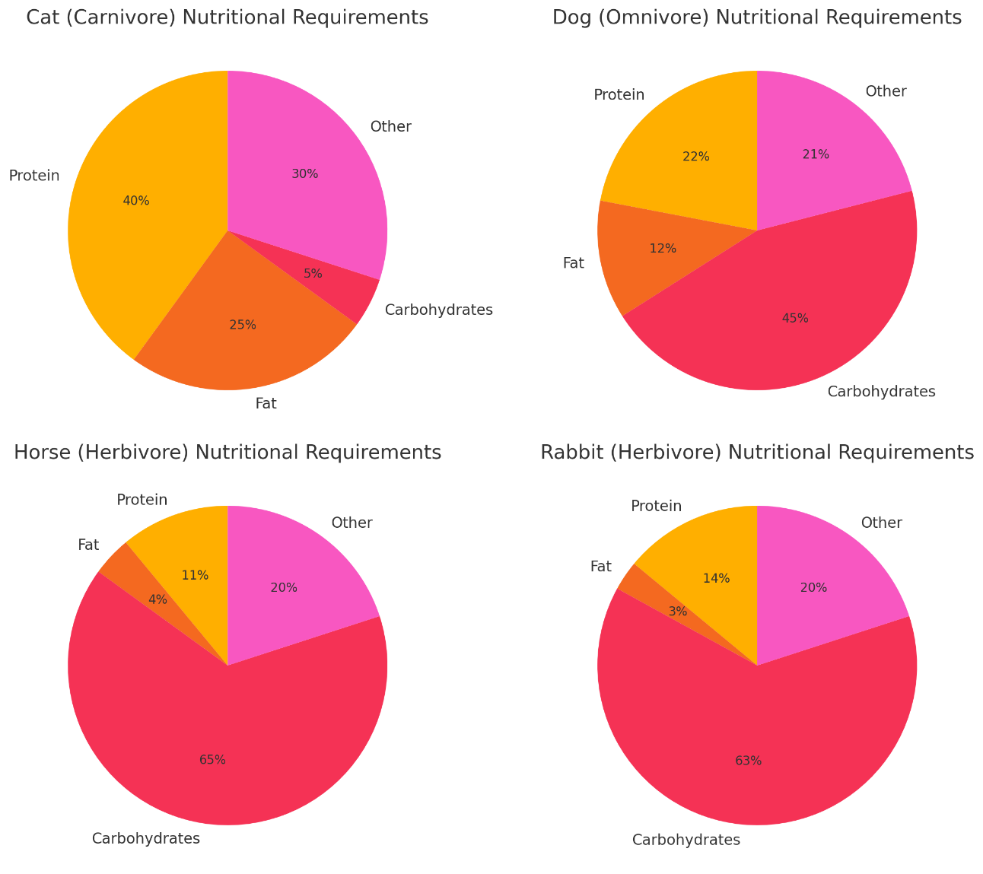
Displaying data

Slide 91
Step 1: Prepare the data
  List the categories (e.g. macronutrients: protein, fat, carbohydrates) in one column.
  Next to each category, enter the corresponding percentage values.
  Make sure the percentages add up to 100%.

Slide 92
Step 2: Select the data
  Click and drag to highlight both the category names and their percentage values.
  Ensure you include headers if you have them.

Slide 93
Step 3: Insert pie chart
  Go to the Insert tab on the Excel ribbon.
  Click on the pie chart icon.
  Choose a pie chart style (e.g. 2D Pie).

Slide 94
Step 4: Format the pie chart
  Click on the chart to reveal chart tools.
  Add data labels by clicking on the ‘Add chart elements’ (the plus icon) and then selecting ‘Data labels’ in the menu.
  Format labels to show percentages for clarity.
  Adjust chart title to describe the data.

Slide 95
Step 5: Review and save
  Check that the pie slices correspond correctly to the percentages.
  Save your workbook.

Slide 96
Task: Pie charts
Using calculated percentages of each behaviour recorded in the previous task, create pie charts to display the data.

Slide 97
Task: Paired analysis
Working in pairs, review each other’s set of data.
For each set of data, write an observation summary about the data.
Write three sentences starting with:
The most observed behaviour was ___.
The least observed was ___.
This might suggest that ___.

Slide 98
Overview of the rabbit stage
  Conduct structured behavioural observations over five weeks.
  Spend four hours each week observing the same animal (rabbit, guinea pig or hamster).
  Total of 20 observation hours required.
Goal: Understand animal behaviour, environment effects and welfare concerns.

Slide 99
Choosing and scheduling
  Select one animal and stick with it for all five weeks.
  Schedule observations at the same time each week for consistency.
  Plan for four-hour sessions weekly and keep to the schedule strictly.

Slide 100
Recording behaviour
  Use an ethogram to document behaviours precisely.
  Focus on feeding, grooming, socialising, resting
  and activity patterns.
  Note unusual behaviours or signs of stress
  (e.g. stereotypical movements).
  Be detailed and objective in your notes.

Slide 101
Environmental influences
  Observe how lighting, temperature, noise and handling affect behaviour.
  Record any changes or responses to different enrichment or housing set-ups.
  Consider how environment supports or limits natural behaviour.

Slide 102
Report and analysis
  Compile weekly observation logs and ethograms.
  Create suitable pie charts to display your collected data.
  Analyse behavioural trends.

Slide 103
Task: Planning rabbit stage
Create a plan template which will record day, time and environmental factors.

Slide 104
Plenary questions: Behaviour monitoring
Explain why monitoring behaviour in animals is important for their welfare.
In your answer, include how relevant legislation supports this practice.

Slide 105
Next steps: Rabbit stage
Undertake requirements as set out in the
Lesson 6 rabbit stage worksheet.

Slide 106
7
Applying learning theories to influence positive animal behaviour

Slide 107
Starter quiz
True or false
Hyperactivity is an example of natural behaviour.
Solitary animals should be housed together.
Jane Goodall is best known for her work with chimpanzees.
Dental issues happen in the senior stage.
Water is an example of macronutrient.
Bonus point: What is 15% of 175?

Slide 108
Starter quiz: Answers
True or false
Hyperactivity is an example of natural behaviour. False
Solitary animals should be housed together. False
Jane Goodall is best known for her work with chimpanzees. True
Dental issues happen in the senior stage. True
Water is an example of macronutrient. False
Bonus point: What is 15% of 175? Answer: 26.25

Slide 109
Task: Reflect
In small groups, reflect on your behavioural observations from the last five weeks.
Consider:
  What behaviour was observed, and did it change?
  Were behaviours observed as anticipated?
  Did everything go to plan?

Slide 110
Classical conditioning
  Form of learning through association.
  First described by Ivan Pavlov, a Russian physiologist.
  Known as Pavlovian conditioning.
Notes:
Teacher note
Highlight to learners that classical conditioning was first described by the physiologist Ivan Pavlov while he was studying dogs salivation responses. It is remembered as associated learning.
Explain that Pavlov’s dogs after hearing a bell before being given food on several occasions Pavlov’s dogs salivated at the sound of the bell, in the absence of food. A new stimulus, the bell, now elicited a reflex, salivation. The dogs learned that the bell indicated food.
Summarise the before, during and after conditioning.
Before conditioning: Neutral Stimulus (bell) results in NO response, AND Unconditioned Stimulus (UCS) (food) produces Unconditioned Response (UCR) (salivation)
During conditioning: Neutral Stimulus (bell) is paired with the Unconditioned Stimulus (UCS) (food) which produces the Unconditioned Response (UCR) (salivation)
After conditioning: Conditioned Stimulus (bell) elicits the Unconditioned Response (UCR) (salivation)
Summarise by advising that basically after conditioning the dog can no longer choose to salivate when only the bell is used. It has associated the bell with the presence and consumption of food.

Slide 111
Operant conditioning
  Learning that happens through consequences.
  The response is strengthened or weakened.
  Based on what happens after the behaviour.
Notes:
Operant Conditioning:
Definition:
Process by which the consequences of a response increase or decrease the likelihood that the response will occur again (Skinner, 1938)
Operant conditioning as responses operate on the world to produce an effect – for instance, if a dog pokes its nose into a fountain and gets sprayed with water there are one of two thing that can occur – if the dog ENJOYS the experience it is more likely to repeat the behaviour BUT if the dog DISLIKES/FEARED the experience it will be LESS LIKELY to repeat the same behaviour for fear of the outcome.
Reinforcers
Any event that increases the frequency of a preceding response
Can be positive or negative
Positive & negative refers to whether the response causes the stimulus to arrive (positive) or be removed (negative)
Shaping
Behaviour can be shaped by reinforcing closer and closer approximations e.g. Rat in Skinner Box
Reinforced for moving near lever
Then when touching lever
Then when pressing lever

Slide 112
Operant conditioning quadrant
Operant conditioning can be divided into two main categories:
  Reinforcement:
    positive (R+)
    negative (R-)
  Punishment:
    positive (P+)
    negative (P-)

Slide 113
Behavioural challenge case studies
Read the case study allocated.
Identify training techniques that could be used to overcome the behavioural challenges displayed by the animal in the allocated case study.

Slide 114
Hot and cold game
One person will be the ‘animal’, one will be the ‘trainer’, one will be the observer.
Total amount of time given: 10 minutes. One minute to hide ‘reward’, five minutes to locate ‘reward’, four minutes for observer feedback (including feedback from ‘trainer’ and ‘animal’).
Aim: to hide a reward and only using ‘hot’ or ‘cold’ as a signal to tell the ‘animal’ where their desired treat is located.

Slide 115
Plenary question: Conditioning
Explain the key differences between classical and operant conditioning in animal training.
Describe the consequences of positive and negative reinforcement in the context of training animals.

Slide 116
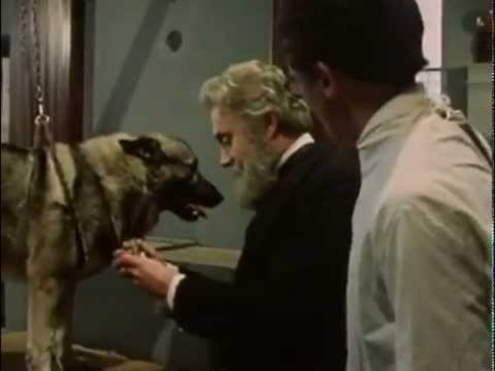
Next steps: Pavlov’s dogs
Watch a video about Pavlov’s dogs.
Make notes regarding its purpose and when it could be used to train animals.

Slide 117
8
Training plans using the S.P.I.D.E.R. framework

Slide 118
Starter: Learning theories
Read the introduction to the article.
As a pair, write a summary of the article.
Add your summary to the collaborative wall.

Slide 119
Task: Planning training case studies
Complete each case study in the allocated time.

Slide 120
Task: Framework
Create a diagram of a framework that could be used to create and monitor animal training.

Slide 121
S.P.I.D.E.R framework
  Setting goals
  Planning
  Implementing​
  Documenting​
  Evaluating​
  Re-adjusting​
​Developed by Sevenich, MacPhee & Mellen, 2002.
Compare the S.P.I.D.E.R framework with your group’s version.

Slide 122
Plenary question: Training conditions
Discuss how to assess an animal’s progress when training.
Explain how to adjust the training plan to ensure success.

Slide 123
Next steps: Training methods
Read the the blog post.
Write a summary on adjusting training methods for different life stages.

Slide 124
9
Developing and proposing an animal training plan

Slide 125
Starter: Hot and cold game
One person will be the ‘animal’, one will be the ‘trainer’.
Total amount of time given: six minutes. One minute to hide ‘reward’, five minutes to locate ‘reward’.
Aim: to hide a reward and adapt ‘hot’ or ‘cold’ as per the life stage card as a signal to tell the ‘animal’ where their desired treat is located.

Slide 126
Task: Creating training plan
Use your rabbit stage behaviour observations and data analysis to complete the task.
Set one or more training goals and create a training plan which improves the welfare of the animal you observed.

Slide 127
Task: Peer review
Peer review the set goals and training plan.
Provide constructive feedback.

Slide 128
Task: Adjusting training plan
Using the feedback, make suitable adjustments to your goals and training plan.

Slide 129
Plenary task: Email collections manager
Write an email to the collections manager who oversees the animals explaining your training plan.
Include:
  a summary of the plan
  how it improves welfare
  reference to your behaviour observations and data.
Notes:
to collections manager

Slide 130
Next steps
Review materials from lessons 1–9 and collate notes in preparation for lesson 10 (bring to next lesson).
Review feedback from the email to the collection manager.

Slide 131
10
Proposing solutions to influence positive animal behaviour

Slide 132
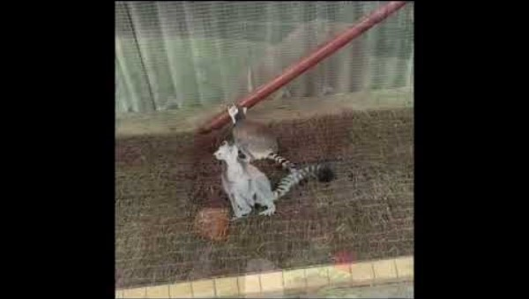
Starter: Task
Watch the video clip and identify as many behaviours as you can.

Slide 133
List of behaviours
Locomotion Play​ Aggression Territorial ​ Feeding​ Socio-sexual Reproduction​ Displacement behaviour​ | Crib-biting Grooming Excessive grooming Foraging​ Hyperactivity Excessive inactivity Pacing​ Self-mutilation​

Slide 134
Task: Dutch rabbit or Syrian hamster
Read the case study allocated.
Complete the Animal training plan template, proposing solutions to influence positive animal behaviour.

Slide 135
Preparing for peer review analysis
Read the peer review pro forma.
Prepare five-minute oral presentation.
Include:
  a brief animal profile
  atypical behaviours and factors
  suggested training techniques.

Slide 136
Peer review analysis
In allocated pairs, each present your Animal training plan.
Provide feedback using the peer review pro forma.

Slide 137
Plenary
Complete the Animal behaviour confidence rating worksheet.
Create SMART targets identifying how you will further develop your skills and knowledge around the
techniques to influence positive animal behaviour;
needs of different animals;
working in different environments.

Slide 138
Next steps: Applying learning
Apply learning of solutions to influence positive animal behaviour to other animals.
Observe other animals and use techniques to influence positive animal behaviour.
Review and use the formative feedback to improve training plans.

Slide 139


ET-FOUNDATION.CO.UK
PRODUCED BY
FUNDED BY
South Staffordshire College has produced this resource on behalf of the Education and Training Foundation
This programme is funded by the Department for Education

