Slide 1


Lesson 2:
Ratios and fractions
Objectives
Write a fraction as a ratio and vice versa
Divide a given quantity into parts in a given part–part and part–whole ratio
Solve multi-step problems using ratios and fractions
Use representations to provide insight into solving problems

Slide 2
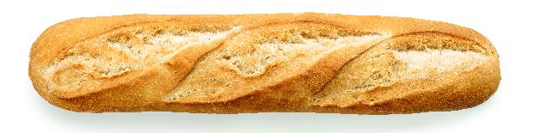


Buying lunch
Amy and Bikram are buying a baguette to share for lunch.
RP_PRJ1403_W2_ph_004N
Notes:
Introduce the context of two friends (Amy and Bikram) buying a baguette to share for lunch. Ask students to suggest a possible way that Amy and Bikram could share the baguette.
It is likely that students will assume that Amy and Bikram will share the baguette equally so will get half each. Ask for an alternative way to share the baguette to encourage students to think more deeply about the problem.
The students may want to know exactly how much Amy and Bikram each paid, but at this stage the amounts are irrelevant as this activity is only intended to remind them of concepts they will have encountered previously.

Slide 3
Buying lunch
Bikram wants to split the baguette half and half.
Amy pays more so she wants to split the baguette in the ratio 3 : 2
Notes:
Slide 3 uses both ratio and fractions to describe how the baguette is shared. Discuss the difference between Bikram’s terminology (fractional) and Amy’s terminology (ratio).
Notice how students engage with the language of fractions and ratios. How easily do they appear to relate fractions to ratios? If they appear to be confused, spend a little time revising the differences between fractions and ratios. Reassure them that the main activity for the lesson is designed to help them understand the different ways of describing how things are shared.

Slide 4
Working in pairs
YOUR
TURN
Take turns to place a card.
Explain your reasoning for the match to your partner.
Your partner must agree, disagree or ask for more explanation.
Complete any blank cards.
Notes:
Tell the students that they are going to be working in pairs. This important slide emphasises the ways in which students should work together. Many students may have very little experience of working collaboratively in maths lessons, and it is helpful for them to be given some guidance about how they should collaborate and what is expected of them.

Slide 5

Matching ratios and fractions
YOUR
TURN
Handout
available
Notes:
Explain that the class is going to explore different ways that Amy and Bikram could share the baguette. Arrange students into pairs and give each pair a copy of the ‘Sharing baguettes’ grid and the ‘Fractions’ cards. (Students will need scissors to cut the cards up if they haven’t already been cut into cards prior to the lesson.)
Note that some rows in the grid have more than one fraction card and some rows don’t have any. Students are not expected to create cards for rows that have no fraction but do need to complete the blank card F10, which they should place in a row that does not have a fraction card or as an additional card in a row that already has a card matched.
Observe students as they complete this task but try not to correct students’ mistakes at this stage. Instead, encourage students to explain their reasoning to each other and listen in to their explanations as you circulate. A common misconception that you may observe is assuming that the ratio 1 : 2 is equivalent to the fraction 1/2.

Slide 6
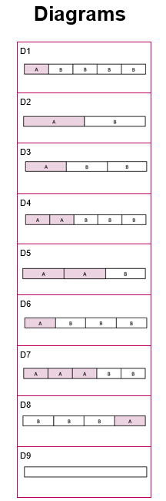
Diagrams
YOUR
TURN
Handout
available
Notes:
When students have matched the majority of the ‘Fractions’ cards, give out the ‘Diagrams’ cards. Ask students to place the cards in the ‘Diagram’ column in the appropriate cell. How do the diagrams support their thinking?
Card D9 is blank and needs to be completed by students.
As students work on the task, support them in working together and encourage them to explain their reasoning. Remind them to take turns. If you notice one partner is placing all the cards or they are not working collaboratively, ask a student to explain a card that has been placed by their partner.

Slide 7
Descriptions
YOUR
TURN
Handout
available
Notes:
Once students have completed the ratio–diagram–fraction matches they can be given the set of ‘Descriptions’ cards.
Students may find it helpful to glue the grid onto an A3 piece of paper so that there is more space to the right of the grid to place the ‘Descriptions’ cards alongside the appropriate row.
Some rows have more than one description card and some rows don’t have any. Students are not expected to create cards for rows that have no description but do need to complete the blank card W8. They may choose to complete this card for a row that has no description card or add a further description to a row that already has a description card matched.
Observe students as they complete this activity and identify which descriptions cards will be particularly important to highlight in the whole class discussion. Students often struggle with ‘one and a half times as much’ (Card W6) and it may be appropriate to withhold this card in some cases.
Deepening understanding Students who have completed their matches can use the ‘More sharing’ handout to explore additional ways in which Amy and Bikram could share the baguette. The blank cards on the handout can also be used to add some additional fractions and/or descriptions to the existing scenarios A to I.

Slide 8
Sharing baguettes
REVIEW
Notes:
Students usually like to know the ‘answers’, and while this is important it is also important to understand how they arrived at these answers. Ask the students to explain their thinking when they first matched the fraction cards to the ratios. You may like to call on a pair who initially got it wrong and later corrected their work. Did the matched card remain in place or did the introduction of additional card sets cause students to move the card? Why was this?
Establish any links and connections that students have made for themselves while working on the task. During the discussion it is important to re-phrase student explanations using the language of parts and whole.

Slide 9
Answers (A to E)
Notes:
(OPTIONAL SLIDE) These slides give the answers for the three Explore tasks
Note that there are two possible positions for F3, in either row B or row H.

Slide 10
Answers (F to I)
Notes:
(OPTIONAL SLIDE) These slides give the answers for the three Explore tasks
Note that there are two possible positions for F3, in either row B or row H.

Slide 11
Ratios and fractions
DISCUSS
Ratios and fractions provide different ways to describe how something is shared.
A | A | A | B | B
Notes:
Arrange a discussion to draw out an understanding of what is the same and what is different about fractions and ratios.
Ask the students what is the total number of parts? What fraction does Amy get? What fraction does Bikram get? What is the ratio in which Amy and Bikram share the baguette? By the end of the discussion, students should understand that, in a ratio, adding gives the total number of parts. In a fraction, the denominator gives the total number of parts.

Slide 12
Comparing ratios
LET’S
LOOK
Amy and Bikram share the baguette in the ratio 1 : 3
Bikram and Amy share the baguette in the ratio 3 : 1
A | B | B | B
Notes:
Present the two scenarios and ask students whether the two ratios are describing the same way of sharing. Give students a couple of minutes to consider this in pairs. Students may want to draw a diagram for each scenario on their mini whiteboards.
Discuss students’ diagrams and use the diagram on the slide to establish that ‘Amy and Bikram share the baguette in the ratio 1 : 3’ is the same as ‘Bikram and Amy share the baguette in the ratio 3 : 1’.
Ask students to work out what fraction of the baguette Amy and Bikram get in each case. They should establish that Amy gets 1/4 of the baguette and Bikram gets 3/4 of the baguette in both scenarios.

Slide 13
Describing ratios
REVIEW
Notes:
The comparison of ratios can be linked back to the ‘Sharing baguettes’ grid. Did students notice that rows B and H describe the same scenario? Which rows did they choose to place cards F3 and D6 in? Did they place them in the same row or different rows?

Slide 14
Sharing a baguette
Amy and Bikram share the baguette in the ratio 2 : 3.
I will get ⅔
of the baguette
Amy is wrong
Amy
Bikram
How are the numbers in a fraction linked to the numbers in a ratio?
Notes:
Present the scenario and ask students to determine who is right – Amy or Bikram. Can students draw a diagram to show whether Amy is correct? Encourage students to draw a diagram and refer to the ‘Sharing baguettes’ grid as appropriate. Some students may have placed card F2 in row D initially and thought the same as Amy. If they corrected this, they may now recognise that Amy is incorrect.
Establish the relationship between the numbers in a fraction and the numbers in the corresponding ratio (e.g. if Amy and Bikram share the baguette in the ratio 2 : 3, Amy gets 2/5 of the baguette. If Amy gets 2/3 of the baguette, Amy and Bikram are sharing in the ratio 2 : 1).

Slide 15

Going deeper: Paying for the baguette
LET’S
LOOK
Amy and Bikram share the baguette in the ratio 2 : 3
Amy gets ⅔ of the baguette
A | A | B | B | B
A | A | B
£1.20
£1.20
£1.20
Notes:
Ask students to calculate how much Amy and Bikram would be paying towards the cost of the baguette (total cost £1.20) for both the fraction 2/3 and the ratio 2 : 3. This supports students in developing their understanding of ratios and fractions still further.
Deepening understanding Students could be asked to calculate how much Amy and Bikram would need to pay for their share of the baguette in each of the scenarios A–I.

Slide 16
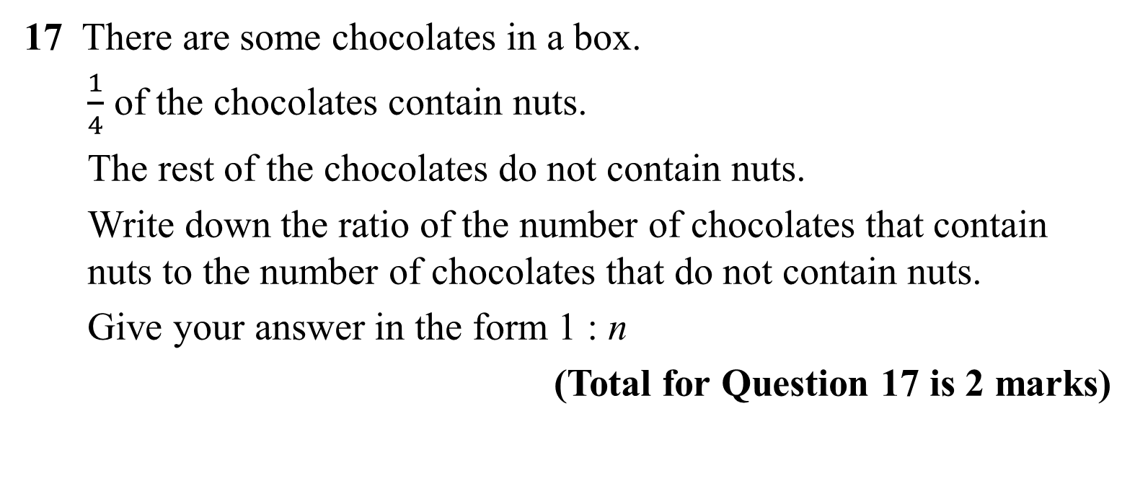
Practice question
REVIEW
Handout
available
17 There are some chocolates in a box.
$\frac{1}{4}$ of the chocolates contain nuts.
The rest of the chocolates do not contain nuts.
Write down the ratio of the number of chocolates that contain nuts to the number of chocolates that do not contain nuts.
Give your answer in the form 1 : n
(Total for Question 17 is 2 marks)
Chocolates with nuts : chocolates without nuts
1 : 3
Notes:
Notice whether students draw a diagram to support their thinking. How does drawing a diagram demonstrate the links between fractions and ratios?
Q17 from June 2018 1MA1/1F

Slide 17
Lesson review:
Ratios and fractions
Objectives
Write a fraction as a ratio and vice versa
Divide a given quantity into parts in a given part–part and part–whole ratio
Solve multi-step problems using ratios and fractions
Use representations to provide insight into solving problems
Suggested further steps/areas to work on
Use ratio notation, including a reduction to simplest form

Slide 18
Lesson 2:
Credits
Photo acknowledgements
Shutterstock.com: MaraZe, Vectorfair.com
Text acknowledgements
Pearson Education Ltd: Pearson Edexcel GCSE (9-1)
In Mathematics (1MA1) Foundation (Non-Calculator) Paper 1F, Summer 2018 Publications Code 1MA1_1F_1806_MS

