Slide 1
TRIP
Materials to support the early years educator holistic delivery

Slide 2
01
Diagnostic activity

Slide 3
Holistic delivery of the early years educator Occupational Specialism
Stage 1
Types and models of plans
(7.5 hours)
Stage 2
Developing differentiated plans
(6 hours)
Stage 3
Planning resources
(9 hours)
Case study from IP
Stage 4
Planning an effective activity plan
(1.5 hour)
Key
The arrows sequence the stages.
The circles highlight activities outside the 24 hours.
IP = Industry Placement.
Notes:
Point out to learners that throughout the framework for learning, Industry Placement will be referred to as IP. Make sure that they are familiar with the abbreviation.

Slide 4
Activity: Create a plan
Case study
A three year old attends nursery. They like to play with bricks and small figures on their own. The child finds it hard to share with other children.
Activity
Individually, create an activity plan to encourage the child to share.
Notes:
Provide learners with a blank piece of paper. They should not be guided, to allow for a diagnostic of any understanding of activity planning in an early years setting.

Slide 5
Activity: Peer review
Working in your allocated activity group:
Peer review each member’s activity plan.
Use a sticky note to add comments identifying good characteristics of the plan.
Notes:
Explain what is meant by the term “good characteristics”. For example, the plan includes timings.

Slide 6
Activity: Produce a mind map
Working in your allocated activity group, produce a mind map on the topic: “What does a good plan look like?”
Identify key characteristics of a good plan.
Notes:
If learners needs support, provide one or two examples – resources, adult roles, adaptive teaching and so on.
Stretch the learners by asking: “Why do you think these characteristics make a good plan?” “Do the characteristics offer children the opportunity to develop holistically?” “How do they do this?”

Slide 7
Activity: What does a good plan look like?
Working in your allocated activity group, feed back to the whole class.
Discuss as a whole group whether all the characteristics reviewed constitute a good plan.
Notes:
Discuss the outcome of this activity and reinforce good characteristics: resources, adult roles, adaptive teaching, timings, prior learning, ages and stages of development, and so on.
Ask learners to put their name on their activity plan. Collect learners’ individual activity plans. These will be used in future lessons.

Slide 8
Next steps
Bring in a daily activity plan that is used at your IP.
Notes:
Advise the learners to ask their mentor from their IP for a daily activity plan for the class. This can be for any day, but ideally one that they have attended so that they can relate to it. This can be a physical copy, photo or scan of the daily activity plan. This will need to be available for use in the next lesson.
Please note that references to the daily activity plan in this resource mean the short-term plan used in any early years educator setting. This term will vary depending upon each setting and organisation. Highlight this to the group and ask them to find out what their IP calls it. The term used reflects the term used in the Employer-set project (ESP). Make sure learners are familiar with the abbreviation.

Slide 9
02
Types of good planning

Slide 10
Recap activity
In your allocated activity group:
Discuss the characteristics of a good activity plan; recap knowledge from the previous lesson and information gathered from your IP.
Allocate a spokesperson and feed back to the whole group one characteristic of a good activity plan.
Notes:
Ask learners what activity plans are referred to as in their IP.
Encourage learners to look at the copy of their daily activity plan from their IP.
Write the key characteristics provided by learners on a flipchart.

Slide 11
Activity: IP activity plans
In your allocated pairs:
Swap IP activity plans.
Read the IP activity plan and highlight any good activity plan characteristics (use a highlighter pen).
Discuss what you have highlighted with your peer to see whether they agree or disagree.
Notes:
Distribute highlighter pens to the learners.

Slide 12
Activity: Comparison
Individually, compare your lesson 1 activity plan with your IP activity plan.
Use a coloured pen to add any missing key characteristics to your lesson 1 activity plan.
Notes:
Distribute activity plans from lesson 1 to the learners. Provide learners with a different coloured pen to that used in lesson 1.
Ensure that learners make amendments using the different coloured pens to see the comparison.

Slide 13
Activity: Create an activity plan
Case study
A two-year-old child attends nursery and likes to play with water and funnels. They find it hard to regulate their emotions and can often find large groups unsettling.
Activity
Individually, create an activity plan to support the child in regulating their emotions in a group.
Notes:
Learners to be encouraged to look at their updated lesson 1 plan.
Learners will be expected to include more detail in this plan, based on their knowledge of the key characteristics of a good activity plan.
To stretch learners, once they have completed their activity plan, they could explain how their activity regulates emotions, to deepen their understanding.

Slide 14
Activity: Peer review
Swap your activity plan with a peer.
Peer review the activity plan, completing the peer review handout.

Slide 15
Activity: Self-reflection
Using a sticky note, identify one good characteristic in your activity plan.
Notes:
Give learners a sticky note each. Instruct them to place the sticky note at the front of the classroom so that it is visible to read.

Slide 16
Next steps
Discuss your amended plans with IP mentor and ask how they compare to those in the IP setting.
Notes:
Read aloud the sticky notes that have been put at the front of the classroom. Ask the learners to discuss their activity plan with their IP mentor and receive feedback.

Slide 17
03
Short-term planning A

Slide 18
Activity: Starter
Research what is meant by the term “short-term planning”.
Write a definition of “short-term planning” on a sticky note.
Notes:
Ask learners to research using the internet, through their phones or on a computer.
Ensure all learners have a sticky note to write their definition.
Select four sticky notes to read to the whole group:
A short-term plan will explain activities that link to the early learning goals.
It will incorporate children’s interests and individual needs.
It may indicate staff roles and adult-led activities.
It may also indicate children who need to focus on a particular area of need.

Slide 19
Types of short-term plans
Weekly plans
Continuous provision plans
In-the-moment plans
Activity plans
Notes:
Explain what each phrase means and give learners time to make notes. The focus of the lesson will be on the top two plans.
Weekly plans
A series of lessons or activities that the practitioner will carry out in line with the age and stage of development.
Continuous provision plans
A plan based on the different areas of play that the setting has set up – for example, role play, construction, creative, literacy, maths, water, sand, reading and calm corner.
In-the-moment plans
A plan based on a child’s interest that allows for a spontaneous learning opportunity.
Activity plans
A plan based on an area of learning, a child or a stage of development that allows them to progress.
https://www.nurseryworld.co.uk/news/article/master-plans

Slide 20
Activity: Weekly short-term plan
Individually, highlight the characteristics of a “good” weekly plan. Consider:
activities children will carry out
adaptive teaching groups
the role of the adult
the form of assessment.
Notes:
Give the learners the weekly short-term plan handout and a highlighter pen.
Facilitate a class discussion based on the highlighted characteristics on the weekly short-term plan.

Slide 21
Activity: Continuous provision plan research
Individually, research the characteristics of a continuous provision plan.
Write the information in your notebook.
Notes:
Suggested websites for learners to look at:
Continuous Provision Planning: abcdoes.com
early-education.org.uk/continuous-provision-in-eyfs
To stretch learners, while they are completing their research, ask the following questions:
Why is this a good characteristic of a continuous provision plan?
Who will the continuous provision plan benefit?
Why is a continuous provision plan used in an early years educator setting?
This will help expand their knowledge and understanding of continuous provision plans.

Slide 22
Activity: Continuous provision poster
Working in your allocated activity groups, produce a poster on what to include in a continuous provision plan.
Notes:
Ensure learners have flipchart paper and a pen to make the poster.
Afterwards, in allocated groups, get the learners to peer-assess each other’s posters, giving a score from 1 to 5: 1 = poor, and 5 = outstanding.

Slide 23
Activity: Continuous provision budget
In your allocated groups,
create a continuous provision plan based on the criteria from the handout
feed back to the whole class two priority characteristics that you have used in your continuous provision plan.
Notes:
Ensure learners have flipchart paper and a pen. Encourage learners to reflect on their prior learning from lesson 1.
Remind the learners to consider budget, space (including the ratio of children in each area), resources, adult roles, and age and stage of development.

Slide 24
Next steps
Compare the continuous provision plan with one used in an IP setting.

Slide 25
04
Short-term planning B

Slide 26
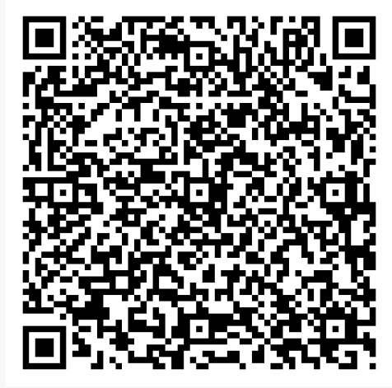
Activity: Recap
Independently answer the questions on the quiz.
Notes:
Ensure learners have access to the internet, through their phones or on a computer.
Get verbal feedback from the learners during and after the quiz.

Slide 27
In-the-moment plans
The three characteristics are:
the child’s spark
the teachable moment
the documentation.
Notes:
Expand on these points:
The child’s spark is when the child first shows an interest in something. The practitioner will capture this through observation.
The teachable moment is the opportunity to extend their interest by asking open-ended questions and considering ways to apply this interest. This is when the practitioner needs to think about their environment.
Documenting the observation and the teachable moment will help to map out each child’s interests and plan an environment that works for them.
Discuss with the learners if in-the-moment planning happens in their IP.

Slide 28
Activity: In-the-moment planning
Individually, research the practitioner’s role in in-the-moment planning.
Notes:
Ensure learners have access to the internet.
Suggested website for learners to look at: An Introduction to In the Moment Planning - Nursery Story
https://nurserystory.co.uk/resource-centre/an-introduction-to-in-the-moment-planning/

Slide 29
Activity: Create an in-the-moment plan
Case study
A four-year-old child has an interest in the royal family. The child gets frustrated when trying to write about them because they cannot hold a pencil.
Activity
Individually, create an in-the-moment plan to support the child’s fine motor skills.
Notes:
Provide learners with a planning template. Explain that they will need to think about the area of development and their interests.
Ensure the learners have a copy of the Development Matters standards.
To stretch learners, ask them to justify why an in-the-moment plan is needed for the child in the case study.

Slide 30
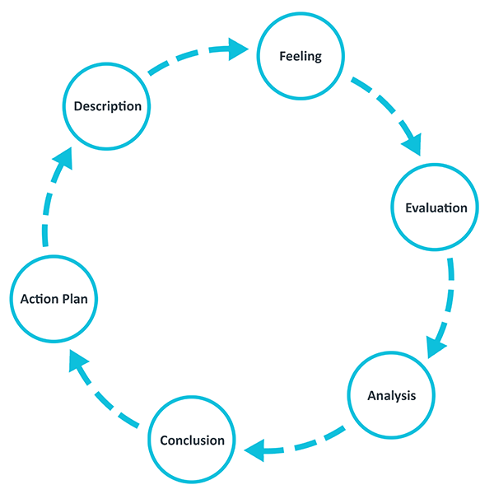
Gibbs’ reflective cycle
Notes:
Ensure the learners understand what needs to be included at each stage of Gibbs’ reflective cycle:
Description: What have you created? What have you done?
Feeling: What were you thinking? What were you feeling?
Evaluation: What is something that is good about your plan? How have you applied the milestones from the Development Matters document?
Analysis: Will this help the child and their needs? How will it help them?
Conclusion: What is one thing you would change? How could you improve your application of the milestones in your plan?
Action plan: If you were to plan this again, what would you change?

Slide 31
Activity: Self-reflection
Individually, self-assess the in-the-moment plan based on Gibbs’ reflective cycle.
Notes:
Ensure learners are completing their reflections in their notebooks.

Slide 32
Next steps
Decide on two children from IP who will be the case studies for your activity plan.
Observe the children at IP.
Notes:
Allow the learners to discuss who they are going to choose as their case study from their IP and write notes on what they need to know about their case study.
They should consider the child’s age, stage of development, interests and preferred way of learning.

Slide 33
05
Medium- and long-term planning

Slide 34
Activity: Starter
What is medium-term planning?
Notes:
Invite learners to write key terms associated with “medium-term planning” around the bubble on a flipchart, whiteboard or smartboard at the front of the class.

Slide 35
Characteristics of a medium-term plan
It can cover a half-term, a month or a fortnight.
It is likely to show adult-led activities linked to the curriculum.
It can be based on themes and children’s interests.
It can be changed based on observation or feedback from the short-term plan.
Notes:
A medium-term plan is never final, so the document may change depending on the cohort of children.
Remind the learners that adult-led activities are when the adult is in charge of play. Child-led activities are when the children are in charge of play.
Provide the learners with examples of themes, like fairy tales, under the sea, celebrations and all about me.
Discuss with the learners that this information will give context to what happens before short-term planning and the other types of planning practitioners do.

Slide 36
Characteristics of a long-term plan
It outlines the skills, knowledge and experience that the setting expects to provide.
It may be altered if the early years foundation stage (EYFS) curriculum changes.
It will show how all seven areas of learning will be covered.
It will be reviewed frequently.
Notes:
A long-term plan is put in place at the end of an academic year in preparation for the year after.
A long-term plan will be based on the early years framework milestones that the setting will need to support children in achieving throughout the year.
A long-term plan can be changed depending on changes in the curriculum that may occur in the next academic year.
The long-term plan can be published on settings’ websites for parents to see, and for the head teacher / manager to assess and ensure that excellent learning is being provided.

Slide 37
Activity: Medium-term and long-term plans
Complete the medium-term and long-term plan activity.
Notes:
Present and discuss the answers to each question in the medium-term and long-term plan handouts. Ensure learners are writing notes.
Adaptive teaching: offer 1:1 support to learners who may need it by reading the question on the activity for them and describing what each command verb expects them to write.
Identify: The learners need to state their answer.
Assess: The learners need to make a judgement and show the value of importance.
Explain: The learners need to say 'why' or 'how'.
Discuss: The learners need to identify and describe more than one point of view.

Slide 38
Next steps
Observe a child in IP for at least 30 minutes.
Produce a written case study about the child. The case study needs to document:
  what was observed
  the child’s interests
  any adaptive teaching requirements
  resources used
  any adult support
  potential hazards
  the child’s age and stage of development.

Slide 39
06
IP activity plan

Slide 40
Starter activity: IP child case study
In allocated groups,
discuss child IP written case studies
nominate a spokesperson to feed back case study observations to the rest of the class.
Notes:
IP case study is the activity the learners completed as next steps in the previous lesson.
Go round the class asking for feedback on each of the following:
what was observed
interests
any adaptive teaching requirements
resources used
any adult support
potential hazards
age and stage of development.
Draw on any similarities as appropriate.

Slide 41
Activity: IP child case study activity plan
Complete the IP activity plan based on your written IP child case study.
Notes:
Hand out the activity plan handout.
Ensure learners have a pen to complete the handout.

Slide 42
Activity: Peer review
Peer review pair’s activity plan. Consider what is clear and any aspect that is unclear.
Add sticky note comments.
Stretch activity: Add reasons why you feel the comments in the activity plan are clear or unclear.

Slide 43
Next steps
1. Discuss the following questions with IP mentor:
  What is adaptive teaching?
  How does the early years educator setting adapt teaching?
2. Create a digital version of the IP activity plan.
Notes:
Collect the completed activity plans. Explain to the learners that these plans will be kept with you and given back to them in the lessons that they need them in.
Introduce the next steps to the learners. Ask if the learners have any other questions.
This information will be used in lessons 7, 8 and 9. This information should also be referred to throughout the creation of plans and the discussions around children's interests and resources, i.e. lessons 10, 11 and 12.
Share a blank version of the IP activity plan with learners.

Slide 44
07
What and who needs adaptive teaching

Slide 45
What is adaptive teaching?
This is when practitioners tailor learning in classes to suit the individual needs of children.
Practitioners will tailor the strategies they use to support children in achieving the seven areas of learning at the end of the early years setting.
Notes:
Encourage learners to take notes based on the information.

Slide 46
Adaptive teaching strategies
Practitioners adapt:
content
grouping
teacher task
environment.
Notes:
Content: The practitioners can adapt teaching objectives to meet the children’s needs.
Grouping: The practitioners can group children depending on the child’s readiness and ability to learn.
Teacher task: The practitioner can adapt the materials they give to children to meet their needs. For example, they may give the children resources in smaller batches rather than all at once.
Environment: The practitioner can adapt the layout of the room. For example, they may have fewer chairs and tables for easier access.

Slide 47
Learners who may require adaptations
Children with learning needs, difficulties or disabilities.
Children with English as an additional language.
Children who have a situation at home, e.g. poverty.
Children who have medical needs.
Children who have physical needs.
Children who have a high level of absence.
Children who have a low level of motivation.

Slide 48
Activity: Adaptive leaflet
Individually, create a digital leaflet for early years practitioners to support their adaptive teaching strategies. The leaflet should include:
    what adaptive teaching is
    adaptive teaching strategies
    the importance of adaptive teaching.
b) Peer review digital leaflet adding online review comments.
Notes:
Suggested adaptive teaching website for learners: Differentiated Instruction and How to Implement It | Learning A-Z.
https://www.learninga-z.com/site/company/what-we-do/differentiated-instruction
Explain to learners that they should read the information on the website before starting their leaflet.
Learners to produce a leaflet using any design format. Any learners who have difficulty using digital formats can complete the activity using a pen and paper.

Slide 49
Activity: Update IP activity plan v1
Update the ‘adaptive teaching’ section of the IP activity plan.
Notes:
Ask learners refer to their IP child case study. Ensure learners have their activity plan from lesson 6 and different colour pens.
To stretch the learners, ask how the strategies of adaptive teaching will support the case study child’s needs.

Slide 50
Next steps
Discuss with IP mentor the adaptive teaching strategies suggested in the updated IP activity plan.
Update digital version of the IP activity plan.

Slide 51
08
How to adapt teaching

Slide 52
How do practitioners adapt their teaching?
Learning environment
Content
Strategies
Notes:
Learning environment: Practitioners need to consider whether the room is suitable for and accessible to all learners – for example, equipment, arrangement, displays.
Content: Practitioners can tailor worksheets or add keys or vocabulary and alternative ways for learners to access the learning – for example, videos, concrete objects, abstract objects.
Strategies: This is the way a practitioner questions/instructs learners, providing additional materials for learners with special educational needs and disabilities (SEND), following a child’s interests.

Slide 53
Recap activity: How questions
In allocated activity groups, discuss answers to the following questions:
How do practitioners know that a child needs adaptive teaching?
How does a practitioner adapt their teaching?
Record answers on a flipchart.
Notes:
Split the learners into two teams. On two separate flipchart pages write: “How do practitioners know a child needs adaptive teaching?” and “How does a practitioner adapt their teaching?”
How do practitioners know a child needs adaptative teaching?
The child may present challenging behaviour, the child will not engage in the activities that are set out, the child may have a delay in a prime area of learning.
How does a practitioner adapt their teaching?
Learning environment, questioning, resources, teaching styles.
Ensure learners have pens to write bullet answers to the questions.
Facilitate teams to swap papers and then have a whole-class discussion based on whether they agree or disagree with the bullet answers for each question.

Slide 54
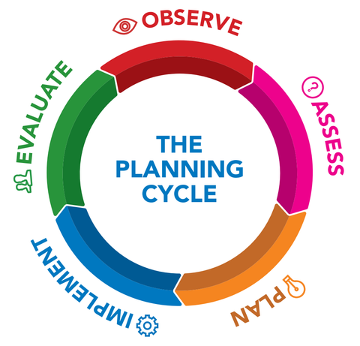
Planning adaptive teaching
Who?
What?
What?
Why?
Notes:
Explain the planning cycle with the learners and explain the process. The planning cycle is what practitioners use to adapt their teaching. Practitioners need to get to know the child’s needs before they can understand how to adapt their teaching.
Highlight that OBSERVE and ASSESS are the two key stages to successfully be able to adapt teaching.
Observe
The practitioner needs to observe the child in the early years educator setting. Their observations should include notes on what the child can do in line with their age and stage of development in the seven areas of learning, and what they still need support on. The early years educator setting may use snapshot observations, narrative observations and checklist observations.
Assess
The practitioner will need to read their observations and decide on the next steps, activities or support the child may need. In line with the age and stage of development in the seven areas of learning, the practitioner will create an activity plan (a short-term plan) to support the child.
Plan
The practitioner will then use the evidence they have to plan to meet the child's needs. The term 'plan' can look different in various settings. For example, in some settings this may be a formal lesson plan that each practitioner creates, or it might be a practitioner planning in the moment. The practitioner will then implement their plan.
Evaluate
The practitioner will decide whether their plan has worked for the child and their needs. This will be done by evaluating whether the child's need has been improved upon and they are more confident in the area of learning or need that they had.

Slide 55
Activity: Observation and assessment
Watch the video.
Complete the observation and assessment activity.
Notes:
Ensure the learners understand the notes they need to write when they observe a child – for example, what they are doing, what they can do in line with the seven areas of learning and what area of learning/milestone they still need support with.
Give the learners time to complete their handouts.
Ask for feedback from four or five learners. What is one observation that you made? What is one area of learning that needs support?
Observation:
What are they doing?
Child A is building a tower with the bricks. Child A is making a wall around the tower. Child B is looking at the pattern and helping Child A put protective ears on. Both children work together to fill in the space around the tower.
What can they do in line with the seven areas of learning?
Both children use physical skills by picking up bricks, sticks and the wheel barrier.
Both children use communication and language skills by asking each other questions and talking about the size of the tower.
Both children use personal, social and emotional skills by taking it in turns to get the sticks and bricks.
Both children use mathematical skills by problem-solving when getting the wheel barrier over the water tray and discussing whether the gap is 'full'.
Both children use expressive arts and design by using their imagination to build the tower and wall around it.
Assessment:
What area of learning do they still need support with?
Mathematics, understanding the world, literacy: These three areas were not demonstrated frequently during the observation. Additional resources and adult support could have supported the children further. For example, an adult could have provided sticky notes, and the children could have number labelled their tower.
What milestone do they still need support with? This is where learners need to consider the learning the child may still need support with, go to the Development matters standards and pick one milestone from the areas of learning.
For example, both children could have developed their understanding of a 'why' question to support their communication and language development.
Both children could have developed their literacy skills by 'writing some letters accurately' through labelling.
Adaptive teaching strategy
Adult support to extend and challenge learners in other areas of learning.
Smaller bricks to make it more challenging for the children to pick them up and manipulate.
Bricks made from lighter material to support the stacking of the bricks.

Slide 56
Activity: Update IP activity plan v2
Update the ‘adaptive teaching’, ‘Adult’s role and responsibility’ and ‘Observation methods’ sections of the IP activity plan.
Notes:
Ask learners to refer to their IP child case study. Ensure learners have their activity plan from lesson 7 and different colour pens.
Explain to learners that adaptive teaching requires consideration of an adult’s role, responsibility and observation methods, so this is why these sections need to be updated. Explain that they are building on the learning so that the IP activity plan reflects good practice and adopts a holistic approach to planning.
To stretch the learners, ask how the strategies of adaptive teaching will support the case study child’s needs.

Slide 57
Next steps
Discuss with IP mentor the updated IP activity plan.
Update digital version of the IP activity plan.

Slide 58
09
Why should teaching be adapted?

Slide 59
Activity: Open-ended resources activity
In allocated groups:
Discuss how open-ended resources could be used to support the case study child’s development.
Feed back ideas to the rest of the class.
Notes:
Ensure each allocated group has at least two open-ended resources, like pine cones, pebbles, shells, sticks, stones, cardboard or pom-poms. Groups should be allocated the child case study they need to consider. Allow 10 minutes.
Facilitate a whole-class discussion and get feedback from the allocated groups. Each group should provide feedback on at least one idea. The activity should take approximately five minutes.
Stretch learning: Ask the learners why they think the open-ended resources support the case study child's development

Slide 60
Why do practitioners need to adapt teaching?
Practitioners adapt:
because children have different needs
to match children’s interests
because they need to have an inclusive and diverse practice
because of individual behaviour.
Notes:
Discuss the following points with the learners to ensure they have a better understanding of why practitioners need to adapt teaching.
Individual needs: A child who has a delay, SEND or low attendance may need an alternative learning process. For example, an English as an additional language (EAL) child may need vocabulary printed out to support their understanding of a topic.
Child’s interests: A child’s learning experience can be adapted and changed in line with their interests.
Inclusive and diverse: The practitioner will change and adapt resources in line with children’s race, gender and ethnic background to ensure that they are in line with policies and procedures.
Individual behaviour: Reasonable adjustments can be made to prevent frustration and boredom.

Slide 61
Activity: How has theory impacted adaptive teaching?
Individually, research the following two theorists who have influenced adaptive teaching:
Lev Vygotsky and his theory on the zone of proximity.
Tomlinson’s theory for the modern approach.
List five key facts about how these theorists have influenced adaptive teaching in early years educator settings.
Notes:
Ensure learners have access to the internet, through their phones or on a computer.
Example key facts:
Positive relationships and the positive impact they can have on supporting children's needs.
Adult interactions and the how children develop from their interactions.
Differentiated questioning and how they support children's understanding.
Allocate 15 minutes for the activity and five minutes for feedback. Go round the room asking for a key fact until all have been given.
To stretch the learners, ask why practitioners need to know about these theories.
Practitioners need to understand the impact that theorists’ findings have had in education. For example, Vygotsky's zone of proximity has influenced the early years curriculum by highlighting 'positive relationships' as one of the key features in a child's education.
Practitioners need to understand the reasons behind adaptive teaching strategies. For example, Tomlinson's modern approach supports the 'differentiated questioning' to support children's understanding and development.

Slide 62
Legislation/policies
Practitioners have a legal obligation to ensure all children are included in education.
These legal obligations are used to inform policies and procedures in early years educator settings.
Notes:
Ask the learners whether they can recall the legislation that supports adaptive teaching. Answer: Equality Act, SEND code of practice, UN Convention on the Rights of the Child (UNCRC).
The Equality Act has eight protected characteristics that all practitioners must protect: age; gender reassignment; being married or in a civil partnership; being pregnant or on maternity leave; disability; race, including colour; nationality, ethnicity or national origin; religion or belief; and sex.
The SEND code of practice provides guidance to organisations working with, and providing support to, children and young people (0-25 years old) with SEND. The code of practice is for head teachers or equivalent, governing bodies, school and college staff, SEND coordinators, early years providers, other education settings, local authorities and health and social services staff.
Under the UNCRC, every child should be recognised, respected and protected as a rights holder and as a unique and valuable human being.
From the legislation, ask the learners what policies they think are influenced by the legislation.

Slide 63
Activity: Update IP activity plan v3
Update the ‘Links to educational theory and pedagogy’ section of the IP activity plan.

Slide 64
Plenary: Adaptive teaching
Should Ofsted consider adaptive teaching in an inspection? What do you think?
Notes:
Points to facilitate the discussion:
Is all teaching adaptive teaching?
Learners who may need adaptions.
How can adaptive teaching be standardised if it needs to be in line with a child’s needs?

Slide 65
Next steps
Read parts 1 and 2 of the Ofsted early years inspection handbook.
Update the digital version of the IP activity plan.
Notes:
Refer learners to the Ofsted website: https://www.gov.uk/government/publications/early-years-inspection-handbook-eif/early-years-inspection-handbook-for-ofsted-registered-provision-for-september-2023#early-years-or-childcare-provision-on-a-school-site

Slide 66
10
Children’s interests

Slide 67
Activity: All about me
Create an “All about me” face based on own likes and dislikes.
Discuss similarities and differences of own likes and dislikes with a peer.
Notes:
Ensure that learners have the creative material for their face, like pens, internet pictures, magazines, scissors and glue.
Once completed, the faces may be used as a classroom display.

Slide 68
Why do early years educator settings consider interests?
To drive children to learn.
To avoid frustration from children.
To promote a child’s self-esteem.
To build upon previous knowledge.
Notes:
Drive children to learn: The interest drives learning, so powering learning by their fascinations/interests, the results are more likely to be successful.
To avoid frustration: By providing for a child's interests, they will feel confident using the resource, and this will avoid a child feeling undervalued or miss out on learning opportunities.
Promote self-esteem: By providing for a child's interests, a child's emotional response will be that they feel loved and therefore more motivated to learn. By acknowledging, and building on children’s own interests, we help them to feel valued as an individual, someone who is an expert in their own life experiences.
To build upon previous knowledge: By providing for a child's interest, practitioners are supporting the independent learning and development children need to have to develop holistically. They will be more engaged in the process of learning if they have had experience in using and manipulating the resource.
To stretch the learners, ask them what impact they think not having the children’s interests involved will have on their development.

Slide 69
Activity: How can practitioners incorporate children's interests?
In pairs, pick one interest from the table.
Produce an outline plan for a 10-minute activity which incorporates the child’s interest.
Notes:
Stretch question: What is the education development impact of including the interest in the activity?

Slide 70
How do interests and milestones link?
In an early years educator setting, practitioners need to consider a child’s development as well as engagement.
Practitioners need to think about:
how an area of development can link to a child’s interest
whether more than one area of development can link to a child’s interest?
Notes:
Ensure learners have a notebook and pen to write with.
Explain to learners that:
Practitioners need to consider the seven areas of learning for a child to progress in their development. This means that, in the planning stage, a practitioner needs to consider what they want children to develop and how they can incorporate the child’s interests. The practitioner will read the early years framework and decide what milestones the children need to achieve for their age and stage of development. Then the practitioner will plan an activity to support the milestone that they are focusing on. Lastly, the practitioner will incorporate enhancements through the child’s interests. For example, a practitioner working in a reception class might pick the milestone of literacy: “write short sentences with words with known sound-letter correspondences using capital letters and full stops”. From this, the practitioner may plan an activity that incorporates a child’s interest by asking them to write a sentence about their favourite toy on toy paper. A practitioner may also get the object, put it in the middle of the table and ask the children to write about what they see. Both ways are small enhancements that allow children to achieve their milestone in a way that incorporates their interests.

Slide 71
Activity: Incorporating interests and milestones in practice
Individually,
read the reception class Incorporating interests and milestones in practice handout
read the Development matters standards
select one milestone from each of the seven areas of learning which is appropriate for the group of five children in the reception class.
Notes:
Distribute the Development matters standards and the reception class Incorporating interests and milestones in practice handouts.
Remind learners about the seven areas of learning within the Development matters standards. Explain that the standards include milestones. Give an example such as “Page 61 Area of Learning Physical Development”. An example of a milestone is “Lift their head while lying on their front”.

Slide 72
Activity: Update IP activity plan v4
Update the ‘Links to interests’ section of the IP activity plan.
Notes:
Ask learners refer to their activity plan from lesson 9 and have a different colour pen available.

Slide 73
Plenary: Peer review of interests
In pairs, discuss what has changed in the updated IP activity plan ‘Links to interests’ section and how the section meets the IP child’s interests.
Peer review and feedback about the updated IP activity plan ‘Links to interests’ section.

Slide 74
Next steps
Discuss with your IP mentor the ways you could incorporate childrens’ interests.
Update the digital version of the IP activity plan.

Slide 75
11
Open-ended resources

Slide 76
Open-ended resources
Open-ended resources refer to materials that can be used in various ways without a set outcome. These resources encourage children to explore, experiment and engage in open-ended play and learning experiences. Open-ended resources promote imaginative play and holistic development in children.
Notes:
Ask learners if they have seen or can identify open-ended resources from their IP. Examples of open-ended resources include loose parts, natural materials, construction toys, art materials and playdough.

Slide 77
Activity: Open-ended resources definition
Individually, write a definition of “open-ended resources” and put it at the front of the classroom.
Notes:
Ensure that learners have sticky notes to write down their definition of “open-ended resources”.

Slide 78
Activity: Using open-ended resources
In pairs,
carry out the role-play activity, taking turns to be the child and the practitioner
evaluate how well using open-ended resources would support the development of a child’s mathematical counting skills 1-5
research alternative open-ended resources to support the development of a child’s mathematical counting skills 1-5
discuss your evaluation and research with another pair.

Slide 79
Types of open-ended resources
Acorns
Nuts and bolts
Playdough
Cardboard box
Pebbles or stones
Pom-poms
Bottle tops
Education and Training Foundation
Notes:
Distribute the open-ended resources and the flipchart paper. Ensure that learners have a pen to write on the flipchart paper. Some of the benefits that learners should be identifying include: creativity, problem-solving, critical thinking skills, sensory development, fine motor skills, and hand-eye coordination, social interaction and collaboration.
To stretch the learners, as they move around the room, ask: “How is this an open-ended resource?” “How might a child or children use the resource?” “What is a benefit to the child of using the resource?”
Ensure that the learners have been to every table.

Slide 80
Benefits of open-ended resources
Supports children’s problem-solving skills.
Supports children develop their imagination.
Supports engagement and motivation to learn.
Supports a wide range of ages and stages of development.
Supports children’s personal, social and emotional development.
Notes:
Problem-solving skills: The open-ended resource can be manipulated in different ways, and it is the child's choice on how and why the resource is used in that way. This is a benefit because it encourages children to become more independent, which will help them with their transition.
Imagination: The open resource allows children to use it in any way that they think of and allows them to express their ideas. This is a benefit for children because imagination allows children to become more creative with their ideas, learn new vocabulary and develop new descriptive writing skills.
Engagement and motivation: The open-ended resources allow children to drive their learning experience, meaning it is a child-initiated experience. This is a benefit for children as, if they are engaged with their learning, they are going to learn more, and their progress will be better.
Age and stages of development: The open-ended resources can be used by any age as it is an opportunity to explore a new object or create a new experience. The resource can be of different complexities or the level of play can be dependent upon the age of the child. This is a benefit because it promotes equal opportunities for all children.
Personal, social, emotional development: The open-ended resources allow children to communicate ideas, thoughts and feelings while exploring the object and how they want to play with it. This is a benefit as children are developing relationships, resilience and self-confidence. All of which support their holistic development and future life skills.

Slide 81
Open-ended resources and the early years framework
Open-ended resources promote holistic development.
This means that the seven areas of learning are being promoted, including the prime and specific areas.
Open-ended resources allow children to use cognitive skills of problem-solving, critical thinking, decision-making and creativity.
Education and Training Foundation
Notes:
Ask the learners: “What does Holistic development mean?”
Holistic development means the social, emotional, physical, mental and intellectual growth of a child’s mind. This growth all happens at the same time.
To stretch the learners, ask: “Is this a benefit for children in early years? And why is it a benefit?”.
The seven areas of learning refer to: (Prime areas) Communication and language, physical development, personal, social, emotional development, (specific areas) mathematics, literacy, expressive arts and design and understanding the world.
Cognitive skills allow children to develop in the seven areas of learning and therefore are crucial to a child’s development. Not all children develop at the same rate with their cognitive skills, however, an open-ended resource means that children can follow their own understanding, interpretation and rate of development.
To stretch the learners, ask: “Is an open-ended resource inclusive?” “How is it inclusive?” “Why is this an important factor in today’s practice?” “What legislation and policies support inclusive practice”
Through open-ended resources, children can develop self-confidence, resilience and a positive self-identity. Children also develop social interactions, cooperation, empathy and understanding of others. Open-ended resources promote emotional wellbeing and assist children in managing and expressing their feelings and emotions effectively.
To stretch the learners, ask: “How can an open-ended resource develop any of the skills listed above?”

Slide 82
Activity: Holistic development handout
In allocated groups, read and complete the Holistic development activity.
Education and Training Foundation
Notes:
Ensure learners have the Holistic development activity, Development matters standards and a pen.
Learners need to be familiar with the child case study from the open-ended resource activity.
Learners need to decide whether the activity is going to be indoors or outdoors and what the activity is going to be.
Learners need to be writing milestones that link to the age of their child case study and that can be achieved using the open-ended resource.
Then ask the learners to swap their holistic development activity handout and child case study with another allocated group. Ensure that each group has swapped their information.

Slide 83
Activity: Peer review handout
Swap Holistic development activity handout and child case study with another allocated group.
Complete peer review handout.
Get Holistic development activity handout and peer review handout from the peer review group.
Assign spokesperson to feed back orally to the class.
Make amendments to Holistic development activity handout if appropriate.

Slide 84
Next steps
Discuss with IP mentor what open-ended resources are incorporated into the early years education setting.

Slide 85
12
Indoor and outdoor resources

Slide 86
The environment
An early years setting environment directly influences a child’s physical, cognitive and emotional development.
These areas of development are stimulated by the resources provided by the early years practitioner.
The early years framework states that the environment is the third guiding principle that shapes practice.
Notes:
Advise learners that the environment needs to be rich and have varied space. This means that the resources provided need to stimulating, meet the child’s needs and be open-ended. The reason practitioners need to do this is because children will only develop if they are provided with the resources that help promote the milestones. This ensures that the environment is safe, warm and welcoming for the children because the resources have been well thought out and planned. The practitioner also does this as it is a legal requirement outlined within the statutory framework.

Slide 87
Indoor and Outdoor resources
Indoor resources
Reading books
Felt-tip pens
Dress-up clothes
Paint
Playdough
Foam bricks
Cylinders
Beakers
Pebbles
Outdoor resources
Bikes
Scooters
Large balls
Tennis rackets
Shovels
Buckets
Clipboards
Felt-tip pens
Notes:
Ensure learners make notes of the examples of indoor and outdoor resources.
Ask learners: “What is one indoor and outdoor resource you can recall from your IP?”

Slide 88
Activity: Indoor versus outdoor resources
In allocated groups, complete the indoor versus outdoor resources activity.
Notes:
Ensure learners are given the indoor versus outdoor resources handout.
Answers: How do the resources support children's development?
Indoor:
All early years settings should be equipped with varied resources that are diverse in ability and interests.
These resources may include toys, books, art materials, sensory materials and manipulative play items.
The indoor environment should promote active and independent learning, providing children with opportunities to explore, experiment and develop their skills.
Outdoor:
All early years setting should place as much emphasis on the outdoor area as on the indoor area.
The resources may include climbing structures, sand and water play areas, natural elements such as plants and trees, and open spaces for running and playing games.
The outdoor environment should promote physical activity, social interaction and exploration.
To stretch the learns, ask them whether they would consider furniture as a resource in the indoor and outdoor learning environment.
Learners should consider the furniture as a resource to ensure that children have the opportunity to move and access resources independently.

Slide 89
Activity: Peer review
In allocated groups, peer review the indoor versus outdoor resources handout.
Use a sticky note to add comments, identifying one indoor and one outdoor resource that could be added.
Notes:
Ensure learners look at the case study age when completing the sticky note so that they consider this when suggesting one indoor and one outdoor resource that could be added.

Slide 90
The importance of the correct resources
Having appropriate resources directly affects children’s engagement, development and learning outcomes.
Appropriate resources support children’s individual interests, needs and stages of development.
They should encourage active exploration, problem-solving and experimentation. They should also promote inclusivity.
Notes:
To stretch to learners, ask: “How does a resource impact a child’s or children’s learning outcomes?”
Early years practitioners need to consider a number of factors to ensure the resources are appropriate. The practitioner needs to carry out observations and have good partnerships with colleagues and parents. This will allow practitioners to make an informed decision based on accurate information about the child and their needs. This process refers back to the planning cycle from element 8, where a practitioner needs to observe, assess and plan, in accordance with individual children’s needs.
The way in which resources are inclusive can be done in various ways.
Ask the learners, “How can resources be inclusive?” “Can they think of any inclusive resources from IP?”
This information also links back to element 10, which is based upon equality and diversity. Please follow on with the next slide.

Slide 91
Inclusive indoor and outdoor resources
  Open-ended resources
  Photographs of the children themselves (where acceptable to the families)
  Books, posters and small world figures
  Role-play clothing
  Soft furniture
Notes:
Resources need to consider the community that the environment is in, as children need to see representations of themselves and others. This allows settings to share first-hand experiences of children, be sensitive to different circumstances and ensure inclusive practice.
Open-ended resources will allow children to manipulate and interpret their understanding at the stage of development that they are at, meaning that no child or children can be at a disadvantage.
Photographs to allow children to identify themselves, others and begin to acknowledge and accept differences.
Books, posters, small world figures that allow children to act out a range of identities and challenge stereotypes.
Role-play clothing that allows children to play in gender-flexible ways and reflects a diverse culture, community and households.
Soft furniture as an area where children can relax with possibly some pictures of cultural, community and household representation.
Note: Direct learners to the website for additional reading.
https://birthto5matters.org.uk/inclusive-practice-and-equalities/

Slide 92
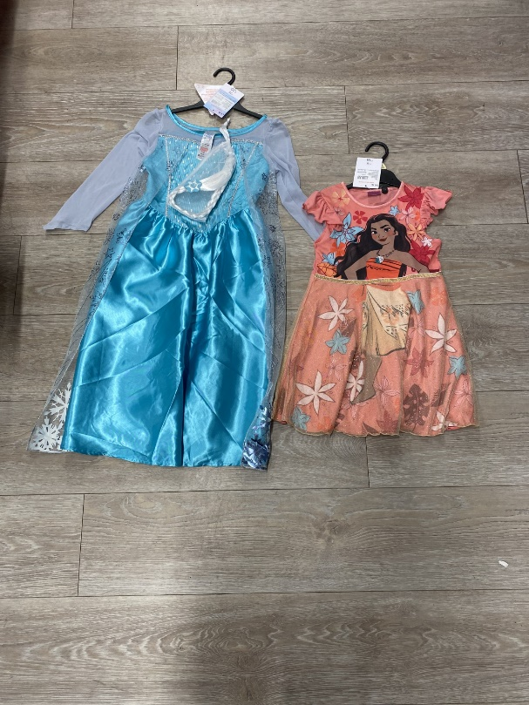
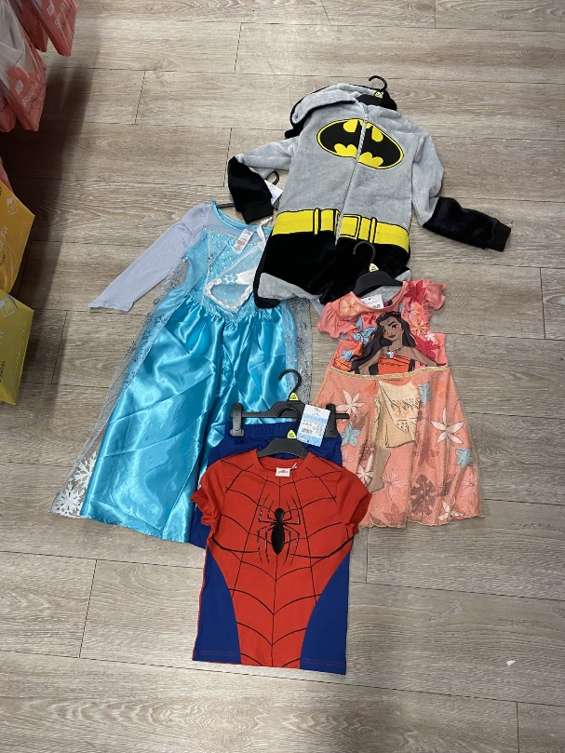
Inclusive indoor and outdoor resources
Author’s own images
Notes:
Facilitate a group discussion based on the question, “Which resource is inclusive?”
Ask the learners “Why?” and “What makes it inclusive?”
To stretch the learners, ask: “How might the non-inclusive resource impact a child’s personal, social and emotional development?”

Slide 93
Activity: Theorists' perspective
In allocated groups,
research the theorist you have been allocated
list five ways in which the theorist has influenced the types of resources in early years educational settings
present feedback to the rest of the class.
Notes:
Ensure that learners have access to the internet, e.g. computer, phone, tablet.
Theorists that they may consider: Maria Montessori and her theory of using real-life objects in play. This allows children to learn from hands on, real-life experiences.
Friedrich Froebel and his theory on using natural materials and block play. He believed that block play would help children develop their number, shape and size knowledge.
Advise the learners that they have 30 minutes to research and prepare feedback.

Slide 94
Activity: Update IP activity plan V5
Update the ‘Links to educational theory and pedagogy and resources’ section of the IP activity plan.
Notes:
Remind learners that they have already looked at the ‘Links to educational theory and pedagogy’, so they should prioritise the resources section to ensure that they have considered all the information from lessons 10 and 11.

Slide 95
Next steps
Discuss with IP mentor ways you could incorporate a suggested indoor and outdoor resource from IP activity plan to the IP setting.
Update the digital version of the IP activity plan.

Slide 96
13
Health and safety

Slide 97
Health and safety
This means regulations and procedures to prevent accidents and injuries in the workplace or public environments.
In early years, this means the settings have a legal obligation to minimise risk by regularly risk assessing, training staff and taking reasonable precautions.

Slide 98
Health and safety procedure
Identify hazards.
Identify who is at risk.
Evaluate the risk and select controlled measures.
Record the findings and implement them.
Monitor and review the risk management.
Notes:
Identify hazards: This means the practitioner needs to see where and what the hazard is. For example, fire or sharp edges.
Who is at risk?: This means in an early years educational setting, the practitioner, child, colleagues, parents/carers or visitors who enter the space.
Evaluate the risk: This means the practitioner needs to know if it is high, medium or low risk for the person or people it may impact. Then the controlled measures are ways that the practitioner is going to minimise or prevent the health and safety risk from occurring.
Record the findings: This means practitioners need to complete a risk assessment form as evidence. They then need to implement them in practice to see whether the controlled measure is going to work or not.
Throughout the activity, term, year, etc., the practitioner will review the measure that they have put in place to see whether or not it is ensuring the children's safety. If it is not, the practitioner needs to look back and change the measures they have put in place.

Slide 99
Activity: Classroom health and safety
Lower yourself to the eye level of the tables in the classroom.
Look around the room and identify any hazards you can see.
In your allocated group, discuss the hazards you have identified.
Notes:
Ensure the learners have enough space to either sit or be as low as the tables in the classroom.
Ensure learners have a notebook to write their risks on.

Slide 100
Discussion: Hazards in the classroom
Feed back to the whole class. ​
Discuss why the hazards identified are a risk to children.
Discuss the potential level of risk.
Notes:
As the learners provide feedback, build a list on flipchart/smartboard or whiteboard.
To stretch the learners, ask them: ”Why is it important to identify a hazard from a child’s height?”

Slide 101
Risk assessments
Under the Management of Health and Safety at Work Regulations 1999, all settings must have a risk assessment process.
The head teacher is responsible for risk assessing an educational setting, but the practitioner is responsible for risk assessing activities and resources.
Notes:
Ensure learners understand that a risk assessment is step 3 of the procedure. This is the controlled measure, meaning the way that a practitioner can lower or prevent the risk from occurring or impacting the people at risk.

Slide 102
Risk assessment
In early years, there are various things to risk assess such as: play equipment, slips or trips, electrical equipment, nappy changing, food safety and fire safety.
Hazard | Who? | Controlled measure
Milk crates, tyres, tubing, etc., are often encouraged as part of creative play. | Children access the resources. The adult supporting the movement of the resources. | Close supervision at all times. Supervising members of staff are strategically placed. All play equipment and surfacing are visually checked on a daily basis.
Notes:
This table demonstrates a typical risk assessment that may take place in an early years setting.
Ask the learners: “Do your IP settings have or use these resources?”
Draw their attention to the assessment that has taken place before the resources have been distributed. This will be something that, as a learner, they may not be a part of or see within their IP.

Slide 103
Activity: Classroom risk assessment
In allocated groups, discuss and pick one hazard identified.
Complete the risk assessment.
Present to the whole class.
Notes:
Distribute the risk assessment handout and ensure learners have a pen to complete it with.
As the learners complete the activity, ensure that each group has used a different hazard to assess risk.

Slide 104
Activity: Update IP activity plan v6
Update the ‘Hazards, risks and controls' section of the IP activity plan.
Notes:
Distribute the IP activity plan that learners began in lesson 6 and made amendments to in lesson 12. Ensure learners have an alternative colour of pen to that they originally used so that they can see the amendments being made.
Ask the learners: “Have all staff who are in charge of looking after the children been informed of the risk assessment?”
Encourage the learners to use the suggested website from the plan.

Slide 105
Next steps
Discuss with IP mentor the hazards, risks and controls suggested in the IP activity plan.
Update the digital version of the IP activity plan.
Notes:
This will consolidate knowledge and understanding of risk assessment within practice. The discussion and feedback may allow learners to think about their amendments to the IP activity plan and want to change them.

Slide 106
14
Practitioners as a resource

Slide 107
Activity: Responsibilities at IP?
Individually, on a sticky note write a list of responsibilities at IP setting.
Swap sticky notes with a peer and highlight similarities in responsibilities.

Slide 108
The role of the practitioner
An early years practitioner must respond to a child’s and children’s emergent needs and interests to guide their development.
To do this, an early years practitioner needs a secure knowledge of child development. They must understand the stages of development and how children learn through play.
Notes:
Understanding children’s emergent needs means a practitioner needs the skill of listening to and observing children in play. This will ensure that practitioners can see, hear and understand the what, when, who and how of supporting children’s needs.
Practitioners also need to understand children’s interests by observing, working in partnerships with parents/carers and research. This will allow practitioners to engage and motivate children’s learning and experience in early years.
The term ‘guide’ is significantly important for practitioners in early years, as the aim of learning in early years is that children develop upon previous experiences and knowledge, the practitioner is there to facilitate this development and not dictate it. The practitioner is a ‘guide’ as they may not be involved in every play-based activity, but they have given children the tools to carry out the play-based activity independently.
From all of this, you have the knowledge from elements 3, 7, 9 and 11 to support this understanding.

Slide 109
Activity: Peer snapshot observations
In allocated pairs, complete the Maths game activity
One pair completes the Peer snapshot observation handout while the other pair completes the Maths game.
Swap once complete.
Notes:
Ensure the learners have the Maths game and observation handout.
Support any learners who may need it when completing the Peer snapshot observation handout.
As you walk around, assess the learners understanding of a snapshot observation.
To stretch the learners, ask them: “Why is this a snapshot observation?” “How do you know it is a snapshot observation?”

Slide 110
The practitioner and planning
When planning for children in early years, practitioners need to consider:
pace
individual learners
resources
home setting.
Notes:
Advise learners:
Pace: The practitioner needs to consider time for learners to explore and carry out activities in the setting. In early years, children are developing and taking time for their thoughts, so practitioners should not take away activities before the children have had a chance to experiment with them.
Stretch the learners, ask them: “Should the provision in an Early years educator setting change daily?” “Why?” “Why not?”
Individual learners: The practitioner needs to consider the stage of development that a child is at. This does not mean that the age and stage of children are the same, as some children are not at the stage of development they should be for their age. It is important for practitioners to know this and consider this when planning activities. This also means that the practitioner needs to understand the learner’s interests. Planning from a child’s interests means that the practitioner needs to consider how they can resource the environment, including a child’s interest and learning needs.
Resources: From the previous lesson, ask the learners: “What do you know about the resources that practitioners need to choose for learners?”
Home-setting: Practitioners need to consider how their learning and development can be carried out and recreated at home. This is important to ensure that learners’ development in a holistic way, as children need support from all the adults they are learning with and from.

Slide 111
The practitioner in play
In an early years setting, practitioners are the second most important contributor to a child’s development.
Positive relationship
Unique child
Enabling environment
Observe
Plan
Question
Notes:
The three pillars of the early years framework are: the unique child, positive relationship and enabling environment. The positive relationship means that children learn to be strong and independent from the adults that support, guide and nurture them. In practice, this means a practitioner will plan activities, observe the children during the activities and support them through resourcing, questioning and responding to their play.
Resourcing means that the practitioner may offer suggestions to help the children develop upon ideas and experiences in their play. For example, the practitioner may suggest sticky notes to add labels to their creations in the construction area. These resources may enhance the children’s development and understanding in their play. This is also known as in-the-moment planning.
Questioning means the practitioner should ask open-ended questions to engage and develop children’s knowledge and skills in their play. Questioning can allow practitioners to help children think about the other seven areas of learning while they play. For example, a child may be cooking in the role-play area, and a practitioner can ask questions such as: “How many eggs are you cooking?” “What if you added one more?” “How else can you cook the eggs?”
These types of questions will encourage children to think about mathematics, communication and language, understanding the world.
Responding to their play means that practitioners can follow the interests of the child after their play. This is also known as child-led planning. This means that the practitioner takes on the child’s interest and exploration from one activity and plans the following activities from this.

Slide 112
Activity: Observation case study
Case study
Child A is playing in the kitchen area with two other children.
Child A asks the practitioner to play in the kitchen.
Activity
In your allocated group, make a list of the practitioner’s roles in practice.
Notes:
Ensure the learners have a plain piece of paper and pen to complete this activity.
Encourage learners to consider the types of questions that the practitioner may want to ask, how the practitioner can observe the child and what the practitioner may do with resources to enhance the child’s or children's play.

Slide 113
Discussion: Case study feedback
Each group to feed back one role of the practitioner from the case study. ​
As a class, discuss whether you agree or disagree with the practitioner’s role in the case study.
Notes:
Build a list of the practitioner’s role from the feedback from the case study.

Slide 114
Activity: Update IP activity plan V7
Update the ‘Adult's role and responsibility' section of the IP activity plan.

Slide 115
Next steps
Discuss with IP mentor the adult's role and responsibility suggested in the IP activity plan.
Update the digital version of the IP activity plan.
Notes:
Explain to the learners that they need to ensure to make notes on this activity to inform their IP activity plan for the next lesson.

Slide 116
15
Final IP activity plan
Notes:
Explain to learners that this is the final stage and lesson in this framework of learning. Advise that this stage draws together stages 1, 2 and 3 and that the aim is now to produce a good plan based on a profile linked to their IP setting.

Slide 117

Reflect: What have I learned?
Independently, answer the quiz questions.
Notes:
Ensure learners have access to their smartphones.
Learners need to scan the QR code, complete the quiz.
Distribute sticky notes and ask the learners to write the number of the question they answered incorrectly. Ask them to stick the sticky note at the front of the classroom and recap the correct answers. Encourage learners to make notes on the correct answers.

Slide 118
Activity: Effective IP activity plan
Complete the IP activity plan.
Notes:
Distribute the effective IP activity plan handout.
Distribute the v1-v6 activity plans for learners to refer to when completing the blank IP activity plan.
Ensure learners have a pen to complete the handout.

Slide 119
Activity: Self-reflection IP activity plan
Complete the self-reflection IP activity plan.
Notes:
Distribute the self-reflection IP activity plan handout and the exemplar effective activity plan. Encourage learners to refer to the exemplar when reflecting on their effective IP activity plan.

Slide 120
Next steps
Discuss the IP activity plan with IP mentor.
Carry out IP activity plan at IP.
Evaluate how effective the plan was.

Slide 121


PRODUCED BY
FUNDED BY
Mary Madden has produced this resource on behalf of the Education and Training Foundation
This programme is funded by the Department for Education
ET-FOUNDATION.CO.UK

