Slide 1
T LEVEL IN DIGITAL SUPPORT SERVICES
Support holistic delivery of Core Content and occupational specialism content: Digital infrastructure

Slide 2
1
Organisation types

Slide 3
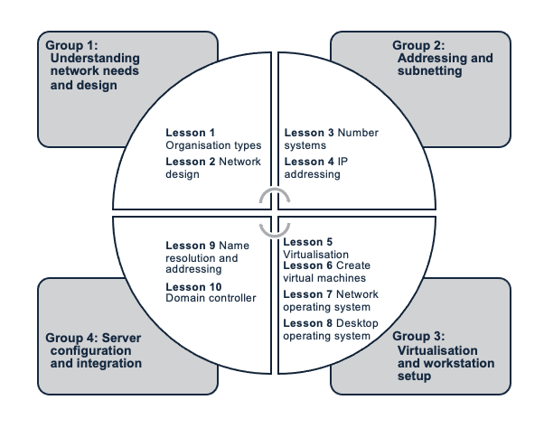
Learning objectives next 10 lessons
The Framework for Learning (FfL)
Notes:
A slide titled ‘Learning objectives next 10 lessons’ featuring a diagram that outlines the structure of the next ten lessons using the Framework for Learning (FfL). The diagram is divided into four groups, each representing a thematic focus with associated lessons:
Group 1: Understanding network needs and design
Lesson 1: Organisation types
Lesson 2: Network design
Group 2: Addressing and subnetting
Lesson 3: Number systems
Lesson 4: IP addressing
Group 3: Virtualisation and workstation setup
Lesson 5: Virtualisation
Lesson 6: Create virtual machines
Lesson 7: Network operating system
Lesson 8: Desktop operating system
Group 4: Server configuration and integration
Lesson 9: Name resolution and addressing
Lesson 10: Domain controller
The content is presented in a quadrant layout with circular segmentation.

Slide 4
Learning objectives for lesson 1
Describe the types of organisation:
  public sector
  private sector (including voluntary and charity).
Identify devices used to facilitate communications in an organisation.
Explain network devices commonly used in an organisation.

Slide 5
Types of organisation
Why do we need to know about different types of organisation?

Slide 6
Organisations
Organisations consist of a group of people who work together to achieve predefined objectives.
There are roles and responsibilities to enable cooperation and governance.
There is a formal hierarchy to manage operations – organisation chart.

Slide 7
Types of organisation
Public sector:
run by the government to provide a service for the population and communities
examples:
  NHS
  military.
Private sector:
owned by private groups
can be for-profit or non-profit
examples:
  public limited company (PLC)
  private limited company (Ltd)
  partnership
  sole trader
  third sector organisation (e.g. charity, community group, social enterprise).

Slide 8
Activity: Identification of organisations
Types | Examples | Services
Public sector
Private sector
Third sector

Slide 9
Organisation chart
This is a visual diagram of the internal structure of a company. It illustrates roles, responsibilities and reporting relationships.
Purpose and benefits include:
  clarity: shows who reports to whom
  communication: streamlines workflow and decision-making
  planning: aids resource allocation and identification of gaps
  transparency: promotes accountability and efficiency
  onboarding: helps new hires understand company structures.

Slide 10
Types of organisation chart
Complete the table with types, descriptions and examples.
Types | Descriptions | Examples
Hierarchical
Flat
Matrix
Divisional
Network

Slide 11
Activity
Activity: Create an organisation chart for your college.

Slide 12
Devices used to facilitate communications in an organisation
Communication devices enable effective and efficient information exchange among employees, departments and teams.
Research devices and group into the following categories:
  communication devices
  collaboration tools
  information-sharing tools.

Slide 13
Activity: Devices used to facilitate communications in an organisation
Category | Device | Function

Slide 14
Network devices commonly used in an organisation
Network devices enable the operations performed by an organisation by facilitating communication, data transfer and connectivity across the network.
Network diagrams, or topology diagrams, use symbols to represent devices within a network.
These devices can be categorised into two types – end devices and intermediary devices – based on their role and the network media they use.

Slide 15
End devices
An end device is where a message originates from or where it is received.
Examples include:
  desktop computer
  laptop
  server
  printer
  IP phone.

Slide 16
Intermediary device
An intermediary device interconnects end devices and manages data as it flows through the network.
Examples include:
  switches
  wireless access points
  routers
  firewalls.

Slide 17
Network medium
A network medium allows a message to travel across a network from source to destination.
Examples include:
  copper
  fibre optics
  wireless.

Slide 18
Packet Tracer activity: Network device representation
Part 1: Identify end devices, intermediary devices and media as represented in Packet Tracer
Part 2: Explain the function of the devices.

Slide 19
Part 1: Identify end devices, intermediary devices and media as represented in Packet Tracer
The icon toolbar at the bottom-left has networking component categories:
  intermediary devices
  end devices
  media.
The Connections category (with the lightning bolt icon) represents Packet Tracer’s networking.

Slide 20
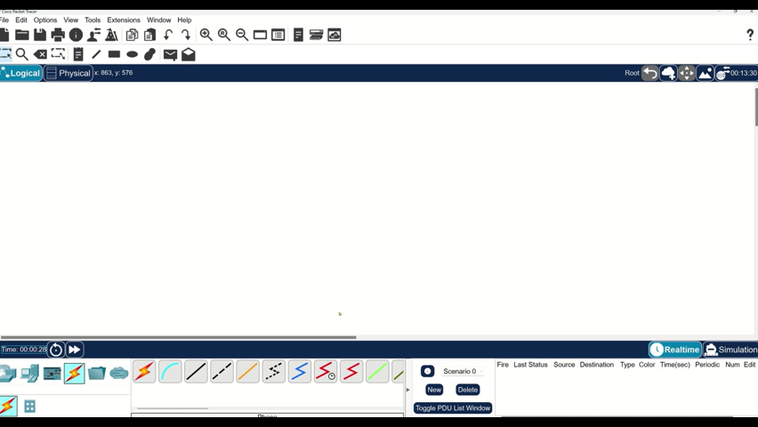
Packet Tracer: Network device representation

Slide 21
Part 2: Explain the function of the devices
In Packet Tracer, only the Server-PT device can act as a server. Desktop or laptop PCs cannot act as a server.
List the functions of servers and clients. Both are end devices. What determines their roles?
List at least two functions of intermediary devices.
List at least two criteria for choosing a network media type.

Slide 22
Challenge activity
Open a new instance of Packet Tracer.
Create a new network with at least four end devices, an intermediary device and a media-type connection.
What else is needed for the end devices to send data to each other?
Verify connectivity between the devices.
Save the Packet Tracer file.

Slide 23
2
Network design

Slide 24
Learning objectives for lesson 2
Describe the requirement of a reliable network, including fault tolerance, scalability, quality of service (QoS) and security.
Explain the function at each layer of hierarchal network design.
Explain the function at each layer of an Open Systems Interconnection (OSI) network reference model.
Explain the function at each layer of the Transmission Control Protocol, Internet Protocol and User Datagram Protocol (TCP/IP) protocol model.

Slide 25
Fault tolerance
A network can continue operations without interruption when one or more components of the network fail.
Implement redundant hardware – e.g. routers, switches, servers and network paths.
Packet switching splits traffic into packets that route over a shared network.

Slide 26
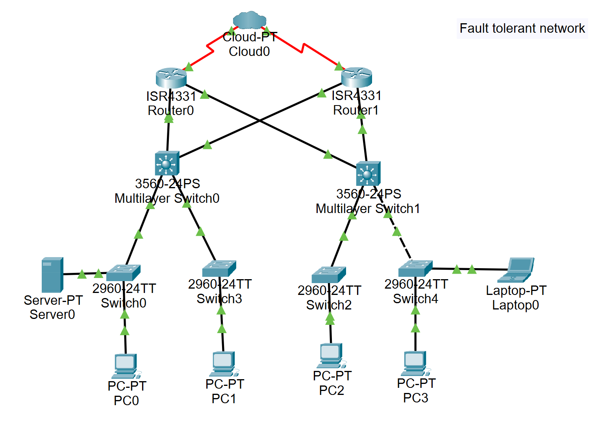
Fault-tolerant network

Slide 27
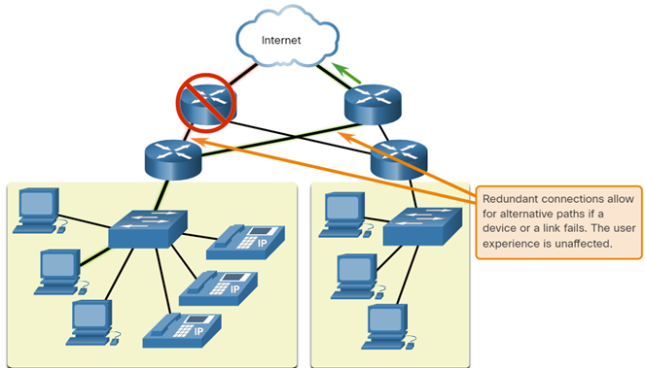
Redundant

Slide 28
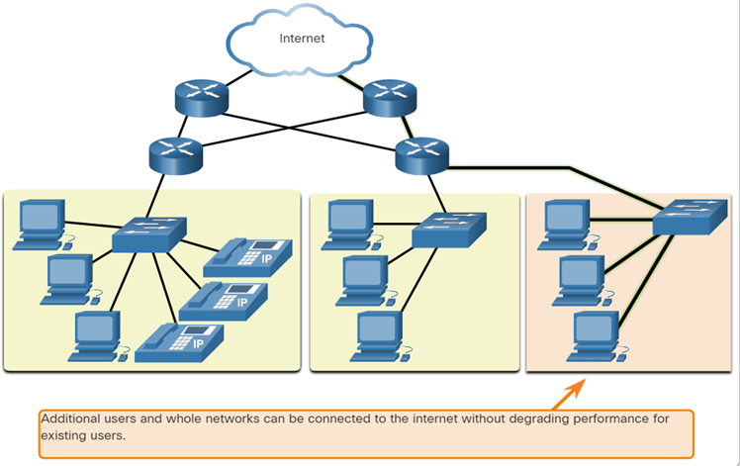
Scalability
A scalable network can be expanded quickly to support new connections without degrading the performance of services that existing users are accessing.
Networks are scalable when the design adheres to standard and protocols.

Slide 29
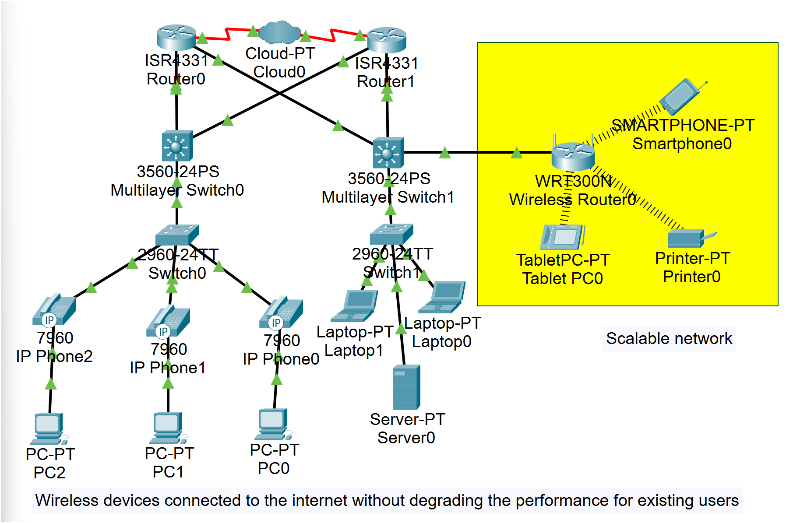
Scalable network

Slide 30
Quality of service (QoS)
Congestion occurs when the demand for network bandwidth exceeds the amount available.
When simultaneous communications are attempted across the network, the demand for network bandwidth can exceed its availability, creating network congestion.
QoS is a primary mechanism for managing congestion and ensuring reliable content delivery for all users.
In the diagram, the router has a QoS policy configured that prioritises time-sensitive traffic (i.e. voice communications) if the network experiences congestion.

Slide 31
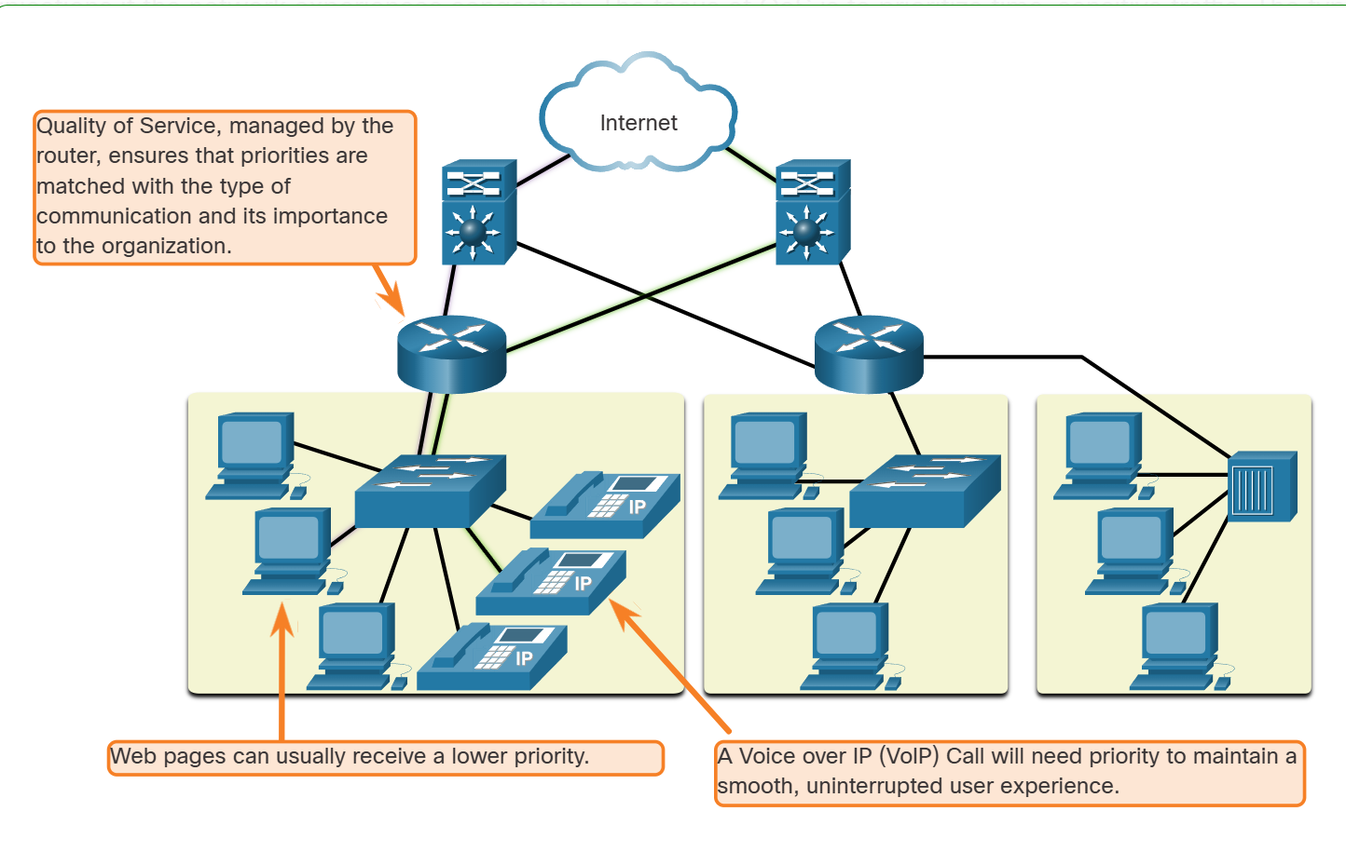
QoS: Implementation

Slide 32
Network security (1)
Administrators must secure the physical network infrastructure and prevent unauthorised management access.
Administrators must also protect packets that transmit over the network and the information stored on network-attached devices.

Slide 33
Network security (2)
The three primary requirements for network security are:
confidentiality: ensures that only the intended and authorised recipients can access and read data
integrity: assures users that the information does not alter in transmission from origin to destination
availability: assures users of timely and reliable access to data services for authorised users.

Slide 34
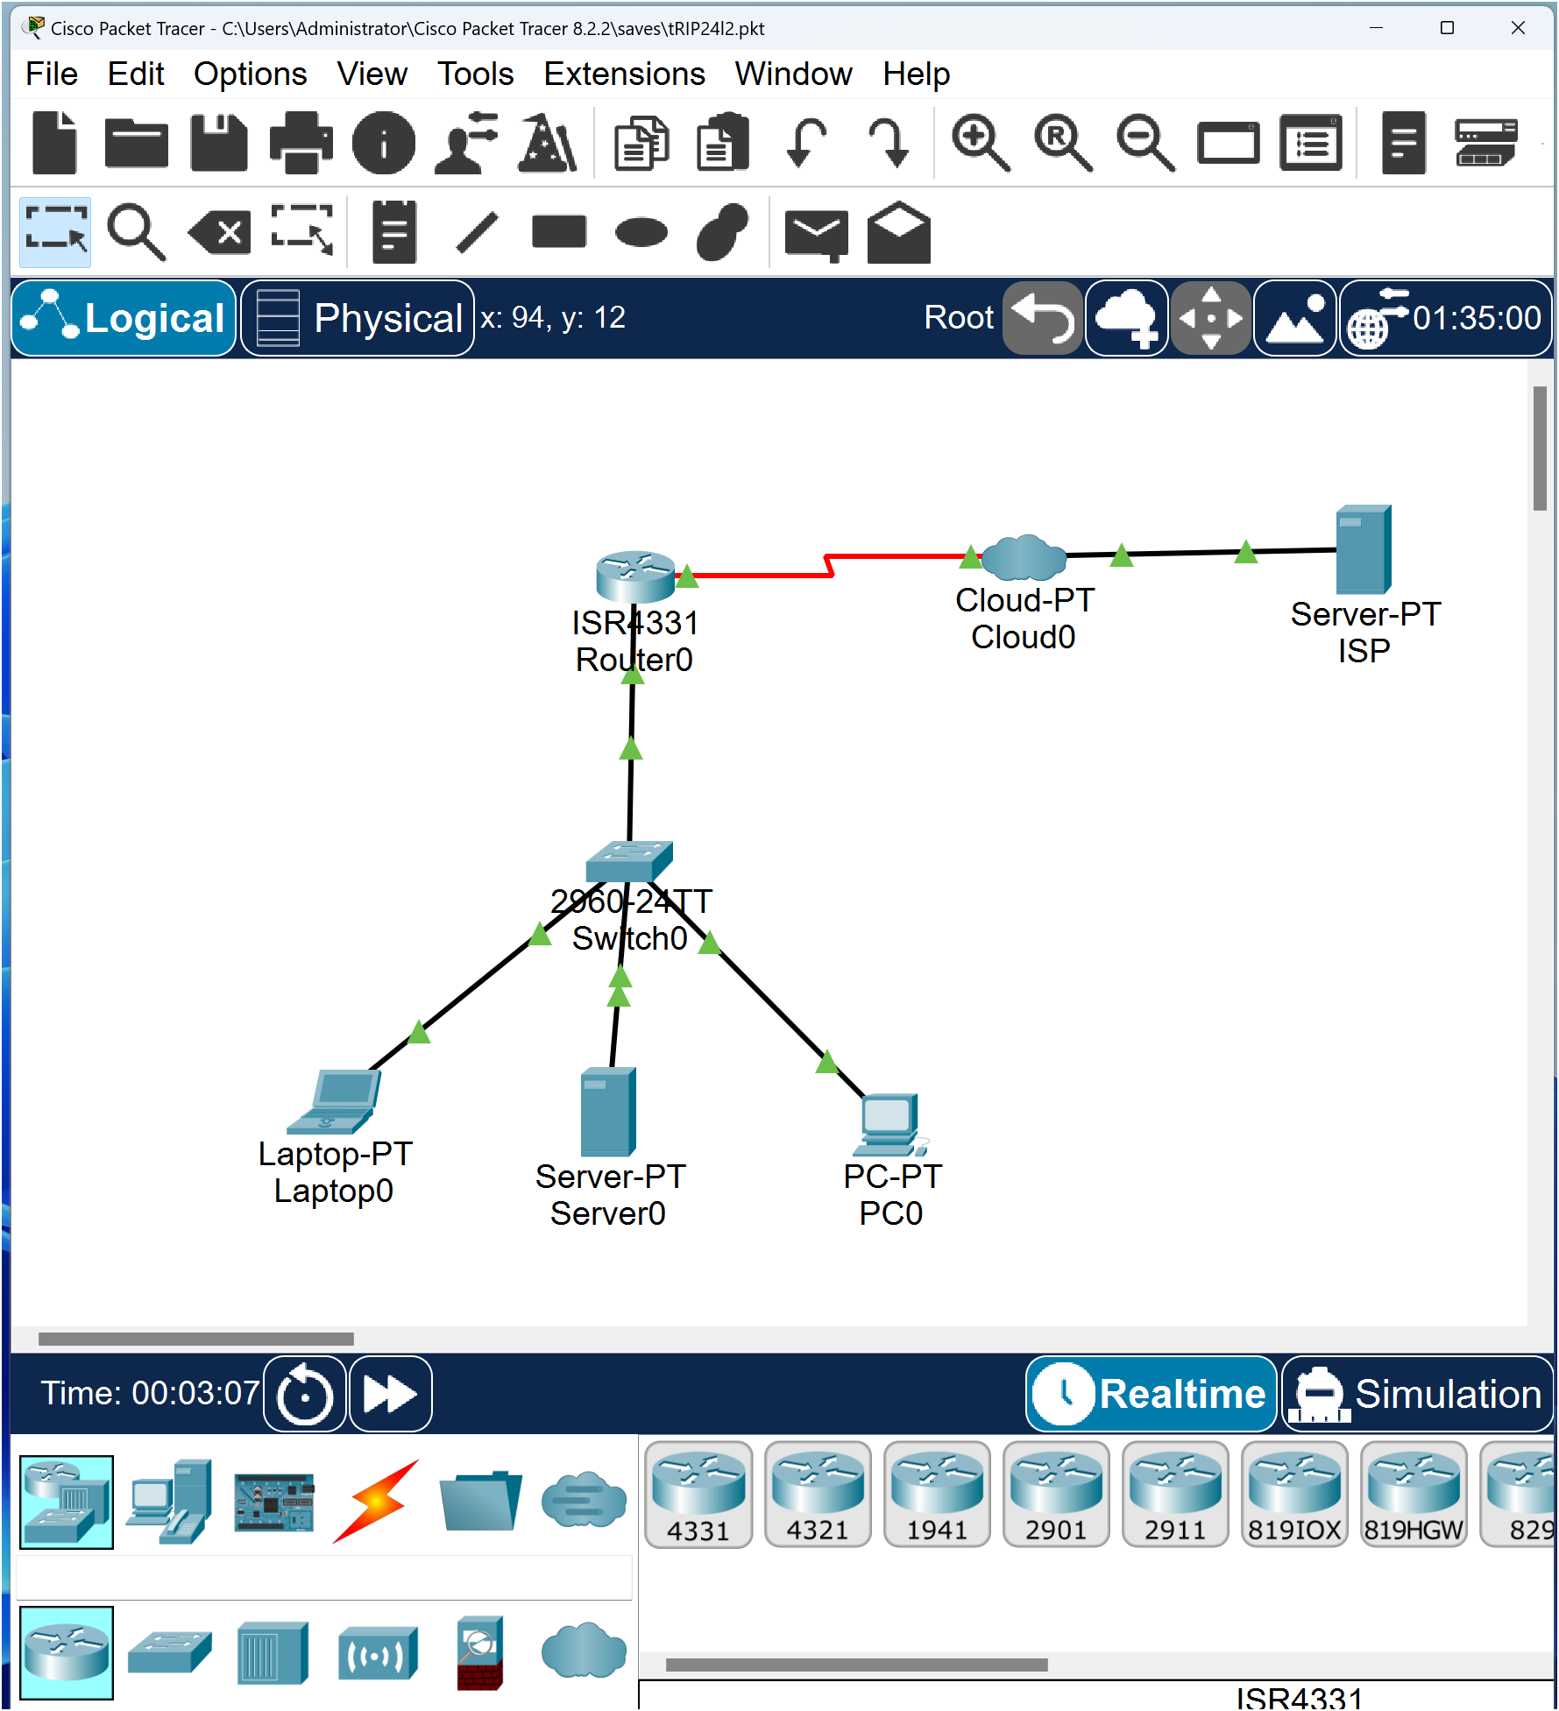
Activity: Create a local area network (LAN)

Slide 35
Hierarchical network
The design of large networks is to scale using a hierarchical design model.
IP networks use a hierarchical design consisting of access, distribution and core layers.

Slide 36
Hierarchical network: Access layer
    The access layer connects end user devices to a switch or a wireless access point.
    All devices within a single access layer will have the same network portion of the IP address.
    The distribution layer devices receive messages destined for different networks.

Slide 37
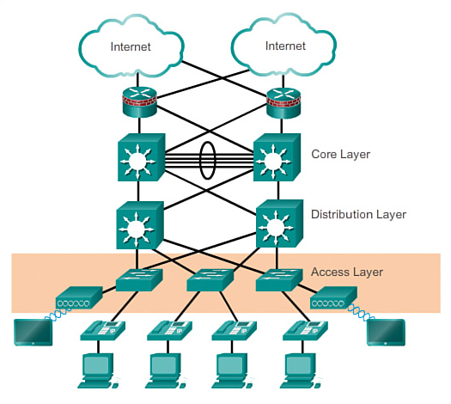
Access layer serves several functions
Layer 2 switching
High availability
Port security
Spanning tree
Virtual access control lists (VACLs)
QoS classification and marking and trust boundaries
Address Resolution Protocol (ARP) inspection
Power over Ethernet (PoE) and auxiliary VLANs for VoIP

Slide 38
Hierarchical network: Distribution layer
    The distribution layer provides a connection point for separate networks and controls the flow of information between the networks.
    Devices include routers and layer 3 switches for routing between networks.
    Devices control the traffic that flows from the access layer to the core layer.

Slide 39
Distribution layer can provide (1)
Aggregation of LAN or WAN links:
policy-based security in the form of access control lists (ACLs) and filtering
routing services between LANs and VLANs and between routing domains (e.g. EIGRP to OSPF)
redundancy and load balancing

Slide 40
Distribution layer can provide (2)
Aggregation of LAN or WAN links:
a boundary for route aggregation and summarisation configured on interfaces toward the core layer
broadcast domain control, because routers or multilayer switches do not forward broadcasts – device acts as the demarcation point between broadcast domains.

Slide 41
Hierarchical network: Core layer
  The core layer:
      transports data quickly between networks
      is a high-speed backbone layer with redundant connections
      is used to transport large amounts of data between multiple end networks
      has very powerful high-speed switches and routers as devices.

Slide 42
Core layer
The core layer is also referred to as the network backbone:
consists of high-speed network devices, such as the Cisco Catalyst 6500 or 6800
switches packets as fast as possible
interconnects multiple campus components, such as distribution modules, service modules, the data centre and the WAN edge
provides reliability and fault tolerance.

Slide 43
The OSI reference model
OSI model layer | Description
7. Application | The application layer contains protocols used for process-to-process communications.
6. Presentation | The presentation layer provides a typical representation of the data transferred between application layer services.
5. Session | The session layer provides services to the presentation layer to organise its dialogue and manage data exchange.
4. Transport | The transport layer defines services to segment, transfer and reassemble the data for individual communications between the end devices.
3. Network | The network layer provides services to exchange individual data over the network between identified end devices.
2. Data link | The data link layer protocols describe methods for exchanging data frames between devices over shared media.
1. Physical | The physical layer protocols describe the mechanical, electrical, functional and procedural means to activate, maintain and deactivate physical connections for a bit transmission to and from a network device.

Slide 44
The TCP/IP model
TCP/IP model layer | Description
Application | Represents data to the user, plus encoding and dialog control
Transport | Supports communication between various devices across diverse networks
Internet | Determines the best path through the network
Network access | Controls the hardware devices and media that make up the network

Slide 45
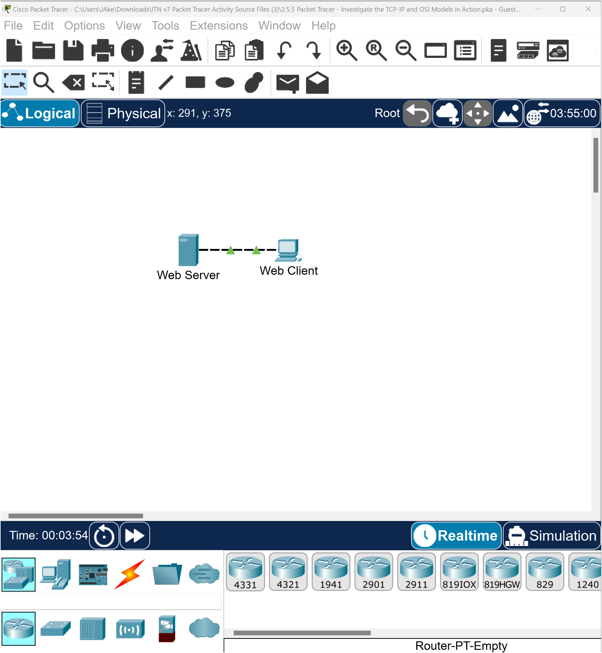
Packet Tracer activity
Investigate the TCP/IP and OSI models.

Slide 46
Question
In a real-life situation, what else can be added that will make the implementation of the network more effective?

Slide 47
Homework
Complete the following activities before the next lesson.
Packet Tracer: investigate the TCP/IP and OSI models:
Part 1: examine HTTP web traffic
Part 2: display elements of the TCP/IP protocol suite

Slide 48
3
Number systems

Slide 49
Learning objectives for lesson 3
Explore the following:
binary number system
binary to decimal conversion
decimal to binary conversion
binary game
hexadecimal number system
IPv4 addresses.

Slide 50
Binary number system
The binary number system uses just two integers: 0 and 1.
Hosts, servers and network devices identify each other using binary that consist of the digits 0 and 1, called bits.
IPv4 addresses display as dotted decimal notation using decimal numbering systems that consist of 10 digits [0,1,2,3,4,5,6,7,8,9].

Slide 51
Decimal: Base 10 [0,1,2,3,4,5,6,7,8,9]
Positional notation – place values for decimal systems:
1,000,000 | 100,000 | 10,000 | 1,000 | 100 | 10 | 1
 |  |  | 6 | 7 | 3 | 9
10⁶ | 10⁵ | 10⁴ | 10³ | 10² | 10¹ | 10⁰
1,000,000 | 100,000 | 10,000 | 1,000 | 100 | 10 | 1
 |  |  | 6 | 7 | 3 | 1
6 x 1,000 | = | 6,000
7 x 100 | = | 700
3 x 10 | = | 30
1 x 1 | = | 1
 | Total | 6,731

Slide 52
Binary: Base 2 [0,1]
2⁷ | 2⁶ | 2⁵ | 2⁴ | 2³ | 2² | 2¹ | 2⁰
128 | 64 | 32 | 16 | 8 | 4 | 2 | 1
0 | 0 | 0 | 0 | 0 | 0 | 0 | 0
0 | 0 | 0 | 0 | 0 | 0 | 0 | 1
0 | 0 | 0 | 0 | 0 | 0 | 1 | 0
0 | 0 | 0 | 0 | 0 | 0 | 1 | 1
0 | 0 | 0 | 0 | 0 | 1 | 0 | 0
Decimal
0
1
2
3
4

Slide 53
Binary: Complete the table
2⁷ | 2⁶ | 2⁵ | 2⁴ | 2³ | 2² | 2¹ | 2⁰
128 | 64 | 32 | 16 | 8 | 4 | 2 | 1
0 | 0 | 0 | 0 | 0 | 1 | 0 | 1
0 | 0 | 0 | 0 | 0 | 1 | 1 | 0
0 | 0 | 0 | 0 | 0 | 1 | 1 | 1
0 | 0 | 0 | 0 | 1 | 0 | 0 | 0
0 | 0 | 0 | 0 | 1 | 0 | 0 | 1
0 | 0 | 0 | 0 | 1 | 0 | 1 | 0
Decimal
5
6
10

Slide 54
Convert binary to decimal
2⁷ | 2⁶ | 2⁵ | 2⁴ | 2³ | 2² | 2¹ | 2⁰
128 | 64 | 32 | 16 | 8 | 4 | 2 | 1
0 | 0 | 0 | 0 | 1 | 1 | 0 | 1
1 | 0 | 1 | 0 | 1 | 0 | 1 | 0
Decimal
13
170
Convert 00001101 to decimal.
Add the place values for digit 1 [8 + 4 + 1 = 13]
Convert 10101010 to decimal
128 + 32 + 8 + 2 = 170

Slide 55
Complete the table
2⁷ | 2⁶ | 2⁵ | 2⁴ | 2³ | 2² | 2¹ | 2⁰
128 | 64 | 32 | 16 | 8 | 4 | 2 | 1
1 | 1 | 0 | 0 | 1 | 1 | 1 | 0
0 | 0 | 0 | 1 | 1 | 1 | 1 | 1
1 | 1 | 0 | 0 | 1 | 1 | 0 | 0
0 | 0 | 0 | 0 | 0 | 0 | 0 | 0
1 | 1 | 1 | 1 | 1 | 1 | 1 | 1
1 | 1 | 1 | 1 | 0 | 0 | 0 | 0
1 | 0 | 0 | 1 | 1 | 1 | 1 | 1
Decimal
206
0
159

Slide 56
IPv4 address – 32 bits – 4 octates
2⁷ | 2⁶ | 2⁵ | 2⁴ | 2³ | 2² | 2¹ | 2⁰
128 | 64 | 32 | 16 | 8 | 4 | 2 | 1
1 | 1 | 0 | 0 | 0 | 0 | 0 | 0
11000000. | 10101000. | 00000000. | 00001010
Convert the octate to decimal.
11000000 | 10101000 | 00000000 | 00000001
192 | 168 | 0 | 1

Slide 57
Activity: Convert binary to dotted decimal notation

Slide 58
Complete the table as dotted decimal notation
2⁷ | 2⁶ | 2⁵ | 2⁴ | 2³ | 2² | 2¹ | 2⁰
128 | 64 | 32 | 16 | 8 | 4 | 2 | 1
11000000 | 10101000 | 00011010 | 11000011
00001010 | 00000001 | 00000001 | 00001010

Slide 59
Activity: Convert IPv4 dotted decimal notation to binary

Slide 60
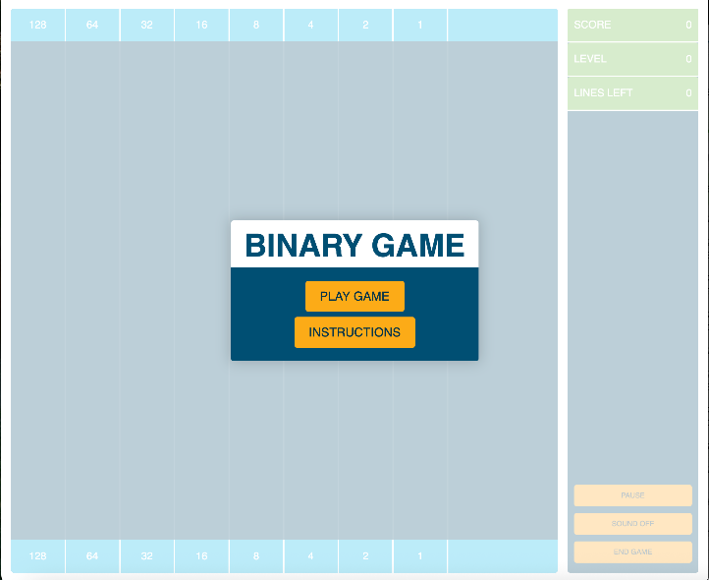
Activity: Binary game
Play the binary game.

Slide 61
Hexadecimal number system
Base 16 number system
16 symbols [0,1,2,3,4,5,6,7,8,9,A,B,C,D,E,F]
Hex symbol represents a 4-bit binary number
8-bit binary can be represented by two hex symbols
16³ | 16² | 16¹ | 16⁰
4096 | 256 | 16 | 1

Slide 62
Hexadecimal: Base 16 system (1)
Decimal |  | Binary |  | Hexadecimal
0 |  | 0000 |  | 0
1 |  | 0001 |  | 1
2 |  | 0010 |  | 2
3 |  | 0011 |  | 3
4 |  | 0100 |  | 4
5 |  | 0101 |  | 5
6 |  | 0110 |  | 6
7 |  | 0111 |  | 7
8 |  | 1000 |  | 8
9 |  | 1001 |  | 9
10 |  | 1010 |  | A

Slide 63
Hexadecimal: Base 16 system (2)
Decimal |  | Binary |  | Hexadecimal
11 |  | 1011 |  | B
12 |  | 1100 |  | C
13 |  | 1101 |  | D
14 |  | 1110 |  | E
15 |  | 1111 |  | F

Slide 64
Hexadecimal to decimal conversions
Convert hex 4A to decimal
Positional notation for the powers of 16
Insert the hex symbols below
Multiply each symbol by the place value
[4 x 16] + [A x 1]
[4 x 16] + [10 x 1]
= 74
Attempt activity: Converting from hexadecimal to decimal
16¹ | 16⁰
16 | 1
4 | A

Slide 65
Converting from hexadecimal to decimal
Convert hex 6E to decimal.
Convert each hex symbol to its 4-bit binary, then combine into one binary number and convert to decimal.
Hex 6
2³ | 2² | 2¹ | 2⁰
8 | 4 | 2 | 0
0 | 1 | 1 | 0
Hex E
Dec 14
2³ | 2² | 2¹ | 2⁰
8 | 4 | 2 | 1
1 | 1 | 1 | 0
2⁷ | 2⁶ | 2⁵ | 2⁴ | 2³ | 2² | 2¹ | 2⁰
128 | 64 | 32 | 16 | 8 | 4 | 2 | 1
0 | 1 | 1 | 0 | 1 | 1 | 1 | 0
64 + 32 + 8 + 4 + 2 = 110 decimal

Slide 66
Converting from decimal to hexadecimal (1)
Convert decimal 197 to hex:
Convert 197 to 8-bit binary number.
Convert the 8-bit binary number to hexadecimal.
2⁷ | 2⁶ | 2⁵ | 2⁴ |  | 2³ | 2² | 2¹ | 2⁰
128 | 64 | 32 | 16 |  | 8 | 4 | 2 | 1
1 | 1 | 0 | 0 |  | 0 | 1 | 0 | 1

Slide 67
Converting from decimal to hexadecimal (2)
Split the 8-bit binary number into 4-bit binary numbers.
Convert the 4-bit to decimal.
197 decimal = C5 Hex or 0xC5
2³ | 2² | 2¹ | 2⁰ | 2³ | 2² | 2¹ | 2⁰
8 | 4 | 2 | 1 | 8 | 4 | 2 | 1
1 | 1 | 0 | 0 | 0 | 1 | 0 | 1
8 + 4 = 12
Hex C
4 + 1 = 5
Hex 5

Slide 68
IPv4 addressing
The IPv4 address is a logical network address that identifies a particular host.
The IPv4 address is unique for both local and remote communications.
Each user device is installed with a network interface card (NIC), on which the IPv4 address is assigned.
List three end user devices.
Which end user device can accommodate more than one NIC?

Slide 69
IPV4 address structure (1)
An IPv4 address:
32-bit hierarchical address
two parts – a network portion and a host portion
four 8-bit decimal values between 0 and 255, separated by periods (octets)
subnet mask used to determine the network and host portions.
Network
Host
192 | . | 168 | . | 43 | . | 100
11000000 |  | 10101000 |  | 00101011 |  | 11001000
11111111 |  | 11111111 |  | 11111111 |  | 00000000
255 |  | 255 |  | 255 |  | 0
Subnet mask

Slide 70
IPv4 address structure (2)
Subnet mask:
32-bit value of 0s and 1s
1s designate network bits; 0s are host bits.
Network
Host
192 | . | 168 | . | 43 | . | 100
11000000 |  | 10101000 |  | 00101011 |  | 11001000
11111111 |  | 11111111 |  | 11111111 |  | 00000000
255 |  | 255 |  | 255 |  | 0
Subnet mask

Slide 71
Determining the network: Logical AND (1)
A logical AND Boolean operation is used in determining the network address.
Logical AND is the comparison of two bits where only a 1 AND 1 produces a 1 and any other combination results in a 0:
    1 AND 1 = 1; 0 AND 1 = 0; 1 AND 0 = 0; 0 AND 0 = 0
    1 = True and 0 = False.

Slide 72
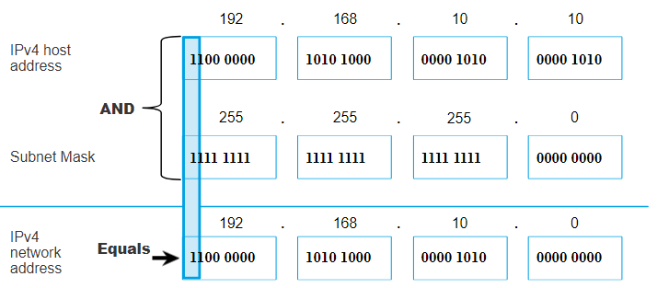
Determining the network: Logical AND (2)
To identify the network address, the host IPv4 address is logically ANDed, bit by bit, with the subnet mask.

Slide 73
Prefix length
Number of bits set to 1 in the subnet mask.
Subnet mask | 32-bit address | Prefix length
255.0.0.0 | 11111111 00000000 00000000 00000000 | /8
255.255.0.0 | 11111111 11111111 00000000 00000000 | /16
255.255.255.0 | 11111111 11111111 11111111 00000000 | /24
255.255.255.128 | 11111111 11111111 11111111 10000000 | /25
255.255.255.192 | 11111111 11111111 11111111 11000000 | /26
255.255.255.224 | 11111111 11111111 11111111 11100000 | /27
255.255.255.240 | 11111111 11111111 11111111 11110000 | /28
255.255.255.248 | 11111111 11111111 11111111 11111000 | /29
255.255.255.252 | 11111111 11111111 11111111 11111100 | /30

Slide 74
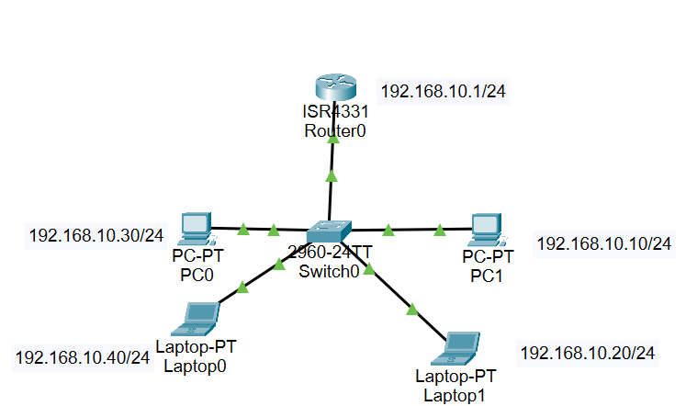
Network, host and broadcast address
In a network, there are three types of IP address:
  network address
  host address
  broadcast address.
 | Network portion | Host portion | Host bits
Subnet mask 255.255.255.0 or /24 | 255 255 255 11111111 11111111 11111111 | 0 00000000
Network address 192.168.10.0 or /24 | 192 168 10 11000000 10100000 00001010 | 0 00000000 | All 0s
First address 192.168.10.1 or /24 | 192 168 10 11000000 10100000 00001010 | 1 00000001 | All 0s and a 1
Last address 192.168.10.254 or /24 | 192 168 10 11000000 10100000 00001010 | 254 11111110 | All 1s and a 0
Broadcast address 192.168.10.255 or /24 | 192 168 10 11000000 10100000 00001010 | 255 11111111 | All 1s

Slide 75
Activity: IPv4 address structure
Example
Host X address: 192.168.1.10 /24 or
Subnet mask: 255.255.255.0
What is the network address of the host?
Network bit is 24 (255.255.255) and host bit is 8.
When all host bits are set to 0(00000000), then the address is the network address.
Network address: 192.168.1.0

Slide 76
Types of IPv4 address: Public and private IPv4 addresses
Network address and prefix | RFC 1918 private address range
10.0.0.0 /8 | 10.0.0.0 to 10.255.255.255
172.16.0.0 /12 | 172.16.0.0 to 172.31.255.255
192.168.0.0 /16 | 192.168.0.0 to 192.168.255.255
Public IPv4 addresses are globally routed between internet service provider (ISP) routers.
Most organisations use private addresses to assign IPv4 addresses to internal hosts.
Private addresses are not globally routable.

Slide 77
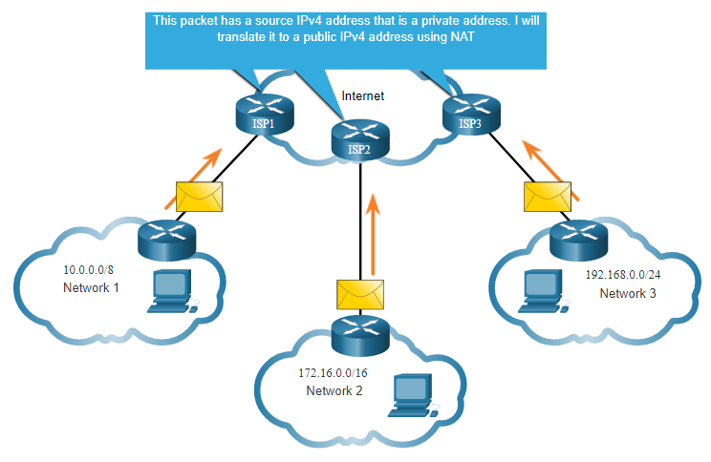
Routing to the internet
Network address translation (NAT) translates the internal private address to a public global IP address.
NAT is configured on the edge router that connect to the internet.
© Cisco Networking Academy, via ITExamAnswers.net. (n.d.). CCNA 1 v6.0 Chapter 7 – IP Addressing. Retrieved 14 May 2025, from https://itexamanswers.net/ccna-1-v6-0-study-material-chapter-7-ip-addressing.html

Slide 78
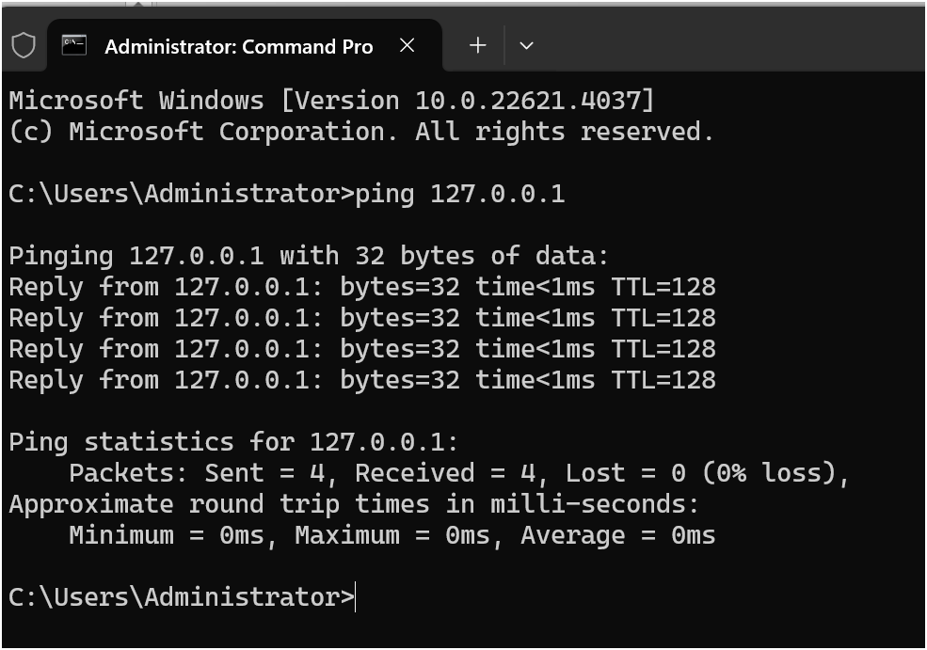
Special-use IPv4 addresses (1)
Loopback addresses:
127.0.0.0 /8 (127.0.0.1 to 127.255.255.254)
commonly identified as only 127.0.0.1
used on a host to test if TCP/IP is operational.

Slide 79
Special-use IPv4 addresses (2)
Link-local addresses:
169.254.0.0 /16 (169.254.0.1 to 169.254.255.254)
commonly known as the Automatic Private IP Addressing (APIPA) addresses or self-assigned addresses
used by Windows Dynamic Host Configuration Protocol (DHCP) clients to self-configure when no DHCP servers are available.

Slide 80
IPv4 address classes RFC 790 (1981)
IP Address Class | Class A | Class B | Class C
First bit values (binary) | 0 | 10 | 110
First byte value (decimal)​ | 0–127 | 128–191 | 192–223
Number of network identifier bits | 8 | 16 | 24
Number of host identifier bits​ | 24 | 16 | 8
Number of possible networks​ | 126 | 16,384 | 2,097,152
Number of possible hosts​ | 16,777,214 | 65,534 | 254
Classful addressing wasted many IPv4 addresses. Classful address allocation was replaced with classless addressing.

Slide 81
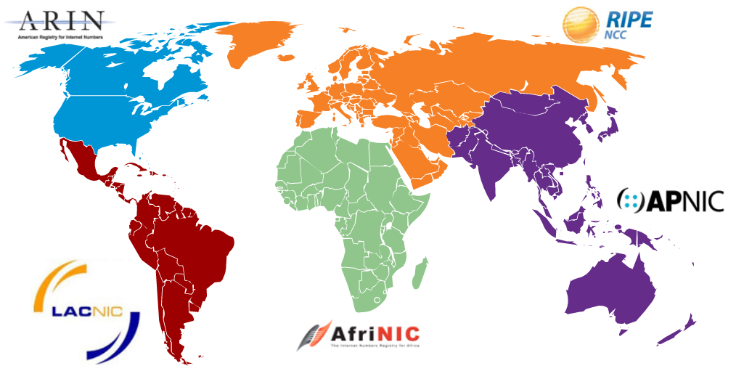
Assignment of IP addresses (1)
The Internet Assigned Numbers Authority (IANA) manages and allocates blocks of IPv4 and IPv6 addresses to five regional internet registries (RIRs).
RIRs are responsible for allocating IP addresses to ISPs that provide IPv4 address blocks to smaller ISPs and organisations.

Slide 82
Assignment of IP addresses (2)
Research the following:
AfriNIC
APNIC
ARIN
LACNIC
RIPE NCC.

Slide 83
Activity: public or private IPv4 address
Select public or private network type for each address.
IPv4 address | Public | Private
10.25.1.160 |  | Private
209.165.100.25 | Public
62.10.1.5
192.168.1.15
172.12.10.5
172.16.0.50

Slide 84
Exit card
Given the IPv4 address and subnet mask, determine the network address and the broadcast address.
10.10.10.15 255.255.255.0
172.16.0.5 255.255.0.0
192.168.1.26 255.255.255.192
192.168.1.60 255.255.255.224
10.0.1.15 255.0.0.0

Slide 85
4
IP addressing

Slide 86
Learning objectives for lesson 4
To explore:
IPv4 unicast, broadcast and multicast
network segmentation
subnetting IPv4 address
subnetting in a large enterprise
magic number.

Slide 87
IPv4 unicast, broadcast and multicast
Transmission | Description | Host address range
Unicast | Sending a packet to one destination IP address | 1.1.1.1 to 223.255.255.255
Broadcast | Sending a packet to all destination IP addresses | Host portion with all ones (1) 255.255.255.255
Multicast | Sending a packet to a multicast address group | 224.0.0.0 to 239.255.255.255

Slide 88
Broadcasts
A device use broadcasts and Address Resolution Protocol (ARP) to locate other devices on an Ethernet local area network.
ARP resolves known IPv4 address to associated MAC address.
Host sends broadcast address to locate DHCP server on LAN to acquire an IPv4 address.
Switches propagate broadcasts to all interfaces except the interface on which it was received.
Routers do not propagate broadcasts.

Slide 89
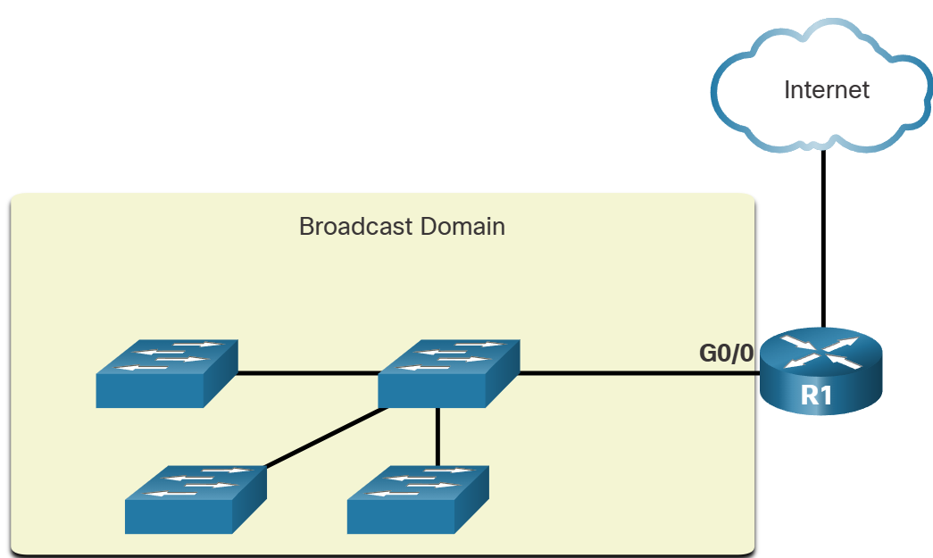
Broadcast domain
A router stops broadcasts.
A router interface connects to a broadcast domain and the broadcast propagate within that specific broadcast domain.

Slide 90
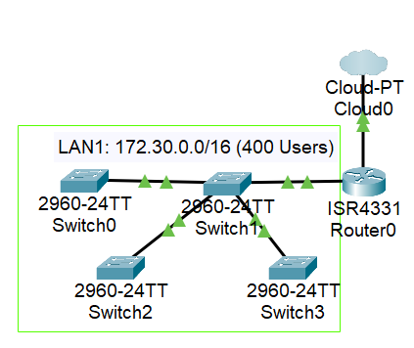
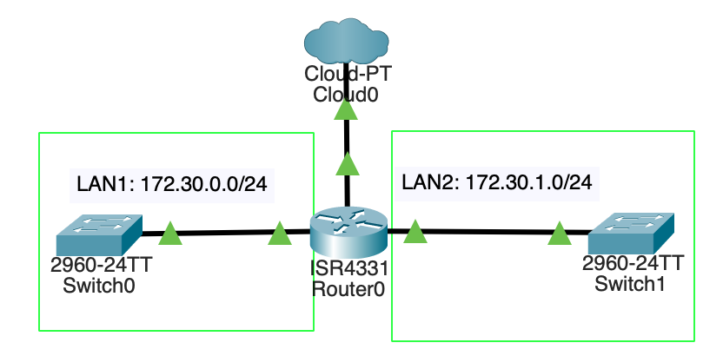
Impact of large broadcast domains
Hosts can generate excessive broadcasts, which results in slow device operations and slow network operations.
To resolve, create a smaller broadcast domain using a process called subnetting. The smaller networks are called subnets.
LAN1: 172.30.0.0./16 divides into subnets of 200 users each. 172.30.0.0/24 and 172.30.1.0/24
Prefix length changes to two /24 networks. Hosts bits are used to create subnets.

Slide 91
Network segmentation: Why?
Network performance: Subnetting reduces network traffic and improves network performance.
Security enhancement: Subnetting allows administrators to implement security policies and control communication between subnets.
Traffic isolation: Subnetting reduces the impact of broadcast traffic caused by misconfigurations, malfunctions or malicious activities.

Slide 92
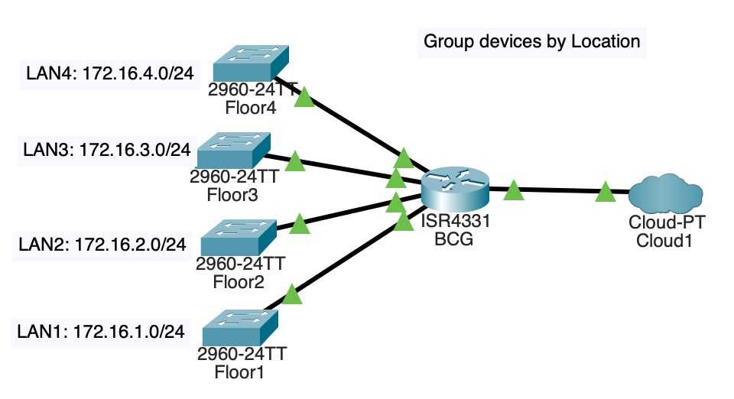
Practical use of subnets to manage network devices

Slide 93
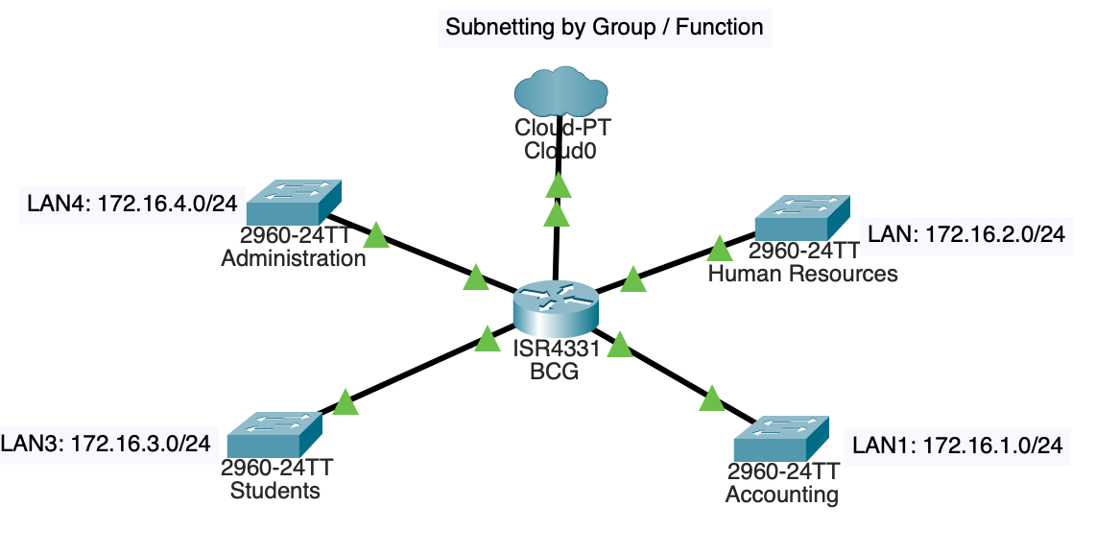

Slide 94
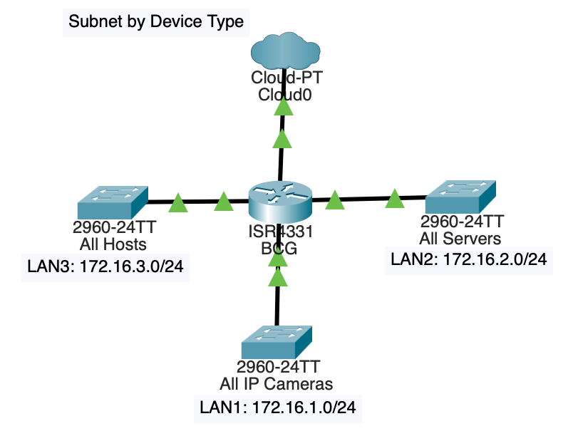
Subnet by device type

Slide 95
Subnet IPv4 network
Segmenting a network is called subnetting.
Subnet creation: IPv4 subnets are created by borrowing host bits to extend the subnet mask and create additional network bits.
Subnet increase: Borrowing more host bits allows for a greater number of subnets to be defined.
Host reduction: Increasing the number of subnets reduces the number of hosts per subnet.

Slide 96
Subnet at octet boundary of /8, /16, /24
Prefix length | Subnet mask | Subnet mask in binary (n = network, h = host) |  |  |  | Number of hosts
/8 | 255.0.0.0 | nnnnnnnn 11111111 | hhhhhhhh 00000000 | hhhhhhhh 00000000 | hhhhhhhh 00000000 | 2²⁴ – 2 16,777,214
/16 | 255.255.0.0 | nnnnnnnn 11111111 | nnnnnnnn 11111111 | hhhhhhhh 00000000 | hhhhhhhh 00000000 | 2¹⁶ – 2 65,534
/24 | 255.255.255.0 | nnnnnnnn 11111111 | nnnnnnnn 11111111 | nnnnnnnn 11111111 | hhhhhhhh 00000000 | 2⁸ – 2 254
Subtract 2 for network and broadcast addresses which are not useable.

Slide 97
Sample: Subnetting enterprise using 10.0.0.0/8 as private address (1)
The network can connect more than 16 million hosts (2²⁴ – 2). NOT GOOD! This needs subnetting informed by devices and functions within the enterprise.
The enterprise can subnet on either a /16 or a /24 octet boundary.
Subnet address | Host range |  | Broadcast
10.0.0.0/16 | 10.0.0.1 | 10.0.255.254 | 10.0.255.255
10.1.0.0/16 | 10.1.01 | 10.1.255.254 | 10.1.255.255

Slide 98
Sample: Subnetting enterprise using 10.0.0.0/8 as private address (2)
/8 to /16 octet boundary
N.H.H.H /8 host bits = 24
N.N.H.H /16 8 bits borrowed to create 2⁸ = 256 subnets; hosts = 2¹⁶ – 2 = 65,534
Network address is when all host bits are set to 0 and broadcast is when all hosts bits are set to 1
Network address = N.N.0.0; broadcast address = N.N.255.255

Slide 99
In binary: /16 subnet
N | N | H | H | Decimal
00001010 | 00000000 | 00000000 | 00000000 | 10.0.0.0
00001010 | 00000001 | 00000000 | 00000000 | 10.1.0.0
00001010 | 00000010 | 00000000 | 00000000 | 10.2.0.0
00001010 | 00000011 | 00000000 | 00000000 | 10.3.0.0
00001010 | 00000100 | 00000000 | 00000000 | 10.4.0.0
00001010 | 00000101 | 00000000 | 00000000 | 10.5.0.0
Complete Activity: Subnet within octet boundary /16

Slide 100
In binary: /16 usable hosts
N | N | H | H | Decimal
00001010 | 00000000 | 00000000 | 00000001 | 10.0.0.1
00001010 | 00000000 | 11111111 | 11111110 | 10.0.255.254
00001010 | 00000001 | 00000000 | 00000001 | 10.1.0.1
00001010 | 00000001 | 11111111 | 11111110 | 10.1.255.254
00001010 | 00000010 | 00000000 | 00000001 | 10.2.0.1
00001010 | 00000010 | 11111111 | 11111110 | 10.2.255.254
Complete Activity: /16 usable hosts.

Slide 101
Subnetting network 10.0.0.0/8 using a /24 prefix (1)
/8 to /24 prefix
Network bits = 16, which create 2¹⁶ possible subnets: 65,536
Host bits = 8, which makes 2⁸ – 2 useable hosts – 254 per subnet
Network address = N.N.N.0 and broadcast address = N.N.N.255

Slide 102
Subnetting network 10.0.0.0/8 using a /24 prefix (2)
Subnet address | Host range |  | Broadcast
10.0.0.0 | 10.0.0.1 | 10.0.0.254 | 10.0.0.255
10.0.1.0 | 10.0.1.1 | 10.0.1.254 | 10.0.1.255
10.0.2.0 | 10.0.2.1 | 10.0.2.254 | 10.0.2.255
Complete Activity: Subnet network 10.0.0.0/8 using a /24 prefix
t

Slide 103
Subnetting within a /24 network (1)
/24 network
Network bits: 24; host bits: 8
To create subnet, borrow bits from the host bits – up to 6 bits
Each bit borrowed creates 2^{n} subnets, where n is the bit borrowed – e.g. n = 1 creates 2¹ = 2 subnets; n = 2 creates 2² = 4 subnets; n = 6 creates 2⁶ = 64 subnets

Slide 104
Subnetting within a /24 network (2)
n bits | Subnets | Host bits | Useable hosts each
1 | 2¹ = 2 | 7 | 2⁷ – 2 = 126
2 | 2² = 4 | 6 | 2⁶ – 2 = 62
3 | 2³ = 8 | 5 | 2⁵ – 2 = 30
4 | 2⁴ = 16 | 4 | 2⁴ – 2 = 14
5 | 2⁵ = 32 | 3 | 2³ – 2 = 6
6 | 2⁶ = 64 | 2 | 2² – 2 = 2

Slide 105
Subnetting a /16 network
Prefix length | Subnet mask | Network address (n = network, h = host) |  |  |  | Number of subnets | Number of useable hosts
/17 | 255.255.128.0 | nnnnnnnn 11111111 | nnnnnnnn 11111111 | nhhhhhhh 10000000 | hhhhhhhh 00000000 | 2¹ = 2 | 2¹⁵ – 2 = 32,766
/18 | 255.255.192.0 | nnnnnnnn 11111111 | nnnnnnnn 11111111 | nnhhhhhh 11000000 | hhhhhhhh 00000000 | 2² = 4 | 2¹⁴ – 2 = 16,382
/19 | 255.255.224.0 | nnnnnnnn 11111111 | nnnnnnnn 11111111 | nnnhhhhh 11100000 | hhhhhhhh 00000000 | 2³ = 8 | 2¹³ – 2 = 8,190
/20 | 255.255.240.0 | nnnnnnnn 11111111 | nnnnnnnn 11111111 | nnnnhhhh 11110000 | hhhhhhhh 00000000 | 2⁴ = 16 | 2¹² – 2 = 4,094
/21 | 255.255.248.0 | nnnnnnnn 11111111 | nnnnnnnn 11111111 | nnnnnhhh 11111000 | hhhhhhhh 00000000 | 2⁵ = 32 | 2¹¹ – 2 = 2,046
Complete Activity: subnet /16 network.

Slide 106
Subnetting in a large enterprise (1)
Use private address 172.16.0.0 /16
Requires 100 subnets
Host octets = 2 ⬄ 8 bits each; host bits = 16 (2 x 8)
Create subnets by borrowing from host bits – start from the third octet (left to right) until the bit borrowed satisfies the required subnets
n bit creates 2^{n} subnets – increase the value of n until it satisfies the requirement of 100 subnets

Slide 107
Subnetting in a large enterprise (2)
n | Subnets
1 | 2¹ = 2
2 | 2² = 4
3 | 2³ = 8
n | Subnets
4 | 2⁴ = 16
5 | 2⁵ = 32
6 | 2⁶ = 64
n | Subnets
7 | 2⁷ = 128
8 | 2⁸ = 256
9 | 2⁹ = 512
The table shows that 7 bits will satisfy the requirement of 100 subnets.
Prefix length will increase by 7.
172.16.0.0/(16 + 7)
172.16.0.0/23

Slide 108
172.16.0.0/23 (1)
172. | 16. | 0000 000 |  | 0. | 0000 0000
255. | 255. | 1111 111 |  | 0. | 0000 0000
172.16.0.0/23
172.16.254.0/23
172.16.0.0/23
Network bits = 23; host bits = (32 – 23) = 9
Useable hosts = 2⁹ – 2 = 510
The first address is reserved for the network address and the last address is reserved for the broadcast address.

Slide 109
172.16.0.0/23 (2)
172.16.0.0/23
Network bits = 23; host bits = (32 – 23) = 9
Useable hosts = 2⁹ – 2 = 510
The first address is reserved for the network address and the last address is reserved for the broadcast address.
172. | 16. | 0000 000 |  | 0. | 0000 0000
172. | 16. | 0000 001 |  | 0. | 0000 0000
172. | 16. | 0000 010 |  | 0. | 0000 0000
172.16.0.0/23
172.16.2.0/23
172.16.4.0/23

Slide 110
Address range for 172.16.0.0/23 subnet
172. | 16. | 0000 011 |  | 0. | 0000 0000
172. | 16. | 0000 100 |  | 0. | 0000 0000
172. | 16. | 0000 101 |  | 0. | 0000 0000
172. | 16. | 1111 111 |  | 0. | 0000 0000
172.16.6.0/23
172.16.8.0/23
172.16.10.0/23
172.16.254.0/23

Slide 111
Useable addresses in the subnet
Network address
172. | 16. | 0000 000 |  | 0. | 0000 0000
172.16.0.0/23
First host address
172. | 16. | 0000 000 |  | 0. | 0000 0001
172.16.0.1/23
Last host address
172. | 16. | 0000 000 |  | 1. | 1111 1110
172.16.1.254/23
Broadcast address
172. | 16. | 0000 000 |  | 1. | 1111 1111
172.16.1.255/23

Slide 112
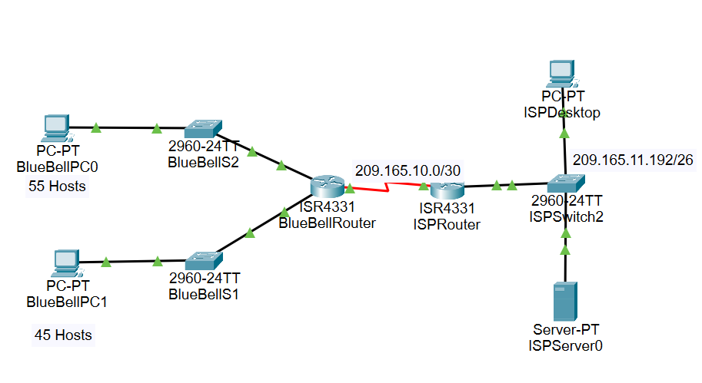
Packet Tracer: Subnetting an IPv4 network
192.168.1.0/24

Slide 113
Subnetting for a small internet service provider (ISP)
Subnets required = 1,000
Network address: 10.0.0.0/8
Address structure: N.H.H.H; N = network portion and H = host portion
N = 8 bits; each H = 8 bits; all H = 8 x 3 = 24 bits
To create 1,000 subnets will require 10 bits borrowed from host bits.
Subnets 2¹⁰ = 1,024
Network bits = 8 + 10 = 18; prefix length is now /18
Host bits = 32 – 18 = 14; usable hosts = 2¹⁴ – 2 = 16,382
10 | 0000 0000. | 00 | 00 0000. | 0000 0000
10. | 1111 1111. | 11 | 00 0000. | 0000 0000
10.0.0.0/18
10.255.192.0/18
10.0.0.0/18 Network

Slide 114
10.0.0.0/18 subnets
10. | 0000 0000. | 00 | 00 0000. | 0000 0000
10. | 0000 0000. | 01 | 00 0000. | 0000 0000
10. | 0000 0000. | 10 | 00 0000. | 0000 0000
10. | 0000 0000. | 11 | 00 0000. | 0000 0000
10. | 0000 0001. | 00 | 00 0000. | 0000 0000
10. | 1111 1111. | 11 | 00 0000. | 0000 0000
10.0.0.0/18
10.0.64.0/18
10.0.128.0/18
10.0.192.0/18
10.1.0.0/18
10.255.192.0/18

Slide 115
Address range for 10.0.0.0/18
Network address
10. | 00000000. | 00 |  | 00 0000. | 0000 0000
10.0.0.0/18
First host address
10. | 00000000. | 00 |  | 00 0000. | 0000 0001
10.0.0.1/18
Last host address
10. | 00000000. | 00 |  | 11 1111. | 1111 1110
10.0.63.254/18
Broadcast address
10. | 00000000. | 00 |  | 11 1111. | 1111 1111
10.0.63.255/18

Slide 116
Magic number (1)
To create subnet, borrow bit from the host portion.
The number is the last 1 in binary.
Given 192.168.0.0/24, create subnet by borrowing 3 bits from the host portion.
192 | 168 | 0 | 0
11000000 | 10101000 | 00000000 | 00000000
11111111 | 11111111 | 11111111 | 11100000
11111111 | 11111111 | 11111111 | 11100000
192.168.0.0/24
Octets as binary
3 bits borrowed = /27
Last bit borrowed is the magic number

Slide 117
Magic number (2)
2⁷ | 2⁶ | 2⁵ | 2⁴ | 2³ | 2² | 2¹ | 2⁰
128 | 64 | 32 | 16 | 8 | 4 | 2 | 1
1 | 1 | 1 | 0 | 0 | 0 | 0 | 0
Place value
Magic bit is in position 32. This means the network will go up by 32.
192.168.0.0/27; 192.168.0.32/27; 192.168.0.64/27

Slide 118
Subnets
Host octet /27
2⁷ | 2⁶ | 2⁵ | 2⁴ | 2³ | 2² | 2¹ | 2⁰
128 | 64 | 32 | 16 | 8 | 4 | 2 | 1
0 | 0 | 0 | 0 | 0 | 0 | 0 | 0
0 | 0 | 1 | 0 | 0 | 0 | 0 | 0
0 | 1 | 0 | 0 | 0 | 0 | 0 | 0
0 | 1 | 1 | 0 | 0 | 0 | 0 | 0
1 | 0 | 0 | 0 | 0 | 0 | 0 | 0
1 | 0 | 1 | 0 | 0 | 0 | 0 | 0
1 | 1 | 0 | 0 | 0 | 0 | 0 | 0
1 | 1 | 1 | 0 | 0 | 0 | 0 | 0
Network address
192.168.0.0/27
192.168.0.32/27
192.168.0.64/27
192.168.0.96/27
192.168.0.128/27
192.168.0.160/27
192.168.0.192/27
192.168.0.224/27

Slide 119
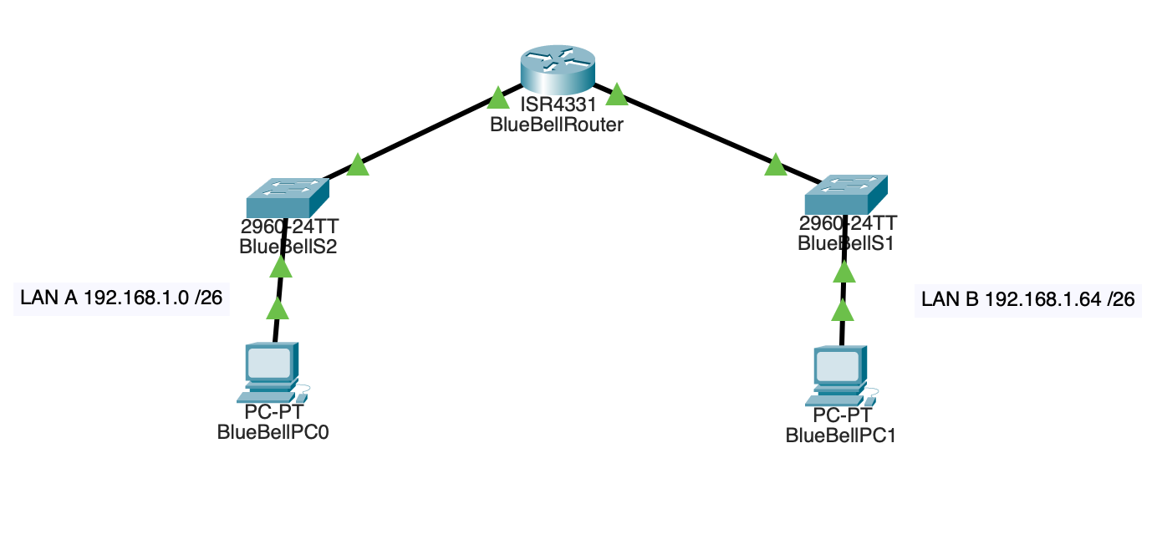
Activity: Packet Tracer: Subnet an IPv4 network

Slide 120
5
Virtualisation

Slide 121
Learning objectives for lesson 5
Explain virtualisation.
Understand types of virtualisation and the benefits of virtualisation.
Explore the purpose of hypervisors in virtualisation.
Experience creating a virtual machine.

Slide 122
Virtualisation
Virtualisation is creating virtual instances of computer resources, such as hardware, storage, networks or applications, using software.
Virtualisation is the foundation of cloud computing.
Developed by VMware to enable a host operating systems to support one or more guest operating systems.

Slide 123
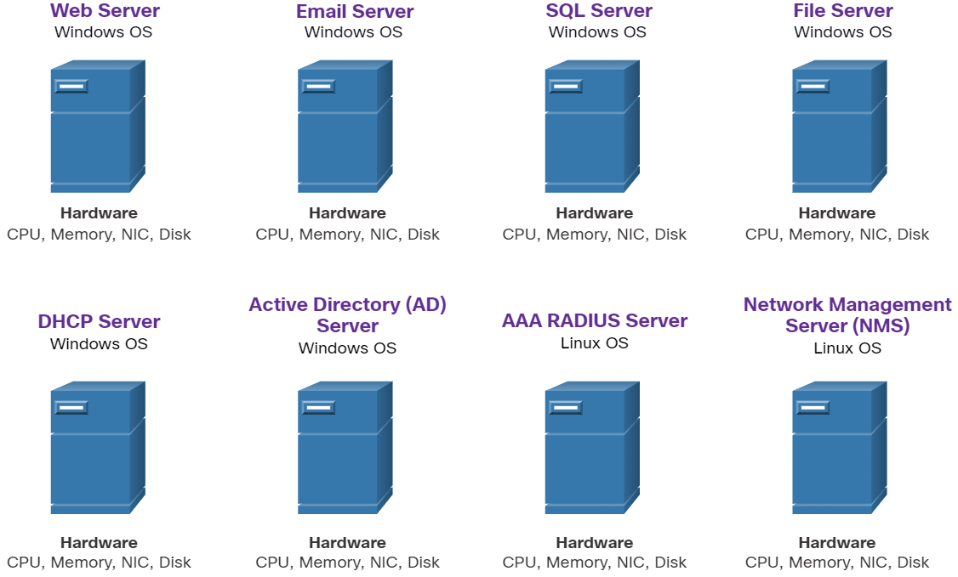
Types of virtualisation (1)
Server: consolidates multiple virtual machines (VMs) on one physical server, improving hardware efficiency
Problems with this model include:
  A hardware failure resulted in a service disruption, creating a single point of failure.
  Dedicated servers were often underused, creating a situation called server sprawl.
Historic server technology consisted of Windows servers installed on individual computers.

Slide 124
Types of virtualisation (2)
Network: abstract network resources such as virtual switches, VLANs from physical infrastructure
Storage: pools physical storage into a single virtualised unit for easier management
Desktop: hosts user desktop environments on centralised servers – e.g. VMware Horizon
Application: runs apps in isolated environments without operating systems installation – e.g. docker containers

Slide 125
Benefits of virtualisation (1)
Cost-efficiency: It reduces overall operational costs:
  Reduces equipment needs: Consolidating servers means fewer servers and lower maintenance costs.
  Reduces energy needs: Consolidating servers lowers the power and cooling costs.
  Reduces space needs: Server consolidation reduces the amount of required floor space.

Slide 126
Benefits of virtualisation (2)
Scalability: Resources are easily allocated or reallocated as demands change.
Isolation: Issues in one VM do not affect others or the host.
Easier prototyping: Prototypes can be rapidly created for testing and prototyping network deployments.
Faster server provisioning: Creating a virtual server is faster than provisioning a physical server.

Slide 127
Benefits of virtualisation (3)
Increased server uptime: Most platforms offer advanced redundant fault tolerance features.
Improved disaster recovery: Most platforms can test and automate failover before a disaster.
Legacy support: It extends the life of operating systems (OSs) and applications and therefore delays the need to migrate to newer solutions.

Slide 128
Hypervisors
The hypervisor adds an abstraction layer to create VMs.
The hypervisor can be a program, firmware or hardware.
Each of the VMs runs a complete and separate operating system.

Slide 129
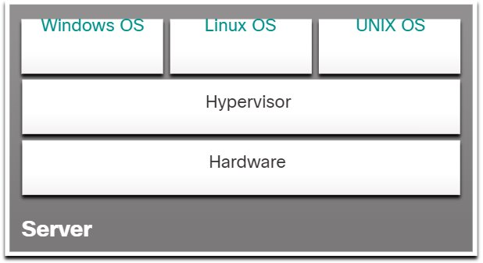
Type 1 hypervisors
Type 1 hypervisors are a ‘bare metal’ approach because the hypervisor is installed directly on the hardware.
Usually deployed by enterprises and data centres
Have direct access to hardware resources and are more efficient
VMware ESXi, Microsoft Hyper-V, VMware vSphere, Xen Project, Red Hat RHEV, KVM and Citrix XenServer

Slide 130
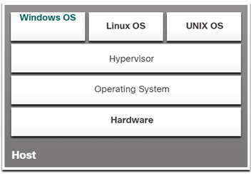
Type 2 hypervisors
Type 2 hypervisors are a hosted approach because the hypervisor is installed on top of the existing OS.
Additional OS instances installed on top of the hypervisor
Note: Host machine must have enough resources to support VMs
Oracle VirtualBox, VMware Workstation, Virtual PC and QEMU

Slide 131
VM hardware
VMs use virtual or simulated hardware.
Default simulated hardware includes:
  BIOS
  memory
  processor
  IDE controller 0 and 1
  SCSI controller
  synthetic network adapter
  COM 1 AND 2
  hard drive.

Slide 132
Added hardware features
SCSI controller
Network adapter
Fibre channel adapter
Remote FX 3D video adapter

Slide 133
Creating VMs
Each VM uses the following files:
  Virtual machine configuration (.vmc) file: This file in XML format contains the VM configuration information, including all settings for the VM.
  Virtual hard disk (.vhd or .vhdx) files: One or more files are used to store the guest operating system, applications and data for the VM.
  Saved-state (.vsv) file: The VM may use this if it has been placed into a saved state.

Slide 134
Create VM in Hyper-V Manager
Microsoft Hyper-V is a type 1 hypervisor-based virtualisation system for x64 computers with Second Level Address Translation (SLAT).
Hyper-V Manager is the primary graphical tool for creating and managing VMs, including VMs on multiple servers.
Hyper-V provides an isolated space for each VM to run its own OS that is independent of the host’s OS and other VMs.

Slide 135
Host system requirements
BIOS: enables hardware virtualisation
RAM: needs 4GB minimum
Processor: 64 bit with SLAT
Windows version: Windows 10 series (Professional, Enterprise, and Education) and Windows 11 series (Professional and Enterprise)

Slide 136
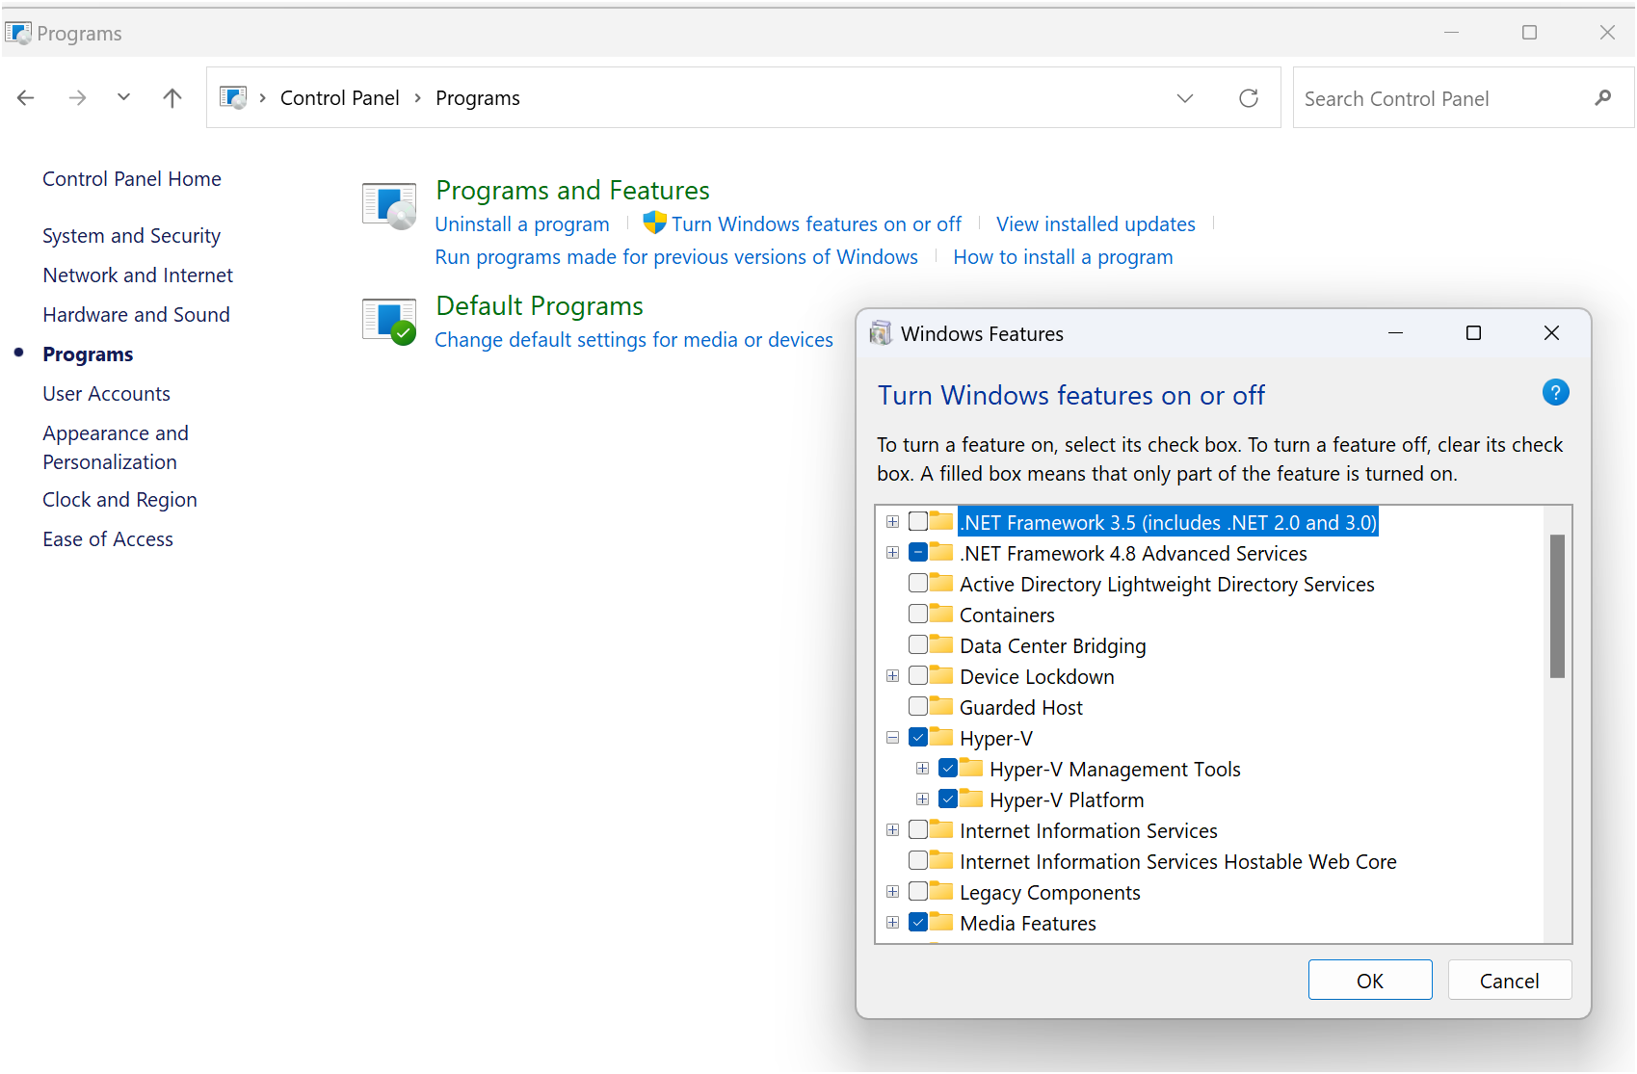
Activity: Enable Hyper-V on Windows
Hyper-V is built into Windows as an optional feature.

Slide 137
Build a new VM
In Hyper-V Manager, click ‘New’.
Select ‘Virtual Machine’.
Use the wizard to configure VM setting:
    number of processors
    memory
    virtual network adapters
    virtual disks.

Slide 138
Desktop virtualisation application
Download and install to create a VM:
Oracle VirtualBox
VMware player
You can obtain the VMware Workstation Player for the Windows installer file from the Broadcom Support Portal

Slide 139
Activity: Create a VM

Slide 140
6
Create virtual machines

Slide 141
Learning objectives for lesson 6
Explain network topology.
Create two server virtual machines (VMs).
Create two desktop VMs.

Slide 142
Network topology
Design the physical topology for the network in Packet Tracer.
Use a private IPv4 address – 192.168.1.0 /24
Test for connectivity.

Slide 143
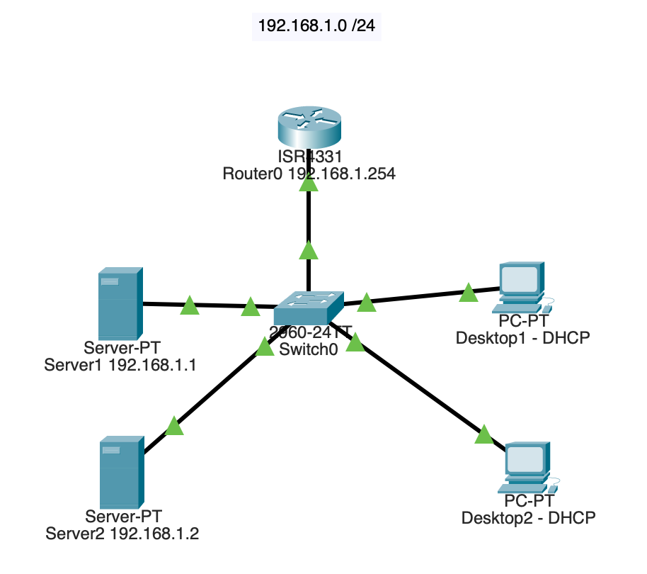
Physical topology

Slide 144
Activity: Create Server VMs and Desktop VMs
Activity: Create Server VM using Hyper-V Manager
Activity: Create Server VM using Oracle VirtualBox
Activity: Create Desktop VM using Oracle VirtualBox
Activity: Create Desktop VM using Hyper-V Manager

Slide 145
Feedback activity
Review peer’s Desktop VM using the Feedback form.
Share feedback with, and receive feedback from, peer. Identify areas for improvement.
Share one area for improvement on the shared collaborative platform.

Slide 146
7
Network operating system

Slide 147
Learning objectives for lesson 7
Consider the options for virtualisation platforms.
Download Windows Server 2019 ISO.
Create virtual manager (VM).
Follow step-by-step installation.

Slide 148
Virtualisation platform
Use one of following to create a VM:
    Microsoft Hyper-V Server (free)
    Hyper-V (Windows Pro/Enterprise)
    Oracle VirtualBox (Cross-platform)
    VMware Workstation Player (Windows/Linux).

Slide 149
Download Windows Server 2019 ISO
Download the evaluation ISO from Microsoft Evaluation Center.
A valid licence key is required – you can use the evaluation version free for 180 days.
Download the standard version.

Slide 150
Create VM: Allocating system resources
  RAM: 4 GB
  Disk space: 40–60GB
  Dynamic disk allocation in Hyper-V
  CPU 2+ cores (more for better performance)
  Trusted Platform Module (TPM 2.0) needed to implement several security features
  Network address translation (NAT) or bridged adapter for internet access
  Attach ISO – download ISO to the VM’s Virtual DVD drive

Slide 151
Step-by-step installation
Activity: Install Windows Server 2019 on Server VM using VirtualBox
Activity: Initial configuration of Windows Server 2019
Activity: Confirm initial configuration

Slide 152
Configuration of Windows Server 2019
Activate Windows Server 2019.
Set the date, time and time zone.
Change the computer name.
Configure the networking.
Configure the Windows Server firewall.
Configure the server to receive Windows updates.
Add roles and features.
Set up the Windows Server OS for remote administration.

Slide 153
8
Desktop operating system

Slide 154
Learning objectives for lesson 8
Explain desktop operating systems.
List different desktop operating systems.

Slide 155
Windows desktop versions
Different versions are used in the workplace. Big businesses tend to use Linux. At home, we might use Windows 10 Home.
A small home business might use Windows 10 Professional.
Here, we are focusing on the work of small and medium-sized organisations that tend to use Windows 10 Pro/Enterprise.

Slide 156
Windows 10 Pro activity
Download Windows 10 Pro ISO.
Install Windows 10 Pro on the Desktop VM developed in lesson 6.
Test the initial configuration.
Complete Feedback sheet for own installation.
Write a reflection for homework.

Slide 157
9
Name resolution and addressing

Slide 158
Learning objectives for lesson 9
Recap IPv4 addressing.
Understand Dynamic Host Configuration Protocol (DHCP).
Implement DHCP.
Understand domain name system (DNS).
Implement DNS.

Slide 159
Recap IPv4 addressing
Scenario:
The network for a branch office is 192.168.1.0/24. This network needs to be subdivided into three subnets that meet the following requirements:
  one subnet with at least 100 IP addresses for clients
  one subnet with at least 10 IP addresses for servers
  one subnet with at least 40 IP addresses for future expansion.
Calculate the bits required to support the hosts on each subnet.
Calculate subnet masks and network IDs.

Slide 160
Understanding Dynamic Host Configuration Protocol (DHCP)
IPv4 addressing assignment:
Static: Network administrator manually configures the network information for a host:
  IP address
  subnet mask
  default gateway
  Dynamic: IPv4 addresses are assigned automatically using a protocol known as DHCP.

Slide 161
DHCP
Automatically configures the IP address and other TCP/IP settings on network computers
No entry errors and reduces burden on administrative network staff
Address lease from and return to pool for reuse after a period of time
Client configuration updated automatically
Eliminates common source of network problem
DHCP client service runs on all computers that have TCP/IP properties set to automatically get an IP address

Slide 162
DHCP components
DHCP server application responds to client requests for TCP/IP configuration settings.
DHCP client issues requests to server and applies the TCP/IP configuration settings it receives to the local computer.
DHCP communications protocol defines the formats and sequences of the messages exchanged by the DHCP clients and servers.

Slide 163
DHCP message types (1)
DHCP communication protocol defines the following message types:
DHCPDISCOVER: used by clients to request configuration parameters from a DHCP server
DHCPOFFER: used by servers to offer IP addresses to requesting clients
DHCPREQUEST: used by clients to accept or renew an IP address assignment
DHCPDECLINE: used by clients to reject an offered IP address

Slide 164
DHCP message types (2)
DHCPACK: used by servers to acknowledge a client’s acceptance of an offered IP address
DHCPNAK: used by servers to reject a client’s acceptance of an offered IP address
DHCPRELEASE: used by clients to terminate an IP address lease
DHCPINFORM: used by clients to obtain additional TCP/IP configuration parameters from a server.

Slide 165
How DHCP works (1)
Discover:
The DHCP client broadcasts a DHCPDISCOVER packet to every computer in the subnet.
Only computers that have the DHCP server role, or computers or routers that are running a DHCP relay agent, respond.
The DHCP relay agent forwards the message to the DHCP server with which it is configured.
Offer:
    The DHCP server responds with a DHCPOFFER packet proposing an IP address.

Slide 166
How DHCP works (2)
Request:
    The client receives the DHCPOFFER packet.
    The client then broadcasts a DHCPREQUEST to formalise the request.
Acknowledge:
    The server confirms with a DHCPACK message finalising the lease.

Slide 167
DHCP IP address allocation methods
Dynamic allocation: The DHCP server assigns an IP address to a client computer from a scope, for a specified length of time. DHCP servers only lease addresses to clients with this method.
Automatic allocation: The DHCP server permanently assigns an IP address to a client computer from a scope. It is essentially dynamic allocation with an indefinite lease.
Manual allocation: The DHCP server permanently assigns a specific IP address to a specific computer on the network. It is called a reservation. You use manually allocated addresses for computers that must always have the same IP address.

Slide 168
Implementing DHCP
Activity: Install and configure dynamic host configuration protocol (DHCP) role on Server VM from Lesson 7

Slide 169
Understand domain name system (DNS)
DNS is a service that resolves fully qualified domain names (FQDNs) and other host names to IP addresses.
DNS is used to locate domain controllers and global catalogue servers. It is used when logging on to AD DS.
It locates mail servers during email delivery. It is used for the delivery of all internet email.
It is the internet’s phone book for computers.

Slide 170
DNS standard (1)
DNS namespace:
  This has a tree structure in which each branch of the tree identifies a domain.
  Each domain has a collection of resource records that consist of host names, IP addresses and other information.
  A query is used to retrieve specific records from a domain.

Slide 171
DNS standard (2)
Name servers:
A DNS server is an application on a server that maintains information about the domain tree structure.
It usually contains authoritative information for one or more specific domains.
DNS servers respond to queries for their domains and forward queries for other domains to other name servers.
This allows any DNS server to access information about any domain in the tree.

Slide 172
DNS standard (3)
Resolver:
This is a client program that generates DNS queries and sends them to a DNS server for fulfilment.
The resolver has direct access to at least a DNS server and can process referrals to direct its queries to other servers when necessary.

Slide 173
DNS zones and records
A DNS zone is the specific portion of a DNS namespace (such as Trip24.com) that contains DNS records.
Zone types:
    forward lookup zone
    reverse lookup zone.
The most used zone types in Windows Server DNS are forward lookup zones and reverse lookup zones.

Slide 174
Forward lookup zones
Forward lookup zones resolve host names to IP addresses and host common resource records, including:
    host (A) records
    alias (CNAME) records
    service (SRV) records
    mail exchanger (MX) records
    start of authority (SOA) records
    name server (NS) records.
The most common record type is the host (A) resource record.

Slide 175
Reverse lookup zones
Reverse lookup zones resolve IP addresses to domain names.
Reverse lookup zones host SOA, NS and pointer (PTR) resource records.
Reverse lookup zones are not always configured.
Configure reverse lookup zones to reduce warning and error messages.

Slide 176
Implementing DNS
Activity: Install the domain name systems (DNS) role on Server VM from lesson 7

Slide 177
10
Domain controller

Slide 178
Learning objectives for lesson 10
Explain active directory.
Deploy Active Directory Domain Services (AD DS).
Create domain controller.

Slide 179
Explain active directory
A directory service is a repository of information about the resources – hardware, software and human resources – that are connected to a network.
Users, computers and applications throughout the network can access the repository for a variety of purposes:
user authentication
storage of configuration data
access to files and printers.

Slide 180
Active Directory Domain Services (AD DS)
AD DS is a directory service that enables administrators to create organisational divisions called domains.
A domain is a logical container of network components, hosted by at least one server designated as a domain controller.

Slide 181
Active directory architecture
The active directory is a hierarchical directory service, based on the domain, which is scalable in both directions.
You can subdivide a domain into organisational units and populate it with objects.
You can create multiple domains and group them into sites, trees and forests.
AD DS provides a highly flexible architecture that can accommodate the smallest and the largest organisations.

Slide 182
Objects and attributes
An AD DS domain is a hierarchical structure that takes the form of a tree, much like a file system.
It consists of objects, each of which represents a logical or physical resource.
Each object consists of attributes, which store information about the object.
Different objects have different attributes, depending on their function.
The directory schema defines the attributes for each object and the information that is required and optional.

Slide 183
Object types
User accounts: User accounts contain the information required to authenticate a user during the sign-in process and build the user’s access token.
Computer accounts: Each domain-joined computer has an account in AD DS. Computer accounts are used for domain-joined computers in the same way that user accounts are used for users.
Groups: Groups are used to organise users or computers to make it easier to manage permissions and group policy in the domain.

Slide 184
Organisation units (OUs)
These are container objects within a domain that are used to divide the security and administrative responsibility among several divisions or departments.
They function in a subordinate capacity to a domain, like a subdomain, but without the complete separation of security policies.
They can contain other OUs as well as leaf objects.
They can have separate Group Policy settings applied to them.

Slide 185
Groups
Group objects contain users (from single or multiple domains or OUs) who require similar access to resources or rights to perform tasks.
Members of a group inherit rights and permissions assigned to the group.

Slide 186
Domain trees
When you create your first domain on an active directory network, you are creating the root of a domain tree.
You can populate the tree with additional domains as long as they are part of the same contiguous namespace.
When using registered internet domain names, subdomains can be used to create other domains within the domain tree.

Slide 187
Forests
An active directory forest consists of one or more separate domain trees, which have the same two-way trust relationships between them as two domains in the same tree.
When you create the first domain on an active directory network, you are creating a new forest, and that first domain becomes the forest root domain.

Slide 188
Global catalogue
Each forest has a global catalogue, which is a list of all of the objects in the forest along with a subset of each object’s attributes.

Slide 189
What is a domain controller?
A domain controller is a server that is configured to store a copy of the AD DS directory database (Ntds.dit) and a copy of the SYSVOL folder.
All domain controllers except RODCs store a read/write copy of both Ntds.dit and the SYSVOL folder.
Ntds.dit is the database itself, and the SYSVOL folder contains all the template settings and files for GPOs.

Slide 190
Domain controllers
These are:
servers that host the AD DS database (Ntds.dit) and SYSVOL
Kerberos authentication service, which User and Computer accounts use for sign-in authentication
Key Distribution Center (KDC), which issues the ticket-granting tickets (TGTs) to an account that signs in to the AD DS domain.

Slide 191
Skills tasks
Activity: Perform domain configuration prerequisites
Activity: Configure server as a domain controller
Activity: Join the domain
Activity: Installation peer review checklist

Slide 192


Contributors to the resource and materials
PRODUCED BY
FUNDED BY
Buckinghamshire College Group has produced this resource on behalf of the Education and Training Foundation
This programme is funded by the Department for Education
ET-FOUNDATION.CO.UK

