Slide 1
T LEVEL IN AGRICULTURE, ENVIRONMENTAL AND ANIMAL CARE
Supporting delivery of T Level Foundation Year

Slide 2
1
Explore the five animal needs (as stated in the Animal Welfare Act 2006)

Slide 3
Session outline
What is active listening?
The Animal Welfare Act 2006.
The five needs.
Meeting the five needs for a variety of animals.

Slide 4
What is active listening?
Fully concentrating, understanding, responding and remembering what the speaker is saying.
Builds trust and understanding.
Prevents misunderstandings.
Helps you respond appropriately.
Improves relationships and communication.

Slide 5
Key components
Pay attention.
Show you are listening.
Provide feedback.
Defer judgement.
Respond appropriately.
Tips:
Practise empathy.
Be patient.
Ask open-ended questions.

Slide 6
The Animal Welfare Act 2006
Places a duty of care onto people to ensure they take reasonable steps in all circumstances to meet the welfare needs of their animals.
Must be over the age of 16 to be legally responsible for an animal.
If an animal belongs to a child, the person responsible for the child has legal responsibility.

Slide 7
The Animal Welfare Act 2006 (cont.)
You cannot win animals as prizes.
It is a crime to cause or permit unnecessary suffering.
Mutilation is banned, including docking and cropping.
So what do animals need?
Create a list with the person next to you of everything an animal needs.

Slide 8
The five needs
The need for a suitable environment.
The need for a suitable diet.
The need to be able to exhibit normal behaviour patterns.
The need to be housed with, or apart from, other animals.
The need to be protected from pain, suffering, injury
and disease.

Slide 9
Task: The five needs (10 minutes)
In small groups, write down on flipchart paper, everything which you would need to consider to meet an animal’s needs.
Stick the flipchart paper up on the wall to discuss as we progress through the lesson.

Slide 10
Examples
Suitable diet: food preparation.
Suitable environment: type of enclosure.
Protected from pain, injury, suffering and disease: vaccinations.
Normal behaviour: enough space.
With or without other animals: mixing species.

Slide 11
The need for a suitable environment
Take into account the size of the accommodation and the animal’s natural behaviour and grouping.
  Aquatic: living completely in water.
  Semi-aquatic: living partly in land and partly in water.
  Terrestrial: living on dry land.
  Arboreal: living in trees.

Slide 12
Location
Where is the animal naturally found?
  Arboreal animals
  Terrestrial animals
Location within a building:
  Next to a window?
  Close to predator or prey?

Slide 13
Temperature
Temperature measured by a thermometer.
Monitored by a thermostat.
Reptiles require a basking spot (area of heat).
Outdoor housing for mammals: radiators,
external heat lamps.

Slide 14
Humidity
Animals should be able to escape heat.
Humidity measured by hygrometer.
Amount of water in the atmosphere.
Spray with water to increase.

Slide 15
Substrates
Should allow for natural behaviour such as digging.
Correct use of substrate increases humidity.
Discuss five different types of substrates you have worked with and which animals use them.
How easy were they to clean?

Slide 16
Materials
Wood: difficult to clean/disinfect; ringworm can survive on it for a long time.
Glass: lack of privacy; easy to clean so good for maintaining hygiene; could lead to stress in animals.
Mesh: easy to transmit diseases; results in increased ventilation; can increase surface area for some animals that climb.

Slide 17
The need for a suitable diet
Diet: the kind of food that a person, animal or community habitually eats.
With the person next to you, identify different feeding methods of animals.

Slide 18
Feeding patterns
Omnivore: eats a variety of food of both plant and animal origin.
Herbivore: an animal that feeds on plants.
Carnivore: an animal that feeds on other animals.
Insectivore: an animal feeds on insects, worms and invertebrates.
Frugivore: an animal that feeds on fruit.

Slide 19
Feeding patterns (cont.)
Foraging: searching widely to obtain food.
Prey capture: capturing other animals/insects.
Selective grazing: searching for particular plants to eat.
Rooting: searching around in soil for food.

Slide 20
Methods of feeding
Bowls
Scatter feeding
Interaction
Enrichment feeding
Discuss how is best to feed:
one cat
a group of six meerkats
a tank of 10 fish
a group of four guinea pigs.

Slide 21
The need to be able to exhibit normal behaviour patterns
Normal behaviour: what we expect to see an animal doing, normal for its species.
Task (5 minutes):
In your pairs, using the whiteboard pens, come to the board and write down everything we expect to see a rabbit, a dog and a bird doing.

Slide 22
Normal behaviour
Feeding behaviour
Defence behaviours – enabling animals to perform defence behaviours
Alarm calls

Slide 23
Sleep/wake cycles
Diurnal: awake in the day.
Nocturnal: awake at night.
Crepuscular: awake at dawn and dusk.
Identify three types of animals in each category.

Slide 24
Grooming
Giving animals the opportunity to perform grooming.
Either self-grooming (auto-grooming) or with others of the same species (allo-grooming).
Animals could be provided with enrichment to do this, such as a broom attached to the wall for cows or pigs.

Slide 25
Stereotypical behaviour
Caused by an absence of being able to perform normal behaviours.
  Pacing
  Bar biting
  Feather plucking

Slide 26
The need to be housed with, or apart from, other animals
Solitary: spend the majority of their life without other animals (with exceptions for mating).
Social: spend the majority of their life with other animals.

Slide 27
The need to be protected from pain, suffering, injury and disease
Providing routine healthcare: vaccinations, flea/worm/dental treatment
Providing care if animals are injured
Recording treatments
Health care plans

Slide 28
Healthcare task (10 minutes)
In your pair, produce a list of what routine healthcare should be given to your animal:
rabbit
dog
horse
chicken
tortoise

Slide 29
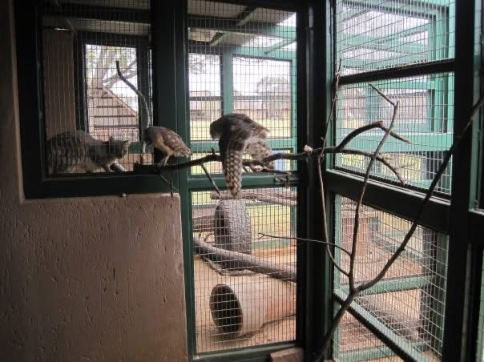
Discuss
Go back to your original group. Evaluate how your need (area of the Animal Welfare Act 2006 you looked at in your group earlier) is met for both the wildcat and the barn owl in this photograph.
Image source: resource producer’s own.
Notes:
Photograph is the resource producer’s own

Slide 30
Feedback from your discussions
The need for a suitable environment.
The need for a suitable diet.
The need to be able to exhibit normal behaviour patterns.
The need to be housed with, or apart from other animals.
The need to be protected from pain, suffering, injury
and disease.

Slide 31
2
Biosecurity and
disease prevention

Slide 32
Knowledge recap: Discussion
What are the five animal needs from the Animal Welfare Act 2006?
Explain a potential challenge animal keepers might face in meeting one of the five needs.

Slide 33
Session outline
Disease transmission.
What is biosecurity?
Biosecurity measures.
Examples of diseases in the animal industry.
Exploring biosecurity measures.

Slide 34
Disease transmission
Key terminology: look up definitions for the following terms:
    pathogen
    aetiology
    epidemiology.
In your pairs, list all the possible modes of disease transmission you can think of.
(2 minutes)
Online Egg Timer
Notes:
Collate a list on the whiteboard. Give each pair a whiteboard pen and ask them to come and add to the list.
Ensure to include: airborne, direct contact, vectors, fomites, food/water, body fluids

Slide 35
Modes of disease transmission
Aerosol: passed from animal to animal via droplets, coughing, sneezing.
Direct contact: animals come directly into contact with each other.
Oral: pathogenic agents are ingested – often through contaminated food or water.

Slide 36
Modes of disease transmission (cont.)
Fomite: contaminated inanimate object transmits disease from one animal to another; involves a secondary route to enter the host, e.g. shovels, grooming brushes.
Vector-borne: an insect transmits the disease from one animal to another.

Slide 37
Disease transmission
Infectious disease: a disease caused by an organism such as viruses, bacteria, fungi or parasites.
Contagious disease: a disease that can be passed between animals.
Zoonotic disease: a disease that can be passed from animal to human.
Notifiable disease: a disease that is required, by law, to be reported to the Animal and Plant Health Agency (APHA).

Slide 38
What is biosecurity?
In pairs, write down what you understand by biosecurity.
(1 minute)
Online Egg Timer

Slide 39
Biosecurity definition
“Biosecurity is the prevention of disease-causing agents entering or leaving any place where they can pose a risk to farm animals, other animals, humans, or the safety and quality of a food product”
(Biosecurity | Department of Agriculture, Environment and Rural Affairs, 2025)

Slide 40
Biosecurity measures
Four main categories:
  Personal protective equipment (PPE)
  Personnel practices
  Working practices
  Facility design

Slide 41
Task: Biosecurity measures
Competition time!
In your pairs, list all the biosecurity measures you can think of.
(1 minute)
Online Egg Timer
Who has the most on their list?

Slide 42
Biosecurity measures and PPE
  Limited personnel/visitors
  Gloves
  Overalls
  Disposable aprons
  Face masks
  Foot dips
  Change footwear/shoe covers

Slide 43
Biosecurity control measures
  Handwashing
  Wheel washes / vehicle cleaning
  Isolation / quarantine procedures
  Separate equipment
  Disinfection of equipment
  Routine health testing

Slide 44
Biosecurity group task
Group 1: Dog kennels (dogs)
Group 2: Farm park (focus on pigs)
Group 3: Cattery (cats)
Group 4: Bird park (birds)

Slide 45
Group task: Phase 1 (15 minutes)
Research and complete the first three columns only of the table:
  Name of disease (common diseases in that species).
  Transmission details (infectious, contagious, zoonotic, notifiable).
  Transmission mode.

Slide 46
Group task: Phase 2 (15 minutes)
Swap sheets:
Group 1: Bird park (birds)
Group 2: Dog kennels (dogs)
Group 3: Farm park (focus on pigs)
Group 4: Cattery (cats)
Research and add information to columns four and five:
  Prevention (biosecurity, vaccination, anything else?)
  Biosecurity measures

Slide 47
Group task: Phase 3 (10 minutes)
Swap sheets:
Group 1: Cattery (cats)
Group 2: Bird park (birds)
Group 3: Dog kennels (dogs)
Group 4: Farm park (focus on pigs)
Evaluate your peers’ suggestions for biosecurity measures for each disease. Will the measures work effectively? Would you add or change anything?

Slide 48
True (stand up) or false (sit down)
Biosecurity refers to the way in which a disease passes between animals.
A zoonotic disease is a disease which can pass from animal to human.
Wearing a face mask will prevent the spread of avian influenza between birds.
A fomite is an inanimate object which can transmit disease between individuals.
Canine parvovirus is an example of a notifiable disease.
Notes:
False
True
False
True
False

Slide 49
True (stand up) or false (sit down) (cont.)
A zoonotic disease must be reported to the Animal and Plant Health Agency (APHA).
An infectious disease is always contagious.
Isolation facilities should be located at the front of the facility and serviced before other animals as these animals are ill.
A double door or airlock system facilitates good biosecurity.
Avian influenza is a notifiable disease.
Notes:
False
False
False
True
True

Slide 50
3
Analyse case studies (to apply learning around the five needs and biosecurity)

Slide 51
Knowledge recap
In pairs:
Partner A explain the term biosecurity.
Partner B explain three modes of disease transmission.
Partner A explain the term zoonotic disease.
Partner B explain what a notifiable disease is.

Slide 52
Session outline
Considering biosecurity and disease prevention in enclosure design.
Analysing potential conflict between the five animal needs and biosecurity measures.

Slide 53
Biosecurity and enclosure design
In your pairs, create a mind map of enclosure features that will have an impact on biosecurity measures.
Add one of the features from your mind map to
the whiteboard.
Notes:
Create a mind map on the whiteboard: Enclosure features that impact biosecurity measures.
Have each pair of learners add one of their ideas.
Ensure to include the following: materials, location of enclosure, location of windows and doors.

Slide 54
Biosecurity measures and the five animal needs
Complete a table, discussing the five animal needs, the biosecurity measures and how that affects animal needs.
Use the table on the next slide to help you set out your page.

Slide 55
Biosecurity measures and the five animal needs
Using the handout, complete the table below. The first of the five needs has been completed for you.
Need | Biosecurity measures | Affect on need
Housed with or apart from other animals | Working practices | Isolation / quarantine for social living animals

Slide 56
Case studies
In your groups, design a temporary enclosure for the animals in the scenario you are given.
You should consider all aspects of biosecurity, including location, design and materials for your enclosure.
You do not need to worry about costings for anything.

Slide 57
4
Understanding and writing
a biosecurity protocol

Slide 58
Session 4 outline
What is a biosecurity protocol?
Review a biosecurity protocol.
How to write professionally.

Slide 59
Biosecurity considerations
When writing a biosecurity protocol, we need to consider:
how diseases can be introduced to an area and take steps to prevent that
what we should do if there is an outbreak of a disease.
A protocol should provide guidance that members of staff and the public can follow to prevent disease spread and ensure hygiene is met.

Slide 60
Key components
Control of access
Personal protective equipment
Cleaning and disinfection
Animal movement
Health monitoring and record keeping
Training and awareness

Slide 61
Control of access
Who can enter the facility?
  Staff
  Owners
  Vets
What barriers are in place to restrict access?
  Gates
  Fences
  Netting over enclosures

Slide 62
Personal protective equipment (PPE)
In pairs, using the handout provided, write down all of the PPE that you can think of.
Next to it, write down the purpose of the PPE.
Discuss your findings as a group.

Slide 63
Cleaning and disinfection
Frequency
  Regular cleaning?
Cleaning equipment
  What should be used to clean equipment?
  How often should equipment be cleaned?
How to deal with an outbreak
  Full clean?
  Change of enclosure?

Slide 64
Animal movement
Quarantine protocol
  New animals: how long should they be kept separate?
Isolation protocol
  What should they do if an animal is sick?
  Do animals in direct contact with each other need to be kept separate?
  What are the differences between isolation and quarantine?

Slide 65
Health monitoring and record keeping
Regular health checks
Accurate records
In small groups, discuss what records are kept on our animal centre.

Slide 66
Training and awareness
Staff awareness of following protocols:
training staff to follow protocols properly.
Familiarity in disease presence and identifying outbreaks: having staff who are suitably qualified to identify ill animals.

Slide 67
Task
Using the biosecurity protocol given to you, evaluate its suitability for purpose (see SMART requirements on next slide).
Discuss with the person next to you.
Extension task: Make recommendations that can be used to improve the protocol.

Slide 68
Evaluating
When assessing the protocol, does it meet the SMART approach?
Specific
Measurable
Achievable
Realistic
Time-constrained

Slide 69
Writing a biosecurity protocol
In pairs, look at the biosecurity protocol and identify the different features of this style of writing.
Think about:
  features of the layout (how the page and individual sections are set out).
  the audience and its purpose. (What does this mean for the language and style used? What needs to be included?)

Slide 70

Professional writing
Watch the video:
Notes:
The closed caption feature within PowerPoint can be used for the hearing impaired when watching this video.
There is also a transcript available of this video.

Slide 71
Using AI to help
Set goals: know what you want artificial intelligence (AI) to help you with (assistance, not reliance,).
Know limits: AI isn’t perfect – double-check your work.
Notes:
Aim for AI percentage to be less than 50%.
Tutor to model using selected AI to demo to students and then run through Grammarly to show how this works. (Grammarly is linked to the text ‘Check work’ on the next slide.)

Slide 72
Using AI to help (cont.)
Inform and enhance your own writing:
  Your work should still be in your own words.
  Combine with your own skills for better results.
  Check language (American is often used).
Be safe:
  Use AI responsibly (always aim for less than 20% in your general work).
  Check work. At this stage, while learning, you must be under 50%.

Slide 73
Task: Biosecurity
Going back to the previous lesson, create a biosecurity protocol for your case study (bird park or kennels), assisted by AI.
It should be professionally written and consider the following:
  How can you limit entry of disease?
  What type of PPE prevents contamination?
  How do we ensure equipment and areas are clean?
  How do we ensure new animals are safe?
  Check through using www.grammarly.com/.

Slide 74
Biosecurity homework
Complete and submit your biosecurity protocol.
Remember:
  professionally written
  AI use under 50%

Slide 75
5
Apply animal handling and capture techniques

Slide 76
Session 5 outline
Considerations for handling animals.
Why do we handle animals?
Different methods of handling.

Slide 77
Considerations for handling
On the sticky note, write down something we need to account for before we try and handle animals.
Then stick it to the board.

Slide 78
Considerations
What do we need to consider before we handle or try and capture animals?
  Individual animal: age
  Species: predator/prey
  Enclosure: ease of smooth transition

Slide 79
Considerations: Prey animals
  Slow movements.
  Don’t chase around the cage.
  Rubbing hands in their substrate can help you to smell familiar and reduce stress.
  Your own confidence and smell.

Slide 80
Why do we handle animals?
On the sticky note, write down a reason we may need to handle animals.
Then stick it to the board.

Slide 81
Handling versus capture
We may not always be able to physically handle animals.
  Handle:
    small mammals
    domestic/companion species.
  Capture:
    exotic species.
    May need chemical assistance, e.g. darting.

Slide 82
Task: Zoo animals
Think back to when you went to the zoo.
  How easy would it be to capture the animal in the enclosure?
  Would the animal be easy to dart from everywhere in the enclosure? Is there anywhere the animal could hide?
  If chemical help was needed, could the handler clearly
  access the animal before and afterwards?

Slide 83
Task: Enclosure suitability
Visit the animal facilities and three enclosures for different taxa.
Complete the checklist on the next slide to determine the suitability of the enclosure.
Does the enclosure meet all five needs?

Slide 84
Enclosure considerations
How easy is it to capture the animal in the enclosure?
Can we handle the animal in its enclosure?
What is the least stressful method of capturing the animal?
Will the animal need transporting to be able to handle it?
If chemical help is needed, can you clearly access the animal before and after?

Slide 85
6
Identification, causes
and prevention of stress
in animals

Slide 86
Session 6 outline
Identification of stress.
Causes of stress.
Prevention of stress.

Slide 87
Task
Think about what stress means to you.
On one of the sticky notes, write a definition of stress.

Slide 88
What is stress?
A state of mental or emotional strain or tension resulting from adverse or demanding circumstances.
Stress occurs when animals have to make extreme or prolonged physiological and behavioural adjustments to cope with their environment.
Stress in animals is when they feel worried, scared or uncomfortable because something around them is not right.

Slide 89
Causes
Fear or danger: animals can get stressed if they feel threatened.
Needs not being met. (Remember our previous lessons.)
Changes in environment: moving to a new place, being separated or changes in surroundings.

Slide 90
Prevention
Provide a safe environment: consider housing of predator and prey species.
Meet basic needs. Are the five needs being met?
Socialisation and routine: being consistent and establishing routines.

Slide 91
Identification
Visual: What changes do you see in the animal?
Auditory: What will you hear?
Olfactory: Will smells change?
On a sticky note, write a sign you have seen of an animal in stress.

Slide 92
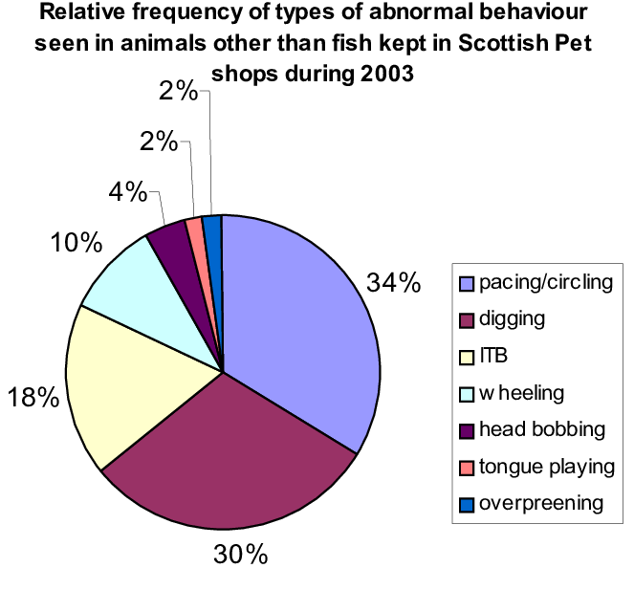
Measuring stress
Using graphs to measure stress-related behaviours.
What is the most common behaviour seen?
What is the least common behaviour seen?
Notes:
Casamitjana, J. (2003) CAGED TO SELL; A study of animal related problems found in Scottish pet shops in the year 2003.

Slide 93
Task: Stress analysis
In small groups, analyse and discuss the graph you have been given.
Summarise in one or two sentences what the graph shows.

Slide 94
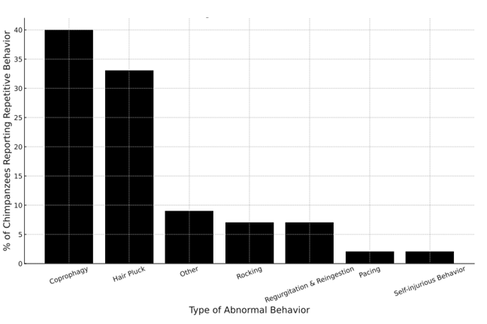
Example 1: Feedback
Notes:
Jacobson, S.L., Ross, S.R. & Bloomsmith, M.A., 2016. Characterizing abnormal behavior in a large population of zoo-housed chimpanzees: prevalence and potential influencing factors. PeerJ, 4, e2225. Available at: https://doi.org/10.7717/peerj.2225

Slide 95
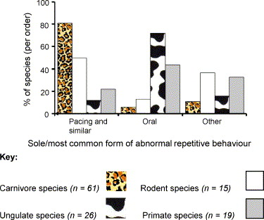
Example 2: Feedback
Notes:
Mason, G., Clubb, R., Latham, N. & Vickery, S. (2007) 'Why and how should we use environmental enrichment to tackle stereotypic behaviour?', Applied Animal Behaviour Science, 102(3-4), pp. 163-188.

Slide 96
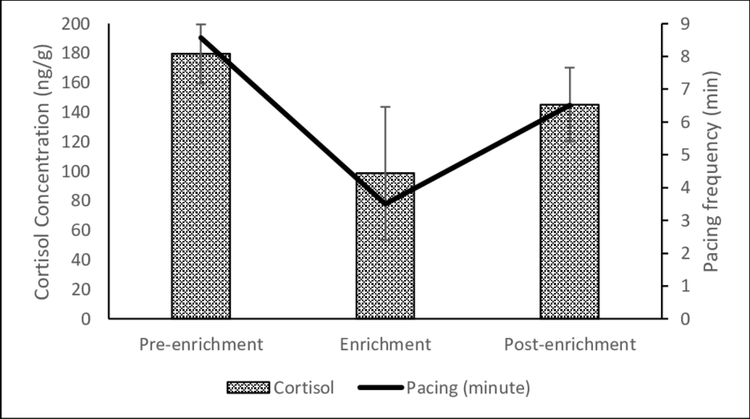
Example 3: Feedback
Notes:
Abdul-Mawah, S.S., Chor-Wai, L., Jasnie, F., Norma-Rashid, Y. and Ramli, R. (2022) ‘Effects of environmental enrichment on behaviours and faecal glucocorticoid levels in captive sun bear (Helarctos malayanus)’, IOP Conference Series: Earth and Environmental Science

Slide 97
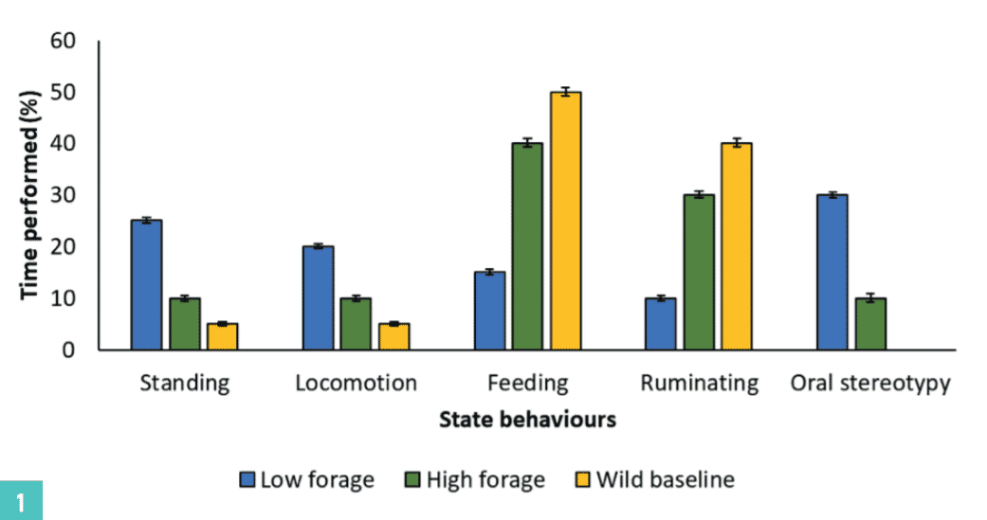
Example 4: Feedback
Notes:
Rose, P. (2019) ‘Keep tabs on behaviour to boost welfare’, Veterinary Practice, 10 June. Available at: Veterinary Practice

Slide 98
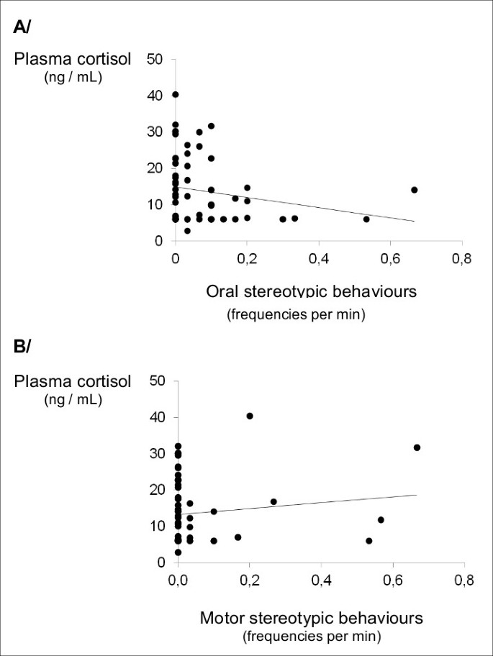
Example 5: Feedback
Notes:
Fureix, C., Benhajali, H., Henry, S. et al. Plasma cortisol and faecal cortisol metabolites concentrations in stereotypic and non-stereotypic horses: do stereotypic horses cope better with poor environmental conditions?. BMC Vet Res 9, 3 (2013). https://doi.org/10.1186/1746-6148-9-3

Slide 99
Reducing stress and animal enrichment
Task:
Choose a species and a form of enrichment from each pot and design a piece of enrichment that could be used.
https://youtu.be/dYixEGI5KvE
Notes:
The closed caption feature within PowerPoint can be used for the hearing impaired when watching this video.
There is also a transcript available of this video.

Slide 100
7
Animal welfare

Slide 101
Session 7 outline
What is welfare?
Good and poor welfare.

Slide 102
What is welfare?
What does welfare mean?
Write on your sticky notes what this word means to you.

Slide 103
Welfare definition
According to the British Veterinary Association, animal welfare is:
“the physical and mental state of an animal in relation to the conditions in which it lives and dies”.

Slide 104
Group discussion
In your groups, discuss the following:
  Is good welfare meeting the five animal needs at all times?
  When the five needs are not being met, is this poor welfare?
  Is it possible to meet all five needs at all times?

Slide 105
Signs of good welfare
Physical | Behavioural
Healthy body condition (weight, coat, skin). | Engaging in natural behaviours.
Clear eyes, ears and nose. | Active and curious.
Normal gait and posture. | Positive interactions.

Slide 106
Task: Signs of poor welfare
Having discussed the signs of good welfare, create a table like the one on the last slide to show the physical and visual indicators of poor welfare.

Slide 107
Monitoring welfare
By constantly monitoring an animal’s physical and behavioural health, we get an overview of its welfare.
What could we use to monitor and record physical and behavioural health and welfare?

Slide 108
Creating good slides
Keep it simple.
Professional layout.
Visuals should support content, not distract.
Font should be legible and accessible.
Limit text – use bullet points and short phrases.
Slides should complement what you are saying.
Use bold or different colours to emphasise critical information.
Check consistency.

Slide 109
Presentation task (30 minutes)
In allocated pairs, research your given animal.
Prepare a five-minute PowerPoint presentation on the signs of good and poor welfare in your animal, including both physical and behavioural indicators.
You will then present this to the rest of the class.
Notes:
Tutor to allocate each pair an animal.

Slide 110
8
Building materials and enclosure design

Slide 111
Session 8 outline
Evaluate enclosure suitability.
Discuss building materials.

Slide 112
Evaluate the enclosure
Consider:
five needs
biosecurity
welfare
capture and handling
stress
good and bad aspects of the enclosure
suitability of building materials.

Slide 113
Building materials
In your groups, fill in the table for your building material.
Consider pros and cons including:
  costs
  animal security
  animal safety
  human health and safety
  ease of cleaning
  what animals this is suitable for.
  Feed back to the class.

Slide 114
Measuring
You will be using a tape measure to measure in centimetres. Once the number turns red, it is then identifying that the one metre point has been reached.
You will need to measure:
  length (the longest side of the enclosure)
  width (the shortest side of the enclosure)
  area (length multiplied by width).
Try measuring the table in front of you and calculating the area.

Slide 115
Task: Bird’s eye enclosure
Visit the animal facilities and, in pairs, choose one enclosure.
Draw a bird’s eye view plan of the enclosure including
(not-to-scale) measurements.
You should include:
  position of all fixtures and fittings
  building materials
  items within the enclosure.

Slide 116
Annotate designs
Stick your design in the middle of the flipchart paper and annotate it with your evaluation of the following:
  the five needs
  biosecurity
  welfare
  capture and handling
  stress
  suitability of building materials.

Slide 117
Homework
From your annotations, suggest:
two improvements
one piece of enrichment.
These suggestions should enhance the enclosure.

Slide 118
9
Design an effective enclosure and rationale around a given brief

Slide 119
Session 9 outline
Consolidate learning from all lessons so far.
Begin designing an animal building.
Peer reviews.

Slide 120
Group design task
You have been allocated to design groups of three for this project.
You will be required to:
  read the design brief for the task
  research the species (15 minutes).

Slide 121
Designing
  Design a building which fits the brief and takes into account:
  the five needs
  biosecurity / prevention of disease
  handling and capture techniques
  good vs. poor health and welfare
  stress prevention and identification.
  (45 minutes)

Slide 122
Peer evaluation
Spend 20 minutes visiting one other design and complete the peer review form.
This should be constructive and useful to other groups.

Slide 123
Looking at feedback from peers
Think about how you can redraft and amend your design to take into account the feedback given.
  Final designs will be completed in the next session.

Slide 124
10
Evaluation of designs
and peer review

Slide 125
Session 10 outline
Complete building designs.
Discuss suitability of designs.
Review and reflect.

Slide 126
Final designs
You have 65 minutes to create your final designs.
Remember to:
  refer to your design brief frequently
  add dimensions
  add labels/annotations to justify the decisions you have made.

Slide 127
Discussion
  Animal welfare
  Suitability
  Access and usability
  Feasibility
  Building materials

Slide 128
Final thoughts: Roll a dice…
State one aspect of your enclosure design that has been designed to reduce stress in your animal.
How have you encouraged normal behaviour within one
of your species?
What have you put into your design to ensure biosecurity?
Name one building material you chose and explain why.
How have you designed your enclosures to reduce
stress for capture?
Identify one aspect that ensures good welfare.

Slide 129


Acknowledgements
PRODUCED BY
FUNDED BY
WCG has produced this resource on behalf of the Education and Training Foundation
This programme is funded by the Department for Education
ET-FOUNDATION.CO.UK

