Slide 1
Underpinning excellence
Presenter name
Time and date
Location

Slide 2
Content page
01 Succession Planning
02 Recruitment channels
03 Need for structured recruitment process
04 Structured recruitment processes
05 Selection interview
06 Ways of working
07 Quantitative analysis
08 Qualitative analysis
09 Presentation

Slide 3
Lesson 01
Succession planning

Slide 4
Purpose of recruitment
Recruitment definition: The process of actively seeking out, finding and hiring candidates for a specific position or job.
Selection definition: The action or fact of carefully choosing someone or something as being the best or most suitable.

Slide 5
Recruitment process factors
Job requirements Recruitment channels Diversity and inclusion Legal compliance Company culture fit Interview process Background checks Candidate experience | Cost considerations Internal resources Time constraints Salary and benefits Employee referrals Succession planning Onboarding process
Notes:
These are factors that businesses typically consider during the recruitment process.
Job requirements
Assessing skills, qualifications and experience needed for the role.
Recruitment channels
Identifying suitable channels for advertising job openings.
Diversity and inclusion
Promoting equal opportunities for candidates from diverse backgrounds.
Legal compliance
Adhering to employment laws and regulations for fair and legal practices.
Company culture fit
Evaluating whether candidates align with the company's values and culture.
Interview process
Designing an effective interview process with appropriate questions.
Background checks
Conducting checks to verify the accuracy of a candidate’s credentials.
Candidate experience
Providing a positive experience for candidates throughout the process.
Cost considerations
Evaluating the costs associated with recruitment, including advertising expenses.
Internal resources
Assessing availability and capacity of internal resources for onboarding.
Time constraints
Considering the urgency to fill the position and time constraints in recruitment.
Salary and benefits
Determining a competitive compensation package based on industry standards.
Employee referrals
Encouraging and considering referrals from existing employees.
Succession planning
Considering how the candidate fits into long-term organisational goals.
Onboarding process
Planning for a smooth onboarding process to integrate new hires effectively.

Slide 6
Homework
What did you find out about Macildowie?

Slide 7
Case studies
Read the two case studies.
Any questions about the terminology?
List the considerations and factors that you can see in the case studies.
Contribute to a class discussion.
Education and Training Foundation

Slide 8
Group work
Individually, read “What if” scenario 1.
In small groups, write an answer for “What if” scenario 1 on the flipchart paper.
This will be followed by a class discussion.
Education and Training Foundation
Notes:
Use the following notes to set probing questions that encourage learners to continue their thinking:
Implementation
Immediate recruitment drive: ABC Electronics launches an urgent recruitment drive to hire skilled workers for various production roles, including assembly line workers, quality control inspectors and logistics staff.
Step
Action
1
Assessment of staffing needs
Collaborate between human resources and production teams to identify specific roles and staffing requirements.
Develop a detailed workforce plan for assembly line workers, quality control inspectors and logistics staff.
2
Job advertisement and posting
Create job advertisements emphasising urgency, company benefits and required skills.
Post ads on the company website, job boards and industry-specific platforms.
3
Utilisation of recruitment agencies
Partner with recruitment agencies specialising in manufacturing and electronics.
Align search criteria with the company’s requirements.
4
Online application and screening
Set up a user-friendly online application system.
Conduct initial screening based on qualifications and experience.
5
Interviews and skills assessment
Invite shortlisted candidates for interviews and skills assessments.
Assess practical tasks or written tests to evaluate key abilities.
6
Offer and onboarding
Extend job offers with details on compensation and working conditions.
Implement an efficient onboarding process for seamless integration of new hires.
Other considerations
Production facility expansion: In tandem with the recruitment efforts, the company explores options for expanding production facilities. This may involve leasing additional manufacturing space, investing in new machinery or optimising existing processes for efficiency.
Ongoing monitoring and adaptation: ABC Electronics implements a system for real-time monitoring of production metrics, customer feedback and market trends. This allows the company to adapt quickly to changes in demand and make informed decisions .
Is this given out to learners? Is it on the same page as the scenario? Probably better if this answer was on a slide deck or a separate page and resource title.​
Check all formatting. No, it is guidance for teachers.

Slide 9
Presentations
Read either “What if” scenario 2 or “What if” scenario 3.
Develop a presentation on the “What if” scenarios.
Education and Training Foundation
Notes:
“What if” scenario 2
Implementation
Strategic workforce planning:
Dante’s develops a flexible workforce plan that includes hiring temporary staff during peak seasons.
Cross-training existing staff members to handle multiple roles, ensuring adaptability during fluctuations.
Customer engagement:
Implementing a customer loyalty programme to incentivise repeat business.
Leveraging social media and online platforms to create buzz around seasonal promotions and special flavours.
Operational efficiency:
Optimising internal processes to handle increased foot traffic efficiently.
Investing in technology solutions, such as point-of-sale systems and online ordering platforms, to streamline operations.
Results
Dante’s Artisan Ice Cream successfully navigates the seasonal peaks by implementing a comprehensive strategy. The business not only meets the heightened demand but also enhances its reputation as a sought-after destination during peak tourism seasons. This case study highlights the importance of strategic planning and adaptability in managing seasonal variations, ensuring that Dante’s remains a beloved local establishment year after year.
“What if” scenario 3
Answer
Implementation
Skills assessment and gap analysis:
Conducting a thorough assessment of the current workforce’s skills and identifying gaps in emerging technologies, project management methodologies and client engagement.
Training and development programmes:
Implementing targeted training programmes to upskill existing employees in areas identified as crucial for upcoming projects.
Providing access to online courses, workshops and certification to enhance both technical and soft skills.
Strategic hiring:
Identifying key roles and skills needed for upcoming projects.
Launching a strategic hiring initiative to attract and onboard professionals with expertise in the identified areas.
Mentorship and knowledge sharing:
Establishing mentorship programmes where experienced team members share knowledge and guide less experienced colleagues.
Encouraging a culture of continuous learning and knowledge sharing in the organisation.
Collaboration with external experts:
Forging partnerships with external experts, consultants or industry leaders to provide specialised insights and guidance.
Collaborating with external training providers for customised programmes tailored to the company’s specific needs.
Results
Zeeshan’s Tech Solutions successfully addresses the identified skill gaps through a combination of strategic initiatives. The company’s workforce becomes more versatile, adept at handling complex projects and aligned with emerging industry trends. Clients notice the enhanced capabilities, leading to increased satisfaction and new growth opportunities. This case study demonstrates the importance of a proactive approach to talent development and strategic hiring to stay ahead in a rapidly evolving industry.

Slide 10
Presentations
As each group gives their presentations, prepare:
constructive feedback
questions to ask.
Education and Training Foundation

Slide 11
Homework
Carry out primary research on how your family and friends obtained their employment.
Education and Training Foundation

Slide 12
02
Recruitment channels

Slide 13
Recap
Let us see what you found out.
On sticky notes, put details of each of your primary research findings.
In groups of three or four, pool your notes. Aim to categorise them into different approaches.
What similarities and differences are there?
What is your opinion on this?

Slide 14
Definition
Recruitment channels refer to the various avenues or methods through which organisations attract, source and engage potential candidates for job opportunities.

Slide 15
Recruitment channels
Internal recruitment
Employer websites
Intranet
External recruitment / employment agency
Social media platforms
Events
Notes:
This slide contains the recruitment channels that are in the specification. However, teachers may want to refer to a wider selection, such as those below. Examples are also provided below for each recruitment channel so that the teacher can give this information if they wish.
Job boards: Indeed, LinkedIn Jobs, Glassdoor, Monster
Social media platforms: LinkedIn, Facebook Jobs, Twitter, Instagram
Company careers page: Direct applications through the company’s official website
Employee referrals: Recommendations from current employees
Recruitment agencies: Third-party agencies specialising in recruitment
Networking events: Job fairs, industry conferences, meet-ups
Professional associations: Membership organisations related to the industry
Internship programmes: Hiring from a pool of interns who have worked with the company
Temp agencies: Utilising temporary staffing services
Industry-specific websites: Niche job boards and websites dedicated to a particular industry
Print media: Newspaper and magazine advertisements
Headhunting / Executive search companies: Specialist companies focusing on high-level executive recruitment
Applicant Tracking Systems (ATS): Software systems that automate the recruitment process
Online communities and forums: Engaging with industry-related online communities
Podcasts and webinars: Participating in or hosting industry-related podcasts and webinars
In-house talent acquisition team: Internal team responsible for managing recruitment process

Slide 16
Activity
Read through the Recruitment channels scenarios and discuss the recruitment channel strategies that could be used.
Make notes in your notebook.

Slide 17
Activity
Following the discussion, complete the Review table worksheet with advantages and disadvantages of each recruitment channel.
You can now use this document for revision in the future.

Slide 18
Activity
Individually, read the case study information you have been given.
In small groups, discuss and complete the Case study worksheet.
Pass your completed Case study worksheet to another group that has been working on the same case study.
Give feedback to the other group. Review the feedback you are given.

Slide 19
Before you leave
Write something you have learnt on the board.

Slide 20
03
Need for structured recruitment process

Slide 21
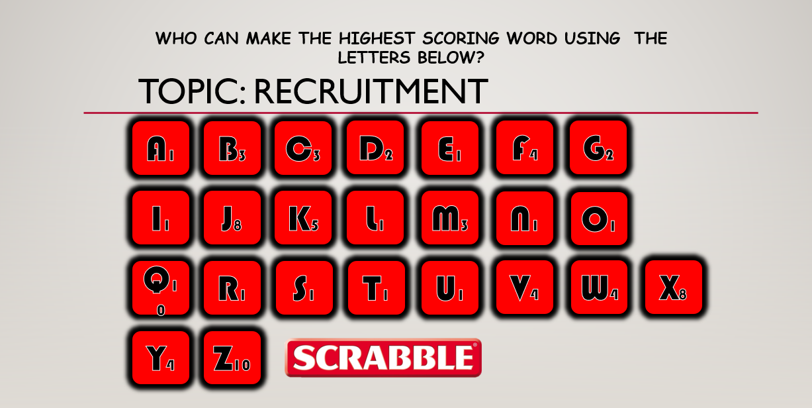
Starter

Slide 22
Exam question
A human resources consultant working at a budget supermarket chain is advising the company on their recruitment strategy. The company is grappling with a concerning rise in employee turnover.
Discuss one recruitment channel that could be used to support the company in recruiting permanent members of staff.
Write no more than two paragraphs.

Slide 23
Peer marking
Pass your answer to another learner. You will now mark the answer passed to you.
In the answer, highlight:
knowledge
application
analysis and evaluation.

Slide 24
Scenarios
You are to be in the same group as the last lesson.
Read the scenario and candidate profiles.
Carry out the role-play interview. You will each take on the role of interviewer, interviewee and observer.
Complete the relevant part of the Role-play crib sheet.

Slide 25
Reflection
Which candidate would you select? Why? Write your justification.
Discuss with others in the group. Try to get a consensus.
Reflect on your role as an observer. What are the key points to share? Discuss as a group.
Education and Training Foundation

Slide 26
Reflection
Write a reflection on the interview process using a laptop or tablet.
Write the advantages and disadvantages of the process followed in the role plays.
Education and Training Foundation

Slide 27
Implications of not having a structured recruitment process
Bias
Discrimination
Wrong person
Legal issues
Cost
Reputation
Education and Training Foundation

Slide 28
04
Structured recruitment processes

Slide 29
“Good” recruitment process
Clear job description: A well-defined job description that is accurate, informative and engaging. This attracts the right candidates and sets expectations from the start.
Defined requirements: Specifying the skills, experience and qualities you are looking for allows for focused sourcing and efficient evaluation.
Structured stages: A clear timeline and sequence of steps, from application to interviews and final decision.
Education and Training Foundation

Slide 30
Protected characteristics in recruitment practices – Equality Act 2010
Age
Disability
Gender reassignment
Marriage and civil partnership
Pregnancy, maternity
Race
Religion or belief
Sex
Sexual orientation

Slide 31
Benefits of a structured recruitment process
Complete the table on the benefits of a structured recruitment process.
Education and Training Foundation
Notes:
For companies
Objectivity and fairness: Minimises bias and ensures fair evaluation.
Improved hiring quality: Hiring the best candidate with the right skills and experience.
Reduced time and cost: Streamlines the process, minimises time spent on unsuitable candidates.
Enhanced candidate experience: A positive and predictable experience.
Compliance and legal protection: Reduces the risk of legal challenges by ensuring compliance with anti-discrimination laws.
For candidates
Transparency and trust: Provides clarity about the process and evaluation criteria.
Equal opportunity: Ensures candidates a fair chance to be assessed on merit.
Better decision-making: Candidates make informed decisions.
Positive impression: Reflects well on the company.

Slide 32
Key documentation required
Job description: Clearly outlines the responsibilities, required skills and experience, and company culture fit.
Application form: Collects initial information about the candidate’s education, experience and skills.
CV: Provides details of the candidate’s professional history and achievements.
Cover letter: This is optional, but it allows candidates to showcase their interest and suitability for the role.
Interview scorecard: Standardises candidate evaluation during interviews with defined criteria and rating scales.

Slide 33
Kyndra job description
Read the job description for Kyndra.
Compare the two application forms and make notes on the differences.
Be ready to discuss the differences and their importance.

Slide 34
CVs
Highlight the differences between the two CVs.
Be ready to discuss the differences and the importance of them.
Why do some companies decide NOT to use CVs as part of the recruitment process?

Slide 35
Homework
Create your CV.

Slide 36
05
Selection interview

Slide 37
Discussion
What do you think makes a good CV?
Notes:
The teacher can stop here and talk about CV parsing and other opportunities for AI.

Slide 38
Peer marking
Swap with the person next to you.
Use the CV marking template to give your peer a score.
Feed back to your peer.

Slide 39
Selection process
Interview questions.
Interview scoresheet.
Notify candidate if successful or not.
Notes:
This would be a good place for the teacher to pause and discuss AI support in the selection process. The teacher can discuss ATS systems, video interviews (e.g. one way video interviews) or psychometric tests.

Slide 40
Video
https://www.youtube.com/watch?v=-QXAG3AT1p0
Make notes on the video.
Be prepared to discuss with the class.
Notes:
The teacher can pause the video to ensure learners understand the information. That will also allow learners to ask further questions or seek clarity.

Slide 41
Group work
Create questions and a scoresheet for the interview using digital software.
Conduct interviews, using your questions and scoresheet.
Select a candidate. Give a justification for your choice.

Slide 42
Review the process
Write a reflection on the process you have followed.

Slide 43
Homework
Complete the following activities:
Management styles homework
Leadership styles homework
Work environments homework

Slide 44
06
Ways of working

Slide 45
Introduction
Homework
Leadership styles
Management styles
Working environments
Pass your completed homework to a peer. Review the homework you have been given against the handouts. Annotate the homework with any comments.
Highlight one learning point.

Slide 46
Quantitative analysis
Quantitative analysis means using numbers and data to understand and solve problems.
For example, say you want to find out how many students in your school prefer pizza over burgers. You could survey 100 students and count how many choose pizza and how many choose burgers.
That is quantitative analysis.

Slide 47
Qualitative analysis
Qualitative analysis involves examining non-numerical data to understand characteristics, behaviours or experiences. It focuses on exploring and interpreting meanings, patterns and themes in the data.
For example, in a study about students’ experiences with online learning, qualitative analysis might involve analysing interview transcripts to identify common themes such as challenges with technology, engagement in virtual discussions or preferences for certain teaching methods.

Slide 48
Types of questions
Closed questions
Open questions
Leading questions
Recall and process questions
Rhetorical questions
Divergent questions
Probing questions
Education and Training Foundation
Notes:
Closed questions: These are questions that typically require a short, specific answer; often a “yes” or “no”. They limit the respondent’s options and are useful for gathering factual information or narrowing down options.
Open questions: These are questions that prompt the respondent to provide a more detailed and expansive answer. They encourage discussion and allow the respondent to express opinions, feelings or thoughts freely.
Leading questions: These are questions that subtly guide or influence the respondent’s answer by suggesting a particular response. They can be used to steer the conversation in a desired direction but may introduce bias.
Recall and process questions: Recall questions are designed to test the respondent’s memory or ability to recall specific information. Process questions, on the other hand, prompt the respondent to explain how they arrived at a particular conclusion or decision.
Rhetorical questions: These are questions that are not meant to be answered but rather to make a point, provoke thought or emphasise a statement. They are often used for rhetorical effect in speeches or writing.
Divergent questions: These are questions that encourage creative and innovative thinking by exploring multiple possible answers or perspectives. They encourage brainstorming and idea generation.
Probing questions: These are questions that seek to delve deeper into a topic by eliciting more detailed or nuanced responses. They are used to explore complex issues, uncover underlying motivations or clarify ambiguous points.
Ask learners to give examples of when each type of question might be used and implications of using this type of question when it is not appropriate.

Slide 49
Definition
Managers are often required to be leaders, as the two functions go hand in hand.
But in the business world, there is a distinction between being a manager and being a leader.
Manager: A person responsible for controlling or ordering an organisation or group of staff.
Leader: Someone who inspires passion and motivation in followers.

Slide 50
Managers vs leaders
Match these tasks and responsibilities to the leader or manager column:
planning; envisioning; influencing stakeholders; controlling; monitoring; inspiring; delegating; organising; energising; coordinating; determining the route to achieving success.
Functions of leaders
Functions of managers
Education and Training Foundation

Slide 51
Activity
Complete the Leadership styles form.
Complete the online leadership survey.
Update the Leadership styles form.
Work in groups to redraft the Online survey questions. Write your questions on a flipchart.
Education and Training Foundation
Notes:
When learners have completed the revised questions, they put the flipchart paper on a wall or leave it on their table. They then circulate to see what questions others have written and annotate these with comments.
This is then followed by a discussion regarding learning points.

Slide 52
Management styles
Directive
Authoritative
Participative
Pacesetting
Delegative
Education and Training Foundation

Slide 53
Activity
Read Kyndra’s leadership scenarios.
Write your response to the question.
Education and Training Foundation
Notes:
When the writing task has been completed, collect the responses to provide written feedback at a later date.
Ask the following questions, selecting a different learner to answer each of them:
Identify the leadership style.
Identify the characteristics that led to the conclusion.
Identify the staff that are motivated by the leadership style.
Explain why they are motivated, based on information provided.
Identify the staff that are not motivated by the leadership style.
Explain why they are not motivated, based on the information provided.
Is the leadership style effective?
What information leads to that conclusion?

Slide 54
Work environments
Traditional office environment
Remote work environment
Hybrid work environment
Flexible work environment
Collaborative work environment
Competitive work environment
Creative work environment
Punitive work environment
Education and Training Foundation

Slide 55
Activity
You are working in groups allocated either the Kyndra or Macildowie case study.
Read the information individually. Discuss in groups the management style that should be used. Produce a written justification.
Education and Training Foundation
Notes:
When the activity has been completed, each group shares one key justification.

Slide 56
Activity
Working in your new group, share one key justification with your new group members.
Agree an action plan for effective management.
Education and Training Foundation

Slide 57
Industry Placement questionnaire
What information do you want to collect about your Industry Placement employer in relation to:
leadership styles
management styles
working environments?
Draft the questions that will provide you with qualitative and quantitative data.
Education and Training Foundation
Notes:
Collect the questions in when complete and provide feedback before the learner goes to their Industry Placement.

Slide 58
07
Quantitative analysis

Slide 59
Quantitative analysis
Quantitative analysis means using numbers and data to understand and solve problems.
For example, say you want to find out how many students in your school prefer pizza over burgers. You could survey 100 students and count how many choose pizza and how many choose burgers.
That is quantitative analysis.

Slide 60
Definition
Qualitative analysis involves examining non-numerical data to understand characteristics, behaviours or experiences. It focuses on exploring and interpreting meanings, patterns and themes in the data.
For example, in a study about students’ experiences with online learning, qualitative analysis might involve analysing interview transcripts to identify common themes such as challenges with technology, engagement in virtual discussions or preferences for certain teaching methods.

Slide 61
Activity
Working in pairs, review the questionnaires that were used on the Industry Placement. Categorise the questions.
Which will produce quantitative data?
Which will produce qualitative data?

Slide 62
Staff food preferences
Notes:
The data can be amended to the learner’s preferences and abilities.
Discussion around what the bar chart shows.

Slide 63
Places staff have been on holidays
Notes:
The data can be amended to the learner’s preferences and abilities.
Discussion around what the pie chart shows.
Differences between pie chart and bar chart.

Slide 64
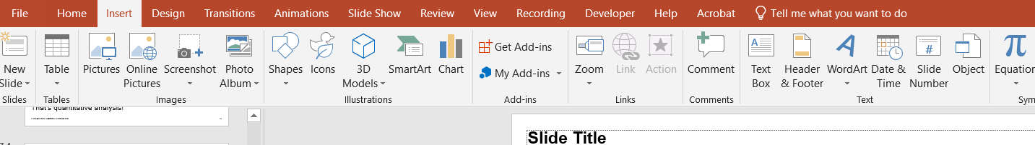
How to find Chart icon on Powerpoint
Click Chart

Slide 65
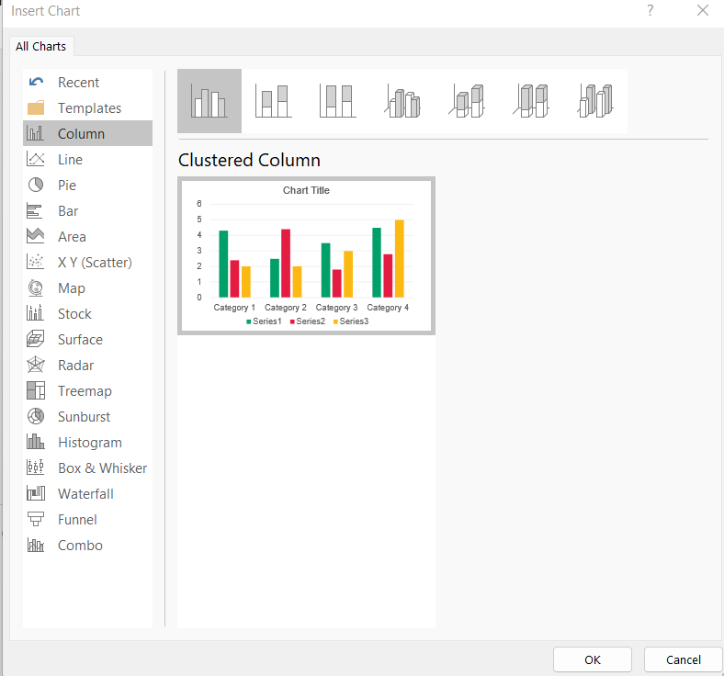
Clustered Column
Notes:
Point out that learners should select pie chart.

Slide 66
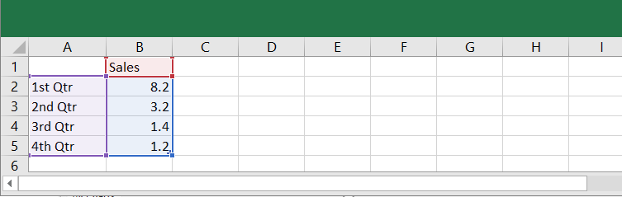
Education and Training Foundation
Notes:
Teacher will explain how the information can be changed to produce charts, e.g. titles may show sales in £ or sales for 2024-25, etc.
The teacher can show various types of charts for this section.

Slide 67
Your turn
You need to create a pie chart or a bar chart on the below data.
Website clicks per hour on the morning of a specific date:
8am to 9am 57
9am to 10am 112
10am to 11am 197
11am to noon 103
Notes:
Teacher to give the learners the information about the date and the organisation for headings.
When learners have created their pie chart or bar chart, ask the following questions:
What does the data show?
How can the data be used?
How do bar charts and pie charts help you to use the data more effectively?

Slide 68
Benefits of using quantitative analysis
Objectivity
Accuracy
Comparability
Trend identification
Data visualisation
Evidence based decision-making
Scalability
Predictive analytics
Notes:
The teacher can provide examples from the previous task to show how quantitative analysis can be beneficial.

Slide 69
Activity
Produce charts for the quantitative data you have collected from your Industry Placement.
Produce an analysis of the quantitative data you have collected from your Industry Placement.

Slide 70
Something you have learnt today
Write something on the board that you have learnt in today’s lesson.

Slide 71
08
Qualitative analysis

Slide 72
SMART targets
Review your feedback on the chart analysis completed previously.
Write two SMART targets in your notebooks on how you intend to improve your quantitative analysis skills.

Slide 73
Definition
Qualitative analysis involves examining non-numerical data to understand characteristics, behaviours or experiences. It focuses on exploring and interpreting meanings, patterns and themes in the data.
For example, in a study about students’ experiences with online learning, qualitative analysis might involve analysing interview transcripts to identify common themes such as challenges with technology, engagement in virtual discussions or preferences for certain teaching methods.
Notes:
This is recap. This could be followed by an open question: “How is this different to quantitative analysis?”

Slide 74
How is qualitative data presented?
For example:
Story accounts
Report
Illustrative quotes or extracts from the data
This can be done in written form, such as in a research report or academic paper, where findings are organised into sections based on key themes or categories identified during analysis.

Slide 75
Qualitative analysis scenario
Look at the first scenario you have been allocated and answer the questions on the document.
Move to the next table and the next scenario. Add comments to what is there.
Move to the next table and the next scenario.
Education and Training Foundation
Notes:
Following three rounds of looking at scenarios, lead a discussion regarding the key learning points.

Slide 76
Benefits of qualitative analysis
Provides in-depth insights
Facilitates exploration
Flexibility and adaptability
Contextual understanding
Participant perspectives
Theory development
Complementary to quantitative data
Notes:
Benefits of using qualitative analysis
Provides in-depth insights: Qualitative analysis allows for a deeper understanding of complex phenomena by capturing rich and detailed data.
Facilitates exploration: Qualitative methods enable researchers to explore diverse perspectives, experiences and contexts, uncovering nuanced insights that quantitative methods may overlook.
Flexibility and adaptability: Qualitative analysis techniques can be adapted to suit the unique needs of the research context, allowing researchers to adjust their approach as new information emerges.
Contextual understanding: Qualitative analysis emphasises the context in which data is collected, providing a holistic view of the subject under study and helping researchers to interpret findings in their broader context.
Participant perspectives: Qualitative analysis prioritises the voices and experiences of participants, giving them a platform to share their stories, beliefs, and perceptions.
Theory development: Qualitative analysis contributes to theory development by generating hypotheses, concepts and frameworks grounded in empirical data, enriching our understanding of social phenomena.
Complementary to quantitative data: Qualitative analysis complements quantitative data by offering depth and context to numerical findings, enhancing the overall rigour and validity of research outcomes.

Slide 77
Structuring a report to analyse qualitative data
Title page
Abstract
Introduction
Methodology
Findings
Discussion
Conclusion
References
Notes:
Title page:
The title page should include the title of the report, the author’s name, the date of submission and any other relevant information required by the institution or organisation.
Abstract:
The abstract provides a summary of the entire report, including the research question, methodology, key findings and conclusions. It should be concise and informative, typically around 150-250 words.
Introduction:
The introduction sets the stage for the report by introducing the topic, providing background information and stating the research question or objectives. It should also explain the significance of the research and outline the structure of the report.
Methodology:
The methodology section describes the methods used to collect and analyse the qualitative data. It should include details about the research design, data collection techniques (such as interviews or observations), sampling methods and data analysis procedures. This section should be clear and comprehensive to allow for replication of the study.
Findings:
The findings section presents the results of the qualitative analysis. It should include a detailed description of the themes, patterns and insights that emerged from the data. Use quotes, excerpts or examples from the data to illustrate key findings. This section may also include tables, charts or other visual aids to enhance understanding.
Discussion:
The discussion section interprets the findings in the context of the research question or objectives. It should analyse the implications of the findings, discuss any unexpected or contradictory results, and compare them to existing literature or theories. This section should also address the limitations of the study and suggest areas for further research.
Conclusion:
The conclusion summarises the main findings of the report and reiterates their significance. It should also reflect on the overall research process, discuss any implications for practice or policy, and offer recommendations for future research or action.
References:
The references section lists all the sources cited in the report. Make sure to include full bibliographic details for each source to allow readers to locate them. Learners can be asked to collect some information from their placements’ websites.

Slide 78
Activity
Select one of your survey questions that required qualitative responses. Analyse the responses received and produce a written analysis for that question.
Pass your written analysis to a peer for feedback.

Slide 79
Homework
Produce your full report based on the research you carried out through your Industry Placement.

Slide 80
Review
Using 20 words or less, write down something you have learnt from this lesson.

Slide 81
09
Presentation

Slide 82
Industry Placement survey reports
You are allocated a report written by one of your peers.
Read the report.
Use the Peer marking report sheet to provide feedback to your peer.

Slide 83
Presentations
Create a five-minute presentation based on the data you collected from the questionnaires during your Industry Placements.
You should be prepared for up to 10 minutes of questions following your presentation.
Notes:
The teacher tells the learners to use the information they gathered to create an engaging and informative presentation.
The teacher asks the learners to ensure their presentations are well-structured, include relevant visuals and effectively communicate their findings.
Your response was:
How would this support ESP? Is there potential for some students to be presenting and some recording? Would that work better?
That is not the purpose of the lesson (ESP), and you have indicated that there are other presentations for ESP.
Lesson amended

Slide 84
Presentation feedback sheet
You are now in small groups.
On your table is a laptop. You need to load your presentation onto the laptop.
Give your presentation. Your peers will ask you questions after your five-minute presentation. They will also complete the Presentation feedback sheet.
Each person in your group will give a presentation.

Slide 85
SMART target
Review the feedback you received from your peers. Synthesise the feedback and write a summary in your notebook.
Write a SMART target for something you would like to improve on in your presentation.

Slide 86


ET-FOUNDATION.CO.UK
PRODUCED BY
FUNDED BY
(Provider Name) has produced this resource on behalf of the Education and Training Foundation
This programme is funded by the Department for Education

