Slide 1
T LEVEL IN DESIGN, SURVEYING AND PLANNING FOR CONSTRUCTION
Supporting the development of contextualised Core Skills – Communication

Slide 2
1
Thinking like a stakeholder

Slide 3
Stakeholder starter task
Who is a stakeholder for a construction project?
Consider a new housing development.
  Who might be affected?
  Who may be hired?
Education & Training Foundation

Slide 4
Stakeholder card sort
Situation: Development of a bypass of a small village
Match the stakeholders with the correct vested interest description.
Education & Training Foundation

Slide 5
Task: stakeholder case studies
The project will involve multiple stakeholders, each with different interests and concerns.
Identify the stakeholders and their vested interests for your allocated case study.
Education & Training Foundation

Slide 6
Conveying confidence
  Use of a confident tone is important during a presentation as this leads to confidence in the audience, which can persuade a client or stakeholder to engage with the project.
  Examples of a confident tone:
    clarity and appropriate pace
    assertive projection of voice
    variable pace with inflection
    strategic pausing
    no filler words.

Slide 7
Avoiding a negative tone
An apprehensive or nervous tone can cause stakeholders and clients to become more defensive and withdrawn.
Examples include:
  use of filler words
  rambling without focus
  inappropriate pace
  quiet presentation or mumbling.

Slide 8
Use of terminology
  Use of phrases such as ‘to make you aware’ and ‘risks include’ may close off the audience as they may focus on this content rather than the next section.
  Use of phrases such as ‘the benefit of’ and ‘this will enhance’ encourage the stakeholder’s investment but may detract from the risks of the project.
  The correct phrasing for the statement is as important as the statement itself.

Slide 9
How to be persuasive
  Identify the needs of the stakeholder.
  Use appropriate acronyms and terminology.
  Use a structure that allows you to walk a stakeholder through the project in a cohesive way.
  Use balanced genuine approaches that are not too forceful, with selective use of adjectives for greater impact while presenting.

Slide 10
Task: confident communication
Individually, write a review about a nearby construction development.
The communication can take a positive or negative viewpoint depending on your thoughts on the development.

Slide 11
Prior to a presentation
  Know your audience.
  Define your purpose.
  Structure what you will include.
  Prepare visual aids.
  Practise your delivery.
  Manage the time.
  Anticipate potential questions.

Slide 12
Presentation tone
  In a presentation, tone:
    refers to the overall mood or feeling conveyed through your voice and delivery
    can influence how your audience perceives your message and your credibility.
  It is crucial to match your tone to the audience, context and purpose of your presentation.
  You need to be careful not to cause conflict through a dismissive tone or an abrupt tone.

Slide 13
Considerations during a presentation
  Make eye contact with people throughout.
  Use positive body language.
  Speak clearly and enthusiastically.
  Engage the audience.
  Use any visual aids effectively.
  Stay focused.
  Manage the time available.
  Handle questions gracefully and end strong.

Slide 14
Technical vs non-technical language
  Identify the style of language to be used for the audience.
  Some audiences need technical language for certain topics and non-technical language for others.
  Take care with abbreviations. Know your audience.

Slide 15
Task: leisure centre
Individually, use the Leisure centre case study to produce a short statement positively presenting details of the leisure centre to a specified stakeholder.

Slide 16
Next steps
Find a television programme relating to construction.
Watch the programme and summarise the use of positive tone used in the programme.
Compare the positive tone used to your notes taken in class.

Slide 17
2
Accuracy of information

Slide 18
Starter discussion topics
Group A: With solar panels, you have free electricity.
Group B: Battery powered trucks use 100% renewable energy.
Group C: A bag for life is made of biodegradable materials.

Slide 19
Two truths one lie: example
All heat lost from a building is through the windows.
A cavity wall provides acoustic insulation.
Not all buildings have a damp-proof course (DPC).

Slide 20
Two truths one lie: example answer
All heat lost from a building is through the windows.
Lie: They also lose heat from doors, roofs, floors, etc.
A cavity wall provides acoustic insulation.
Not all buildings have a damp-proof course (DPC).

Slide 21
Two truths one lie: energy
Triple glazing is more energy-efficient than double glazing.
A heat pump can have efficiency over 100%.
An Energy Performance Certificate (EPC) rating shows how environmentally friendly your building is.

Slide 22
Two truths one lie: energy answer
Triple glazing is more energy-efficient than double glazing.
A heat pump can have efficiency over 100%.
An Energy Performance Certificate rating shows how environmentally friendly your building is.
Lie: It identifies the energy running cost of a home, not the materials used in the construction and their environmental impact.

Slide 23
Two truths one lie: trees
A tree preservation order (TPO) protects all trees.
A tree with a TPO can be pruned.
You can be fined for cutting down a tree.

Slide 24
Two truths one lie: trees answer
A tree preservation order (TPO) protects all trees.
Lie: A tree preservation is assigned to specific trees; a map is available for all trees covered by a TPO.
A tree with a TPO can be pruned.
You can be fined for cutting down a tree.

Slide 25
Misinformation
  False information can manifest through good intentions. Sometimes people do not like to accept that they do not know all the information. This can lead to filling in blanks with the best fit; but this is not always the right fit, as it may not be accurate.
  Example roots of misinformation:
    time pressure
    invalid reference source(s)
    audience / peer pressure.

Slide 26
Task: accuracy handout
Individually read the Accuracy handout.
Identify misinformation or exaggerations.
Rewrite the email as a statement, ensuring that all content is accurate.
Plan to present a recording of the accuracy statement.

Slide 27
What could cause misinformation?
  Where you have seen misinformation, did you know the root of it?
  Was it addressed. If so, how?
  What would happen if you were a professional and provided misinformation?

Slide 28
Recall advertisement task
Identify which of the columns contains the most accurate script for adverts 1 and 2.
Justify the decision made.
The other advertisement was a recall. Identify the possible reasons for this.

Slide 29
Plenary
  Preparation is key to an effective delivery of information, and errors in statements can lead others to make incorrect decisions.
  It is important to only provide information that you know is true and factual.
  If opinion is used, this needs to be clear.

Slide 30
Next steps: partner voice recording
Review partner’s voice recording.
Assess the accuracy of information.
Construct an email detailing the feedback. Send to your partner and copy in the teacher.

Slide 31
3
Supporting delivery

Slide 32
Starter topics
Topic 1: Computer-aided design (CAD)
Topic 2: Critical path analysis
Topic 3: Gantt chart
Topic 4: Graphical conventions

Slide 33
Visual aids
  Visual aids can support an oral presentation.
  Many projects create infographics that contain CAD imagery and provide a description of key features to use during a presentation.

Slide 34
Examples of visual aids
  Gantt charts
  Infographics
  Posters
  Documents – e.g. tenders
  Leaflets
  Brochures
  Photographs
  Fly-through videos
  Line of balance
  Critical path analysis

Slide 35
Task: wall graphics
Use the allocated image to prepare a presentation about where the wall could be used.
Research the type of wall and the terms used in the labelling.
Present to your partner, using the image to support the delivery.
Provide feedback to your partner on how well the image was used to support the presentation.

Slide 36
What to consider when using visual aids?
  Do not just look at the visual aid.
  Use eye contact, and connect with the audience.
  Point out key information from the visual aid – i.e. do not just read it verbatim.

Slide 37
Streetlight infographic
28/07
Removal of traffic control and clear out.
Work on substation on adjoining road.
Noise disruption caused by plant equipment use.
Work commences, traffic management installed.
On the way highways limited.
``
Application submitted, notification signs installed.
01/04

Slide 38
Task: streetlight infographic
Situation: Town hall meeting to discuss the impact of the installation of street lighting
Stakeholders in attendance:
  local business owners
  local residents
  road users.
Identify the required information that is missing.
Create a draft version, using annotations.
Present the design.

Slide 39
Targeting information
  Identify the needs of the audience.
  Identify the value of the information and the predisposition of the audience to this.
  Present the information in an accessible format with persuasive writing if applicable.
  Create a graphic that relates to this information and allows for a clear layout.

Slide 40
Simplicity is key
  Concise, appropriate language allows information to be presented in a more accessible manner. Understanding your audience and their knowledge of technical terminology is essential when creating a graphic.
  A graphic should be structured in a cohesive way. Randomly sorting information can lead to confusion, so group the information appropriately and make sure it is connected to the graphic correctly.

Slide 41
Finding the right level
  Different audiences require different levels of information. It is important to strike a balance between being too simplistic and being too complicated.
  Using information distributed in advance and responses from the audience allows for reflection to find this balance.

Slide 42
Project plan task
Produce a draft flyer to inform local residents about the upcoming construction work for a traffic control system at a busy junction, which will help pedestrians near a local school. Use persuasive language to show the need for this improvement.

Slide 43
Plenary task: visual aid flowchart
Produce a flowchart that explains how to use a visual aid effectively in a presentation.

Slide 44
Next steps: record presentation
Produce a visual aid for a truss structure for a roof style of your choice.
Prepare a presentation on the suitability of the structure for the roof style selected.
Record the presentation using the visual aid to explain the structure.

Slide 45
4
Methods of review

Slide 46
Overview of feedback
  The purpose of feedback is just as important as the process of feedback.
  When feedback is applied, it should identify the outcome from the actionable points.
  Feedback could be superficial or detailed. Both are relevant depending on the conditions.

Slide 47
Pond starter task
In pairs, discuss the aesthetics of the design solution for a community duck pond.
  Additionally, consider:
  the safety of the pond for the residents
  the effects of warm weather on the pond and wildlife
  the use of the pond as a sustainable urban drainage system.

Slide 48
Feedback
  On the collaborative wall, list:
  What you have been given feedback on and the method used
  Who you have given feedback to and how you presented the feedback.

Slide 49
Types of feedback
  Formative review
  Peer review
  Self-review

Slide 50
Methods of feedback in construction
Written examples:
  annotated document – e.g. revision CAD cloud
  email
  report – e.g. structural report
  surveys results.
Oral examples:
  phone call – e.g. from a supplier
  stakeholder feedback – e.g. at a meeting.

Slide 51
Formative review
  Formative reviews enable improvements without affecting the overall task as they are completed during the live stage of the project.
  Formative reviews can include surveys and panels to influence the design decisions.
  A review of need – e.g. checking if there is a need for housing in an area.

Slide 52
Task: formative feedback
Individually, produce formative feedback on the design for the local pond, including changes that could be made.
Provide reasons for any suggestions.
  Consider:
  the safety of the pond for the residents
  the purpose of the pond in the community
  the use of the pond as a sustainable urban drainage system.

Slide 53
Constructive feedback
  Clear: unambiguous
  Specific: related to the focus
  Actionable: provides methods to address issues
  Positive: focus is on how to improve, not on what is wrong.

Slide 54
Peer feedback
  This process depends on the expertise and objectivity of the selected reviewer.
  Consulting a knowledgeable colleague can help ensure technical accuracy. However, their familiarity with the subject might introduce bias, particularly if the content is intended for a non-expert audience.
  Choosing the right peer is crucial to ensure the feedback aligns with the purpose of the resource and the audience.

Slide 55
Task: peer feedback
Individually, complete the Drainage work handout for the piece of land shown.
Peer review your partner’s Drainage work handout.
Provide constructive oral feedback.

Slide 56
Self-review
  Involves critically evaluating own performance, achievements and areas for improvement
  Has a predisposition towards a negative or a positive viewpoint
  Is best completed with key questions to control the flow of the review

Slide 57
Self-review in construction
Self-review should be built into all activities. It is very important to check all stages of work and have time to review thoughts, ideas, concepts and actions.
For example:
  tenders – e.g. read to check criteria are met
  planning – e.g. check the timings are realistic
  design specifications – e.g. review to improve iterations.

Slide 58
Plenary task: improving pricing sheet
Suggest three improvements that could be made to the method outlined in the pricing sheet.
Consider:
  treating all rooms equally
  not identifying electrical systems per room
  ambiguity in use of the materials.

Slide 59
Next steps: response to feedback
Collect feedback from the clients (family) as to what would be required and what would be desired if the kitchen was rewired.
Produce a materials list to rewire the kitchen.

Slide 60
5
Delivering a solution

Slide 61
Overview: delivering a solution
  Effective delivery of information is essential for mitigating misinformation and confusion.
  Identifying the client’s needs in the solution through labelling increases accessibility of the solution.

Slide 62
Starter: site office solution
Review the images of the site office for the development of 60 homes.
Identify the additional information that would be needed to deliver a successful pitch for the design.

Slide 63
Effective layout
  The layout of a slide should be consistent and accessible.
  Text should be orientated in one direction where possible.
  Good use of slide space is essential, making sure the information and images are not compacted.

Slide 64
Detailed views
  One slide is rarely enough for a solution to be conveyed effectively.
  Using individual slides to look at key aspects is good practice. Slides should have a logical order.
  Consider the size of the detailed view and crop to remove unnecessary parts of the images.

Slide 65
Ordering information
Questions to consider when creating a presentation:
  Does this information relate to this image/section?
  Is there more information related to this?
  Is all the information novel in nature?

Slide 66
Road improvement task
Produce a six-slide presentation that outlines the project’s scope and the benefits of the project for residents.
Produce speaker notes to accompany the presentation slides.

Slide 67
Presentation skills
Consider:
  orientation to the audience
  position relative to the screen
  volume and tone.

Slide 68
Orientation to the audience
Make sure to face the viewers during most of a presentation as it boosts engagement and conveys confidence in delivery.

Slide 69
Position relative to the screen
  Position is important. Avoid blocking key information on a slide. Crossing the screen often to point out key details on the other side can be a distraction.
  Use of the laser pointer feature or animations to highlight information can address this.

Slide 70
Volume and tone
  Investigate the space to check on the acoustics.
  Work with a peer or colleague to identify the correct volume for front and back delivery.
  Use of microphones and speakers to assist with large rooms provides a better experience for the audience at the back.

Slide 71
Plenary: checklist template
Complete the Checklist template.

Slide 72
Next steps: poster
Using the site office images from the starter task, produce a poster that outlines the suitability of the design for the given users provided in the Site office requirements sheet.
Suggest improvements to the design in terms of the office fit-out.

Slide 73
6
Removing distractions

Slide 74
Starter: tower block
Imagine you are delivering a presentation about a tower block to a group of investors. The presentation is being delivered on the potential site. There is an artist’s impression of the tower on the security fencing.
What could draw your attention away from the presentation of the concept?
List three examples of what could be added to the artist’s impression that could detract from it.

Slide 75
Reasons to remove distractions
  Audience attention is fragile. Distractions pull focus quickly.
  Clear environments and slides improve comprehension and recall.
  Every element should support – not compete with – your spoken message.

Slide 76
Equipment noise
  Check all equipment before presenting.
  Silence unnecessary devices (laptops, phones, microphones).
  Minimise distracting sounds, such as mouse clicks, projectors or fans.
  Tip: Arrive early for a sound check.

Slide 77
Environmental noise
  Be aware of noise from corridors, nearby rooms or open windows.
  Politely request quiet before starting if necessary.
  Choose a room layout that minimises interruptions.
Tip: Close doors and windows where possible.

Slide 78
Room chat and side conversations
  Set expectations early: “Please save questions for the end” (if appropriate).
  Use body language (pause, eye contact) to gently regain control.
  Maintain engaging delivery to minimise boredom-driven chatter.

Slide 79
Noise discussion
  What would you do if the following noises were to happen part way through a live presentation?
  phone rings
  Teams feedback loop (online presentation)
  door opens for late arrivals.

Slide 80
Stick to a layout
  Consider the synergy of the presentation.
  Ensure the layout allows the audience to follow the information, to avoid confusion.
Think about this when looking at the next two slides.

Slide 81
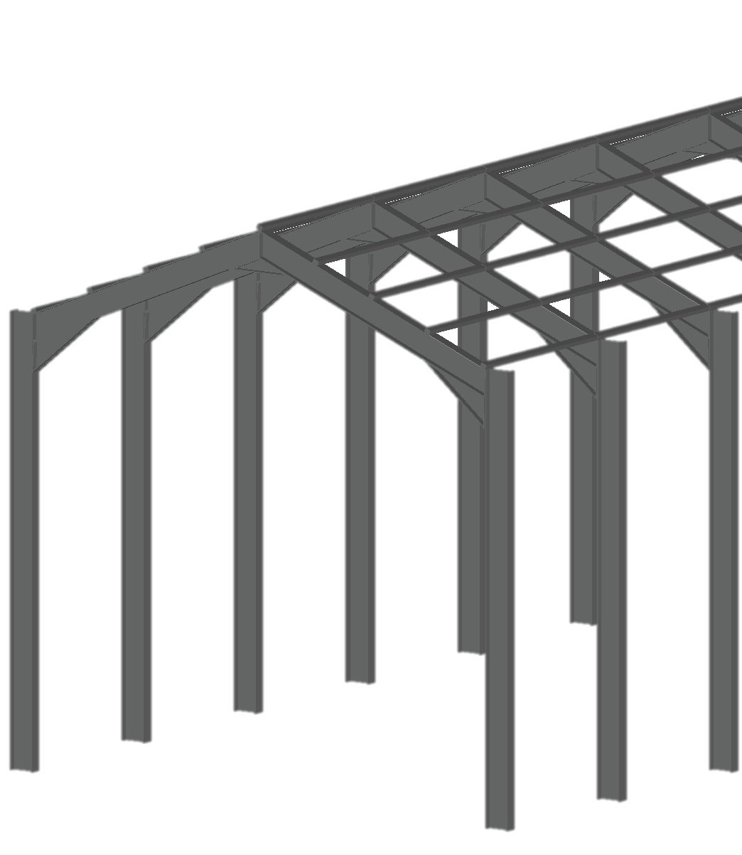
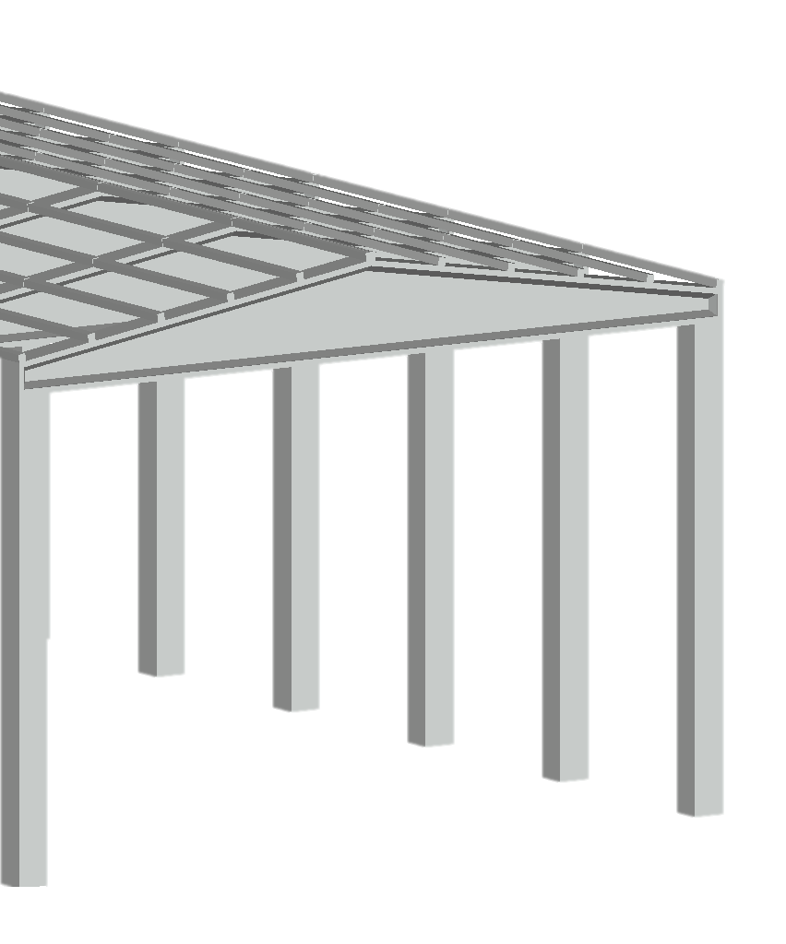
Portal frame construction
Retail park

Slide 82
Benefits of steel portal frame construction for retail units in the UK
Steel vs concrete portal frames:
  The choice of structure plays a crucial role in the design and cost of retail units.
  This presentation explores the advantages of using a steel portal frame construction over a concrete portal frame for retail units in the UK.
  We will discuss key factors like speed, cost, strength, durability and flexibility.

Slide 83
Layout discussion
Was the location of the information between the previous two slides easy to follow?
Are there other aspects of the slides that seem disconnected?

Slide 84
Overcrowded slides
  Limit each slide to one key idea.
  Use keywords, not full sentences.
  Avoid walls of text – aim for visual breathing room.
Tip: If you have to say everything, say it – do not show it.

Slide 85
Steel vs concrete example
  Steel structures are prefabricated off-site, allowing for quick assembly once delivered.
  On-site construction time is shorter owing to fewer complex steps, such as curing and drying time.
  The reduced construction period can lead to quicker occupancy and revenue generation.
  Concrete frames often require mixing and longer curing times.
  The building process may be delayed because of weather conditions affecting concrete hardening.
  Steel construction typically reduces build time by up to 20–30% compared to concrete.

Slide 86
Cost-effectiveness
Transport and handling:
  Steel is a lighter material, resulting in reduced transport and handling costs.
  Concrete is heavier, leading to higher transport and handling expenses.
Foundation requirements:
  Steel has lower foundation costs because of the lighter weight of steel frames.
  Concrete frames often require more complex foundation work, increasing overall costs.

Slide 87
Durability
Steel portal frame:
  Steel frames are corrosion-resistant when treated, improving their longevity.
Concrete portal frame:
  Applying surface coatings (such as sealers, epoxies or waterproof membranes) significantly enhances durability by reducing water and chemical ingress.

Slide 88
Strength
Steel portal frame:
  Steel provides excellent tensile strength, allowing it to resist significant stresses.
Concrete portal frame:
  Concrete offers excellent compressive strength, making it highly effective at bearing heavy vertical loads.
Comparison:
  Steel excels under tension and dynamic loads, making it ideal for flexible, open-span retail spaces.
  Concrete is robust under compression but less suited to designs requiring wide open spans without additional reinforcement.

Slide 89
Image selection
  Images must support specific points, not distract.
  Avoid low-quality, irrelevant or overly complex visuals.
  Choose clear, simple graphics that reinforce words.
  Consider contrast for accessibility.
Tip: Ask yourself, “Does this image add clarity?”

Slide 90
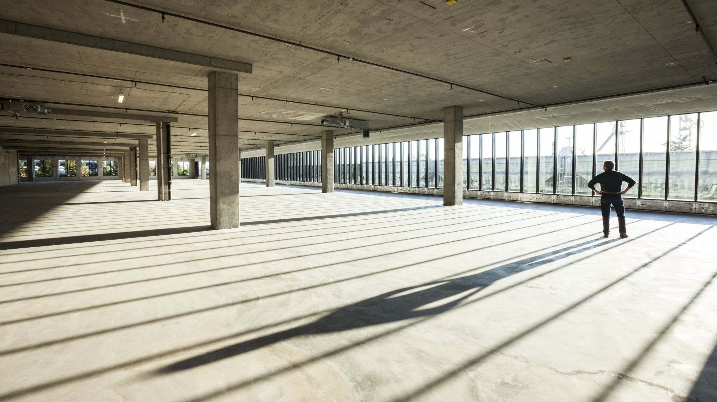
Design versatility
Steel portal frame:
  open-span designs with fewer internal columns
  offers future expansion or modification
  Ideal for retail units needing large, open interiors.
Concrete portal frame:
  less flexible because of the material’s weight and rigid nature.
  more internal columns are needed
  Less ideal for retail units that need a large open interior.
Comparison:
Steel portal frames provide greater design versatility, allowing for larger and more adaptable retail spaces.
Notes:
Teacher note: This slide is designed to be purposely busy and be a poor example to discuss with learners. It has a busy background, some font that is too small, no clear contrast in the text to the background. If it was font 24 it would be too much text for the slide. There are other areas such as not all the bullets have a capital letter at the side.​
​
For accessibility consider using the slide but remove the image and ask the learners if an image would further affect the quality.

Slide 91
Clear and accurate placement of information
  Group related points together to aid understanding.
  Align text and images neatly – avoid random placement.
  Prioritise important information by putting it at the top or top-left.
  Use white space to separate different ideas clearly.
Tip: Design your slide to guide the viewer’s eye naturally.

Slide 92
Managing your own noise
  Avoid distracting habits when presenting, such as pacing, tapping or using filler words excessively.
  Speak clearly, and vary your tone and pace to maintain engagement.
  Use purposeful pauses instead of filling silence with ‘um’ or ‘er’.
Tip: Calm, confident delivery keeps the focus on your message.

Slide 93
Simplifying complex ideas
  Break complex topics into smaller, manageable points.
  Use simple, supportive visuals to illustrate key ideas.
  Reinforce important messages through subtle repetition.
Tip: Clarity beats complexity – make your key ideas easy to grasp.

Slide 94
Preparing for the unexpected
  Test equipment and know how to troubleshoot basic problems.
  Stay composed if interruptions occur. Acknowledge them and move on.
  Have a back-up plan for visuals and technology (e.g. printed notes).
Tip: The more you prepare, the less noise you will face on the day.

Slide 95
Final thoughts
  Practise with your environment and equipment.
  Design slides for clarity, not decoration.
  Remember: less noise equals more impact.

Slide 96
Plenary: simplify to clarify
Read the Simplify to clarify document and identify the information that is necessary for the client.
Produce a list of five slide titles that could be used for the presentation, excluding the title slide and the ‘any questions’ slide.

Slide 97
Next steps
Produce presentation slides using the Simplify to clarify document. The title of the presentation is:
  The benefits of replacing halogen lighting with LED lighting

Slide 98
7
The audience journey

Slide 99
Starter
Think of a time when a presentation felt like it was meant just for you.
What made it feel that way?

Slide 100
What is the audience journey?
The audience journey is the experience your audience goes through while they listen to your presentation.
It covers:
  how they feel
  what they think
  what actions they are likely to take.
Your goal: Guide the audience smoothly from curiosity to conviction.

Slide 101
Why empathy matters
If you do not understand your audience:
  You may lose their attention.
  You might confuse them.
  You may fail to persuade them.
Empathy lets you deliver a message they care about and understand.

Slide 102
Considering the secondary audience
What is a secondary audience?
  They are people who are affected by your presentation’s outcome but are not in the room.
  They could be future users, customers, community members or colleagues.
  Why should you consider them?
  Presentations are stronger when they show empathy beyond the main audience.
  Showing you have thought about everyone affected builds trust and credibility.

Slide 103
Task: playground design layout
Produce a design layout for a playground for children aged 4 to 12.
Consider:
  efficient use of space
  cost-efficiency
  safety
  inclusive design.
Dimensions
10m
7m
3.5m
13m

Slide 104
Four-stage journey
Every great presentation follows a path:
  Stage 1: the hook – grab attention early
  Stage 2: the engagement – build emotional or logical interest
  Stage 3: the climax – deliver the main message or solution
  Stage 4: the resolution – provide a call to action or emotional closure.

Slide 105
Council presentation
What the council cares about:
  community approval
  inclusivity and accessibility
  safety standards
  budget limits.
Make sure your plan clearly shows how the design meets all these areas.

Slide 106
Task: plan your audience journey
  Hook: Include a story or photo showing children enjoying safe play.
  Engagement: Show features – e.g. slides, swings, inclusive equipment.
  Climax: Explain budget, safety and community impact.
  Resolution: Inspire them to fund the playground.
You should:
  Draw key scenes.
  Write short captions.
  Focus on how the council will feel at each step.

Slide 107
Research for reach
Before planning:
  Ask: What does the audience already know?
  Research: What are their values, worries and goals?
  Imagine: Step into their shoes.

Slide 108
Methods to gather information
  Ask questions: If possible, talk directly to similar people.
  Desktop research: Examples include council meeting notes, company websites and community surveys.
  Empathy mapping: Consider what the audience might see, think, feel, say and do.
  Case studies: Research similar past projects and their audiences.

Slide 109
Footbridge planning task
Discuss who would be impacted by the installation of a pedestrian footbridge across the bypass.
Identify stakeholder interests, priorities and any potential conflicting viewpoints.
Produce a flash card with a conflicting viewpoint on one side and a solution on the other.

Slide 110
Thinking emotion
  There are different stages to consider when presenting a pitch.
  Each stage involves different emotions:
  Hook stage: curious, intrigued
  Engagement stage: interested, hopeful
  Climax stage: excited, convinced
  Resolution stage: motivated, ready to act.

Slide 111
Storyboarding is…
  A tool to plan your presentation visually
  A way to map what the audience sees, hears and feels
  It is like making a ‘comic strip’ of the audience’s experience.

Slide 112
Presentation storyboard
A storyboard for a presentation should include:
  a sketch (what they see – visual)
  a key message (what they hear)
  an audience feeling (how they feel).
Slide 1 | Slide 2 | Slide 3 | Slide 4
Visual | Visual | Visual | Visual
Key message | Key message | Key message | Key message
Feeling(s) | Feeling(s) | Feeling(s) | Feeling(s)

Slide 113
Benefits of a storyboard
  Organises your ideas clearly so the story flows naturally
  Focuses on how the audience feels at every stage
  Saves time by spotting problems early and boosting creativity

Slide 114
Bakery design brief
Brief: Design a cosy, functional bakery building for a forest escape resort.
Audience: The baker who may rent and run the new bakery.
What the baker cares about:
  practical kitchen space
  cosy and welcoming environment
  easy customer flow
  maintenance simplicity.

Slide 115
Bakery design task
Plan your audience journey:
  hook
  engagement
  climax
  resolution.
Use the storyboarding method.

Slide 116
Self-review: ask yourself
  Did I plan for how the audience would feel at each point?
  Did I build a clear, logical flow?
  Did I anticipate questions and concerns?
Good storyboards equal clearer, more persuasive presentations.

Slide 117
Final points
Use storyboarding to help you prepare a presentation. This helps:
  organise ideas
  control emotional journey
  increase confidence.
Remember:
A great presentation is not just what you say – it is how you make the audience feel.

Slide 118
The audience journey quiz
What should a storyboard for a presentation include?
Describe stage three of the four-stage journey.
Give one consequence of not knowing your audience.
Bonus question: Name one method for gathering information.

Slide 119
The audience journey answers
1. What should a storyboard for a presentation include?
  A sketch, key message and audience feeling
2. Describe stage three of the four-stage journey.
  Climax – delivery of the main message or solution
3. Give one consequence of not knowing your audience.
  Lose their attention; confuse them; fail to persuade them
Bonus question: Name one method for gathering information.
  Ask questions; desktop research; empathy mapping; case studies

Slide 120
Next steps: storyboard
Choose a small construction project (a cycle shelter, bus stop or park seating area) and:
Identify the primary audience for a presentation (e.g. council, contractor, user group).
List at least two secondary audiences and describe their potential viewpoints.
Produce a simple storyboard showing how you would communicate your idea to the primary audience while also reflecting the needs of secondary stakeholders. You should include the four-stage journey.

Slide 121
8
Planning a presentation

Slide 122
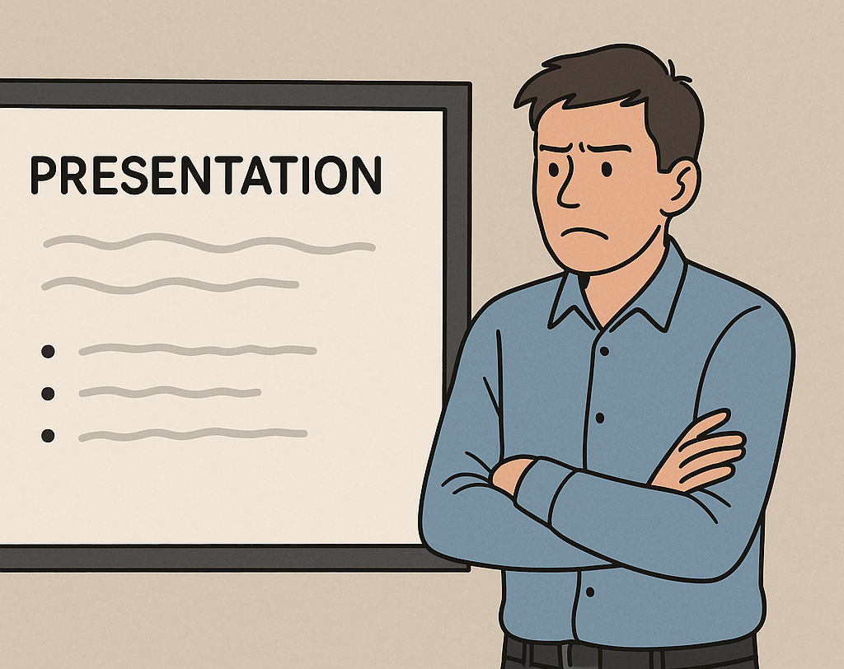
What is wrong with this set-up?
Source: ChatGPT

Slide 123
The four key areas of focus
  Preparing for questions
  Reading body language
  Providing time for digestion
  Managing whole-body energy manifestations

Slide 124
Why preparing for questions is crucial
  Anticipating possible questions helps you maintain composure and stay in control.
  You can avoid feeling caught off-guard.
  Preparation enhances credibility.
  Types of questions include:
  clarifying questions
  challenging questions
  off-topic questions
  open-ended questions.

Slide 125
Clarifying questions
  Purpose: To get more detail or explanation on a specific point.
  Example: “Can you explain that part about the design process in more detail?”
  Strategy: Be clear and concise when answering. Repeat the question to ensure understanding.

Slide 126
Challenging questions
  Purpose: To question the validity of your points or argument.
  Example: “How do you know your approach will work in a different context?”
  Strategy: Stay calm, acknowledge the challenge and provide evidence or reasoning. Do not get defensive.

Slide 127
Off-topic questions
  Purpose: To diverge from your main points – they are often related but not directly tied to main points.
  Example: “What is your opinion on a different method that is not part of your presentation?”
  Strategy: Politely steer the conversation back to the relevant topic. “That is an interesting question, but let me focus on the main points of today’s presentation…”

Slide 128
Open-ended questions
  Purpose: To invite detailed answers or encourage discussion.
  Example: “What do you think is the future of this technology in the next five years?”
  Strategy: Provide a thoughtful, thorough response. Take time to structure your answer.

Slide 129
How to prepare for questions
  Know your content: Be deeply familiar with your material.
  Anticipate common questions: What might the audience ask based on the content?
  Rehearse responses: Practise delivering answers confidently, even for tough questions.

Slide 130
Question task
  Topic 1: Benefits of pile foundations
  Topic 2: Tape measures vs laser measures
  Topic 3: Polished concrete vs resin flooring
  Topic 4: Use of zinc for cladding
  Topic 5: Use of recycled steel in a steel portal frame
Research your allocated topic and prepare notes to assist an oral presentation to a peer.
Email a summary of the research to a partner who has researched the same topic. Your partner will question you on your knowledge, and you are to question your partner.

Slide 131
Reading body language
Reading an audience’s body language gives valuable feedback about how delivery is being received.
  Is the audience engaged? Disengaged? Interested?
  Adjustments can be made based on this feedback (e.g. if the audience seems confused, slow down or clarify).

Slide 132
Body language cues
  Positive cues:
    Nodding, leaning forward, eye contact.
  Negative cues:
    Looking at watches, crossed arms, yawning.

Slide 133
Providing time for digestion
  Pausing gives the audience time to process a message and ensures better retention and understanding.
  It allows the audience to reflect on the points made.
  It also gives the audience space to ask questions if something is not clear.
Discuss: How can pauses be effective in both speech (between points) and visually (waiting for audience reactions)?

Slide 134
Purpose of a pause
  Allows processing: Pauses give the audience time to absorb the information.
  Builds anticipation: Pauses create a dramatic effect before making a key point.
  Controls pace: Pauses prevent rushing, making the message clearer.

Slide 135
The sweet spot
  Too short (under one second): does not allow enough time for the audience to process or reflect
  Ideal pause length (one to five seconds): just long enough to give the audience time to absorb what was said and reflect on it
  Too long (over five seconds): can make the audience feel uncomfortable or lose focus

Slide 136
Strategic use of pauses
  Pause after key points: lets the points resonate
  Pause before moving to the next section: gives people time to absorb what has been said
  Pause before answering a question: shows thoughtfulness and control

Slide 137
Whole-body energy manifestations
  Energy can manifest through various body movements: twitching, shaking, sweating and fast movements
  Nervous energy can be disruptive, while controlled energy helps maintain confidence and engagement.
  Body language can either support or detract from a message.

Slide 138
Common physical manifestations
  Twitching, shaking, sweating: common nervous reactions
  Fidgeting, fast body movements: can make the presenter seem anxious or unprepared
  Large, open gestures: help convey confidence and authority

Slide 139
Management techniques
  Breathing exercises can be used to calm physical nervousness.
  Posture: Stand tall with your shoulders back.
  Movement: Use intentional movement to emphasise points (e.g. moving to different spots on stage).
  Hand gestures: Keep gestures open and controlled to convey confidence.

Slide 140
Task: final practice
Research your assigned topic.
Take it in turns to present your research, and remember to:
      stand tall
      use deliberate hand gestures
      keep still during pauses to avoid fidgeting
      be mindful of any physical reactions – e.g. twitching, sweating.

Slide 141
Summary
  Effective delivery is a combination of awareness and control.
  By practising these techniques, the presenter will be able to engage their audience more powerfully and present with confidence.

Slide 142
Plenary: reflection
Skills improve with practice and reflection.
List three techniques from today’s lesson that you want to improve on or incorporate in your next presentation.
Set a goal for each area (questions, body language, pauses, energy).

Slide 143
Next steps: body language task
Present your allocated topic to your partner.
  Topic 1: Benefits of glulam beams for a ski resort
  Topic 2: Theodolites vs total stations
  Topic 3: Concrete render vs lime render
  Topic 4: Use of Corten steel for cladding
  Topic 5: Use of existing services in a repurposed building
Adjust your presentation according to your peer’s body language.
Email your personal evaluation to the teacher.

Slide 144
9
Record and produce

Slide 145
Starter task
If a new coffee shop was to be constructed near your home, what would you want it to provide?
How could the development of a new coffee shop benefit the community?
How could the development of a new coffee shop perform poorly?

Slide 146
Overview reminder
  Producing an effective presentation is an essential skill when it comes to presenting to a target audience.
  Delivering unfamiliar slides where you have not had an input into the layout of information can leave a presentation disjointed.

Slide 147
Thinking like a stakeholder
  Identify the key requirements of those you are targeting with a presentation.
Discussion point:
What would a parent want for a playground designed for children aged 4 to 7?

Slide 148
Accuracy of information
  Be careful with the wording used in a presentation, as this can lead to misconceptions or confusion among the audience.
Discussion point: What could be confusing about the following statement?
“A new road layout with pedestrianised area”

Slide 149
Supporting a delivery
  Visuals can be highly effective when delivering a presentation, as they allow for a considerable amount of information to be conveyed compared to a written description.
  The visual should be targeted, and an appropriate style is essential to convey the message well.

Slide 150
Methods of review
  Before delivering a presentation to an audience, practise and complete a self-evaluation.
  Once the self-evaluation is complete, consider practising with a colleague or peer to make sure the message is clear.

Slide 151
Delivering a solution
  Those presenting rarely create the design. They may work closely with those who do, and they should gather all necessary information to make it their own.
  Conveying ownership of a design instils confidence that the presentation is well founded.

Slide 152
Presenting for a colleague
Imagine you have been given a presentation/design that was produced by a colleague at the company you work for. It is for a tender. You have a vested interest in the success of the presentation, although you do not like the concept and design of the slides.
The presentation is tomorrow, and you have been asked to present it as your colleague is on holiday.
Discuss how you would manage this situation.

Slide 153
Removing the noise
  Use more slides rather than overpopulating each one.
  If all the information must go on a slide, consider using animations to remove information as new information appears.

Slide 154
Audience journey
  Consider the expected impact of each slide. Does it add value, or does it cloud the message?
  Too much information or not focusing on the relevant parts will lead to lack of concentration in the audience.

Slide 155
Planning a delivery
Finally, remember to plan your approach to questioning, and practise pausing and whole-body energy manifestation control measures.

Slide 156
Task: stakeholder roles
  Review the Stakeholder roles information and collate into information relating to the local area and information relating to the economic benefits of the development.
  Produce a presentation to deliver to a given target stakeholder.

Slide 157
Task: coffee shop case study
The local area: Review the Coffee shop case study for information on the local area and produce a list of project requirements.
The economic benefits: Review the Coffee shop case study for information on the economics and finances of the project, and produce a summary showing the feasibility of the potential project.
Produce presentations relevant for each of your two given stakeholders. The presentations should target relevant information given in the role description.

Slide 158
Task: coffee shop presentation
Deliver the presentation to your targeted stakeholder, played by your partner.
Provide feedback on the delivery of your peer.

Slide 159
Plenary: presenting for others
Reflect on the previous activity.
What did you find challenging about delivering a presentation prepared by others?
What would you do differently if you had to deliver a presentation on behalf of others again?

Slide 160
Next steps: recording of final delivery
Record a final delivery of your presentation and upload to the designated folder for review.
The recording can be slides with audio only overlapped. Key considerations are:
  use of pauses
  tone
  clarity of information.

Slide 161
10
The stakeholder panel

Slide 162
Starter activity
Review your partners pre-recorded presentation.
Provide feedback on their approach to presentation and how this could be improved for other potential stakeholders.

Slide 163
Task: prepare a presentation
Read Case study: TRetail Park expansion plans, highlighting key points with a highlighter pen.
Look through the TRetail Park tender presentation slides.
Prepare a poster for a 5-minute presentation to the operation director and the public relations manager for the national coffee chain.

Slide 164
Task: present to stakeholders
Regional manager role:
  Present the solutions to the operating director and public relations manager.
  Respond to three stakeholder questions.
Stakeholder role:
  Listen to the presentation.
  Prepare three stakeholder questions.
  Take notes throughout about the effectiveness of the communication skills demonstrated by the regional manager.

Slide 165
Task: presenting feedback
Reflect on the communication skills demonstrated by your peer, and prepare to provide oral feedback.
Give a 5-minute oral presentation to your peer, presenting your observations and highlighting areas of improvement.
Respond to any questions asked about your feedback.

Slide 166
Task: presenting to new stakeholders
Re-read Case study: TRetail Park expansion plans – highlight the correct key points for the audience.
Look through the TRetail Park tender presentation slides again.
Prepare for a 5-minute presentation to the retailers.

Slide 167
Task: present to stakeholders
Regional manager role:
  Present the solutions to the operations director and the public relations manager.
  Respond to three questions.
Stakeholder role:
  Listen to the presentation.
  Ask three questions.
  Take notes throughout about the effectiveness of the communication skills demonstrated by the regional manager.

Slide 168
Task: the critical review
Complete the Personal evaluation form.

Slide 169
Next steps: improving oral skills
Observe oral communication skills.
Compare the oral communication skills demonstrated with your own communication skills.
Identify any areas for improvement.
Devise a plan for how you can further improve your oral communication skills.

Slide 170
10 Learner slides
TRetail Park tender presentation slides

Slide 171

Access and site plan
Below is the site plan for the coffee shop, the drive-thru route and disabled parking bays have bollards to keep customers safe.
Route for drive-thru
Coffee shop
Outdoor seating
Accessible parking

Slide 172
Potential customer survey
Questions asked to potential customers | Retail park | Town centre
How many times have you used the retail park this year? | 6.8 | 1.8
How often would you visit a retail park with a coffee shop? | 5.5 | 2.5
What is the average time spent at the retail park? | 1.7 hours | 1.1 hours

Slide 173
Financial: building costs
Financial overview for the building of the coffee shop
Building | £300,000
Furniture | £40,000
Kitchen | £45,000
Accessible parking | £50,000
Combined heat and power unit | £60,000
Total cost | £495,000

Slide 174
Financial: estimated sales
Financial overview for the sale values per month.
Coffee/tea | £14,000
Sweet treats | £4,000
Hot food counter | £11,000
Reuseable cups | £2,000
Total cost | £31,000

Slide 175
Financial: estimated costs
Financial overview for the building of the coffee shop, these are estimated costs and sales per month.
Staffing | £6,000
Drinks consumables | £1,000
Food consumables | £1,000
Electricity and gas | £3,000
Total cost | £11,000

Slide 176


Produced and funded by
PRODUCED BY
FUNDED BY
East Norfolk Sixth Form College MAT has produced this resource on behalf of the Education and Training Foundation
This programme is funded by the Department for Education
ET-FOUNDATION.CO.UK

