Slide 1



Lesson : 11
Factors and multiples
Objectives
Find factors and multiples of numbers less than 100
Find common factors and common multiples of two numbers
Solve problems involving HCF and LCM
Understand how to use representations to provide insight
into solving problems

Slide 2
What do these words mean?
Factors
Multiples
Explain the two words to the person next to you,
or write their meanings in your notebook.
Notes:
Before introducing the context for the lesson, spend a few minutes checking students’ understanding of the terms ‘factors’ and ‘multiples’.

Slide 3

Chocolate bar factory
How many pieces are in this chocolate bar?
A chocolate bar containing 24 pieces of chocolate
is described as a 24-bar.
Notes:
Tell students that a factory makes chocolate bars of various sizes. Ask them how many pieces are in the bar shown on the slide. Ask them to explain how they worked out the number of pieces. Explain that a chocolate bar containing 24 pieces of chocolate is described as a 24-bar.

Slide 4
24-bars
YOUR TURN
6 pieces by 4 pieces
What other possible 24-bars are there?
Notes:
Ask students to work in pairs to find other possible 24-bars and draw them on their mini whiteboards. Some students may find it helpful to use squared paper.
Students may struggle to get started, but once they know what to do, it is likely that they will find all possible 24-bars. However, they may not be systematic. Some students may draw a rectangular array, whereas others may simply draw a rectangle with labelled dimensions.

Slide 5




Possible 24-bars
LET’S
LOOK
The bars produced by the factory are at least 2 pieces wide
6 pieces by 4 pieces
8 pieces by 3 pieces
12 pieces by 2 pieces
24 pieces
by 1 piece
Notes:
Ask students to share the other 24-bars they have found and the methods they used to find them. Make sure that all the different configurations of a 24-bar are discussed.
Tell students that the factory decides that it is not practical to make chocolate bars that are only one piece wide. Establish that the bars that the factory produces will be at least 2 pieces wide.

Slide 6
Multiplying
24-bar
4
6
4
6
6 × 4 = 4 × 6
We can multiply the two numbers in any order.
Notes:
If students have drawn their arrays in different orientations, you may want to discuss multiplicative commutativity. Ensure that students understand that a ‘6 by 4’ bar is the same as a ‘4 by 6’ bar and that we can multiply two numbers in any order.

Slide 7

Factors and multiples
KEY IDEA
8
3
24-bar
3 is a factor of 24
8 is a factor of 24
24 is a multiple of 3
24 is a multiple of 8
24 is a common multiple of 3 and 8.
Notes:
Ensure that students understand the mathematical vocabulary of ‘factor’, ‘multiple’ and ‘common multiple’.

Slide 8
Factors of 24
KEY IDEA
24-bar
24
1
All numbers
have a factor of 1 and the number itself.
Notes:
Reinforce that all numbers have a factor of 1 and the number itself.

Slide 9
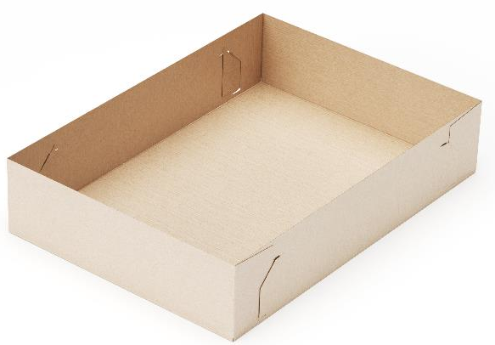
Packing chocolate bars into trays
Cardboard tray
The trays are described by the number of pieces of chocolate that fit the base layer.
Notes:
Introduce the cardboard trays used to pack the chocolate bars. Explain that the trays are described by the number of pieces of chocolate that fit the base layer.

Slide 10
Describing trays
96 pieces of chocolate
fit on the base layer.
We describe this as a 96-tray.
Notes:
Establish that a 96-tray is so-called because 96 pieces of chocolate fit into the base layer.

Slide 11
Why are these 96-trays?
The chocolate factory makes these two 96-trays.
24
16
4
6
Explain why these are 96-trays.
Notes:
Explain that the chocolate factory wants to use 96-trays and makes two different trays. Show students the two trays and ask them to explain why they are 96-trays.

Slide 12




Packing 96-trays
Handout
available
24
Which 24-bars are being packed in this 96-tray?
12 by 2
12 by 2
4
12 by 2
12 by 2
24
Can any other
24-bars be packed in this 96-tray?
4
6 by 4
6 by 4
6 by 4
6 by 4
Notes:
Tell students that the factory wants the base layer of each tray to be full when packing the chocolate bars. Ask students to identify which 24-bars are being packed in this ‘24 by 4’ 96-tray and discuss how the ‘12 by 2’ bars have been packed. Check that students are clear about what the 12 and 2 refer to on the ‘12 by 2’ chocolate bars.
Tell students that the factory wants to pack each tray with chocolate bars of the same size. Ask students whether any other 24-bars can be packed into the ‘24 by 4’ tray. You may want to distribute the ‘24-bars’ and ‘96-trays’ handouts for students to use.
Show students the diagram of four ‘6 by 4’ bars packed in the tray. Check that students can explain why the ‘8 by 3’ bars cannot be packed into this ‘24 by 4’ tray. Remind students that the base layer needs to be full.

Slide 13
A different 96-tray
YOUR TURN
16
Which 24-bars can be packed in this 96-tray?
6
16
16
8 by 3
8 by 3
6
4 by 6
4 by 6
4 by 6
4 by 6
6
8 by 3
8 by 3
Notes:
Give students a few minutes to determine which 24-bars can be packed into the ‘16 by 6’ 96-tray. Reveal the answers as appropriate, depending on the order in which students suggest arrangements.
Left: Packing ‘8 by 3’ bars
Right: Packing ‘4 by 6’ bars

Slide 14
The ‘16 by 6’ tray
DISCUSS
16
6
12
Can ‘12 by 2’ bars be packed into this 96-tray?
2
Notes:
After showing how ‘8 by 3’ bars and ‘4 by 6’ bars can be packed into a ‘16 by 6’ tray, check that students can explain why ‘12 by 2’ bars cannot be packed into a ‘16 by 6’ tray.
Remind students that the factory does not want to mix bars with different dimensions in the same tray (so we cannot fill the space that would remain after packing three ‘12 by 2’ bars with a ‘4 by 6’ bar, for example).

Slide 15
Packing ‘24 by 4’ 96-trays
These bars fit in the ‘24 by 4’ 96-trays because:
24
24 is a
common multiple
of 12 and 6
12 by 2
12 by 2
4
12 by 2
12 by 2
24
4 is a
common multiple of 2 and 4
4
6 by 4
6 by 4
6 by 4
6 by 4
Notes:
After establishing that ‘12 by 2’ and ‘6 by 4’ bars can be packed into a ‘24 by 4’ 96-tray, use the animations on the slide to explain to students that bars with dimensions of 6 and 12 will fit into a tray with a side of 24 because 24 is a common multiple of 6 and 12. Similarly, 4 is a common multiple of 2 and 4.

Slide 16
Packing ‘16 by 6’ 96-trays
These 24-bars fit in the ‘16 by 6’ 96-trays because:
16
16 is a
common multiple
of 8 and 4
8 by 3
8 by 3
6
8 by 3
8 by 3
16
6 is a
common multiple
of 3 and 6
6
4 by 6
4 by 6
4 by 6
4 by 6
Notes:
This slide uses the same approach as slide 15 to explain why ‘8 by 3’ and ‘4 by 6’ bars can be packed into a ‘16 by 6’ 96-tray; 16 as a common multiple of 8 and 4, and 6 is a common multiple of 3 and 6.

Slide 17
Other possible 96-trays?
DISCUSS
The chocolate factory makes these two 96-trays:
16
24
6
4
What other possible 96-trays are there?
Notes:
Ask students if there are any other possible 96-trays that could be made, in addition to the two trays that have been explored. Remind students that the factory only produces chocolate bars that are at least 2 pieces wide so trays need to have a width of at least 2.
The next slide shows the other possible 96-trays.

Slide 18
All possible 96-trays
24
16
4
6
12
32
3
8
48
2
Notes:
Identify all possible 96-trays, highlighting to students that a ‘96 by 1’ tray is not included as the factory only produces chocolate bars that are a least 2 pieces wide. You may want to write the factor pairs for 96 on the board.

Slide 19
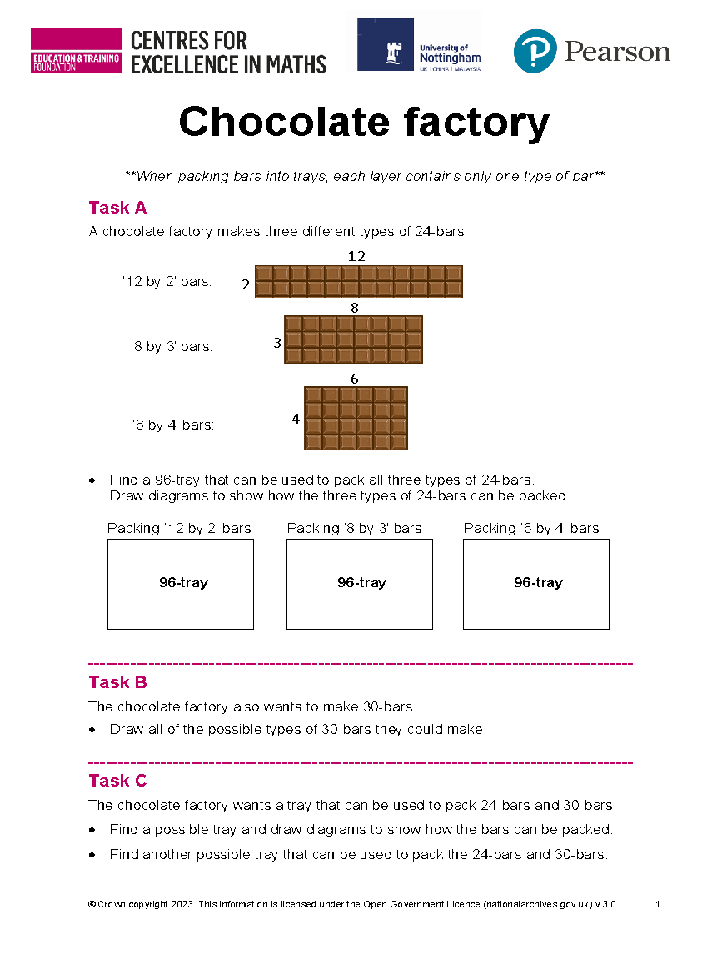
Working in pairs
YOUR TURN
Handout
available
Work in pairs.
Take turns.
Explain your reasoning to your partner.
Agree on the answers before writing them down.
Notes:
Distribute the ‘Chocolate factory’ handout and ask students to work on the tasks in pairs. It is important that they work collaboratively and that they are both able to articulate their collective thinking, as either student may be called upon to explain their work as part of the discussion that follows. Some students may find using squared paper helpful.
As students work, circulate amongst them and observe what they are doing. Make a mental note of which pairs’ work you might like to share in the class discussion later. Let students work without your help, but if they are clearly struggling to get started, ask some questions to nudge their thinking.
When students have had sufficient time on the tasks, use slides 20 – 26 to support a class discussion.

Slide 20



Task A
REVIEW
Find a 96-tray that can be used to pack all three types of 24-bars:
6
8
12
4
2
3
Possible 96-trays:
‘48 by 2’ tray
‘32 by 3’ tray
‘24 by 4’ tray
‘16 by 6’ tray
‘12 by 8’ tray
‘12 by 2’ bars are the only bars that fit
‘8 by 3’ bars are the only bars that fit
‘12 by 2’ and ‘6 by 4’ bars both fit
‘8 by 3’ and ‘6 by 4’ bars both fit
‘12 by 2’, ‘8 by 3’ and ‘6 by 4’ bars all fit
Notes:
Students may have eliminated some 96-trays without any further exploration by considering the properties of the 24-bars that need to be packed.
Check that students can explain why each of the 24-bars can/cannot be packed into each of the 96-trays. Confirm that all three types of 24-bars can be packed into a ‘12 by 8’ tray.

Slide 21

Task B
REVIEW
All possible types of 30-bars?
30
1
15
6
2
10
5
3
Notes:
When discussing Task B, highlight the value in being systematic and the links with factor pairs of 30.
Remind students that the chocolate factory only produces bars that are at least 2 pieces wide so a ‘30 by 1’ bar does not need to be considered.

Slide 22



Task C
REVIEW
6
24-bars:
8
12
4
2
3
6
30-bars:
10
15
3
5
2
The chocolate factory wants a tray that can be used to pack 24-bars and 30-bars.
Notes:
Check that students have correctly identified all the different types of 24-bars and 30-bars that need to be packed.

Slide 23
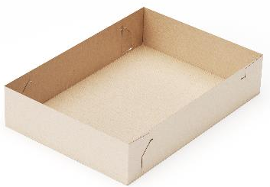
Highest Common Factor / Lowest Common Multiple
DISCUSS
24-bar
30-bar
How can working out the highest common factor help in packing chocolate bars?
How can working out the lowest common multiple help in packing chocolate bars?
Notes:
Discuss these two questions as a class, making sure that students understand the mathematical vocabulary of ‘highest common factor’ and ‘lowest common multiple’.

Slide 24
Highest common factor
How can working out the highest common factor help in packing chocolate bars?
Factors of 24
1, 2, 3, 4, 6, 8, 12, 24
Factors of 30
1, 2, 3, 5, 6, 10, 15, 30
6 is the highest common factor of 24 and 30.
Notes:
Draw out that the highest common factor of 24 and 30 is 6, and that this means that a tray that is 6 wide could be used to pack 24-bars and 30-bars.

Slide 25
Lowest common multiple
How can working out the lowest common multiple help in packing chocolate bars?
Multiples of 24
24, 48, 72, 96, 120, 144, 168, 192, …
Multiples of 30
30, 60, 90, 120, 150, 180, 210, 240, …
120 is the lowest common multiple of 24 and 30.
Notes:
The lowest common multiple of 24 and 30 is 120; this gives the shortest length of a tray that could fit all possible 24-bars and 30-bars.

Slide 26
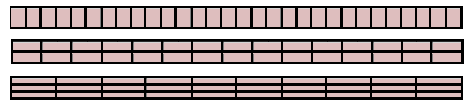
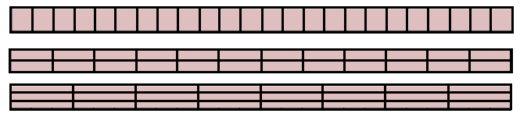
Packing 24-bars and 30-bars
120
6
24-bars or 30-bars
Packing 24-bars:
120
6
30 ‘4 by 6’ bars
30 ‘8 by 3’ bars
30 ‘12 by 2’ bars
6
6
Packing 30-bars:
120
24 ‘5 by 6’ bars
24 ‘10 by 3’ bars
24 ‘15 by 2’ bars
6
6
6
Notes:
Check that students can explain how each of the 24-bars and 30-bars can be packed into a ‘120 by 6’ 720-tray.

Slide 27
Packing 24-bars and 30-bars
120
6
24-bars or 30-bars
What other dimensions could the tray have?
Is there a limit?
Notes:
Bring the discussion to a close by exploring other possible trays that could be used. Students may have found a different tray when completing Task C. Check that the 24-bars and 30-bars can all be packed in the tray and establish that a 720-tray is the smallest size of tray that can be used to pack all the 24-bars and 30-bars.

Slide 28
Practice question
REVIEW
Handout
available
Find the highest common factor (HCF) of 72 and 90.
………………………………………
(2)
Q24 from May 2019, 1MA1/1F
18
Notes:
Distribute a copy of the ‘Practice question’ handout to each student. Give students a couple of minutes to work on the question individually and then discuss their thinking.
Students may draw diagrams to help them to answer the exam question. The solution has been provided, but rather than using the discussion merely as a check of accuracy, it is important to focus on students’ thinking.

Slide 29
Lesson review:
Factors and multiples
Objectives
Find factors and multiples of numbers less than 100
Find common factors and common multiples of two numbers
Solve problems using HCF and LCM
Understand how to use representations to provide insight into
solving problems
Suggested further steps/areas to work on
Find all the factor pairs, HCF and LCM using prime factorisation

Slide 30
Lesson 11:
Credits
Photo acknowledgements
Shutterstock.com: Vincent Giordano Photo
Text acknowledgements
Pearson Education Ltd: Pearson Edexcel GCSE (9 – 1) Mathematics Paper 1F (Non-Calculator) Foundation Tier May 2019 1MA1/1

