Slide 1
APPRENTICESHIP WORKFORCE DEVELOPMENT
CPD to Support Academic Colleagues with Apprenticeship Requirements
SESSION 3 - End Point Assessment
By University of Portsmouth

Slide 2
Delivery guidance
Three sessions have been created grouping together three key themes to underpin degree apprenticeship delivery.
Introduction to apprenticeships
Knowledge, Skills and behaviours
End Point assessment
Colleagues are welcome to attend any session but it is strongly advised that Session 1 is attended first as an introduction, after which the remaining sessions can be completed in any order.
The slide package has been designed as a base for providers to adapt to their own institution and apprentice population. We recognise the slides may be text heavy, but again this is to allow full dissemination of the content from our aligned CPD Site. This will allow provider colleagues to create their own online CPD or develop alternative face to face delivery. Text will be written in blue where it prompts for personalised content to be added.

Slide 3
Welcome
All colleagues (number dependent) introduce themselves and their involvement, interest and understanding level of apprenticeships.
Colleagues should also share their expectation of the session.
How can I support apprentices
What are the rules and regs?
Practical takeaways
How apprentices may differ from standard students
Introduction session - we do recommended you have attended or completed the introduction session

Slide 4

Introduction to EPA
This session covers
Types of end point assessment
Common assessment methods
The importance of end point assessment
Best practice
How you can help.

Slide 5
What is End Point Assessment
Apprenticeship standards are designed by Trailblazer Groups (employers/industry regulators) and are designed for specific job roles.
End-point assessment (EPA) is an independent assessment that takes place at the end of the apprenticeship training. This is to test that the apprentice is competent in their occupation.
The assessments are also designed by employers in the sector as part of the Trailblazer and are conducted by independent bodies known as end point assessment organisations (EPAO)
Depending on if you are delivering to a group delivering a specific course, you may wish to explain the specific end point assessment from here and adapt delivery of the session.

Slide 6
End Point Assessment Plan
Each apprenticeship includes an End Point Assessment plan.
This describes how the apprentice will be tested against the knowledge, skills and behaviours required.
There are a variety of assessment methods used to test apprentices’ competency. The methods for each apprenticeship are selected as the most appropriate to assess against the KSBs. Each selected method has specific KSBs mapped to it which must be demonstrated using that method.

Slide 7
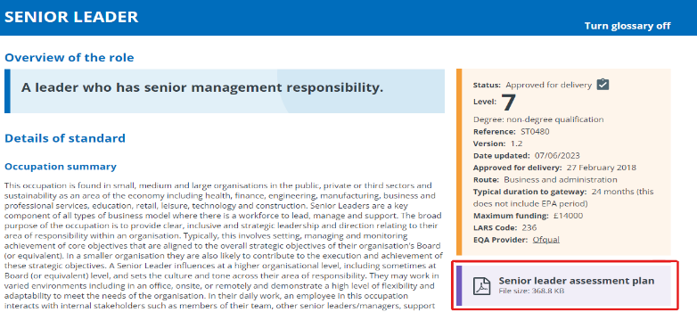
Understanding the standard
How to find the assessment plan. What information can be found on IFATE and how to navigate to the assessment plan. We include direct links to all standards we deliver on our internal CPD site and encourage regular refreshing.

Slide 8

Integrated End Point Assessment
The End Point Assessment Plan will indicate if the EPA is integrated. If it is integrated, the University will provide the on-programme learning and training as well as the EPA. The EPA is the final assessment and holds a credit weighting for the final degree award stipulated in the plan. It will be conducted in line with the requirements set out in the relevant apprenticeship standard and will be completed as part of the programme of study.
You may wish to adapt this section to reflect you as a provider and your end point assessments.

Slide 9

Non-integrated end point assessment
When the EPA is non-integrated, apprentices will be required to successfully achieve the degree award before the EPA can be attempted. The EPA will be conducted by a designated End Point Assessment Organisation (EPAO). The employer typically decides the EPAO and therefore the University may have more than one EPAO for each cohort of apprentices.

Slide 10
Common types of end point assessment
A practical assessment
This is a set task that is assessed within a simulated environment. The EPAO and assessment plan will describe the conditions of the practical assessment.
An interview
An interview takes place between the apprentice and the end point assessor; it may also involve the employer and an industry expert. The end point assessment plan for the relevant standard will provide information on the interview requirements and the KSBs that will be assessed.
A project
If an apprentice is required to undertake a project this typically will meet the needs of a business and often require employer approval. Some projects are completed prior to gateway, others may require approval at Gateway and are conducted between gateway and the live assessment. The EPAO will provide information on the type of project, the KSBs it must cover and the parameters of the project and the required time frames.
A presentation
This assessment method is often used to allow an apprentice to report or demonstrate something they have achieved, this could be a project or portfolio, or a set task from the EPAO.
Knowledge based test
There are different types of test that an apprentice might be set, for example multiple choice, short answer and scenario based. The end point assessment plan will identify the style of test and the relevant KSBs it will cover.
Portfolio of evidence and/or competency log
A portfolio is made up of evidence that demonstrates competence against the KSBS. Different EPAOs will require different forms of evidence within the portfolio but some typical examples could be: work based reports, work based projects, minutes of meetings, examples of CPD, appraisals or witness testimonies. Portfolios often underpin other elements of an end point assessment for example a professional discussion or interview.
You can find more information at https://www.instituteforapprenticeships.org/developing-new-apprenticeships/resources/assessment-methods-and-grading-descriptors/

Slide 11
Portfolio of Evidence
Evidence and competency logs
Many of the apprenticeship standards delivered at UoP require the apprentices to create a portfolio of evidence or competency log as part of the end point assessment. This assessment method is designed to allow an apprentice to share a range of examples from their time on the apprenticeship that demonstrates their occupational competency.
This can be a difficult task for apprentices if they are not provided direction on this activity from the early stages of their programme or given clear guidance on how it can be developed. It has often been a barrier to apprentices successfully completing their end point assessments on time if they are asked to create this work in the final stages of the programme, particularly if this coincides with final academic assessments. It can add more pressure to an already challenging period for apprentices especially when there have been no timetabled sessions to support this activity.
It is vital that apprentices are informed of this requirement and are regularly encouraged to consider if any of their recent activities could be used to demonstrate their knowledge, skills and behaviours to encourage gradual development. This advice is echoed by many of the external end point assessment organisations (EPAOs) we use for our non integrated degree apprenticeships.
Portfolio mapping documents and/or competency logs will be provided by the End Point Assessment Organisation assessing apprentices on your standard or will need to be created if internal Here is an example page of a blank mapping document. These require apprentices to clearly signpost the end point assessor to evidence of how they meet the required. KSBs.

Slide 12
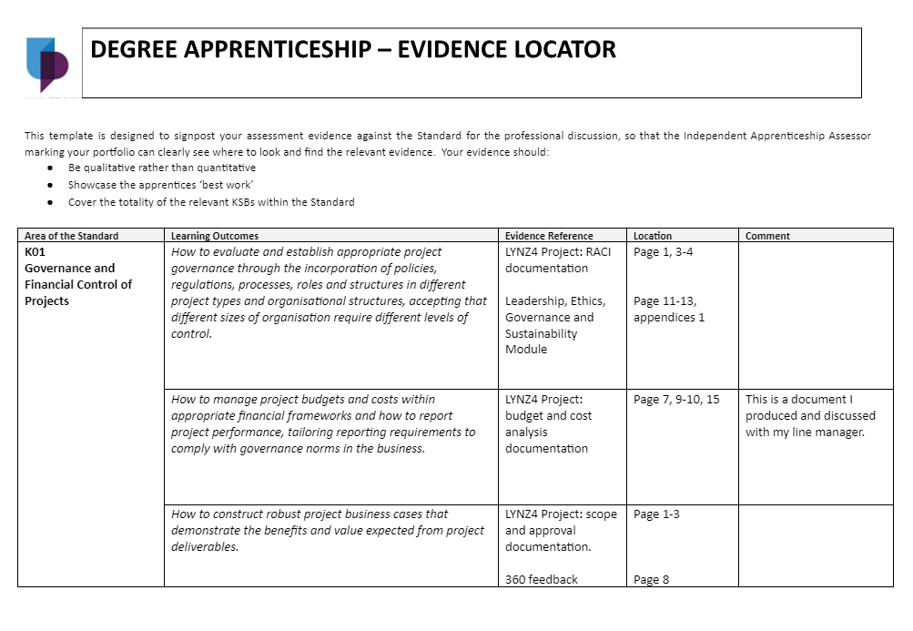
Example evidence locator
REPLACE WITH YOUR OWN

Slide 13
Portfolio Activity
This section can be adapted to your setting or audience. Suggested activities depend on the groups level of existing knowledge could include:
Pair and share or groups together creating lists of suggested evidence.
If the group needs to focus on a specific standards, they could populate sections of the evidence template with ideas. Copies should be handed out at the session.
Those teaching specialist sections or modules could share what ideas they have for evidence (and perhaps how they integrate this into teaching)
This could also include pre-made recordings from apprentices describing what evidence they used in their end point assessment.
You could also use pre-recorded or written guidance from specific EPAOs.

Slide 14


Case studies
Watch the two recordings and highlight good practice and concerns with the experiences of the two apprentices.
You could also embed videos or podcasts from your own apprentices. We have embedded a podcast of an apprentices describing what they found helped them towards successfully achieving their end point assessment

Slide 15

Reflections from case studies
Mark received constructive feedback on his formative assessments.
Emily did not fully understand what was expected from the start of their apprenticeship.
Mark’s module assessments were reflective of what is required in their End Point Assessment throughout their apprenticeship.
Emily did not receive extra time during her End Point Assessment as the EPAO was not aware of her additional requirements.
Mark knew who their End Point Assessment Organisation were and accessed their End Point Assessment Plan.
Mark was made aware of the importance of their EPA, and made arrangements ensuring they were in a quiet and private room, with no interruptions.

Slide 16

Gateway
Gateway takes place before an EPA can start. The University will liaise with the employer and review the apprentice’s knowledge, skills and behaviours to see if they have met the minimum requirements of the apprenticeship set out in the apprenticeship standard, and are ready to take EPA. Once the requirements are evidenced, the apprentice can begin the EPA.
As the training provider, the University can no longer provide new learning for apprentices after they have gone through the gateway, but will still maintain a supportive role during the EPA period for its apprentices.
For non-integrated apprenticeships, the University will gather EPA gateway evidence to submit to the chosen EPAO.
What are the key gateway criteria?
Achieved level 2 in English and Maths or equivalent.
Reached the minimum Off the Job hours requirement.
The apprentice has reached the minimum duration required on their apprenticeship programme.
The apprentice, employer and university have confirmed that the apprentice has met the required KSBs
For a non-integrated apprenticeship, they have achieved the required qualification.

Slide 17
Benefits of working with former apprentices
Supports building a network of apprentices. Our apprentices value the opportunity to network with like minded professionals.
Apprentices can see the end results. It also allows all involved in delivery the opportunity to see progression after completion.
Former apprentices have offered relatable top tips on managing time, expectations and other commitments. We can build upon what they find helpful.
Apprentice appreciate hearing from someone who has “been there and done it”.
Strengthens collaborative relationships with your institution. For example, we have had an apprentice employer sponsor a PHD.
This may support with progression to further studies including moving from level 6 to level 7 and beyond.
After studying at level 7, some apprentice express interest in academic careers. We have seen some moves into the space and some supporting guest lectures in both degree apprenticeship and standard programmes.
We have collected examples from our own apprentices providing reflections on what was helpful in preparing for their end point assessment. These are available as podcasts and these are helpful in adding personal examples.

Slide 18
Achievement
Apprenticeship achievement data is reported and published via the Education and Skills Funding Agency (ESFA) which is accessible to employers and is published annually. For more information on this please refer to session 1 (what is an apprenticeship).
As EPA is a key component of the apprenticeship standard, an apprentice can not fully achieve their programme if they do not complete this part. Failure to do so impacts the University achievement data, as well as funding we receive.
End Point Assessment accounts for 20% of the overall funding the University is able to draw down. If an apprentice does not complete their EPA, the University will only receive 80% of the available funds.
Non-integrated apprenticeships can result in apprentices completing their degree award and then disengaging from the end point assessment. Eventually, all degree apprenticeships will become integrated, until this change, we need to ensure that the end goal we are supporting the apprentice to achieve is the end point assessment.
If you have concerns that an apprentice is not planning to engage with the EPA, this should immediately be raised to the correct department/person in your organisation as it is a contractual arrangement between the University, the apprentice and their employer.

Slide 19

Case study
Watch the video and reflect on the the case study. What steps could have been taken to ensure Samuel successfully completed EPA?

Slide 20
Knowledge check
Where can you find all of the information relevant to the apprenticeship standard and what is required for End Point Assessment in your area?
Portfolios of evidence are one of the most common forms of assessment used within End Point Assessments. How can apprentices be supported to meet the requirements of this type of assessment?
Which statements apply to non-integrated apprenticeships?
EPA has credits that contribute to the overall Degree Award
There is a higher rate of withdrawal from this type of apprenticeship standard
Apprentices must complete their Degree prior to EPA
The University of Portsmouth is the EPAO
The employer chooses the EPAO
Discuss as a group - answers shown on next slide.

Slide 21
Knowledge check - answers
Where can you find all of the information relevant to the apprenticeship standard and what is required for End Point Assessment in your area?
Ifate - but can also include institution specific support.
Portfolios of evidence are one of the most common forms of assessment used within End Point Assessments. How can apprentices be supported to meet the requirements of this type of assessment?
- Answers include
Integrate Knowledge, Skills and Behaviours into delivery, enabling links to theory and practice.
To compile evidence for their portfolio from the start of the apprenticeship.
Use the relevant evidence locator/mapping document provided by the End Point Assessment Organisation.
Direct apprentices to the required EPA plan which contains the assessment expectations and marking criteria.
Please tick all that apply to non-integrated apprenticeships.
EPA has credits that contribute to the overall Degree Award
✓ There is a higher rate of withdrawal from this type of apprenticeship standard
✓ Apprentices must complete their Degree prior to EPA
The University of Portsmouth is the EPAO
✓ The employer chooses the EPAO

Slide 22

Knowledge check
When is an apprentice ready for Gateway? Discuss what is required. Click for answers.
When they have evidence of maths and English at level 2 or equivalent
When they have met their required Off the Job Training hours
When the apprentice, employer and University have agreed that the apprentice is competent in all Knowledge, Skills and Behaviours
When the apprentice, employer and University has signed the required Gateway Declaration
When the apprentice has provided all evidence for Gateway as listed in the assessment plan

Slide 23
Who can support
List the the contacts and departments it may be necessary to liaise with in your organisation. You may wish to then have a discussion on why they may need to contact each type of contact.
Course leaders
Course administrators
Quality manager
Head of school
Work based tutor
Degree apprenticeship team
Attend session 1 and 2 if you haven't already done so
?

Slide 24
CPD for you - Further Support
Engage in continuous professional development to stay up-to-date with the latest industry practices, teaching methodologies, and assessment techniques. Actively seek opportunities for training, networking, and collaboration to enhance your own expertise and contribute to the continuous improvement of the degree apprenticeship program. You can take advantage of our UVAC membership as UVAC regularly delivers apprenticeship CPD.
Colleagues can access UVAC. You will need to register under your institution, and this will allow access to all the member content. You can do this here - https://uvac.ac.uk/registration/ and just select your institution from the dropdown menu.
Once your membership is approved, you can access previously recorded webinars, resources and guides and can register for upcoming live webinars and sessions.
You can also access The AWD training and resources via the UVAC site, or you can go direct to ETF to book. There are 8 open access online courses available delivered via the FutureLearn Platform.
You can also access our own learning and teaching gateway here to browse a range of CPD options.
You can remind colleagues that the Powerpoint will be shared or provide a link at the end to all the resources. You may wish to ask if colleagues have undertaken any other training.

Slide 25
AWD Project: CPD to Support Academic Colleagues with Apprenticeship Requirements
Session 3 - EPA

